Slide 1
Chapter 17: Transactions (事务)
Transaction Concept
Transaction State
Implementation of Atomicity and Durability
Concurrent Executions
Serializability
Recoverability
Implementation of Isolation
Transaction Definition in SQL
Testing for Serializability

Slide 2

1 Transaction Concept
For a DBMS, two main issues must be dealt with:
  Concurrent executions of multiple users or multi-programs.
  Failures of various kinds, such as hardware failures and system crashes.

Slide 3
售票员甲 (事务1)
售票员乙 (事务2)
时间
t1
读：A=16
t2
读：A=16
更新：A←A-3 A=13
t3
t4
更新：A←A-1 A=15
A
13
15
16
并发操作丢失修改数据

Slide 4
Transaction Concept (cont.)
How to keep the database correctness, consistency and integrity when it concurrently executes?
Transaction --- proposed by Jim Gray
A transaction is a unit of program execution that accesses and possibly updates various data items.
  Usually a transaction is of a number of SQL statements, ended with commit or rollback statement. (提交，回滚)
  A transaction must see a consistent database.
  During transaction execution the database may be inconsistent, but when the transaction is committed, the database must be consistent.

Slide 5
ACID Properties of transaction
To preserve integrity of data, the database system must ensure:
Atomicity (原子性). Either all operations of the transaction are properly reflected in the database or none are. (responsibility of transaction-management component, also recovery-management component)
Isolation (隔离性). Although multiple transactions may execute concurrently, each transaction must be unaware of other concurrently executing transactions. Intermediate transaction results must be hidden from other concurrently executed transactions. (responsibility of concurrency-control component)

Slide 6
ACID Properties of transaction (cont.)
Consistency (一致性). Execution of a transaction in isolation preserves the consistency of the database. (the duty of application programmer)
Durability (持久性). After a transaction completes successfully, the changes it has made to the database persist, even if there are system failures. (responsibility of recovery-management component)

Slide 7
Example of Fund Transfer
( to understand ACID )
Transaction to transfer $50 from account A to account B:
  1. read(A)
  2. A := A – 50
  3. write(A)
  4. read(B)
  5. B := B + 50
  write(B)
  (commit )
Atomicity requirement — if the transaction fails after step 3 and before step 7, the system should ensure that its updates are not reflected in the database, else an inconsistency will result.
Consistency requirement – the sum of A and B is unchanged by the execution of the transaction.

Slide 8
Example of Fund Transfer (cont.)
Durability requirement — once the user has been notified that the transaction has completed (i.e., the transfer of the $50 has taken place), the updates to the database by the transaction must persist despite failures.
Isolation requirement — if between steps 3 and 6, another transaction is allowed to access the partially updated database, it would see an inconsistent database (the sum A + B will be less than it should be). How to deal with ?
  Can be ensured trivially by running transactions serially, that is one after the other. However, executing multiple transactions concurrently has significant benefits, as we will see.
It’s the responsibility of concurrency-control component of DBMS.
Note : ACID 是对“事务”宏观上的要求。

Slide 9

Transaction Definition in SQL
Data manipulation language must include a construct for specifying the set of actions that comprise a transaction.
In SQL, a transaction begins implicitly.
A transaction in SQL ends by:
  Commit work commits current transaction and begins a new one.
  Rollback work causes current transaction to abort.

Slide 10
2 Transaction State (事务状态)
Active, the initial state; the transaction stays in this state while it is executing
Partially committed, after the final statement has been executed. (此时要输出的结果数据可能还在内存buffer中)
Failed, after the discovery that normal execution can no longer proceed.
Committed, after successful completion.
Aborted, after the transaction has been rolled back and the database restored to its state prior to the start of the transaction. Two options after it has been aborted:
  restart the transaction – only if no internal logical error
  kill the transaction

Slide 11

Transaction State (cont.)
Next Transaction
Start transaction

Slide 12
3 Implementation of Atomicity and Durability (原子性和持久性的一种实现方法)
The recovery-management component of a database system implements the support for atomicity and durability.
The shadow-database scheme - a simple but inefficient scheme: a pointer called db_pointer always points to the current consistent copy of the database.
  all updates are made on a newly created copy of the database. The original copy --- shadow copy (影子拷贝) is untouched---pointed by db_pointer
    If aborted: merely delete the new copy.
    If commit:
      1)put all pages in memory of the new copy to disk(in unix, flush command).
      2) db_pointer is changed to point to the new copy---become the current copy and at the same time the old copy is then deleted.

Slide 13
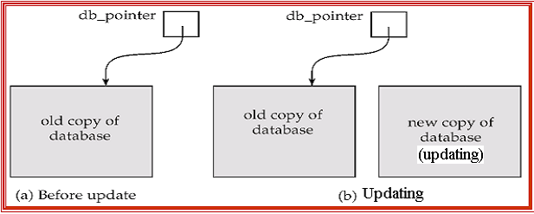
Implementation of Atomicity and Durability (cont.)
The shadow-database scheme:
Update operations

Slide 14
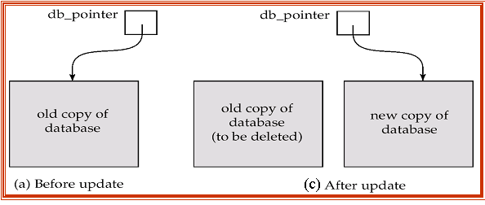
Implementation of Atomicity and Durability (cont.)
The shadow-database scheme:
Required: update db-pointer atomically (which is guaranteed by disk system, store it in a single sector (扇区)); no concurrent transactions; assumes disks not to fail.
The idea is useful for text editors.
But extremely inefficient for large databases: executing a single transaction requires copying the entire database.
  Will see better schemes in Chapter 19.
  And using Rollback Segment (区段) in Oracle

Slide 15
4 Concurrent Executions (并发执行)
Multiple transactions are allowed to run concurrently in the database system.
Advantages of concurrent executions are:
  increased processor and disk utilization, leading to better transaction throughput (吞吐量): one transaction can be using the CPU while another is reading from or writing to the disk.
  reduced average response time for transactions: short transactions need not wait behind long ones.

Slide 16
Concurrent Executions (cont.)
Problems: concurrency may destroy consistency, despite the correctness of each individual transaction. (如并发售票问题)
Concurrency control schemes – mechanisms to achieve isolation, i.e., to control the interaction among the concurrent transactions in order to prevent them from destroying the consistency of the database. --- The important job of DBMS
  Here we study the notion of correctness of concurrent executions, serializability, recoverability, etc.
  Will study concurrency control in Chapter 18

Slide 17
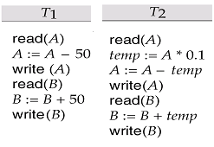
Schedules (调度)
Example: two transactions T1 and T2 are running concurrently, which transfer funds between account A and B.
Because CPU can only execute instructions serially, we should……
Schedules – sequences that indicate the chronological order in which instructions of concurrent transactions are executed
  a schedule for a set of transactions must consist of all instructions of the transactions
  must preserve the order in which the instructions appear in each individual transaction.

Slide 18

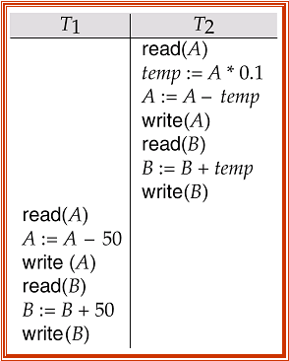
Example Schedules - serial schedule (串行调度)
Before transaction: A=1000, B=2000, A+B=3000
Schedule 1
Schedule 2
950
900
2050
950
2100
855
2145
A=855, B=2145, A+B=3000
A=850, B=2150, A+B=3000
■ Both schedule1 and schedule2 are serial（串行的）. N个并行事务有n!种可选择的串行调度 (如<t1,t2,t3,…>, <t2,t1,t3,…>,<t3,t1,t3,…>, …)
■串行的调度必能保持一致性，但低效。

Slide 19


Example Schedule (cont.) - concurrent schedule (并发调度)
A=1000, B=2000, A+B=3000
Schedule 3
Schedule 4
950
A=1000
950
A=900
855
A=950
X
2050
B=2050
2050＋95 =2145
B=2000+100
A=855, B=2145, A+B=3000
A=950, B=2100, A+B=3050
In both Schedule 1, 2 and 3, the sum A + B is preserved.---consistency
But Schedule 4 does not preserve the value of the the sum A + B ---not consistent. - a bad schedule!
How to judge? How to schedule?

Slide 20
5 Serializability (可串化)
How to schedule?
Obviously, serial execution of a set of transactions (i.t. Serial schedule) preserves database consistency.
How about the concurrent schedules ?
Definition: A schedule is serializable if it is equivalent to a serial schedule. A serializable schedule must be correct.

Slide 21
Serializability (cont.)
Different forms of schedule equivalence give rise to the notions of:
  1. conflict serializability（冲突可串行化）- conflict equivalent
  2. view serializability（视图可串行化）- view equivalent
For convenient discussion below, we ignore operations other than read and write instructions, and we assume that transactions may perform arbitrary computations on data in local buffers in between reads and writes. Our simplified schedules consist of only read and write instructions.

Slide 22
(1) Conflict Serializability
Definition: For instructions l_{i} and l_{j} of transactions T_{i} and T_{j} respectively, conflict if and only if there exists some item Q accessed by both l_{i} and l_{j}, and at least one of these instructions wrote Q.
1. l_{i} = read(Q), l_{j} = read(Q). l_{i} and l_{j} don’t conflict.
2. l_{i} = read(Q), l_{j} = write(Q). They conflict.
3. l_{i} = write(Q), l_{j} = read(Q). They conflict
4. l_{i} = write(Q), l_{j} = write(Q). They conflict
Intuitively, a conflict between l_{i} and l_{j} forces a (logical) temporal order between them.
If l_{i} and l_{j} are consecutive in a concurrent schedule and they do not conflict, then their results would remain the same even if they had been interchanged in the schedule.
二个事务对同一数据项进行读写操作，当其中至少一个为写时，则称这二个操作是冲突的。
★若2个操作是有冲突的，则二者执行次序不可交换。 若2个操作不冲突，则可以交换次序。

Slide 23
Conflict Serializability (cont.)
Definition: If a schedule S can be transformed into a schedule S’ by a series of swaps of non-conflicting instructions, we say that S and S’ are conflict equivalent (冲突等价的).
Definition: We say that a concurrent schedule S is conflict serializable if it is conflict equivalent to a serial schedule
Example of a schedule that is not conflict serializable:
T₃ T₄
read(Q)
write(Q)
write(Q)
We are unable to swap instructions in the above schedule to obtain either the serial schedule < T₃, T₄ >, or < T₄, T₃ >，so the schedule is not conflict serializable.
T₃ T₄
read(Q)
write(Q)
write(Q)
反例：
X

Slide 24

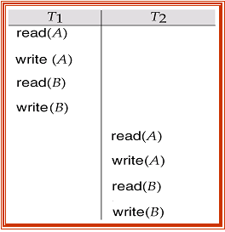
Conflict Serializability (cont.)
Schedule 3 below can be transformed into Schedule 1, a serial schedule where T₂ follows T₁, by series of swaps of non-conflicting instructions. Therefore Schedule 3 is conflict serializable.
conflict serializability 的正例
Schedule 3
Schedule 1

Slide 25
*(2) View Serializability
Let S and S´ be two schedules with the same set of transactions. S and S´ are view equivalent (视图等价的)if the following three conditions are met:
  1. For each data item Q, if transaction T_{i} reads the initial value of Q in schedule S, then in schedule S´ transaction T_{i} must also read the initial value of Q.
  2. For each data item Q, if transaction T_{i} executes read(Q) in schedule S, and that value was produced by transaction T_{j} (if any), then transaction T_{i} in schedule S´ must also read the value of Q that was produced by transaction T_{j} .
  3. For each data item Q, the transaction (if any) that performs the final write(Q) operation in schedule S must perform the final write(Q) operation in schedule S´.
As can be seen, view equivalence is also based purely on reads
and writes alone.
首读
写读
末读

Slide 26
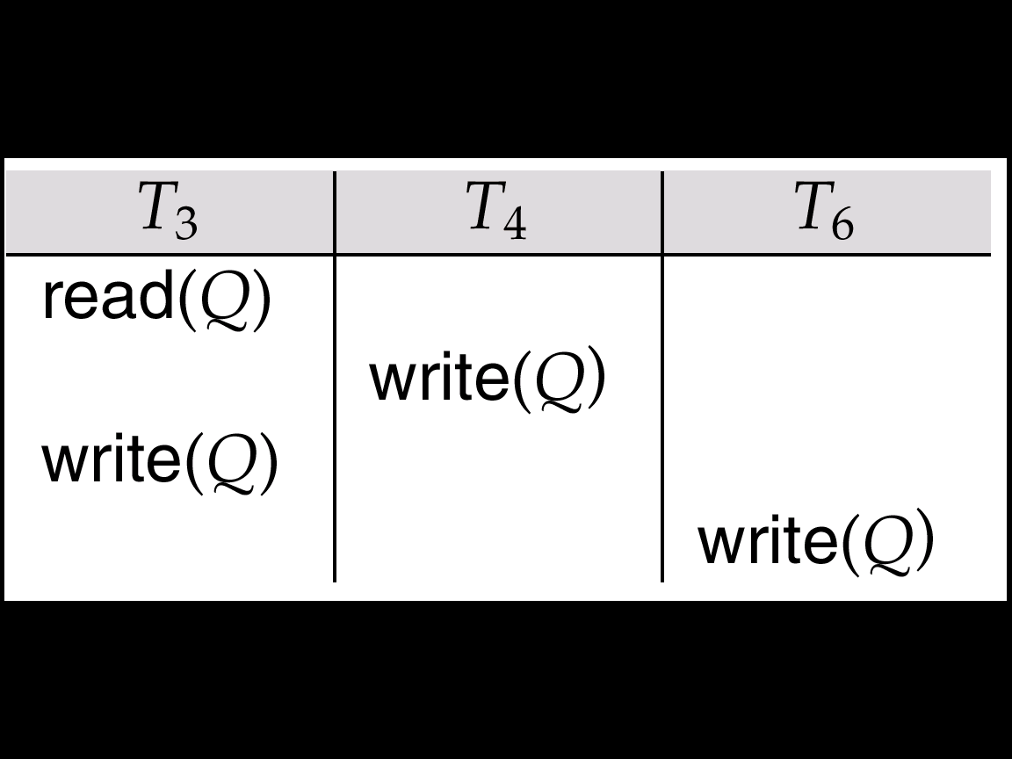
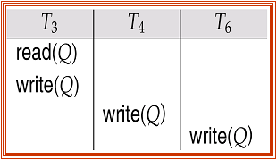
View Serializability (cont.)
A schedule S is view serializable if it is view equivalent to a serial schedule.
Every conflict serializable schedule is also view serializable.
Schedule 9 - a schedule which is view-serializable but not conflict serializable.
Every view serializable schedule that is not conflict
serializable has blind writes (盲目写).
Schedule 9
view equivalent
Schedule 9’

Slide 27
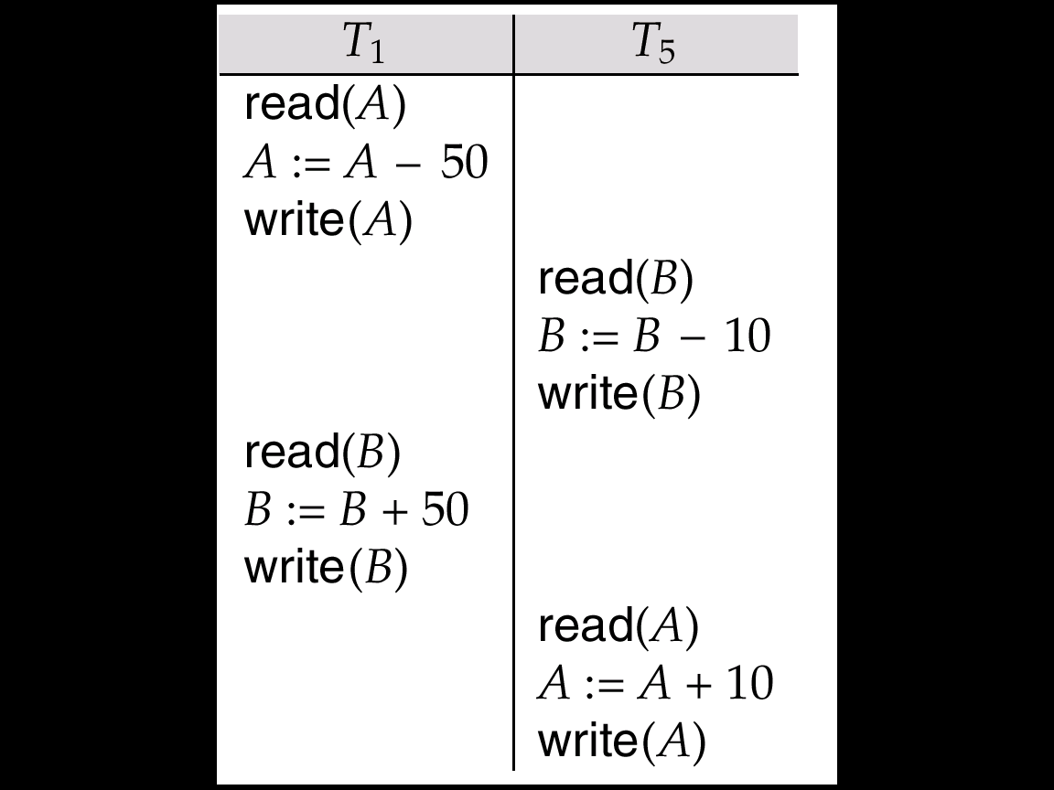
Other Notions of Serializability
Schedule 8 given below produces same outcome as the serial schedule < T₁, T₅ >, yet is not conflict equivalent nor view equivalent to it.
Determining such equivalence requires analysis of operations other than read and write. (Eg. not equiv. for B:= B+0.1B)
Equivalent to schedule1, i.t. < T₁, T₅ >
例外:
Schedule 8

Slide 28
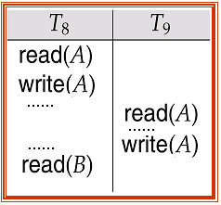
6 Recoverability (可恢复性)
Now we need to address the effect of transaction failures on concurrently running transactions.
The following schedule (Schedule 11) is not recoverable if T₉ commits immediately after the read(A), or T₉ commits before T₈ commits.
If T₈ should abort, T₉ would have read or write (and possibly shown to the user) an inconsistent database state.
  Hence database must ensure that schedules are recoverable.
First look at schedule 11
Schedule 11:
……
commit
abort
commit

Slide 29
Recoverability (可恢复性)
Definition: Recoverable schedule(可恢复的调度) — if a transaction T₉ reads a data item previously written by a transaction T₈ , the commit operation of T₈ should appears before the commit operation of T₉.
……
abort
commit
commit
可恢复调度：先写的事务，先提交。

Slide 30
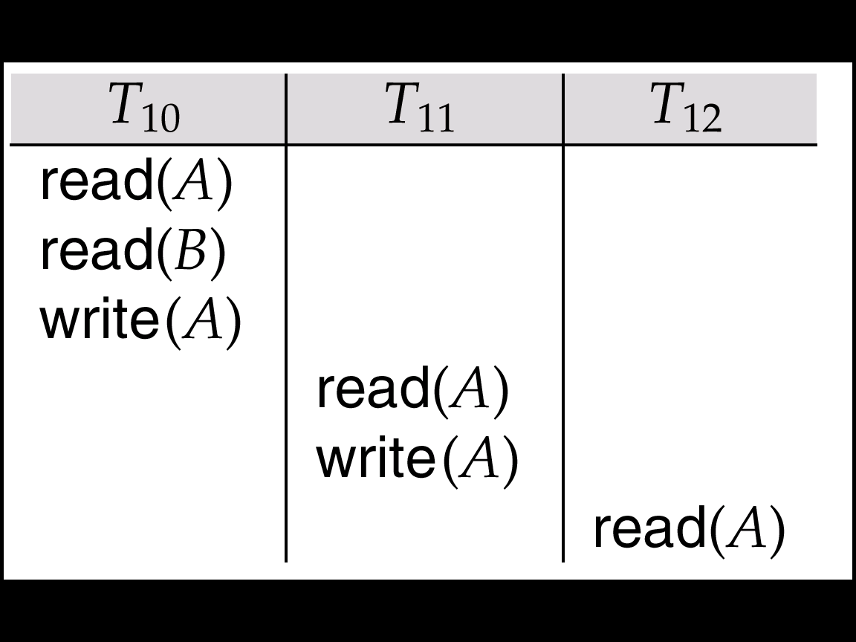
Recoverability (cont.)
Cascading rollback(级联回滚) - a single transaction failure leads to a series of transaction rollbacks.
  Consider the following schedule where none of the transactions has yet committed :
  If T₁₀ fails, T₁₁ and T₁₂ must also be rolled back.
Can lead to the undoing of a significant amount of work - This is undesirable, and should be avoided.
……
……
……
abort
……
commit
commit
commit

Slide 31
Recoverability (cont.)
Cascadeless schedules (无级联调度) — cascading rollbacks cannot occur。
  For each pair of transactions T₁ and T₂ ，such that T₂ reads a data item previously written by T₁, the commit operation of T₁ appears before the read operation of T₂.
Every cascadeless schedule is also recoverable
It is desirable to restrict the schedules to those that are cascadeless.
commit
commit

Slide 32
7 Implementation of Isolation
A policy in which only one transaction can execute at a time generates serial schedules, but provides a poor degree of concurrency.
Schedules must be conflict or view serializable, and recoverable, for the sake of database consistency, and preferably cascadeless.
Concurrency-control schemes tradeoff between the amount of concurrency they allow and the amount of overhead that they incur.
Some schemes allow only conflict-serializable schedules to be generated, while others allow view-serializable schedules that are not conflict-serializable.

Slide 33
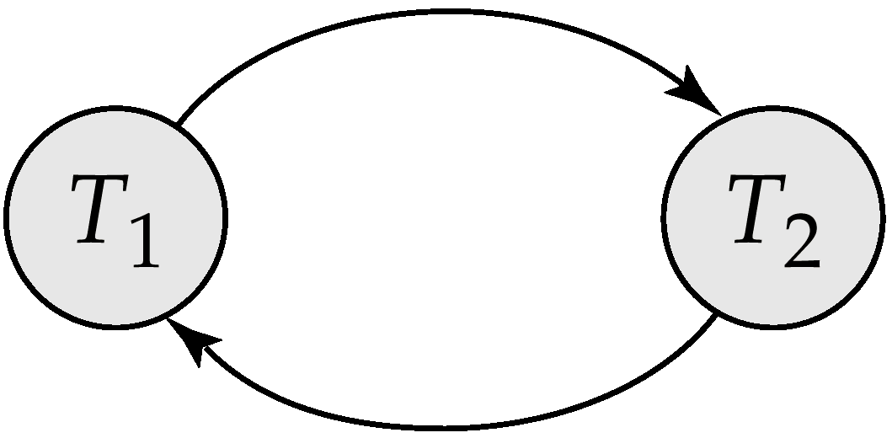
8 Testing for Serializability
Consider the schedule of a set of transactions T₁, T₂, ..., T_{n} , how to tell its serializability
Precedence graph (优先图, 前驱图) — a direct graph where the vertices are the transactions (names).
We draw an arc from T_{i} to T_{j} if the two transaction conflict, and T_{i} accessed the data item on which the conflict arose earlier.
We may label the arc by the item that was accessed.
Example 1
x
X, Y are data items, on which conflict operations arose.
Y

Slide 34
Example Schedule (Schedule A)
T₁ T₂ T₃ T₄ T₅
read(X)
read(Y)
read(Z)
read(V)
read(W)
read(W)
read(Y)
write(Y)
write(Z)
read(U)
read(Y)
write(Y)
read(Z)
write(Z)
read(U)
write(U)
Y
T₁
T₂
Y
Z
T₃
T₄
Z

Slide 35
Test for Conflict Serializability
A schedule is conflict serializable if and only if its precedence graph is acyclic (无环的).
If precedence graph is acyclic, the serializability order can be obtained by a topological sorting (拓扑排序) of the graph. This is a linear order consistent with the partial order of the graph.
  For example, a serializability order for Schedule A would be:
  T₁ → T₃ → T₂ → T₄ . Or T₁ → T₂ → T₃ → T₄
( T₅ can be any order)
Y
T₁
T₂
Y
Z
T₃
T₄
Z

Slide 36
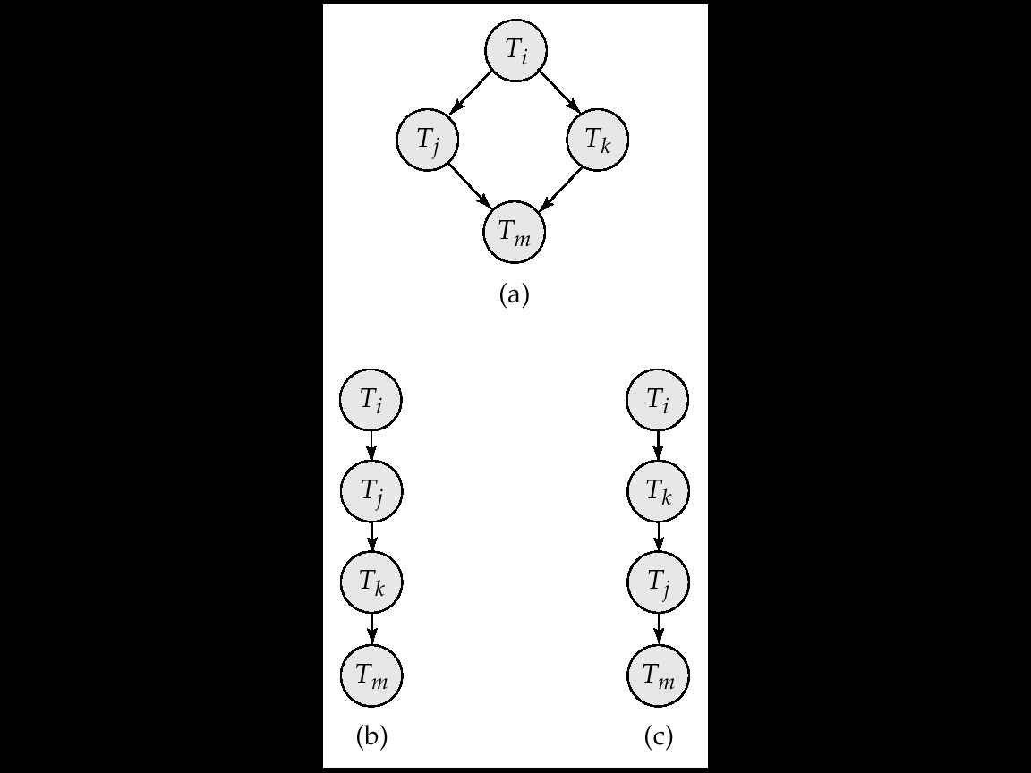
Test for Conflict Serializability

Slide 37
*Test for View Serializability
The precedence graph test for conflict serializability must be modified to apply to a test for view serializability.
The problem of checking if a schedule is view serializable falls in the class of NP-complete problems. Thus existence of an efficient algorithm is unlikely.
However practical algorithms that just check some sufficient conditions for view serializability can still be used.

Slide 38
Concurrency Control vs. Serializability Tests
Testing a schedule for serializability after it has executed is a little too late!
Goal – to develop concurrency control protocols that will assure serializability. They will generally not examine the precedence graph as it is being created; instead a protocol will impose a discipline that avoids nonseralizable schedules.
  Will study such protocols in Chapter 15.
Tests for serializability help understand why a concurrency control protocol is correct.

Slide 39
End of Chapter
7th Edition: Ex17.6, 17.12, 17.15

