Slide 1
Chapter 18: Concurrency Control
Lock-Based Protocols
*Timestamp-Based Protocols
*Validation-Based Protocols
Multiple Granularity
*Multiversion Schemes
Deadlock Handling
Insert Operations, Delete Operations, and Predicate Reads
Weak Levels of Consistency
*Concurrency in Index Structures

Slide 2
1 Lock-Based Protocols
Serializable schedule is the basis of the concurrent control.
A lock is a mechanism to control concurrent access to a data item .
Data items can be locked in two modes :
1. exclusive (X, 排它锁) mode. Data item can be both read as well as written. X-lock is requested using lock-X instruction .
2. shared (S, 共享锁) mode. Data item can only be read. S-lock is requested using lock-S instruction.
Lock requests are made to concurrency-control manager. Transaction can proceed only after the lock request is granted.

Slide 3

Lock-Based Protocols (cont.)
T₂
Lock-compatibility matrix
A transaction may be granted a lock on an item if the requested lock is compatible with locks already held on the item by other transactions
Any number of transactions can hold shared locks on an item, but if any transaction holds an exclusive on the item, no other transaction may hold any lock on the item.
If a lock cannot be granted, the requesting transaction is made to wait till all incompatible locks held by other transactions have been released. The lock is then granted.
If T₁ has already held a lock on item Q, what kind of lock can T₂ be grant on Q ?
T₁

Slide 4
Lock-Based Protocols (cont.)
Example of a transaction performing locking:
T1:
lock
-
X(B)
;
T
2
:
lock
-
S
(A)
;
Read(B);
read
(A)
;
B
:=
B
－
50
unlock
(A)
;
Write(B);
lock
-
S
(B)
;
lock
-
S
(B)
;
Unlock(B);
read
(B)
;
read
(B)
;
Lock
-
X(A)
;
unlock
(B)
;
lock
-
S
(B)
;
unlock
(B)
;
Read(A);
display
(A+B)
;
read
(B)
;
;
display
(A+B)
A
:=
A+50;
unlock
(B)
;
Write(A);
display
(A+B)
;
Unlock(A);

Slide 5
Lock-Based Protocols (cont.)
A=100, B=200
T1:
lock
-
X(B)
;
T
2
:
Read(B);
B
:=
B
－
50
lock
-
S
(A)
;
Write(B);
Unlock(B);
read(A)
lock
-
S
(B)
;
read
(B)
;
unlock
(A)
;
Lock
-
X(A)
;
display
(A+B)
得A+B → 250
;
Read(A);
unlock
(B)
;
A
:=
A+50;
Get inconsistent result
Write(A);
A+B →300
Unlock(A);
Violate non-conflict and isolation
A locking protocol is a set of rules followed by all transactions while requesting and releasing locks. Locking protocols restrict the set of possible schedules.

Slide 6
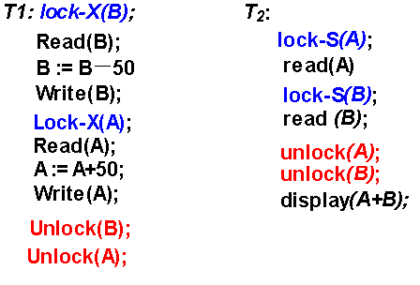
Two-Phase Locking Protocol (两段锁协议)
…
Deadlock (死锁)！！！

Slide 7

Pitfalls of Lock-Based Protocols
Consider the partial schedule
Neither T₃ nor T₄ can make progress — executing lock-S(B) causes T₄ to wait for T₃ to release its lock on B, while executing lock-X(A) causes T₃ to wait for T₄ to release its lock on A.
Such a situation is called a deadlock (死锁).
  To handle a deadlock one of T₃ or T₄ must be rolled back
  and its locks released.
…
…
Unlock(B)
Unlock(A)

Slide 8
Pitfalls of Lock-Based Protocols (cont.)
The potential for deadlock exists in most locking protocols. Deadlocks are a necessary evil.
Starvation（饿死）is also possible if concurrency control manager is badly designed. For example:
  A transaction may be waiting for an X-lock on an item, while a sequence of other transactions request and are granted an S-lock on the same item.
  The same transaction is repeatedly rolled back due to deadlocks.
Concurrency control manager can be designed to prevent starvation.

Slide 9
(1) The Two-Phase Locking Protocol (两段锁协议)
Phase 1: Growing Phase
  transaction may obtain locks
  transaction may not release locks
Phase 2: Shrinking Phase
  transaction may release locks
  transaction may not obtain locks
The protocol assures serializability. It can be proved that if a schedule is following the 2PL, then the transactions can be serialized in the order of their lock points (锁点，i.e. the point where a transaction acquired its final lock).
See next slide

Slide 10
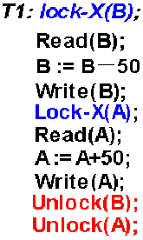
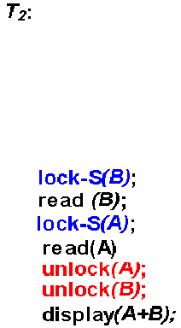
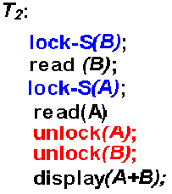
Lock point
Lock point
……
……
COMMIT;

Slide 11
Prove: The 2PL protocol ensures conflict serializability
Suppose two-phase locking does not ensure serializability. Then there exists a set of transactions T₀ , T₁ ... T_{n-1} which obey 2PL and which produce a non-serializable schedule. A non-serializable schedule implies a cycle in the precedence graph, and we shall show that 2PL cannot produce such cycles.
Without loss of generality, assume the following cycle exists in the precedence graph: T₀ →T₁ →T₂→... →T_{n-1}→T₀. Let α_{i} be the time at which T_{i} obtains its last lock (i.e. T_{i}’s lock point). Then for all transactions such that Ti→ Tj, αi < αj . Then for the cycle we have α0 < α1 < α2 < ... < α_{n-1} < α₀
Sinceα₀ <α₀ is a contradiction, no such cycle can exist. Hence 2PL cannot produce non-serializable schedules. Because of the property that for all transactions such that T_{i}→ T_{j} , α_{i} < α_{j} , the lock point ordering of the transactions is also a topological sort ordering of the precedence graph. Thus transactions can be serialized according to their lock points.

Slide 12
Prove2:
For T₀, T₁ ... T_{n-1} following 2PL in schedule, suppose T_{i} with the first lock point, we claim it is possible to move all read and write actions of T_{i} forward to the beginning of the schedule without passing any conflicting actions. If it is not true, suppose w_{j}(y) precedes w_{i}(y), then:
If U_{j}(y) precedes L_{i}(y), it’s not 2PL or T_{i} is not with the first lock point.
T_{i}
T_{j}
Only two possibilities: T_{j} is not 2PL, or T_{i} ’s lock point is behind the T_{j} ’s . All these are in contradiction with premise. In other word, the locking (2PL) would fail.
L(x)
W(x)
L(y)
W(y)
U(x)
U(y)
L(y)
W(y)
L(z)
W(z)
L(v)
W(v)
U(z)
U(y)
U(v)
U(y)
lock point
lock point
L(x)---Lock (x) U(x)---Unlock (x) W(x)--- Write (x)

Slide 13
The Two-Phase Locking Protocol (cont.)
But two-phase locking does not ensure freedom from deadlocks (like above example)
And cascading roll-back is possible under two-phase locking.
To avoid this, follow a modified protocol called strict two-phase locking (严格的两段锁). Here a transaction must hold all its exclusive locks till it commits/aborts. (make cascadeless rollback)
Rigorous two-phase locking (强的两段锁) is even stricter: here all locks are held till commit/abort. In this protocol transactions can be serialized in the order in which they commit.
(X锁在提交后释放)
(所有锁在提交后释放)
（以降低并发度为代价）
串行化是为了保证并发调度的正确性，即数据一致性。2PL理论上可保证可串化，但不能避免死锁。但死锁不会破坏一致性。

Slide 14
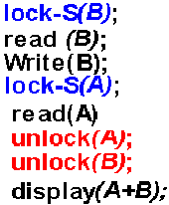
……
……
Abort
COMMIT;
COMMIT;

Slide 15

The Two-Phase Locking Protocol (cont.)
There can be conflict serializable schedules that cannot be obtained through two-phase locking protocol. (see below)
However, in the absence of extra information (e.g., ordering of access to data), two-phase locking is needed for conflict serializability in the following sense:
(冲突可串化不一定非要2PL，如下图)
(在没有附加信息的情况下，要保证冲突可串化，2PL是必要的)
L (A)
U (A)
L(A)
L (B)
L (B)
U(A)
U (B)
L(B)
U(B)

Slide 16
Lock Conversions (锁转换)
Two-phase locking with lock conversions: (to increase concurrency )
–First Phase:
  can acquire a lock-S on item
  can acquire a lock-X on item
  can convert a lock-S to a lock-X (upgrade)
–Second Phase:
  can release a lock-S (unlock)
  can release a lock-X (unlock)
  can convert a lock-X to a lock-S (downgrade)
This protocol assures serializability. But still relies on the programmer to insert the various locking instructions.
Ti: read(A)
read(B)
……
read(Y)
write(A)
Lock-s(A)
Lock-s(B)
……
Lock-s(Y)
upgrade(A)

Slide 17
Automatic Acquisition of Locks
A transaction T_{i} issues the standard read/write instruction, without explicit locking calls.
The operation read(D) is processed as:
if T_{i} has a lock on D
then
read(D)
else
begin
if necessary wait until no other
transaction has a lock-X on D
grant T_{i} a lock-S on D;
read(D)
end

Slide 18
Automatic Acquisition of Locks (cont.)
write(D) is processed as:
if T_{i} has a lock-X on D
then
write(D)
else
begin
if necessary wait until no other trans. has any lock on D,
if T_{i} has a lock-S on D
then
upgrade lock on D to lock-X
else
grant T_{i} a lock-X on D
write(D)
end ;
All locks are released after commit or abort

Slide 19
(2) Implementation of Locking
A Lock manager can be implemented as a separate process to which transactions send lock and unlock requests
The lock manager replies to a lock request by sending a lock grant messages (or a message asking the transaction to roll back, in case of a deadlock)
The requesting transaction waits until its request is answered
The lock manager maintains a datastructure called a lock table to record granted locks and pending requests
The lock table is usually implemented as an in-memory hash table indexed on the name of the data item being locked

Slide 20

Lock Table
Black rectangles indicate granted locks, white ones indicate waiting requests
Lock table also records the type of lock granted or requested
New request is added to the end of the queue of requests for the data item, and granted if it is compatible with all earlier locks
Unlock requests result in the request being deleted, and later requests are checked to see if they can now be granted
If transaction aborts, all waiting or granted requests of the transaction are deleted
  lock manager may keep a list of locks held by each transaction, to implement this efficiently
Data items
transactions

Slide 21
Draw the precedence graph for the schedule.
Is it conflict serializable ?
Is it possible that the schedule is generated by the 2PL protocol ? Explain.
T1 T2 T3
Lock-X (B)
read B
Lock-X (A)
read A
write A
Lock-X (A)
UL (A)
read A
write B
T2
A
T1
B
T3
UL (B)
Lock-X (B)
< T2, T1, T3 >
read B
write A
Yes.
UL (A)
write B
UL (B)

Slide 22
1), 2), 3), as above.
4). Which conditions should be satisfied if we want the schedule to be recoverable?
T1 T2 T3
T1 T2 T3
T1 T2 T3
Lock-X (C)
Lock-X (A)
write C
Lock-X (C)
UL (C)
Lock-X (A)
write A
write A
write A
UL (A)
Lock-X (C)
Lock-S (A)
UL (A)
read A
T3
C
T1
A
T2
read A
Lock-X (A)
read A
UL (A)
? Lock-S (C)
write C
UL (A)
write C
< T3, T1, T2 >
write C
write C
write C
UL (C)
Yes.
UL (C)
(Another schedule)
T1 must commit before T2 does.

Slide 23
(3) Graph-Based Protocols (基于图的加锁协议)
Graph-based protocols are an alternative to two-phase locking
Impose a partial ordering → on the set D = {d₁, d₂ ,..., d_{h}} of all data items.
  If d_{i} → d_{j} then any transaction accessing both d_{i} and d_{j} must access d_{i} before accessing d_{j}.
  Implies that the set D may now be viewed as a directed acyclic graph（有向无环图）, called a database graph.
The tree-protocol（树形协议） is a simple kind of graph protocol.
（偏序）

Slide 24

Tree Protocol
A,B,C,D,E,F,G,H,I,J are data items.
Every transaction T_{i} must conform the locking order.
Only exclusive locks are allowed.
1) The first lock by T_{i} may be on any data item.
2) Subsequently, a data Q can be locked by T_{i} only if the parent of Q is currently locked by T_{i}.
3) Data items may be unlocked at any time.
4) A data item Q can not be relocked by the same T_{i} after locked and unlocked

Slide 25
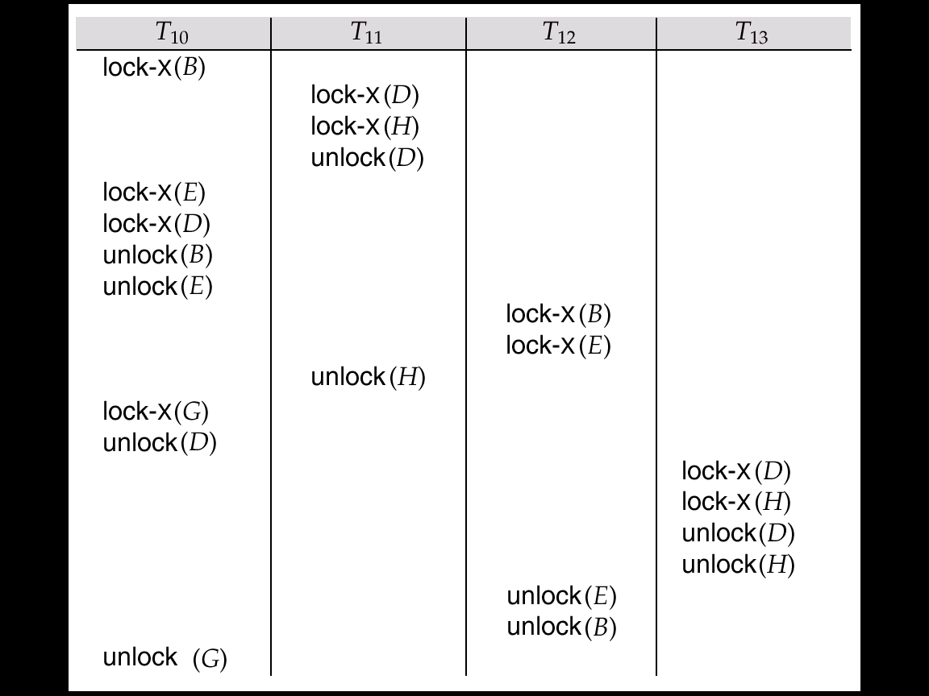
Serializable Schedule Under the Tree Protocol
T₁₁
D
H
T₁₀
D
B
T₁₃
T₁₂
Precedence graph
Serializable Schedules:
T₁₁ →T₁₀ → T₁₂ → T₁₃ ,
或 T₁₁ →T₁₀ → T₁₃ → T₁₂ ,

Slide 26

Graph-Based Protocols (cont.)
Advantages:
  The tree protocol ensures conflict serializability as well as freedom from deadlock.
  Unlocking may occur earlier in the tree-locking protocol than in the two-phase locking protocol.
    shorter waiting times, and increase in concurrency
    protocol is deadlock-free, no rollbacks are required
    but the abort of a transaction can still lead to cascading rollbacks.

Slide 27
Graph-Based Protocols (cont.)
Disadvantage: a transaction may have to lock data items that it does not access. E.g: to access data item A, J, need lock A, B, D, H, J
  increased locking overhead, and additional waiting time
  potential decrease in concurrency
Schedules not possible under two-phase locking are possible under tree protocol, and vice versa.

Slide 28
*2 Timestamp-Based Protocols
(基于时间戳的协议)
Each transaction is issued a timestamp when it enters the system. If an old transaction T_{i} has time-stamp TS(T_{i}), a new transaction T_{j} is assigned time-stamp TS(T_{j}) such that TS(T_{i}) <TS(T_{j}).
The protocol manages concurrent execution such that the time-stamps determine the serializability order.
In order to assure such behavior, the protocol maintains for each data Q two timestamp values:
  W-timestamp(Q) is the largest time-stamp of any transaction that executed write(Q) successfully.
  R-timestamp(Q) is the largest time-stamp of any transaction that executed read(Q) successfully.

Slide 29
Timestamp-Based Protocols (cont.)
The timestamp ordering protocol ensures that any conflicting read and write operations are executed in timestamp order.
Suppose a transaction T_{i} issues a read(Q)
1. If TS(T_{i}) ≤ W-timestamp(Q), then T_{i} needs to read a value of Q that was already overwritten. Hence, the read operation is rejected, and T_{i} is rolled back.
2. If TS(T_{i})≥ W-timestamp(Q), then the read operation is executed, and R-timestamp(Q) is set to the maximum of R-timestamp(Q) and TS(T_{i}).

Slide 30
Timestamp-Based Protocols (cont.)
Suppose that transaction T_{i} issues write(Q).
If TS(T_{i}) < R-timestamp(Q), then the value of Q that T_{i} is producing was needed previously, and the system assumed that that value would never be produced. Hence, the write operation is rejected, and T_{i} is rolled back.
If TS(T_{i}) < W-timestamp(Q), then T_{i} is attempting to write an obsolete value of Q. Hence, this write operation is rejected, and T_{i} is rolled back.
Otherwise, the write operation is executed, and W-timestamp(Q) is set to TS(T_{i}).

Slide 31
Example Use of the Protocol
A partial schedule for several data items for transactions with timestamps 1, 2, 3, 4, 5
T₁
T₂
T₃
T₄
T₅
read(X)
read(Y)
read(Y)
write(Y)
write(Z)
read(Z)
read(X)
abort
read(X)
write(Z)
abort
write(Y)
write(Z)

Slide 32
Correctness of Timestamp-Ordering Protocol
The timestamp-ordering protocol guarantees serializability since all the arcs in the precedence graph are of the form:
Thus, there will be no cycles in the precedence graph
Timestamp protocol ensures freedom from deadlock as no transaction ever waits.
But the schedule may not be cascade-free, and may not even be recoverable.
transaction
with smaller
timestamp
transaction
with larger
timestamp

Slide 33
Recoverability and Cascade Freedom
Problem with timestamp-ordering protocol:
  Suppose T_{i} aborts, but T_{j} has read a data item written by T_{i}
  Then T_{j} must abort; if T_{j} had been allowed to commit earlier, the schedule is not recoverable.
  Further, any transaction that has read a data item written by T_{j} must abort
  This can lead to cascading rollback --- that is, a chain of rollbacks
Solution:
  A transaction is structured such that its writes are all performed at the end of its processing
  All writes of a transaction form an atomic action; no transaction may execute while a transaction is being written
  A transaction that aborts is restarted with a new timestamp

Slide 34
Thomas’ Write Rule
Modified version of the timestamp-ordering protocol in which obsolete write operations may be ignored under certain circumstances.
When T_{i} attempts to write data item Q, if TS(T_{i}) < W-timestamp(Q), then T_{i} is attempting to write an obsolete value of {Q}. Hence, rather than rolling back T_{i} as the timestamp ordering protocol would have done, this {write} operation can be ignored.
Otherwise this protocol is the same as the timestamp ordering protocol.
Thomas' Write Rule allows greater potential concurrency. Unlike previous protocols, it allows some view-serializable schedules that are not conflict-serializable.

Slide 35
*3 Validation-Based Protocol (基于有效检查的协议)
Execution of transaction T_{i} is done in three phases.
1. Read and execution phase: Transaction T_{i} writes only to
temporary local variables
2. Validation phase: Transaction T_{i} performs a ``validation test'' to determine if local variables can be written without violating serializability.
3. Write phase: If T_{i} is validated, the updates are applied to the database; otherwise, T_{i} is rolled back.
The three phases of concurrently executing transactions can be interleaved, but each transaction must go through the three phases in that order.
Also called as optimistic concurrency control since transaction executes fully in the hope that all will go well during validation

Slide 36
Validation-Based Protocol (cont.)
Each transaction T_{i} has 3 timestamps
Start(T_{i}) : the time when T_{i} started its execution
Validation(T_{i}): the time when T_{i} entered its validation phase
Finish(T_{i}) : the time when T_{i} finished its write phase
Serializability order is determined by timestamp given at validation time, to increase concurrency. Thus TS(T_{i}) is given the value of Validation(T_{i}).
This protocol is useful and gives greater degree of concurrency if probability of conflicts is low. That is because the serializability order is not pre-decided and relatively less transactions will have to be rolled back.

Slide 37
Validation Test for Transaction T_{j}
If for all T_{i} with TS (T_{i}) < TS (T_{j}) either one of the following condition holds:
  finish(T_{i}) < start(T_{j})
  start(T_{j}) < finish(T_{i}) < validation(T_{j}) and the set of data items written by T_{i} does not intersect with the set of data items read by T_{j}.
then validation succeeds and T_{j} can be committed. Otherwise, validation fails and T_{j} is aborted.
Justification: Either first condition is satisfied, and there is no overlapped execution, or second condition is satisfied and
1. the writes of T_{j} do not affect reads of T_{i} since they occur after T_{i}
has finished its reads.
2. the writes of T_{i} do not affect reads of T_{j} since T_{j} does not read
any item written by T_{i}.

Slide 38
Schedule Produced by Validation
Example of schedule produced using validation
T₁₄
T₁₅
read(B)
read(B)
B:- B-50
read(A)
A:- A+50
read(A)
(validate)
display (A+B)
(validate)
write (B)
write (A)

Slide 39
4 Multiple Granularity (多粒度)
For the convenience, allow data items to be locked in various sizes according to the requirements - multiple granularity.
Define a hierarchy of data granularities, where the small granularities are nested within larger ones, and can be represented graphically as a tree (but don't confuse with tree-locking protocol) (see next page)
When a transaction locks a node in the tree explicitly, it implicitly locks all the node's descendents in the same mode.

Slide 40
Granularity of locking (level in tree where locking is done):
  fine granularity (细粒度，lower in tree): high concurrency, high locking overhead
  coarse granularity (粗粒度，higher in tree): low locking overhead, low concurrency

Slide 41
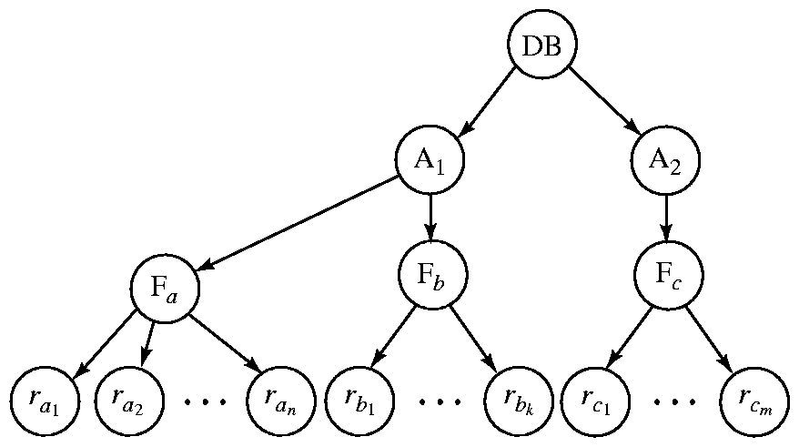
Example of Granularity Hierarchy
?
The highest level in the example hierarchy is the entire database.
The levels below are of type area, file and record in that order.
Type area
contain
Table (file)
?
Tuples

Slide 42
Intention Lock (意向锁)
Problem: T₁ locked r_{a1} in X-lock, T₂ locked F_{b} in S-lock. Now T₃ wishes to lock F_{a} in S-lock? T₄ wishes to lock the entire DB in S-lock? (search the entire tree!)
Intention locks are put on all the ancestors of a node before that node is locked explicitly.
Intention locks allow a higher level node to be locked in S or X mode without having to check all descendent nodes.

Slide 43
Intention Lock Modes (意向锁类型)
there are three intention lock modes with multiple granularity:
  intention-shared (IS，共享型意向锁): indicates explicit locking at a lower level of the tree with shared locks. (表明其后代存在S锁)
  intention-exclusive (IX ，排它型意向锁): indicates explicit locking at a lower level with exclusive locks。 (表明其后代存在X锁)
  shared and intention-exclusive (SIX，共享排它型意向锁): the subtree rooted by that node is locked explicitly in shared mode and explicit locking is being done at a lower level with exclusive-mode locks. SIX=S+IX

Slide 44
Is
Ix
Is
Ix
Ix
Is
x
S ?
s
x
s
x
s
s
s
s
s

Slide 45
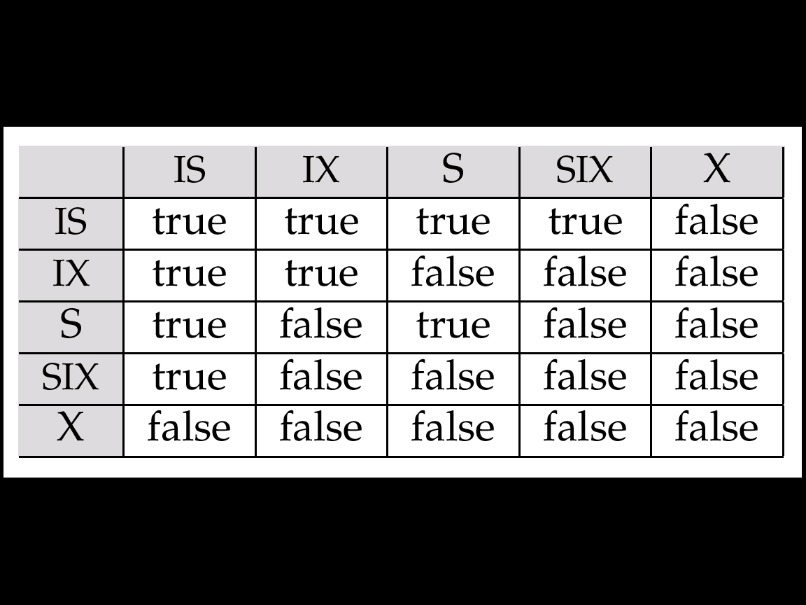
Compatibility Matrix

Slide 46
Compatibility Matrix with Intention Lock Modes
The compatibility matrix for all lock modes is: （二个事务对同一数据对象加锁时的相容或冲突）
其他事务已加的锁
IS
IX
S
S IX
X
一个事务的加锁申请
IS
✓
✓
✓
✓
×
IX
✓
✓
×
×
×
S
✓
×
✓
×
×
S IX
✓
×
×
×
×
X
×
×
×
×
×

Slide 47
Is
Ix
Is
Ix
A
Is
Is
Ix
B
Ix
J
Ix
Is
C
Q
Ix
?
s
s
x
s
E
F
x
G
S
S
S ?
x
H
I
x
x
x
S ?
S ?
To Lock-s (Q) ?
(A) Ix, Is兼容
(B) Ix, s不兼容
Notes:
(C)在当前情况下(黑色部分)，能加上锁么(蓝色部分)？

Slide 48
Multiple Granularity Locking Scheme
Transaction T_{i} can lock a node Q, using the following rules:
1. The lock compatibility matrix must be observed.
2. The root of the tree must be locked first, and may be locked in any mode.
3. A node Q can be locked by Ti in S or IS mode only if the parent of Q is currently locked by Ti in either IX or IS mode.
4. A node Q can be locked by Ti in X, SIX, or IX mode only if the parent of Q is currently locked by Ti in either IX or SIX mode.

Slide 49
Multiple Granularity Locking Scheme (cont.)
5. T_{i} can lock a node only if it has not previously unlocked any node (i.e., 2PL).
6. T_{i} can unlock a node Q only if none of the children of Q are currently locked by T_{i}
Observe that locks are acquired in root-to-leaf order, whereas they are released in leaf-to-root order.
(加锁自顶向下，解锁自下而上，且遵守2PL协议)
Advantages: 增强并发性，降低加锁开销。

Slide 50
*5 Multiversion Schemes
Multiversion schemes keep old versions of data item to increase concurrency.
  Multiversion Timestamp Ordering
  Multiversion Two-Phase Locking
Each successful write results in the creation of a new version of the data item written.
Use timestamps to label versions.
When a read(Q) operation is issued, select an appropriate version of Q based on the timestamp of the transaction, and return the value of the selected version.
reads never have to wait as an appropriate version is returned immediately.

Slide 51
Multiversion Timestamp Ordering
Each data item Q has a sequence of versions <Q₁, Q₂,...., Q_{m}>. Each version Q_{k} contains three data fields:
  Content -- the value of version Q_{k}.
  W-timestamp(Q_{k}) -- timestamp of the transaction that created (wrote) version Q_{k}
  R-timestamp(Q_{k}) -- largest timestamp of a transaction that successfully read version Q_{k}
when a transaction T_{i} creates a new version Q_{k} of Q, Q_{k}'s W-timestamp and R-timestamp are initialized to TS(T_{i}).
R-timestamp of Q_{k} is updated whenever a transaction T_{j} reads Q_{k}, and TS(T_{j}) > R-timestamp(Q_{k}).

Slide 52
Multiversion Timestamp Ordering (cont.)
The multiversion timestamp scheme presented next ensures serializability.
Suppose that transaction T_{i} issues a read(Q) or write(Q) operation. Let Q_{k} denote the version of Q whose write timestamp is the largest write timestamp less than or equal to TS(T_{i}).
1. If transaction T_{i} issues a read(Q), then the value returned is the content of version Q_{k}.
2. If transaction T_{i} issues a write(Q), and if TS(T_{i}) < R-
timestamp(Q_{k}), then transaction T_{i} is rolled
back. Otherwise, if TS(T_{i}) = W-timestamp(Q_{k}), the contents of Q_{k} are overwritten, otherwise a new version of Q is created.
Reads always succeed; a write by T_{i} is rejected if some other transaction T_{j} that (in the serialization order defined by the timestamp values) should read T_{i}'s write, has already read a version created by a transaction older than T_{i}.

Slide 53
Multiversion Two-Phase Locking
Differentiates between read-only transactions and update transactions
Update transactions acquire read and write locks, and hold all locks up to the end of the transaction. That is, update transactions follow rigorous two-phase locking.
  Each successful write results in the creation of a new version of the data item written.
  each version of a data item has a single timestamp whose value is obtained from a counter ts-counter that is incremented during commit processing.
Read-only transactions are assigned a timestamp by reading the current value of ts-counter before they start execution; they follow the multiversion timestamp-ordering protocol for performing reads.

Slide 54
Multiversion Two-Phase Locking (cont.)
When an update transaction wants to read a data item, it obtains a shared lock on it, and reads the latest version.
When it wants to write an item, it obtains X lock on; it then creates a new version of the item and sets this version's timestamp to ∞.
When update transaction T_{i} completes, commit processing occurs:
  T_{i} sets timestamp on the versions it has created to ts-counter + 1
  T_{i} increments ts-counter by 1
Read-only transactions that start after T_{i} increments ts-counter will see the values updated by T_{i}.
Read-only transactions that start before T_{i} increments the
ts-counter will see the value before the updates by T_{i}.
Only serializable schedules are produced.

Slide 55
6 Deadlock Handling (死锁处理)
Consider Schedule with deadlock
T₁
T₂
lock-X (X)
write (X)
lock-X (Y)
write (Y)
wait for lock-X (X)
Write (X)
wait for lock-X (Y)
Write (Y)
System is deadlocked if there is a set of transactions such that every transaction in the set is waiting for another transaction in the set.
How to handing?
● Deadlock prevention
● Deadlock detection and deadlock recovery

Slide 56
(1) Deadlock prevention
Deadlock prevention protocols ensure that the system will never enter into a deadlock state. Some prevention strategies:
  1) Require that each transaction locks all its data items before it begins execution (predeclaration)–conservative 2PL. (Either all or none are locked )
    Disadvantages: bad concurrency, hard to predict
  2) Impose partial ordering of all data items and require that a transaction can lock data items only in the order (graph-based protocol). --- therefore never form a cycle.

Slide 57
More Deadlock Prevention Strategies
Following prevention strategies use rollback mechanism, and use transaction timestamps to decide which one to be rolled back.
3) wait-die scheme — non-preemptive
  Older transactions wait for younger transactions to release data item. Younger transactions never wait for older ones; they are rolled back instead.
4) wound-wait scheme — preemptive
  Older transactions are rolled back. Younger transactions wait for older transactions to release data item.

Slide 58
Wait-die
rollback
Wound-wait
wait
……
rollback

Slide 59
Deadlock prevention (cont.)
In wait-die scheme, a rolled back transaction is restarted with its original timestamp, and starvation is hence avoided.
5) Timeout-Based Schemes :
  A transaction waits for a lock only for a specified amount of time. After that, the wait times out and the transaction is rolled back.
  Advantage: thus deadlocks are not possible; simple to implement.
  But starvation is possible. Also difficult to determine good value of the timeout interval. Too long and too short are bad.

Slide 60
(2) Deadlock Detection
Deadlocks can be described as a wait-for graph (等待图), which consists of a pair G = (V,E),
  V is a set of vertices (all the transactions in the system)
  E is a set of edges; each element is an ordered pair T_{i} →T_{j}.
If T_{i} → T_{j} is in E, then there is a directed edge from T_{i} to T_{j}, implying that T_{i} is waiting for T_{j} to release a data item.
When T_{i} requests a data item currently being held by T_{j}, then the edge T_{i} → T_{j} is inserted in the wait-for graph. This edge is removed only when T_{j} is no longer holding a data item needed by T_{i}.
The system is in a deadlock state if and only if the wait-for graph has a cycle. Must invoke a deadlock-detection algorithm periodically to look for cycles.

Slide 61


Deadlock Detection (cont.)
Wait-for graph without a cycle
Wait-for graph with a cycle

Slide 62
(3) Deadlock Recovery
When deadlock is detected :
  Some transaction will have to rolled back (made a victim) to break deadlock. Select that transaction as victim (受害者) that will incur minimum cost. (选择代价最小的事务进行回滚)
  Rollback --- determine how far to roll back transaction
    Total rollback: Abort the whole transaction and then restart it.
    Partial rollback: More effective to roll back transaction only as far as necessary to break deadlock.
  Starvation happens if same transaction is always chosen as victim. 解决办法：Include the number of rollbacks in the cost factor to avoid starvation

Slide 63
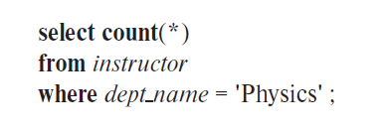

7 Insert Operations, Delete Operations, and Predicate Reads
If two-phase locking is used :
  A delete operation may be performed only if the transaction deleting the tuple has an exclusive lock on the tuple to be deleted.
  A transaction that inserts a new tuple into the database is given an X-mode lock on the tuple.
Insertions and updates can lead to the phantom phenomenon.
  A transaction that scans a relation and a transaction that inserts a tuple in the relation may conflict in spite of not accessing any tuple in common.
  If only tuple locks are used, non-serializable schedules can result.

Slide 64
Insert Oprations, Delete Operations, and Predicate Reads (cont.)
The transaction scanning the relation is reading information that indicates what tuples the relation contains, while a transaction inserting a tuple updates the same information.
  The information should be locked.
One solution:
  Associate a data item with the relation, to represent the information about what tuples the relation contains.
  Transactions scanning the relation acquire a shared lock in the data item.
  Transactions inserting or deleting a tuple acquire an exclusive lock on the data item. (Note: locks on the data item do not conflict with locks on individual tuples)
Above protocol provides very low concurrency for insertions/deletions. (two transactions that insert different tuples into a relation are prevented from executing concurrently)
Index locking protocols provide higher concurrency while
preventing the phantom phenomenon.

Slide 65
Index Locking Protocol
Every relation must have at least one index.
Access to a relation must be made only through one of the indices on the relation.
A transaction T_{i} that performs a lookup must lock all the index leaf nodes that it accesses, in S-mode.
A transaction T_{i} may not insert, delete, or update a tuple t_{i} into a relation r without updating all indices to r.
T_{i} must perform a lookup on every index to obtain locks in X-mode on all index leaf nodes that are affected by the insertion, deletion, or update.
The rules of the two-phase locking protocol must be observed.

Slide 66
8 Weak Levels of Consistency
Degree-two consistency: differs from two-phase locking in that S-locks may be released at any time, and locks may be acquired at any time
  X-locks must be held till end of transaction
  Serializability is not guaranteed, programmer must ensure that no erroneous database state will occur
Cursor stability:
  For reads, each tuple is locked, read, and lock is immediately released
  X-locks are held till end of transaction
  Special case of degree-two consistency

Slide 67
Weak Levels of Consistency in SQL
SQL allows non-serializable executions
  Serializable: is the default
  Repeatable read: allows only committed records to be read, and repeating a read should return the same value (so read locks should be retained)
    However, the phantom phenomenon cannot be prevented
      T1 may see some records inserted by T2, but may not see others inserted by T2
  Read committed: same as degree two consistency, but most systems implement it as cursor-stability
  Read uncommitted: allows even uncommitted data to be read

Slide 68
*9 Concurrency in Index Structures
Indices are unlike other database items in that their only job is to help in accessing data.
Index-structures are typically accessed very often, much more than other database items.
Treating index-structures like other database items leads to low concurrency. Two-phase locking on an index may result in transactions executing practically one-at-a-time.
It is acceptable to have nonserializable concurrent access to an index as long as the accuracy of the index is maintained.
In particular, the exact values read in an internal node of a
B⁺-tree are irrelevant so long as we land up in the correct leaf node.
There are index concurrency protocols where locks on internal nodes are released early, and not in a two-phase fashion.

Slide 69
Concurrency in Index Structures (cont.)
Example of index concurrency protocol:
Use crabbing instead of two-phase locking on the nodes of the B⁺-tree, as follows. During search/insertion/deletion:
  First lock the root node in shared mode.
  After locking all required children of a node in shared mode, release the lock on the node.
  During insertion/deletion, upgrade leaf node locks to exclusive mode.
  When splitting or coalescing requires changes to a parent, lock the parent in exclusive mode.
Above protocol can cause excessive deadlocks. Better protocols are available; see Section 15.10 for one such protocol, the B-link tree protocol

Slide 70
End of Chapter
7th Edition: Ex18.1, 18.2, 18.17

