Slide 1

Laboratory Studies
IS 306 Interaction Design & Prototyping
2015-16, Term 1, G5
1
Notes:
1
Much of the content of these slides was borrowed from Scott Klemmer’s CS147, Fall 2010.

Slide 2
Overview
Planning a Laboratory study
Goals
Methods
Participants & Environment
Types of data
Qualitative vs. Quantitative
Observations vs. Questions
Running a lab study
Notes:
Before you start your study you should articulate these things.

Slide 3
Laboratory Studies
Approach:
Observe in controlled environment
Pros:
Precise
Cons:
Less realistic than field studies
Laboratory Studies
Field Studies
Surveys
Inspections
Notes:
Laboratory studies involve bringing participants into a controlled environment (e.g., a laboratory) and observing their behavior.
This is one of the most precise methods, because you can control what people do.
It’s difficult to quantitatively measure human behavior, but there are well-established methods for doing so, and we’ll look at them in this class.

Slide 4


Why “Laboratory”?
Controlled Environment
We can control the conditions for a precise test
Notes:
Why is this a “laboratory”? Because it is a controlled environment.
What variables can we control?
Participants
Data to collect (time, eye tracking, clicks, etc)

Slide 5
Tasks & Procedure
Plan the study
Recruit participants
Prepare materials
Run the study
Analyze data
Recommend
Prepare Tests
Start with lighter and faster test
1
2
3
Task Order
Simple to Complex
4
5
6
Notes:
http://www.alistapart.com/articles/usability-testing-demystified/
If you follow this process in a linear way, you’ll end up with thorough planning, solid controls, heaps of data, rigorous analysis, and—finally—results. (As well as a lot of documentation.) It can feel like a big deal, and sometimes it should be.
But most real-world usability tests need to be lighter and faster. Some of the best user experience teams do only a few hours of testing every month or so, and they may not even think of it as “usability testing.” They’re “getting input” or “gathering feedback.”
Whatever. As long as it involves observing real people using your design, it’s usability testing.

Slide 6

Step 1: Plan the study
Goals
What should participants think, feel, or do?
Method
What tasks will participants perform?
What is your test procedure?
Participants
How many users of what types will you recruit?
Environment
Where and under what conditions?
Data
Collect what qualitative and quantitative data?
Notes:
A good plan for usability testing gives the participants:
- a goal/task (what to do or what question to find the answer for)
data, if needed, that a real user would have when going to the site to do that task
You can give the scenario as just the statement of the goal/task or you can elaborate it a little with a very short story that gets people in the mindset of a user and adds motivation to get to the goal.

Slide 7
Earlier studies can have non-specific goals
“Users should be able to do task without guidance.”
Useful early in design
Required in Iter 2
How to measure “without guidance”?
Look for signs that users are lost
Track how path deviates from expected path
“Users should find system’s functions useful.”
Helps to validate functions
How to measure “useful”?
Look at user comments
Open-ended question: how would function be used?
Notes:
Many claims relate to how easily users can accomplish tasks. If users make mistakes, this could indicate a variety of problems, and you’ll have to find the cause.
The conceptual model may be unclear
Users may have trouble navigating through the interface
Functional testing
Verification: meet its specification (does it right)
Validation: meets what is wanted (the right system)
Verification is objective if the specifications are sufficiently precise
Validation is subjective and difficult to determine

Slide 8

Later studies are better with specific goals
“Users should be able to do task in 5 seconds.”
Defines task and time measure
“95% of users should be able to do tasks with no errors.”
Defines task and error measure
“Users should find design pleasing (average rating 5/7).”
Defines subjective rating (hard to measure accurately)
“Users should interpret UI terminology without errors.”
Count comments or number of times users get lost due to wording problems when performing tasks? (Hard)
If you have a specific goal, then you should be able to explain where it comes from!
Notes:
Claims are best when they are specific.

Slide 9

Method: Selecting Tasks
Choose realistic tasks
Focus on goals
Make as concrete as possible
(bad) “Try out the UI”
(better) “Search for a movie”
(good) “Search for ‘Spider Man’”
Don’t train participants, unless this is normal
Don’t choose tasks biased in favor of your system
Avoid fragmenting tasks
Don’t break into steps for them!
Later tasks can use results of previous tasks.

Slide 10
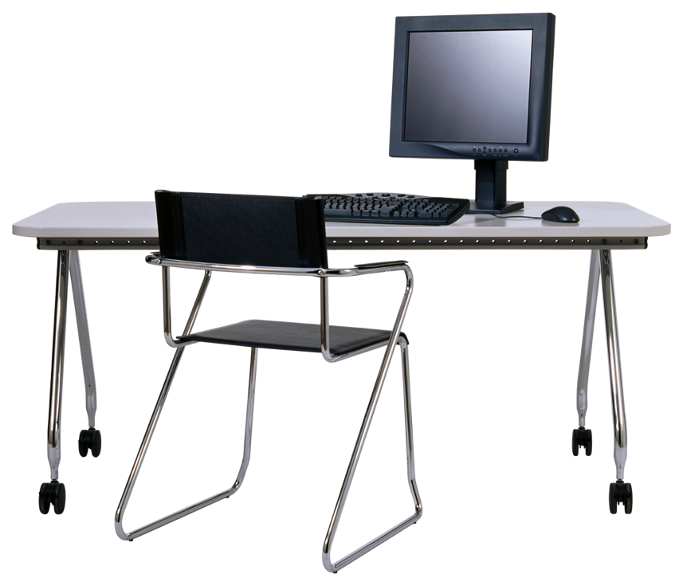
Method: Defining Procedures
What sequence of events?
Consent, training, questionnaires, etc.
What order for tasks?
Simple to complex: reduces training
Counterbalanced: reduces ordering effects
Notes:
http://www.usability.gov/articles/newsletter/pubs/092006news.html
http://www.uiaccess.com/accessucd/ut_plan.html#characteristics

Slide 11

Participants
How many?
More: higher cost and time
Less: may fail to detect important problems
Less participants for common (frequent) bugs
Who are they?
Real/target users? Students? Demographics?
Some problems may only be discovered by users with special skill sets
Expert users, domain experts, disabilities, etc.
Notes:
http://www.usability.gov/articles/newsletter/pubs/092006news.html
http://www.uiaccess.com/accessucd/ut_plan.html#characteristics

Slide 12

Ethical Considerations
Informed consent: Make it clear that it is voluntary
Avoid pressure to participate
They can stop at any time
Make collected data as anonymous as possible.
Refer to people by number, not by name
Notes:
Sometimes tests can be distressing. Some people feel a great deal of anxiety when performing tasks. If they perform badly, they will take it personally, even if the system is at fault. Sometimes participants leave in tears!
You have a responsibility to alleviate this.
Make it as clear as possible that the test is voluntary with informed consent.
Avoid pressure to participate
Let them know they can stop at any time
Make collected data as anonymous as possible.
- and finally…

Slide 13
“We are testing the interface. This is not a test of your abilities.”
Notes:
Make it as clear as possible that the test is voluntary with informed consent.
It can be hard for this to sink in. It’s good to keep stressing, though, because it gets users to feel like *collaborators* in your project. They are helping you find usability bugs!

Slide 14

Environment
Use Realistic Conditions
Where it will be used
When it will be used
Often hard to do in practice
Can simulate real conditions
Noise level
Distractions
Even temperature and humidity (if necessary)!
Notes:
http://www.usability.gov/articles/newsletter/pubs/092006news.html
http://www.uiaccess.com/accessucd/ut_plan.html#characteristics

Slide 15
Data: Qualitative vs. Quantitative
Qualitative | Quantitative
Descriptions | Numbers
Hard to measure | Easy to measure
Themes and Patterns | Statistical Analysis
Notes:
Chapter 4, "Assessment Methods" in the book: Demonstrating Student Success, A Practical Guide to Outcomes-Based Assessment of Learning and Development in Student Affairs, by Marilee J. Bresciani, Megan Moore Gardner, and Jessica Hickmott. Published by Stylus Publishing , LLC 2283 Quicksilver Drive, Sterling, Virginia 20166-2102.[http://www.styluspub.com] © Copyright 2009 by Stylus Publishing, LLC. All rights reserved. Reprinted with permission.

Slide 16
Examples of Qualitative and Quantitative Data
 | Qualitative Data | Quantitative Data
Questions | Responses to open questions Responses to “further comment” Respondent’s opinions | Age, job role, years experience Responses to closed questions
Observations | Critical incidents Think aloud data Participant Comments Description of how task is performed Notes/Audio/Video/Pictures | Time spent on a task Number of errors
Notes:
Source: Sharp, Rogers, & Preece, Interaction Design, 2nd ed. P359
Interaction Design beyond human computer interaction 2nd edition, Box 8.2 page 360
Open ended questions
“How do you feel about the UI?” – qualitative, answers are likely to be homogeneous and will need to be treated individually
“In your opinion, is the UI easy or hard to use?” – answers hard, easy or neither. Can analyze further.
Use scale/rank/etc to get more detail analysis of data but these could still be very subjective answers

Slide 17
Observations vs. Questions
Observations are generally better
Not always aware of what we do
Not always able to put thoughts into words
But questions are useful, too
Demographics
age
gender
occupation
etc.
Subjective Assessments
Notes:
Interaction Design beyond human computer interaction 2nd edition, Box 8.2 page 360
Open ended questions
“How do you feel about the UI?” – qualitative, answers are likely to be homogeneous and will need to be treated individually
“In your opinion, is the UI easy or hard to use?” – answers hard, easy or neither. Can analyze further.
Use scale/rank/etc to get more detail analysis of data but these could still be very subjective answers

Slide 18

Open questions vs. Closed questions
Open questions (qualitative)
What did you like about the UI?
What did you dislike about the UI?
Closed questions (quantitative)
In your opinion, is the UI easy or hard to use?
Bad (binary)
The UI is easy to use. (Agree/Disagree)
Strongly agree, agree, neither, disagree, strongly disagree
Better
The data entry UI is easy to use. (Agree/Disagree)
Strongly agree, agree, neither, disagree, strongly disagree
Best (specific)
Notes:
Interaction Design beyond human computer interaction 2nd edition, Box 8.2 page 360
Open ended questions
“How do you feel about the UI?” – qualitative, answers are likely to be homogeneous and will need to be treated individually
“In your opinion, is the UI easy or hard to use?” – answers hard, easy or neither. Can analyze further.
Use scale/rank/etc to get more detail analysis of data but these could still be very subjective answers

Slide 19

The “Thinking Aloud” Method
Need to know what users are thinking
Not just what they are doing
Ask users to talk while performing tasks
Tell us what they are thinking
Trying to do
Questions that arise as they work
Things they read
Prompt the user to keep talking
“Tell me what you are thinking”
Make a recording or take good notes
Make sure you can tell what they were doing

Slide 20

Problems with Thinking Aloud
Time to complete tasks will take longer
The user needs to talk
Alternative
Record video of the task (no interruption)
Review the video with participants (thinking aloud)
Will thinking aloud give the right answers?
Not always
If you ask a question, people will always give an answer, even if it is has nothing to do with facts
Try to avoid specific questions
“Tell me what you are thinking”
Notes:
Because thinking aloud requires participants to pause and speak while doing tasks, you can’t time how long it takes them to perform tasks. If both are important, then a good alternative to thinking aloud is to record video of participants and then review that video later. Participants can often reconstruct their thought process pretty well.

Slide 21
Example Plan #1 (bare minimum)
Method
Help participants walk through design
Use same scenarios used for design
Participants
6 representative users
Environment
Conference room
Data
Comments
Subjective ratings
What claims could you make from a study like this?

Slide 22
Example Plan #2 (better)
Method
Participants are self-guided
Use low-level tasks (you break into small steps)
Participants
~10 representative users
Environment
Conference room
Data
Comments
Subjective ratings
Critical incidents
What claims could you make from a study like this?

Slide 23
Example Plan #3 (best)
Method
Participants are self-guided
Use high-level tasks (they must break into steps)
Participants
> 20 representative users
Environment
Where system would normally be used
Data
Comments & subjective ratings
Critical incidents & paths
Task times & error rates
What claims could you make from a study like this?

Slide 24

Step 2: Recruit Participants
How?
Call your friends
Use e-mail lists
Current users
Professional groups
Recruit from product web site
Use a Panel
Research Now: http://www.researchnow.com/en-US.aspx
SSI: http://www.surveysampling.com/
Things to consider
Screening questionnaires
Incentives
Notes:
Things to consider:
The participants must be like the people who will use your site.
You might end up using a screening questionnaire to make sure you get the right people.
How will you convince people to participate?
One strategy: require people to participate:
Employees in a company
Students in a class
Another strategy: persuade people
Give them money or knickknacks
Appeal to their sense of altruism (Your participation makes the world a better place!)

Slide 25

Step 3: Prepare Materials
Experimenters
Script
Observation forms
Participants
Informed consent
Training materials?
Task instructions
Goals, Data entry content
Questionnaires
Pre test and Post test
Online or hardcopy
http://www.usability.gov/templates/index.html
Systems set up
Deployed system
Use real content if possible
Collecting data
Log time automatically
Video/audio recorders
Screen captures
Notes:
Give these to the participant in written form (either on computer or on paper).
They might forget!
It guarantees that participants will receive instructions in a consistent form. (Helps internal validity.) It’s hard to be consistent when you are running a study.
Video can give you very detailed information, but it’s often too much data to deal with.
The best use for video is for capturing short (~20 second) snippets of activity that communicate important points about the system you are evaluating (successes or problems). If you want to convince someone of something, and they weren’t at the study, showing them a video clip is often *very* convincing.
Make sure you have everything you need
the prototype you are going to test
the computer set up for the participant with the monitor, resolution, and connection speed that you indicated in the test plan
note-taking forms on paper or set up on a computer
consent forms for participants to sign and a pen in case the participant does not bring one
questionnaires, if you are using any
the participant's copy of the scenarios
cameras, microphones, or other recording equipment
folders to keep each person's paperwork in
spare paper

Slide 26

Step 4: Run the study
Choose Roles for experimenters
facilitator
note takers
videographer
tech support
Pilot study
A dry run before the real study begins
Helps you fix problems with the study
Do 2, first with colleagues, then with real users
Make sure you have everything you need
Notes:
The participants must be like the people who will use your site.
You might end up using a screening questionnaire
… plan on a cost associated with finding the people … you may still
need to plan on incentives to get participants to participate ...
Where will you recruit participants for your study?

Slide 27
Example Test Script: Part 1
Test
Analyze data
Recommend
Facilitator: greet participant
Introduce everyone
Describe the purpose of the evaluation
This is not a test of your abilities.
You can quit at any time.
Ask participant to sign the consent form
Give the pre test (demographics) questions
Explain thinking aloud
May demonstrate it and do a practice run
Train participants to use the system
Give training users would get in real life
Usually keep brief or eliminate altogether
Notes:
Appoint a facilitator for each session:
- welcomes the participant and introduces anyone else who is in the room
- invites the participant to sit in front of the computer where the participant will be working
- explains the general goal of the session—to have the participant try out a Web site (or whatever the product is that is being tested)
- asks participant profile questions and has the participant sign the release form
- explains thinking aloud (and may demonstrate it and have the participant do a think aloud exercise)
- asks if the participant has any questions before starting and answers any that will not give away what you want to learn from the participant
- tells the participant where to start

Slide 28
Example Test Script: Part 2
Test
Analyze data
Recommend
Repeat for all tasks
Participant starts
Work on scenario while thinking aloud
Note-takers: record
Pathways: how differ from expectations
Task success, failure, or success with help
Critical incidents: where things are smooth or bumpy
http://www.usability.gov/templates/docs/notetaker.doc
If the participant has any questions
Answer if it won’t give away what you want to learn
Or explain why you will not provide help
If someone can’t finish?
Decide if you will help or interrupt
If you do, make note of when and how
Notes:
Critical incidents are moments during the study where things are particularly smooth or particularly bumpy.
You will discuss these with your team when revising your user interface.
You can also discuss these incidents with participants after the study. Remind them of the incident (which they may have already forgotten) and ask them to explain what was going on in their mind at moments of great success or great difficulty.

Slide 29
Example Test Script: Part 3
Test
Analyze data
Recommend
Facilitator: Debriefs Participant
give the post test questions
Ask the participant “How did it go?”
Ask for comments
On specific features
On critical incidents
Review the video if necessary
Thank the participant
Gives the participant the agreed-on incentive
Notes:
It’s often helpful to debriefing test users when the test has completed
- mention alternatives that they didn’t see. (They can’t give a complete assessment, but their comments might still be valuable.)
- ask for comments on specific features
keep in mind that users often donʼt remember things they did, so demonstrate, show video segments, or show them screens (online or on paper)

Slide 30
Steps 5&6: Analyze and Recommend
Test
Analyze data
Recommend
Step 5: Analyze Data
Collect raw data into one place
Summarize the analysis in a report
Include references back to raw data
Weigh the evidence
Did UI work the way you thought it would?
Did participants use pathways you expected?
Was something missing?
Step 6: Recommend
Rethink your design
Rate severity & ease of fixing usability bugs
Fix: include most severe problems & easy fixes
Notes:
Report what you did & what happened Images & graphs help people get it!
Thorough analysis of test results is a complex process. Here’s a simple analysis process that will work for our class.
It’s important to do *at least* this much work after every test. You’ll be surprised how little you can recall without notes. You’ll also be surprised at how much you can remember even with some simple notes.

Slide 31
Summary
Plan the study
Goals: scope & purpose
Method
Tasks
Procedures
Participants
Set target number & type
Ethical considerations
Environment
Data
Qualitative & quantitative
Think aloud
Critical incidents/pathways
Recruiting participants
Screening
Incentives
Prepare materials
Script, note-taking
Consent, training, task instrs., questionnaires
Run the study
Roles
Pilot studies
Analyze Data
Recommend

Slide 32
Readings
Recommended
Preece et al, Interaction Design
7.5 (Questionnaires, p244 – 252)
7.6.2 (Direct Observation in Controlled…, p260 – 262)
13.6.1 (Informed Consent, p469 – 470)
14.2 (Usability Testing, p474 – 484)

