Slide 1
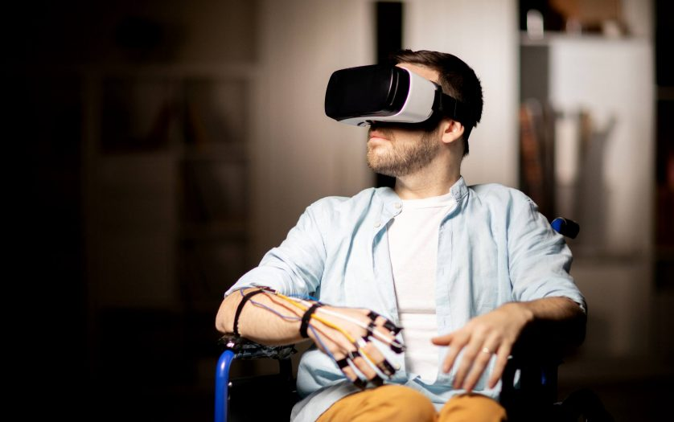
Game and Go
(EE) Garrett Bradshaw, (EE) Slade Hicks (EE) Brandon Waldrup, and (CPE) Kyler Smith

Slide 2
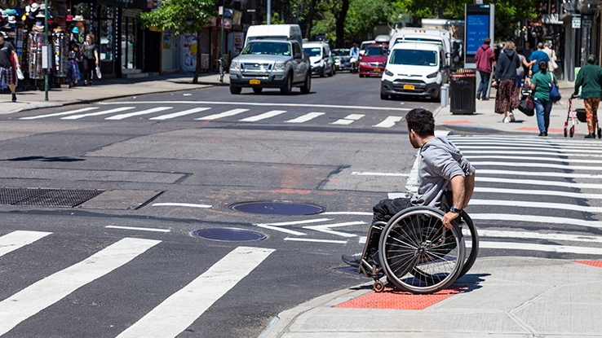
Problem
1 in 4 people in the U.S. have some form of disability [2]
Operating a wheelchair can be anxiety-inducing and confusing for people with cognitive disabilities
Meaningful exposure therapy and training for difficult situations is not an available treatment option

Slide 3
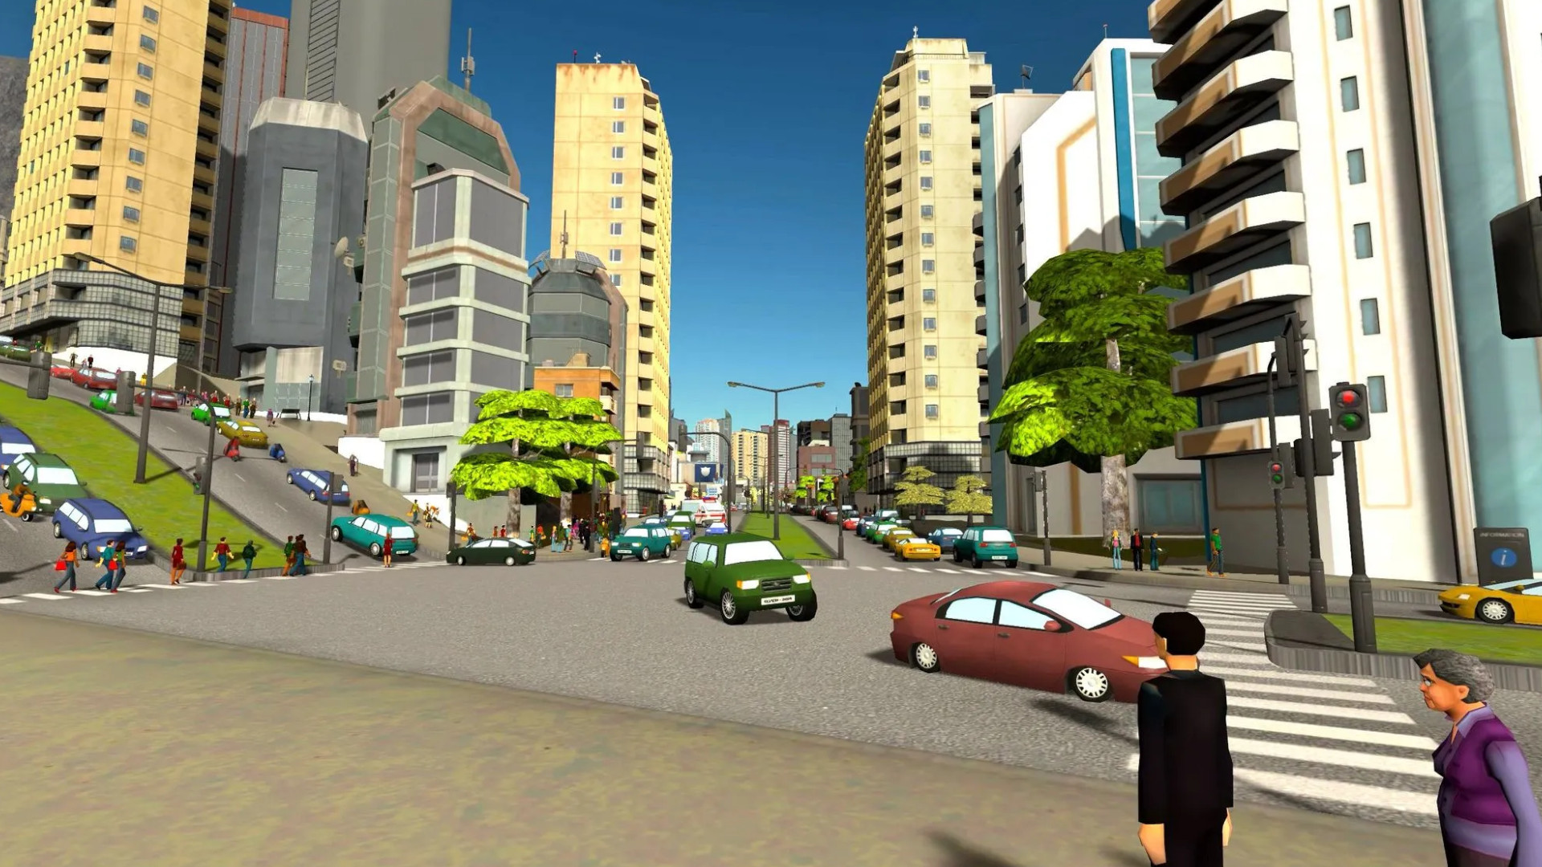
Solution
Safe virtual reality (VR) environment that provides:
Training on wheelchair operation
Improved spatial awareness
Realistic stressful situations for the purpose of exposure therapy
[4]

Slide 4
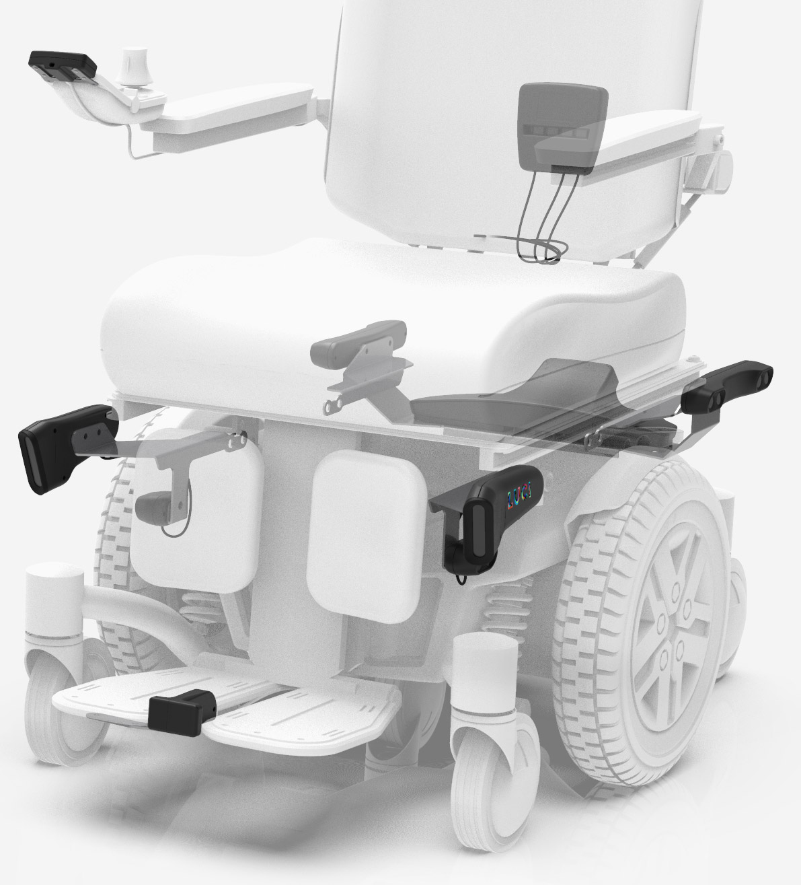
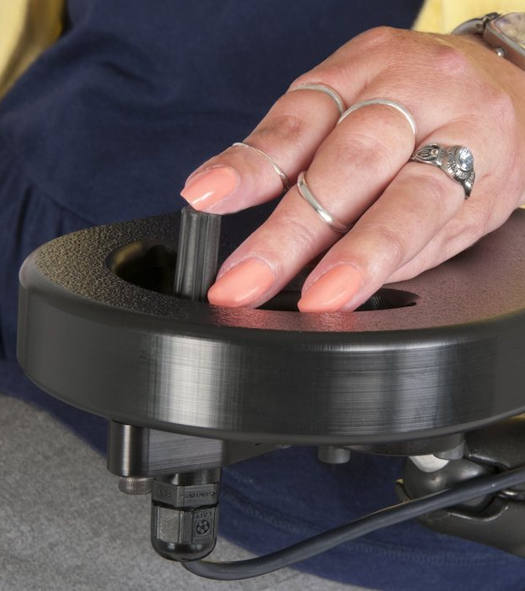
Competition
Numotion
[5]​
LUCI
[6]​

Slide 5
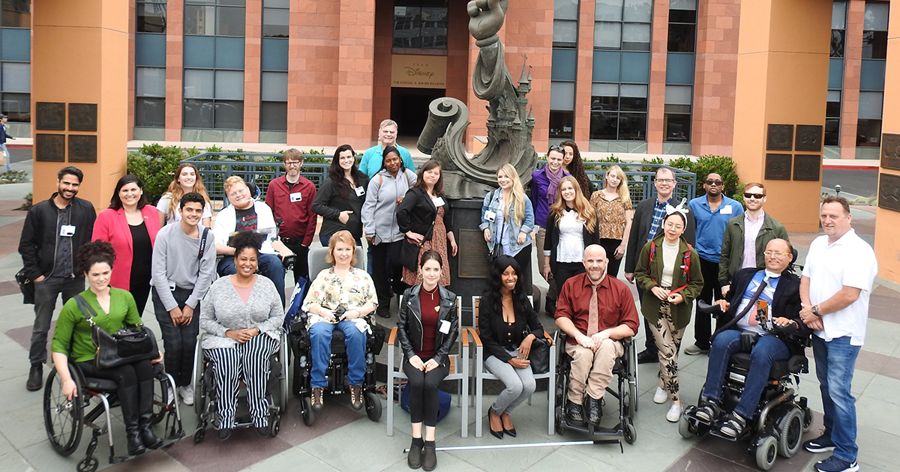
Audience
Healthcare facilities
Caretakers of people with disabilities
Insurance companies
Veterans
[7]

Slide 6

Marketing
Social media
Healthcare conventions
Targeted web ads
[8]

Slide 7
Sources
[1] S. Fisher, "How can virtual reality technology help persons with disabilities?" Disabilityinsider.com. https://disabilityinsider.com/story/how-can-virtual-reality-technology-help-persons-with-disabilities/ (accessed January 31, 2023)
[2] Centers for Disease Control and Prevention, "Disability impacts all of us," Cdc.gov. https://www.cdc.gov/ncbddd/disabilityandhealth/infographic-disability-impacts-all.html (accessed January 31, 2023)
[3] United Spinal Association, "NYC sidewalks finally complying with ADA," unitedspinal.org. https://unitedspinal.org/nyc-sidewalks-finally-complying-with-ada/ (accessed January 31, 2023)
[4] L. Faria, "Review-cities VR," waytoomany.games. https://waytoomany.games/?s=cities+vr (accessed January 31, 2023)
[5] LUCI, "Wheelchair smarter," luci.com. https://luci.com/ (accessed January 31, 2023)
[6] Numotion, “Alternative access controls,” numotion.com. https://www.numotion.com/products-services/adults/power/alternative-access-controls (accessed February 2, 2023)
[7] Respect Ability, "Entertainment and news media," respectability.org. https://www.respectability.org/entertainment-news-media/ (accessed January 31, 2023)
[8] Physicians Committee for Responsible Medicine, “PRIM&R22,” pcrm.org. https://www.pcrm.org/sites/default/files/ICNM2018.jpg (accessed January 31, 2023)

