Slide 1
Newton’s Third Law — Mini Research Proposal
Action–Reaction in Everyday Systems
September 14, 2025

Slide 2
Problem
Confusion persists in labs and classrooms about how “equal and opposite” appears in real systems.
Friction, compliance, and sensor noise can mask action–reaction equality in measurements.
There is a lack of a small, clean, open dataset demonstrating the law across multiple contexts.

Slide 3
Goal & Hypothesis
Goal: Produce a compact, replicable dataset + analysis to test action–reaction across cases.
H1: Force pairs are equal in magnitude within measurement uncertainty.
H2: Any deviations can be explained by identifiable biases (calibration, alignment, or friction).
Metric: Regression of Reaction vs. Action with slope≈1 and intercept≈0; paired-difference CI includes 0.

Slide 4
Methodology (Flow)
Sensors
(force plates / load cells)
Calibration
(bias & sync)
Protocol
(≥30 trials)
Analysis
(paired tests,
regression)
Notes:
• Calibrate sensors before each session
• Randomized trial order
• Store data in CSV + JSON metadata

Slide 5
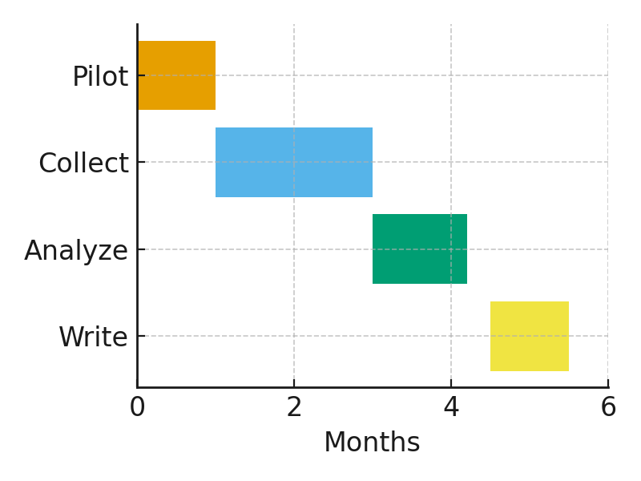
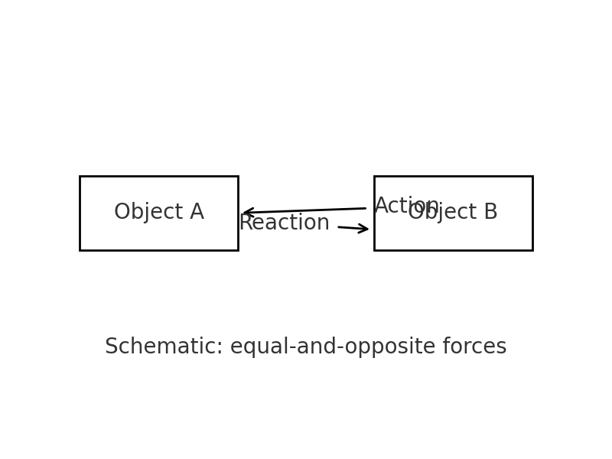
Experiment Plan
1) Human push on wall (two force plates + push bar)
2) Two carts with spring bumper (inline load cells)
3) Magnetic repel (coil mounts + force sensors)

Slide 6
Reference
Halliday, D., Resnick, R., & Walker, J. (2013). Fundamentals of Physics (10th ed.). Wiley.

