Slide 1
CS 488 Computer Networks and the Internet
Lecture 9-1: TCP connection management and intro to networking layer
Prepared by: Jun Yua
Credits: Srinivas Narayana

Slide 2
TCP connections need lots of bookkeeping
Socket buffer memory
Entries in connection lookup tables
Data structures and parameters (e.g., sequence numbers) in the operating system kernel
These resources can get expensive on machines running many connections, e.g., web servers

Slide 3
Handshake
Client app
Server app
Before starting data transmission, TCP client and server perform a handshake and agree on parameters
TCP is bidirectional: independent set of sequence numbers for each direction
Sequence numbers start from a random initial value
Specific TCP flags indicate connection initiation and acceptance
accept()
connect()
Client
Server
SYN
Client → server seq #
SYN / ACK
Server → client seq #

Slide 4
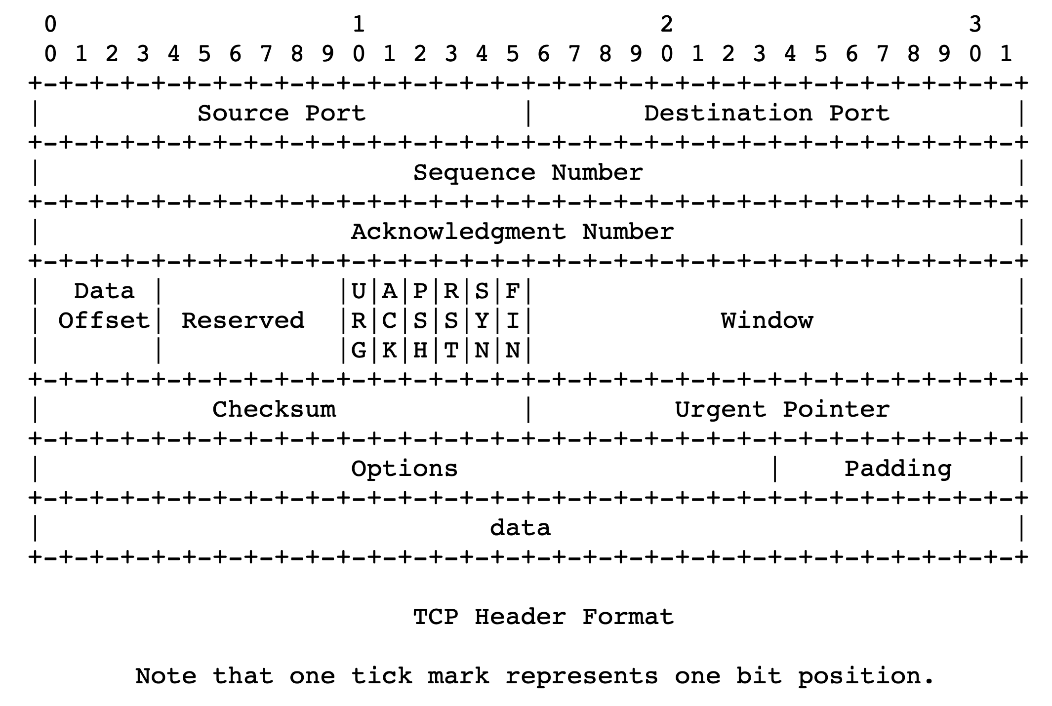
TCP flags in the header

Slide 5

2-way handshake not enough
Client app
Server app
Suppose the server receives the first SYN packet and decides to allocate all the resources needed for the connection.
What happens if a malicious client sends a ton of SYN packets?
Asymmetric work: client doesn’t need to allocate any resources of its own
Just have to send a well-crafted packet
However, server’s resources exhausted!
SYN flood attack: a form of denial of service
accept()
connect()
Client
Server
SYN
SYN
SYN
SYN
SYN

Slide 6
Consequences
Client app
Server app
The server should not allocate resources upon receiving the first client message (SYN)
The server cannot carry any application data in SYN/ACK
Server hasn’t yet allocated all necessary resources
Client cannot send any data in the SYN packet
Recall: HTTP requires an RTT for the handshake before sending HTTP request
accept()
connect()
Client
Server
SYN
SYN
SYN
SYN
SYN

Slide 7
Mitigating the denial of service problem
Key idea: Make the client do more work before allocating server resources
The client should send at least one more packet, responding to the data in the server’s SYN/ACK, before the server decides to call the connection established
That is, before all required server resources like buffers are allocated
Result: 3-way handshake
Per-connection finite state machine tracks this process

Slide 8
TCP 3-way handshake
Client
Server
connect()
bind()
listen()
CLOSED
CLOSED
accept()
SYN
Send SYN
SYN-SENT
LISTEN
Upon receiving SYN
Send SYN/ACK
SYN/ACK
ESTAB
Upon receiving SYN/ACK
SYN-RCVD
Send ACK
Return from
connect()
ACK
ESTAB
Upon receiving ACK
This packet can contain application data!
Server
resources
only allocated
at this point
Return from
accept()

Slide 9
TCP: Closing a connection
Client, server each close their side of connection
send TCP segment with FIN bit = 1
In general, TCP is full-duplex: both sides can send
However, FIN is unidirectional: stop one side of the communication
Respond to received FIN with ACK
On receiving FIN, ACK can be combined with own FIN
Simultaneous FIN exchanges can be handled

Slide 10
Summary of TCP connection management
TCP connections have associated resources: managing them requires book-keeping the establishment of a connection carefully
Simple 2-way handshakes suffer from denial of service vulnerability
Moral: don’t allocate resources on the first client message
3-way handshake mitigates this issue by making client work harder
Client must send ACK to server’s SYN/ACK before server can handle data
The cost: increased time before sending application data from client

Slide 12
Network Layer: Intro

Slide 13


Transport
Application
HTTPS
FTP
HTTP
SMTP
DNS
Transport
TCP
UDP
Network
IP
Host-to-Net
X.25
…
802.11
ATM

Slide 14




The network layer
Endpoint
Main function: Move data from sending to receiving endpoint
on sending endpoint: encapsulate transport segments into datagrams
on receiving endpoint: deliver datagrams to transport layer
The network layer also runs in every router
The router examines header fields in all network-layer datagrams passing through it
Process
Network Layer
Process
Endpoint

Slide 15
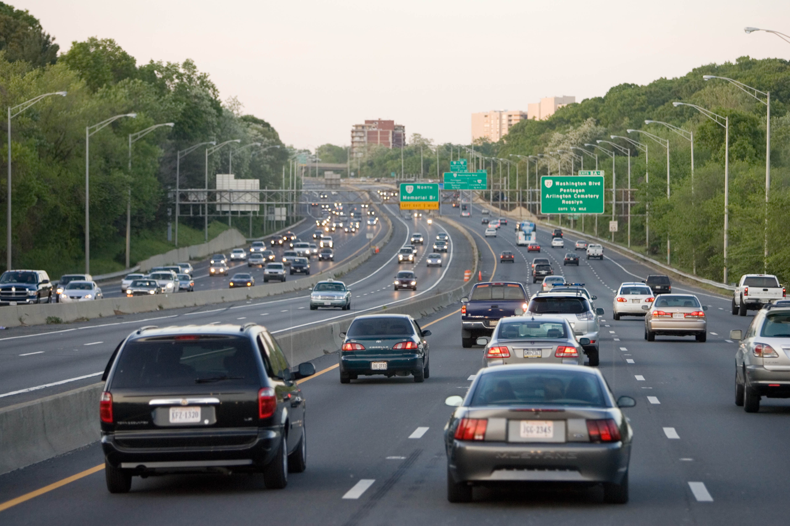
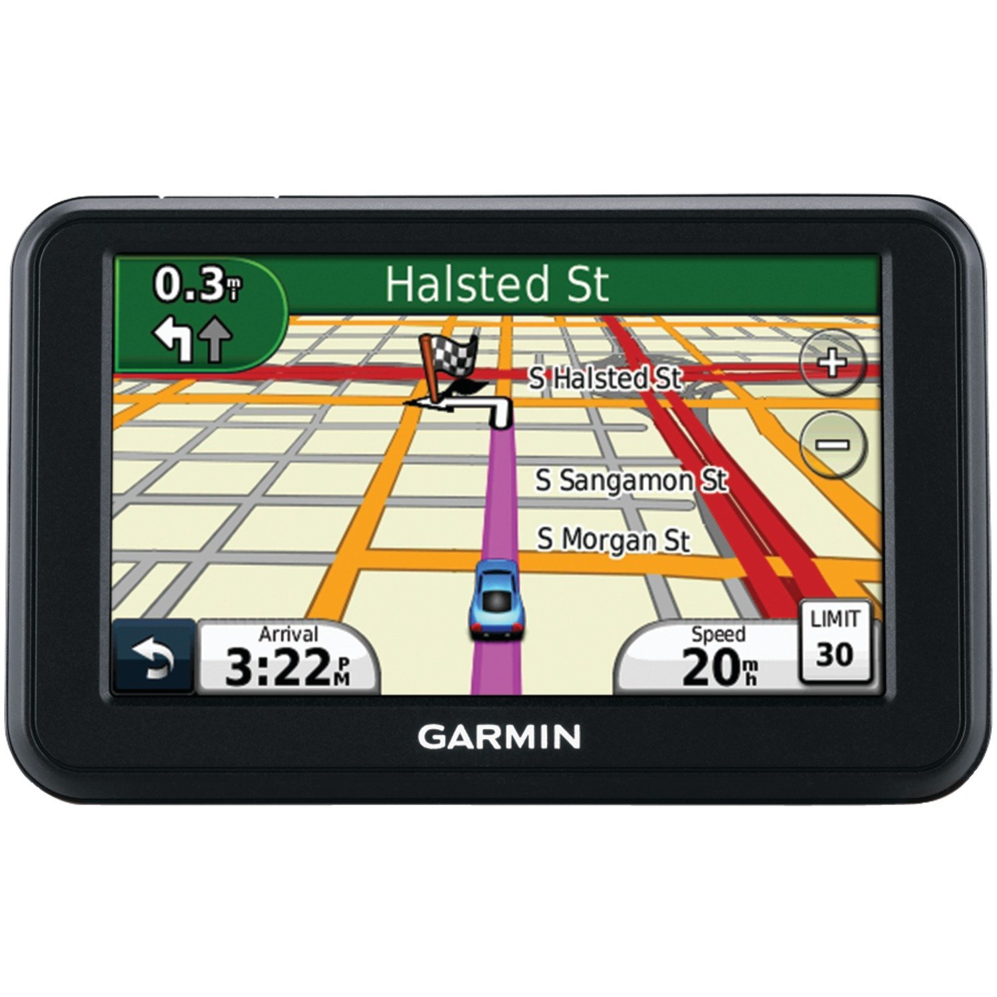
Two key network-layer functions
Forwarding: move packets from router’s input to appropriate router output
Routing: determine route taken by packets from source to destination
routing algorithms
The network layer solves the routing problem.
Analogy: taking a road trip
Forwarding: process of getting through single interchange
Routing: process of planning trip from source to destination

Slide 16
Data plane and Control Plane
Data plane = Forwarding
local, per-router function
determines how datagram arriving on router input port is forwarded to router output port
Control plane = Routing
network-wide logic
determines how datagram is routed along end-to-end path from source to destination endpoint
two control-plane approaches:
Distributed routing algorithm running on each router
Centralized routing algorithm running on a (logically) centralized server
values in arriving
packet header
0111
1
3
2

Slide 18
Internet Addressing

Slide 19
The Internet needs addresses
Addresses allow endpoints to identify, and hence talk to each other
E.g., like people have names
Addresses allow routers to determine how to move a packet
E.g., like the postal system
Network layer addresses are designed to help routers perform the forwarding and routing functions efficiently
Specifically, we’ll look at Internet Protocol (IP) addresses.
Most popular: IP version 4 or IPv4. (Coming up later: IPv6)

Slide 20
IPv4 Addresses
32 bits long
Identifier for a network interface
An IP address corresponds to the point of attachment of an endpoint to the network.
An IP address is NOT an identifier for the endpoint
Dotted quad notation: each byte is written in decimal in MSB order, separated by dots. Example:
10000000 11000011 00000001 01010000
128
.
95
.
1
.
80

Slide 21
Grouping IP addresses by prefixes
IP addresses can be grouped based on a shared prefix of a specified length
Example: consider two IP addresses:
128.95.1.80 and 128.95.1.4
The addresses share a prefix of (bit) length 24: 128.95.1
The addresses have different suffixes of (bit) length 8
IP addresses: prefix corresponds to the network component and the suffix to an endpoint/host component of the address

Slide 22
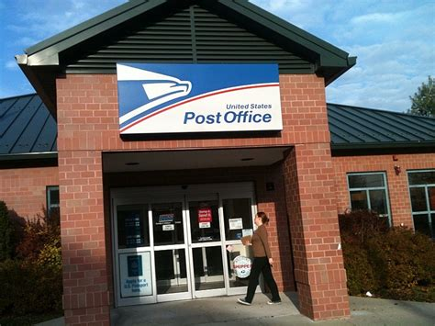
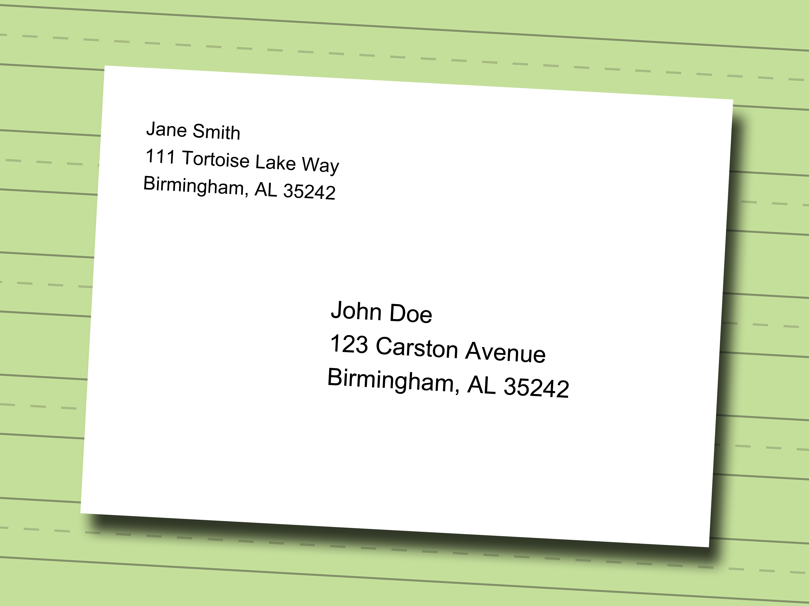
IP addresses use hierarchy to scale routing
IP addresses of endpoint interfaces in a network (e.g., Pace NYC campus) share a prefix of some length
Each interface/endpoint has a different suffix, and hence a different 32-bit IP address
Using prefixes reduces the amount of information needed to forward packets over the Internet
IP prefixes are like zip codes: routers don’t need to store info for each endpoint, just each prefix
Prefixes also allow IP addresses to be delegated from one network to another (more on this later)
NJ

Slide 23
IP addresses use hierarchy to scale routing
Postal envelopes should show clearly delineated zip codes.
Q: How to identify the prefix from a 32-bit IP address?
Two methods:
Old: Classful addressing
New: Classless addressing (also called classless inter-domain routing, or CIDR)
NJ

Slide 24
Classful IPv4 addressing

Slide 25
Classful IPv4 addressing
Class
32 bits
A
0
Net
Host
0.x.x.x – 127.x.x.x
Unicast: single endpoint dest
B
10
Net
Host
128.x.x.x – 191.x.x.x
Unicast: single endpoint dest
C
110
Net
Host
192.x.x.x – 223.x.x.x
Unicast: single endpoint dest
D
1110
Multicast address
224.x.x.x – 239.x.x.x
Destination is a group of hosts
E
1111
Reserved
240.x.x.x – 255.x.x.x
8 bit
prefix
16 bit
prefix
24 bit
prefix
First octet of IP address gives you the prefix length.

Slide 26
Classful IPv4 addressing
Class A:
For very large organizations
2²⁴ = 16 million hosts allowed
Class B:
For large organizations
2¹⁶ = 65 thousand hosts allowed
Class C
For small organizations
2⁸ = 255 hosts allowed
Class D
Multicast addresses
No network/host hierarchy

Slide 27
Problems with classful addressing
IP prefixes are allocated to organizations (e.g., Pace) by Internet Registry organizations (e.g., ARIN, in North America)
Many organizations required something bigger than class C address, but smaller than a class A (or even B) address
However, the Internet was running out of class B addresses
Too many networks required multiple class C addresses
Not enough nets in class A for large + medium organizations
Key issue: Classful addressing is too coarse-grained: The addressing strategy must allow for greater diversity of network sizes

Slide 28
Classless IPv4 addressing (CIDR)

Slide 29
Classless IPv4 addressing
Also called classless inter-domain routing (CIDR)
Key idea: Network component of the address (ie: prefix) can have any length (usually from 8—32)
Address format: a.b.c.d/x, where x is the prefix length
Customary to use 0s for all suffix bits
network
part
host
part
11001000 00010111 00010000 00000000
200.23.16.0/23

Slide 30
CIDR
An ISP can obtain a block of addresses and partition this further to its customers
Say an ISP has 200.8.0.0/16 address (65K addresses).
The ISP has customer who needs only 64 addresses starting from 200.8.4.128
Then that block can be specified as 200.8.4.128/26
200.8.4.128/26 is “inside” 200.8.0.0/16
200.8.0.0/16
200.8.0.0
200.8.0.1
200.8.4.128/26
…
200.8.1.0
200.8.1.1
…
200.8.255.255

Slide 31
Netmask (or subnet mask)
An alternative to denote the IP prefix length of an organization
32 bits: a 1-bit denotes a prefix bit position. 0 is the host part.
network
part
host
part
11001000 00010111 00010000 00000000
200.23.16.0/23
network part of mask
Host part of mask
11111111 11111111 11111110 00000000
Netmask: 255.255.254.0

Slide 32
Detecting addresses from same network
Given IP addresses A and B, and netmask M.
1. Compute logical AND (A & M).
2. Compute logical AND (B & M).
3. If (A & M) == (B & M) then A and B are
on the same subnet.
Ex: A = 165.230.82.52, B = 165.230.24.93, M = 255.255.128.0
A and B are in the same network according to the netmask
A & M == B & M == 165.230.0.0

Slide 33
Finding your own IP address(es)
A small demo

