Slide 1
Text Mining: Detecting Insults in Social Commentary?
—2012 kaggle competition
Jumao Yuan
EXST 7152 Final Project
April 28th, 2015

Slide 2
Agenda
Background
Data Description
Data Preprocessing
Evaluation
Models
Results
Summary

Slide 3
Agenda
Background
Data Description
Data Preprocessing
Evaluation
Models
Results
Summary

Slide 4
Comments | Insult
“Either you are fake or extremely stupid...maybe both...” | yes
“@tonnyb Or they just don’t pay attention” | no
“You with the ’racist’ screen name\\n\nYou are a PieceOfShit......” | yes
“your such a dickhead...” | yes
http://www.youtube.com/watch?v=tLYLLPHKRU4 | no
“You are a liar.” | no

Slide 5
Agenda
Background
Data Description
Data Preprocessing
Evaluation
Models
Results
Summary

Slide 6
Workflow
Pre-processing
Select Variables
Build Models
Compare Models
Results

Slide 7
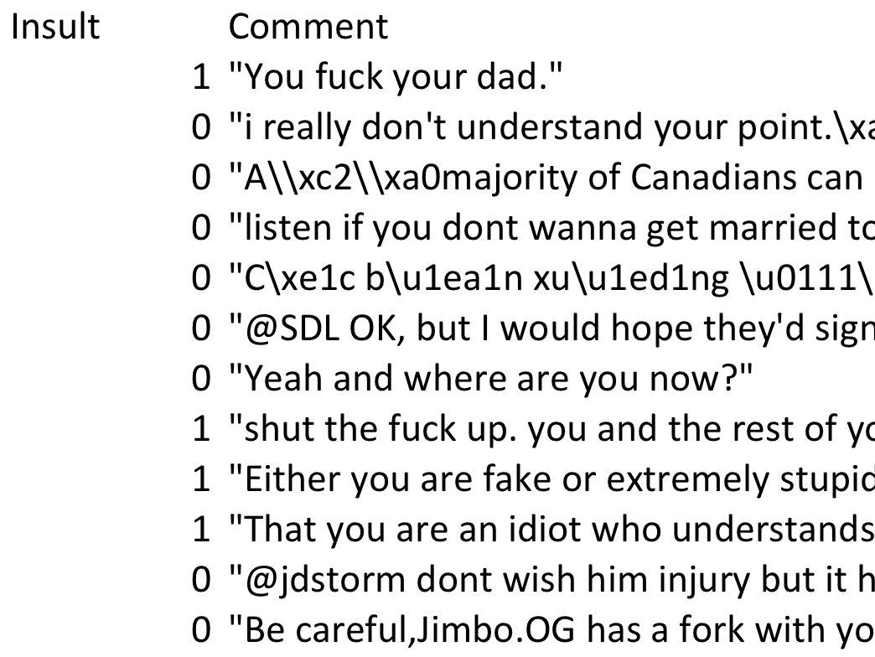
Single-classifier problem

Slide 8
Agenda
Background
Data Description
Data Preprocessing
Evaluation
Models
Results
Summary

Slide 9
2 variables and 3947 observations
Response variable is binary: “Is Insult” or “Is Not Insult”.
No missing values, but need do token and regular expression analysis.
TF-IDF (term frequency – inverse document frequency):
reflect how important a word is to a document in a collection
Library(tm) in R
9

Slide 10
Text Parsing
“You with the ’racist’ screen name\\n\n\xc2You are a PieceOfShit 012......”
TermDocumentMatrix
D1 = “I like databases”
D2 = “I hate databases”,
Stemming
“use”, “uses”“used”, “useful”, “using” have the same stem “use”
 | I | like | hate | databases
D1 | 1 | 1 | 0 | 1
D2 | 1 | 0 | 1 | 1

Slide 11
Feature Extraction
The sparse matrix is huge with high dimensional variables.
Our main task is to downsize the high dimensional sparse matrix since the stack pointer of memory in R is limited (500000).
Data split
70% training data set and 30% testing data set

Slide 12
R code
dd <- Corpus(VectorSource(docs))
dd <- tm_map(dd, stripWhitespace) % Eliminating Extra White Spaces
dd <- tm_map(dd, tolower) % Convert to Lower Case
dd <- tm_map(dd, removePunctuation) % Remove Punctuations
dd <- tm_map(dd, removeWords, stopwords("english")) % Remove stopwords %dd <- tm_map(dd, stemDocument)
dd <- tm_map(dd, removeNumbers) % Remove numbers
dd <- tm_map(dd, stemDocument,language = 'english') % Do Stemming
16297 features

Slide 13
“You with the ’racist’ screen name\\n\n\xc2You are a PieceOfShit 012......fuckkkkkkkk”
You with the racist screen name You are a PieceOfShit fuckkkkkkkk
racist screen name PieceOfShit fuckkkkkkkk
racist screen name PieceOfShit fuck

Slide 14
Agenda
Background
Data Description
Data Preprocessing
Evaluation
Models
Results
Summary

Slide 15
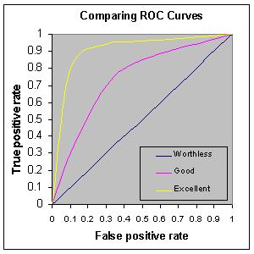
In R (using the verification package):
auc = roc.area(true_labels, predictions)
ROC Curve
AUC Score
https://www.kaggle.com/c/stumbleupon/details/evaluation
http://gim.unmc.edu/dxtests/roc3.htm

Slide 16
Agenda
Background
Data Description
Data Preprocessing
Evaluation
Models
Results
Summary

Slide 17
Models
Classification Tree
Random Forest

Slide 18
Models
Classification Tree
Random Forest

Slide 19
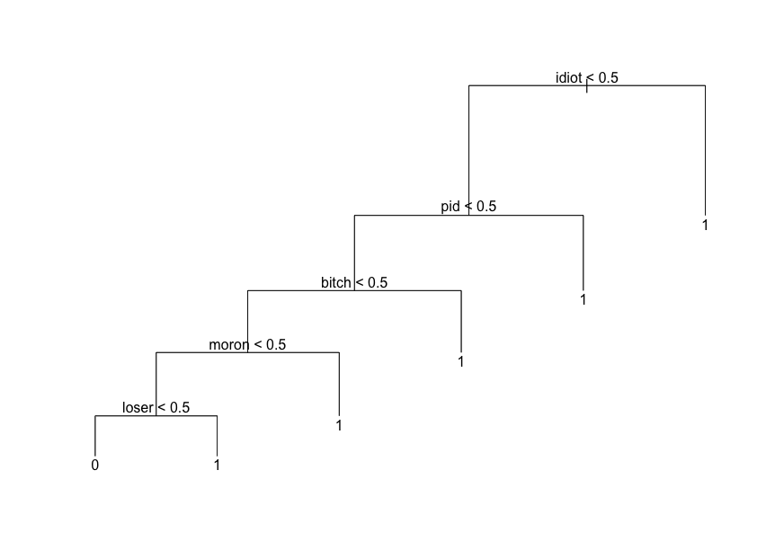
Library(tree)

Slide 20
Models
Classification Tree
Random Forest

Slide 21
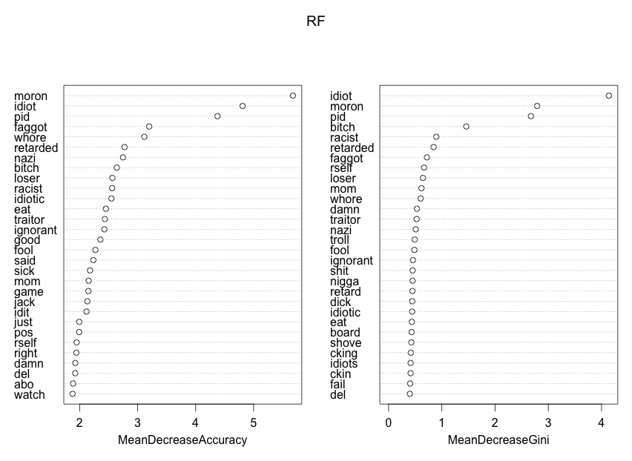
Library(randomForest)

Slide 22
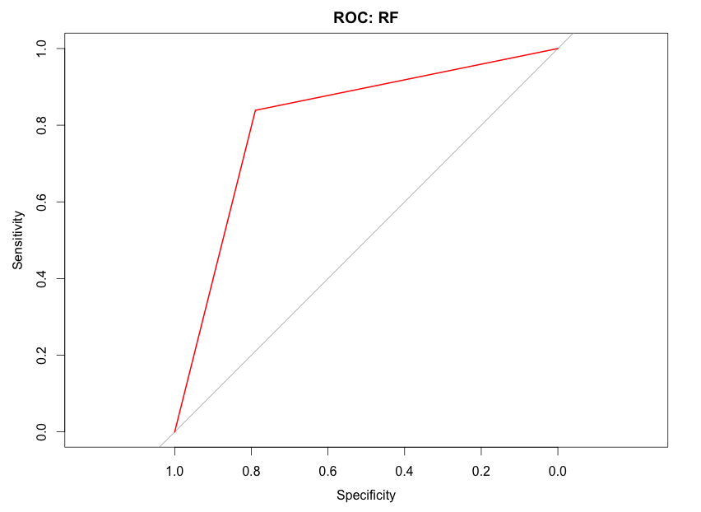
AUC score = 0.814

Slide 23
Agenda
Background
Data Description
Data Preprocessing
Evaluation
Models
Results
Summary

Slide 24
Method | AUC Score | Computation Time (s)
Random Forest | 0.814 | 323.362
Decistion Tree | 0.789 | 46.725
Logistic Regression | 0.785 | –
Naive Bayes | 0.798 | –
KNN | 0.730 | –
SVM | 0.786 | –

Slide 25
Agenda
Background
Data Description
Data Preprocessing
Evaluation
Models
Results
Summary

Slide 26
1. Sparse matrix optimization (16297 variables)
PieceOfShit = Shit; You’re (need be deleted)
2. Random Forest, SVM and Naïve Bayes work well
3. It is still difficult to detect some false negative results such as ”this book is fXXXing good” or new words (wordplays) such as ”yuck fou”

Slide 27
Thanks ☺

