Slide 1

A.I.nbox
Will free you from dealing with inbox management

Slide 2
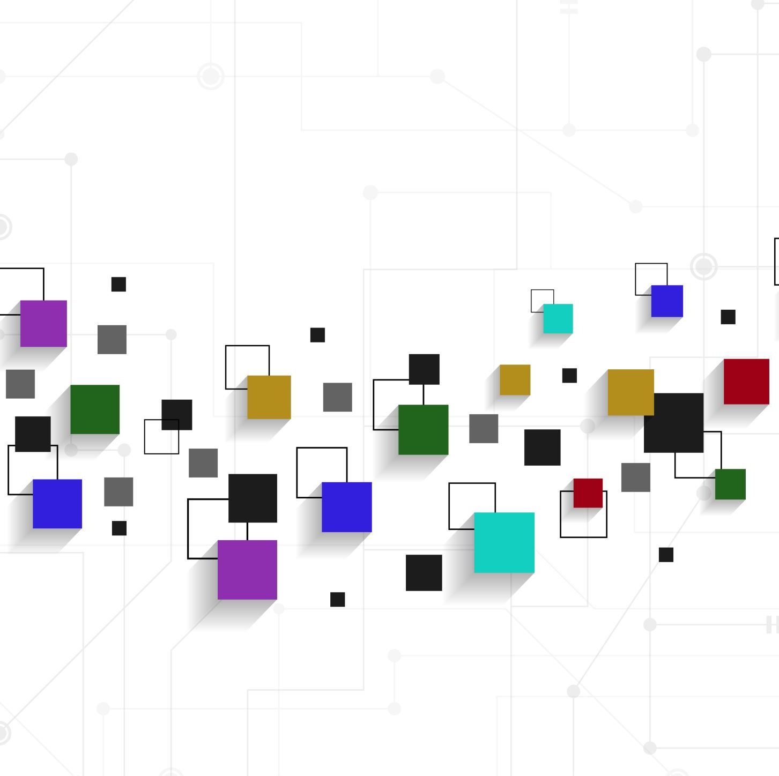
Business Discussion

Slide 3
Imagine Products
Our app, tentatively named "InboxMaster," is an AI-driven email management solution designed to streamline the inbox management process for users of Gmail and Outlook (potentially all types of email).
Integration with other platform
Injection of emails, schedule, files
Categorization, flagging, organization, prioritization, summarization
Reactive: reply, scheduling, investigation

Slide 4
Who Entered the Market?
Astro: Astro uses AI to prioritize emails, sort them into categories, and even draft replies based on your email history. (https://slack.com/blog/news/slack-acquires-astro-to-help-email-and-channels-work-together)
Newton Mail: Newton Mail employs AI to categorize emails, prioritize them, and even schedule reminders for important messages. (https://newtonhq.com/)
Boomerang: Boomerang integrates AI to analyze your email usage patterns and suggest optimal times for sending emails to maximize response rates. (https://www.boomeranggmail.com/)
SaneBox: SaneBox uses AI to automatically filter and prioritize emails into different folders, ensuring that your inbox remains clutter-free. (https://www.sanebox.com/home)
Front: Front incorporates AI to help teams manage shared inboxes more effectively by automating repetitive tasks and routing emails to the appropriate team members. (https://front.com/)
Superhuman: Superhuman combines AI-driven features with a streamlined interface to help users manage their email more efficiently, with features like snoozing, scheduling, and keyboard shortcuts. (https://superhuman.com)

Slide 5
Market Analysis
The email management market is growing rapidly as individuals and businesses struggle to handle increasing email volumes efficiently.
Existing solutions may lack intelligent automation and personalized assistance, and cool services presenting an opportunity for InboxMaster to fill this gap.
The app can be used by individuals, a group by family, a small team, enterprises.

Slide 6
Value Proposition
InboxMaster offers intelligent categorization of emails, customizable taggings, color-coded flags for importance, and AI-driven draft reply suggestions for urgent emails, enhancing productivity and organization.
The product should offer integrated platform that can connect various other platform and potentially form a community (stories and characters preferred).

Slide 7
Revenue Model
We plan to adopt a freemium model, offering basic features for free with premium subscription tiers for advanced functionalities such as unlimited email tagging, priority support, and customization options.
Premium services for investigation, reply, etc.

Slide 8
Marketing Strategy
Our marketing strategy will focus on content marketing, social media engagement, and partnerships with influencers and productivity experts to promote InboxMaster as the go-to solution for email management.
Utilize digital marketers.
Targeting individuals, small business, enterprises

Slide 9
Exit Strategy
If not decided to operate business, the company needs to exit from business by selling the business to other companies like Google or Microsoft.
Need to define the criteria that would trigger the exit, such as reaching a certain number of users, achieving a specific revenue milestone, or receiving acquisition offers above a certain valuation.

Slide 10
Technical Discussion

Slide 11
Email Integration
1.Technique: Use OAuth authentication to securely integrate with Gmail and Outlook APIs.
2.Tools: Google API Client Library for Python for Gmail integration, Microsoft Graph API for Outlook integration.

Slide 12
Data Preprocessing
1.Technique: Clean and preprocess email data using text preprocessing techniques, including tokenization, stop-word removal, and stemming.
2. Tools: Natural Language Toolkit (NLTK) or SpaCy for text preprocessing in Python.

Slide 13
Categorization
1.Technique: Implement supervised machine learning algorithms for email categorization, such as Support Vector Machines (SVM) or Naive Bayes classifiers.
2.Tools: Scikit-learn for machine learning models in Python.

Slide 14
Tagging
1.Technique: Allow users to assign one or multiple tags to each email using a user-friendly interface.
2.Tools: Custom UI design integrated with backend functionality using frameworks like React.js (for web) or SwiftUI (for iOS).

Slide 15
Importance Flagging
1.Technique: Use machine learning techniques to predict the importance level of emails based on features such as sender importance, keywords, and user behavior.
2.Tools: Gradient Boosting libraries like XGBoost or LightGBM for importance flagging models in Python.

Slide 16
Draft Generation
1.Technique: Implement Natural Language Generation (NLG) techniques to generate human-like email responses.
2.Tools: OpenAI's GPT (Generative Pre-trained Transformer) model, GPT-3, or similar language models for generating text. Or Google’s GenAI

Slide 17
User Interface Design
1.Technique: Design an intuitive and responsive user interface to provide a seamless user experience.
2.Tools: Adobe XD, Figma, or Sketch for UI/UX design, with frontend frameworks like React.js or Flutter for development.

Slide 18
Security and Authentication:
1.Technique: Implement OAuth 2.0 for secure authentication and authorization with Gmail and Outlook APIs.
2. Tools: OAuth libraries provided by Google and Microsoft for Python or other programming languages.

Slide 19
Testing
1.Technique: Conduct unit testing, integration testing, and user acceptance testing to ensure the app's functionality and reliability.
2. Tools: Pytest for unit testing in Python, Selenium for automated UI testing, and TestFlight for iOS app beta testing.

Slide 20
Continuous Improvement
1.Technique: Gather user feedback and data analytics to iteratively improve the app's performance and user experience.
2. Tools: Google Analytics or Firebase Analytics for tracking user engagement and behavior, and tools like Sentry for error monitoring and logging.

Slide 21
DevOp Platform Discussion

Slide 22
Amazon SageMaker
1.Amazon SageMaker is a fully managed service that simplifies the process of building, training, and deploying machine learning models at scale. It supports a wide range of algorithms and frameworks, and provides built-in capabilities for data preprocessing and model optimization.
2.Pricing is based on usage, with pay-as-you-go pricing for training instances, inference endpoints, and storage. Amazon also offers free tiers and credits for startups, as well as cost-saving options like Spot Instances for training.

Slide 23
Microsoft Azure Machine Learning
1.Microsoft Azure Machine Learning is a cloud-based platform that provides tools and services for building, training, and deploying machine learning models. It supports popular frameworks like TensorFlow, PyTorch, and scikit-learn, and offers automated machine learning capabilities for faster model development.
2. Pricing is based on usage, with options for pay-as-you-go pricing or reserved capacity pricing for cost savings. Azure also provides free tiers and credits for startups, along with cost management tools for optimizing spending.

Slide 24
Google Cloud AI Platform
1.Google Cloud AI Platform offers a suite of AI and machine learning services, including pre-trained models, custom model training, and deployment capabilities. It supports popular frameworks like TensorFlow and scikit-learn, making it suitable for various AI tasks.
2.Pricing is based on usage, with options for pay-as-you-go pricing or discounted prices for committed usage. Google Cloud also offers free tiers and credits for startups, providing cost-effective options for experimentation and development.

Slide 25
Big Data Architecture

Slide 26
Data Flow and Real-time Analysis
Data Collection Layer
Gmail
Outlook
Yahoo
AoL
Real-time transaction data
Data Warehouse
Postgres
Real-Time Analysis
SparkSQL
& MLlib
Streaming Layer
Kafka
Data Trans-formation Layer
Spark
Data Lake
Postgres
Static historical data
Notes:
https://medium.com/@nsidana123/apache-kafka-and-apache-spark-real-time-streaming-271346d5340c
https://medium.com/@farsim/data-engineering-using-nifi-hive-spark-kafka-and-quicksight-a325d3df80a2

Slide 27
Proposed Architecture - High Level
Data Collection Layer
Real-time Data Ingestion Layer
Streaming Layer
Data Trans-formation Layer
Analytics Layer
Real-time Search and Dashboard
Layer
Static Data Ingestion Layer
Data Storage

Slide 28
Data Flow and Real-time Analysis
Data Collection Layer
IoT
ERP
DB
Real-time transaction data
Ingestion Layer
NiFi
Streaming Layer
Kafka
Data Trans-formation Layer
Spark
Real-Time Analysis
Spark
SQL
& MLlib
Data Storage
HDPS / HBase
Incrementally update the AI/ML model
Static structured data
Notes:
https://medium.com/@nsidana123/apache-kafka-and-apache-spark-real-time-streaming-271346d5340c
https://medium.com/@farsim/data-engineering-using-nifi-hive-spark-kafka-and-quicksight-a325d3df80a2

Slide 29
Data Storage, Retrieval, and Advanced Analysis
Data Storage
Solr
Real-time Query
Dashboard
Detecting
Monitoring
Alerting
Fraudulent activities
Hbase
Real-time data Storage
HDFS
Static Data Storage
Hive SQL
Batch Data Analytics
Notes:
Hive
Hive is a data warehousing tool built on top of HDFS, providing a SQL-like interface to query and analyze large datasets stored in HDFS.
Processed transactional data is organized into Hive tables for structured querying and analysis.
Hbase
HBase is a NoSQL database that provides real-time read/write access to large amounts of data stored in HDFS.
HBase stores processed data that requires low-latency access, such as transaction records that need to be quickly retrieved for real-time analysis or fraud detection.
Solr
providing powerful indexing, search, and real-time analytics capabilities.
Solr indexes key transactional data to enable fast and efficient search capabilities, allowing the bank to quickly identify and analyze suspicious transactions.
Real-time monitoring dashboards can be built using Solr to provide insights and alerts on transaction activities as they occur.

Slide 30
The End

