Slide 1
Intro ashdas to git & github
Global App Initiative and Girls Who Code

Slide 2

Motivation

Slide 3

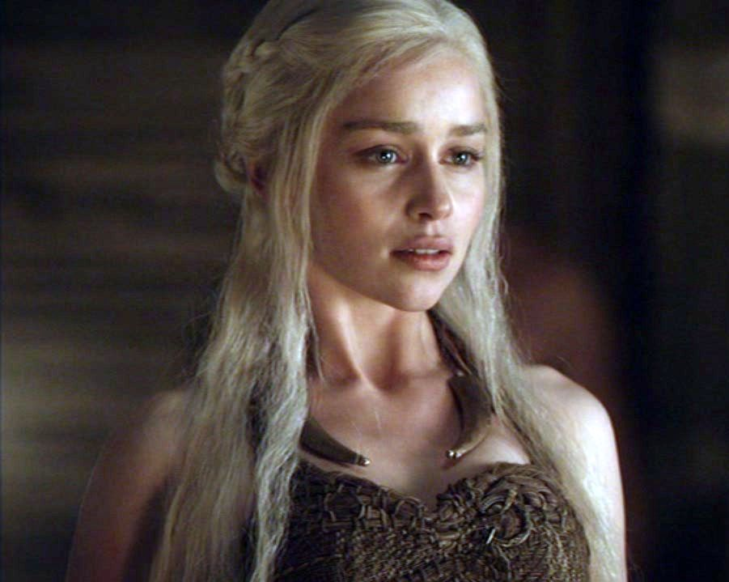

Motivation

Slide 4
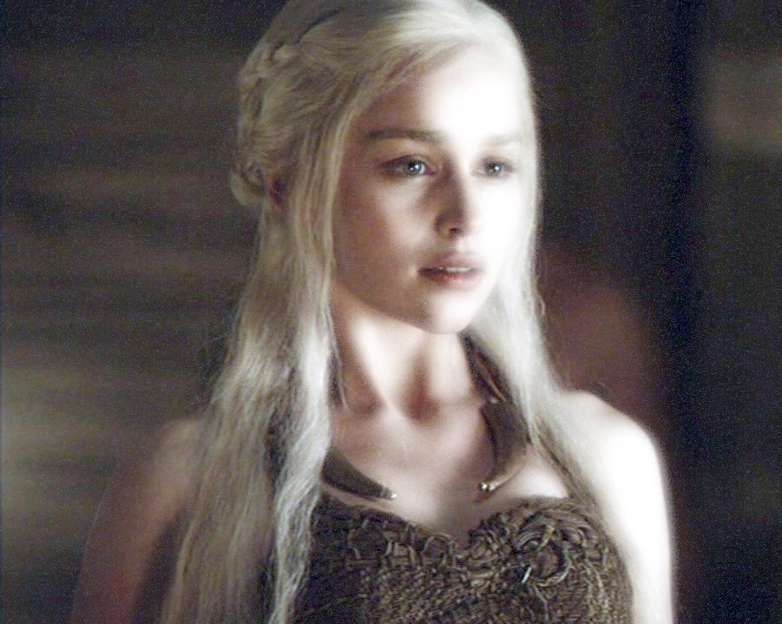
Chapter 3
Chapter 1
Master
Chapter 2
Chapter 4

Slide 5

Image from:
http://nvie.com/posts/a-successful-git-branching-model/

