Slide 1
MD2 Loader

Slide 2
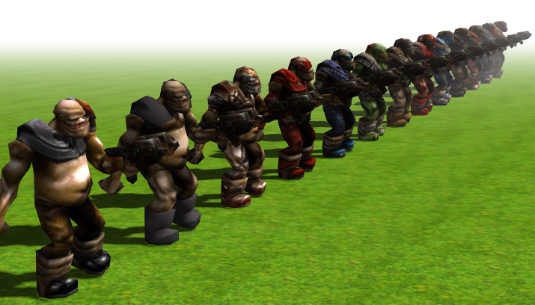
Reference threejs/examples
https://threejs.org/examples/webgl_loader_md2_control.html

Slide 3
Objectives
Study code
Replace with single Laalaa, with controls

Slide 4

