Slide 1
Hexagonal Grids
Reference: http://www.redblobgames.com/grids/hexagons/

Slide 2
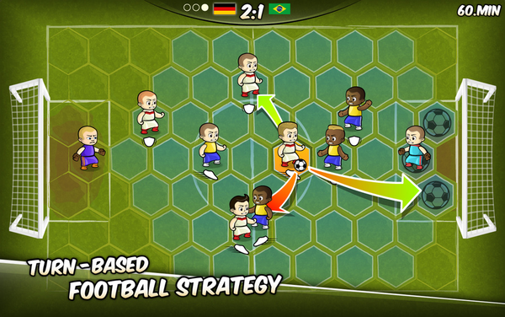
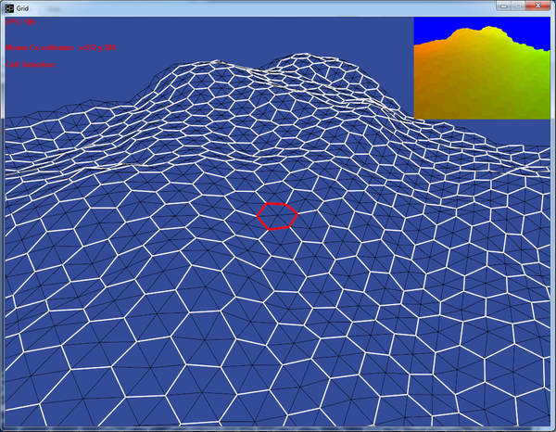
What is it?

Slide 3
Coordinate System
Cube coordinate
Axial coordinate

Slide 4
Idea of Cube Coordinates

Slide 5
+X
Cube Coordinates
+Y
1
0
0
1
0
0
0
0
y
x
+Z
1
z
?
?
?

Slide 6
1
0
0
Fill in the Cube Coordinates

Slide 7
Axial Coordinates
Constraint: x + y + z = 1
q = x, r = z
(q, r)
(x, z)
Only two are independent!
y
x
(q, r)
z

Slide 8
1
0
0
1
-1
2
-2
3
0
0
0
0
0
0
-1
1
-2
2
-3
3
1
1
1
1
0
-1
-1
0
-2
1
-3
2
2
2
2
2
Fill in the Cube Coordinates (answer)

Slide 9
Axial Coordinates (x,z)
(q, r): (column, row)
(0,0)
(1,0)
(2,0)
(3,0)
(0,1)
(1,1)
(2,1)
(3,1)
(-1,2)
(0,2)
(1,2)
(2,2)

Slide 10
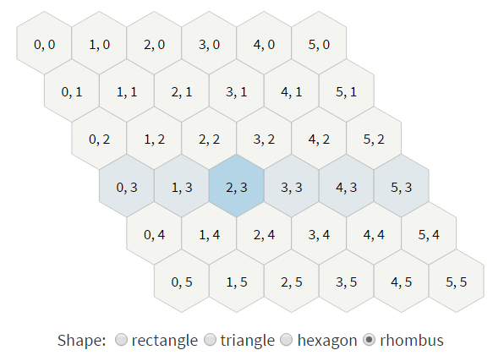
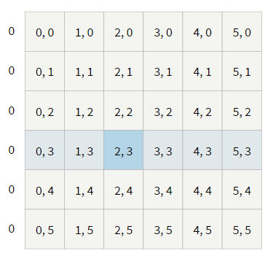
Store Rhombus Map in 2D array
Array [6] [6]
Rows = 6
Columns = 6

Slide 11
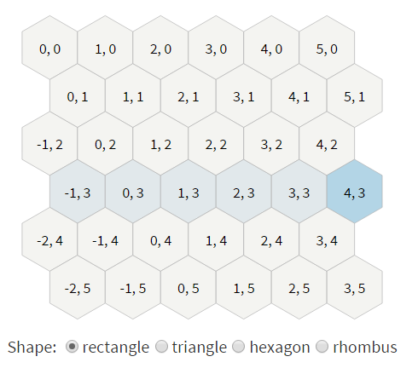
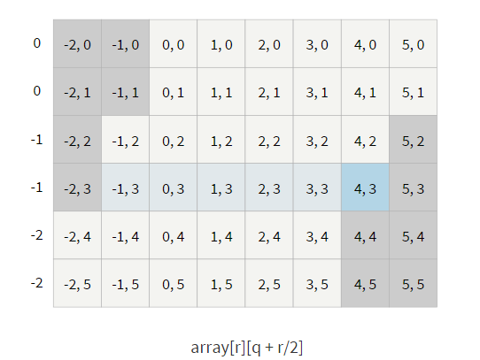
Store Rectangular Map in 2D array
Array [6] [6 + floor((6-1)/2)]
Rows = 6
Columns = 6

Slide 12
Height Field in a Hex Grid
Grid point in center of each hexagon
Forms triangular mesh
Compute normal vectors for each triangle and vertex

Slide 13
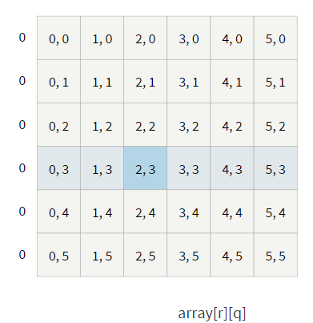
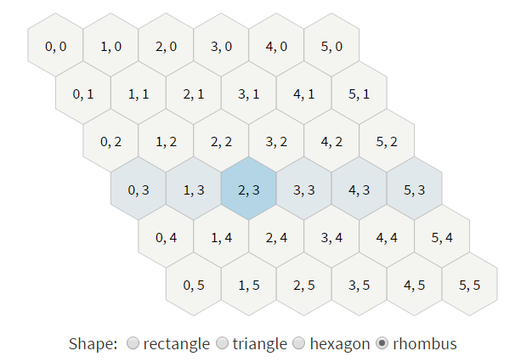
HashTable (rhombus)
0
1
2
3
4
5
6
7
8
9
10
11
(q,r)→ vIDs(q + r*columns)
In rhombus shape, every hex has a vertex.
vIDs contains the vertex IDs.

Slide 14
HashTable (rectangular)
0
1
2
3
4
5
6
7
8
9
10
11
12
13
14
15
Array [5] [8]
vID: every row has exactly columns vertices
First, set all (columns + offset) vID’s in a row to -1
From first row (j = 0),
first “skip” (offset – floor(j/2)),
then start creating columns vertices
offset = floor ( (r-1)/2 );
(q,r)→ (q’ = q+offset, r)
→ vIDs(q’ + r * columns)

Slide 15
About
Amit (was a Stanford grad student) has many important resources on hex grid
Red blob games (http://www.redblobgames.com/grids/hexagons/)
Amit’s thoughts on grids (http://www-cs-students.stanford.edu/~amitp/game-programming/grids/)
He also has a JavaScript implementation
Page (http://www.redblobgames.com/grids/hexagons/implementation.html#offset)
JavaScript library (http://www.redblobgames.com/grids/hexagons/codegen/output/lib.js)

Slide 16
Experiment So Far
Rhombus and rectangular maps, on XY plane
Pick and grow height
(not yet)
Single source dripping
Balancing
Tooling

Slide 17
About Amit’s Implementation
Grid is on XY plane
Its relation to Cartesian space depends on
Layout style (pointy or flat)
Origin (where 0,0 is)
Size

Slide 18
List for Required Functions for Sand-Art Functions
pixel_to_hex, hex_to_pixel
Hex_corner, …

