Slide 1
Node.js, Shell, Three.js

Slide 2
Node.js & NPM
Node.js: a program and an environment
NPM (node.js package manager): the name says it all

Slide 3
Content
Explained in three examples
callShell
callShellWithServer
callShellWithServerAndThree_differentDomain
roseCurve

Slide 4
callShell from node.js

Slide 5
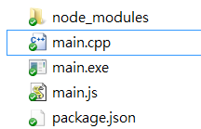
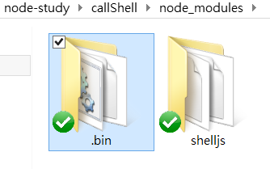
In the Directory …
got created after ‘npm install’

Slide 6
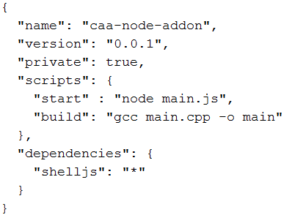
package.JSON
(reference)
Shelljs of any (“*”) version

Slide 7
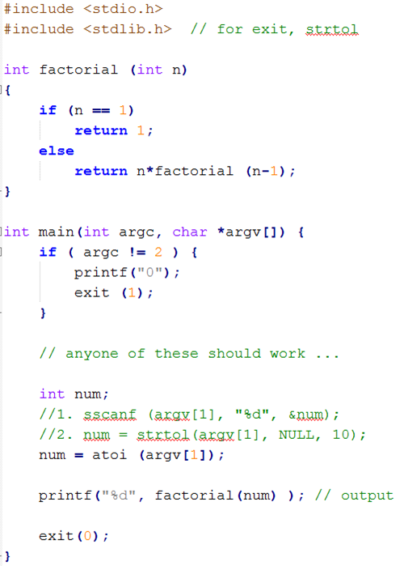
main.cpp
> main.exe 5
120

Slide 8
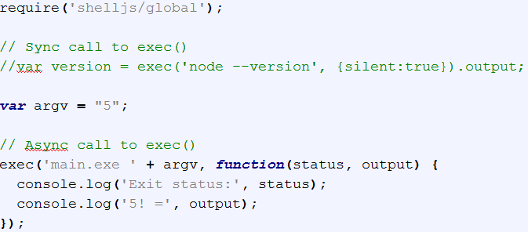
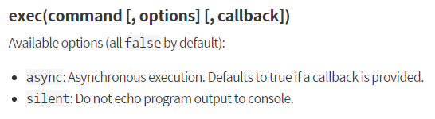
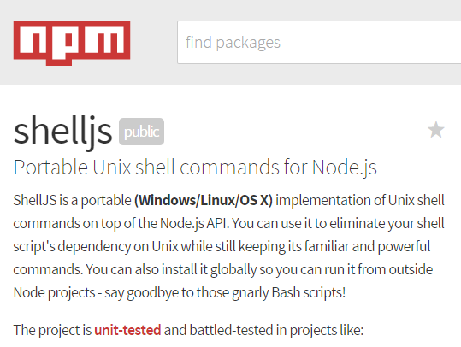
main.js
url

Slide 9
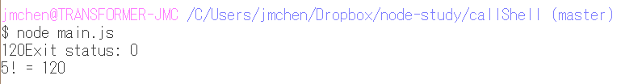
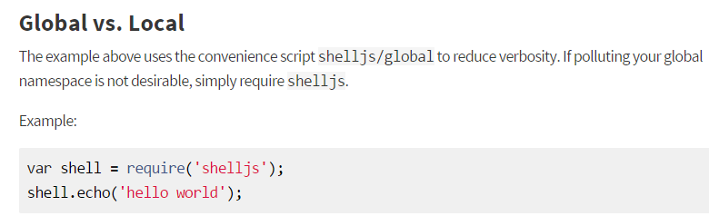
Running …
Alternatively, this can be started with:
$ npm run start
(as specified in scripts of package.JSON)

Slide 10
callShellWithServer

Slide 11
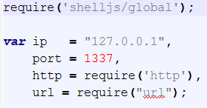
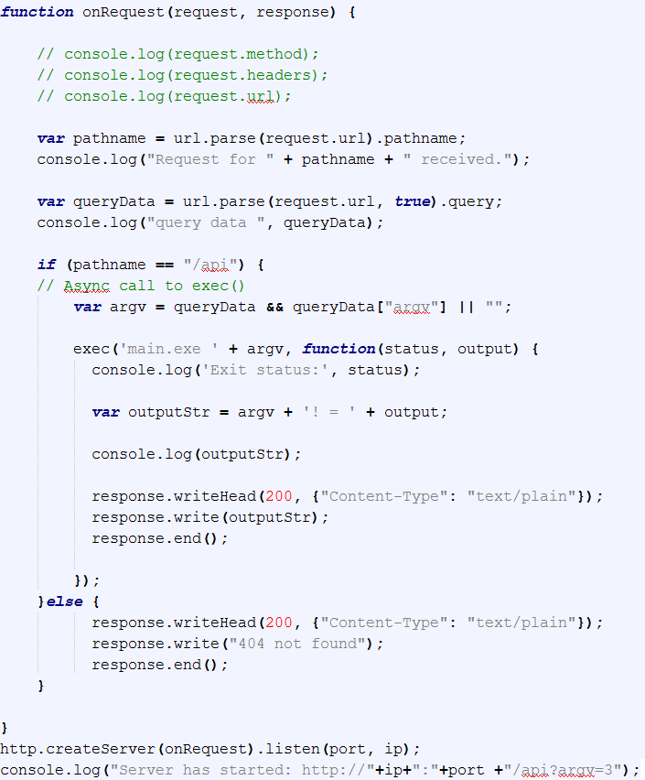
main.js
“/api”
{ argv: 6 }

Slide 12


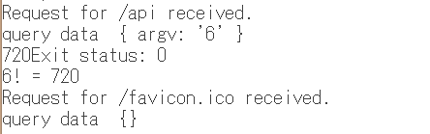


Running …
1. Start server first …
2. Client issued a request …
3. Server responds …
Two POST
4. Client gets a reply …

Slide 13
callShellWithServerAndThree_differentDomain

Slide 14
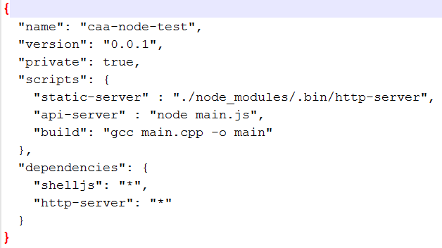
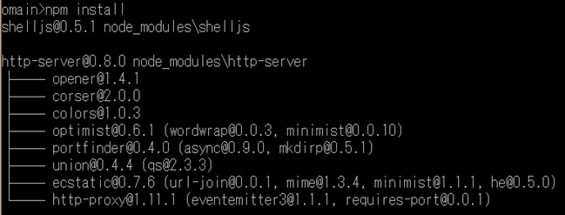
Package.json
127.0.0.1
Cube.html
8080
http-server
1337
api-server

Slide 15
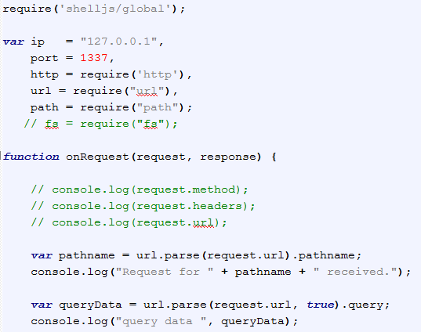
main.js
Router handler: next page

Slide 16
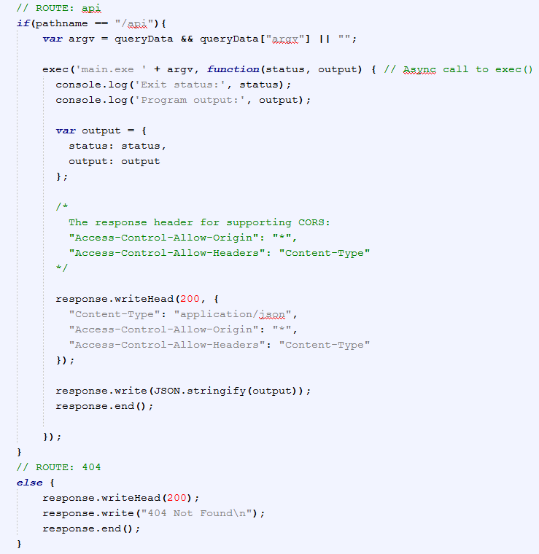


Slide 17
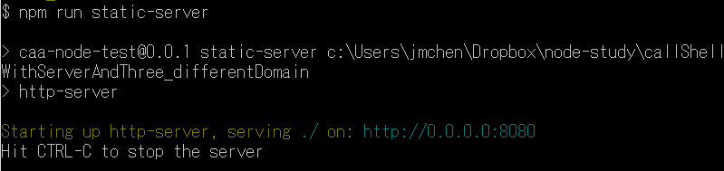
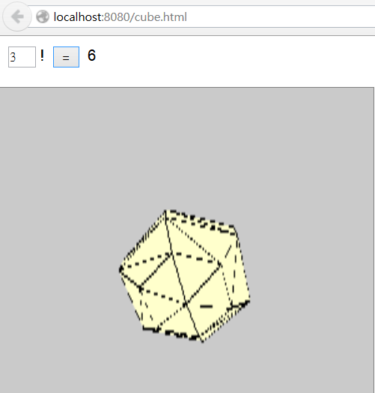
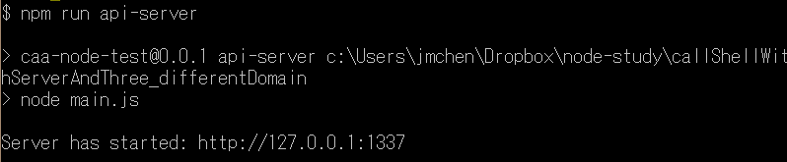
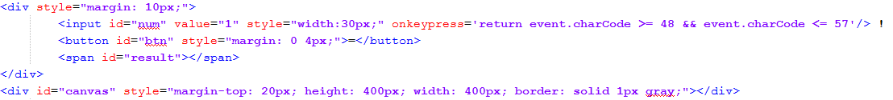
cube.html
1. Start servers …
2. Connect to HTML …

Slide 18
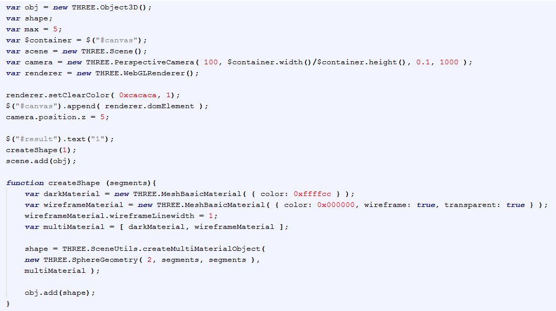
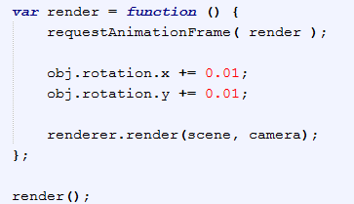

Slide 19
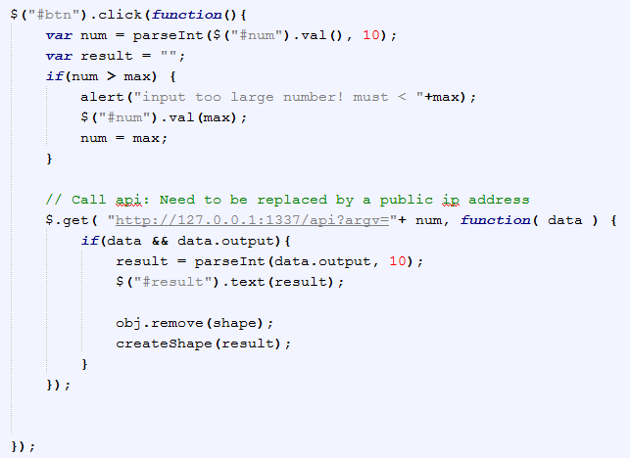
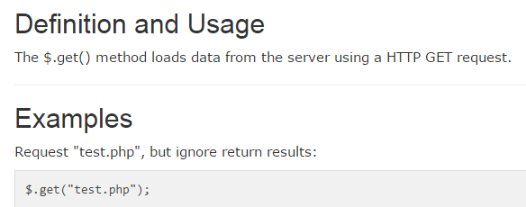
reference
reference

Slide 20
Rose Curve

Slide 21
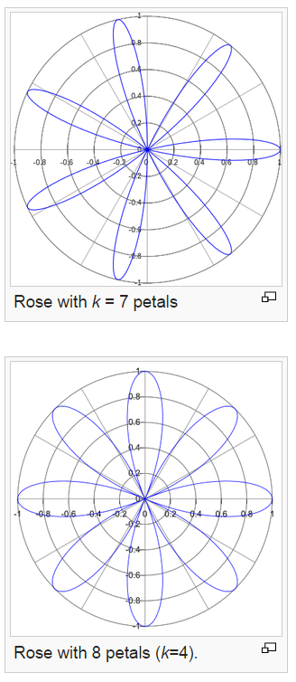
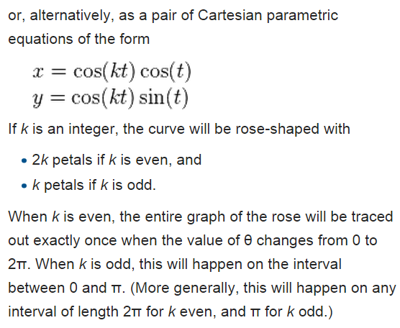
rose or rhodonea curve

Slide 22
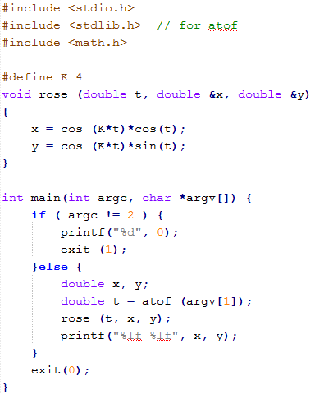
main.cpp

Slide 23
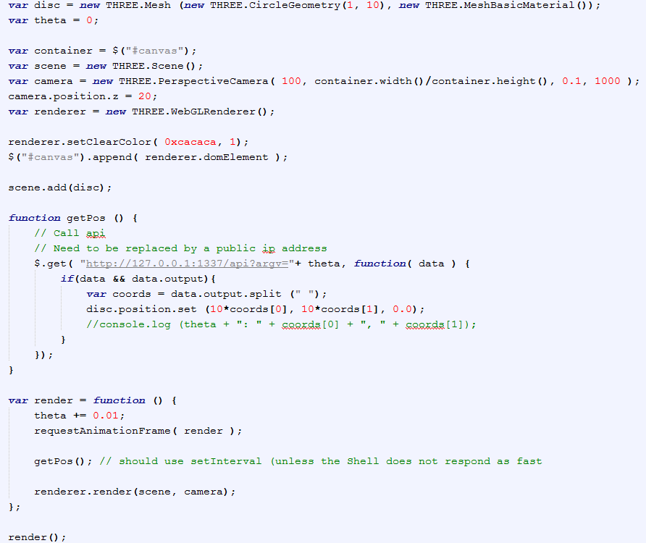
rose.html

Slide 24
main.js (same as previous one)

Slide 25
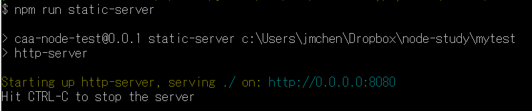
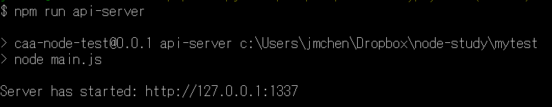
Running…

Slide 26
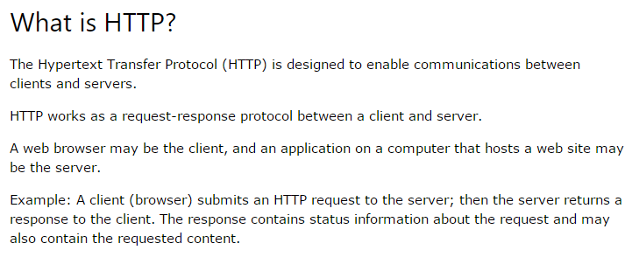
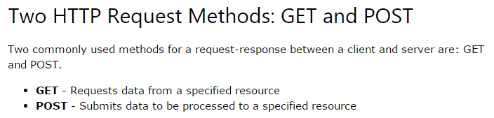
HTTP: GET & POST (reference)

Slide 27
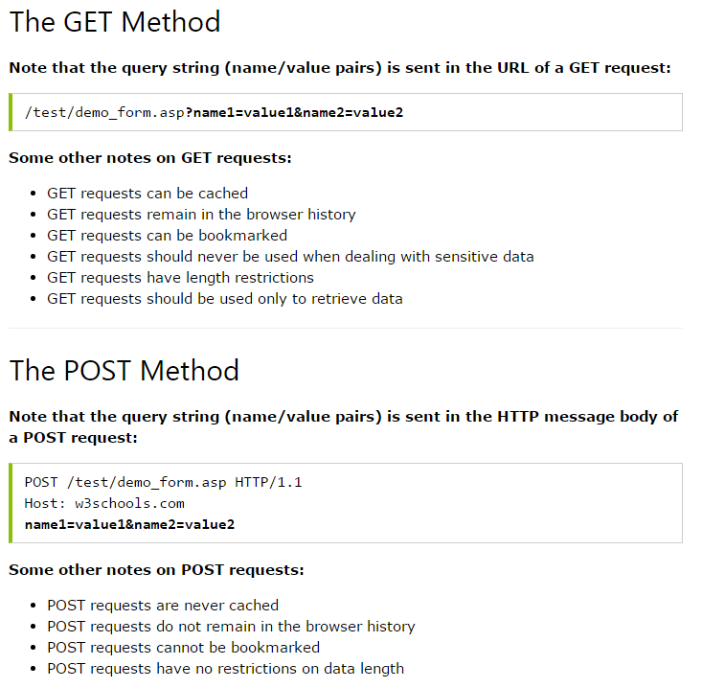

Slide 28
Statistics Server of Game Action Prediction

Slide 29
Prototype
Server
Win:
/100
Submit
localStorage

Slide 30
LocalStorage in Node.js
localStorage (of HTML 5) is client-side API. Not available in servers. (ref)
Npm has localStorage extension (reference)

Slide 31
obsolete

Slide 32
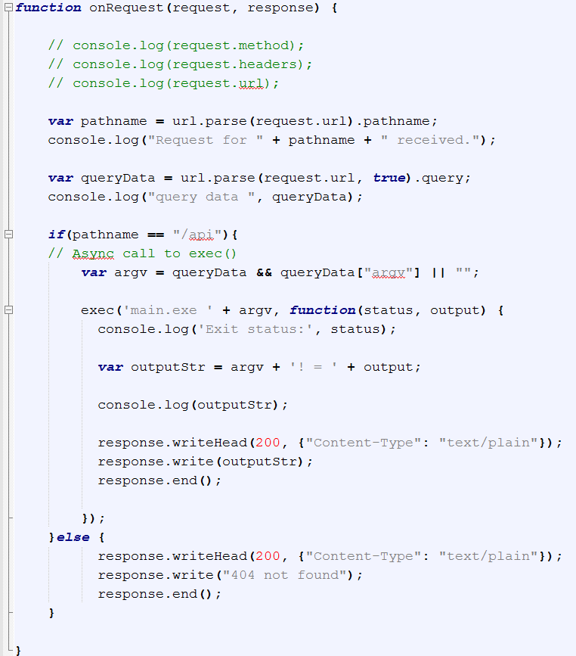
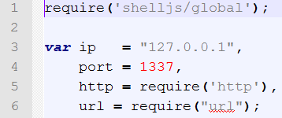


main.js
“/api”
{ argv: 5 }

Slide 33
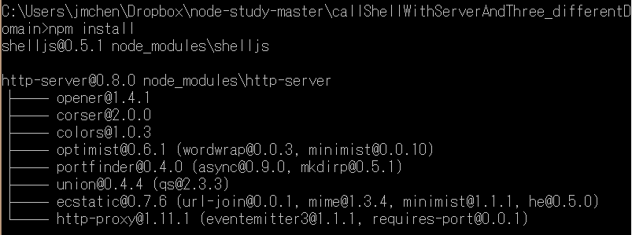
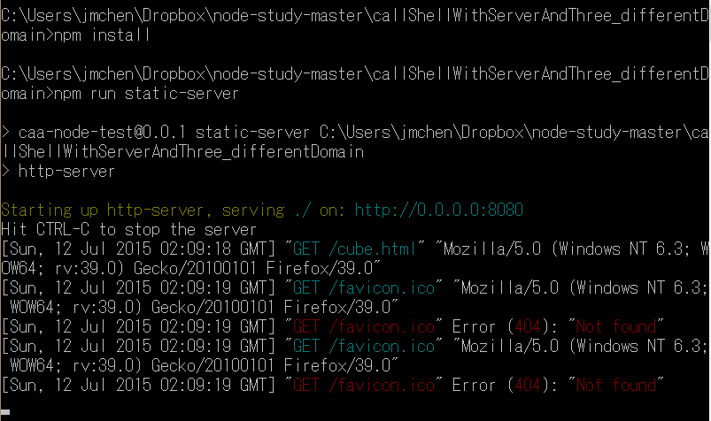
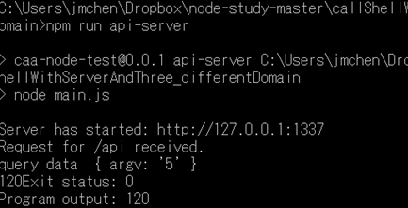

Slide 34
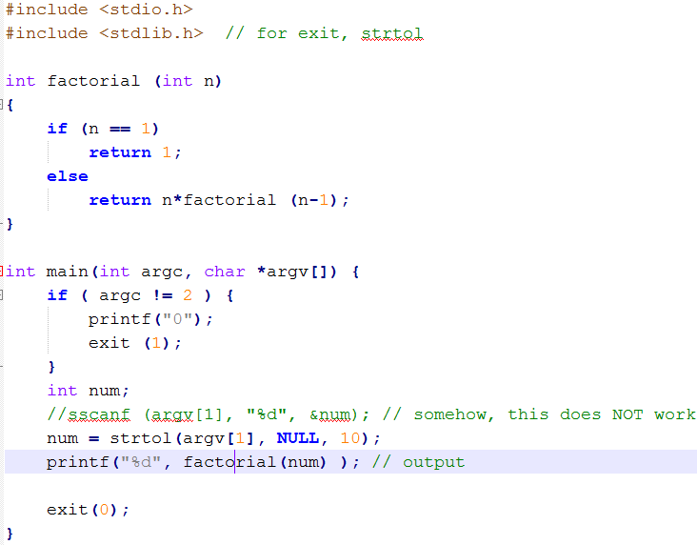
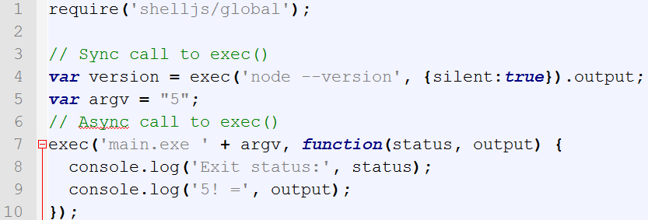
main.cpp
main.js

Slide 35
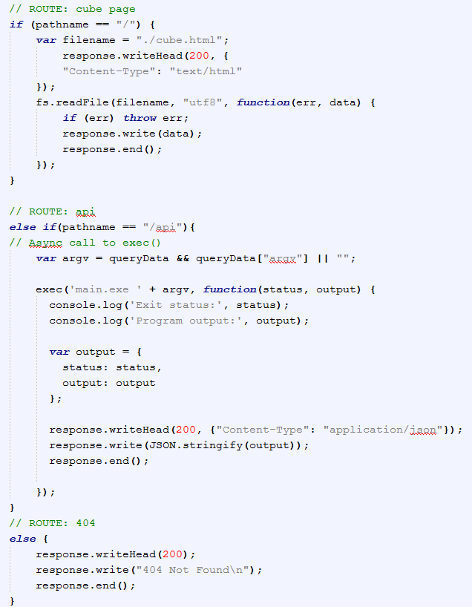
main.jsxx

Slide 36
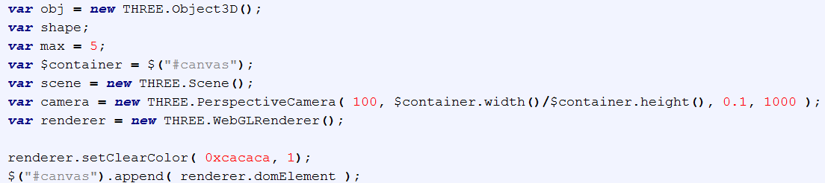

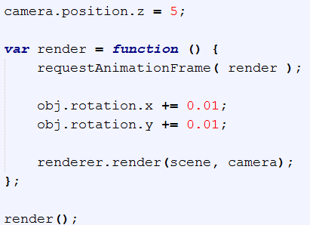
Three.JS

Slide 37
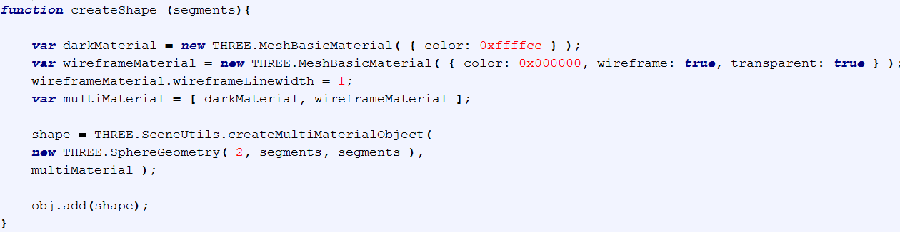
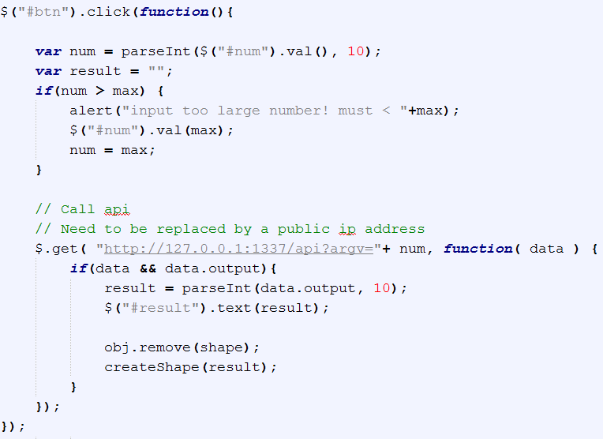
reference

Slide 38

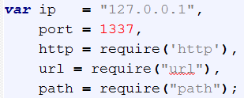
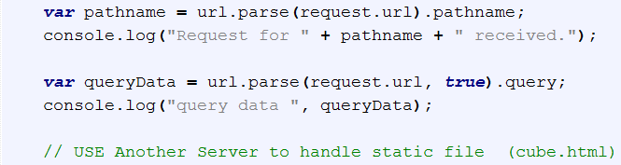
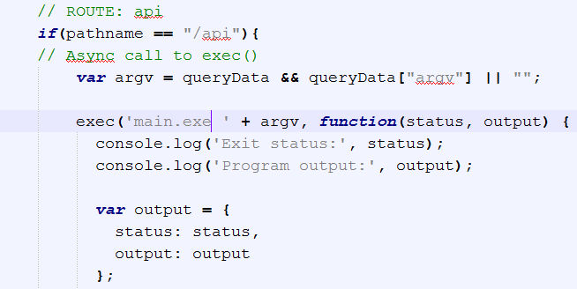
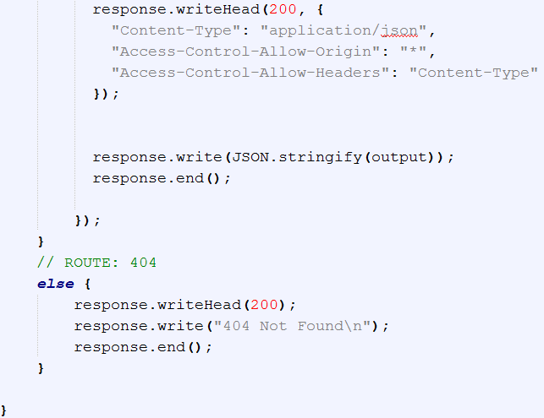
main.js
for CORS

Slide 39
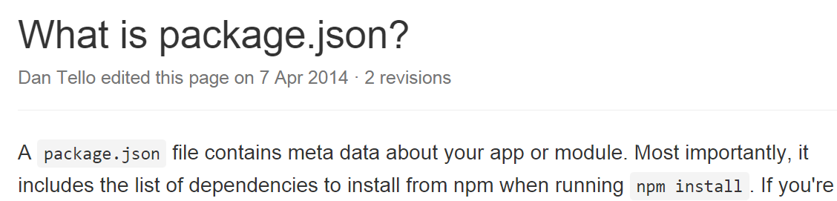

Package.json
Shelljs of any (“*”) version

