Slide 1
Node.js, Shell, Three.js

Slide 2

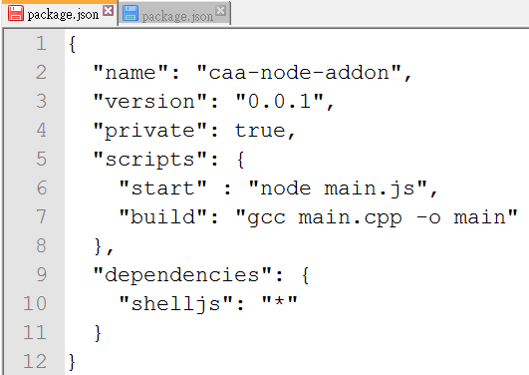
Package.json
Shelljs of any (“*”) version

Slide 3
callShell from node.js

Slide 4

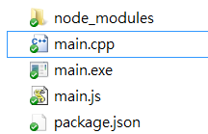
got created after ‘npm install’

Slide 5
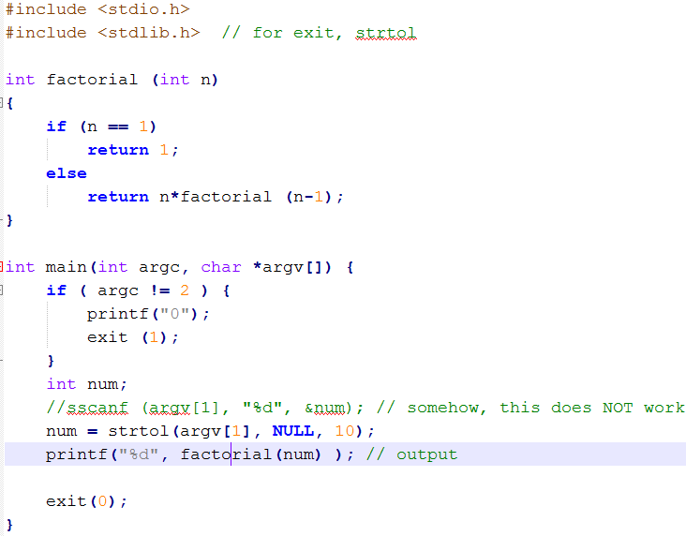

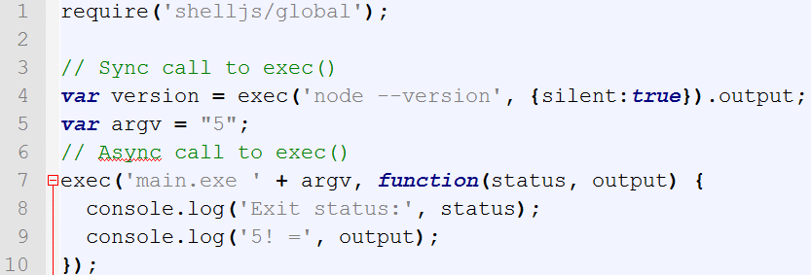
main.cpp
main.js

Slide 6
callShellWithServer

Slide 7
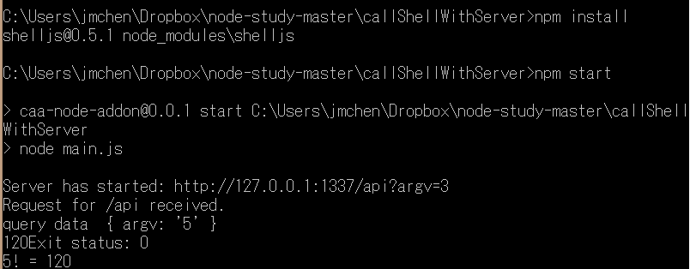


Slide 8
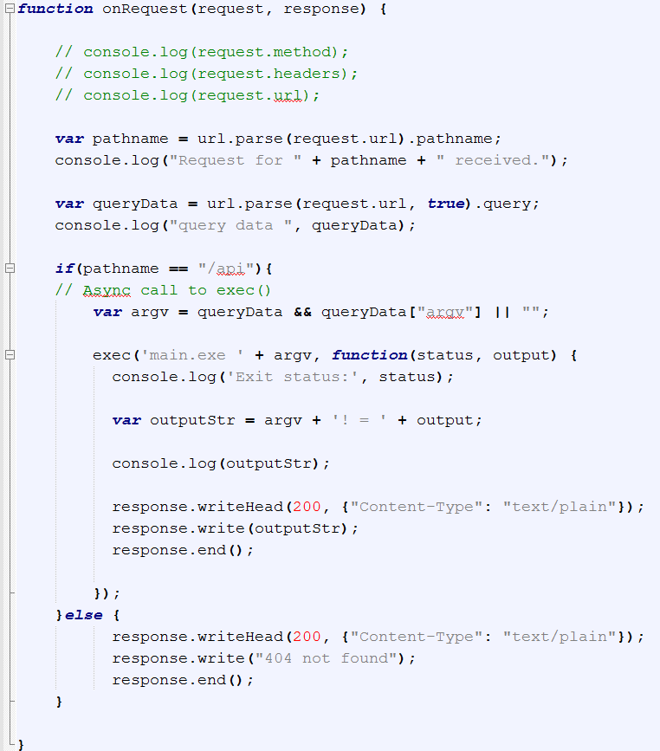
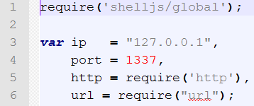

main.js
“/api”
{ argv: 5 }

Slide 9
callShellWithServerAndThree

Slide 10
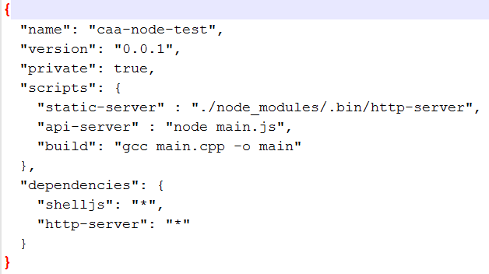
Package.json
127.0.0.1
Cube.html
8080
http-server
1337

Slide 11
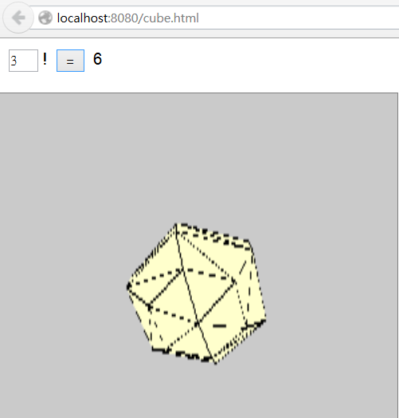
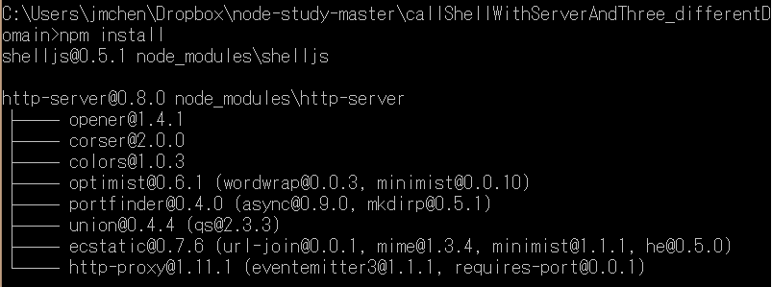
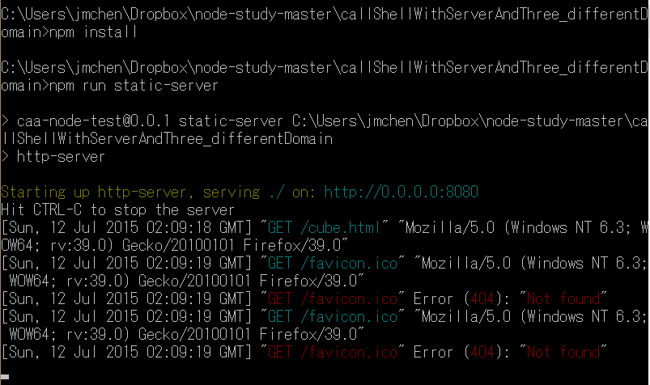
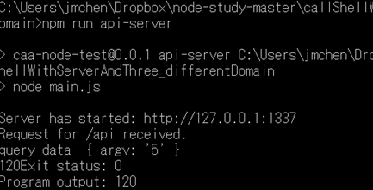

Slide 12


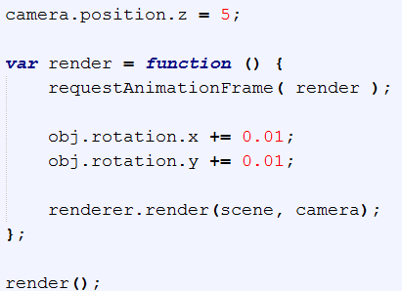
Three.JS

Slide 13

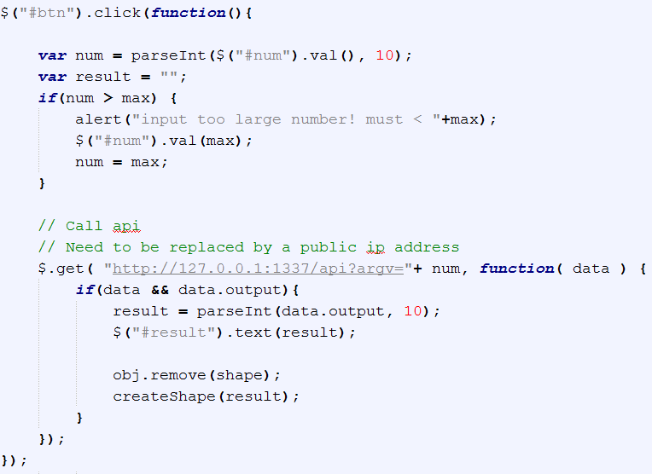
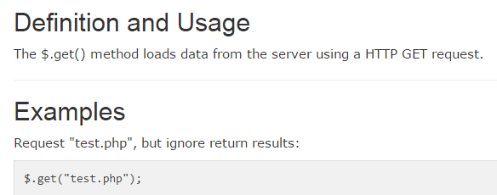
reference

Slide 14

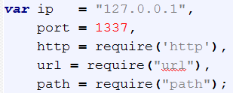

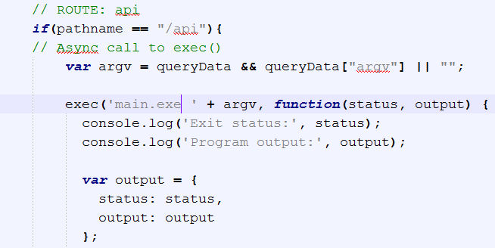
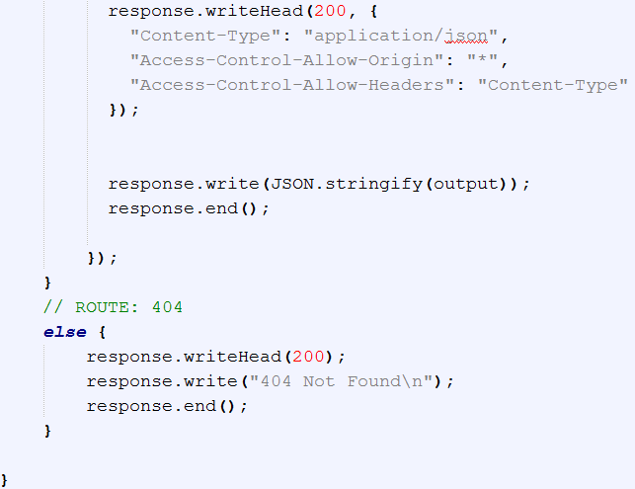
main.js
for CORS

Slide 15
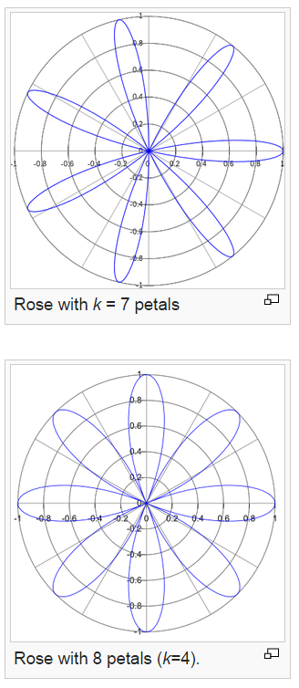
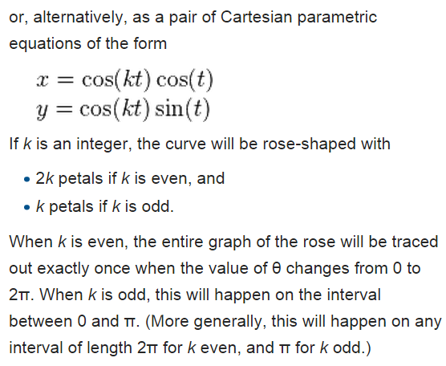
rose or rhodonea curve

Slide 16
Statistics Server of Game Action Prediction

Slide 17
Prototype
Server
Win:
/100
Submit
localStorage

Slide 18
LocalStorage in Node.js
localStorage (of HTML 5) is client-side API. Not available in servers. (ref)
Npm has localStorage extension (reference)

