Slide 1
Node.js, Shell, Three.js

Slide 2
Node.js & NPM
Node.js: a program and an environment
NPM (node.js package manager): the name says it all

Slide 3
Content
Explained in these examples
callShell
callShellWithServer
callShellWithServerAndThree_differentDomain
roseCurve
vectorNorm
gameServer

Slide 4
callShell from node.js

Slide 5
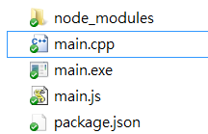
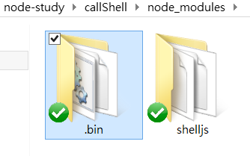
In the Directory …
got created after ‘npm install’

Slide 6
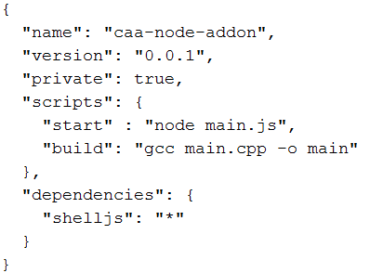
package.JSON
(reference)
Shelljs of any (“*”) version
You need to install first:

Slide 7
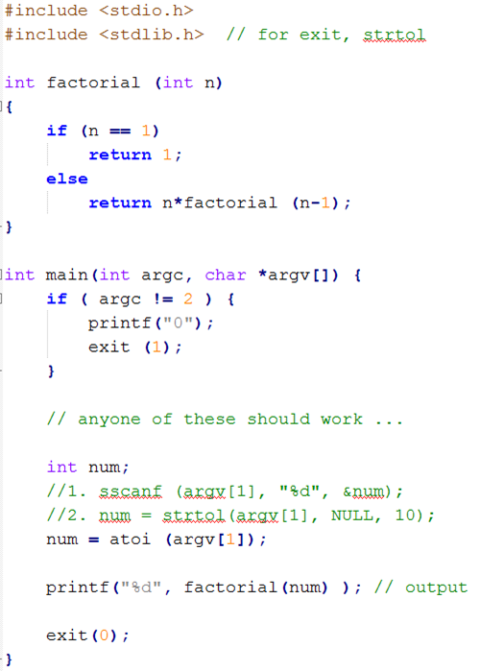
main.cpp
> main.exe 5
120

Slide 8
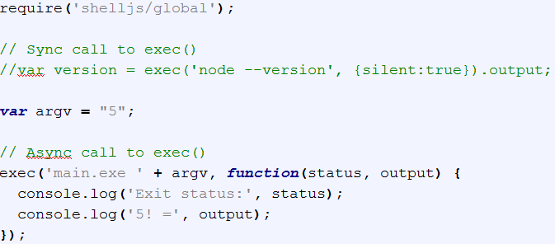
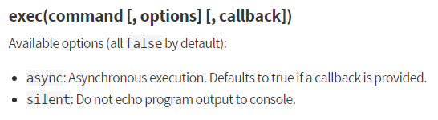
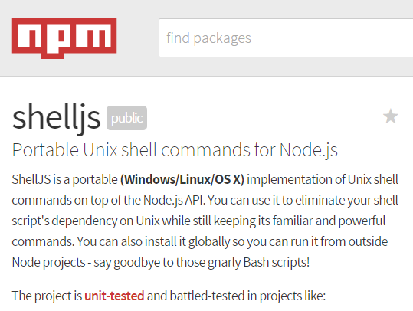
main.js
reference

Slide 9
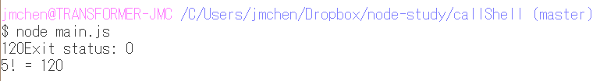
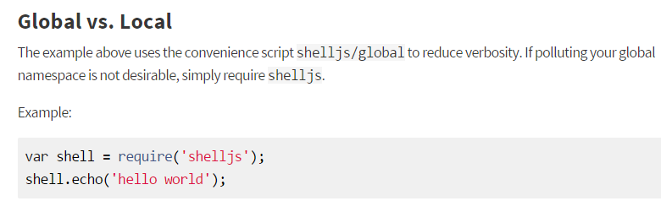
Running …
Alternatively, this can be started with:
$ npm run start
(as specified in scripts of package.JSON)

Slide 10
callShellWithServer

Slide 11
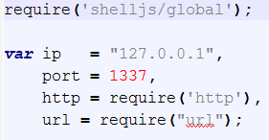
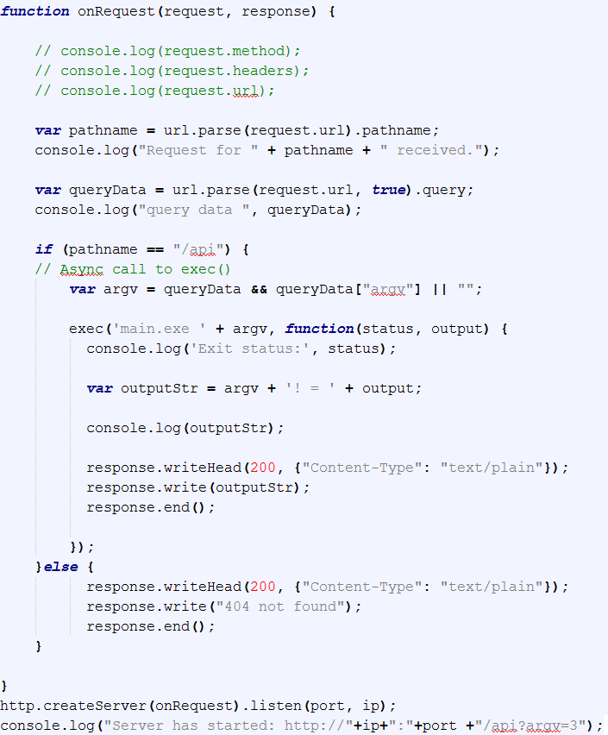
main.js
“/api”
{ argv: 6 }

Slide 12


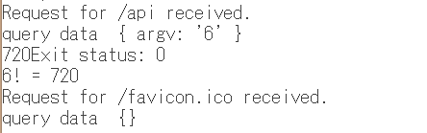


Running …
1. Start server first …
2. Client issued a request …
3. Server responds …
Two POST
4. Client gets a reply …

Slide 13
callShellWithServerAndThree_differentDomain

Slide 14
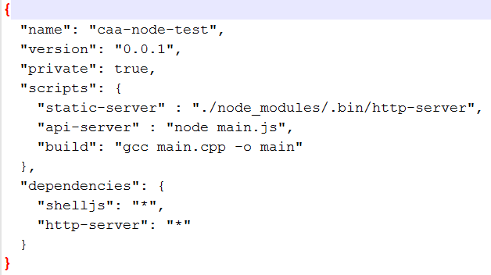
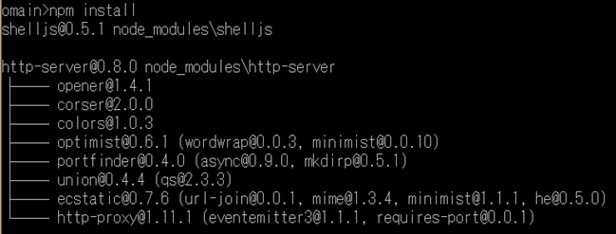
Package.json
127.0.0.1
Cube.html
8080
http-server
1337
api-server

Slide 15
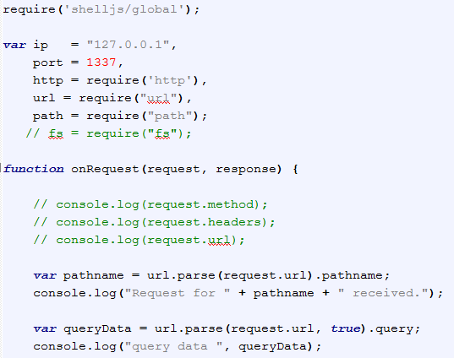
main.js
Router handler: next page

Slide 16
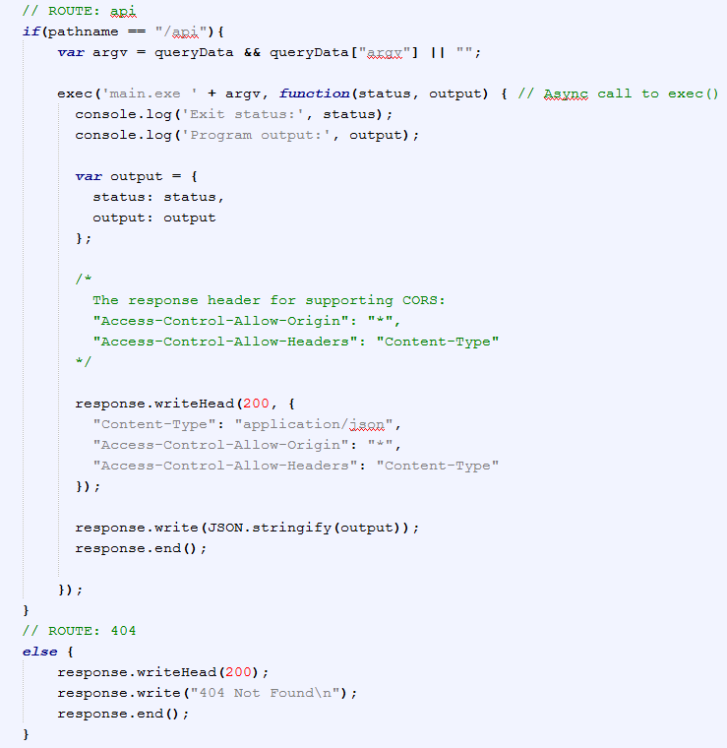


Slide 17
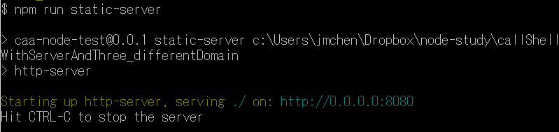
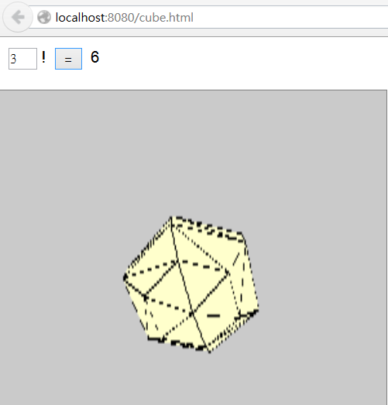
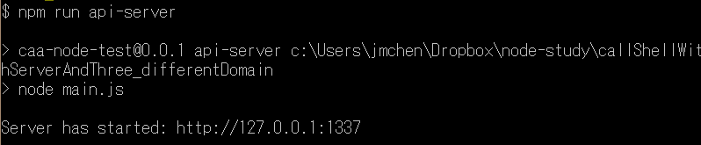
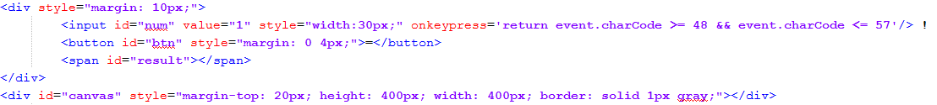
cube.html
1. Start servers …
2. Connect to HTML …

Slide 18
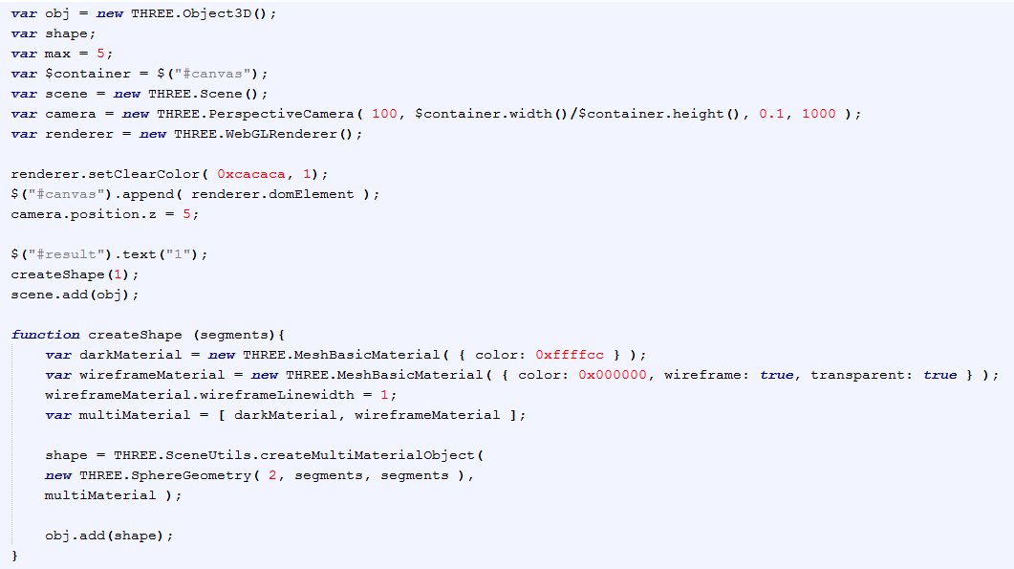
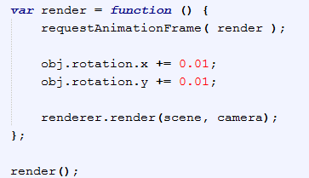

Slide 19
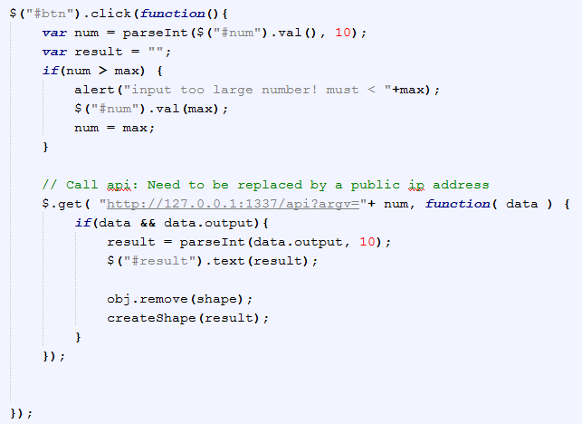
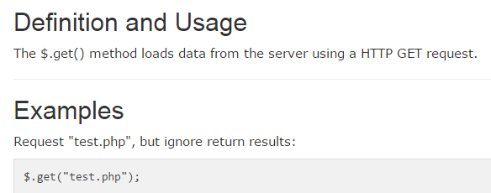
reference
reference

Slide 20
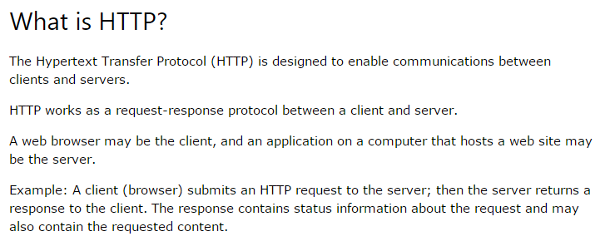
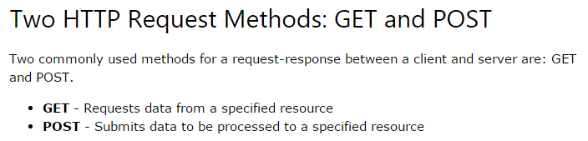
HTTP: GET & POST (reference)

Slide 21
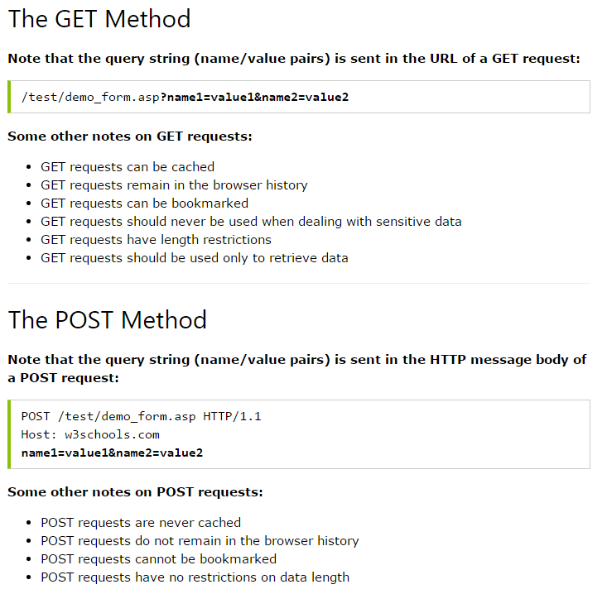

Slide 22
Rose Curve

Slide 23
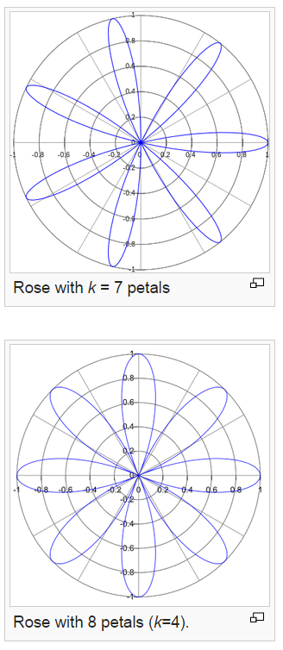
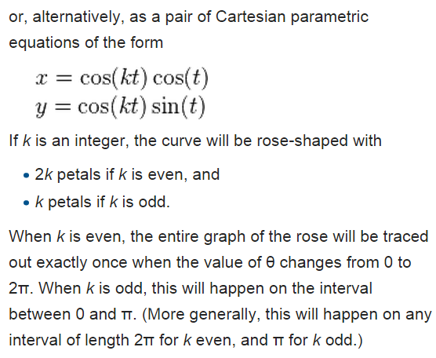
rose or rhodonea curve

Slide 24
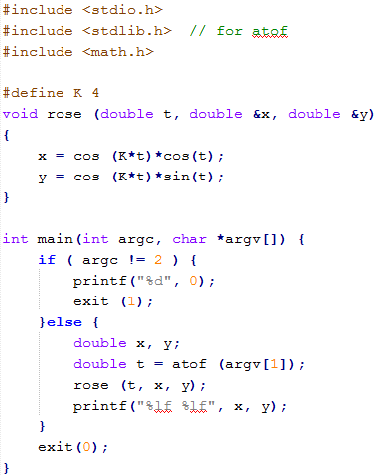
main.cpp

Slide 25
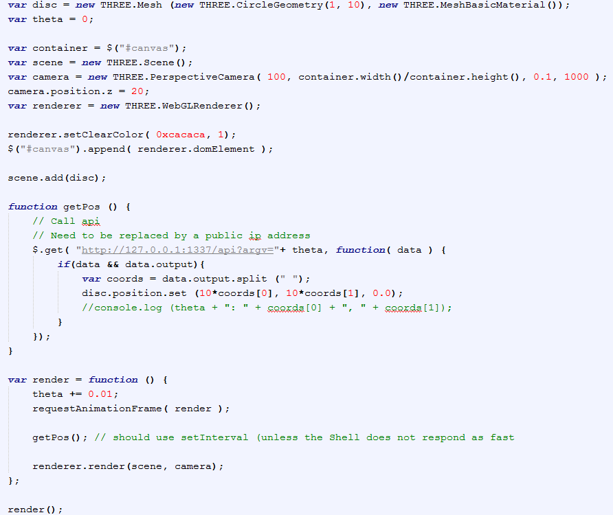
rose.html

Slide 26
main.js (same as previous one)

Slide 27
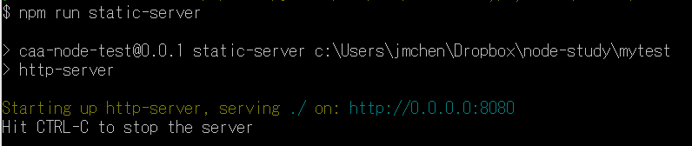
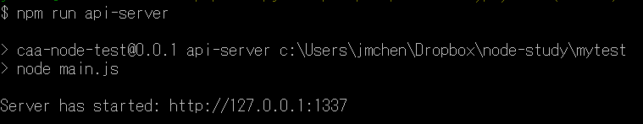
Running…

Slide 28
Vector Norm

Slide 29
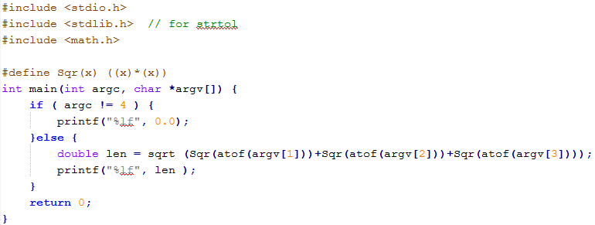
main.cpp

Slide 30
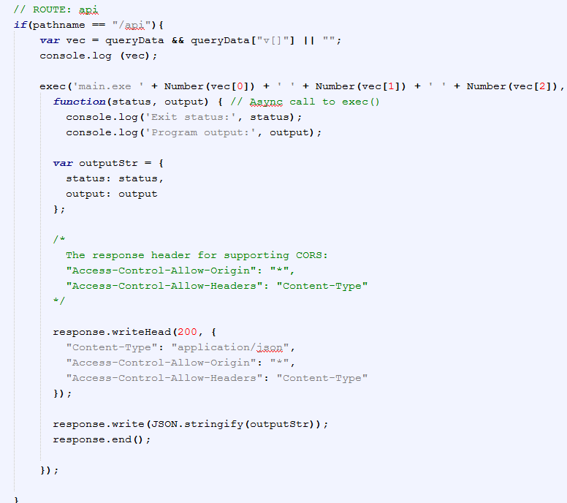
main.js

Slide 31
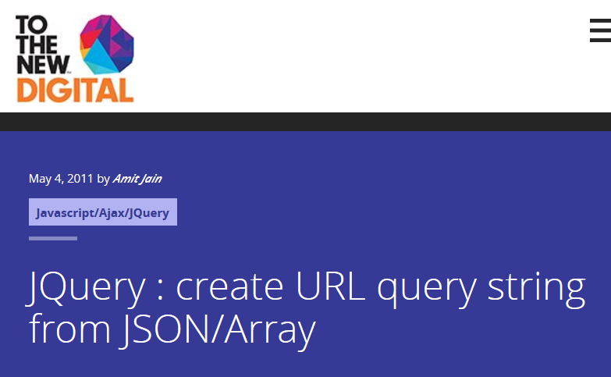
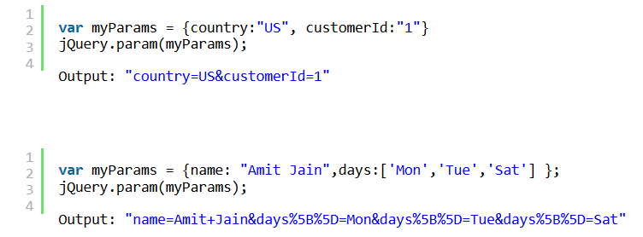
(ref1)
(ref2)

Slide 32


Two cases: JSON & Array
query data { num: '13', 'denom[time]': '1', 'denom[val]': 's' }
query data { 'v[]': [ '1.1', '2.2', '-3.2' ] }

Slide 33
Desired Interface
Input a 3-vector
v[0]:
v[1]:
v[2]:
Norm =

Slide 34
Statistics Server of Game Action Prediction

Slide 35
Prototype
Server
Win:
/100
Submit
localStorage

Slide 36
localStorage in Node.js
localStorage (of HTML 5) is client-side API. Not available in servers. (ref)
npm has localStorage extension (reference)

Slide 37
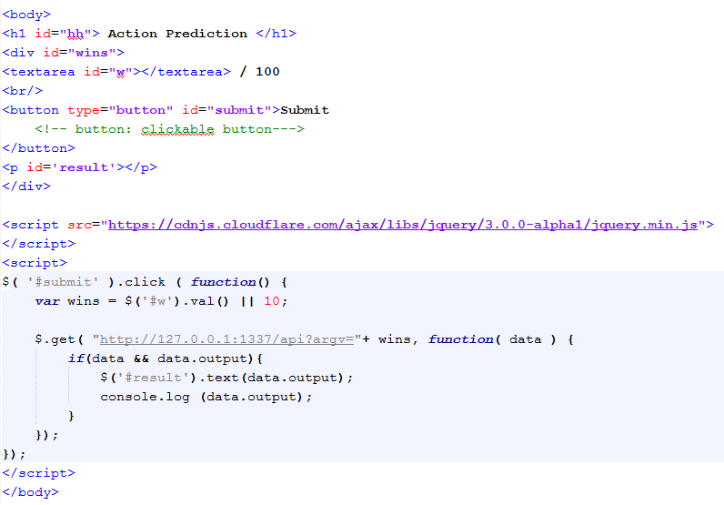
game.html

Slide 38
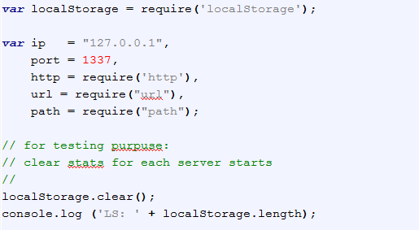
main.js

Slide 39
