Slide 1
API for Mobile Devices

Slide 2
Outline
Device orientation events (alpha, beta, gamma angles)
Device motion events (acceleration data, with or without gravity)

Slide 3
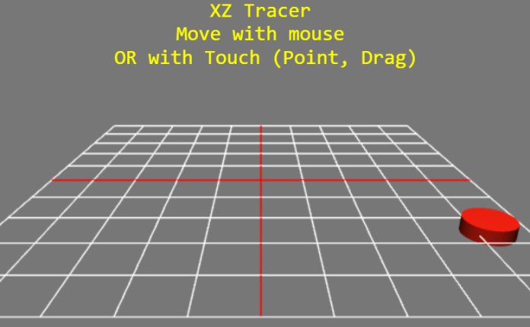
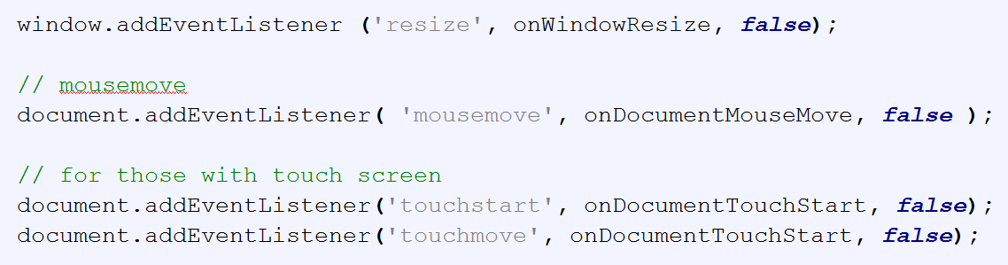
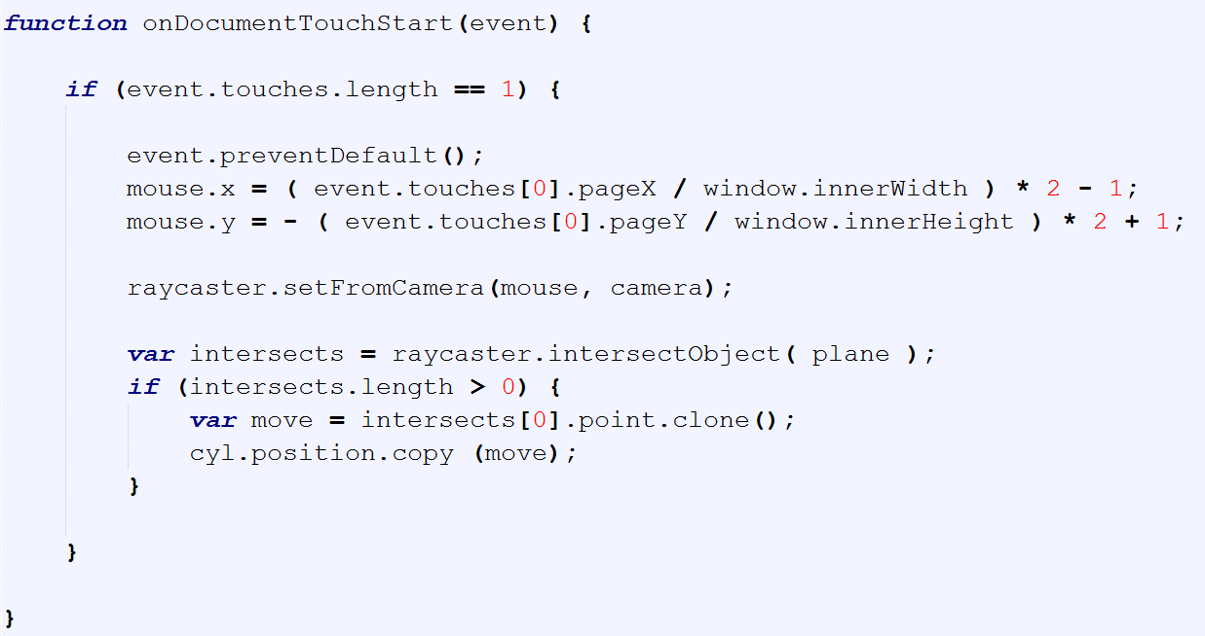
XZ Tracer

