Slide 1
Sound, Speech, and others

Slide 2
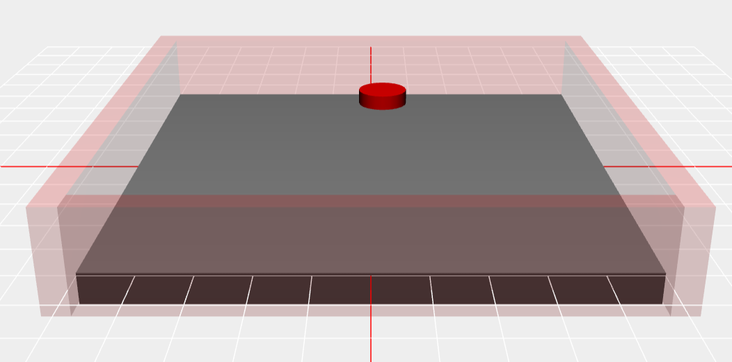
BGM, Sound Effect
<audio> tag (w3cschool)
Requirement:
preload, play, pause, stop, volume control, loop
Triggered by Three.js

Slide 3
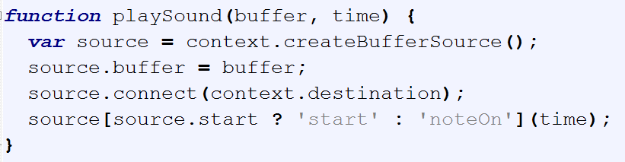
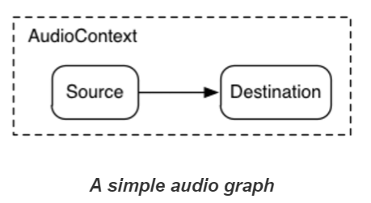
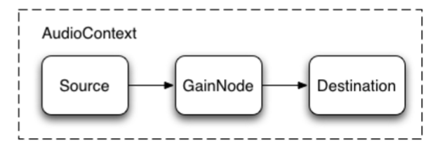
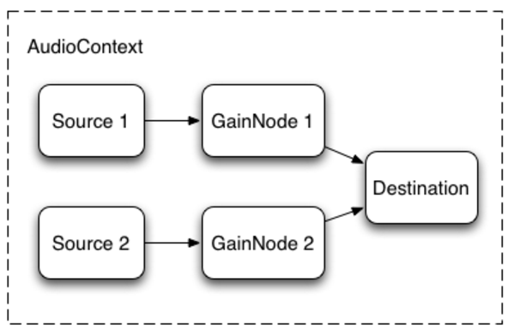
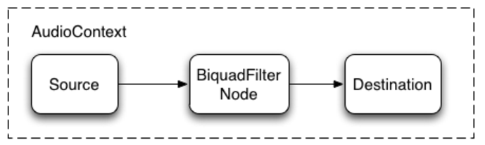
WebAudio API (reference)
Simple playSound

Slide 4
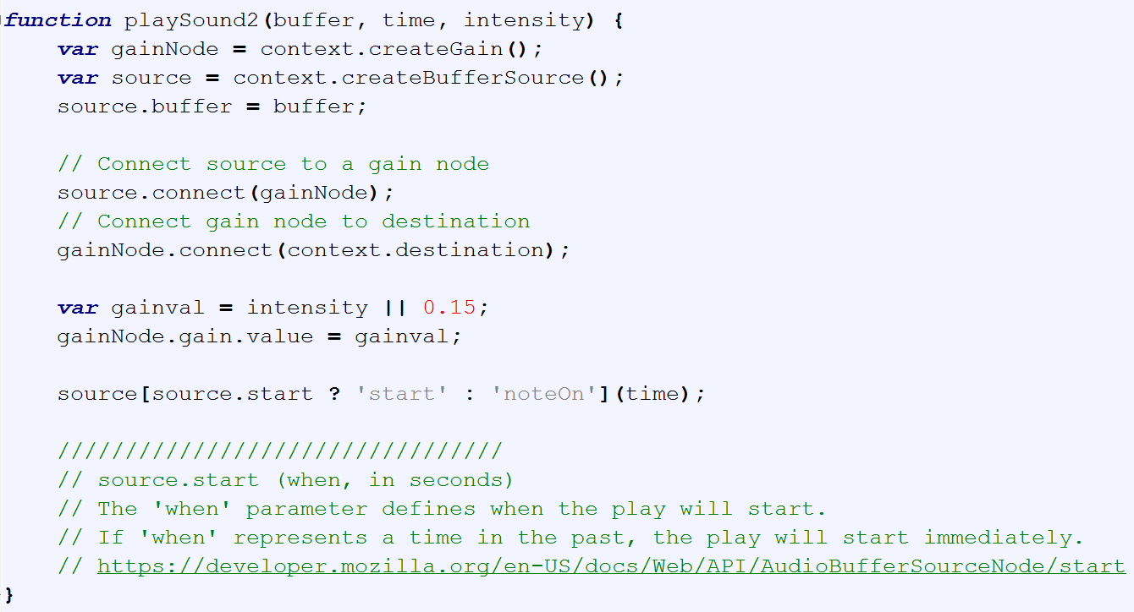
playSound with Gain

Slide 5
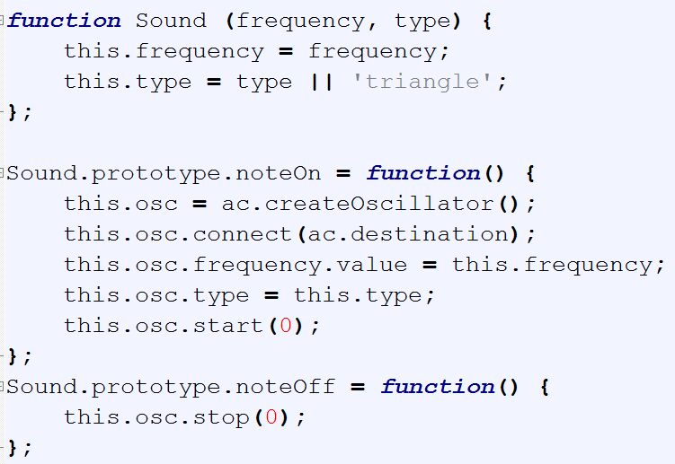
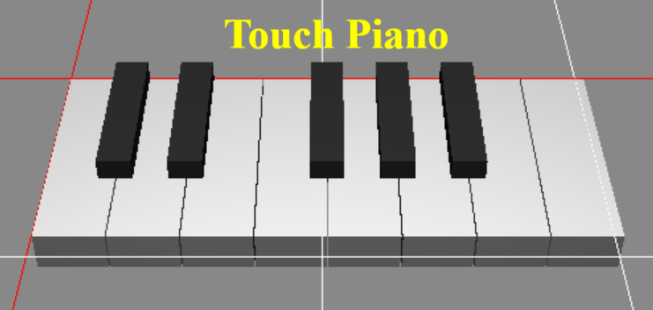
Web Audio API
BasicPianoExample (no 3JS)

Slide 6
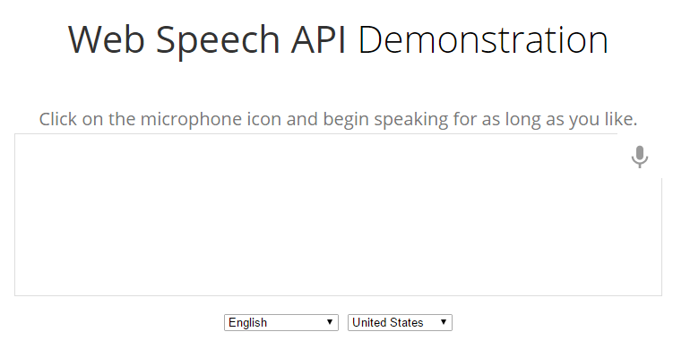
Webspeech API (reference)
http://jsfiddle.net/jmchen/j12v4zjf/light/
RobotSpeaker: english, chinese, …
AudioListener: only new Chrome supports

