Slide 1
CMPINF 2110
Spring 2022
Week 12
Queries in lecture not in the other presentations

Slide 2
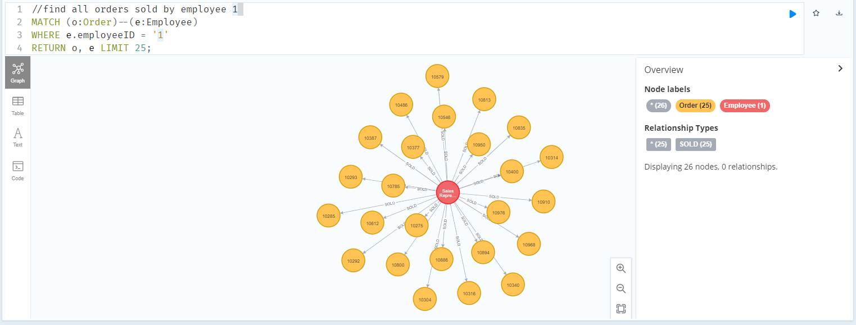
Orders sold by EmployeeID 1

Slide 3
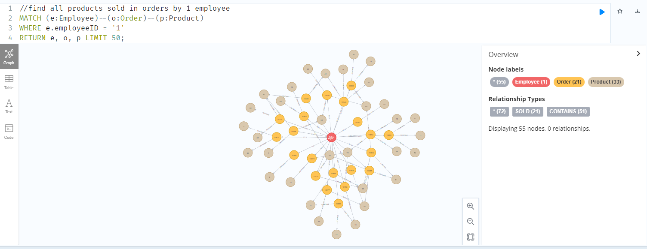
Products contained in Orders sold by EmployeeID 1

Slide 4
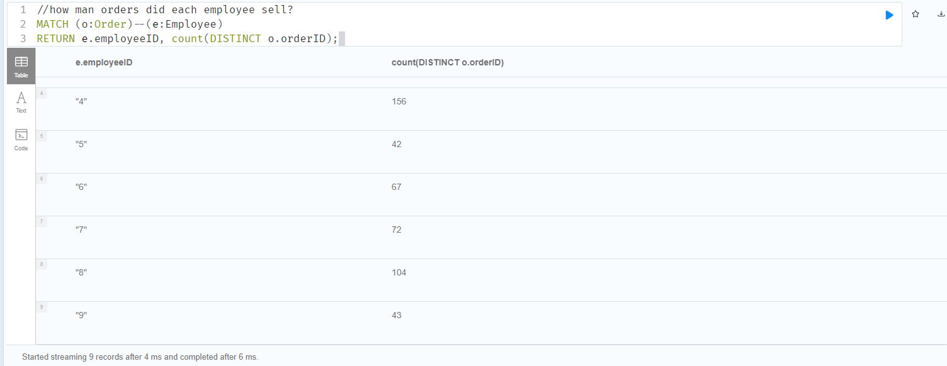
How many orders did each employee sell?

Slide 5
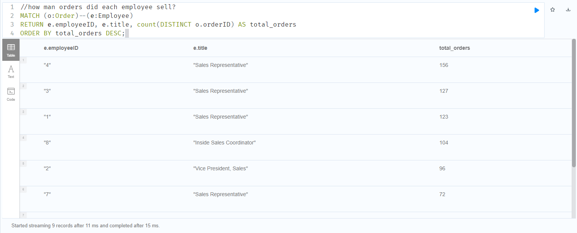
Which employee sold the most orders?

Slide 6
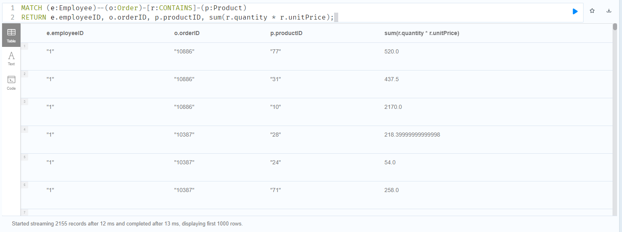
Total price of each product contained in an order sold by an employee

Slide 7
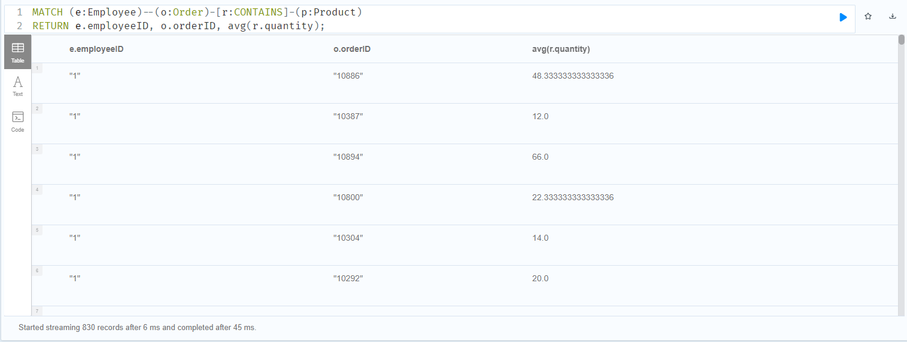
Average quantity (number of each product) contained in each order sold by each employee

