Slide 1
Exploring Spatial Data
with sf
Sheila Saia
Thursday, July 19, 2018
Duke Library, The Edge Workshop Room

Slide 2
Lightning Talks & Announcements
Share something interesting and related to R or data science!
Sign-in Link:

Slide 3
Consider organizing our next R-Ladies RTP Meetup!
Some ideas we’ve discussed previously…
Regular expressions
Low-key chat (coffee shop or bar or both?)
Unfinished talks
Shiny (interactive applications and plotting)
< insert your idea here >
Notes:
(5 min introductions?, 5 min with previous slide)

Slide 4
Workshop Materials
You can find the workshop materials on GitHub at
https://github.com/rladies/meetup-presentations_rtp/tree/master/2018-07-19-sf
You will also need to download the data for the workshop. See GitHub download > workshop_data > README.md for the link.
Notes:
(5 min how to download dataset)

Slide 5
Workshop Learning Outcomes
By the end of this workshop you will be able to:
Describe what the sf package is and how to use it
Explain some different sf spatial operations
Apply sf operations to a real-world geospatial dataset

Slide 6
What is (geo)spatial data?
Data that’s measured in space/associated with a place
Has a coordinate system
4 dimensions
Is the Moon included?? 🌜
Satellite data
🗺
Geospatial dinos
Notes:
(5 min for open discussion)
Data that describes the spatial distribution of something/someone on Earth (or any planet really), has coordinates and geometric shape (= topology)

Slide 7
Major Types of Spatial Data
Vector data
Raster data
Can you think of examples of each?
Can you think of example file extensions for each?
Notes:
(10 min for discussion, 30 min total after this)
Vector - way to represent spatial features using points, lines, and polygons (e.g., gps points, bus route, lot parcel, park boundary), .shp files
Raster - way to represent points spatial features using grid where each cell has one value that represents some attribute (e.g., elevation, land cover type, inches of rainfall), .img files

Slide 8
What is sf?
sf stands for simple features
Package was first published this past May (very new!)
Was developed to replace the sp package, which didn’t meet all ISO simple features standards
Use for spatial operations & plotting (also works well with the tidyverse! - dplyr, ggplot, etc.)
More info here: https://github.com/r-spatial/sf
Notes:
What is a feature? - refers to points, lines, polygons so therefore sf is associated with vector data only

Slide 9

USGS GAGES-II Dataset
“...Geospatial Attributes of Gages for Evaluating Streamflow, version II, provides geospatial data and classifications for 9,322 stream gages maintained by the U.S. Geological Survey (USGS)”
Available online at:
https://water.usgs.gov/GIS/metadata/usgswrd/XML/gagesII_Sept2011.xml
*We will also use some TIGER data...see README in the GitHub repository for more info.

Slide 10
USGS GAGES-II Dataset (continued)
Includes:
Watershed bounds by region (reference and non-reference)
Watershed characteristics (tabular data)
USGS gage locations
Notes:
(35 min total here)

Slide 11
Activity 1: Getting Started with sf
Open up sf_workshop_script.R
Install sf and load libraries
Change the directory paths based on where you saved the GitHub repository
Load in the spatial data using st_read( )
Use class( ) and glimpse () to view one of the new files you loaded in
Notes:
(5 min to do this, 5 min to discuss what they liked, didn’t like, had trouble with, was easy, 45 min total)
Maybe would have used rgdal package’s readOGR( ) function before this but would have to tell it which values were the coordinates, sf figures this out automatically

Slide 12
What might you want to do with your vector data?
Think about spatial operations that might be helpful to use.
Make a list with your group of 2-3 people (5 min)
Discuss with everyone (5 min)
Ideas:
See if certain ZIP codes touch each other
Merging census tracts into one unit
Make heat map (vector format)
Calculating centroids
Measuring distances
Counting how many bus stops are within ¼ mile of my house
Notes:
(10 min, 55 min total)
Some answers:
Define a coordinate system using st_set_crs( )
Project it to another coordinate system using st_transform( )
Save just the attributes using st_set_geometry = NULL
Find the area using st_area( )
Find the centroid of a polygon using st_centroid( )
Do spatial operations like intersection using st_intersection( ), st_buffer( ), st_union( ), st_merge( ) - some of these I’m not sure how they work
Convert points to lines, lines to polygons, etc. using
Add tabular data (using the joins/the tidyverse!)

Slide 13
Activity 2: Common Operations in sf
Open up sf_workshop_script.R
Let’s try some of the operations we just talked about.
*(For later) Look here for more inspiration: https://cengel.github.io/rspatial/3_spDataOps.nb.html
Notes:
(15 min, 1 hour 10 min total)

Slide 14
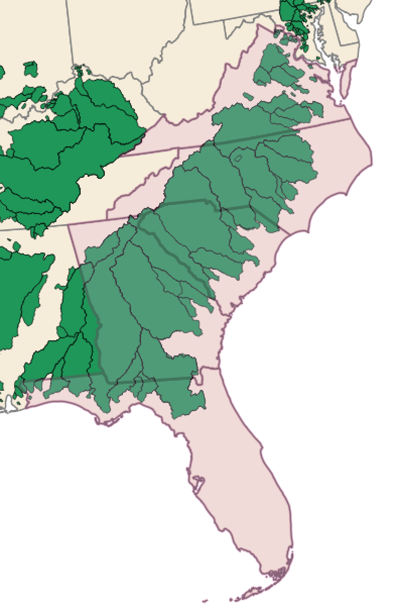
Activity 3: Putting sf to Work with USGS GAGES-II Data
Pick your favorite SE state
(Hint: Make a new variable)
Find all the watersheds that overlap
Plot the watersheds in your favorite
state.
Notes:
(10 min, 1 hour 20 min total)

Slide 15
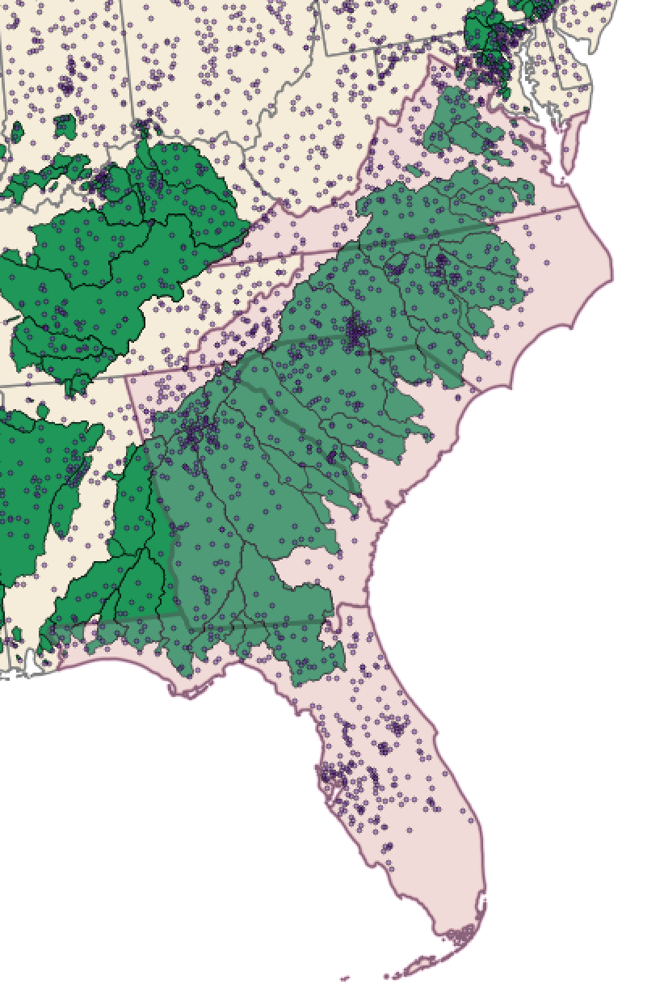
Activity 4: Bringing in the tidyverse
Use your favorite state (from Activity 2)
Select all the gages in that state
Join some of the tabular data and color
these gages by your favorite variable
(Hint: see the tabular_data file for
GAGES-II variable descriptions)
Extra: Download USGS gage data for
one (or multiple) gage(s) in your state
using the dataRetrieval package
Notes:
(15 min, 1 hour 35 min total)

Slide 16
Workshop Learning Outcomes Revisited
Now that it’s the end of this workshop, we hope you are able to:
Describe what the sf package is and how to use it
Explain some different sf spatial operations
Apply sf operations to a real-world geospatial dataset
Notes:
(5 min, 1 hour 40 min total)

Slide 17
Consider organizing our next R-Ladies RTP Meetup!
Some ideas we’ve discussed previously…
Regular expressions
Low-key chat (coffee shop or bar or both?)
Unfinished talks
Shiny (interactive applications and plotting)
< insert your idea here! >
Sign-in Link:

