Slide 1
EECS 289 – 2024 Lab 1
Neurotransmitter sensors and IrOx pH electrodes

Slide 2

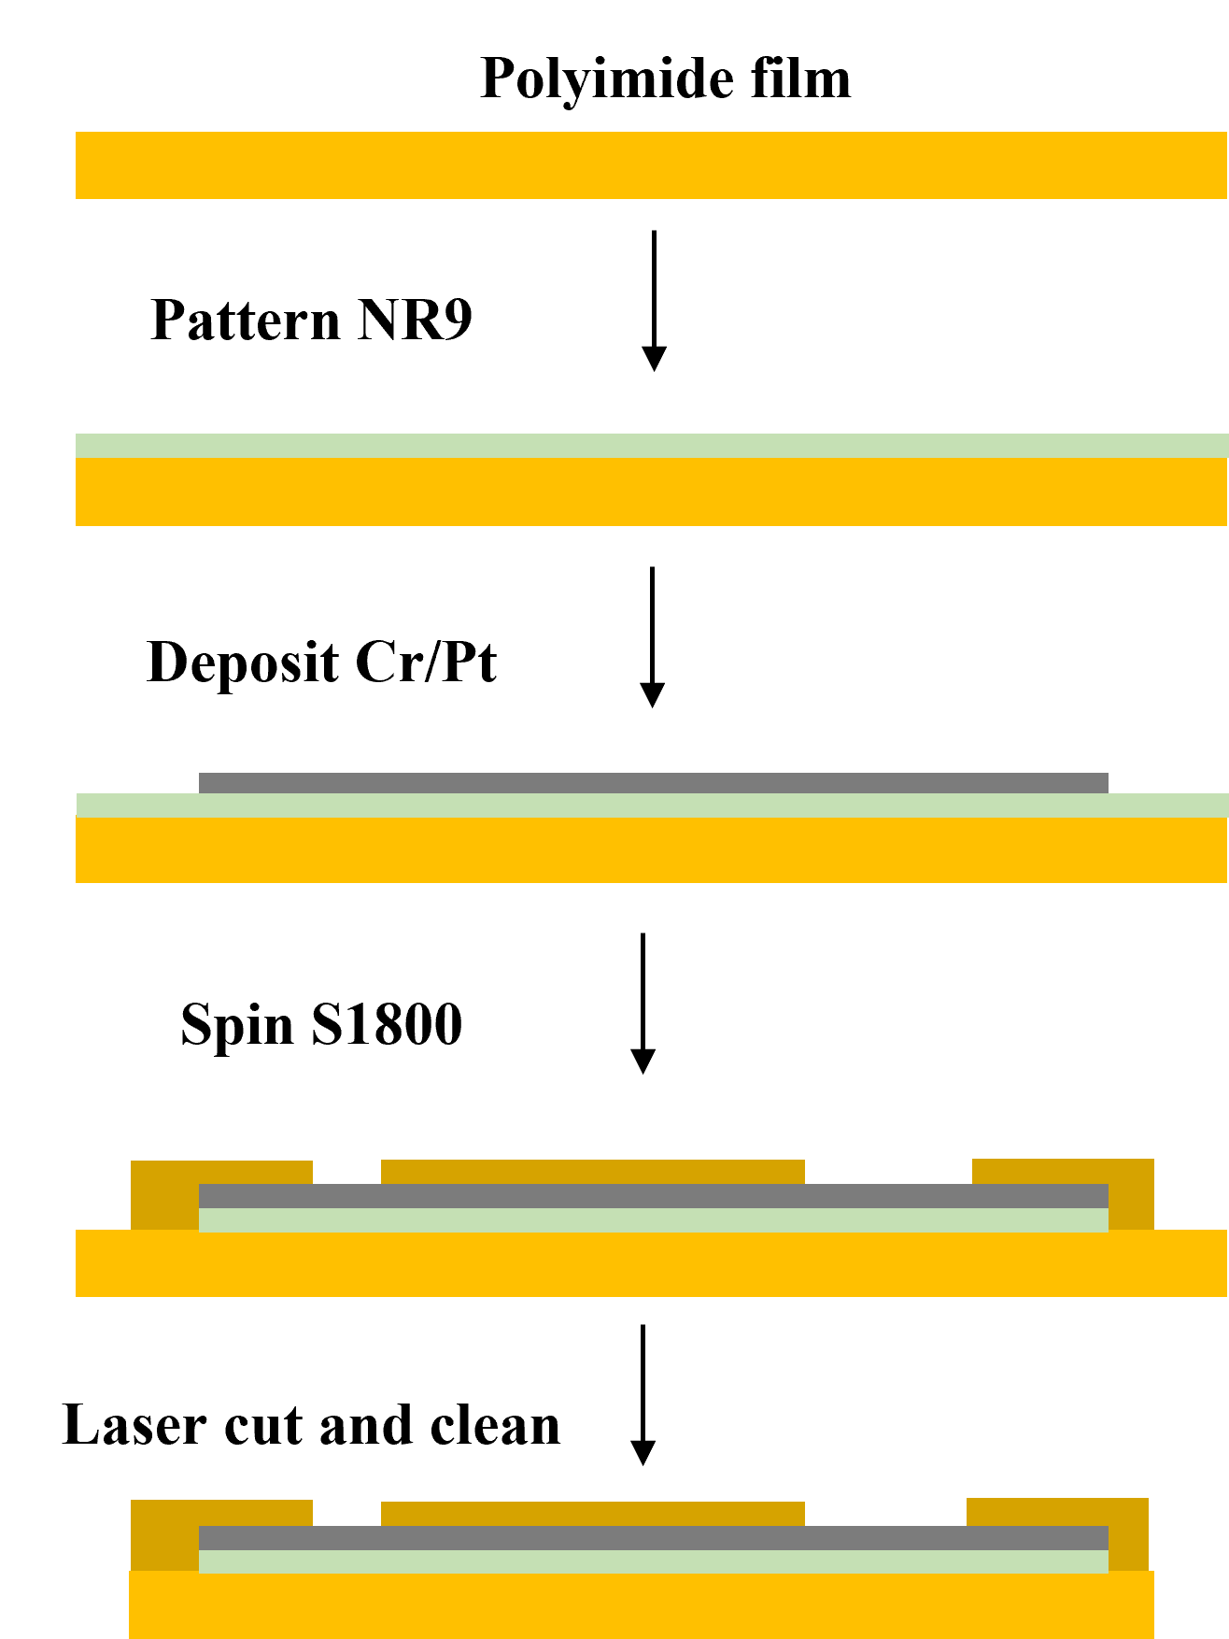
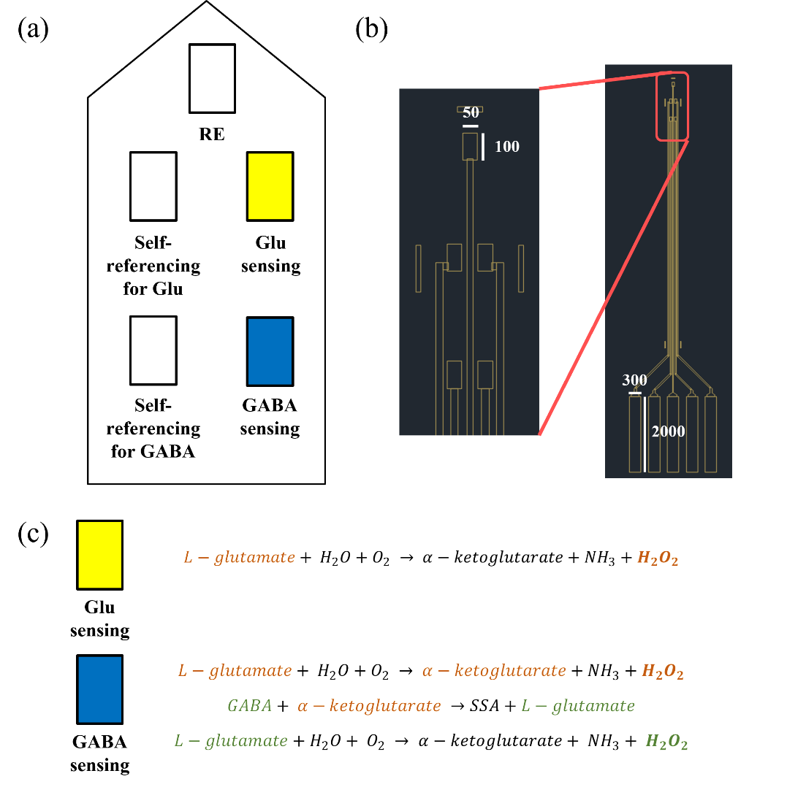

Schematic for electrode fabrication process
Orientation of pads in the electrode
CAD image of the electrode with dimensions
(unit = μm)

Slide 3
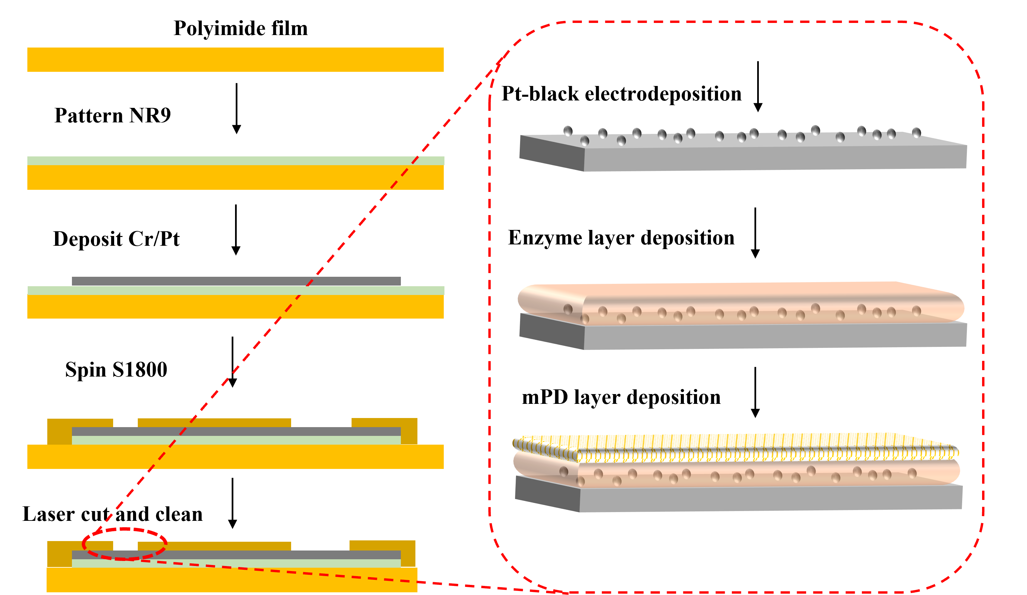
Sensor Fabrication
Higher Sensitivity
Specificity
Selectivity

Slide 4
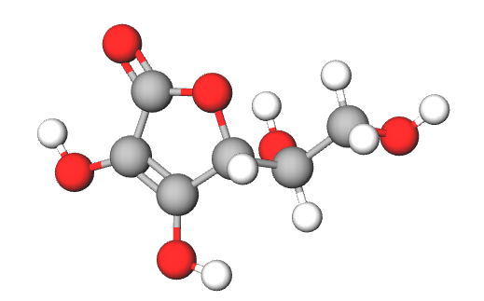
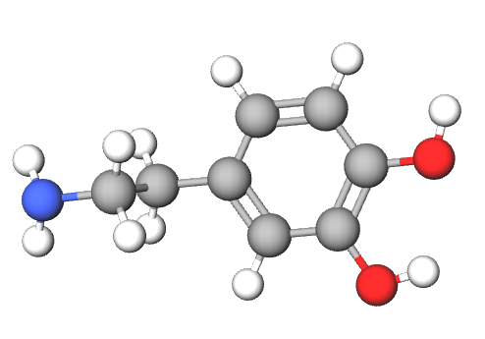
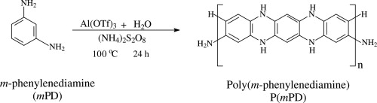
Sensor Fabrication
Electropolymerization of mPD
Ascorbic Acid (C₆H₈O₆)
Dopamine (C₈H₁₁NO₂)
Other electroactive molecules can generate current and interfere with the signal
Exclusion layer to block the molecules from reaching the electrode surface needed
Selectively lets ions or molecules through the aromatic diamine polymer film through size exclusion
Applying different process result in different pore size of the formed polymer

Slide 5
Self-referencing
Self-referencing: Monitors any other signal except for the one from the target
$$I_{sensing}=i_{Glu}+\left(i_{F1}+i_{F2}+⋯+i_{Fn}\right)+(i_{nonF1}+i_{nonF2}+⋯+i_{nonFn})$$
$$I_{self−ref}=\left(i_{F1}+i_{F2}+⋯+i_{Fn}\right)+(i_{nonF1}+i_{nonF2}+⋯+i_{nonFn})$$
$$I_{Glu}=I_{sensing}−I_{self−ref}$$
Detects all signals from other electro-active chemicals except for the target
Receives same ambient noise that the sensing site does
Can later be subtracted from sensing site to get higher signal-to-noise ratio (SNR)
Orientation of pads in the electrode

Slide 6
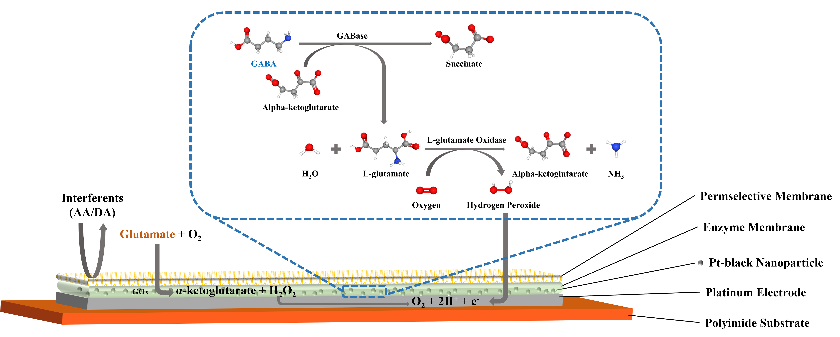

Slide 7
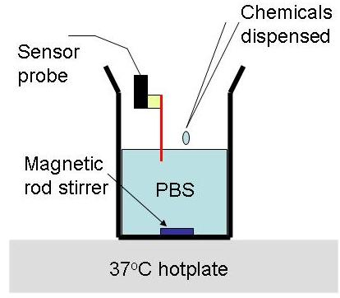
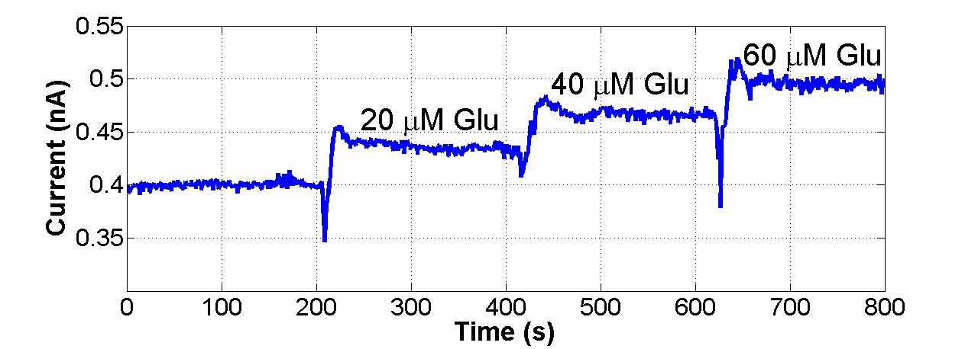
Calibration
Potentiostat Pinnacle 3104
+0.7 V bias between WE and RE
30 minutes required to reach the baseline
Calibration
20 μM of L-glutamate in steps
Interferences
10 μM of Dopamine – DA
200 μM of Ascorbic Acid – AA

Slide 8
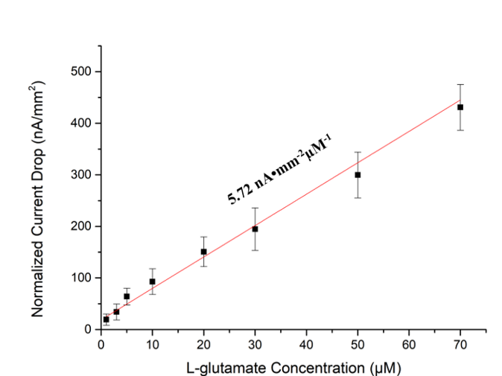
Sensor Performance - Sensitivity
R² = 0.98
Limit of Detection (LOD) = 1.92 μM
Calibration curve and the sensitivity for Pt-black on Pt to sequential addition of L-glutamate (n=4)

Slide 9
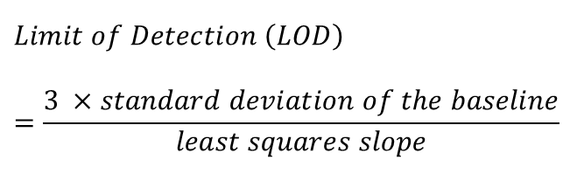
Sensor Performance - Sensitivity
$$Limit of Detection \left(LOD\right)=\frac{3 ×standard deviation of the baseline}{least squares slope}$$
R² = 0.98
Limit of Detection (LOD) = 1.92 μM
Calibration curve and the sensitivity for Pt-black on Pt to sequential addition of L-glutamate (n=4)

Slide 10
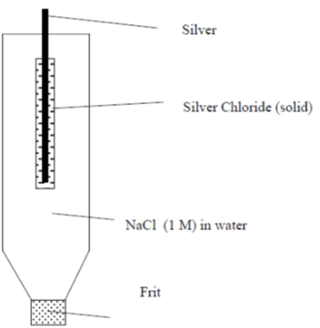
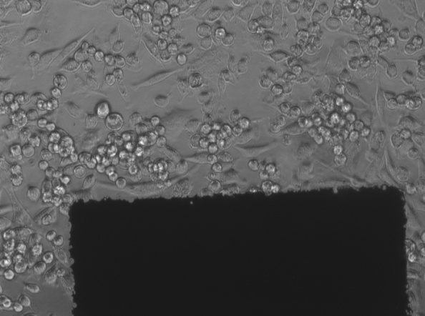
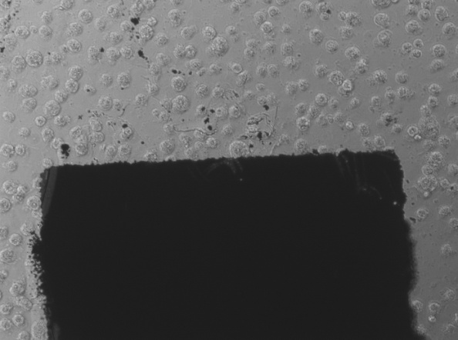
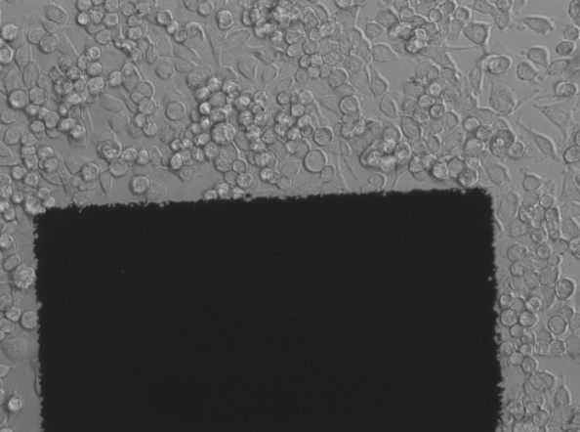
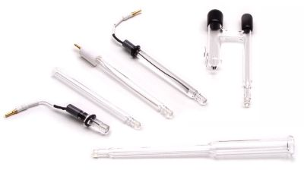
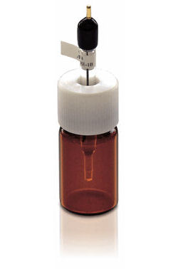
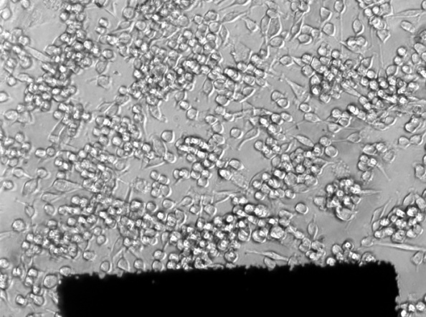
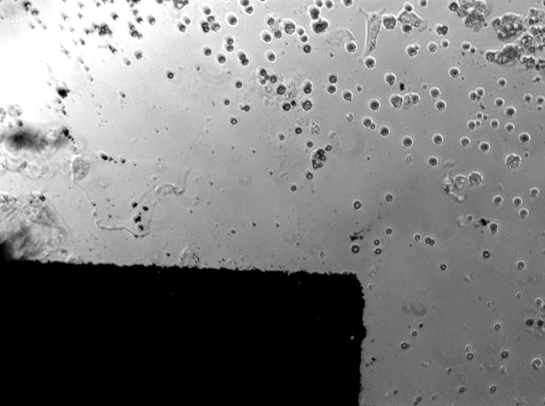
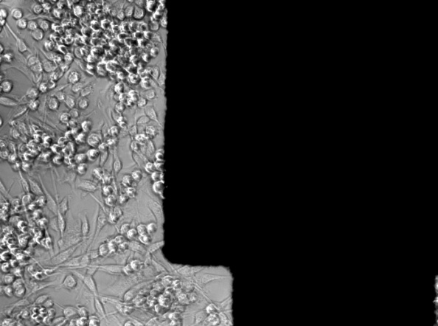
IrOx electrode as pseudo-RE
Regular RE
Why IrOx?
IrOx is used to sense pH. In the brain, pH slightly changes, so an IrOx electrode can be used as a pseudo-RE
IrOx is biocompatible (see slides in the Neuro-lecture)
Au
AgCl
IrOx
Day I
Day III

Slide 11
Lab 1 to do list
IrOx electrodes for pH measurement
pH calibration
Plot the curve and calculate the sensitivity
Neurotransmitter sensors
Either L-glutamate sensor or DA sensor with glass RE and IrOx pseudo-RE
Plot the curves
Calculate the sensitivity and the LOD

