Slide 1
EDC Apprentice - Work Topic Demonstration
Yash Vardhan Jaiswal
Apprentice
11/27/2025

Slide 2
1. My Current contribution To Relevant project/objective
2. Learning Before Coming To Project
3. Learning After Coming To Project
4. Key Learning And Methodologies applied.
5. My Tech Skill in Different Field
6. My Certifications
6. Conclusion and Q&A
Agenda:

Slide 3
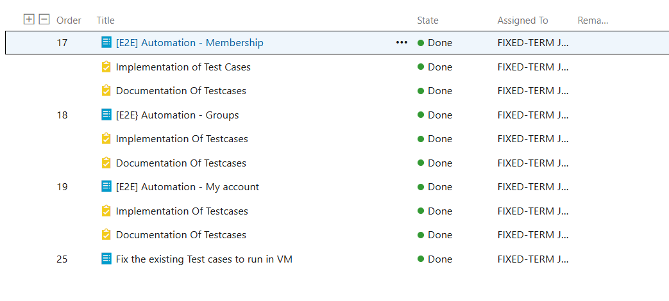
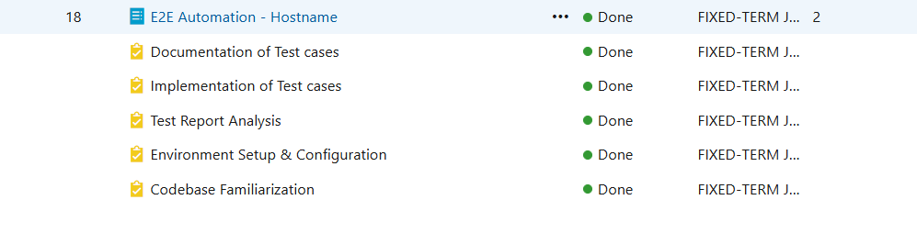
1. Tested Multiple Screen Functionality At LuxaOS Project Using Robot Framework With Selenium Library
Currently What I had Done In project

Slide 4
Learning Before Coming To Project (Training)
1. Core Java
2. Front-End Development – Angular
3. Back-End Development – Spring Boot
4. Junit Testing
5. Microservices Architecture

Slide 5
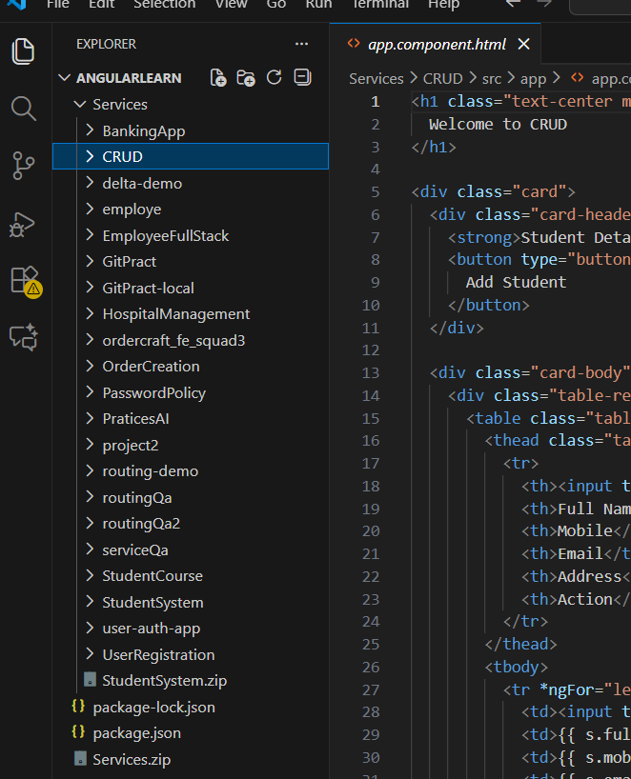
HandsOn Project
--By Using Angular Framework Only
1.Ordering System UI
2.Employee Service
3.Bus Ticket Booking App
4. CRUD Operations

Slide 6
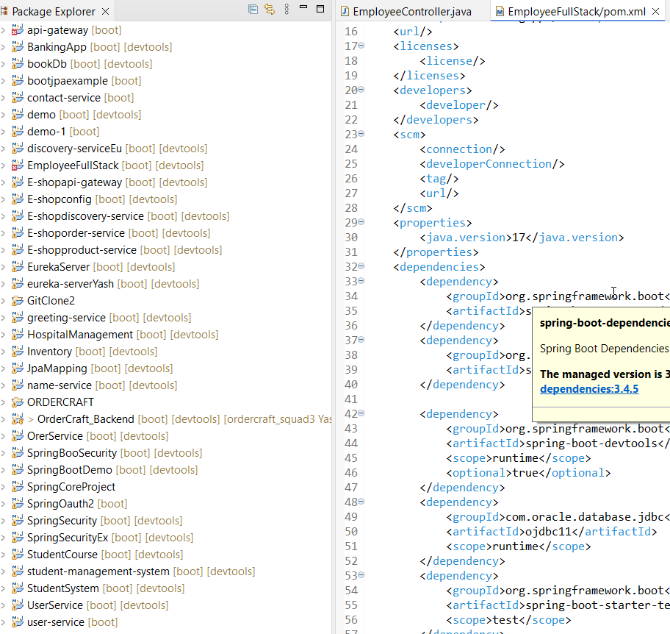
HandsOn Project
--By Using Spring Boot Framework Only – Backend
1.BookDb (Database with backend Storage Library)
2.Student Courses
3.Student Management System
4.Basic CRUD Operations

Slide 7
HandsOn Project
-- Full Stack Development
1.Banking App
2.Employee Management
3.Hospital Management
4.Student System

Slide 9
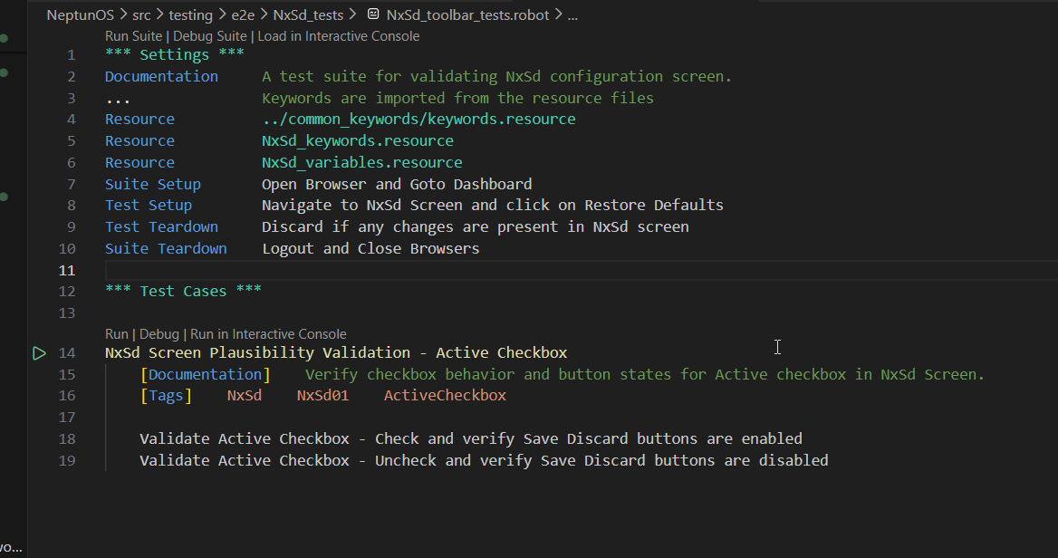
After Coming To Project – E2E Automations
1.Robot Framework Using Selenium Library

Slide 10
Key learnings and methodologies applied
1.Enhanced Testing Approach using Robot Framework
2. Real-Scenario Learning **
3. Improved test quality and reliability.
4.Reduce Manual Testing

Slide 11
My Contribution For Current Project
1.Developed and Enhanced UI Automation using Robot Framework
2.Significant Support in Bug Identification**
3.Practical Impact - Reduced manual testing efforts.
4.Improved test coverage by 90% and reliability

Slide 12
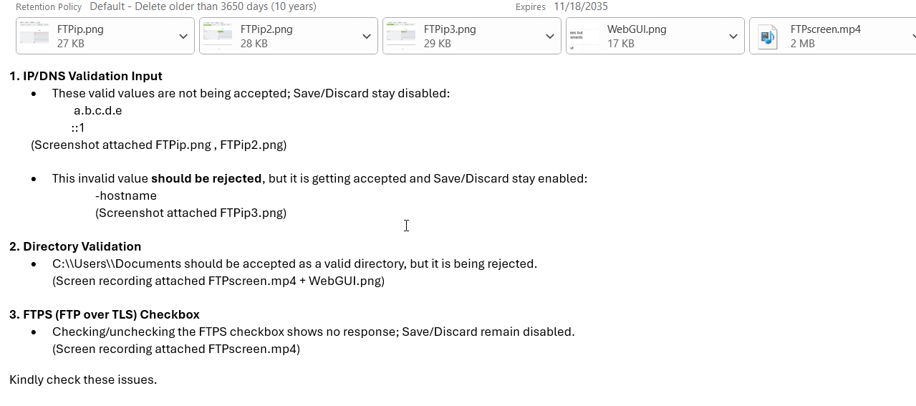
A Few Significant Bugs Identified During Testing

Slide 13
My Previous Learning Experience
AI / ML Certifications & Practical Implementations
----Key Projects Implemented
1. PDF Scanner & Text Extractor
2. Virtual AI Assistant
3. Smart Specs for Visually Impaired
Work Experience
1.Ericsson – on site
2.Robotic Engineer At EGB4 – on site

Slide 14
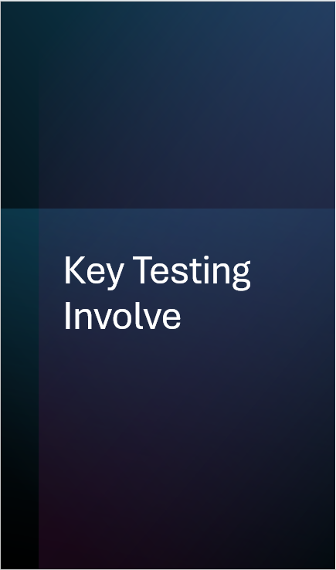

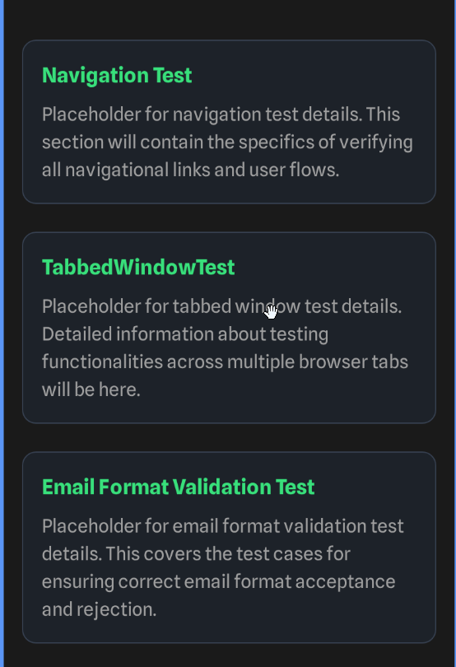
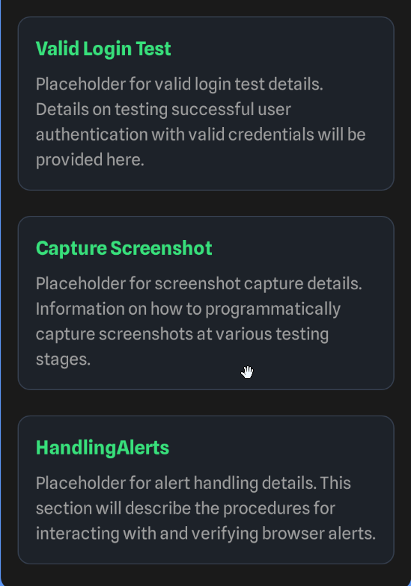

Slide 15
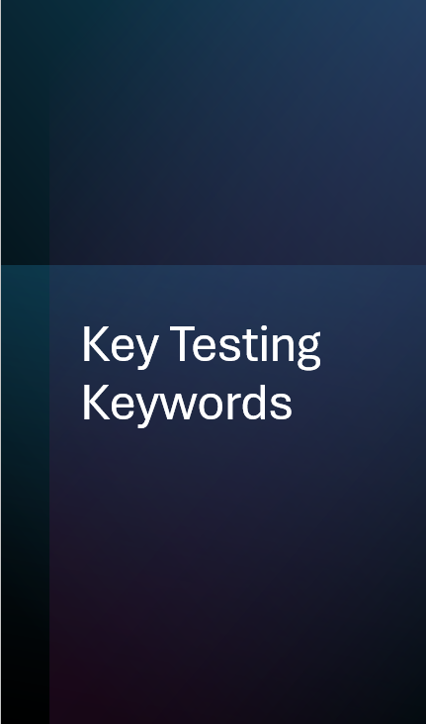
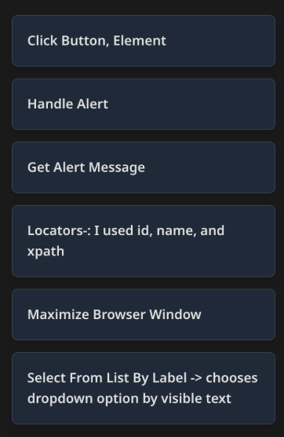
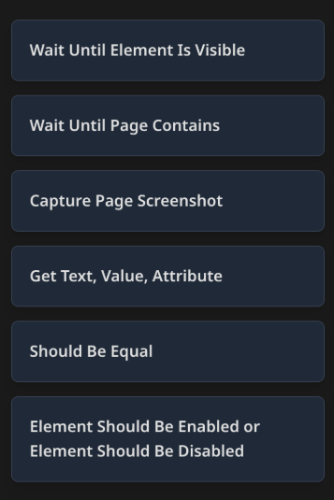

Slide 16
ThankYou

