Slide 1

CSCI E-25 Computer Vision
Attention and Transformers for Computer Vision
Steve Elston
Copyright 2022, 2023, Stephen F Elston. All rights reserved.

Slide 2
Attention and Transformers
Transformer architectures introduced a new generation of CV models
Attention is All You Need (Vaswani et.al. 2017) introduced the transformer architecture
Transformer architectures have revolutionized natural language processing
Transformers quickly adopted for CV
Alternative to CNNs
Wider spatial extent
Transformers build on multiple attention layers

Slide 3
Basics of Self-attention
Images of real-world scenes have a significant spatial extent
Convolutional operators used to create an embedding (latent) space have a small spatial extent – receptive field
As a result of only local sensitivity for complex scenes
Attention works across wide span
Jaterberg, et.al., 2016, applied transformer a algorithm to the spatial problem of images
Wang, et. al., 2018, develop a non-local neural network algorithm using a self-attention mechanism which gives superior performance for several tasks

Slide 4
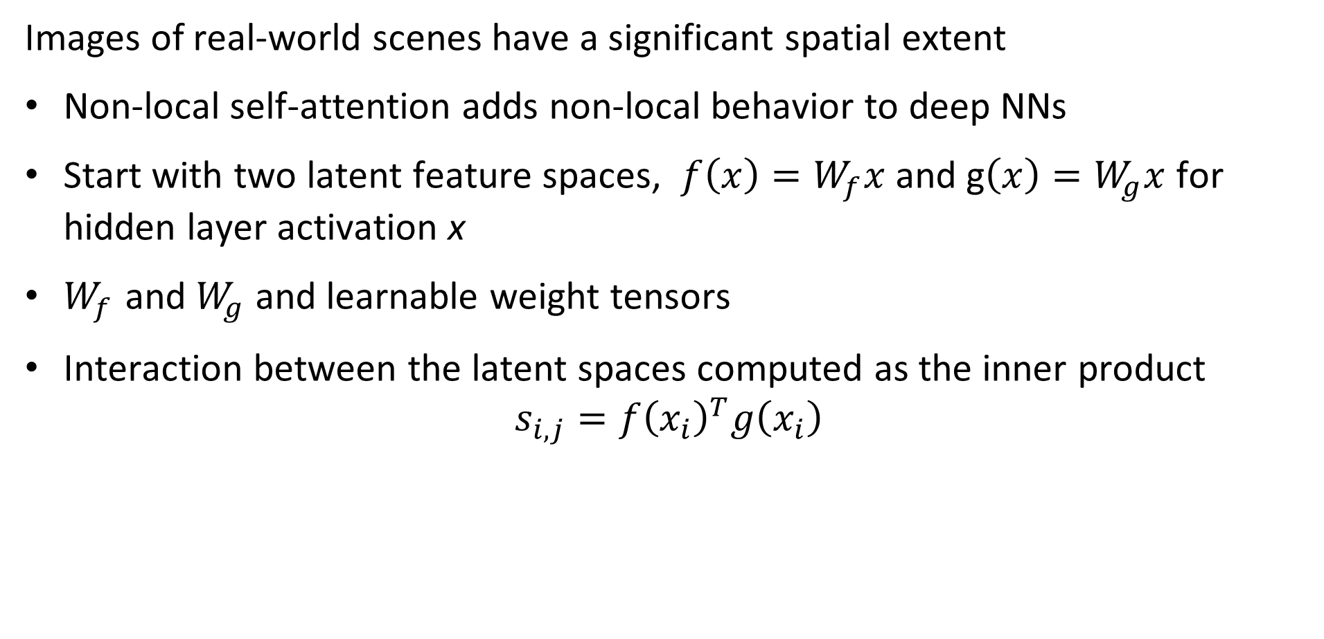
Basics of Self-Attention
Images of real-world scenes have a significant spatial extent
Non-local self-attention adds non-local behavior to deep NNs
Start with two latent feature spaces, $f\left(x\right)=W_{f}x$ and g$\left(x\right)=W_{g}x$ for hidden layer activation x
$W_{f}$ and $W_{g}$ and learnable weight tensors
Interaction between the latent spaces computed as the inner product
$$s_{i,j}={f\left(x_{i}\right)}^{T}g\left(x_{i}\right)$$

Slide 5
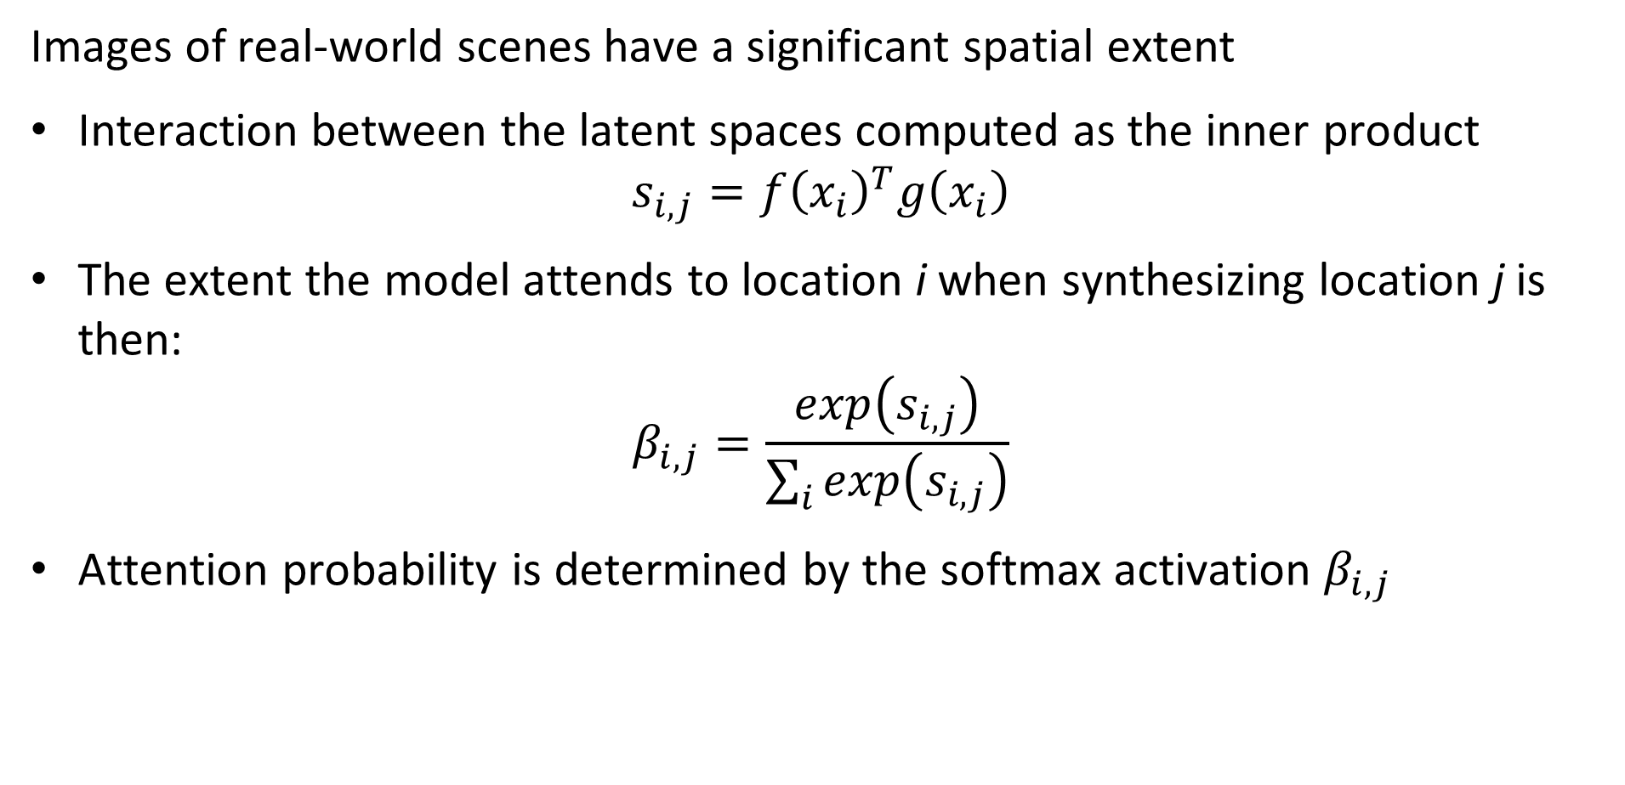
Basics of Self-Attention
Images of real-world scenes have a significant spatial extent
Interaction between the latent spaces computed as the inner product
$$s_{i,j}={f\left(x_{i}\right)}^{T}g\left(x_{i}\right)$$
The extent the model attends to location i when synthesizing location j is then:
$$β_{i,j}=\frac{exp\left(s_{i,j}\right)}{\sum_{i}{exp\left(s_{i,j}\right)}}$$
Attention probability is determined by the softmax activation $β_{i,j}$

Slide 6
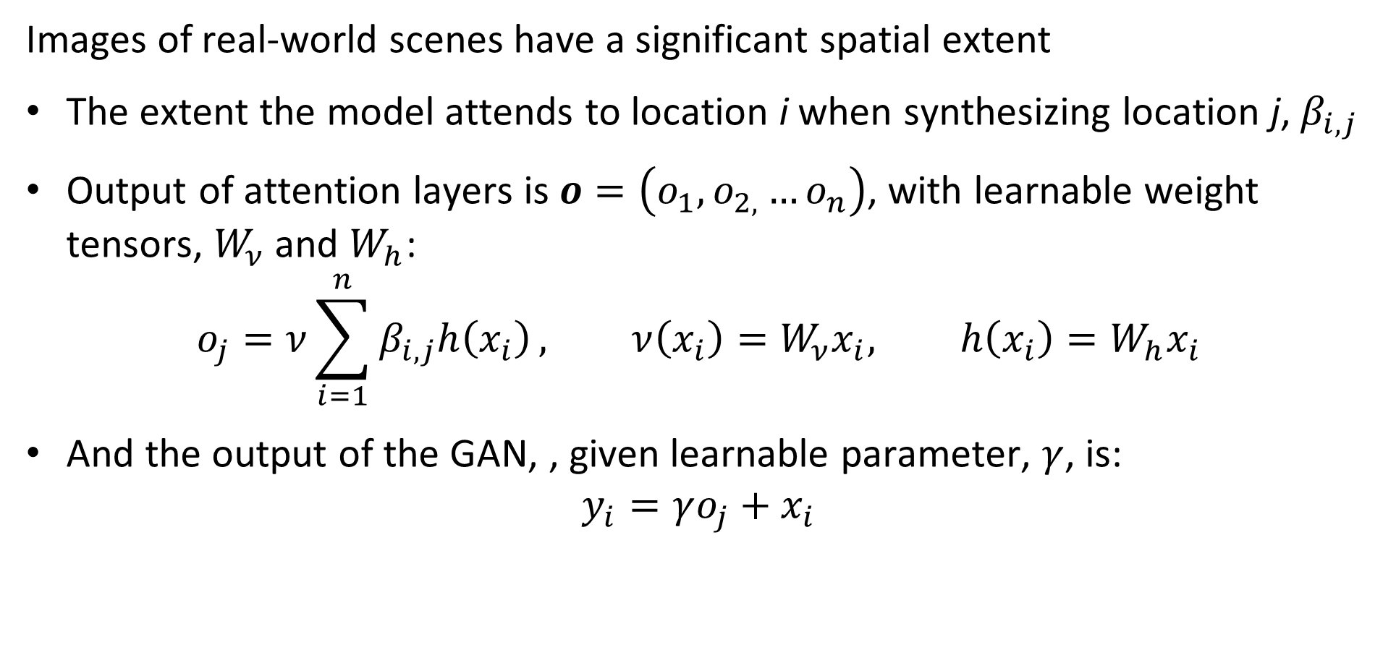
Self-attention GAN
Images of real-world scenes have a significant spatial extent
The extent the model attends to location i when synthesizing location j, $β_{i,j}$
Output of attention layers is $o=\left(o_{1},o_{2,}…o_{n}\right)$, with learnable weight tensors, $W_{ν}$ and $W_{h}$:
$$o_{j}=ν\sum_{i=1}^{n}{β_{i,j}h\left(x_{i}\right)}, ν\left(x_{i}\right)=W_{ν}x_{i}, h\left(x_{i}\right)=W_{h}x_{i}$$
And the output of the GAN, , given learnable parameter, $γ$, is:
$$y_{i}=γo_{j}+x_{i}$$

