Slide 1

CSCI E-25 Computer Vision
Convolutional Neural Networks and Feature Learning
Steve Elston
Copyright 2021, 2022, 2023, Stephen F Elston. All rights reserved.

Slide 2
Convolutional Neural Networks
Convolutional neural networks (CNNs) learn complex feature maps
Parameters of the feature maps are learned from the data
Features are learned by reducing the loss function
CNNs are a powerful alternative to constructing hand engineered features
Feature maps created by CNNs are rich and complex
Feature maps have many layers or channels
More complex feature maps have greater capacity
Almost always outperform hand-engineered features

Slide 3
Convolutional Neural Networks
CNNs learn complex feature maps
Invariant to translation and distortion of features
Reduce the dimensionality of input tensors
Share weights and are relatively easy to train
CNNs have a long history in CV
LeCun et. al. (1989) first employed CNNs for automatic check handling
Era of general use started when Krizhevsky et. al. (2012) won an ImageNet object recognition competition
Now commonly used for image problems

Slide 4
Convolutional Neural Networks
Representation
Inference
Input = X
Output = Y
Learning

Slide 5
Convolutional Neural Networks
Key points for this lesson
CNNs learn complex feature maps
Feature maps have many layers or channels
CNNs use parameter sharing
Pooling and invariance
Deeper CNNs create feature maps with higher capacity
Training very deep NNs with ResNets
Multi-scale architectures use parallel feature map paths

Slide 6
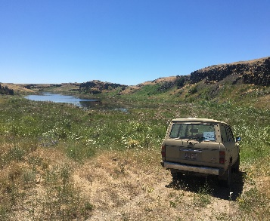
Convolutional Neural Networks
CNN creates feature map in inference pipeline
CNN
Flatten feature map
Inference
Input Image
Each of K output channels is a part of feature map
Classifier
NN
SVM
Etc.

Slide 7
Convolution in 2 and higher dimensions

Slide 8
2-D Convolution
Example:
4 x 4 input tensor
3 x 3 convolution operator
2 x 2 output tensor
Input
Output

Slide 9
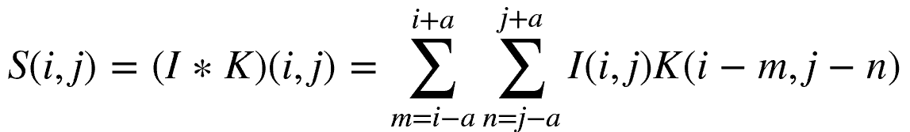
2-D Convolution
Mathematically, we express 2-d convolution as a weighted sum over a discrete rectangular kernel:
Where S, I and K are tensors:
I is the image tensor
K is the convolutional kernel tensor
S is the output tensor of the convolution operation

Slide 10
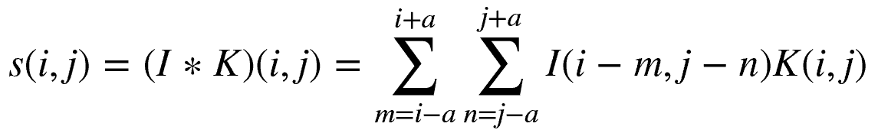
2-D Convolution
There is a more efficient way to perform convolution
The image and kernel tensors are commutative in the convolution relationship
This allows an operation known as kernel flipping with the following alternative result:
The operate over the indices of the image, I, rather than the kernel

Slide 11
Convolution in Higher Dimensions
Creating rich feature maps requires applying convolution to large multidimensional tensors
Tensor notation allows easy extension to higher dimensions
Input tensor has multiple input channels
3-D for color image
4-D for video
Create rich multiple channel feature maps
Convolution kernel tensor has multiple output channels
Each channel is a different feature map with different kernel weights
Features in a channel might be vertical lines, horizontal lines, corners, etc., but are often highly abstracted

Slide 12
Convolution in Higher Dimensions
Tensor of K output channels
Each channel is a part of feature map
Convolution kernel tensor
of K x L x Span x Span
weights
L input channels
i x j dimensions

Slide 13
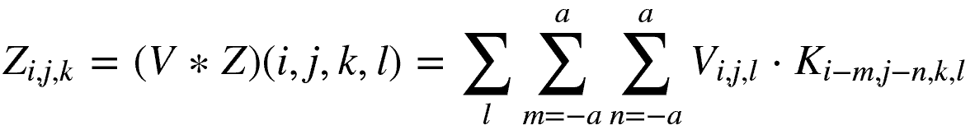
Convolution in Higher Dimensions
A multi-dimensional convolution relationship can be written:
Where:

Slide 14
Parameter Sharing

Slide 15
Parameter Sharing
The weights of the convolutional kernel are learned
Each weight of a fully connected network must be learned independently
CNNs are efficient to train, since fewer parameters
CNNs use parameter sharing
Statistical strength from more samples per weight
Reduced variance of parameter estimates
Weights are learned using backpropagation and gradient descent methods
Also called tied weights or sparse interaction

Slide 16
Parameter Sharing
Weights of fully connected network are independent
e.g. requires 5² = 25 weights

Slide 17
Parameter Sharing
Weights are shared in CNN
W₁
W₃
W₁
W₃
W₁
W₃
W₂
W₂
W₂
Requires 3 weights

Slide 18
Pooling and Invariance

Slide 19
Pooling and Invariance
Convolution provides reduced dimensionality of input tensor
How can we obtain greater reduction in dimensionality?
Pooling of convolution kernel output values reduces dimensionality
e.g. 2x2 operator pools 4 values into 1
How to pool?
Average pooling? Useful in some cases
Max pooling; simple and highly effective

Slide 20
Pooling and Invariance
Max pooling provides invariance to small shifts of the input tensor:
0.3
1.0
0.3
0.3
1.0
0.2
0.3
0.1
1.0
0.2
0.1
0.3
0.2
0.3
0.1
1.0
0.2
0.1
Original
Shift Right by One

Slide 21
Pooling and Invariance
Max pooling provides invariance to small shifts of the input tensor:
1.0
1.0
1.0
0.2
1.0
0.3
1.0
1.0
0.3
1.0
1.0
0.3
1.0
0.3
0.1
1.0
0.2
0.1
0.1
0.3
0.1
1.0
0.2
Original
Shift Right by One

Slide 22
Early CNN Example: LeNet5

Slide 23
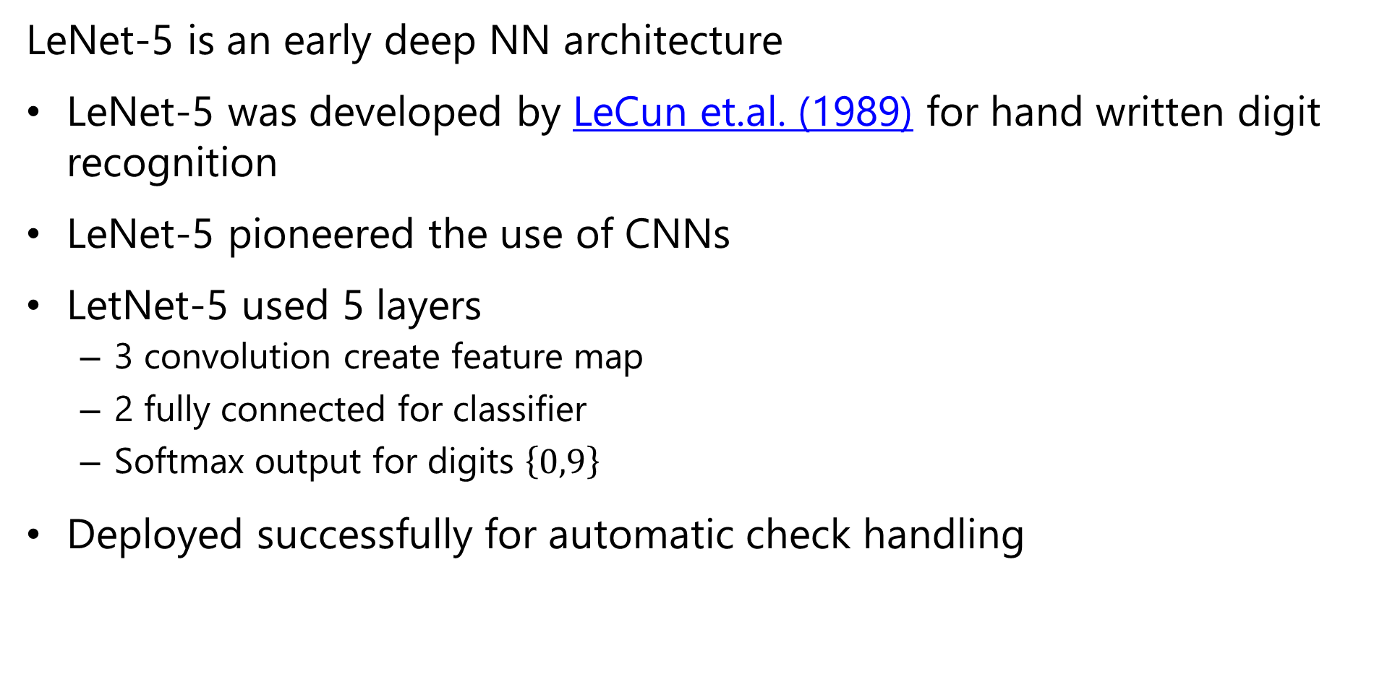
LeNet-5 Architecture
LeNet-5 is an early deep NN architecture
LeNet-5 was developed by LeCun et.al. (1989) for hand written digit recognition
LeNet-5 pioneered the use of CNNs
LetNet-5 used 5 layers
3 convolution create feature map
2 fully connected for classifier
Softmax output for digits $\left\{0,9\right\}$
Deployed successfully for automatic check handling

Slide 24
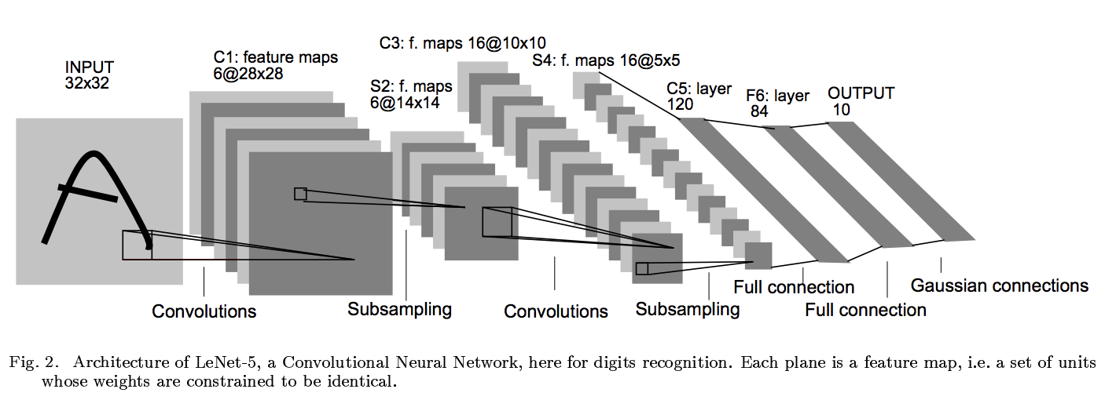
LeNet5: Imports
# import the necessary packages
from keras.models import Sequential
model = Sequential()

Slide 25
LeNet5: Input layer
# import the necessary packages
from keras.datasets import mnist
(x_train, y_train), (x_test, y_test) = mnist.load_data()

Slide 26
LeNet5: First convolution layer
model.add(Convolution2D(6, 5, 5,
border_mode="valid",
input_shape=(depth, height, width)))

Slide 27
LeNet5: First non-linear activation
from keras.layers.core import Activation
model.add(Activation(" sigmoid "))

Slide 28
LeNet5: First pooling layer
from keras.layers.convolutional import MaxPooling2D
model.add(MaxPooling2D(pool_size=(2, 2), strides=(2, 2)))

Slide 29
LeNet5: Second convolution layer
model.add(Convolution2D(16, 5, 5,
border_mode="valid"))

Slide 30
LeNet5: Second nonlinear activation
model.add(Activation(”sigmoid"))
Notes:
Mention again that sigmoid is a horrible idea, when you go deep.

Slide 31
LeNet5: Second pooling layer
model.add(MaxPooling2D(pool_size=(2, 2), strides=(2, 2)))
Notes:
Mention again that sigmoid is a horrible idea, when you go deep.

Slide 32
LeNet5: Third convolution layer
model.add(Convolution2D(120, 1, 1, border_mode='valid'))

Slide 33
LeNet5: Flattening layer – map multidimensional tensor to 1-d vector
from keras.layers.core import Flatten
model.add(Flatten())
Notes:
Mention again that sigmoid is a horrible idea, when you go deep.

Slide 34
LeNet5: First fully connected layer and activatio – the classifier
from keras.layers.core import Dense
model.add(Dense(84))
model.add(Activation("sigmoid"))

Slide 35
LeNet5: Second fully connected layer – 10 classes
model.add(Dense(10))

Slide 36
LeNet5: Softmax activation for 10-class classifier
model.add(Activation('softmax'))

Slide 37
Deeper Architectures

Slide 38
Deeper Architectures
Deeper architectures create richer feature maps
Rich feature maps have a high number of channels
Deep neural net architectures learn more powerful and abstracted features
Models trained on very large benchmark datasets
Generally, classification accuracy found to improve with depth
But, training deep networks is problematic

Slide 39
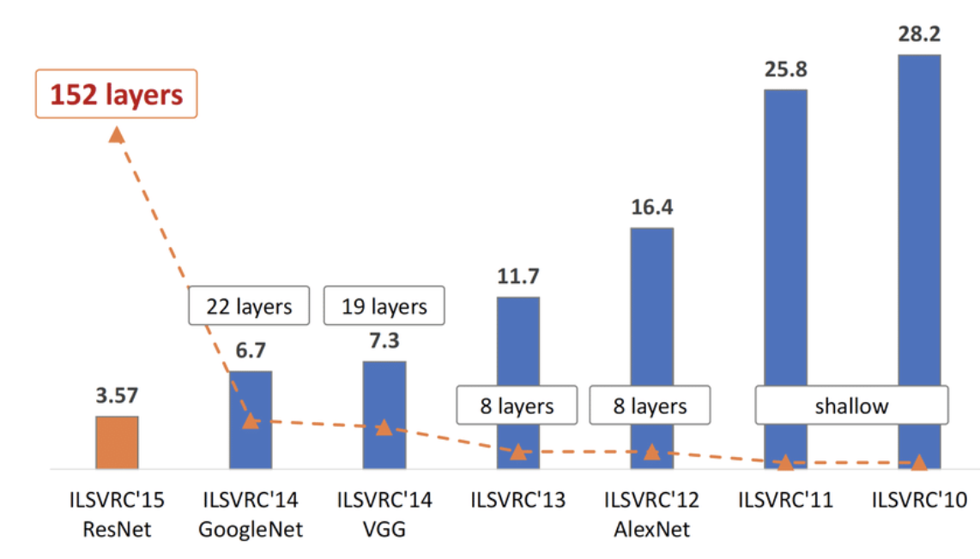
Deep Architectures
Introduction of deep architectures for the ImageNet Large Scale Visual Recognition challenge in 2012 marked a major advance in error rate
Subsequent improvements have resulted from deeper NNs
Similar improvements in object localization – we discuss this later

Slide 40
Deep and Multi-Scale Architectures
VGG11 - Simanyan and Zdisserman, 2015
Feature map channels Increasing with depth, decreasing dimensionality per channel
Max pool
Max pool
Max pool
1000 Fully connected
3x3 conv, 256 channel
3x3 conv, 128 channel
3x3 conv, 64 channel
3x3 conv, 256 channel
Max pool
3x3 conv, 512 channel
3x3 conv, 512channel
3x3 conv, 512 channel
3x3 conv, 512channel
4096 Fully connected
4096 Fully connected
Max pool
Softmax
Convolution and max-pool create feature map
Classifier layers use feature map

Slide 41
Training Very Deep Networks and ResNet

Slide 42
Deep and Multi-Scale Architectures
Very deep CNNs can provide significant improvements in accuracy
But, learning is hard in very deep networks

Slide 43
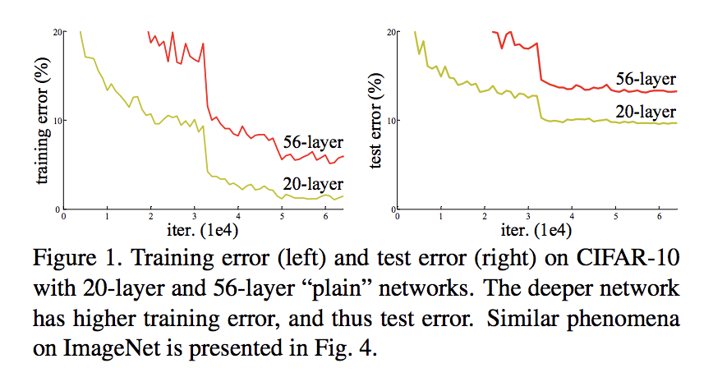
How Deep a Stack of Layers Can We Train
Try backpropagation to train deep NNs with larger number of layers:
Possible explanations for these results:
Vanishing gradients?
Exploding gradients?
Overfitting?
None of the above!
Vanishing gradients – batch normalization
Exploding gradients – gradient clipping
Overfitting – dropout regularization
From He, et.al., 2015

Slide 44
How Deep a Stack of Layers Can We Train
Possible explanations for these results:
The learning with backpropagation on stacked layers no longer learns useful features past a certain depth!
From He, et.al., 2015

Slide 45
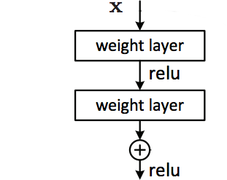


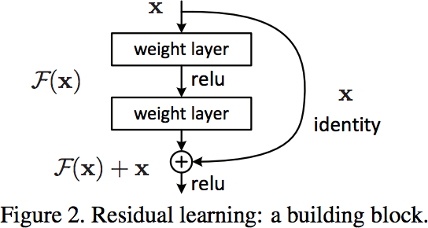
How Deep a Stack of Layers Can We Train?
Ideally a subset of stacked layers learns a nonlinear function,
Alternatively, learn a residual function
Rearrange terms to find the residual mapping function
Layers now have an identity shortcut
From He, et.al., 2015

Slide 46
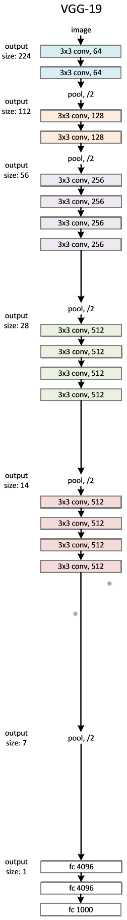
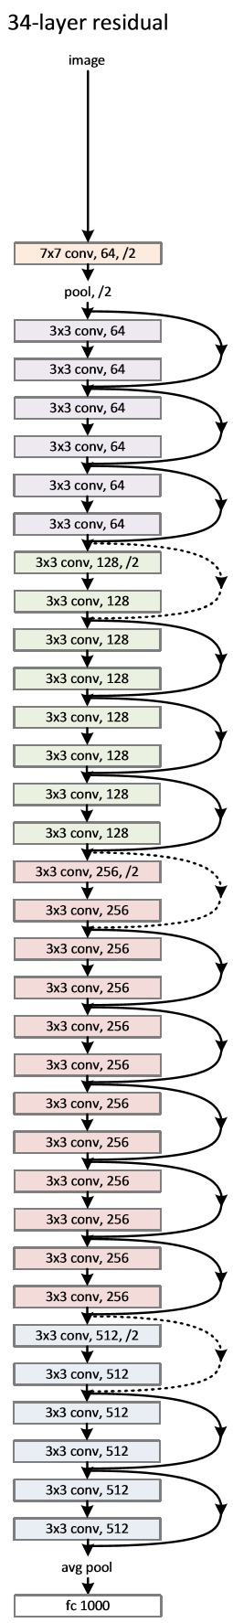
ResNet Representation with Residuals
Start with VGG19 architecture
34 stacked layer network – poor training characteristics
34 layer ResNet with identity shortcuts
From He, et.al., 2015

Slide 47
ResNet Representation with Residuals
How does computational complexity compare?
Notice ResNet has only 2 max pooling filters!
Forward propagation with VGG19 requires 19.6 B Floating Point Operations (GFLOPs)
Forward propagation with ResNet-34 requires 3.6 GFLOPs!
From He, et.al., 2015

Slide 48
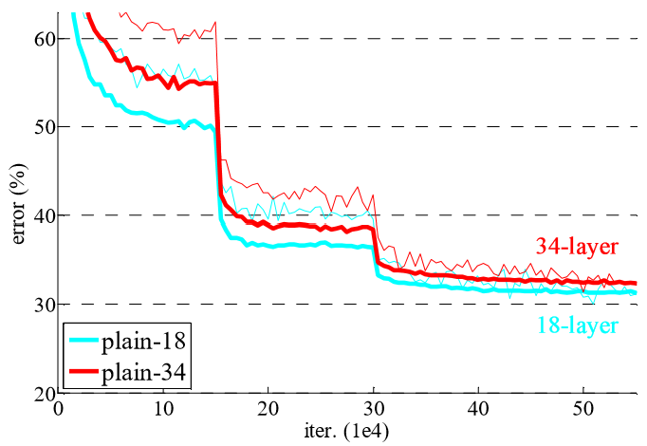
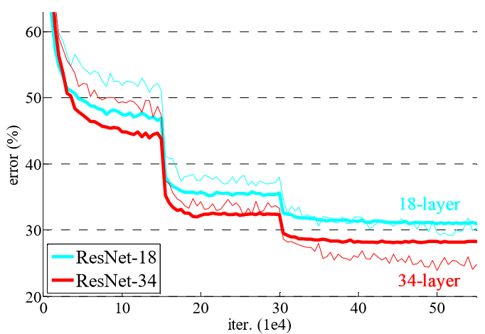
ResNet Representation with Residuals
How well does ResNet work?
18 and 34 layers stacked network performance
18 and 34 layer ResNets
From He, et.al., 2015

Slide 49
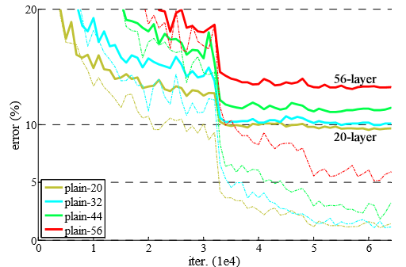
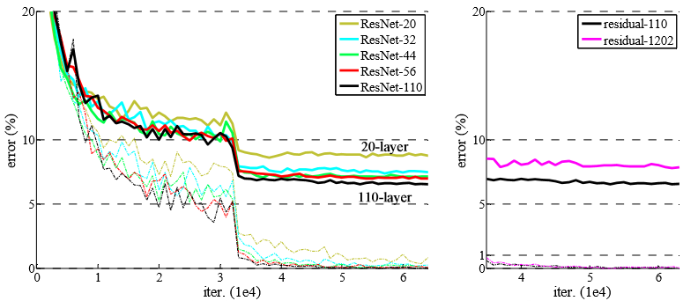
ResNet Representation with Residuals
What are the limits of ResNet Learning?
Compare stacked network performance drops past about 20 layers
ResNets allow greater depth and accuracy, but with limits!
From He, et.al., 2015

Slide 50
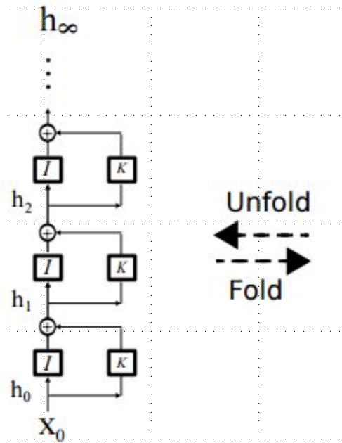
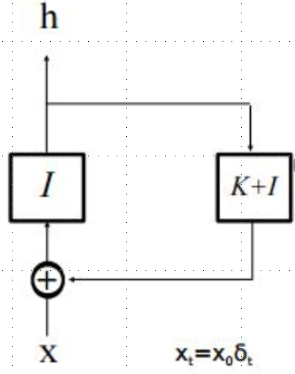
Why do ResNets work?
What makes learning easier for ResNets?
Start with ResNet feed-forward layers
Now, unroll the recurrence for several learning steps
Learning in the unrolled model resembles ensemble learning
From He, et.al., 2015

Slide 51
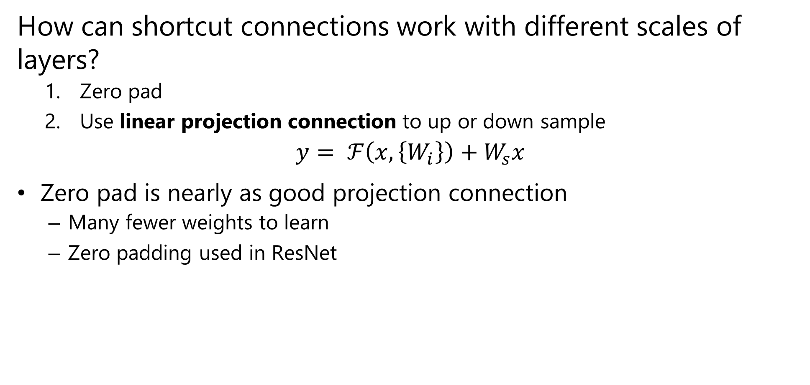
Scaling and ResNets
How can shortcut connections work with different scales of layers?
Zero pad
Use linear projection connection to up or down sample
$$y= ℱ\left(x,\left\{W_{i}\right\}\right)+W_{s}x$$
Zero pad is nearly as good projection connection
Many fewer weights to learn
Zero padding used in ResNet

Slide 52
Multi-Scale Architectures

Slide 53
Multi-Scale Architectures
How can convolutional layers be expanded to multiple scales
Single convolutional layers work at single scale
But, real-world images contain objects with different scales
Need architecture that supports multiple scales
CNN layers with different scales in parallel
Concatenate the results
Numerous pretrained models, using complex architectures, are now available
Trained on very large benchmark datasets
Built into deep learning frameworks; Keras, PyTorch, etc.

Slide 54
Example: Multi-Scale Architecture
Xception
Chollet, 2017
Input tensor
1x1 Conv
Ave Pool
1x1 Conv
1x1 Conv
3x3 Conv
3x3 Conv
3x3 Conv
3x3 Conv
Concatenated multi-scale feature map

Slide 55
Interactions Between Channels
Squeeze and Expand Layers

Slide 56
Why Squeeze and Expand Layers?
In CNNs convolutional operators applied independently to channels
CNN model ignores possible interaction between feature maps in channels
Squeeze and excitation (SE) layers model interactions between channels
Squeeze aggregates information from each channel of the feature map
Excitation creates weights to emphasize important aspects of the feature map

Slide 57
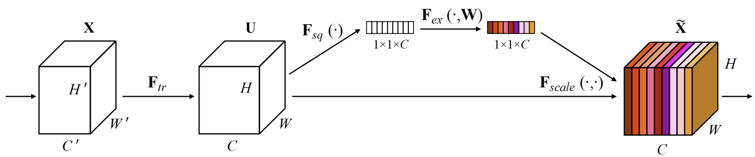
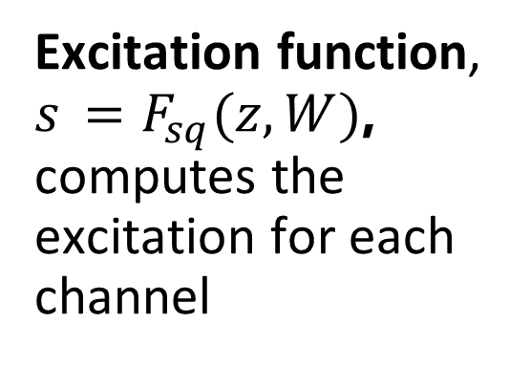
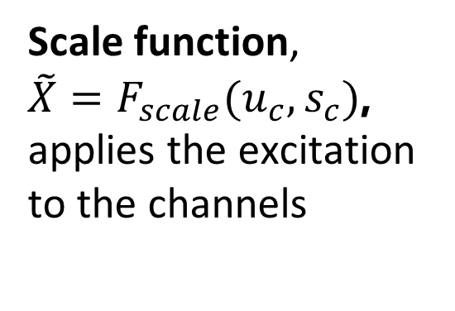
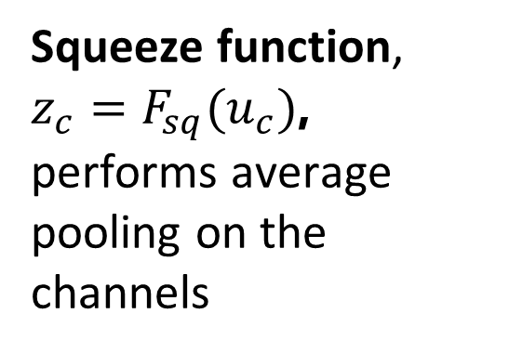
Why Squeeze and Expand Layers?
Squeeze and expand (SE) layers model interactions between channels
Excitation function, $s_{ }=F_{sq}(z,W)$, computes the excitation for each channel
Scale function, ${\tilde{X}=F}_{scale}(u_{c},s_{c})$, applies the excitation to the channels
Squeeze function, $z_{c}=F_{sq}(u_{c})$, performs average pooling on the channels
From Hu, et.al., 2019

Slide 58
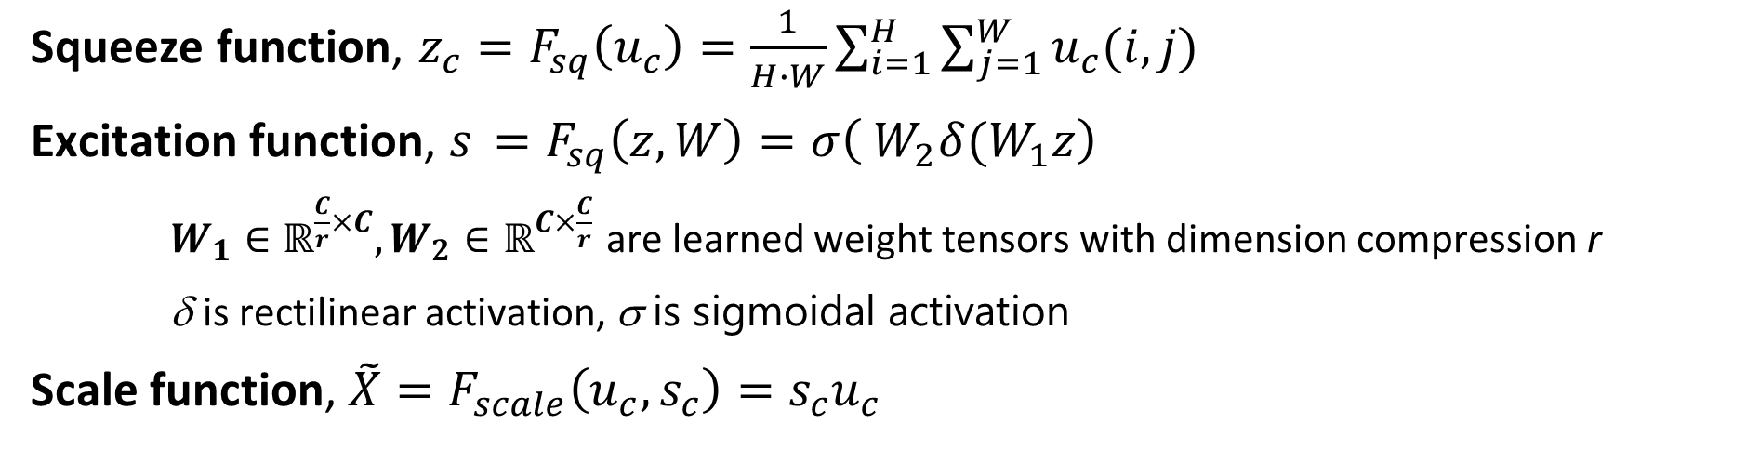
Why Squeeze and Expand Layers?
Squeeze and expand (SE) layers model interactions between channels
Squeeze function, $z_{c}=F_{sq}\left(u_{c}\right)=\frac{1}{H∙W}\sum_{i=1}^{H}{\sum_{j=1}^{W}{u_{c}(i,j)}}$
Excitation function, $s_{ }=F_{sq}\left(z,W\right)=σ\left( W_{2}δ(W_{1}z\right)$
$W_{1}∈ℝ^{\frac{C}{r}×C},W_{2}∈ℝ^{C×\frac{C}{r}}$ are learned weight tensors with dimension compression r
δ is rectilinear activation, σ is sigmoidal activation
Scale function, ${\tilde{X}=F}_{scale}\left(u_{c},s_{c}\right)=s_{c}u_{c}$
From Hu, et.al., 2019

Slide 59
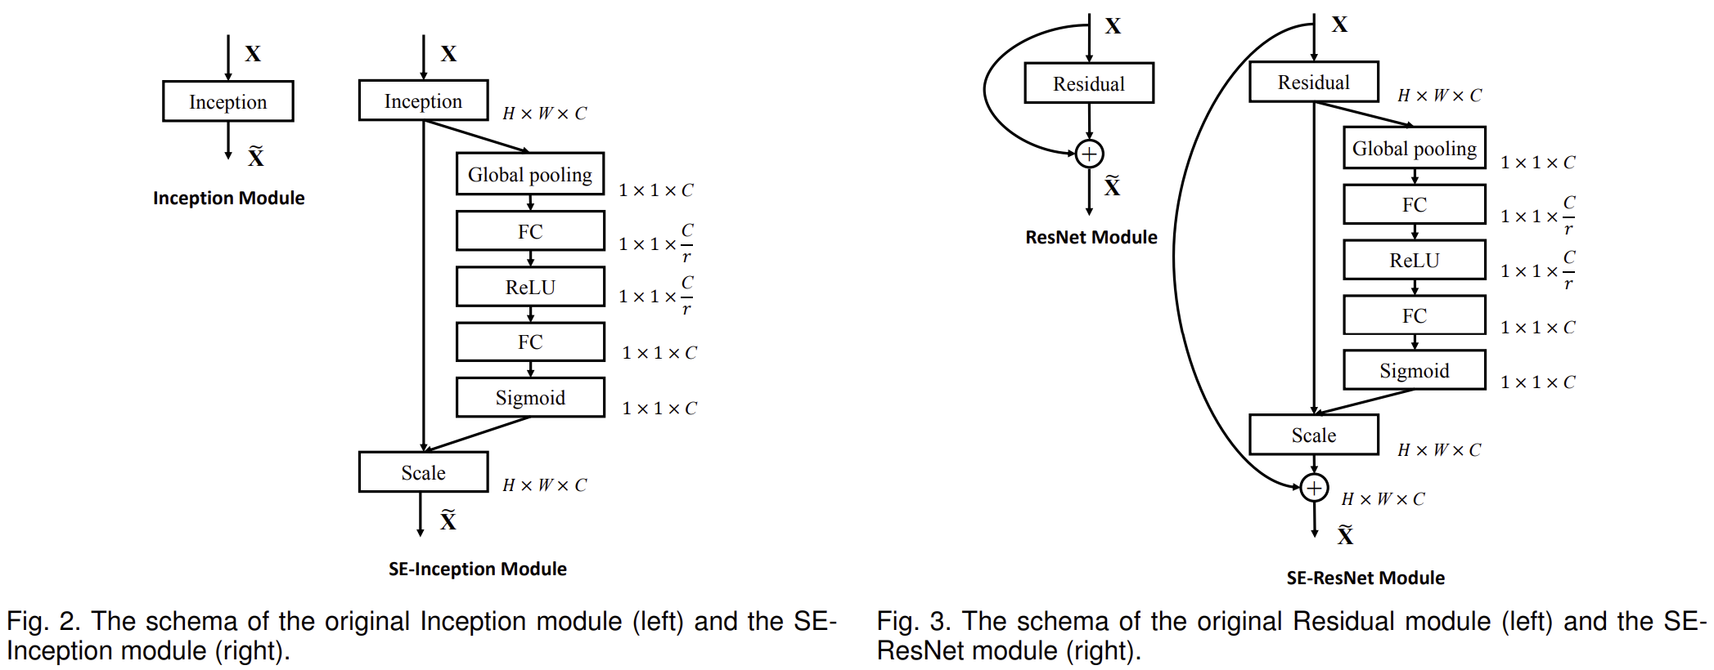
Integrate SE Layers with CNN Architectures
From Hu, et.al., 2019

Slide 60
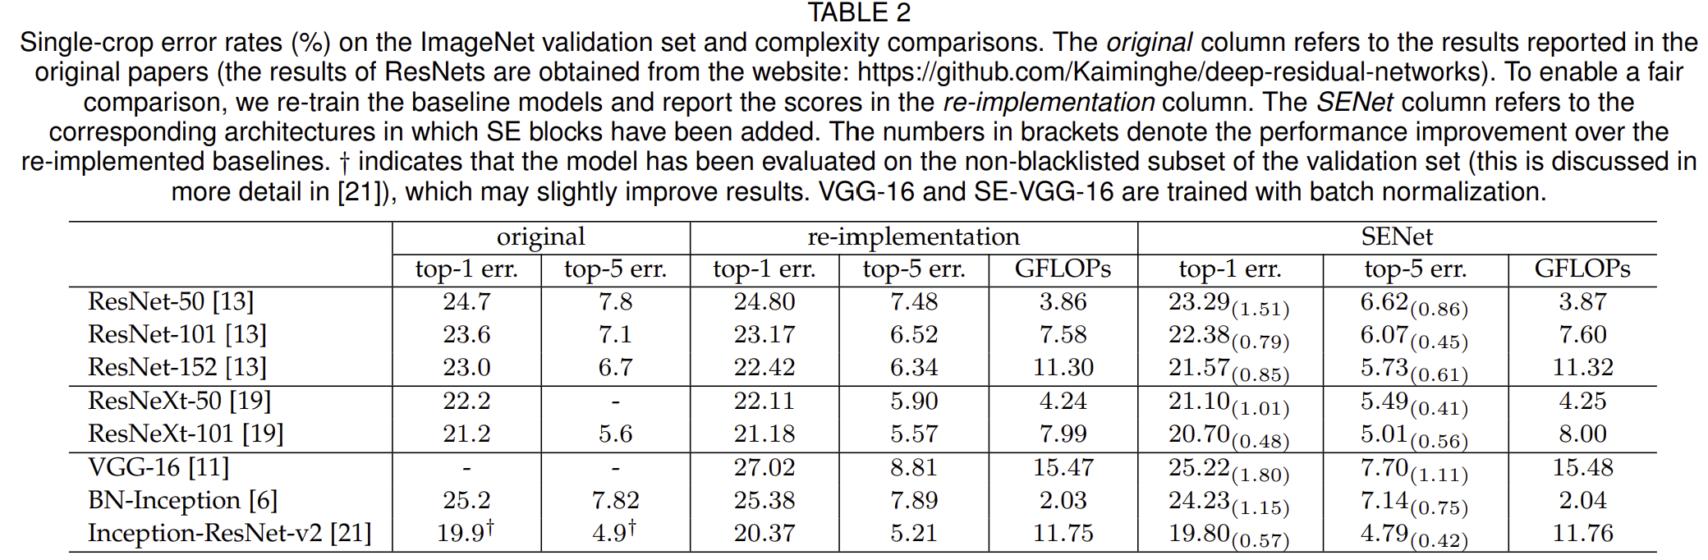
How Much Does SE Help?
From Hu, et.al., 2019

Slide 61
Scaling and EfficientNet

Slide 62
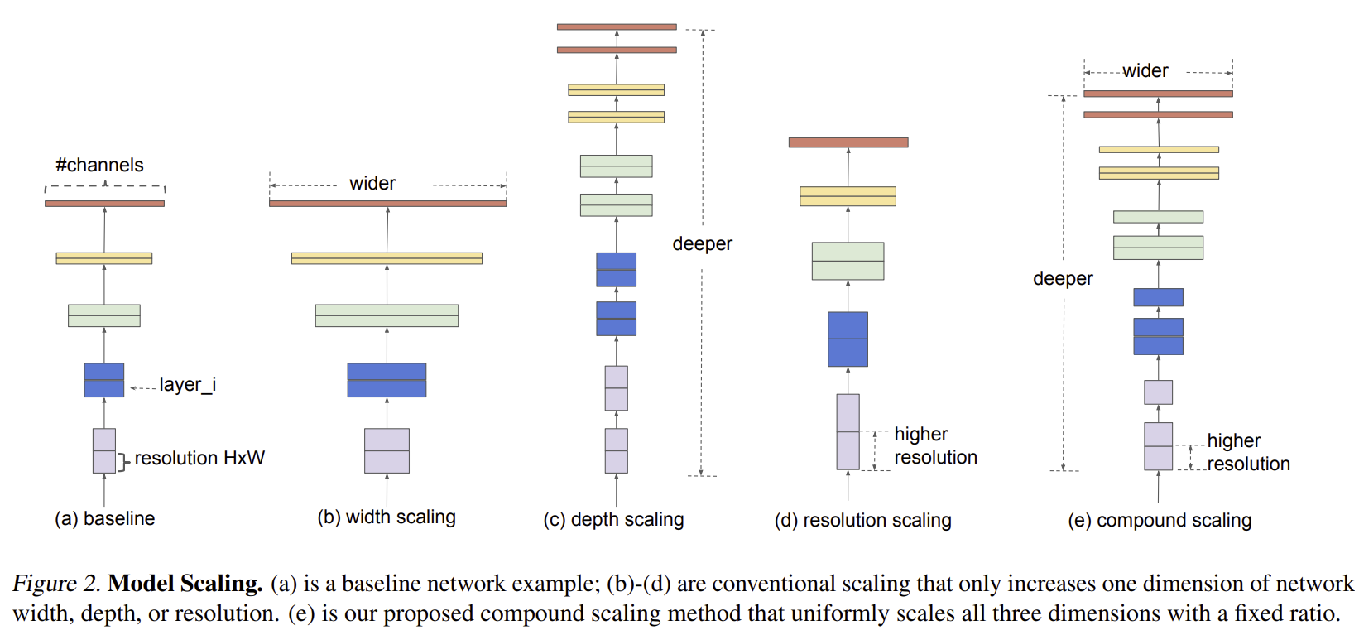
How Can We Scale Deep CNNs
Are three dimensions we can scale CNN to improve accuracy
Width – Channels
Depth – number of layers
Resolution – Hight and width
From Tan and Le, 2020

Slide 63
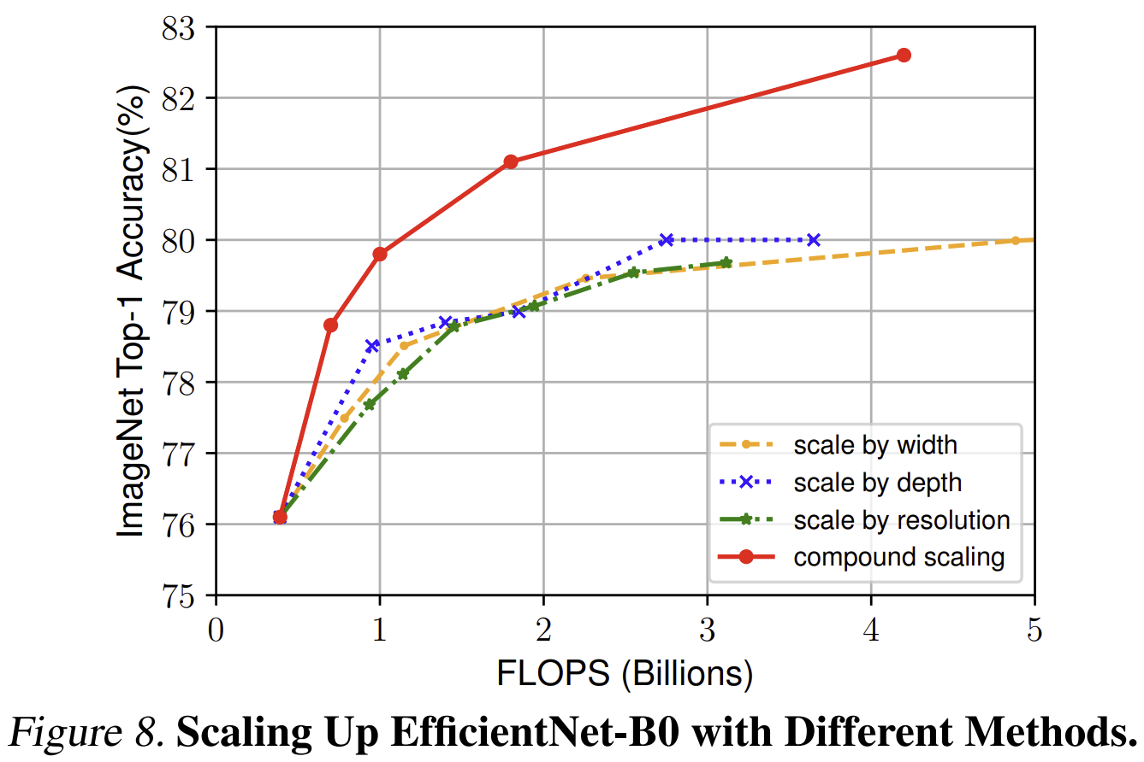
How Can We Scale Deep CNNs
Are three dimensions we can scale CNN to improve accuracy
Width – Channels
Depth – number of layers
Resolution – Hight and width
From Tan and Le, 2020

Slide 64
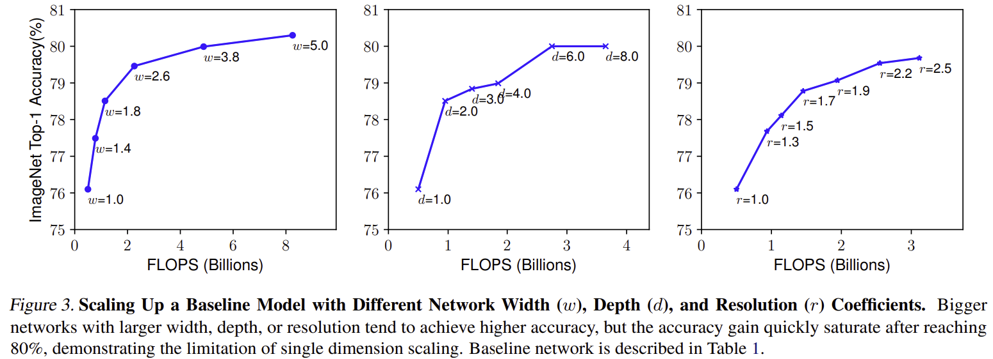
How Can We Scale Deep CNNs
Limits on all 3 dimensions of scaling
Width – Channels
Depth – number of layers
Resolution – Hight and width
From Tan and Le, 2020

Slide 65
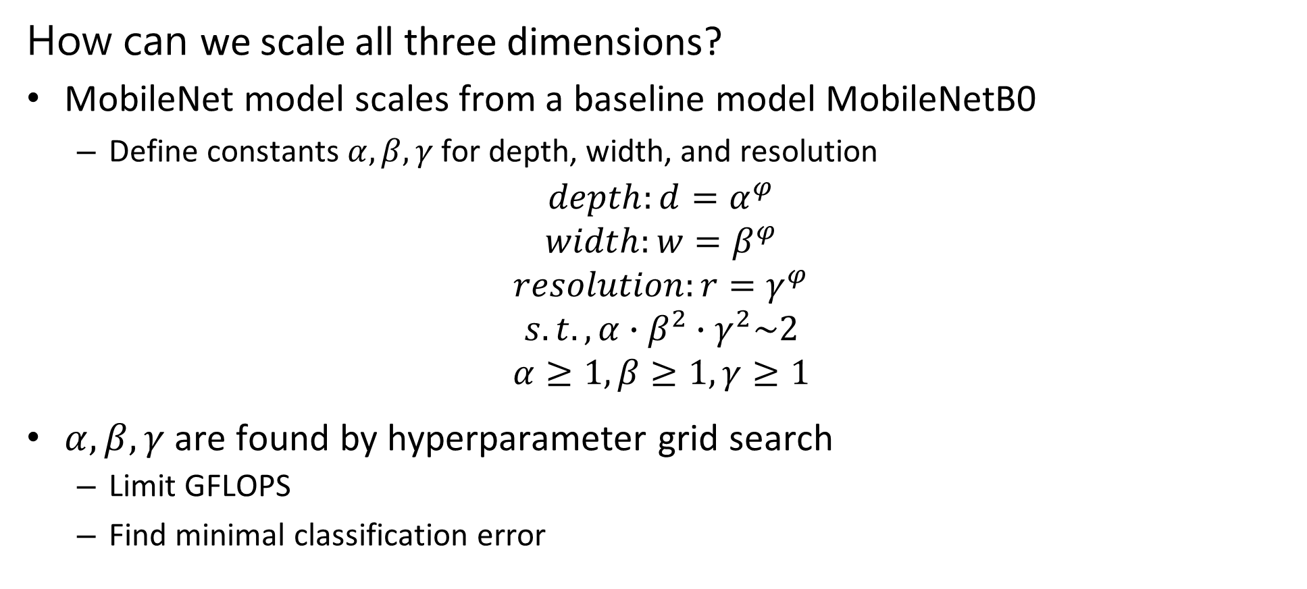
How Can We Scale Deep CNNs
How can we scale all three dimensions?
MobileNet model scales from a baseline model MobileNetB0
Define constants $α,β,γ$ for depth, width, and resolution
$$depth:d=α^{φ}$$
$$width:w=β^{φ}$$
$$resolution:r=γ^{φ}$$
$$s.t., α∙β^{2}∙γ^{2}\sim 2$$
$$α≥1,β≥1,γ≥1$$
$α,β,γ$ are found by hyperparameter grid search
Limit GFLOPS
Find minimal classification error

Slide 66
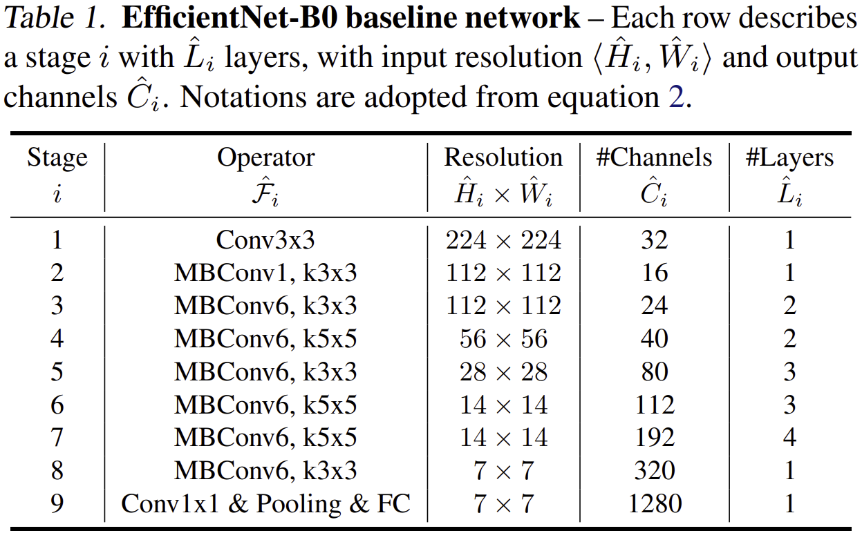
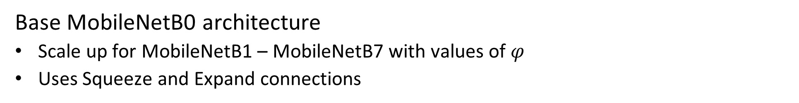
How Can We Scale Deep CNNs
Base MobileNetB0 architecture
Scale up for MobileNetB1 – MobileNetB7 with values of $φ$
Uses Squeeze and Expand connections
From Tan and Le, 2020

Slide 67
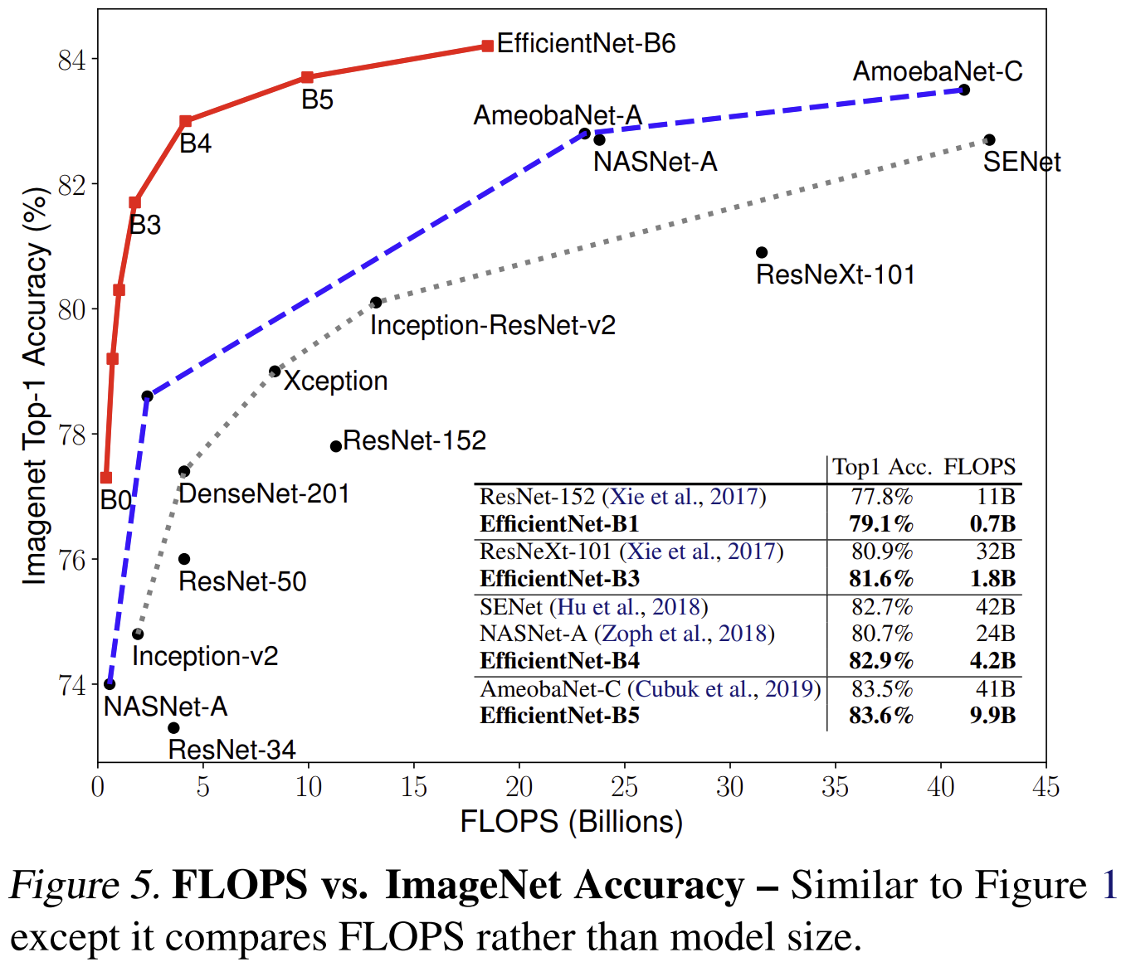
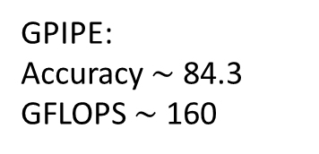
How Can We Scale Deep CNNs
EfficientNet is a significant improvement in scaling CNNs
Compare to hand-engineered scaling
GPIPE:
Accuracy $\sim$ 84.3
GFLOPS $\sim$ 160
From Tan and Le, 2020

Slide 68
Transfer Learning

Slide 69
Transfer Learning
Transfer learning transfers the training of deep NNs from one problem to another
Large scale models are trained on massive data sets
For example see the pretrained models available in Keras
The pre-trained models often learn considerable general information which applies to other situations
Edges, corners, etc.
Textures and colors
An example of using a pretrained MobileNet model in Kares, including data augmentation
Assignment 7 used pretraining on EfficientNet B0

Slide 70
Transfer Learning
Pretrained backbone network
creates feature map
Task-specific head
CNN
Inference
Input Image
Each of K output channels is a part of feature map
Classification
Object detection
Semantic segmentation
Etc.

Slide 71
Transfer Learning
Transfer learning work flow
Start with pre-trained backbone with frozen weights
Trained on large datasets
Add untrained task-specific head (top)
Train task-specific head using task-specific dataset
Feature map from pre-trained backbone
Unfreeze backbone weights and fine-tune all weights using task-specific dataset
Both backbone and head weights fine-tuned
Feature map can become more task-specific

Slide 72
Transfer Learning
Transfer learning exploits learning of backbone trained with similar data
Transfer learning can greatly speed learning for specific solutions
Fine tune not
just head but
backbone
Train task specific head
Size of Data
Train Model
From Scratch,
Expect limited
results
Train task specific head
Fine tune backbone
Data Similarity
Notes:
Data small but similar. Can’t fine tune, we will overfit. Just learn the top layers using a linear classifier.
Data large and similar. No concern with overfitting. Fine tune the whole network.
Data small and not similar. Overfitting problems if we were to finetune the whole network. Data not similar, so only earlier filters are applicable, not the later ones. Fine tune from somewhere in the middle.

Slide 73
Transfer Learning
Freeze weights
One possible transfer learning workflow
Workflow must fit problem!
First test is model is adequate as is
If not, try tuning the classifier alone – feature map frozen
Finally tune convolutional and classifier layers together if required
Is performance Adequate?
Yes
Done
Unfreeze weights classifier weights only
Tune classifier weights
Is performance Adequate?
Yes
Done
Unfreeze all weights
Tune model
Done
Notes:
Data small but similar. Can’t fine tune, we will overfit. Just learn the top layers using a linear classifier.
Data large and similar. No concern with overfitting. Fine tune the whole network.
Data small and not similar. Overfitting problems if we were to finetune the whole network. Data not similar, so only earlier filters are applicable, not the later ones. Fine tune from somewhere in the middle.

Slide 74
Transfer Learning
Transfer learning: example using learned feature map
from tensorflow.keras.applications import EfficientNetB0
inputs = layers.Input(shape=(IMG_SIZE, IMG_SIZE, 3))
x = img_augmentation(inputs)
model = EfficientNetB0(include_top=False, input_tensor=x,
weights="imagenet")
# Freeze the pretrained feature map
model.trainable = False
# Rebuild top by training output classifier layers on specific dataset
x = layers.GlobalAveragePooling2D(name="avg_pool")(model.output)
x = layers.BatchNormalization()(x)
top_dropout_rate = 0.2
x = layers.Dropout(top_dropout_rate, name="top_dropout")(x)
outputs = layers.Dense(NUM_CLASSES, activation="softmax", name="pred")(x)
Notes:
Data small but similar. Can’t fine tune, we will overfit. Just learn the top layers using a linear classifier.
Data large and similar. No concern with overfitting. Fine tune the whole network.
Data small and not similar. Overfitting problems if we were to finetune the whole network. Data not similar, so only earlier filters are applicable, not the later ones. Fine tune from somewhere in the middle.

Slide 75
Data Augmentation

Slide 76
Data Augmentation
Data Augmentation applies a collection of methods to the generation of new labelled training examples
Generative models create new cases given randomized input
Generate completely new cases with known labels
Complex to create and evaluate
Transformation of existing cases
Can apply one or more transformations to create unique cases

Slide 77
Data Augmentation
A few image transformation examples
Projective transforms: rotation, translation, scale..
Resampling and cropping – random patches, crop left, crop right
Flip image right to left – mirror images
Blurring filters – e.g. Gaussian filter
Color – Change intensity ratio of color channels
Random noise – add random noise to one or more color channels
Combine several of the above….
Etc….

Slide 78
Data Augmentation
Keras/TensorFlow supports data augmentation
Example, of augmentation
from tensorflow.keras.models import Sequential
from tensorflow.keras import layers
img_augmentation = Sequential([
layers.RandomRotation(factor=0.15),
layers.RandomTranslation(height_factor=0.1,
width_factor=0.1),
layers.RandomFlip(),
layers.RandomContrast(factor=0.1),
],
name="img_augmentation",)

Slide 79
Summary
Key points for this lesson
CNNs learn complex feature maps
Feature maps have many layers or channels
CNNs use parameter sharing
Pooling and invariance
Deeper CNNs create feature maps with higher capacity
Training very deep NNs with ResNets
Multi-scale architectures use parallel feature map paths
Speed training with transfer learning

