Slide 1
Trion ARPES

Slide 2
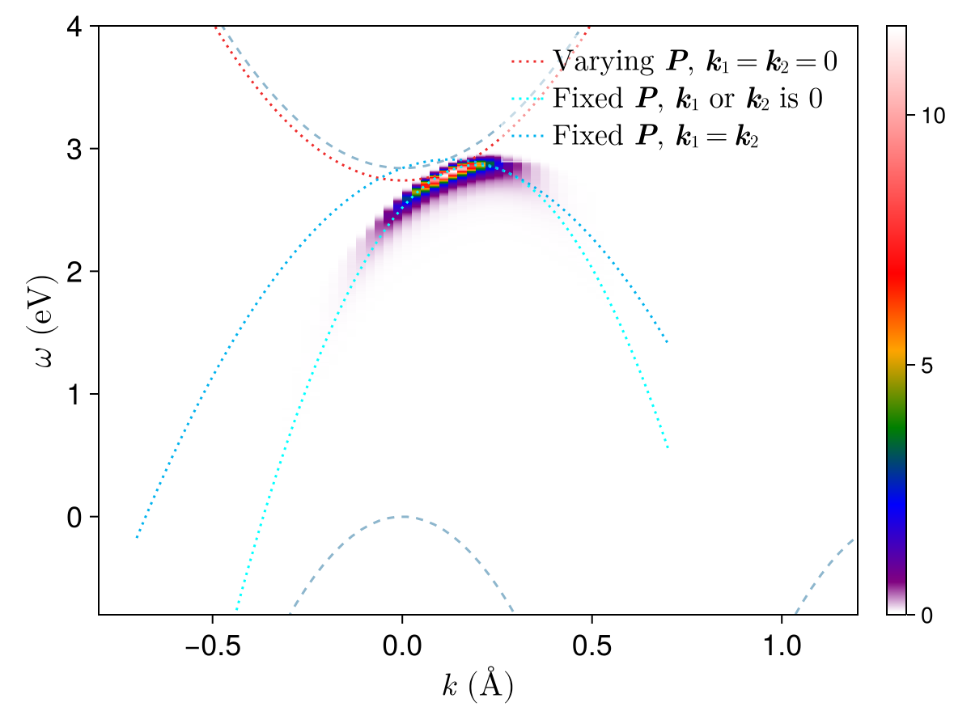
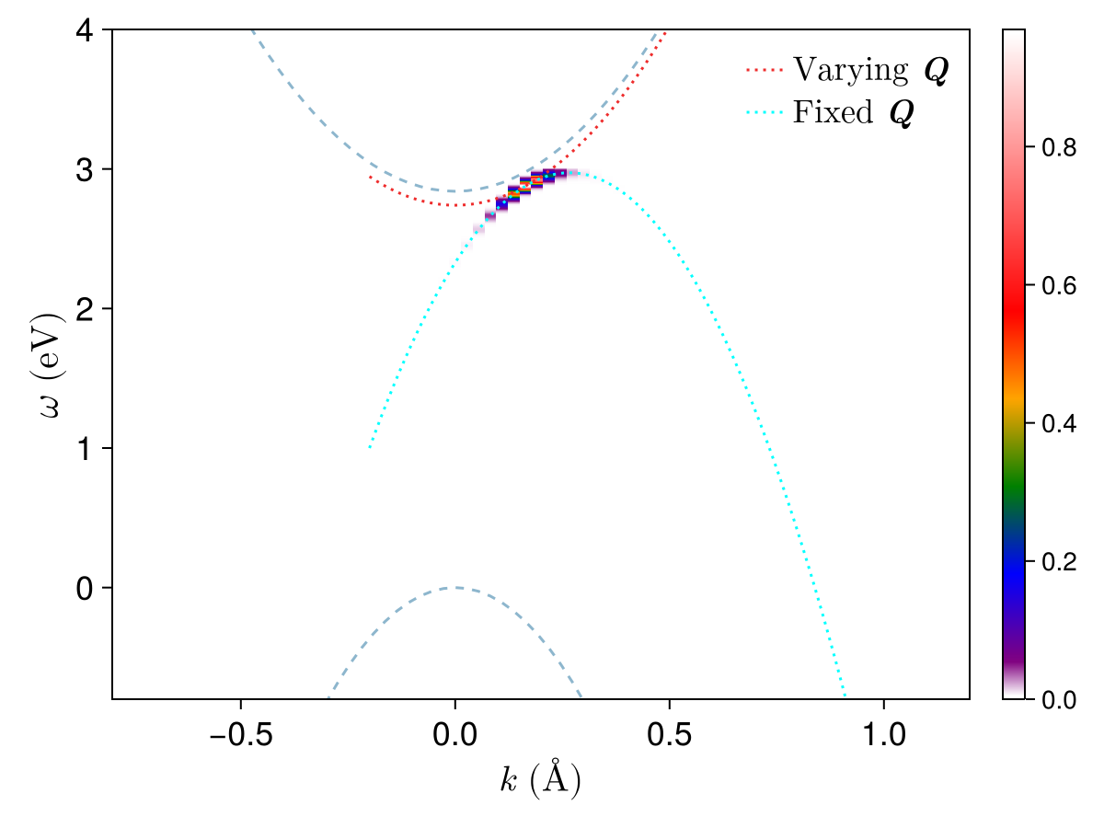

Slide 3
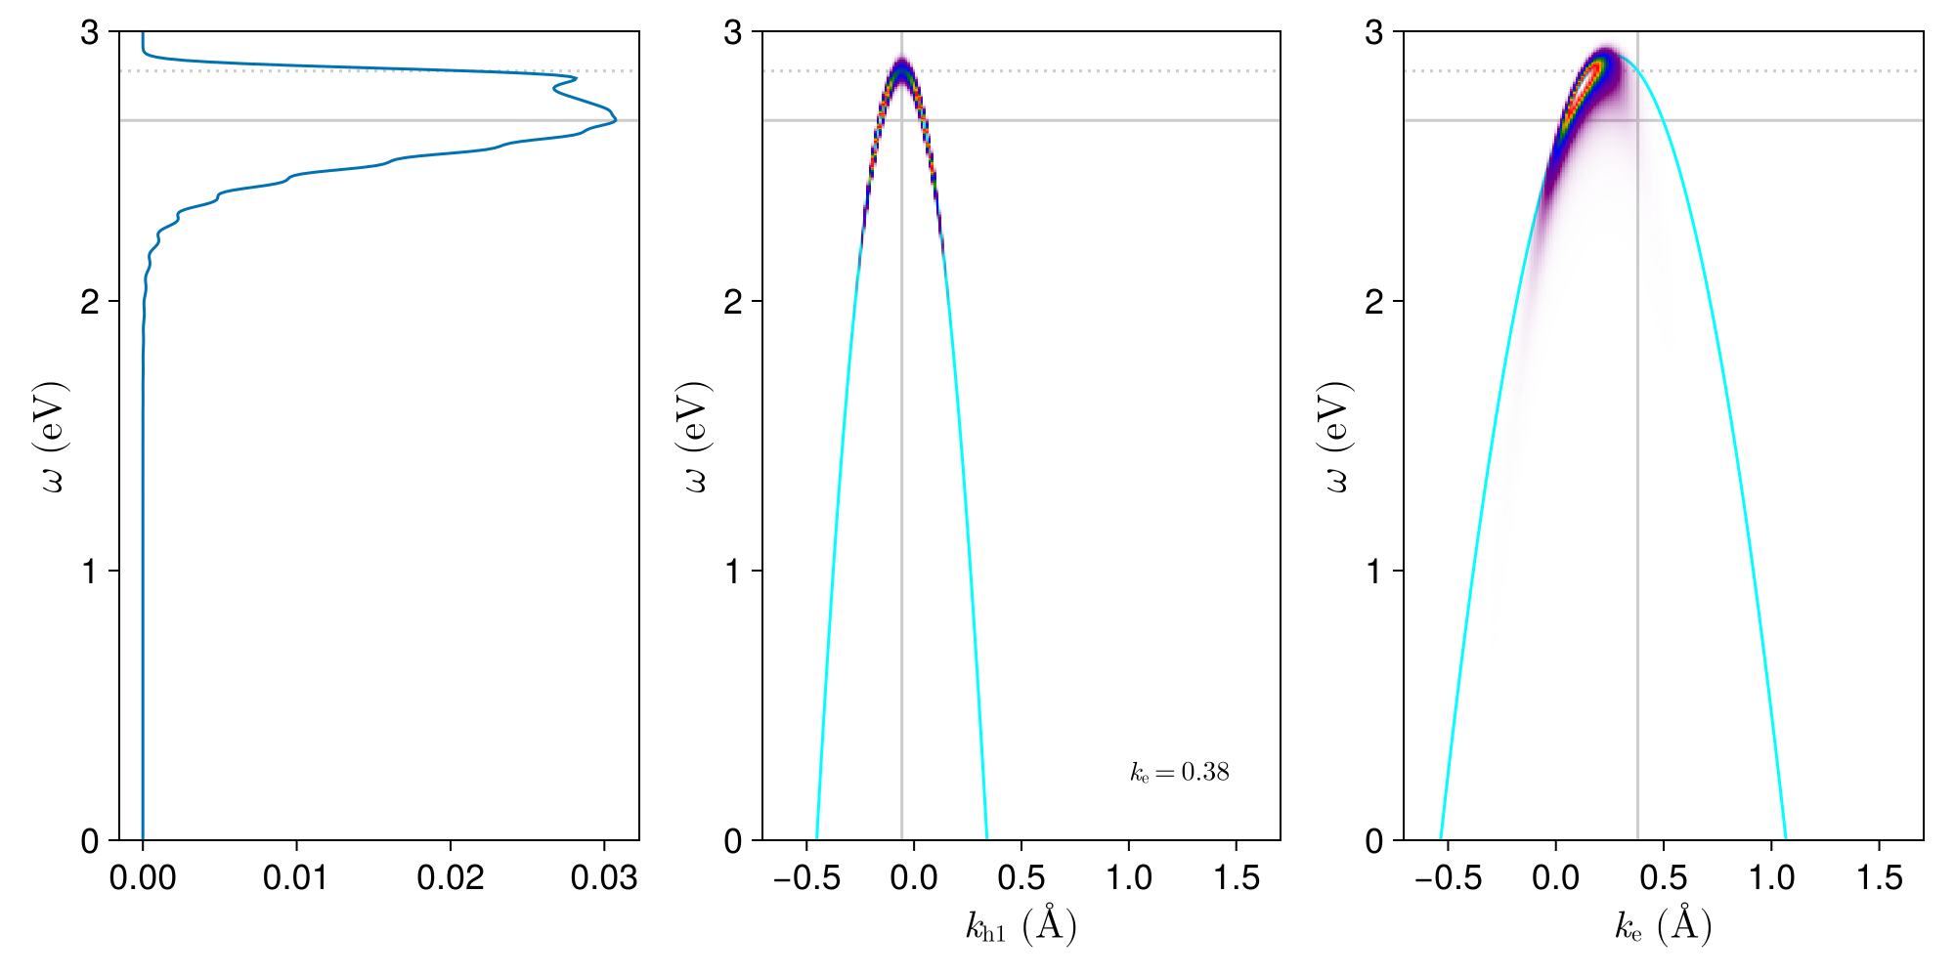
Anatomy of the ehh case
Let’s consider the contribution of each kh1 vector:
This point is reached with k1=k2
The peak is not the k1=k2 position!
Consequence:
The k1=k2 line doesn’t reflect the true shape of the ARPES signature
Dispersion relation calculated by setting k1=k2
Contributions of different kh1 vectors to a single ke point
The intensity seen as a variable of freq.

Slide 4
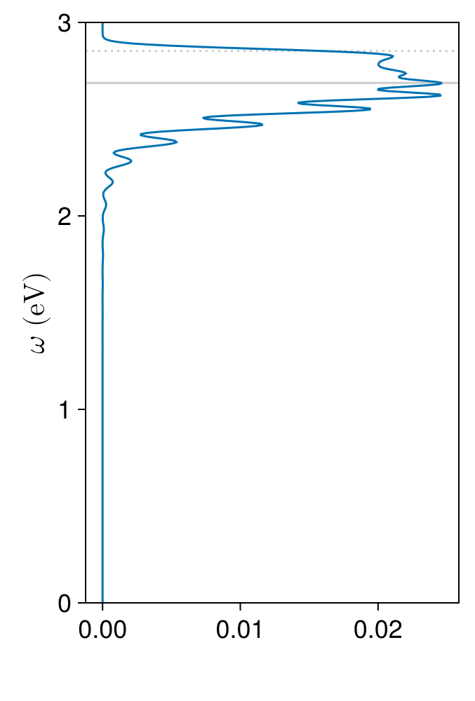
Anatomy of the ehh case
Wiggles because of finite k grid
200×200
150×150

Slide 5
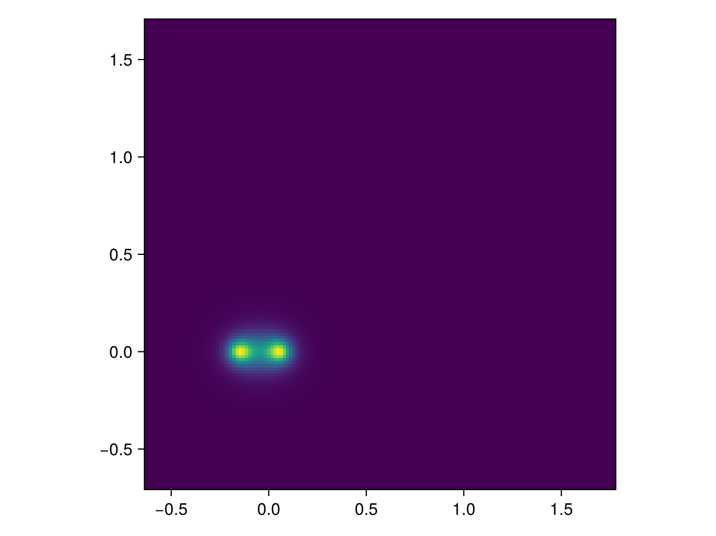
Anatomy of the ehh case
Why the intensity peak differ from the k1=k2 position
The strength: trion wave function
The shape: energy conservation
The trion wave function amplitude w.r.t. kh1 (kh2 is calculated via energy conservation)

Slide 6
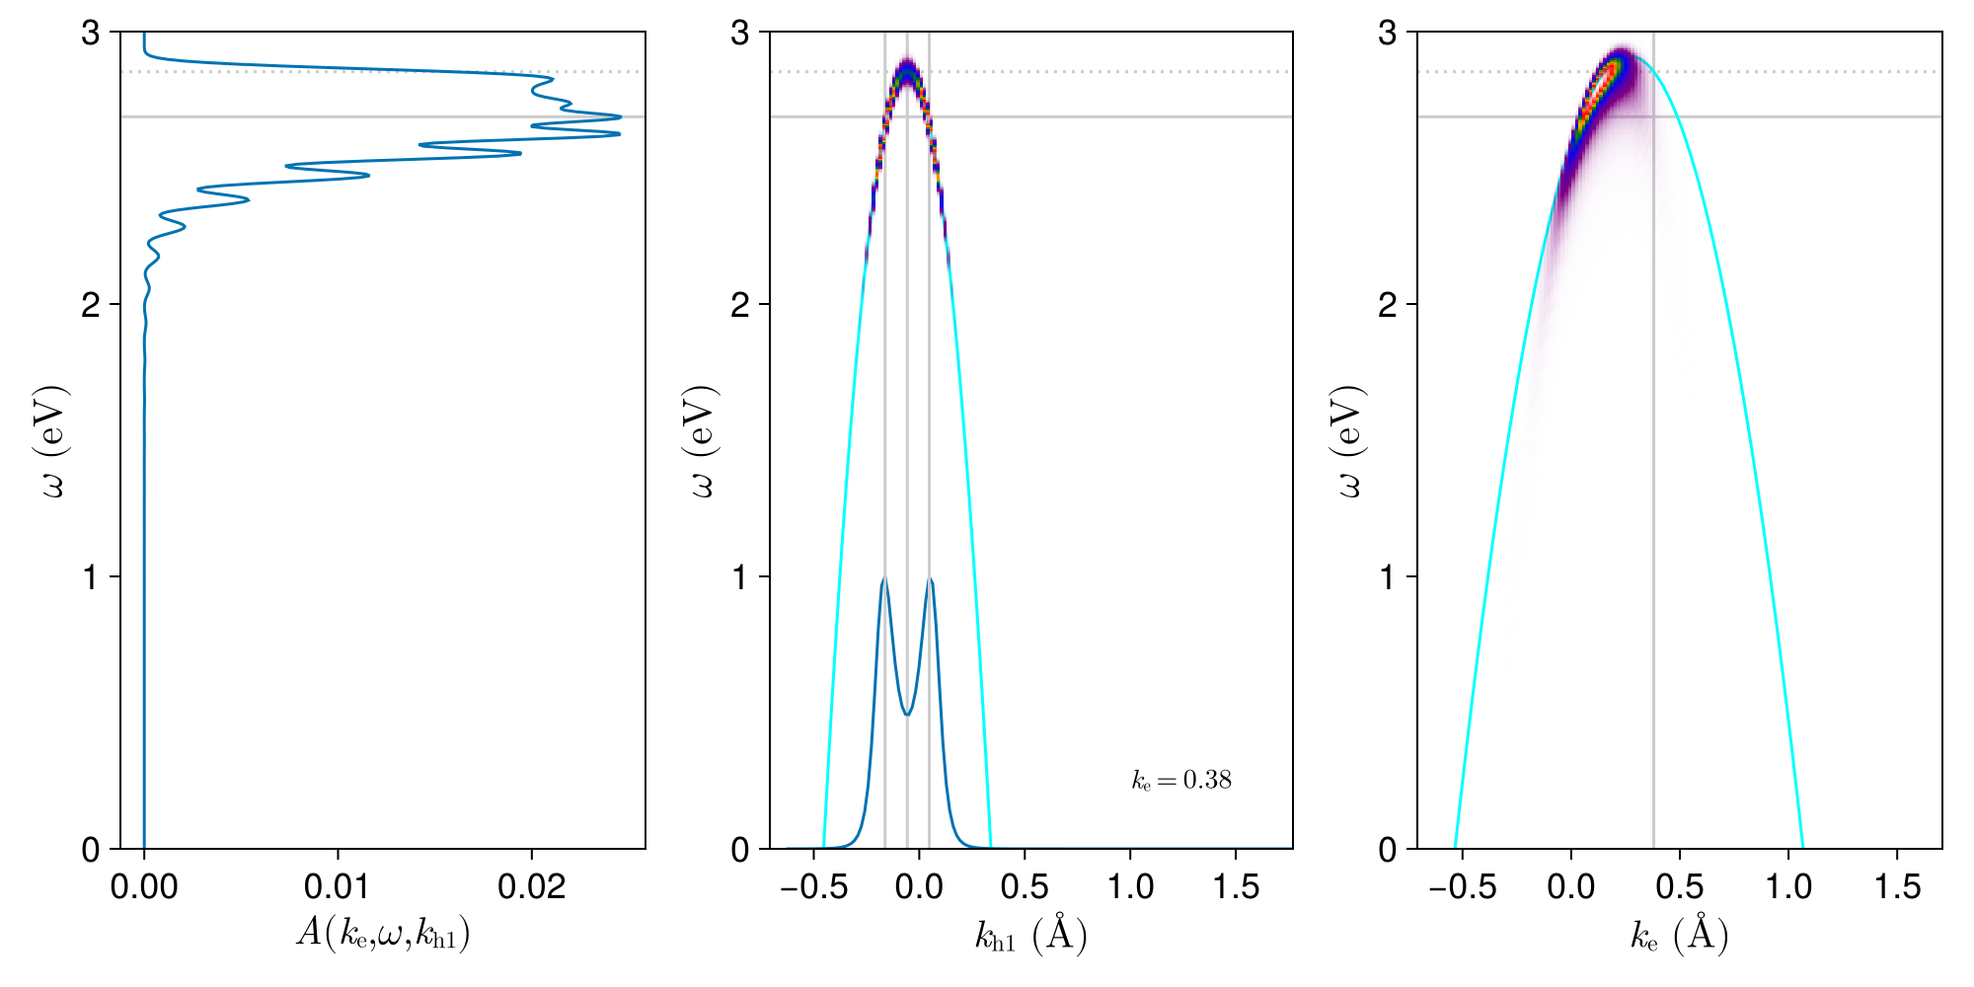
Anatomy of the ehh case
The peak comes from the peak of trion wave function, which can’t be decided by either kh1=kh2 or k1=0/k2=0

Slide 7
Anatomy of the ehh case
This also means the structure of the trion wave function is important, because it determines where we find the peak (and hence the shape of the signature)
The kh1=kh2 point is a saddle point

Slide 8
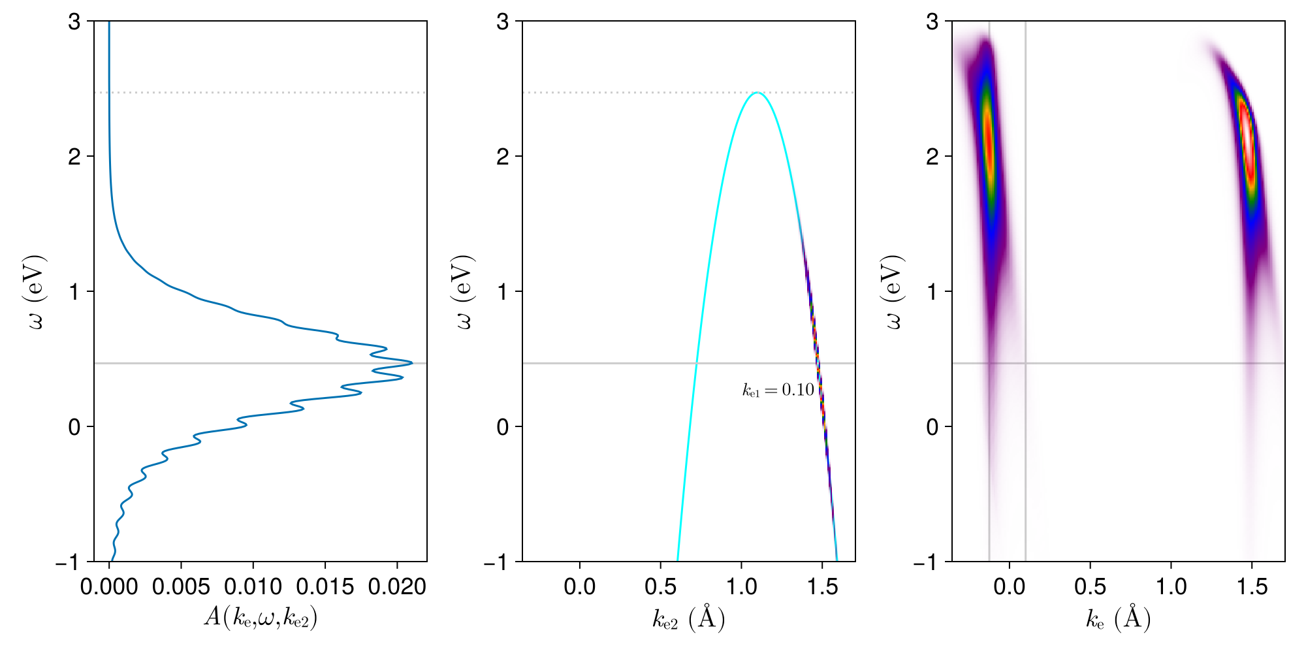
Anatomy of the eeh case
Feature 1: ke1 fixed, ke2 varies freely
Fixing ke1, changing ke2
Feature 2: trion wave function peak

Slide 9
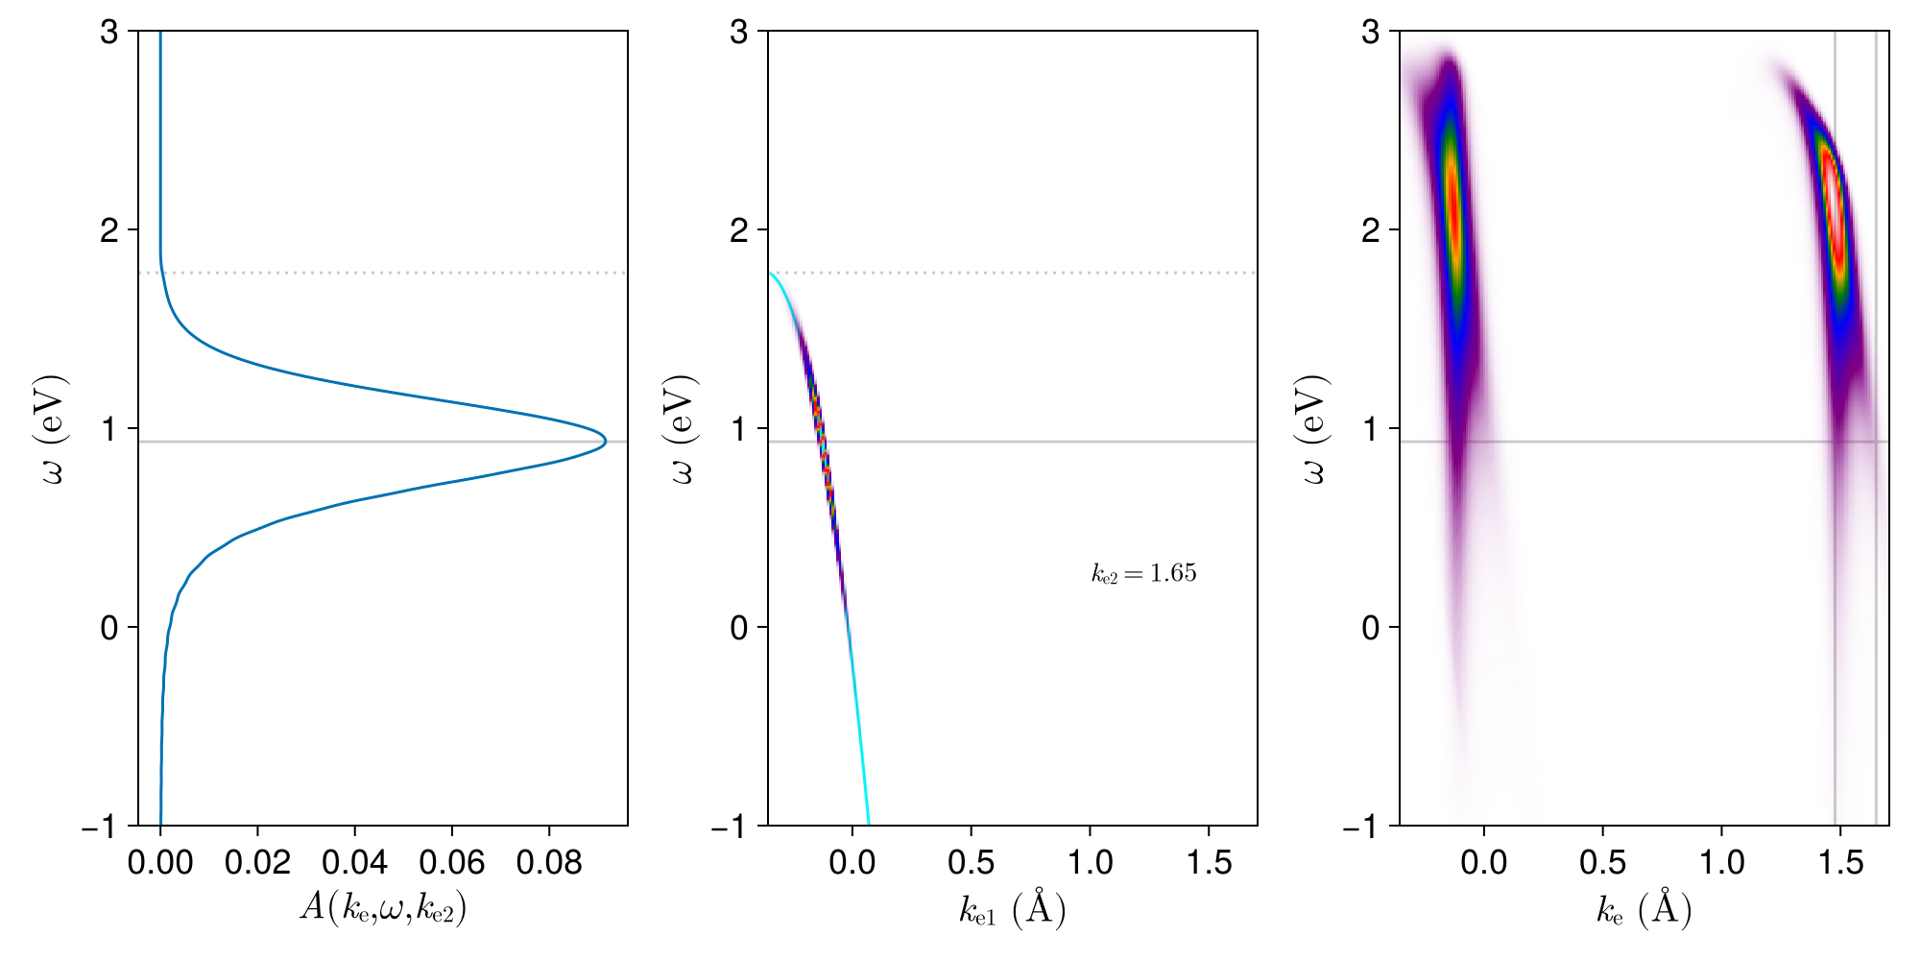
Anatomy of the eeh case
Feature 1: ke2 fixed, ke1 varies freely
Fixing ke2, changing ke1
Feature 2: trion wave function peak

Slide 10
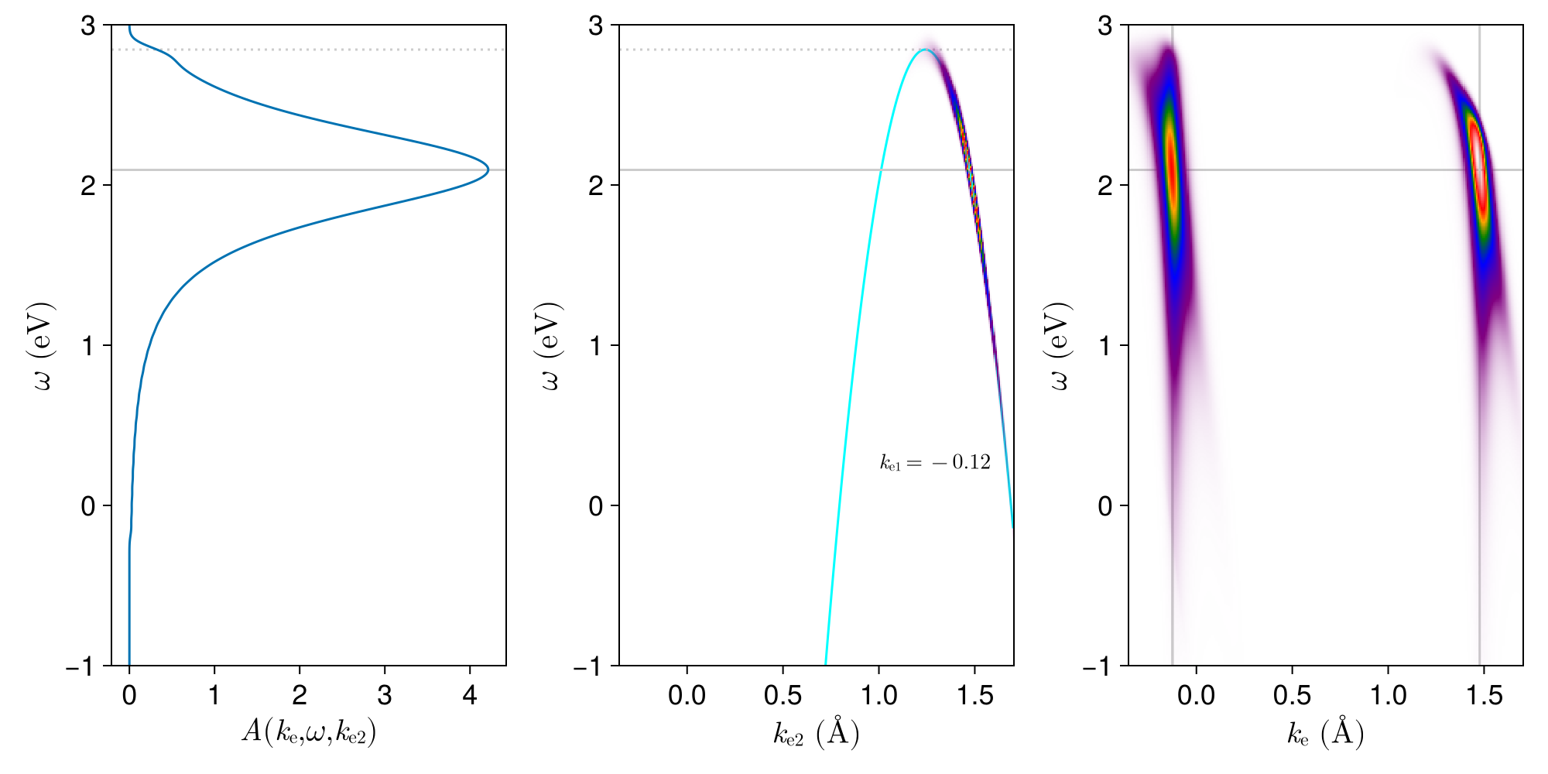
Anatomy of eeh
The most important distinction with the ehh case: the vertical stripe. Why it’s here?
High intensity when ke1 is chosen s.t. k1=0

Slide 11
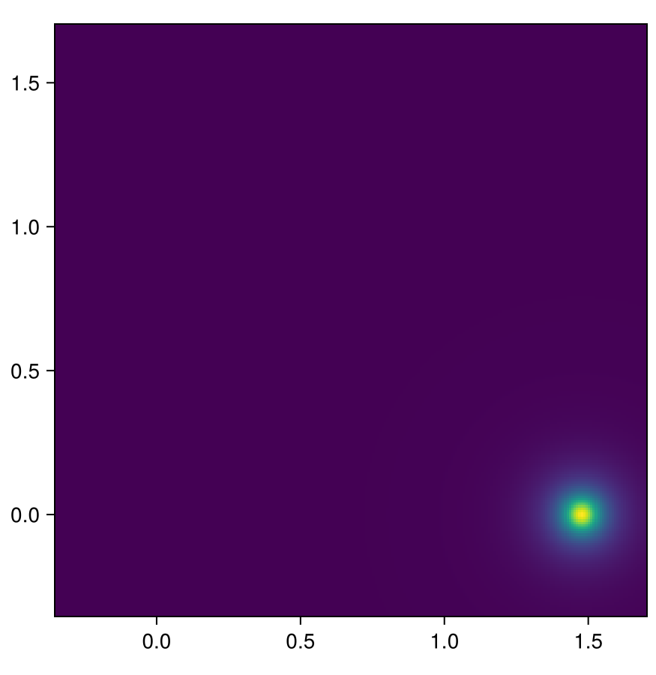
Wave function structures of eeh and ehh
Different momentum conservation laws lead to different structure
ehh w.r.t. kh1: kh2=f(kh1, ke), wfn=wfn(kh1,kh2)
eeh w.r.t. ke2: wfn=wfn(ke1,ke2)
Although the wave function’s relation with k1 and k2 remains the same, the relation between (k1, k2) and (k_ARPES, k_inner) isn’t

Slide 12
Wave function structures of eeh and ehh
This distinction can also be seen in this way:
Single spot
Double sided
Single sided
Double spot

