Slide 1
Binary Image Analysis
Image topology: connectivity and Euler number
Boundary representation
  Chain codes, shape numbers, Fourier descriptors*
Skeleton representation
  String codes, tree grammar*, automata*
Fractal representation
  Fractal everywhere: coastlines, snow-flakes, leaf veins …
Applications
  Character/barcode/handwriting recognition

Slide 2



From Processing to Analysis
Localized perspective in binary image processing
Low-level vision
PHIL
High-level vision
Holistic perspective in binary image analysis

Slide 3
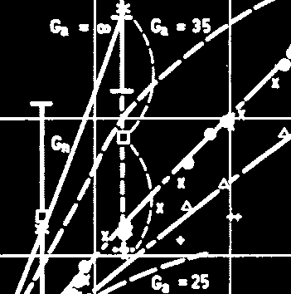
High-level Vision Questions
How many objects?
What is each object?
What is the relationship
among different objects?
… …

Slide 4

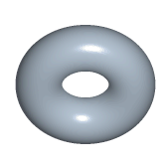
Image Topology
Topology is the study of properties of a figure that are unaffected
by rubber-sheet distortions
=

Slide 5
Connectivity
X’
Y’
Y
X
X and Y are connected
X’ and Y’ are NOT connected
a and b are connected if there exists a path from a to b
Notation: if a and b are connected, we write a ~ b

Slide 6
Connectivity Properties
Reflexive: x ~ x for all x
Symmetric: if x ~ y, then y ~ x
Transitive: if x ~ y and y ~ z, then x ~ z
How do we define the path for discrete images?
4-neighbors
8-neighbors

Slide 7
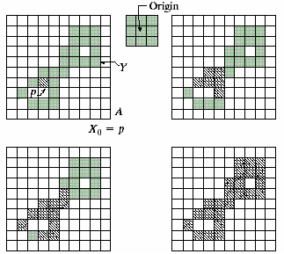
Finding Connected Component
X_{k}=(X_{k-1}⊕B)∩A, k=1,2,3…

Slide 8
Connected Component Labeling
1
2
3
4
5
MATLAN function: > help bwlabel

Slide 9


Image Example
X
label2rgb(y)
>y=bwlabel(x);
>imshow(label2rgb(y));

Slide 10
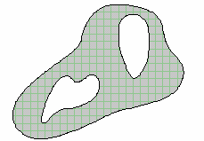
Objects With Holes
Euler Number EN=number of connected components – number of holes

Slide 11

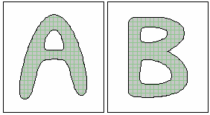
Image Examples
EN=0
EN=-1
EN=-3
MATLAB codes: >help bweuler

Slide 12
Binary Image Analysis
Image topology: connectivity and Euler number
Boundary representation
  Chain codes, shape numbers, Fourier descriptors*
Skeleton representation
  String codes, tree grammar*, automata*
Fractal representation
  Fractal everywhere: coastlines, snow-flakes, leaf veins …
Applications
  Character/barcode/handwriting recognition

Slide 13
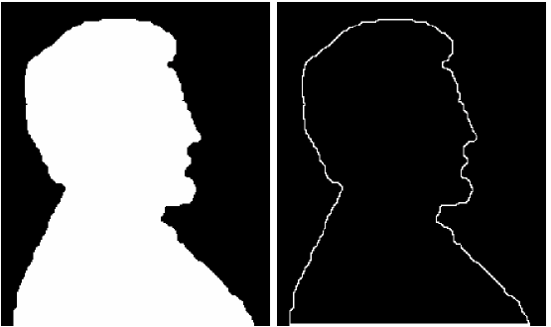
Boundary of Binary Objects
X
∂X
_
∂X=X-(X B)
∂X=(X B) – B
or
+

Slide 14
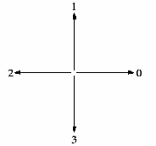
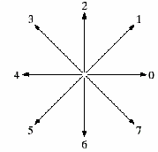
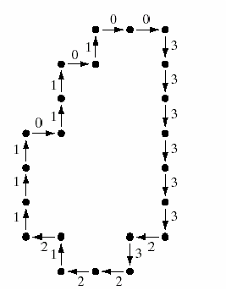
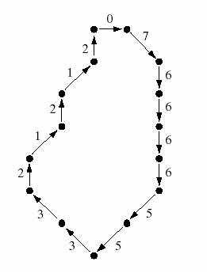
Chain Codes Boundary Representation
4-directional chain code:
0033333323221211101101
8-directional chain code:
076666553321212

Slide 15
Two Problems with the Chain Code
Chain code representation is conceptually appealing, yet has the following two problems
  Dependent on the starting point
  Dependent on the orientation
To use boundary representation in object recognition, we need to achieve invariance to starting point and orientation
  Normalized codes
  Differential codes

Slide 16
Normalization Strategy
33001122
33001122
30011223
00112233
01122330
11223300
12233001
22330011
23300112
00112233
01122330
11223300
12233001
22330011
23300112
33001122
30011223
First row gives the
normalized chain code
Sort
rows
00112233

Slide 17
Differential Strategy
90º
33001212
33010122
normalize
normalize
00121233
01012233
Differential coding:
d_{k}=c_{k}-c_{k-1} (mod 4) for 4-directional chain codes
dk=ck-ck-1 (mod 8) for 8-directional chain codes

Slide 18
Shape Numbers= Normalized Differential Chain Codes
33001212
33010122
Differential code:
d_{k}=c_{k}-c_{k-1} (mod 4)
differentiate
differentiate
10101131
10113110
normalize
normalize
01011311
01011311
Note that the shape numbers of two objects related by 90º rotation
are indeed identical

Slide 19
Exercise
What are the shape numbers of this shape? (Problem 2 in HW2)

Slide 20
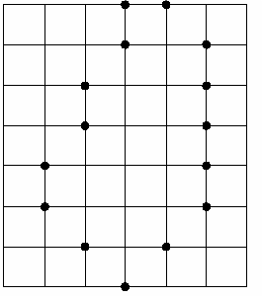
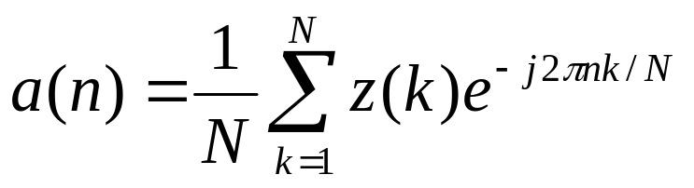
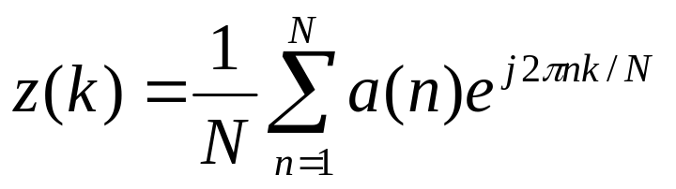
Fourier Descriptor*
z(k)=x(k)+j y(k)
DFT
Fourier
descriptors
IDFT
{x(k),y(k)}, k=1,2,..,N

Slide 21
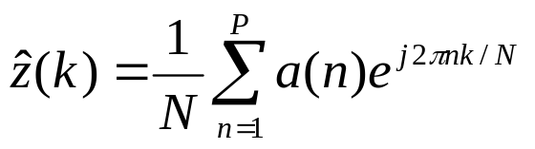
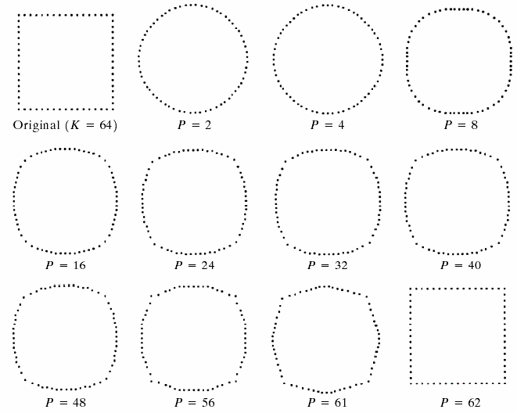
Numerical Example
P : the number of Fourier coefficients used in reconstruction

Slide 22
Binary Image Analysis
Image topology: connectivity and Euler number
Boundary representation
  Chain codes, shape numbers, Fourier descriptors*
Skeleton representation
  String codes, tree grammar*, automata*
Fractal representation
  Fractal everywhere: coastlines, snow-flakes, leaf veins …
Applications
  Character/barcode/handwriting recognition

Slide 23
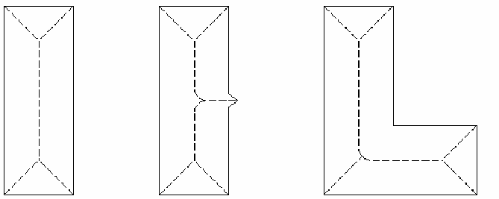
Skeleton Finding

Slide 24
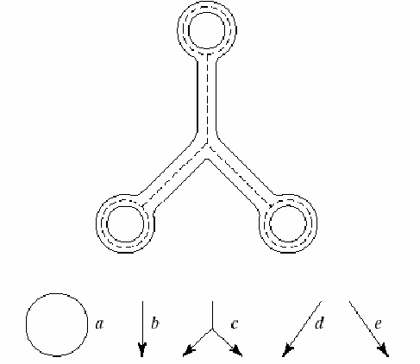
String Codes

Slide 25
Tree Grammar*
G={N, ∑, P, r, S}
N={X₁,X₂,X₃,S}
nonterminals
∑={a,b,c,d,e}
terminals
S: start symbol
r: ranking function
P: a set of productions
Expansive production example
X
k
X₁
…
X_{n}
X₂

Slide 26
Example
1)
S
a
2)
X₁
b
X₁
X₁
3)
X₁
c
4)
X₂
d
X₂
X₃
X₂
5)
X₂
a
6)
X₃
e
7)
X₃
X₃
a

Slide 27
Automata as String Recognizer*
0
Examples
1
0
1
1
S₁
S₂
0
start
state
accept
state
010
Recognizable string
(0*1*)*1
0011
a* denotes n concatenated a (n=0,1,2,…)

Slide 29
Binary Image Analysis
Image topology: connectivity and Euler number
Boundary representation
  Chain codes, shape numbers, Fourier descriptors*
Skeleton representation
  String codes, tree grammar*, automata*
Fractal representation
  Fractal everywhere: coastlines, snow-flakes, leaf veins …
Applications
  Character/barcode/handwriting recognition

Slide 30

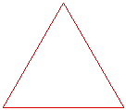

What are Fractals? – Simple Examples
Cantor set (dust)
Koch curve (snowflake)

Slide 31
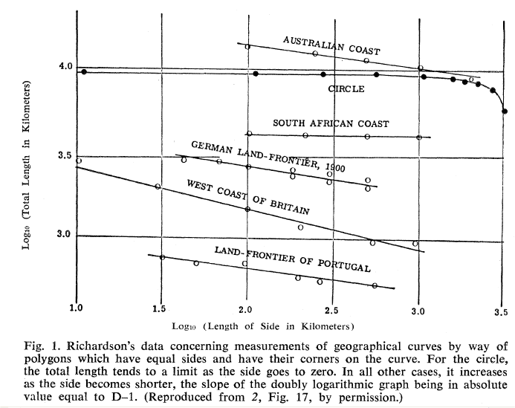
How Long is the Coast of Britain?
Mandelbrot, Science’1967

Slide 32


Fractal Dimension

Slide 33

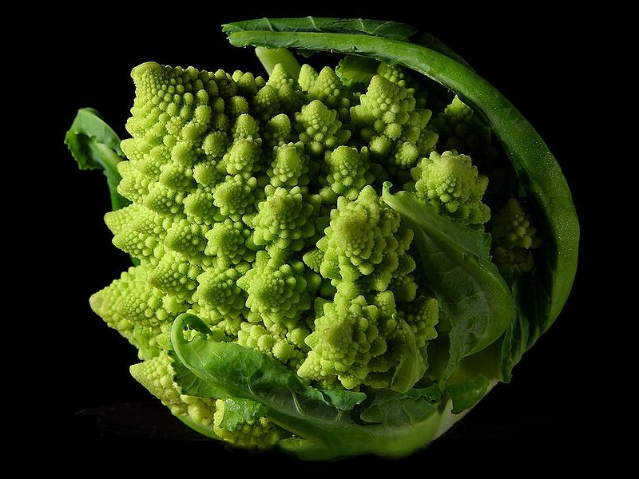
Fractals in Nature
More can be found at:
http://en.wikipedia.org/wiki/Fractal#In_nature

Slide 34
Applications of Binary Image Processing and Analysis
Optical Character Recognition (OCR)
  Tax form processing, Google Books, …
Barcode recognition
  Grocery shopping
Handwriting recognition
  Biometrics, forensics
Fingerprint recognition
  Biometrics, forensics

Slide 35
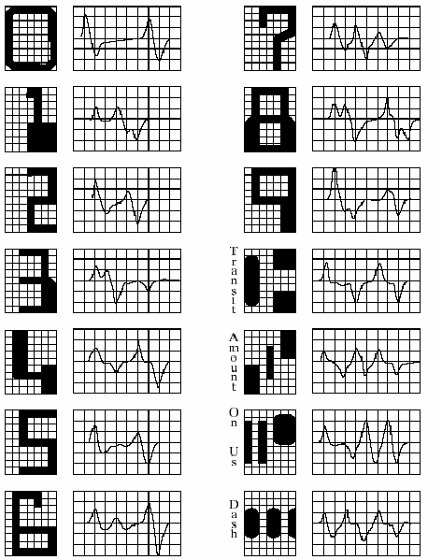
Bank Note Character Recognition
American Banker’s
Association E-13B
Font character set:
14 characters
9-by-7 grid
Distinct 1D signature
is generated as the
reading head moves
from left to right and
detects the change
of ink area under the
head

Slide 36
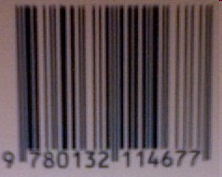
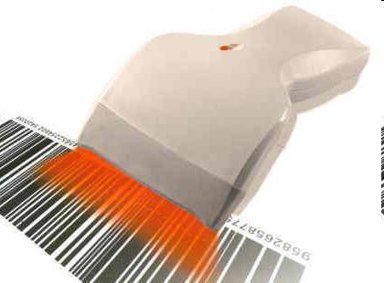
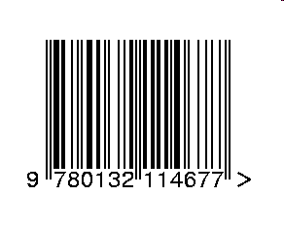
Barcode recognition
optical scanner
Laser scanner

Slide 37
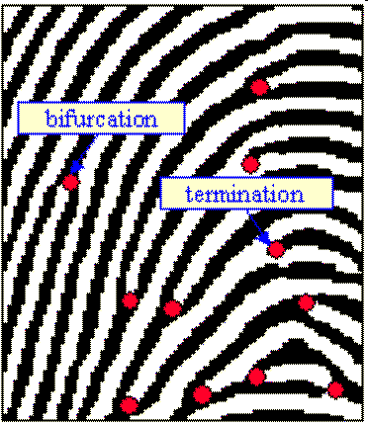
Minutiae-based Fingerprint Recognition

Slide 38
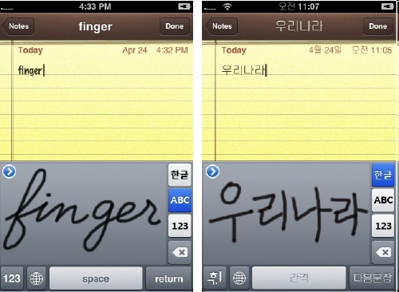
Handwriting Recognition

Slide 39
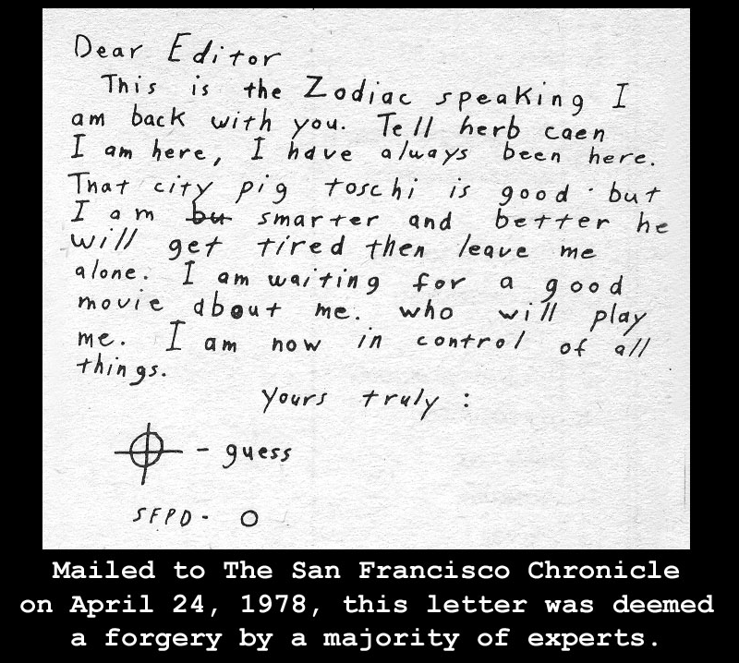
The Story of Zodiac Killer

Slide 40
Summary for Binary Image Analysis
Useful topological attributes
  Connected components, Euler number
Useful structural representations
  Boundary (chain codes and shape numbers)
  Skeleton (string code and tree grammar)
  Fractal (self-similarity based)
Various important applications
  Some are more successful than others
  Always the tradeoff between cost and performance

