Slide 1
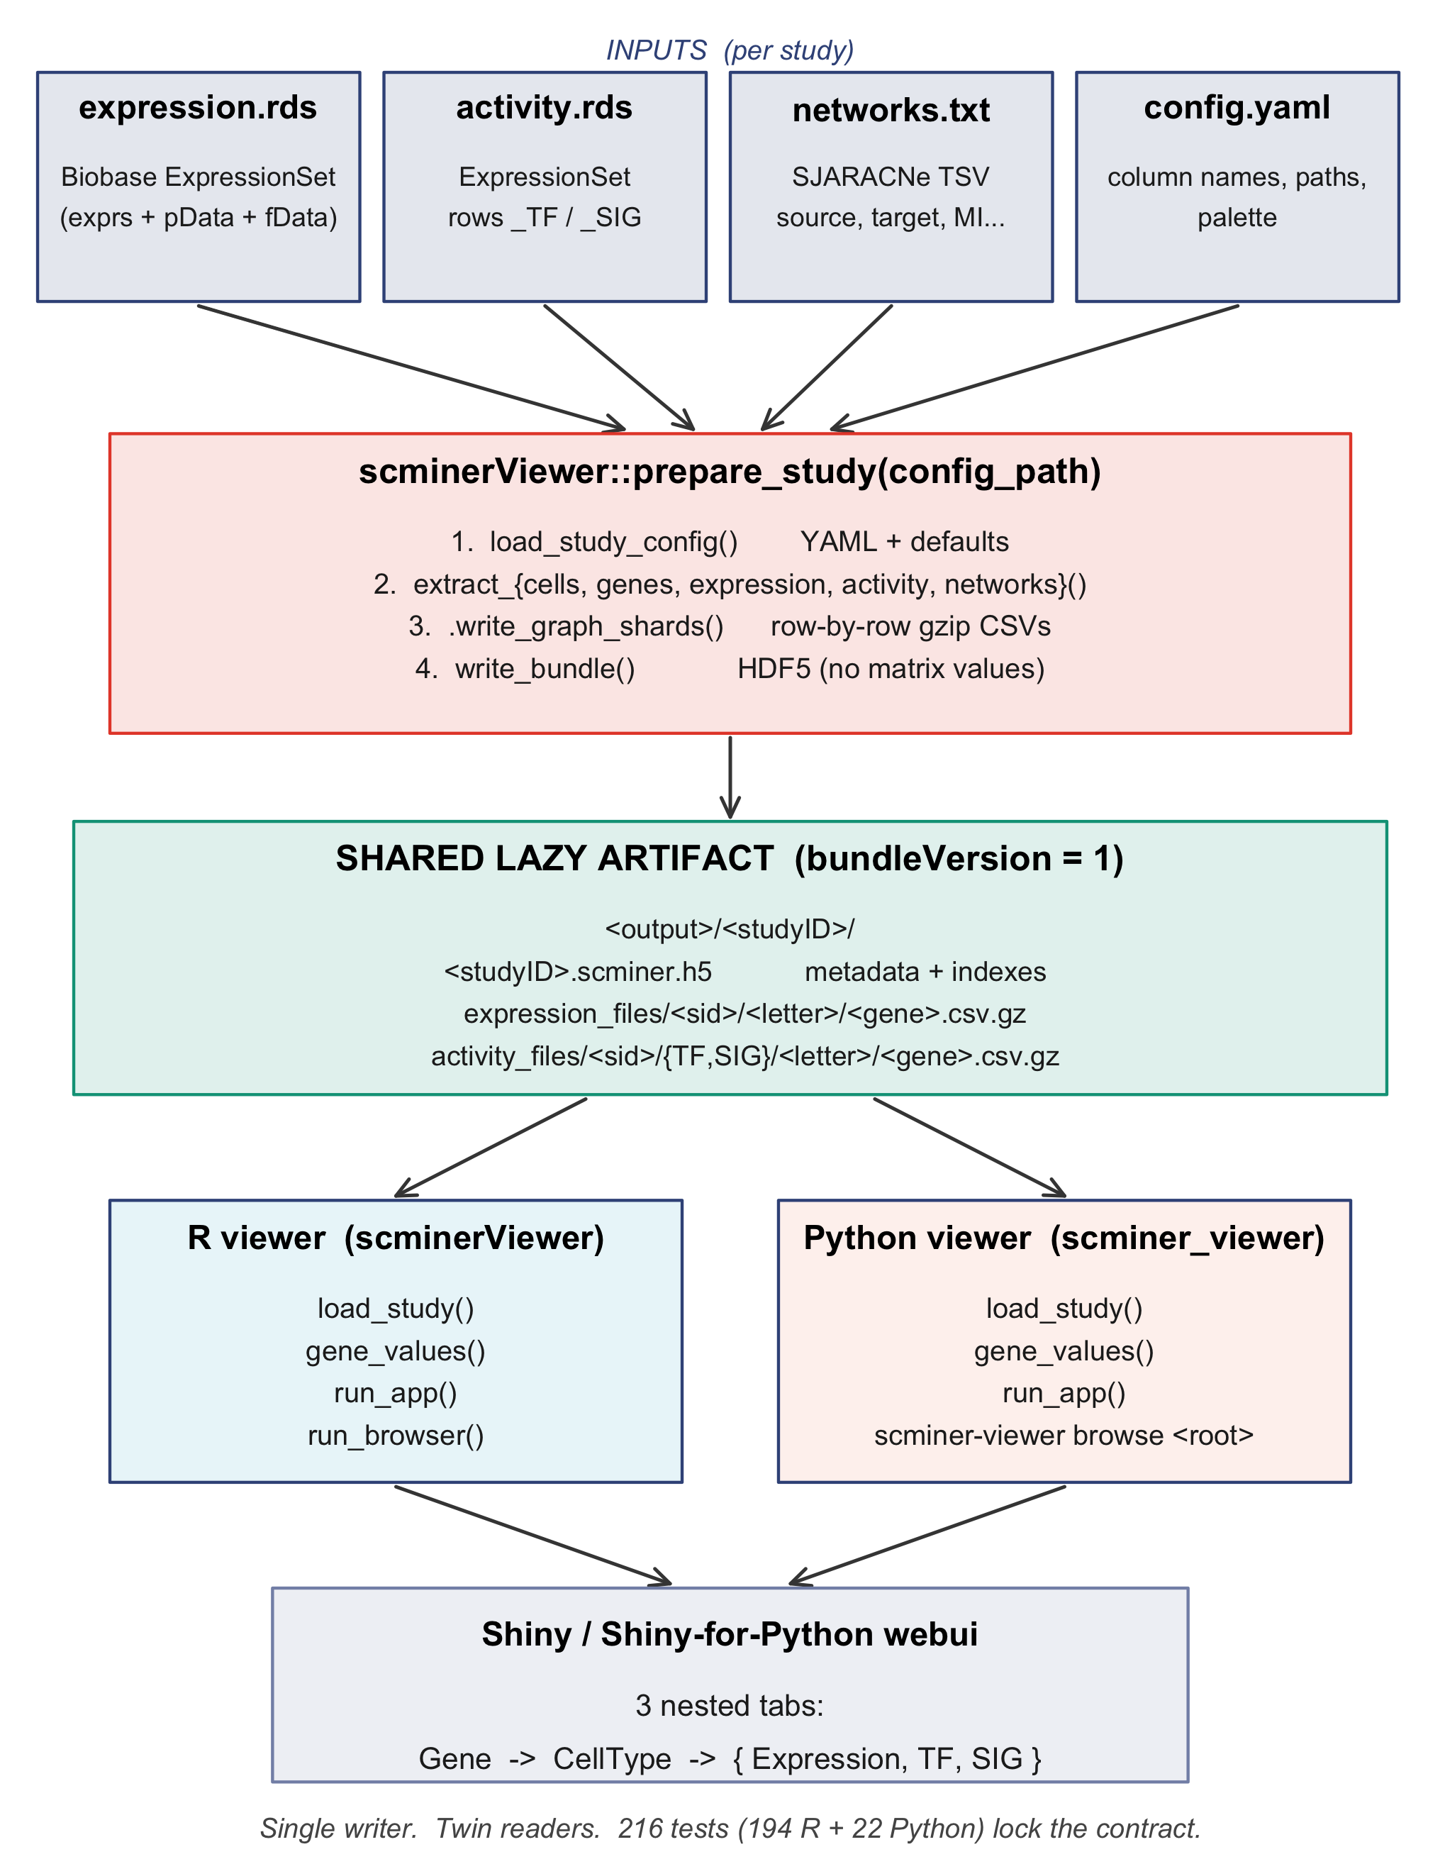
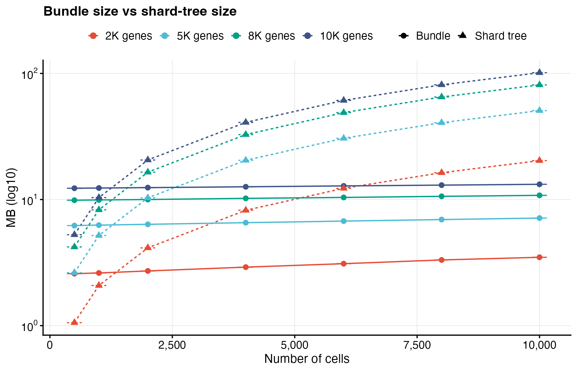
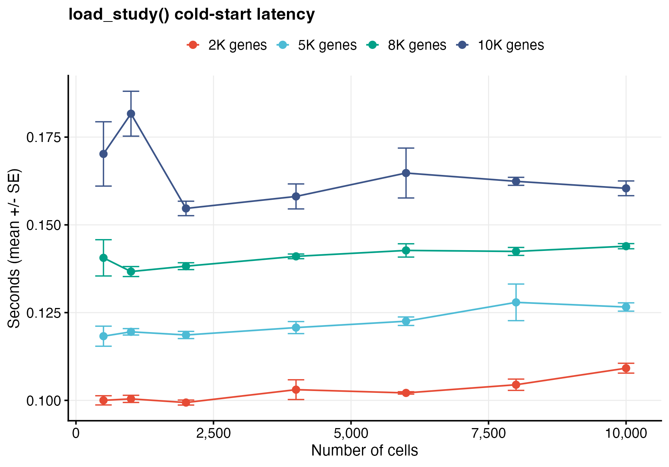
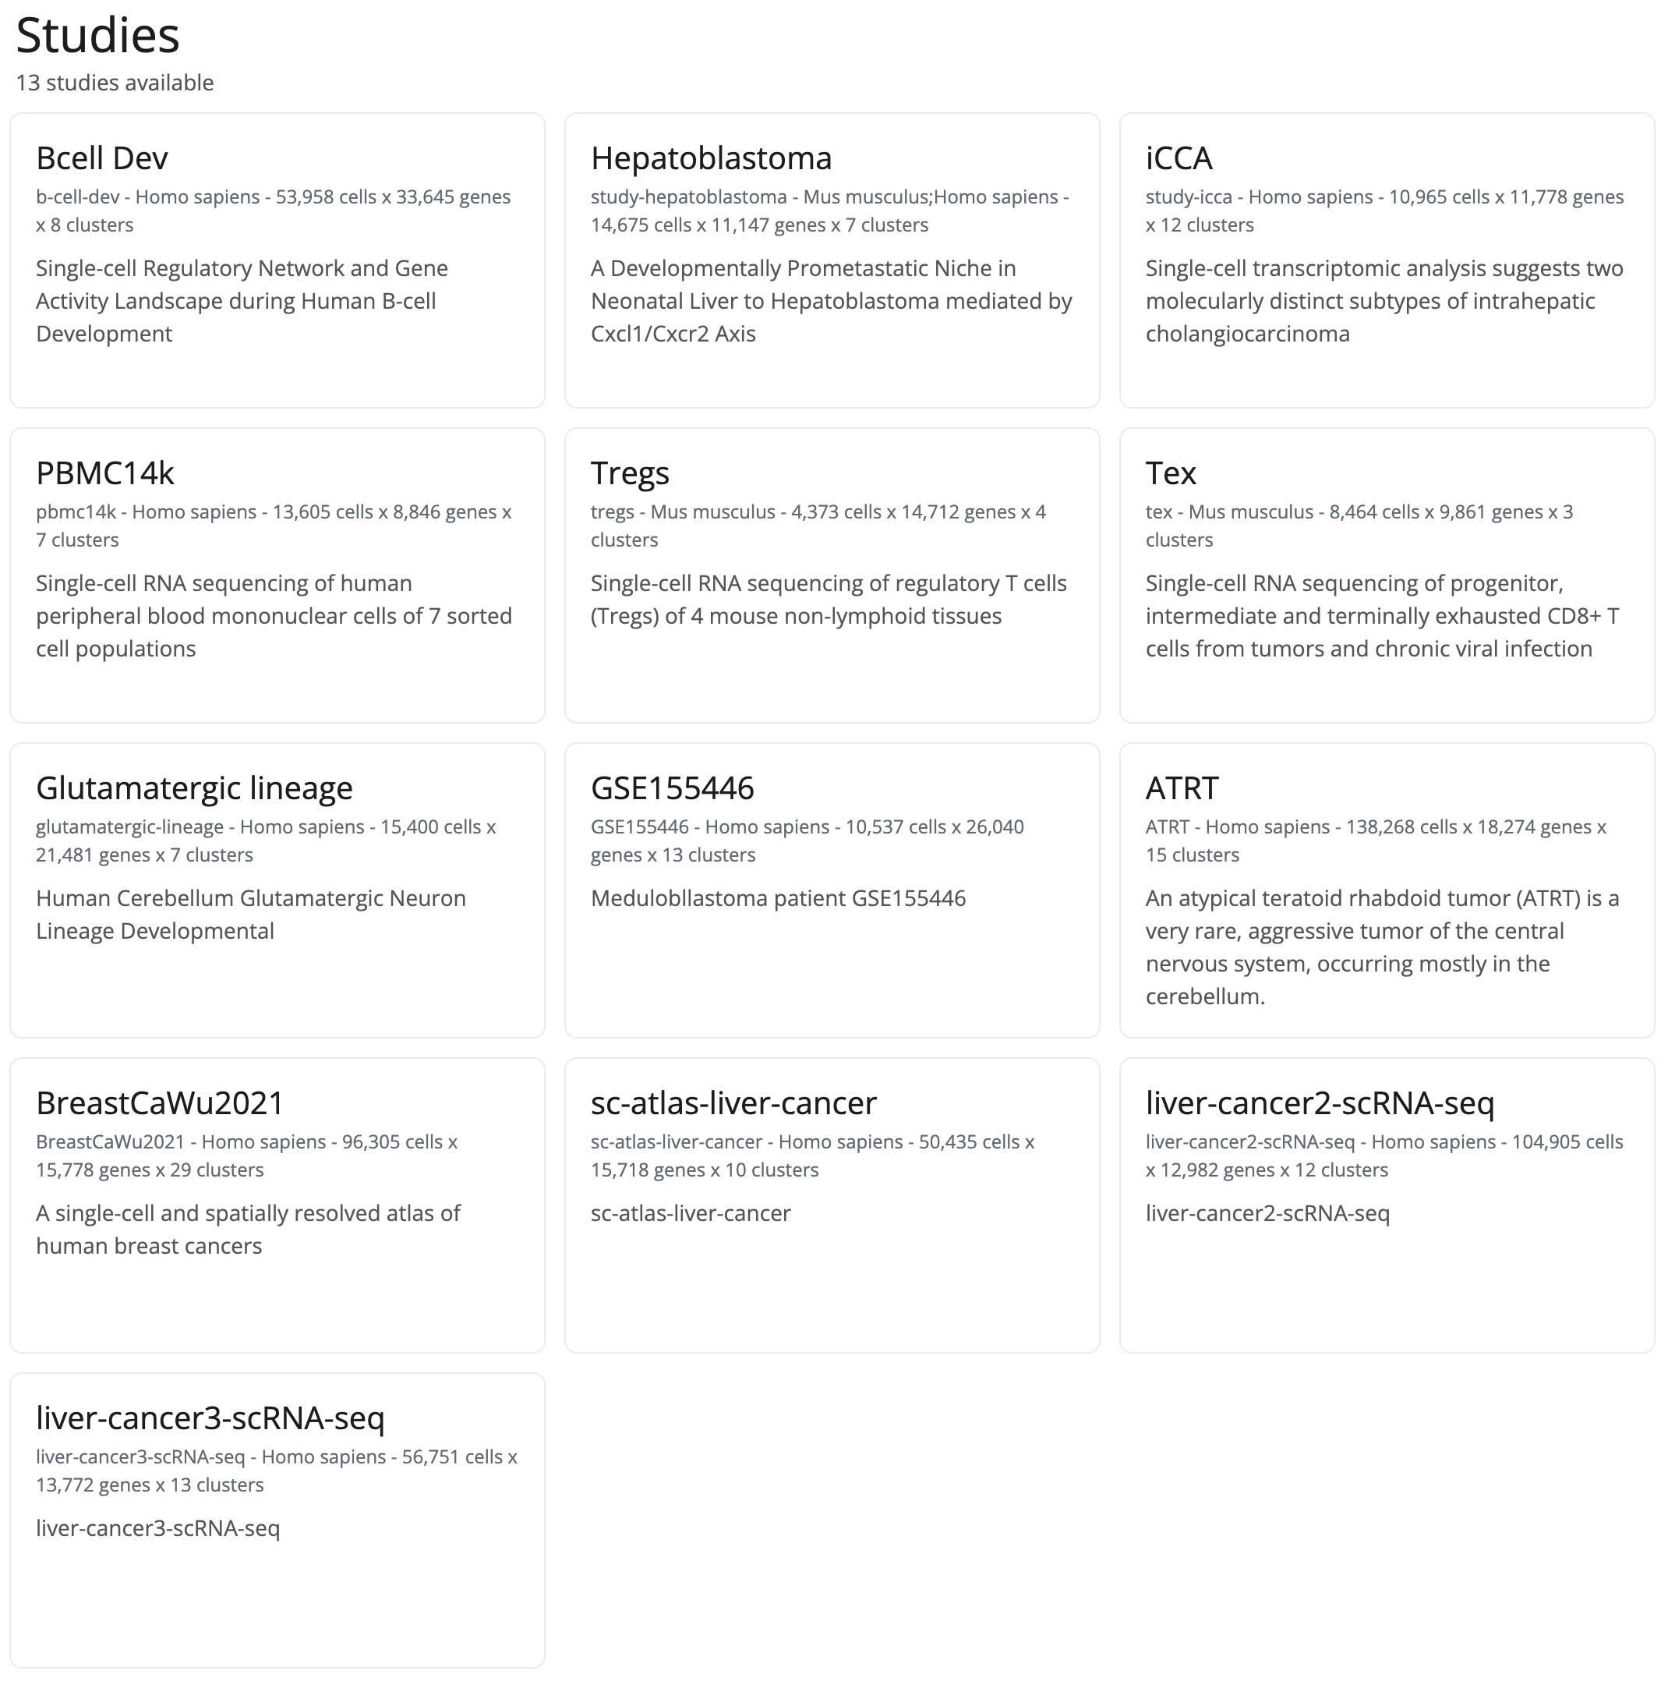
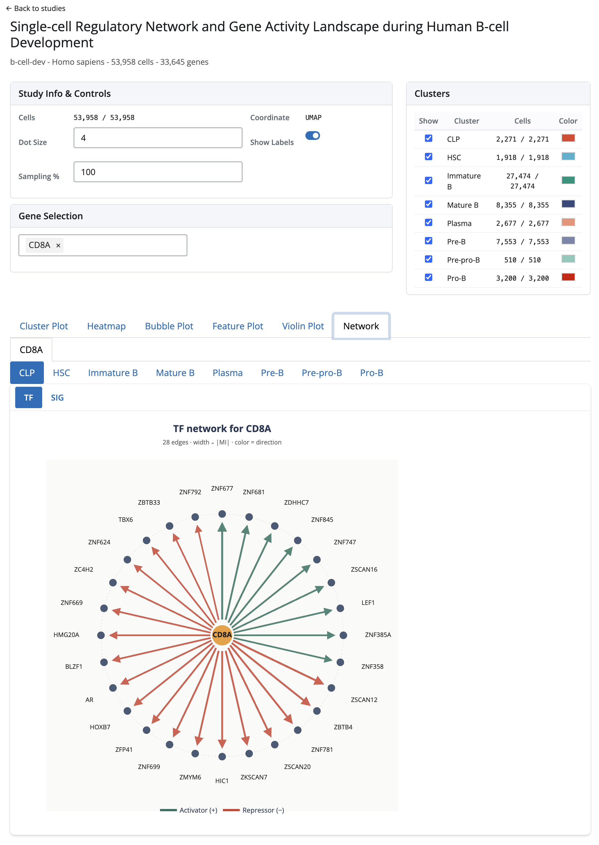
A
B
D
C
studyID | n_cells | n_genes | bundle MB | shard MB | load s | fetch ms | TF edges | SIG edges
2326 | 4,373 | 14,712 | 295.1 | 306.1 | 8.02 | 62 | 1,549,003 | 1,531,394
2327 | 8,464 | 9,861 | 77.1 | 457.6 | 2.2 | 92 | 429,516 | 314,348
2332 | 10,537 | 26,040 | 73.4 | 167.5 | 2.1 | 117 | 263,440 | 424,897
2319 | 10,965 | 11,778 | 785.6 | 748.9 | 19.62 | 109 | 3,286,884 | 4,685,586
2325 | 13,605 | 8,846 | 314.9 | 602.8 | 8.58 | 125 | 666,244 | 2,696,465
2318 | 14,675 | 11,147 | 482.1 | 930.4 | 11.13 | 124 | 1,938,848 | 2,884,379
2331 | 15,400 | 21,481 | 73.4 | 169.5 | 2 | 141 | 263,440 | 424,897
2339 | 50,435 | 15,718 | 812 | 3,918.90 | 19.36 | 403 | 4,173,419 | 4,068,560
2203 | 53,958 | 33,645 | 576.9 | 3,427.30 | 14.23 | 409 | 2,144,370 | 3,778,244
2342 | 56,751 | 13,772 | 775.5 | 4,258.20 | 20.23 | 449 | 3,904,489 | 4,005,173
2338 | 96,305 | 15,778 | 1,363.30 | 7,427.70 | 34.25 | 827 | 6,557,601 | 6,973,009
2341 | 104,905 | 12,982 | 743.2 | 6,579.70 | 12.75 | 655 | 2,900,665 | 4,723,739
2333 | 138,268 | 18,274 | 105.8 | 3,149.10 | 2.77 | 1,208 | 384,817 | 528,311

