Slide 1
CIS 530 project- Cross Lingual NER using Multilingual Word Embeddings
-Aashish Singh, John Zhang, Sanjeevini Ganni, Simmi Mourya
Notes:
Hello and welcome to our team’s CIS 530 term project. We are a team of 4- Aashish Singh, John Zhang, Sanjeevini Ganni and Simmi Mourya. Our term project is based on the topic- Cross Lingual NER using Bilingual word embeddings.

Slide 2

Problem- Definition & Illustrative Example
The problem we seek to solve is- to generate a model that can identify the named entities in a target language L2 given labelled NER training data in a source language using resources mostly in source language. This results in an unsupervised transfer of resource from L1 to L2 since no labelled training data is given for the target language.
Only English Training Data
Our model
NER tagging on Spanish texts!
Wolff B-PER
currently O
a O
journalist O
in O
Argentina B-LOC
We Developed a Spanish NER tagging model
La O
Multinacional O
Española O
Telefónica B-ORG
ha O
impuesto O
Notes:
Defintion:
The problem we seek to solve is- to generate a model that can identify the named entities in a target language L2 given labelled NER training data in a source language L1, monolingual corpora of L1, L2 (which we will convert to bilingual word embeddings), a bilingual dictionary from L1 to L2. This results in an unsupervised transfer of resource from L1 to L2 since no labelled training data is given for the target language.
In our case specifically we use: L1 (source language) = Spanish, L2 (target language) = English, English to Spanish dictionary.
We generate: Bilingual word embeddings (English-Spanish word embeddings in same space), translation algorithms, Spanish NER model
Goal is NER tagging of spanish text.
In the illustrative example we see that we are given a set of NER labelled English Training data as shown in bottom left. Our goal is to build a state-of-the-art model that can predict spanish NER tags on spanish test data as shown in bottom right.

Slide 3


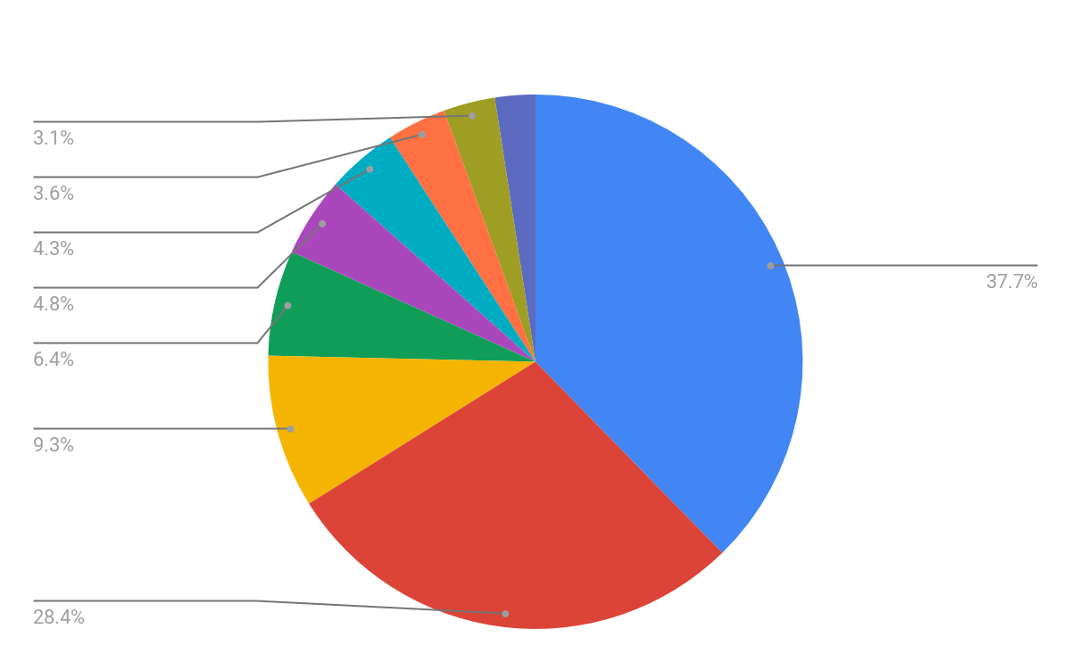



Interest/Relevance, Motivation & new explorations
Preservation
Educational applications
Knowledge Expansion
Monitoring demographic/political processes
Emergency Response
Courtesy: https://medium.com/sciforce/nlp-for-low-resource-settings-52e199779a79
Courtesy: https://twitter.com/catherinehavasi/status/1158804116476440576/photo/1
Notes:
We are interested in this problem because it allows us to develop and research NLP models (in our case NER model)- ways in which we can help a low resource language. Additionally it is very relevant field with immense potential to help a low resource language like Uyghur or the many regional languages around the world. Following are the reasons that make this interesting to research into and relevant in the modern world
Preservation: Having NER models for low resource language can help develop resources (both digital and otherwise) and preserve these languages.
Educational Applications: Making models for low resource language can help revive old languages. Reviving new languages can be speeded up significantly by using NLP models like NER.
Knowledge Expansion: Help gain knowledge that might be untapped just because they are encoded in a low resource language with few active speakers.
Monitoring demographic and political processes: India has over 700 languages and so does Papua New Guinea. Having NLP models for such languages can help know about the demographics, economics, political scenario of such places.
Emergency Response: Pandemic spreading in small regions in local languages can be picked up if cross learning models like our NER model is in place. Additionally prevention methods in high resource language can reach low resource languages.
Furthermore we can see the inequality between resources present for a language through the pie chart which shows the percentage of edge counts on cnet. English, French, German turn out to be high resource (in terms of edge counts on CNET) while Portuguese is seen to be low resource with huge disparity in percentage numbers. Lot of world’s languages suffer from this inequality.
Apart from the technical sophistication of creating such models without any NER training data in the target language, it is really exciting to us that our learnings in this class can potentially be used or help researchers gain insight into low resource languages that can help innumerable people around the world.
New explorations we did were:
We attempted mapping monolingual embeddings and projecting them to a shared space to create bilingual embeddings. We learnt how to make translations between words while taking care of the hubness problem. We explore the idea of using neural networks for NER task by using attention based bi-lstm model along with CRF. We used char-embeddings to take into account the effect of capitalisations and other character level nuances. We also used transformer models for getting word embeddings. While the attention model helps us take into account the different ordering of words in the source and target language.

Slide 4
Data and Evaluation
Evaluation Metric
F1 Score
NER training data for English:
CoNLL 2003 shared task
NER test data for Spanish
CoNLL 2002 shared task
Notes:
For our task we are considering the languages English and Spanish. We choose both high resource languages as it will be easier to evaluate the performance of the model on a high resource language. Once, implemented the saame model can be used for low resource languages as well.
We will be training our model on the English NER dataset provided in the CoNLL 2003 shared task. After transferring our model, we will evaluate on the Spanish NER dataset provided in the CoNLL 2002 shared task. Non-entity tokens are labeled as O, and there are 4 named entity phrases: person names (PER), organizations (ORG), locations (LOC) and miscellaneous names (MISC), as well as a prefix B- to indicate the starting token of a named entity phrase and I- to indicate the interior of a phrase. All sentences in both datasets are fully labeled. The English dataset consists of 20744 sentences, with 14041, 3250, and 3453 training, development, and test sentences, respectively, and the Spanish dataset contains 11754 sentences in total, with 8323, 1914, and 1517 sentences for the training, development, and test sets.
English NER dataset looks like this:
CRICKET NNP B-NP O
- : O O
LEICESTERSHIRE NNP B-NP B-ORG
TAKE NNP I-NP O
OVER IN B-PP O
AT NNP B-NP O
TOP NNP I-NP O
AFTER NNP I-NP O
INNINGS NNP I-NP O
VICTORY NN I-NP O
. . O O
Spanish NER dataset looks like this:
Sao NC B-LOC
Paulo VMI I-LOC
( Fpa O
Brasil NC B-LOC
) Fpt O
, Fc O
23 Z O
may NC O
( Fpa O
EFECOM NP B-ORG
) Fpt O
. Fp O
For NER data the class distribution is uneven with O being the majority class. So we are using macro F1 score as evaluation metric.
We are using the English train, validation and test data to train our model. We are using Spanish validation data for Validation.
For testing we are using Spanish Train and Test data.

Slide 5

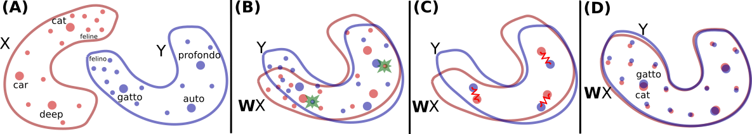
Simple Baseline Model
Projection of word embeddings. Courtesy of https://github.com/facebookresearch/MUSE
Evaluation Metric Output
Processed 51533 tokens Gold: 3558 phrases Found: 3937 Phrases Correct: 1410
Metric | Percentage
Overall F1: | 37.63
LOC F1: | 49.93
MISC F1: | 4.34
ORG F1: | 33.21
PER F1: | 47.29
Notes:
And so that was our simple model, and now we can look at some of the results it obtains. So here on the left we can see the kind of predictions it makes on the Spanish test set, and we can see two main kinds of errors. One is it just gets the category plain wrong, it’s supposed to predict B-LOC instead of B-ORG for Santander (which honestly I think is a better prediction, but uh...yeah...). And similarly, I don’t know why, but it predicts the parentheses as an I-ORG. Another error is a sequencing error with the 4 word phrase on the bottom, where we do not predict the I-ORGs, and this can be explained by the fact that our logistic regression is not really designed for predicting sequences of labels.
This was one of our more error filled outputs, and honestly even here our model does ok. We can see this reflected on our results on the test set on the right, where we got an overall F1 score of about 40%. So we can see that, if with this simple model, we are getting such good results, this cross-lingual task of NER is quite feasible, and as explained by Aashish quite worthwhile. So what past approaches have been tried?

Slide 6
Past Approaches
LSTM-CRF
Phonetic Transfer
Word Cluster Approaches
(Lample et al.)
(Bharadwaj et al., Chaudhary et al.)
(Täckström et al.)
Cross-lingual Embeddings + Neural Model
+5% F1
MultilingualMethods
(Xie et al.)
+2% F1
Lexicon, Wikipedia
(Some cross-lingual emb.)
(Chen et al.)
(Mayhew et al., Ni et al.)
Notes:
So here is a graphical overview of some of the past approaches to cross-lingual NER. One of the first approaches was this word clustering approach by Tackstrom et al. So what’s interesting is that word clusters are another form of distributional semantics, they cluster similar words together based on context, and what Tackstrom et al did was they projected word clusters across from one language to another. Side note this came out in 2012.
And some other methods that came out a few years later, in 2017, were based off of parallel lexicons or projection of annotations using Wikipedia features. For example Mayhew et al. had the ability to not use that much data, it could use just bilingual lexicons, and Ni et al. used some cross-lingual embeddings.
So then we can get into the middle model, by Xie et al., Cross-lingual embeddings + Neural Model, which achieved a +5% F1 score on the state of the art. It did this by combining some past approaches, for example recent improvements on projection of word embeddings, new LSTM CRF … can see here … performing consistently very well on monolingual data … some own modifications such as Self-Attention
el. It did this making use of recent projection advances in embeddings, powerful neural models, as well as some of its own modifications such as a self attention layer to avoid word order errors across translations. And this was in 2018.
So there have been some recent improvements on this model as well. One is in the phonetic tranfer setting. So in these two papers by Bharadwaj et al. and Chaudhary et al. they investigate whether you can project information across languages using how a word sounds, rather than for example how it is spelled. They mostly tested on low-resource languages such as Uygher, you can imagine that for some languages you might have just audio recordings, and they were actually able to achieve state of the art … on uygher … in this area?
Another paper that has improved on the score of Xie et al. is this paper by Chen et al. And they use multilingual methods! (Insert here) And they achieved a plus 2% F1 score
(You can imagine that some languages are more similar to the target language than others, so what they do is they train adversarial networks to find features that are common among all the source and target languages. And they use a Mixture-of-experts models to learn language specific features and these features can be used in varying amounts among the source languages for different target languages.)
And so yeah, those are the past approaches. For our published baseline we decided to...

Slide 7
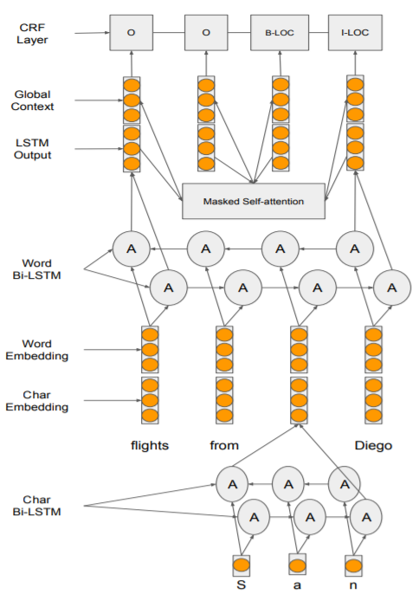
Published Baseline
Self-Attention Bi-LSTM CRF model for NER
The model can be divided into four major chunks:
Char Bi-LSTM: Generates character representations for each word
Word Bi-LSTM: Models contextual dependency within each sentence
Self Attention: Models order free context feature vectors
Linear Chain CRF: Models dependency between labels
Achieved F1 score on Validation set: 0.58
Figure source: Published Baseline paper
Notes:
We’d like to give a little backstory about data preprocessing before proceeding to the architecture:
For our published baseline we decided to utilize a combination of Self Attention Bi-LSTM model with CRF attached in the end for generating predictions.
Monolingual embeddings from fasttext was downloaded and later MUSE was used to project Spanish embeddings onto English using a small dictionary. The projection helps us get the translation of words which are present in the English training data. The translations are found via an implementation of CSLS method (cross-domain similarity local scaling ) metric as suggested by Lample et al., 2018. The word orders and Capitalization patterns are preserved during this translation.
A Self-Attention module is added on top of the word Bi-LSTM. It provides each word with a context feature vector based on all the words of a sentence, hence disregarding the ordering of words. As the context vectors are obtained irrespective of the words’ positions/order in a sentence, at test time, the model is more likely to see vectors similar to those seen at training time, which makes the model robust with respect to word order and hence offers better generalization.
In the world of sequence tagging, a rule of thumb for better accuracy: just stack a CRF on top of your LSTM layer and voila! Well the reason behind this rule is the sequential nature of the task NER tagging. CRFs tend to encode this sequential information which we will explore soon in the next slide.
So now, the original output of word level LSTM (h1, h2, h3, …) are concatenated with the Attention output (h1a, h2a, h3a, …) to make the final input for the Chain CRF layer, ([h1, h1a], [h2, h2a], [h3, h3a], …) Finally, a CRF layer is applied on top of self-Attention word Bi-LSTM outputs ([h1, h1a], [h2, h2a], [h3, h3a], …). The CRF defines the joint distribution of all possible output label sequences. For e.g. an example output label sequence could be the following: O , O, I-PER, B-PER, I-ORG, B-ORG, O, O. We use Viterbi algorithm for decoding the transition matrix weights to final output labels.
The compute the loss associated with CRF, we also send in a mask input to the model which looks like this, it ensures to penalize only for the input positions for which there exists a label.
input = [['lorem', 'ipsum 'dolor', 'sit', 'amet'],
['another', 'sentence', 'here', '<pad>', '<pad>']]
mask = [[1, 1, 1, 1, 1],
[1, 1, 1, 0, 0]]
See how <pad> is masked by 0 in the mask matrix.

Slide 8
Extensions

Slide 9
Extension 1: Using m-BERT/BETO word embeddings
Step 1: Char level
Step 2: Word level
Step 3: Word level pro
Step 4:All embeddings
Char Embedding
Glove word embedding
m-BERT/BETO embedding
Concatenate all
100 dimension character embedding encapsulating to capture morphological variations and capitalization patterns
100 dimension spanish word embedding
768 dimension word embedding from m-BERT/BETO
Concatenating char, glove and m-BERT/BETO embeddings to get 968 dimension vector
Notes:
For extension 1 we perform two sub-experiments: Sub experiment 1 is using 768 dimension word embeddings from pretrained m-BERT. Sub experiment 2 is using 768 dimension word embeddings from pre trained BETO model. Word embeddings are only extracted for the cheaply translated spanish words. 25 dimension Character embedding and 100 dimension GloVe word embedding are concatenated with 768 dimension m-BERT or BETO as shown in step 4 to produce a 893 dimension vector that is passed onto the bidirectional word LSTM.

Slide 10
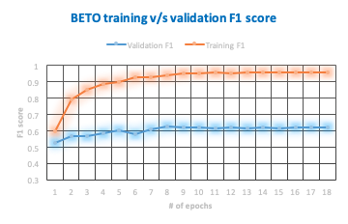
Extension 1: Using m-BERT/BETO word embeddings-Results
F1 Score
Word embedding used | Training F1 | Validation F1
m-BERT+GloVe | 0.89 | 0.656
BETO+GloVe | 0.94 | 0.627
Only GloVe | 0.92 | 0.580
Notes:
We noticed overfitting similar to what is shown in graph on right wherein F1 training score reached 0.95 whereas F1 validation was only around 0.6. We were already using dropout of 0.5 after bidirectional word LSTM. So for our best model we used a weight decay of 1e-4. We were able to reduce overfitting and achieved our best F1 validation of 0.6560 on the model utilizing pre-trained m-BERT word embeddings. This F1 validation score is around 8 points higher than our published reimplemented baseline. BETO word embeddings utilizing model performed slightly worse with best F1 validation score of 0.6270. This we suspect is due to the fact that m-BERT is much larger than BETO in terms of encompassing number of spanish words. So while for BETO embeddings we were marking OOV words with a unique <UNK> or “unknown” word embedding for m-BERT we received word embeddings for all the words required by our model.

Slide 11
Extension 2: Using Entity Distribution Information & Dutch Language
ENTITY INFO
DUTCH DATA
Intuition: Using prior Entity type distribution information helps
Proposed two experiments to include the previous tags information
Intuition: Dutch is syntactically similar to Spanish. Hence, using both English and Dutch to transfer to Spanish will help
Finding the average embedding of each entity type from the training data and computing the distance vector
Using the ratio of times the word appears as each entity
We use Unsupervised Multilingual Word Embeddings(UMWE) to transfer English and Dutch data to Spanish
Notes:
The main intuition for extension 2 is that using prior Entity/Category distribution information will help the model learn better. We also wanted to consider the language Dutch, which is more related to Spanish than English. That is, use both English and Dutch language as source language and Spanish as target language.
We performed two experiments to the observe the effect of categorical information on predicting the entity. For the first experiment(DISTANCE) we calculated the average embedding of each entity on the training data. We calculated an additional vector that computes the distance between the given embedding and all the entity embeddings. We used this vector as an input by concatenating it with the word embedding. For the second experiment(RATIO) we used the distribution information of each word as it appears in the training data. That is the ratio of times the word appears as each entity.
We also try to train the model on both English and Dutch data using UMWE Multilingual vectors(UMWE). We use the 300 dimensional Spanish vectors created in this method to train our model. We are using no additional data.

Slide 12
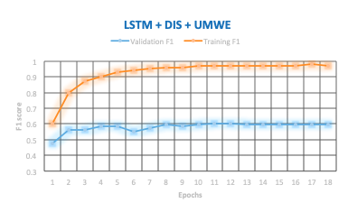
Extension 2: Using Entity Distribution Information & Dutch Language
 | TRAIN F1 | VAL F1
LSTM | 0.92 | 0.580
LSTM + DIS | 0.95 | 0.579
LSTM + RATIO | 0.94 | 0.569
LSTM + DIS + UMWE | 0.97 | 0.602
LSTM + RATIO + UMWE | 0.93 | 0.580
Notes:
LSTM: Published Baseline
DIS: Vector of distance from the average word embeddings of each entity
RATIO: Vector of ratio of times the word appears as each entity
UMWE: Additional Dutch data using UMWE word embeddings
We can clearly observe that using by Dutch data, the performance of the model improves. Dutch having similar syntax to Spanish improves the translations. Using distance to average entity embeddings feature has better performance than using ratio of times each word appears. This could be due to that ratio information would make the model biased towards the entity with the higher ratio. And ratio feature also depends on the prior that the word appears in the training data. Whereas the distance feature could capture the dimensional information pertaining to that entity. It is easily generalizable compared to ratio feature.

Slide 13
INTEGRATED MODEL
DISTANCE ENTITY INFORMATION
+
DUTCH DATA
Final Model
m-BERT
TRAIN F1: 0.830
VAL F1: 0.675
TEST F1: 0.637
Model | Test F1 Score
LSTM | 0.540
LSTM + DIS +UMWE | 0.563
LSTM +m-BERT and Glove | 0.627
LSTM +m-BERT +DIST +NED | 0.637
Notes:
We integrated the best performing combinations of both the extensions into one model. For our final model we used m-BERT embeddings, distance to average entity embeddings and Dutch dataset. Since, m-BERT handles multilingual embeddings, we used it for translating Dutch and English training data instead of UMWE vector. We also used m-BERT for finding the distance to average category vector.
This resulted in a model with validation F1 of 67.5% and test F1 of 63.7%. This model outperformed the published baseline by 9%.

Slide 14
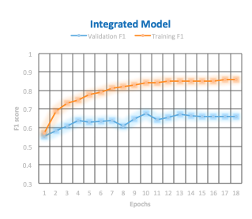
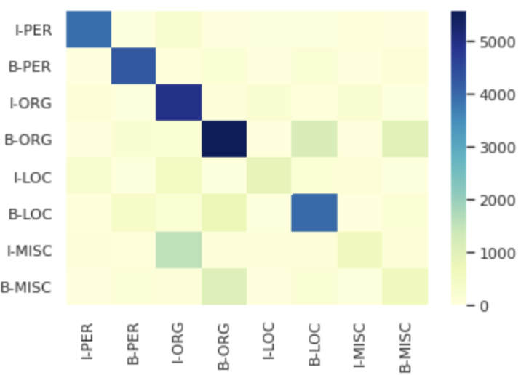
INTEGRATED MODEL
Confusion Matrix
Notes:
The model overfits after the 10th epoch. At the 10th epoch we observe a train f1 score of 0.84 and validation f1 score of 0.67. The test f1 score is 0.63.
As we can see in the confusion matrix, the model best identifies the entities PER and ORG. It has a hard time trying to identify MISC entities. It usually misidentifies MISC as ORG or LOC based on the context. The model also confuses when two entities are next one another. It considers the second entity as part of the first entity.
When a LOC entity such as “A Coruna”, the first word is labelled wrongly as non-entity and subsequently “Coruna” was labelled “B-LOC” instead of “I-LOC”. Some words like "de la" which mean "of the" are usually not considered entities when they appear in entities. For example: "Ernesto Gomez de la Hera" (Ernesto Gomez of the Hera).

Slide 15
References
Xie, J., Yang, Z., Neubig, G., Smith, N.A. and Carbonell, J., 2018. Neural cross-lingual named entity recognition with minimal resources. arXiv preprint arXiv:1808.09861.
Zhai, Z., Nguyen, D.Q. and Verspoor, K., 2018. Comparing CNN and LSTM character-level embeddings in BiLSTM-CRF models for chemical and disease named entity recognition. arXiv preprint arXiv:1808.08450.
Chen, X., Cardie, C.: Unsupervised multilingual word embeddings. arXiv preprint arXiv:1808.08933 (2018)
http://blog.echen.me/2012/01/03/introduction-to-conditional-random-fields/
https://towardsdatascience.com/implementing-a-linear-chain-conditional-random-field-crf-in-pytorch-16b0b9c4b4ea
http://www.cs.columbia.edu/~mcollins/crf.pdf

