Slide 1

IOS Mobile APP Analysis Cohort B Team 4
Yuhong Lu, Xiaohan Mei, Ziyan Pei,
Peng Yuan, Mengqing Zhang, Jiayuan Zou

Slide 2
QUESTIONS TO SOLVE
Visualization and Analytics of IOS Apps
The most popular category & Apps
Free/Paid Apps
Success of an App:
How could I develop the most popular App in the world???
Predict the Rating by ML models

Slide 3
Dataset
Source: Mobile App Store from Kaggle
URL: https://www.kaggle.com/ramamet4/app-store-apple-data-set-10k-apps/kernels
Collected Date: July 2017
Via: ITUNES Search API from APPLE Inc with R/Linux Web scraping
DATASETS:
appleStore.csv
appStore_description.csv
*Merged into one datasets BY id

Slide 4
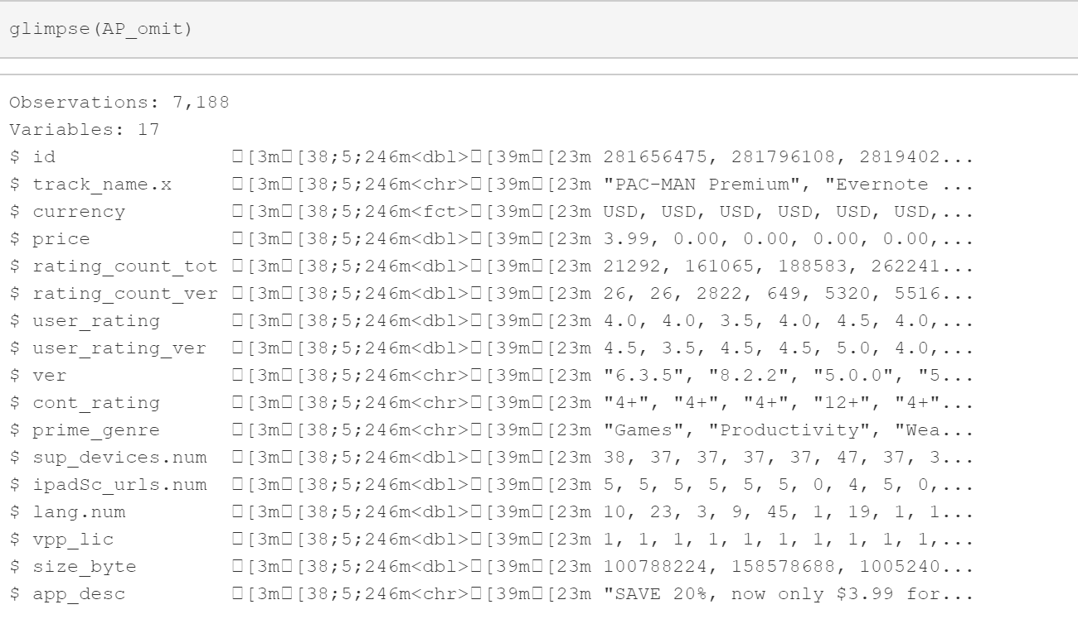
Dimension of Dataset

Slide 5
Dependent & Independent Variables
Dependent variable: user_rating
Independent variables
price
rating_count_tot (the number of ratings for an App)
cont_rating (content rating)
sup_devices.num (number of supporting devices)
size_bytes (the size of app in bytes),
prime_genre (the category of the app)
ipadSc_urls.num (number of screenshots shown for display)
lang.num (number of supported languages)
vpp_lic (Vpp Device Based Licensing Enabled,1 means APP uses device-based license, 0 means APP uses apple-id based license)

Slide 6
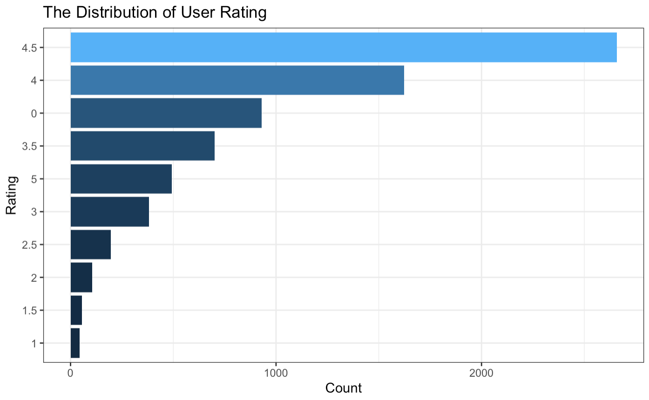
Distribution of Category & Rating
 | Category | Number
1 | Games | 3855
2 | Entertainment | 534
3 | Education | 453
4 | Photo & Video | 348
5 | Utilities | 248
6 | Health & Fitness | 180
7 | Productivity | 178
8 | Social Networking | 167
9 | Lifestyle | 144
10 | Music | 138
11 | Shopping | 122
12 | Sports | 114
13 | Book | 112
14 | Finance | 104
15 | Travel | 81
16 | News | 75
17 | Weather | 72
18 | Reference | 64
19 | Food & Drink | 63
20 | Business | 57
21 | Navigation | 46
22 | Medical | 23
23 | Catalogs | 10

Slide 7
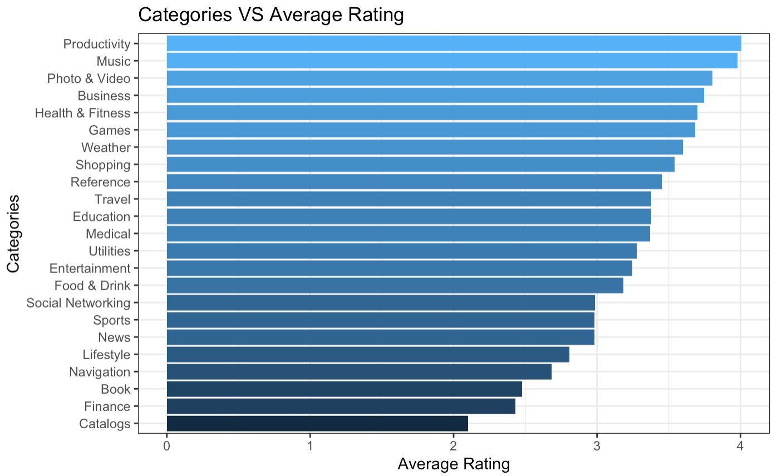
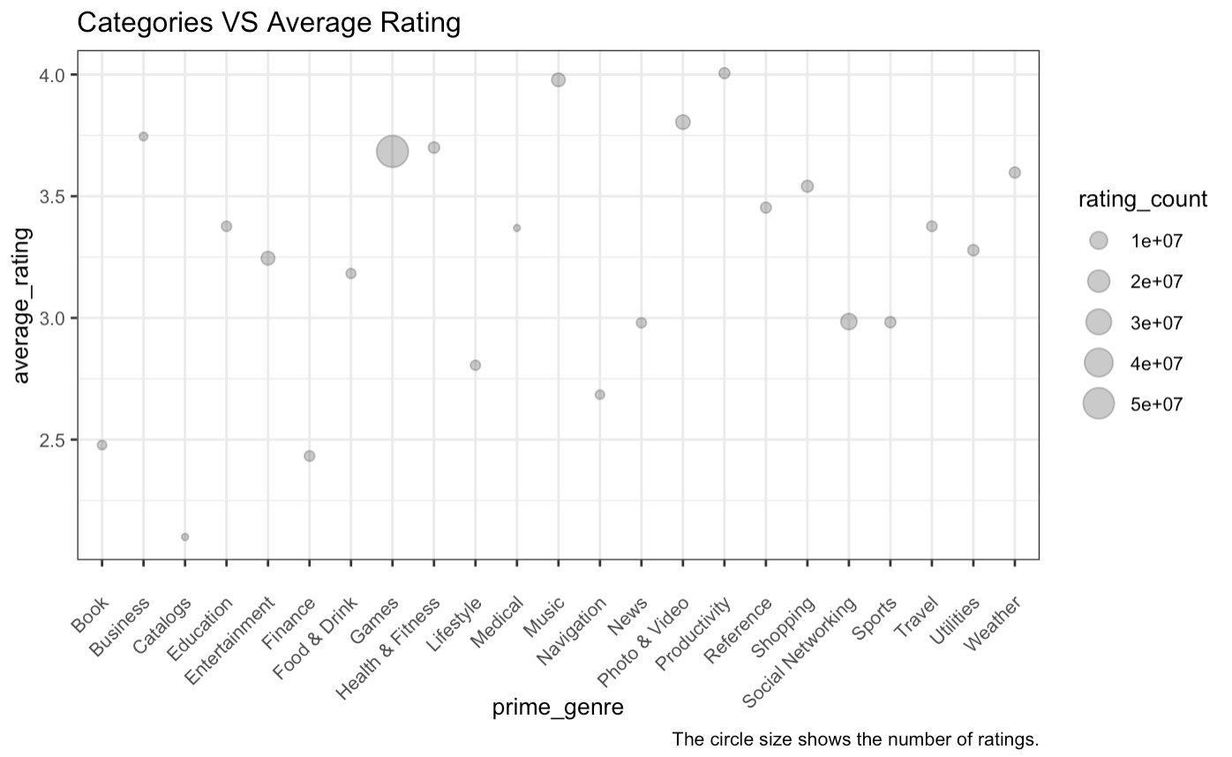
Categories VS Average User Rating

Slide 8
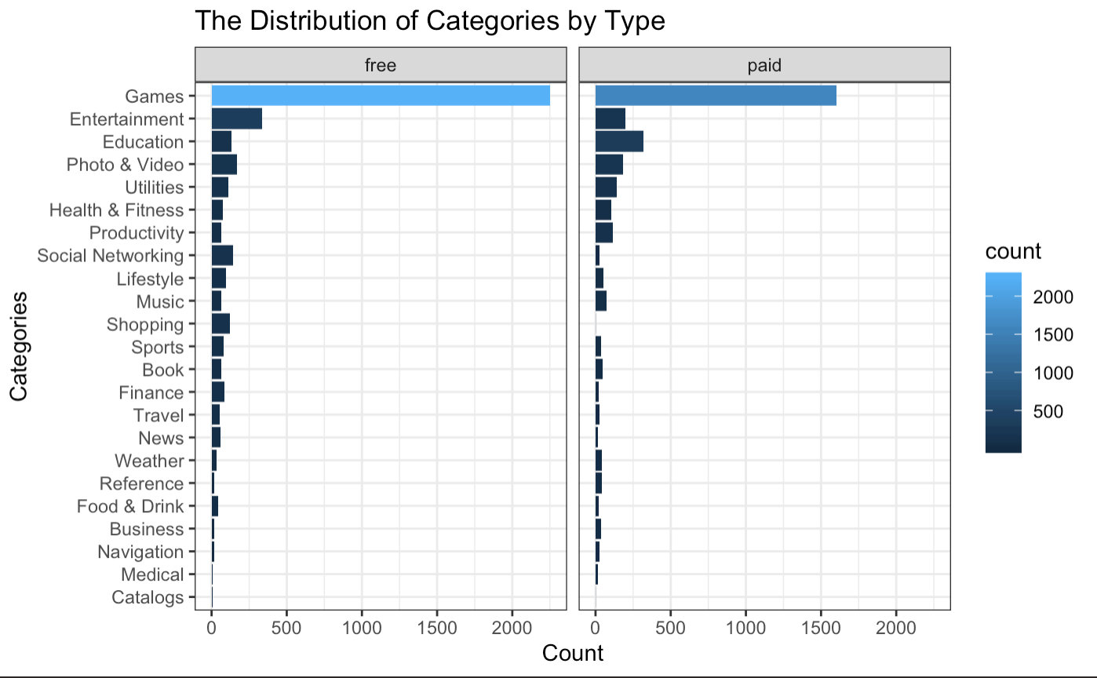
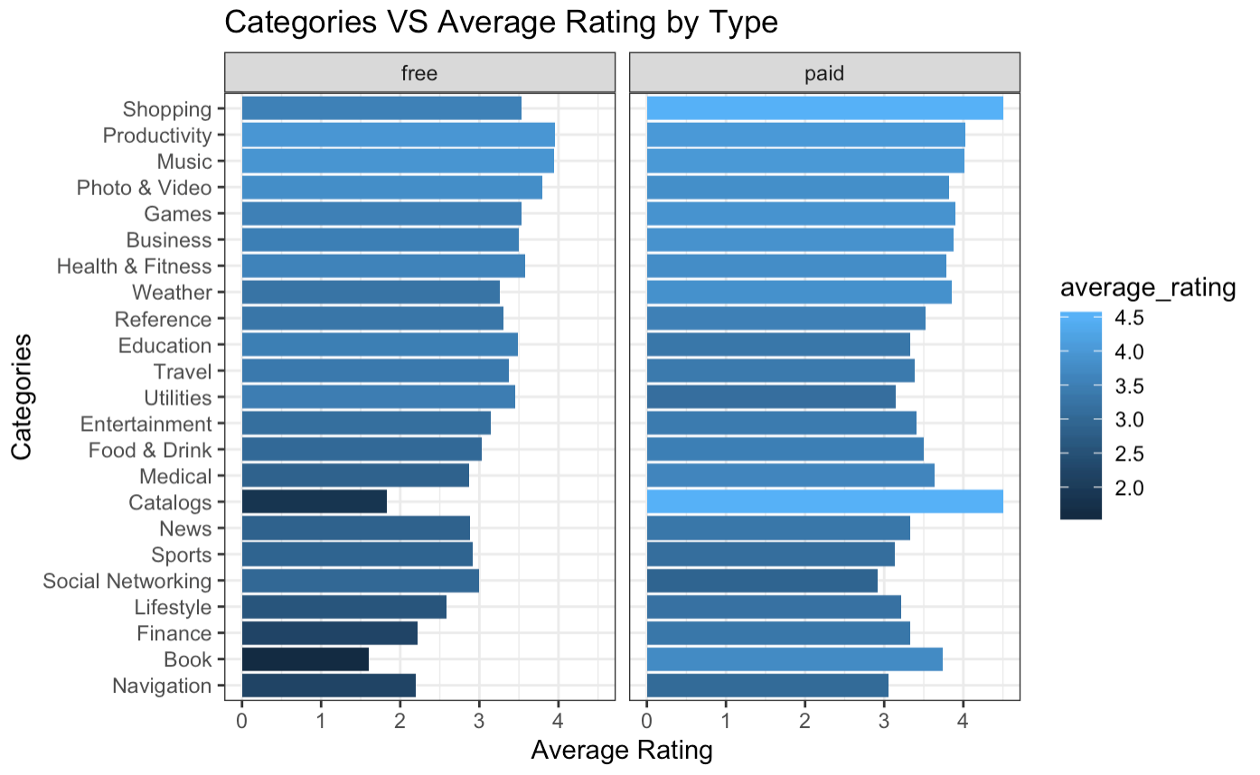
Free and Paid Apps

Slide 9
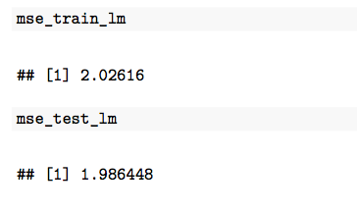
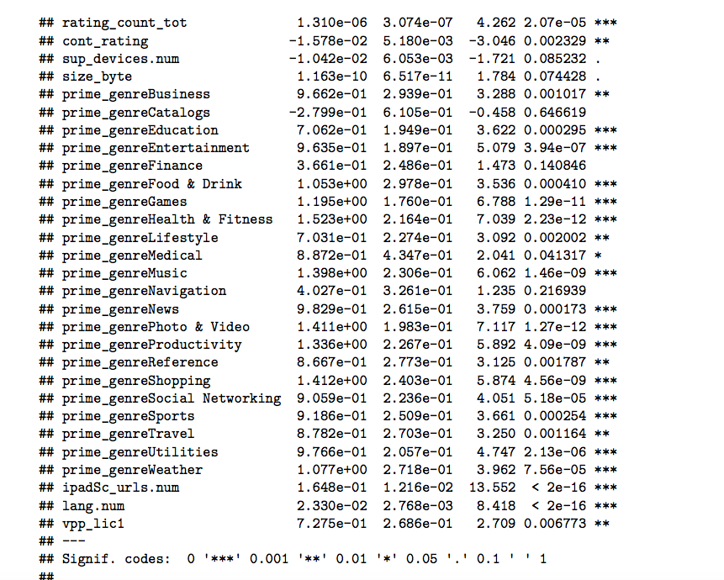
Linear
Linear regression without CV
Linear regression with CV

Slide 10
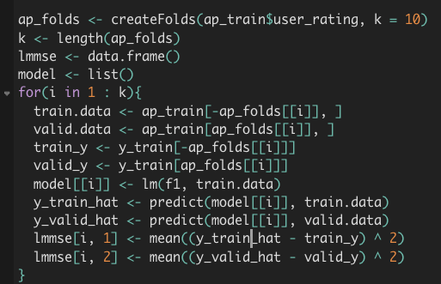
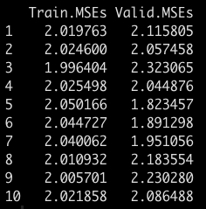
Linear
How to train better LR Model?
VS. Test MSE without CV
= 1.986

Slide 11
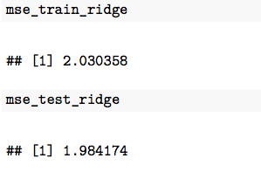
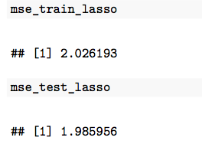
Linear Ridge Lasso
Linear
Ridge
Lasso
with CV
without CV
Test mse =1.986449

Slide 12
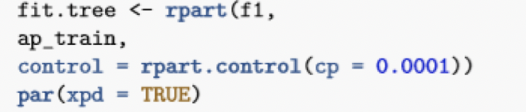


Tree - Regression Tree
1. Printcp will tell you what the cp of splitting into different number layer and show their different error and std.
2. Choose the parameter (cp) with the smallest xerror.
3. Then refit and prune back the tree with the cp that has the smallest xerror.

Slide 13
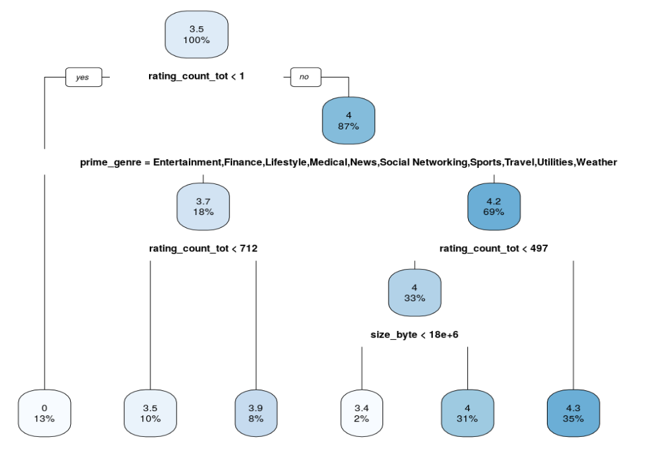
Tree - Regression Tree
MSE of train = 0.3956153
MSE of test = 0.39381

Slide 14
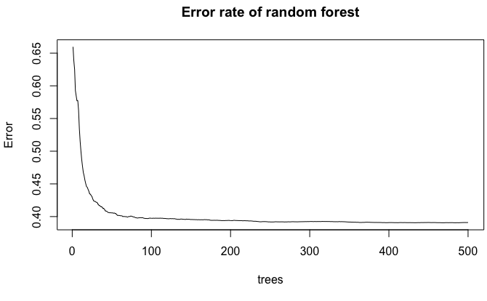
Random Forest
Notes:
#This plot shows the error of the random forest model. As the number of trees increases, the error approaches around 0.3. Thus we choose ntree =300 into the randomForest function.

Slide 15
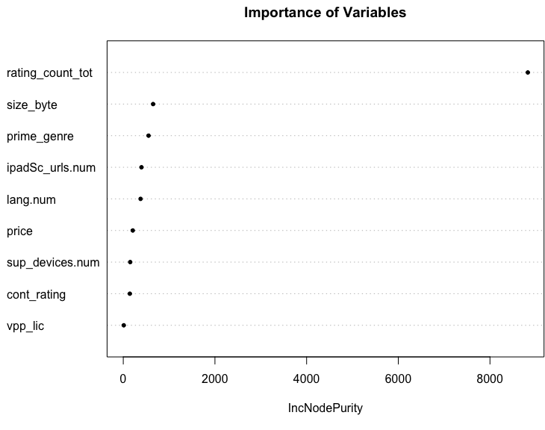
Random Forest
MSE of train =
0.1044315
MSE of test = 0.3684317
Notes:
#This plot shows the error of the random forest model. As the number of trees increases, the error approaches around 0.3. Thus we choose ntree =300 into the randomForest function.

Slide 16
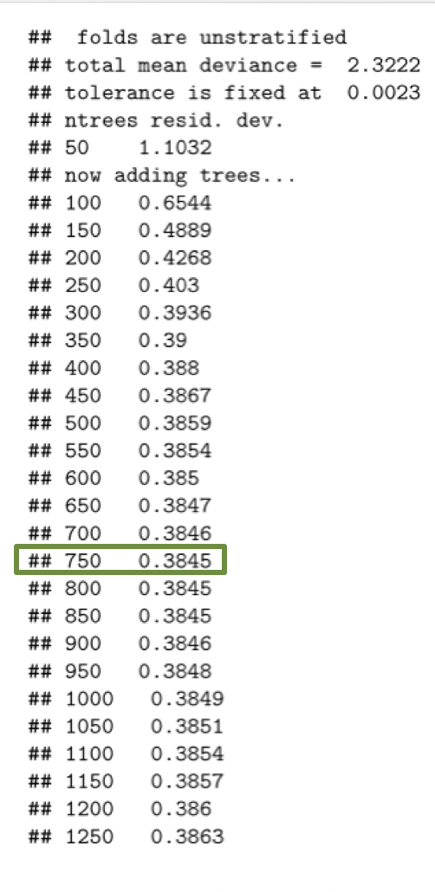
Boosting
Alpha / Learning Rate = 0.01
# of Trees - by gbm.step
# of Trees = 750

Slide 17
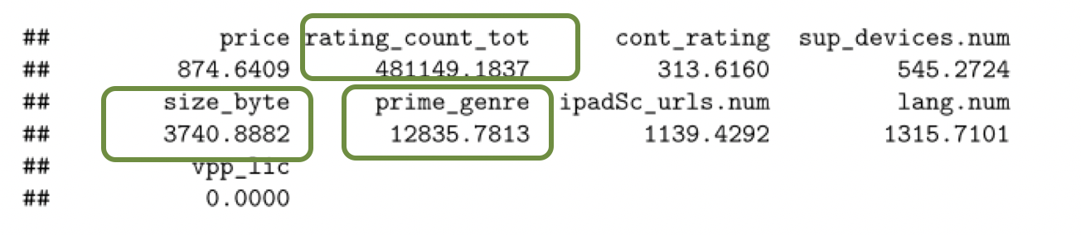
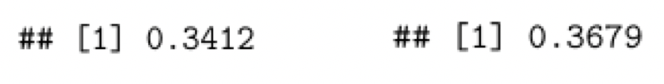
Boosting
Significance Level
MSE for Test vs Validation Set

Slide 18
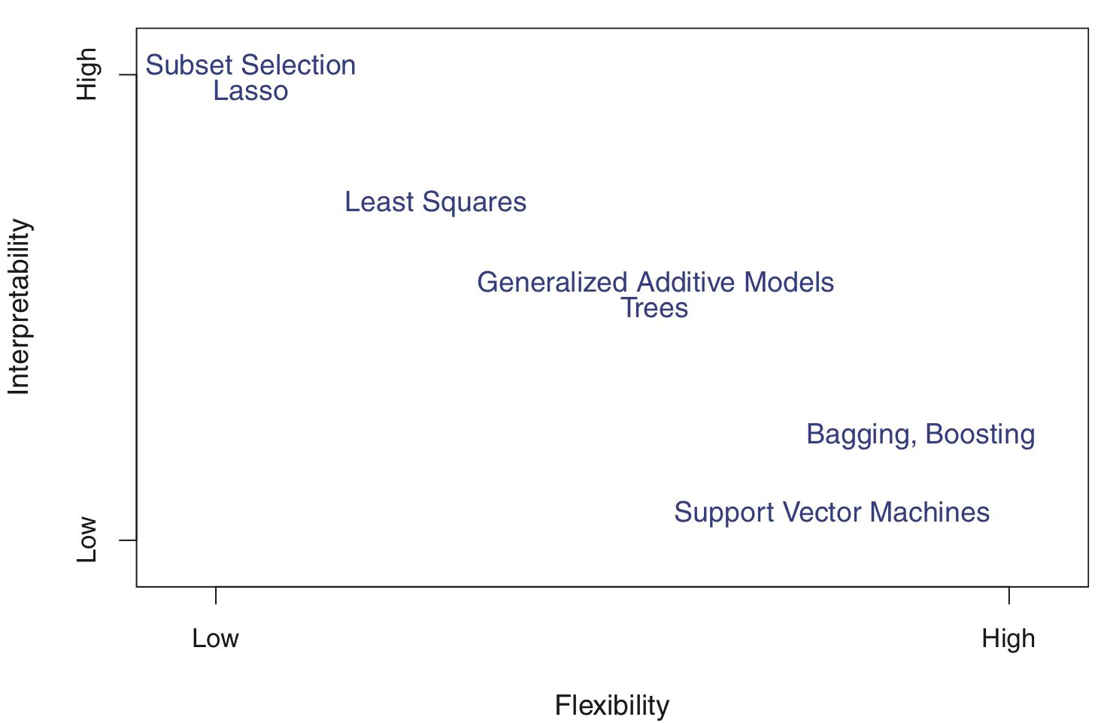
Summary
How could I develop the most popular APP in the world?

Slide 19
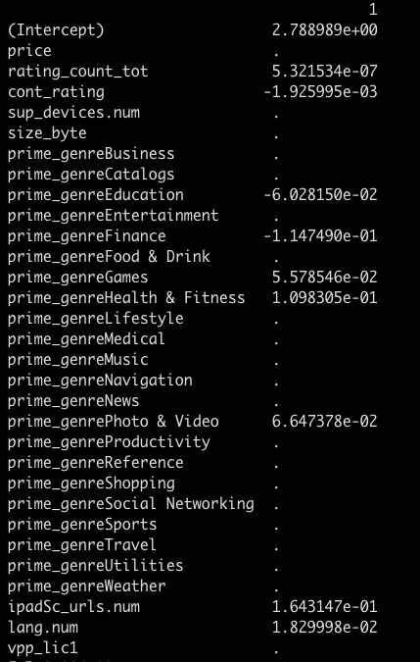
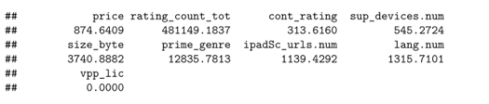
Summary

Slide 20
Summary
Many
Comments
Price +++
Languages
Game
Screen
Shots

Slide 21
Challenge
Lesson
How to construct cross validation for our poor linear regression?
Trade – off between interpretability vs. Flexibility
Choose Tree (higher MSE, but better to interpret)
or Boosting (Better MSE, but very hart to interpret)

Slide 22
Q & A

