Slide 1
Motor Fault Detection Using MCSA & Machine Learning
ELECTRICAL MACHINES EE-260
INSTRUCTOR NAME: DR. FARID GUL
LAB ENGINEER NAME : YASIR RIZWAN
STUDENT NAME | CMS ID
MUHAMMAD HUSSAIN | 457358
SAMI HAIDER MIRZA | 469908
MUHAMMAD JAHAN ZAIB | 458924
RANA MUHAMMAD BILAL | 465138

Slide 2
Introduction to Induction Motor Fault Detection
Background:
  Induction motors are critical components in industrial applications, accounting for 40-50% of industrial electricity consumption
Problem Statement:
  Unexpected motor failures lead to costly downtime, production losses, and safety hazards
Types of Faults Studied:
  Bearing faults: Broken Rotor Bar (BRB), Ball Fault Inner race (BFI), Ball Fault Outer race (BFO)
  Fault severity levels: 100, 200, 300 (representing increasing damage)
Solution Approach:
  Early fault detection using current signature analysis and machine learning classification

Slide 3
Dataset and Experimental Setup
Motor Specifications:
  Three-phase induction motor
Data Collection:
  Current measurements from all three phases (Phase A, B, C)
Sampling Rate:
  10,000 Hz
Dataset Structure:
  9 classes: Healthy, BRB100, BRB300, BFI100, BFI200, BFI300, BFO100, BFO200, BFO300
  Each CSV file contains time-series current data (rows = timestamps, columns = phases)
Data Split:
  60% Training, 20% Validation, 20% Testing

Slide 4
Signal Processing Architecture
Two-Domain Analysis Approach:
Time-Domain Features:
  Raw current waveform analysis
  Statistical features (mean, std, RMS)
  Amplitude modulation patterns
Frequency-Domain Features (FFT):
  Focus on 40-70 Hz range (around supply frequency)
  6 features per phase (18 total):
    Peak magnitude, Mean magnitude
    Supply frequency (50 Hz) magnitude
    Sideband asymmetry (left vs right)
    Total sideband power
    Peak frequency location

Slide 5
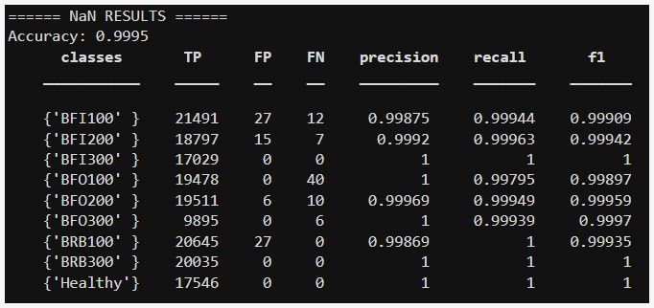
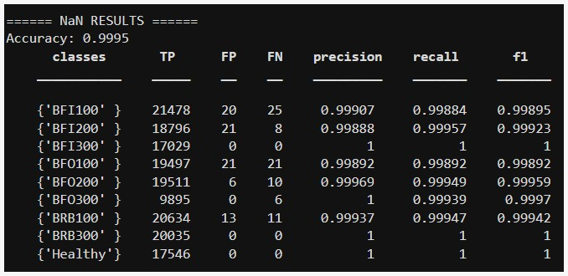
Machine Learning Models
TRAINING MODEL | ACCURACY
Naive Bayes | 0.2951
Decision Tree | 0.3359
Linear Discriminant | 0.1515
KNN | 0.9995
Random Forest | 0.9995
AdaBoost | 0.3324
Quadratic Discriminant | 0.5390

Slide 6
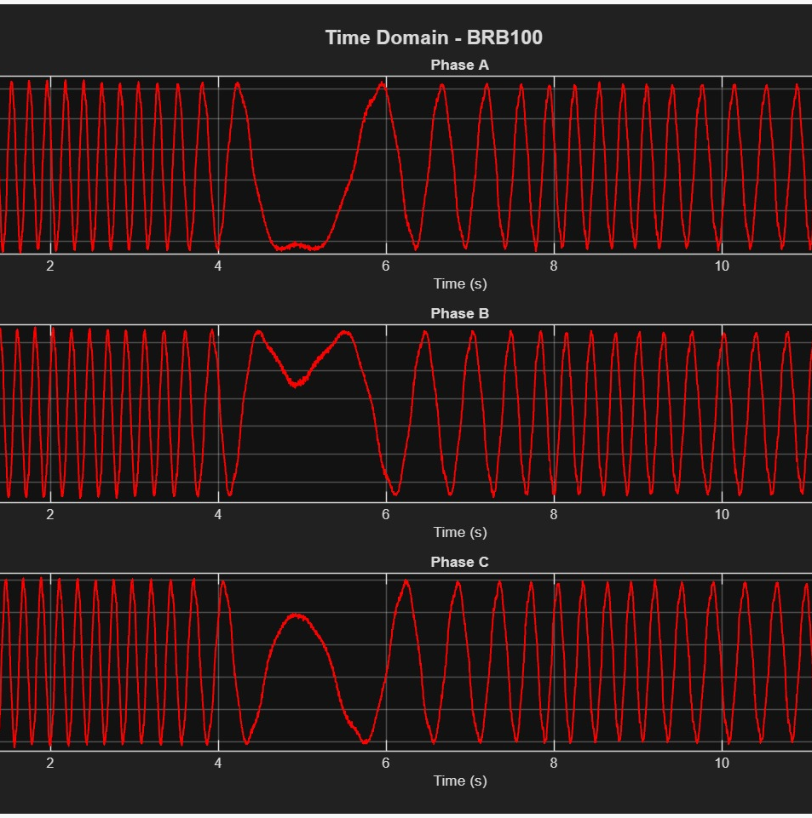
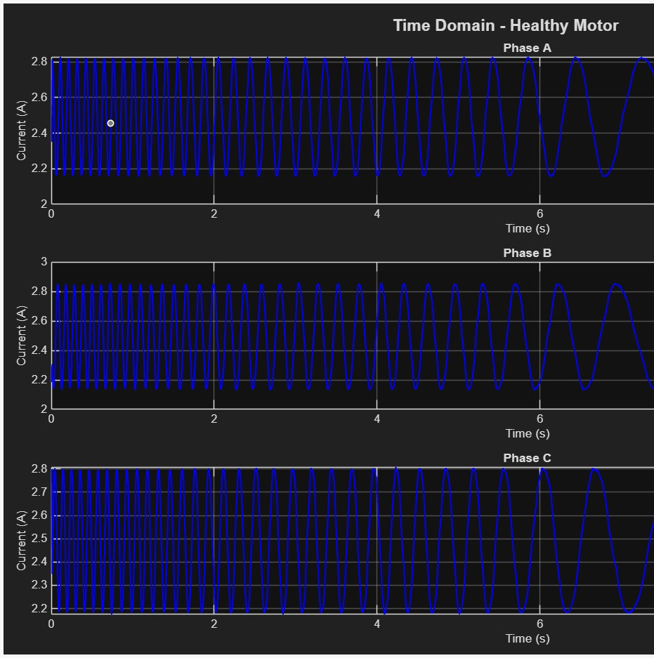
Time Domain Analysis

Slide 7
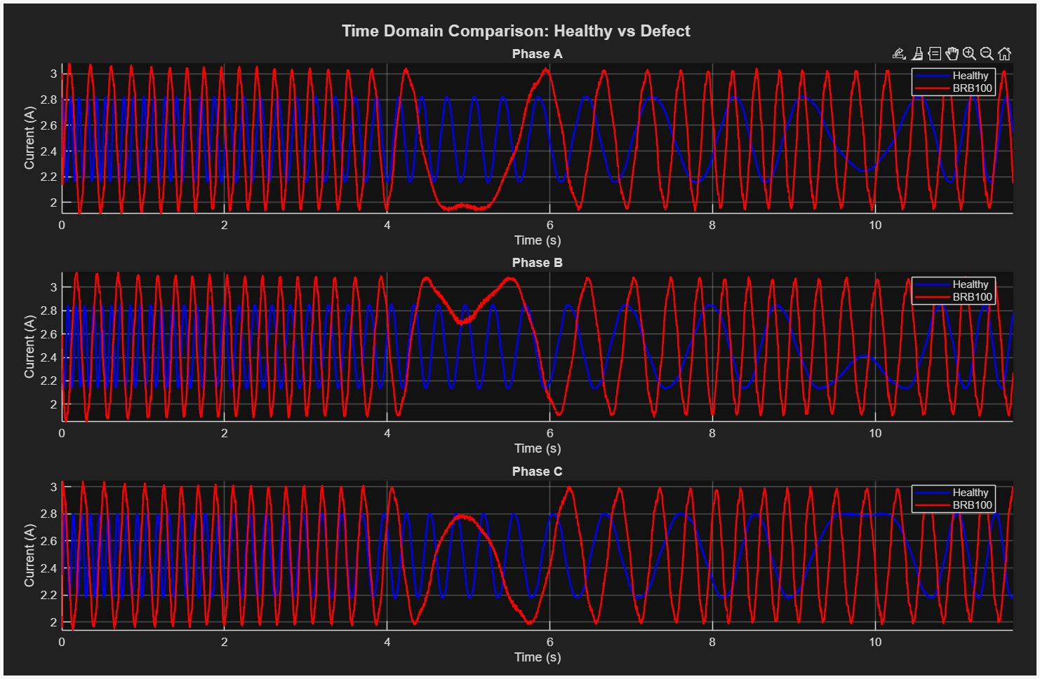
Time Domain Healthy vs Defective

Slide 8
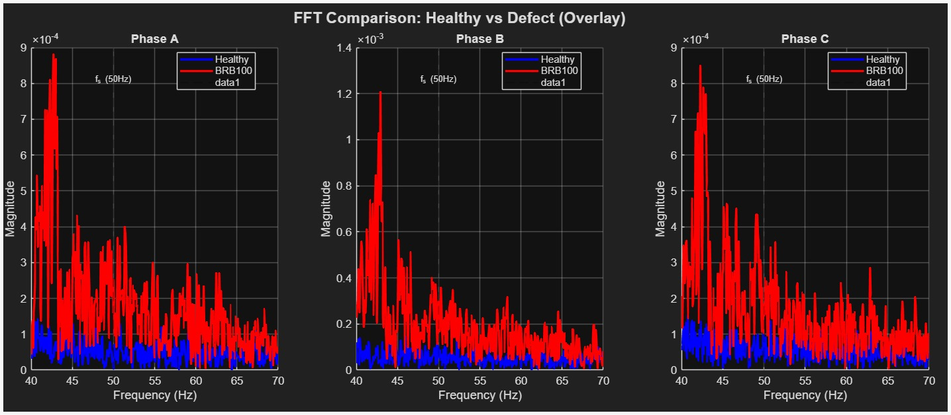
FFT Analysis

Slide 9
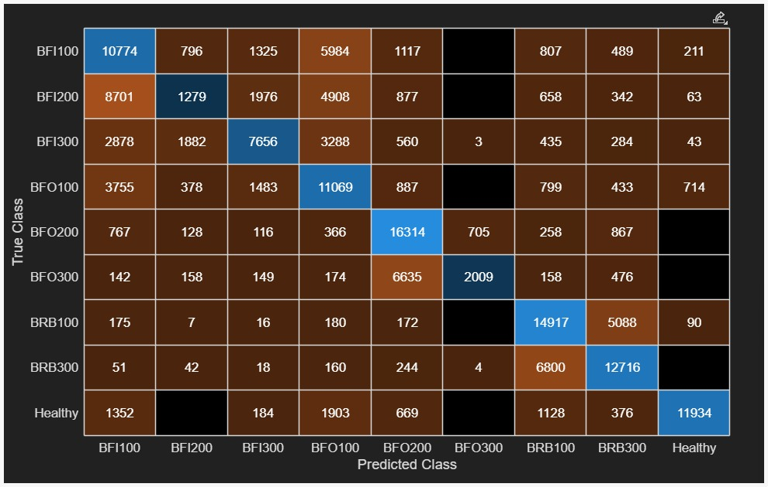
Confusion Matrix Analysis

Slide 10
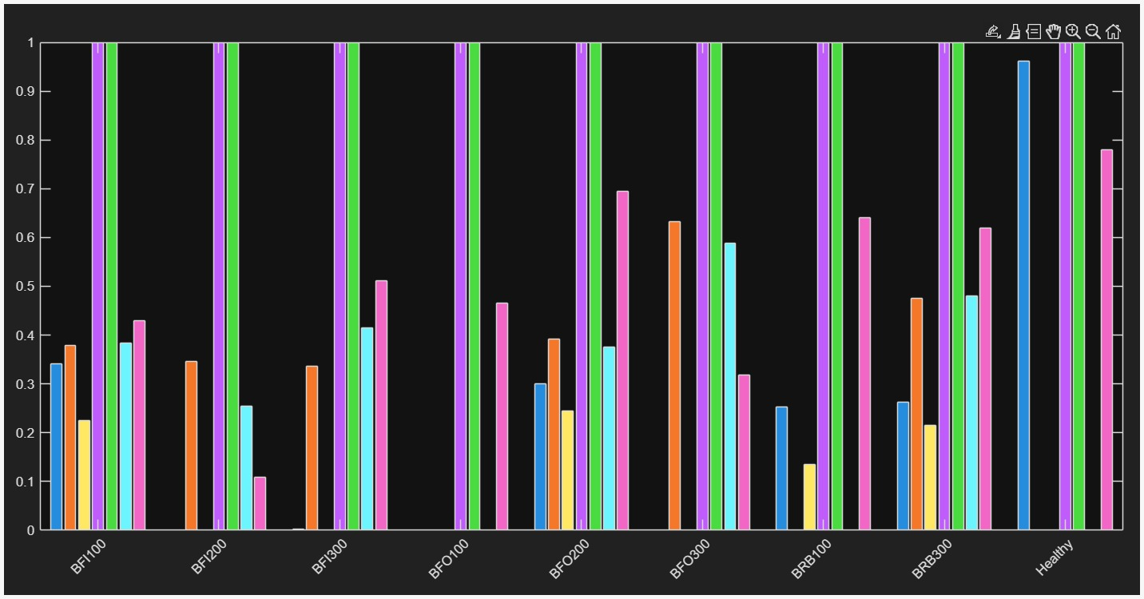
Different Models with Accuracy

Slide 11
Conclusion
Major Achievements:
  Successfully developed ML-based motor fault classifier with 99.8% accuracy
  Identified optimal frequency range (40-70 Hz) for bearing fault detection
  Random Forest proved most effective among 7 ML algorithms tested
Practical Benefits:
  Non-invasive condition monitoring (current sensors only)
  Real-time fault detection capability
  Reduces maintenance costs through predictive maintenance

Slide 12
Current Research Areas
Deep Learning Approaches:
  CNNs and LSTMs for automatic feature extraction from raw signals
  Transfer learning to reduce training data requirements
  Attention mechanisms identifying critical fault patterns
Multi-Sensor Fusion & IoT Integration:
  Integration of current, vibration, thermal, and acoustic sensors
  Edge computing for real-time monitoring with low-power devices
  Cloud-based predictive maintenance platforms
Explainable AI (XAI):
  Interpretable models using SHAP and LIME techniques
  Feature importance visualization for maintenance personnel
  Transparent fault diagnosis for operator trust

Slide 13
References
Analysis of multiple faults in induction motor using machine learning techniques
Fault detection in induction motors based on motor current signature analysis and accelerometer
Dataset from Mehran University of Engineering and Technology
Current Signature Dataset of Three-Phase Induction Motor under Varying Load Conditions

