Slide 1
Youtube Trending Video Views Prediction and Latent Semantic Analysis
Jiajie Zhang
12/15/2019
Notes:
1) specific challenges unique to your datasets, and 2) interesting insights derived from your analysis.

Slide 2
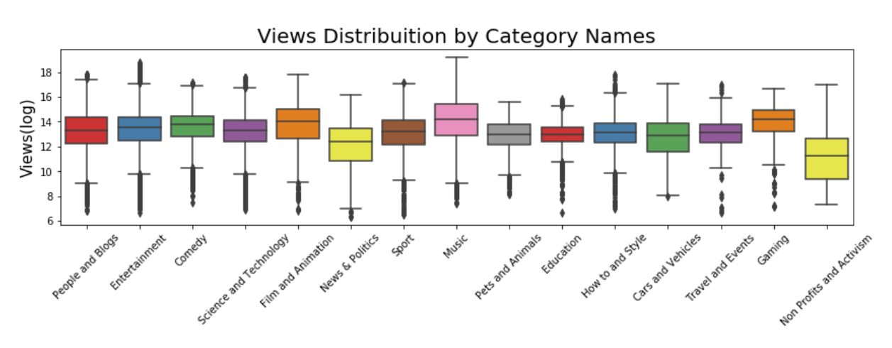
Dataset Overview
    Most viewed video category?
https://www.kaggle.com/kabure/extensive-usa-youtube-eda

Slide 3
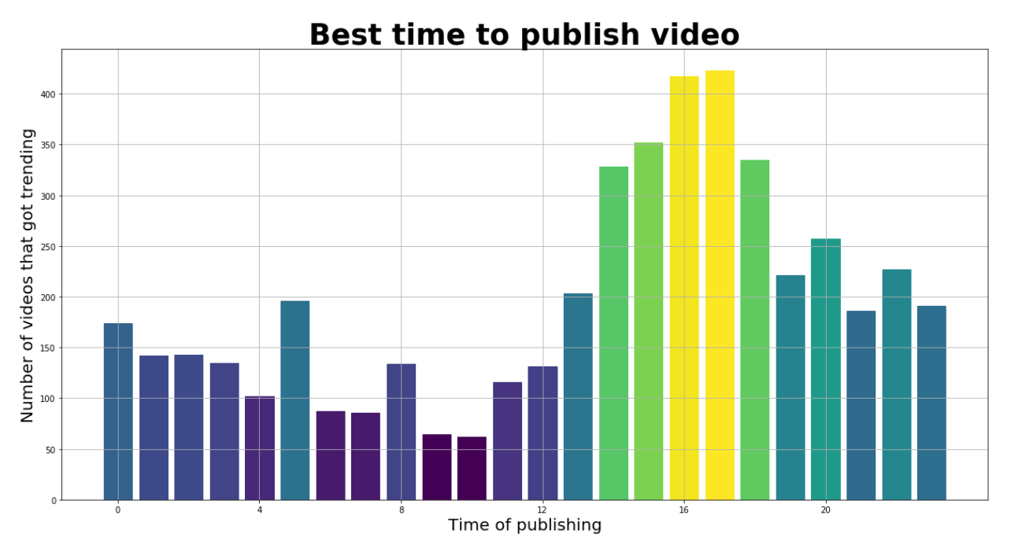
Dataset Overview
    Best hour in a day to publish video?
https://www.kaggle.com/skalskip/youtube-data-exploration-and-plotly-visualization

Slide 4
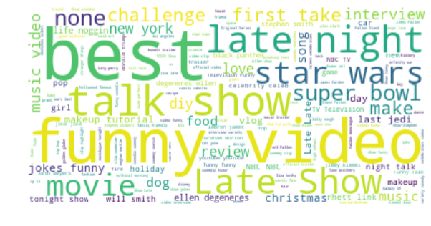
Dataset Overview
    Popular video topics?

Slide 5
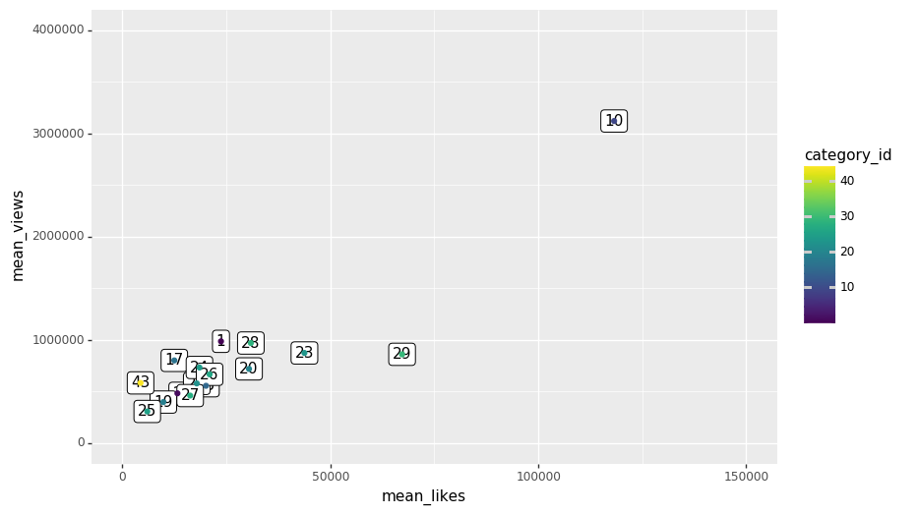
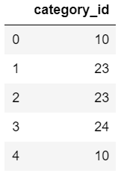
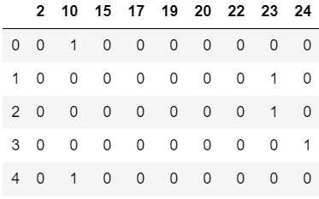
Unique Data Engineering
Categorical variables
  Dummy coding

Slide 6
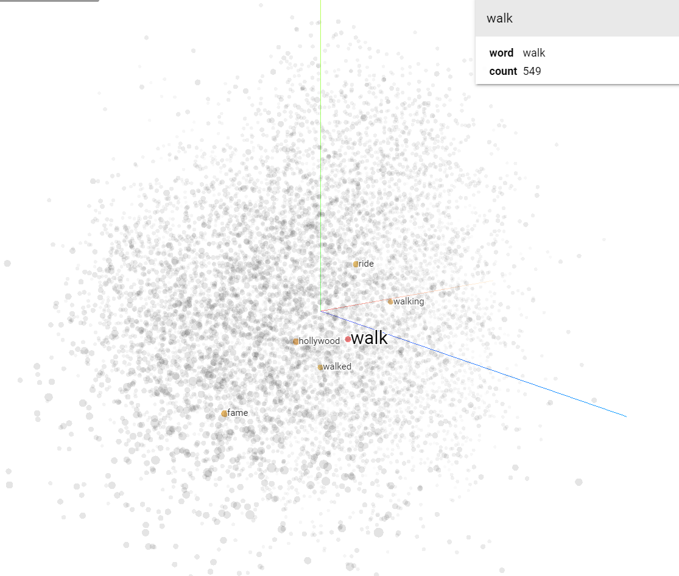
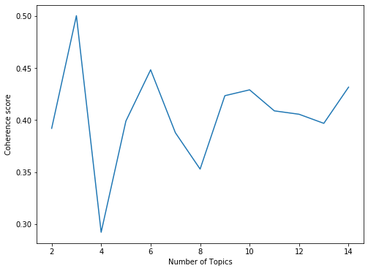
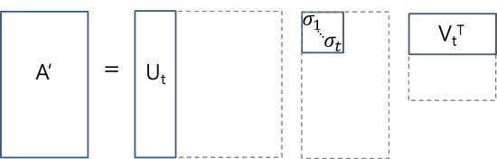
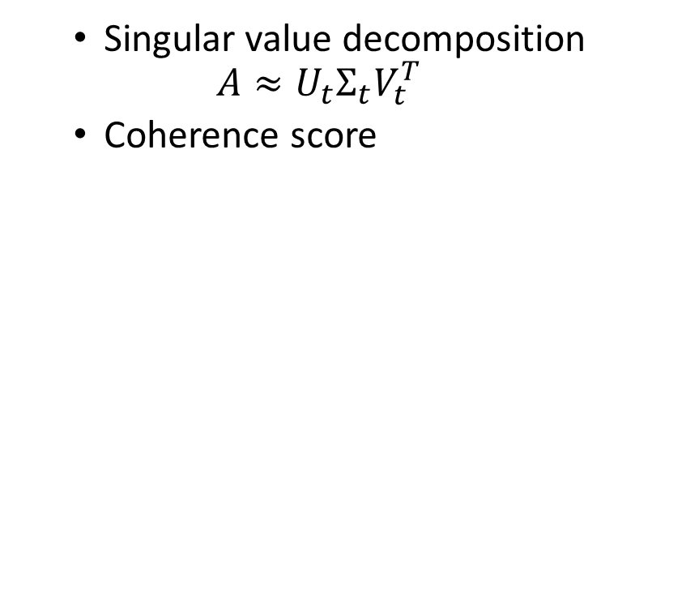
Latent Semantic Analysis on Tags
  Word to vec
  Singular value decomposition
  $$A≈U_{t}Σ_{t}V_{t}^{T}$$
  Coherence score
C×C
C×D
T – term
D – document
C - concept
T×D
T×C
Coherence score vs. number of topics
David Mimno, Hanna M. Wallach, Edmund Talley,Miriam Leenders, and Andrew McCallum. 2011Optimizing semantic coherence in topic models. In Proceedings of the 2011 Conference on Empirical Methods in Natural Language Processing
Notes:
LSA assumes that words that are close in meaning will occur in similar pieces of text (Distributional semantics )
Where that U and V are orthogonal matrices and $Σ$ is a diagonal matrix. Whereas t here denotes term, C is the concept or topic we’d like to conclude, D is length of term vectors.
Similar to Principle Component Analysis, LSA finds a low-rank approximation, the first few dimensions often explain most of the variance in the original matrix A.
Coeherence score is an Is an aspect that evaluates the quality of the number of topics you choose, the higher the covariance score is indicates that the the way we define the topics is more meaningful

Slide 7
Results
Bayesian Regression Model & Support Vector Machine
Input size: 23888×(# numerical values + dummy variables + LSA matrix)
Topics:
0.575*"song" + 0.312*"punjabi" + 0.293*"2018" + 0.264*"new" + 0.258*"meme" + 0.200*"latest" + 0.186*"news" + 0.124*"2017" + 0.116*"dank" + 0.116*"funni"
-0.770*"meme" + -0.351*"dank" + 0.264*"song" + -0.240*"compil" + -0.171*"funni" + 0.147*"punjabi" + -0.117*"comment" + -0.116*"award" + 0.102*"2018" + 0.093*"latest"
-0.648*"news" + -0.388*"trump" + 0.358*"song" + 0.199*"punjabi" + -0.175*"live" + -0.141*"show" + -0.137*"donald" + -0.108*"polit" + -0.091*"msnbc" + -0.089*"presid"
0.472*"vs" + 0.416*"highlight" + 0.387*"game" + -0.263*"news" + 0.213*"nba" + 0.178*"cavali" + -0.173*"song" + -0.155*"trump" + 0.136*"2018" + 0.128*"warrior"
0.429*"crime" + 0.286*"tv" + 0.273*"episod" + 0.262*"serial" + -0.262*"song" + 0.206*"drama" + -0.200*"news" + 0.192*"comedi" + 0.163*"soni" + 0.162*"show"
0.683*"food" + 0.234*"street" + 0.201*"link" + 0.199*"rhett" + 0.156*"mythic" + 0.150*"video" + -0.132*"2018" + 0.127*"react" + -0.123*"tulfo" + 0.112*"good"

Slide 8
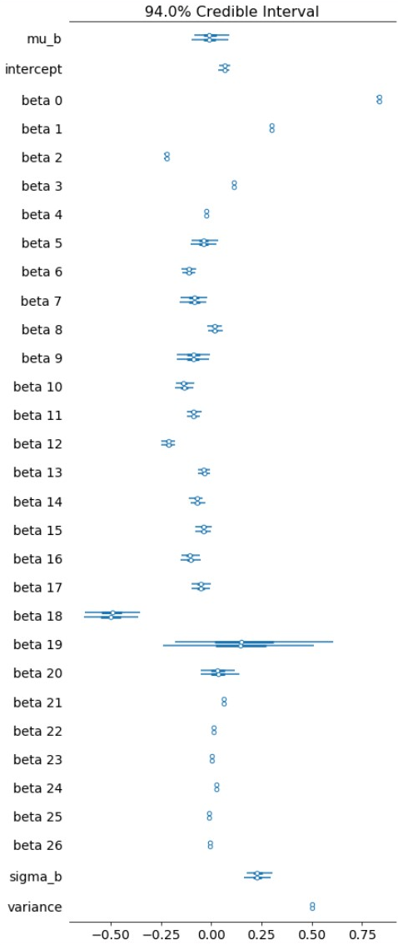
Effective Coefficients
 | mean | sd | hpd_2.5 | hpd_97.5
mu_b | -0.00971 | 0.045733 | -0.09736 | 0.079747
intercept | 0.064742 | 0.015011 | 0.036601 | 0.097235
likes | 0.83344 | 0.005801 | 0.822138 | 0.845003
dislikes | 0.298911 | 0.003883 | 0.291036 | 0.306245
comment_count | -0.22152 | 0.006064 | -0.23349 | -0.20988
trending_days | 0.11124 | 0.003396 | 0.104438 | 0.117628
like_dislike_ratio | -0.02461 | 0.003256 | -0.03117 | -0.01869
2 | -0.03744 | 0.034307 | -0.10615 | 0.025644
10 | -0.11076 | 0.020473 | -0.14903 | -0.07047
15 | -0.08416 | 0.038401 | -0.15619 | -0.00593
17 | 0.018741 | 0.02 | -0.02277 | 0.055893
19 | -0.08871 | 0.042319 | -0.17375 | -0.01112
20 | -0.13278 | 0.022769 | -0.17636 | -0.08992
22 | -0.0862 | 0.018097 | -0.12267 | -0.0508
23 | -0.21231 | 0.019145 | -0.24989 | -0.1764
24 | -0.03525 | 0.016031 | -0.0671 | -0.00319
25 | -0.06979 | 0.018121 | -0.10757 | -0.03559
26 | -0.03833 | 0.020886 | -0.08052 | 0.00046
27 | -0.1038 | 0.024876 | -0.15344 | -0.05875
28 | -0.05188 | 0.024369 | -0.09903 | -0.00178
29 | -0.49965 | 0.075258 | -0.63869 | -0.35395
30 | 0.180475 | 0.21648 | -0.22975 | 0.630939
43 | 0.031423 | 0.048161 | -0.05721 | 0.126992
topic_0 | 0.060405 | 0.003584 | 0.053046 | 0.067106
topic_1 | 0.013677 | 0.00325 | 0.006633 | 0.019457
topic_2 | 0.002966 | 0.003751 | -0.00408 | 0.010677
topic_3 | 0.025863 | 0.003856 | 0.019022 | 0.033606
topic_4 | -0.0112 | 0.003699 | -0.018 | -0.0036
topic_5 | -0.00797 | 0.003981 | -0.0169 | -0.00072

Slide 9
Discussion
Pros of LSA
  Fast & low memory
  Incremental (update with added document)
Cons of LSA
  Topics (dimensions) lack interpretation
  Limitations of Bag of Words model:
Alternatives to LSA:
  Latent Dirichlet Allocation (LDA)
  Probabilistic LSA (PLSA)
Notes:
Reduce complexity of documents
where a text is represented as an unordered collection of words. Words in tense or in plural formal need to be preprocessed.

