Slide 1
MIDTERM
JERRY ZHAO

Slide 2
CONCEPT/EVENTUAL GOAL
Portfolio design for all my multimedia works
The midterm is the start (and I plan to finish in the final)

Slide 3
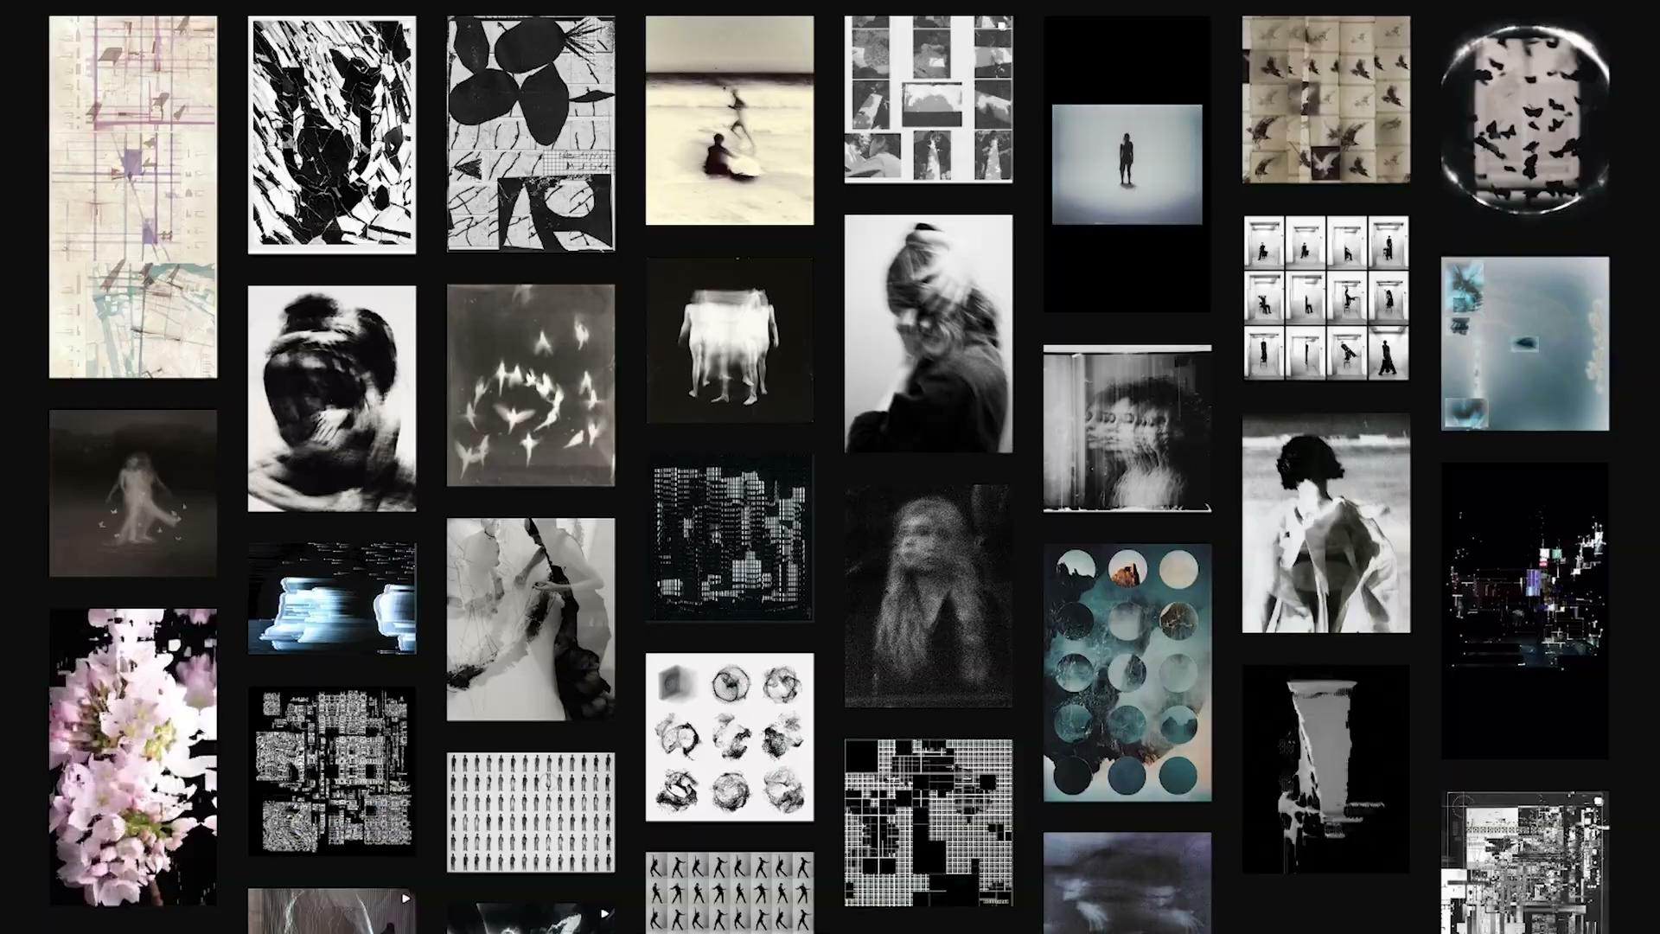

Slide 4
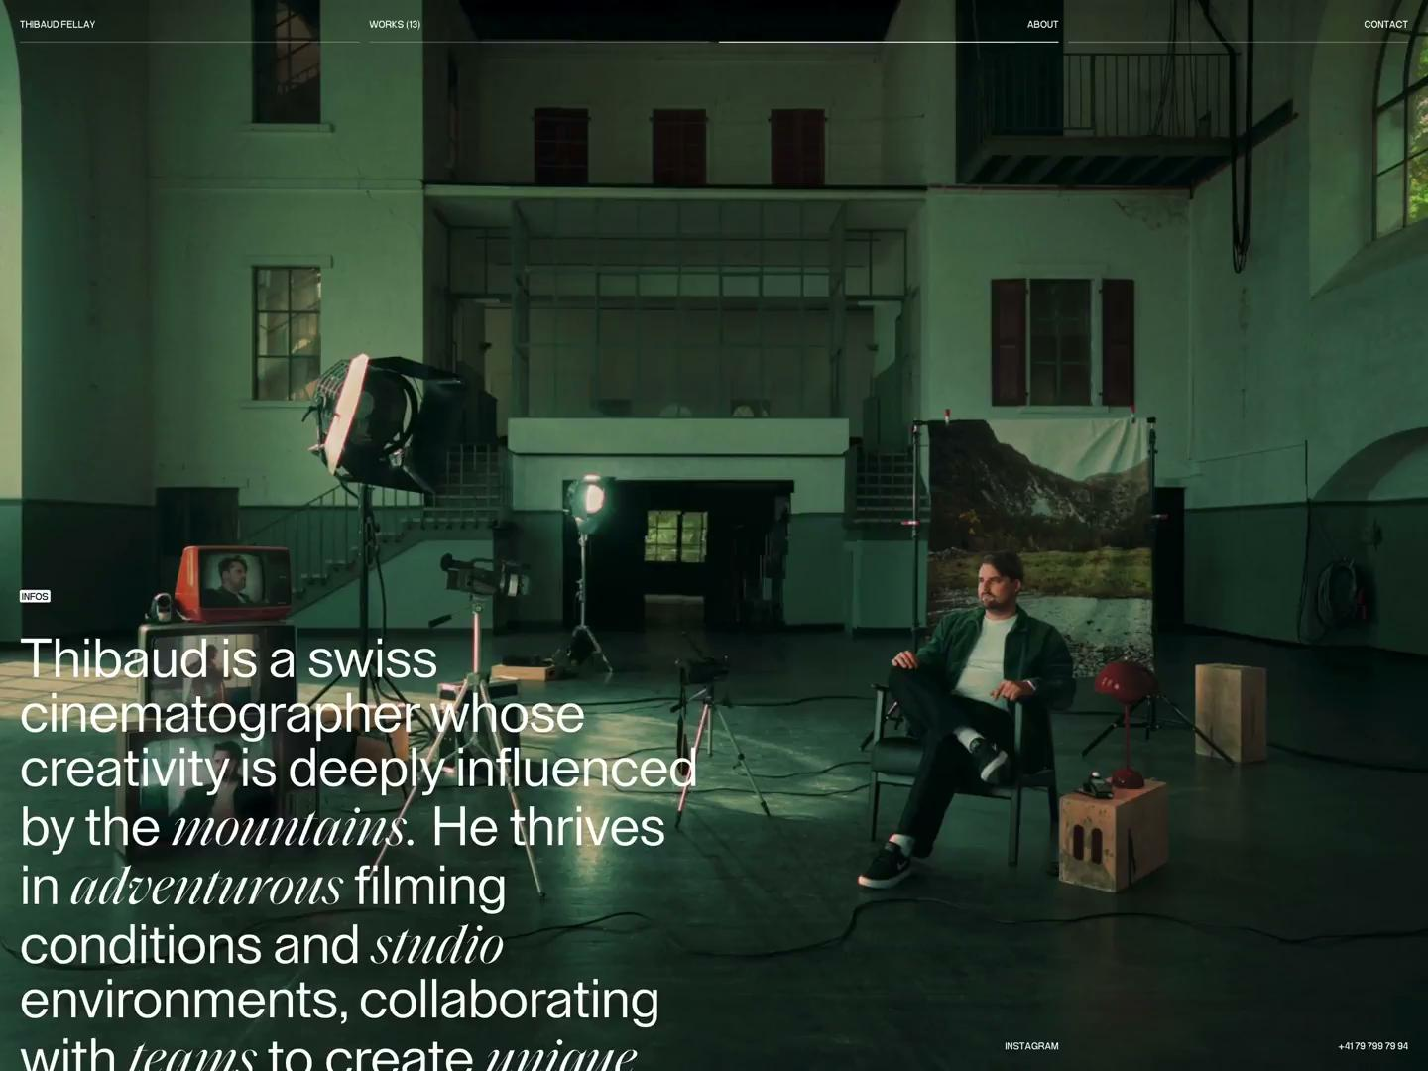
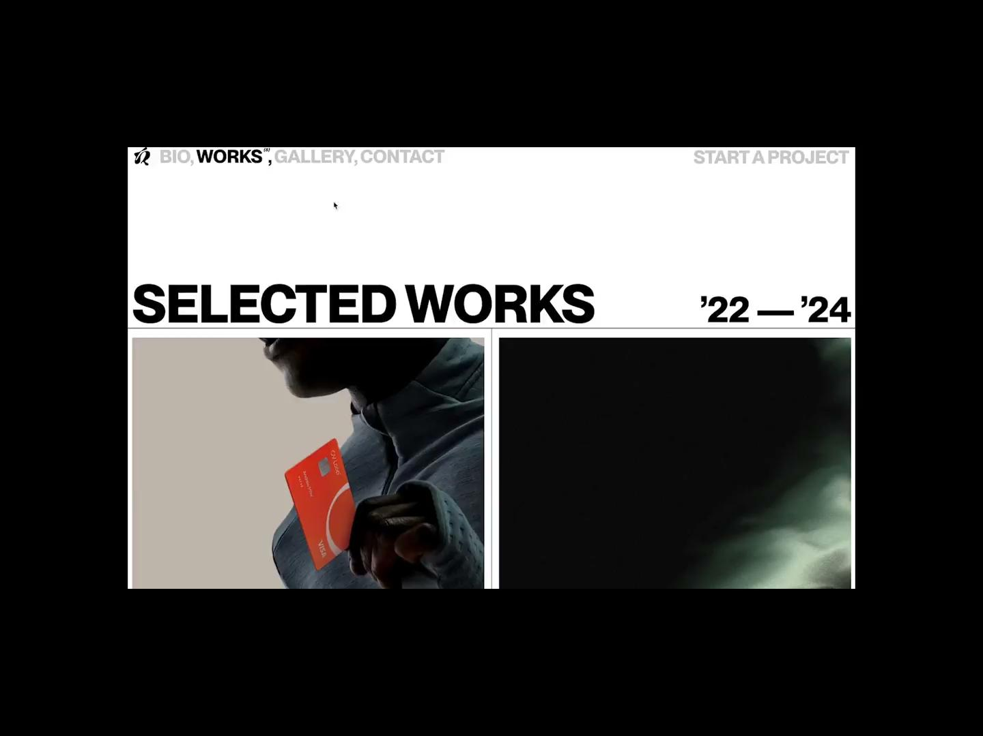
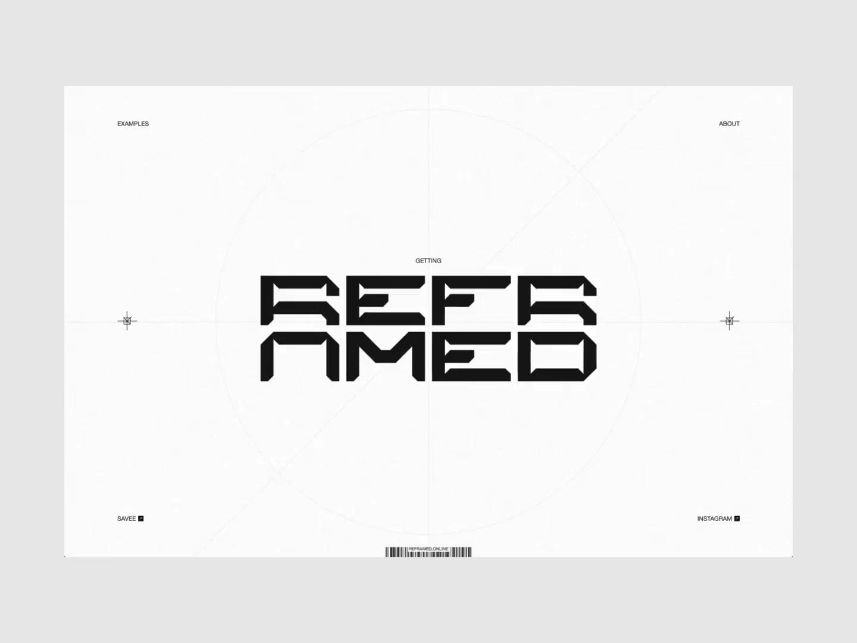

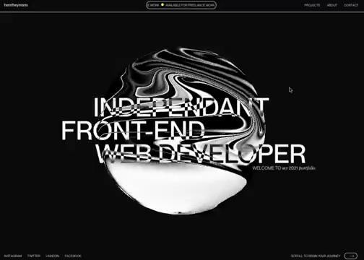

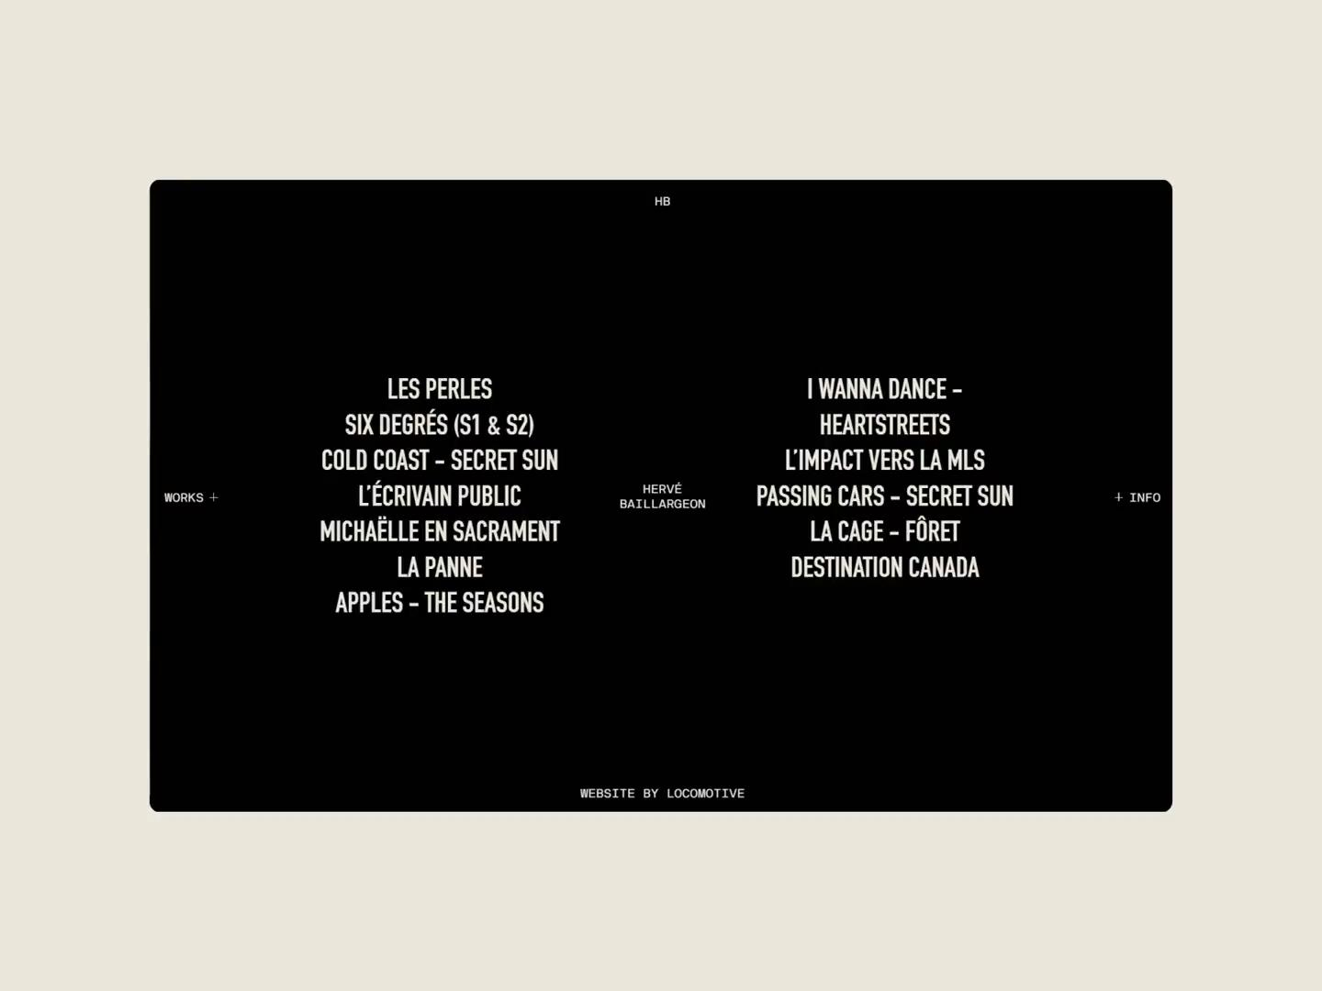
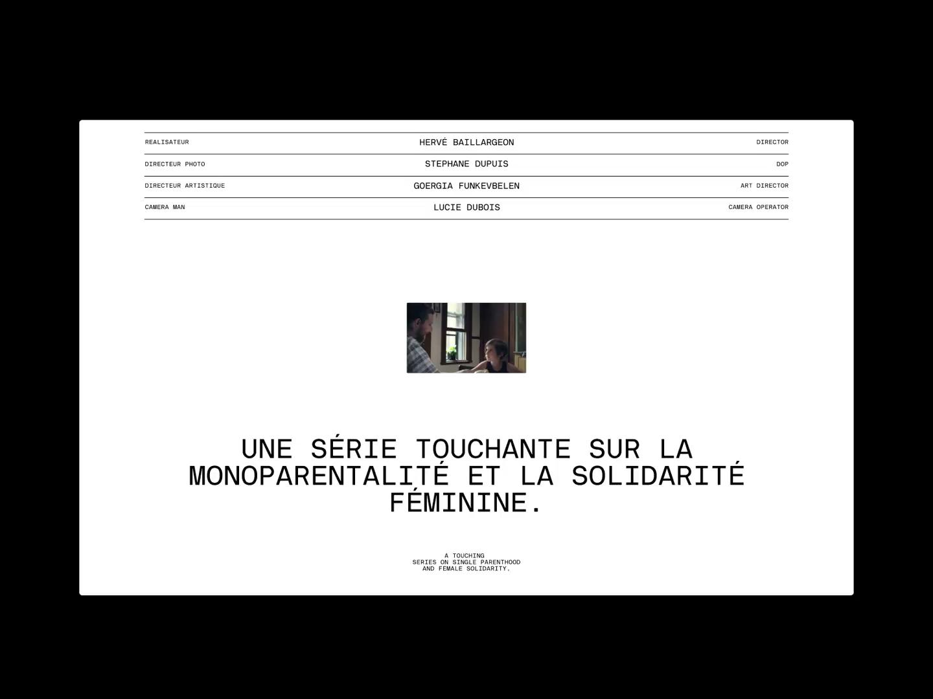
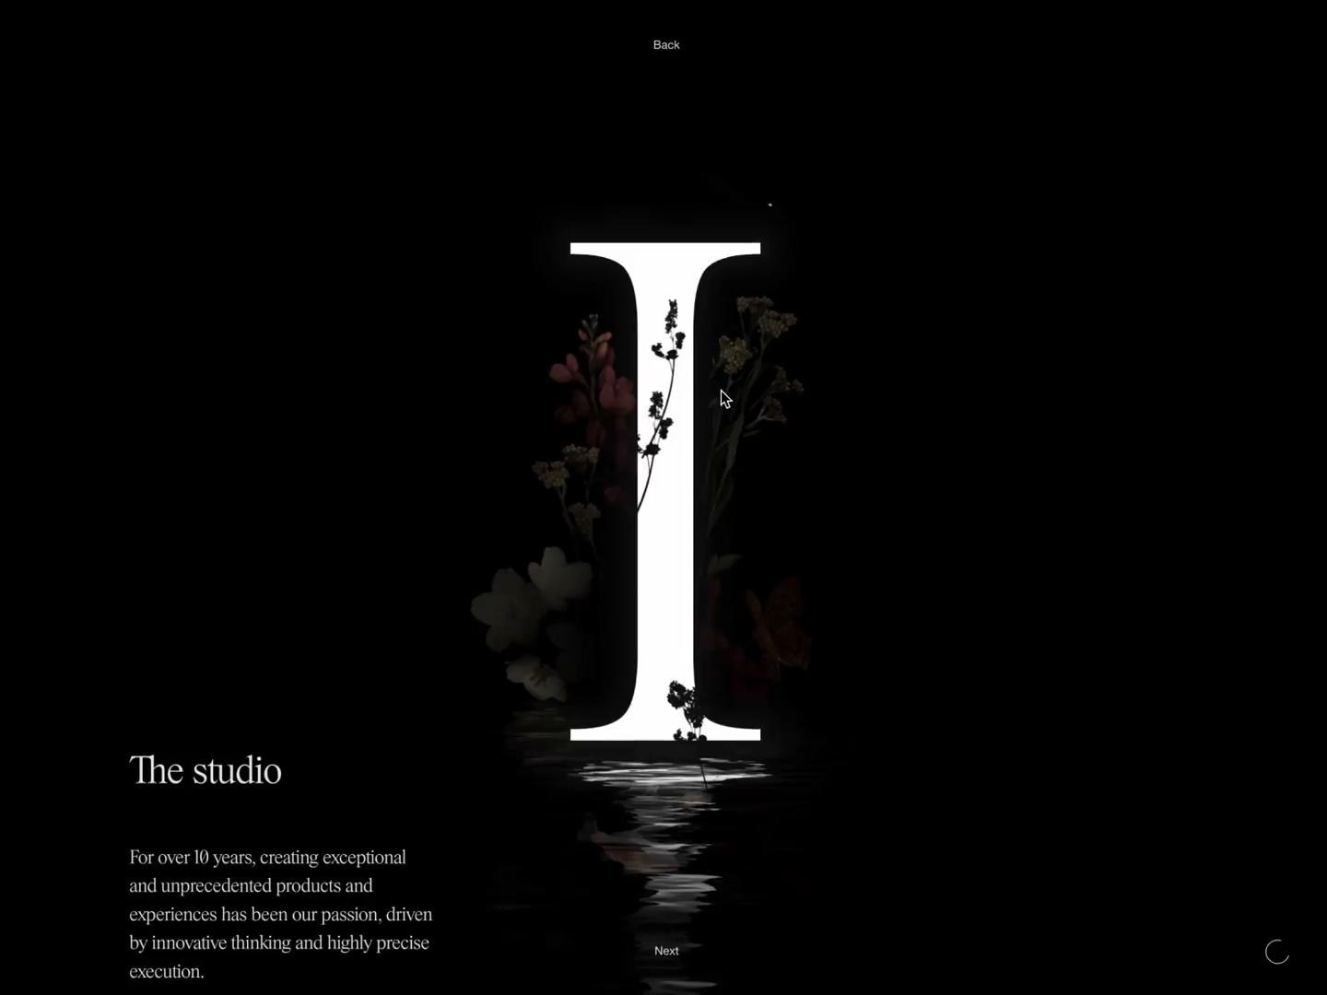
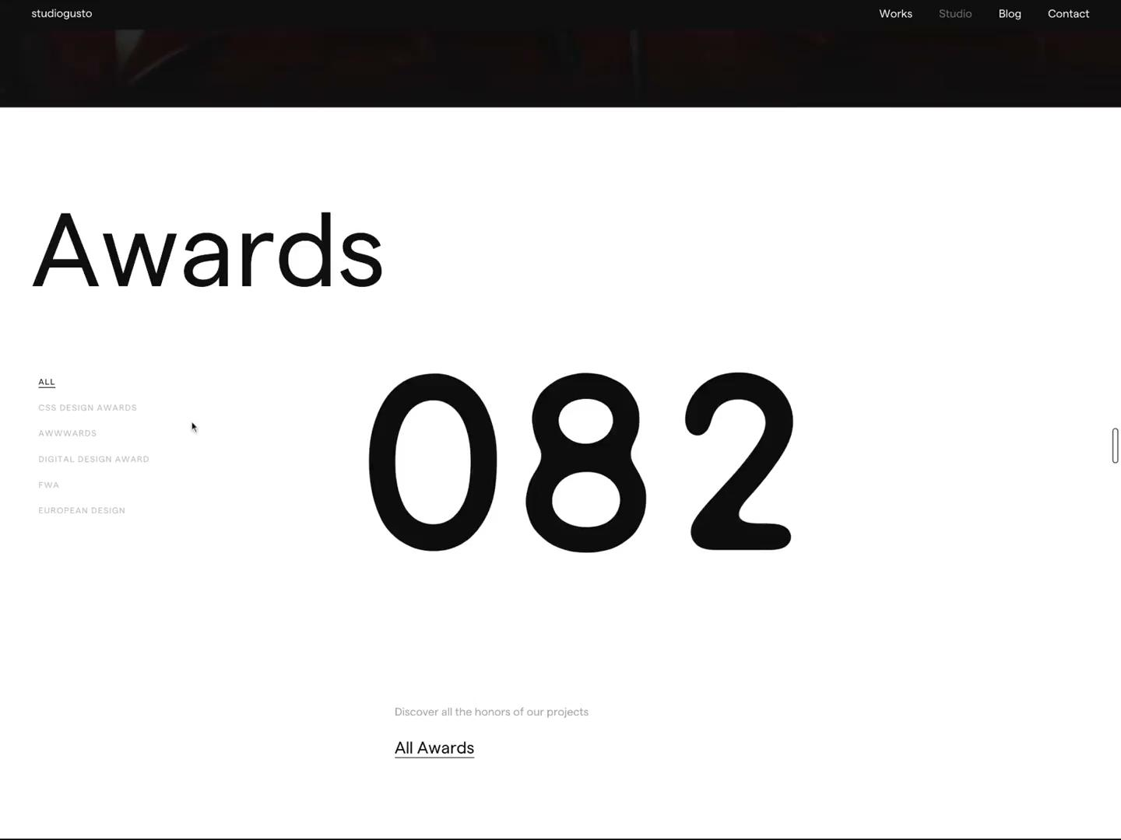
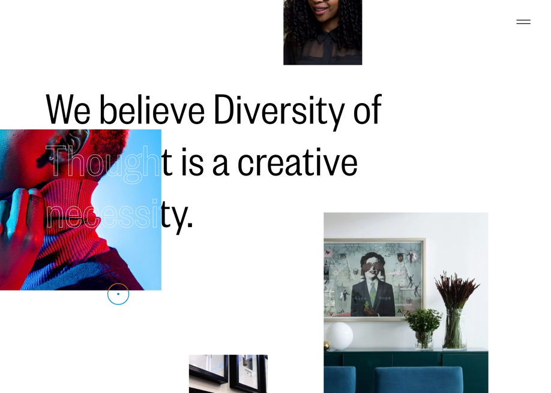
INSPIRATION

Slide 5
EXISTING SKILLS
Flexbox organization of text & images
Hover states in combination with animation
Absolute and relative positioning
Custom text styling
Image import
Linking between pages & external linking
Inputs (button & forms)

Slide 6
NEW/EVENTUAL SKILLS
Import videos and audio to autoplay
Cursor change to image on hover over certain text area
Hover states that show image specifically when on text area
Define specific action for click on button or image
CSS-based animations
SVG + CSS animations (specifics to be detailed in wireframe)
Text morphing/animation

Slide 7
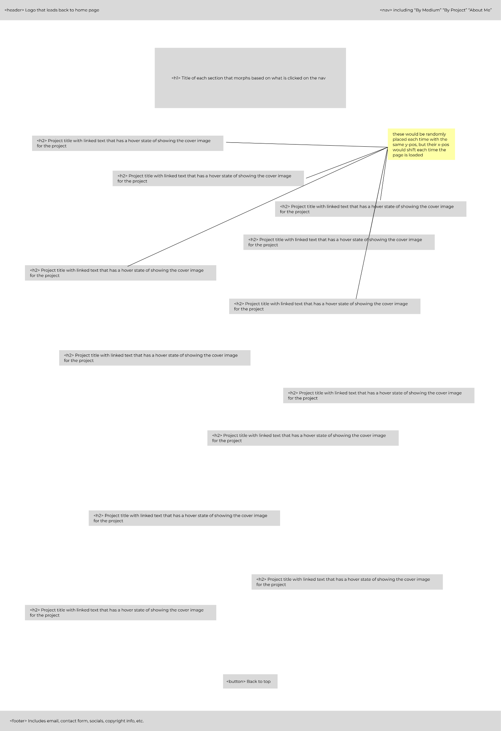
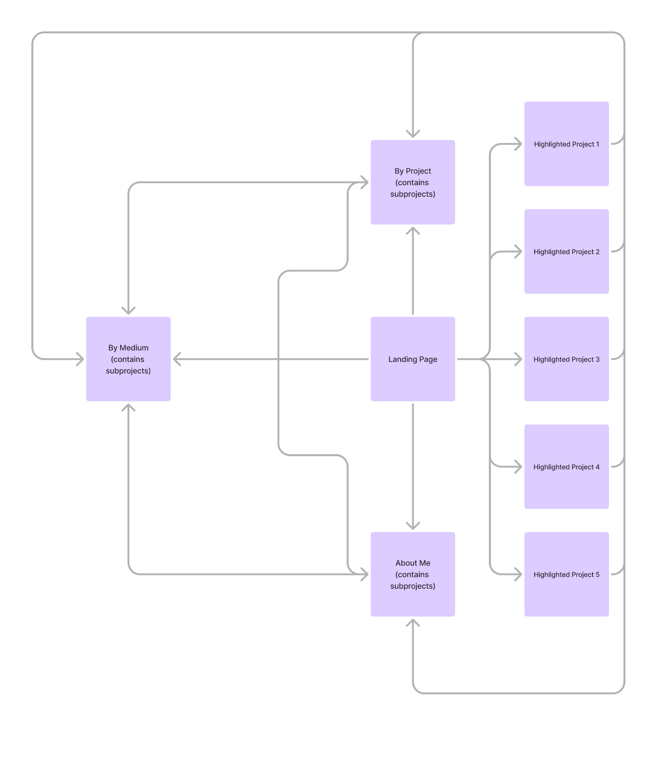
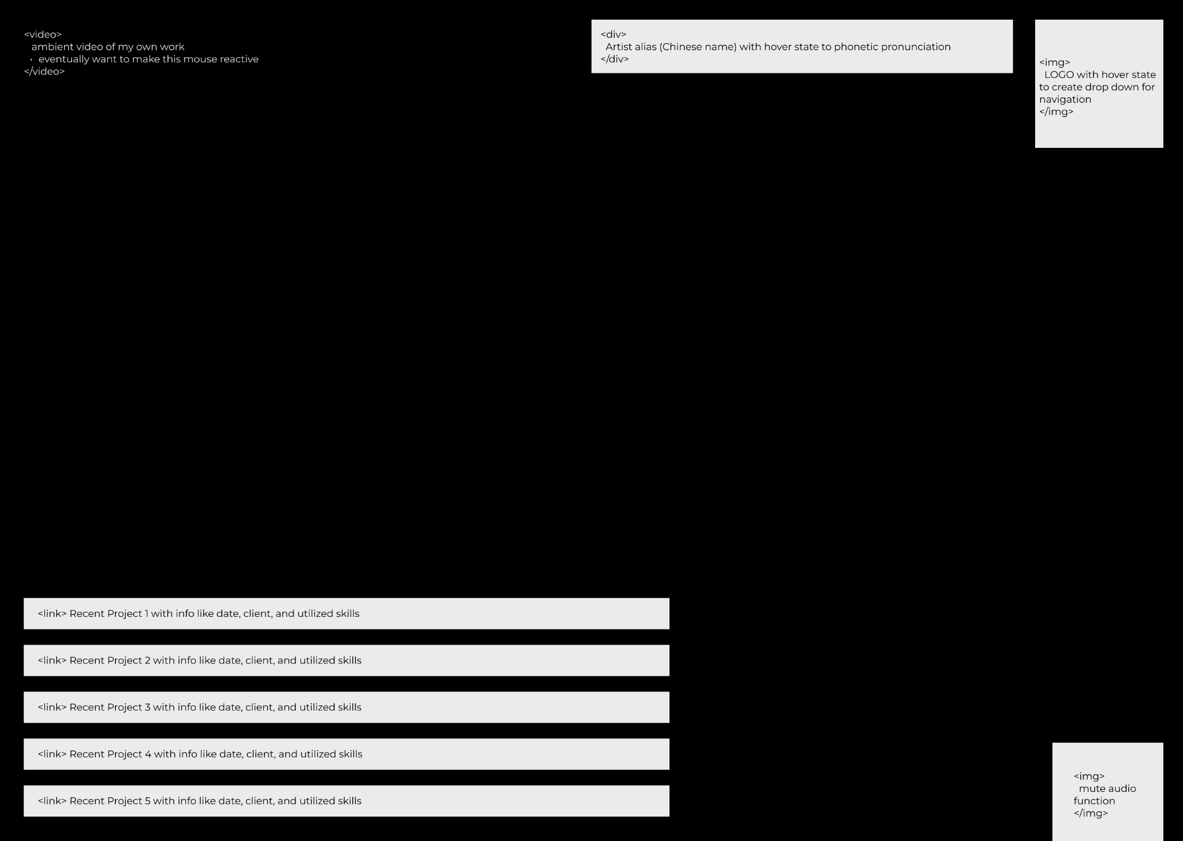
SITEMAP & WIREFRAME

Slide 8
WIREFRAME DETAILS

Slide 9
WIREFRAME DETAILS

