Slide 1

Compilers
Principles, Techniques, & Tools
Taught by Jing Zhang
(jzhang@njust.edu.cn)

Slide 2
Code Generation

Slide 3
Outlines
Issues in the Design of a Code Generator
The Target Language
Addresses in the Target Code
Basic Blocks and Flow Graphs
Optimization of Basic Blocks
Peephole Optimization
Register Allocation and Assignment
Instruction Selection by Tree Rewriting

Slide 4
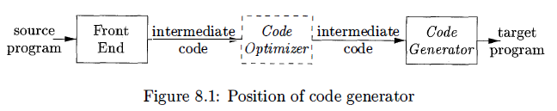
9.1 Issues in the Design of a Code Generator
The final phase in our compiler model is the code generator. It takes as input the intermediate representation (IR) produced by the front end of the compiler, along with relevant symbol table information, and produces as output a semantically equivalent target program.
The challenge is that, mathematically, the problem of generating an optimal target program for a given source program is undecidable; many of the subproblems encountered in code generation such as register allocation are computationally intractable. In practice, we must be content with heuristic techniques that generate good, but not necessarily optimal, code. Fortunately, heuristics have matured enough that a carefully designed code generator can produce code that is several times faster than code produced by a naive one.

Slide 5
9.1 Issues in the Design of a Code Generator
Input to the Code Generator
  The many choices for the IR include three-address representations such as quadruples, triples, indirect triples; virtual machine representations such as bytecodes and stack-machine code; linear representations such as postfix notation; and graphical representations such as syntax trees and DAG's. Many of the algorithms in this chapter are couched in terms of the representations considered in Chapter 6: three-address code, trees, and DAG 's.
The Target Program
  The instruction-set architecture of the target machine has a significant impact on the difficulty of constructing a good code generator that produces high-quality machine code. The most common target-machine architectures are RISC (reduced instruction set computer) , CISC (complex instruction set computer) , and stack based.
  A RISC machine typically has many registers, three-address instructions, simple addressing modes, and a relatively simple instruction-set architecture. In contrast, a CISC machine typically has few registers, two-address instructions, a variety of addressing modes , several register classes, variable-length instructions, and instructions with side effects.
  We shall use a very simple RISC-like computer as our target machine. We add to it some ClSC-like addressing modes so that we can also discuss code-generation techniques for CISC machines. For readability, we use assembly code as the target language.

Slide 6

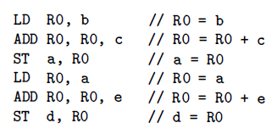
9.1 Issues in the Design of a Code Generator
Instruction Selection
  The code generator must map the lR program into a code sequence that can be executed by the target machine. The complexity of performing this mapping is determined by a factors such as
    the level of the IR
    If the IR is high level, the code generator may translate each IR statement into a sequence of machine instructions using code templates.
    the nature of the instruction-set architecture
    Instruction speeds and machine idioms are other important factors.
    the desired quality of the generated code
    The quality of the generated code is usually determined by its speed and size. On most machines, a given IR program can be implemented by many different code sequences, with significant cost differences between the different implementations. A naive translation of the intermediate code may therefore lead to correct but unacceptably inefficient target code.

Slide 7
9.1 Issues in the Design of a Code Generator
Register Allocation
  A key problem in code generation is deciding what values to hold in what registers. Registers are the fastest computational unit on the target machine, but we usually do not have enough of them to hold all values.
  The use of registers is often subdivided into two subproblems:
    1. Register allocation, during which we select the set of variables that will reside in registers at each point in the program.
    2. Register assignment, during which we pick the specific register that a variable will reside in.
Evaluation Order
  The order in which computations are performed can affect the efficiency of the target code. As we shall see, some computation orders require fewer registers to hold intermediate results than others. However, picking a best order in the general case is a difficult NP-complete problem.

Slide 8
9.2 The Target Language-instructions
The underlying computer is a byte-addressable machine with n general-purpose registers, R₀, R₁, . . . , R_{n-1}. We assume the following kinds of instructions are available:
Load operations: The instruction LD dst, addr loads the value in location addr into location dst. An instruction of the form LD r₁ , r₂ is a register-to-register copy in which the contents of register r₁ are copied into register r₂.
Store operations: The instruction ST x, r stores the value in register r into the location x.
Computation operations of the form OP dst, src₁ , src₂ , where OP is a operator like ADD or SUB, and dst, src₁ , and src₂ are locations. The effect of this machine instruction is to apply the operation represented by OP to the values in locations src₁ and src₂ , and place the result of this operation in location dst.
Unconditional jumps: The instruction BR L causes control to branch to the machine instruction with label L. (BR stands for branch.)
Conditional jumps of the form Bcond r, L, where r is a register, L is a label, and cond stands for any of the common tests on values in the register r. For example, BLTZ r, L causes a jump to label L if the value in register r is less than zero, and allows control to pass to the next machine instruction if not.

Slide 9
9.2 The Target Language-addressing modes
Assume our target machine has a variety of addressing modes:
In instructions, a location can be a variable name x referring to the memory location that is reserved for x (that is, the I-value of x)
A location can also be an indexed address of the form a(r), where a is a variable and r is a register. Instruction LD R₁, a(R₂) has the effect of setting R₁ = contents (a+contents (R₂)), where contents(x) denotes the contents of the register or memory location represented by x.
A memory location can be an integer indexed by a register. For example, LD R₁, 100 (R₂) has the effect of setting R₁= contents (100+contents (R₂)).
We also allow two indirect addressing modes: *r means the memory location found in the location represented by the contents of register r and *100(r) means the memory location found in the location obtained by adding 100 to the contents of r. For example, LD R₁, *100(R₂) has the effect of setting R_{l}=contents(contents (100+contents (R₂) ) )
Finally, we allow an immediate constant addressing mode. The constant is prefixed by #. The instruction LD R₁, #100 loads the integer 100 into register R₁, and ADD R₁, R₁, # 100 adds the integer 100 into register R₁.

Slide 10
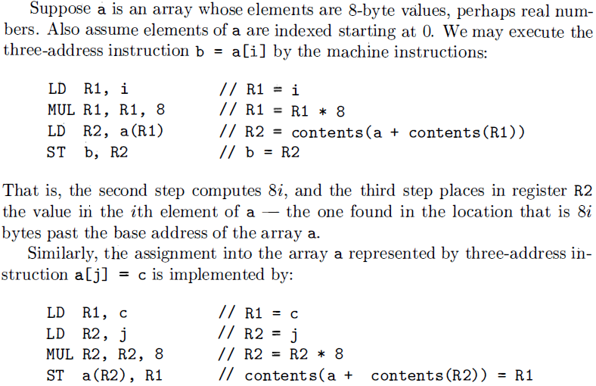
9.2 The Target Language – Examples

Slide 11
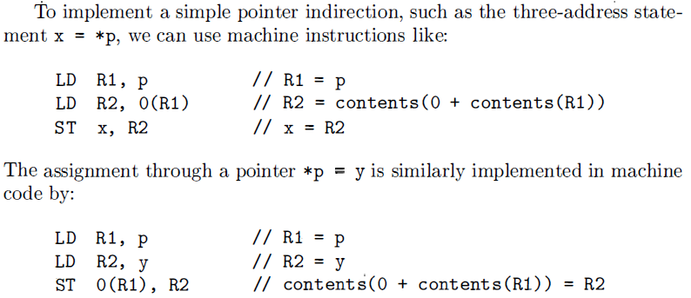

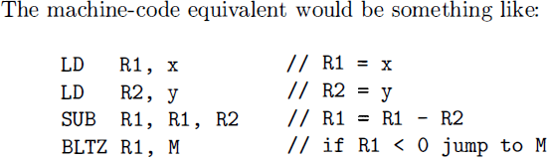
9.2 The Target Language – Examples

Slide 12
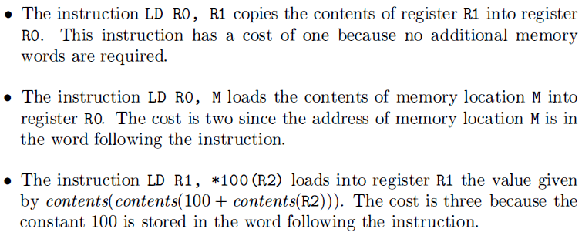
9.2 The Target Language – Instruction Cost
We assume each target-language instruction has an associated cost. For simplicity, we take the cost of an instruction to be one plus the costs associated with the addressing modes of the operands.

Slide 13
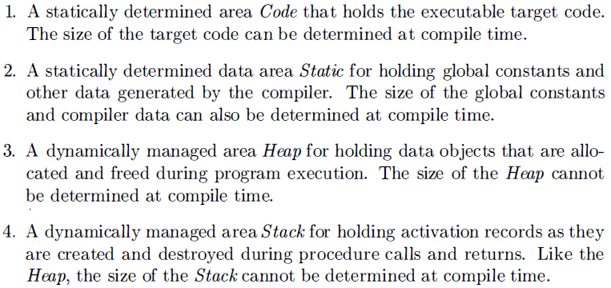
9.3 Addresses in the Target Code
In the last chapter, we described how each executing program runs in its own logical address space that was partitioned into four code and data areas:

Slide 14
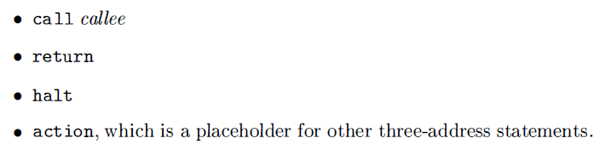

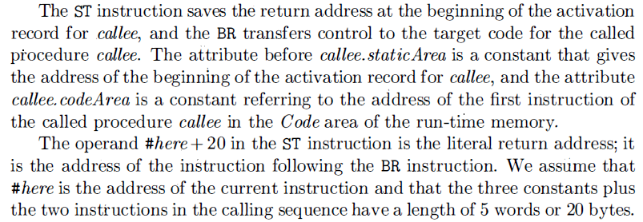
9.3 Addresses in the Target Code-Static Allocation
code generation for simplified procedure calls and returns, three-address statements:
Here, a call callee statement in the intermediate code can be implemented by a sequence of two target-machine instructions:

Slide 15

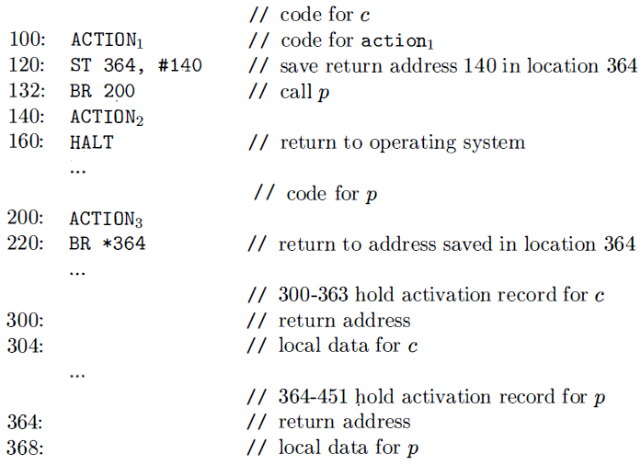
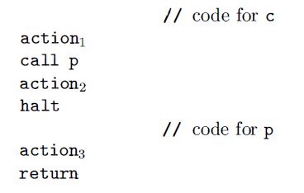
9.3 Addresses in the Target Code-Static Allocation
A return callee statement can be implemented by a simple jump instruction
which transfers control to the address saved at the beginning of the activation record for callee.
Example：

Slide 16
9.3 Addresses in the Target Code-Stack Allocation
Static allocation can become stack allocation by using relative addresses for storage in activation records. In stack allocation, however , the position of an activation record for a procedure is not known until run time. This position is usually stored in a register, so words in the activation record can be accessed as offsets from the value in this register.
We shall use positive offsets by maintaining in a register SP a pointer to the beginning of the activation record on top of the stack. When a procedure call occurs, the calling procedure increments SP and transfers control to the called procedure. After control returns to the caller, we decrement SP, thereby deallocating the activation record of the called procedure.

Slide 17
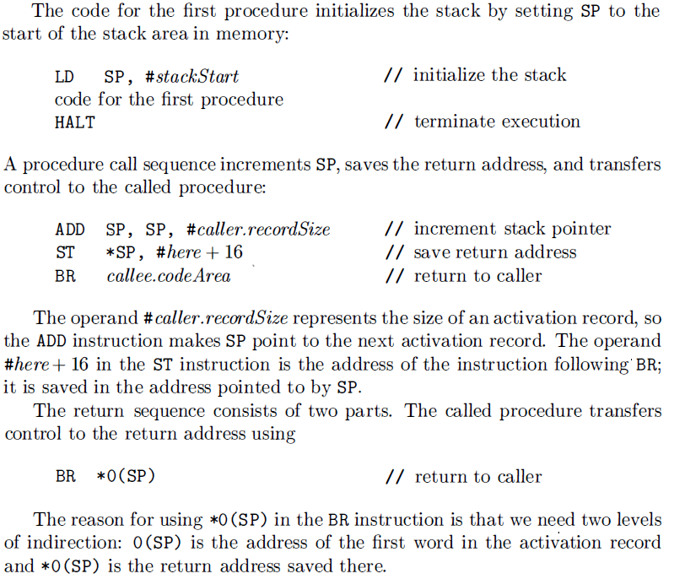
9.3 Addresses in the Target Code-Stack Allocation

Slide 18
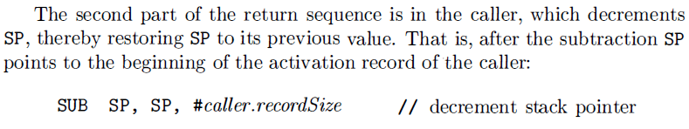

9.3 Addresses in the Target Code-Stack Allocation
Run-Time Addresses for Names
Names in symbol table must eventually be replaced by code to access storage locations. We thus consider some elaborations of the simple three-address copy statement x=0. After the declarations in a procedure are processed, suppose the symbol-table entry for x contains a relative address 12 for x. For consider the case in which x is in a statically allocated area beginning at address static.
Then the actual run-time address of x is static + 12. Although the compiler can eventually determine the value of static + 12 at compile time, the position of the static area may not be known when intermediate code to access the name is generated. In that case, it makes sense to generate three-address code to "compute" static + 12, with the understanding that this computation will be
carried out during the code generation phase, or possibly by the loader, before the program runs. The assignment x = 0 then translates into
If the static area starts at address 100, the target code for this statement is

Slide 19
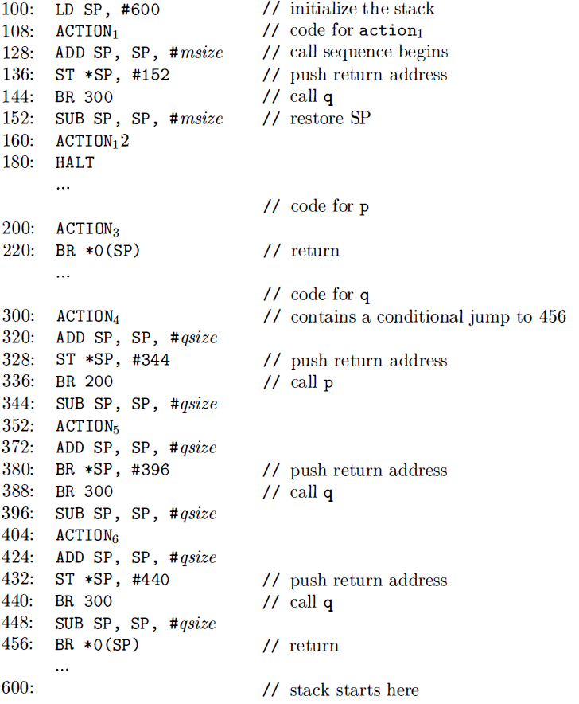
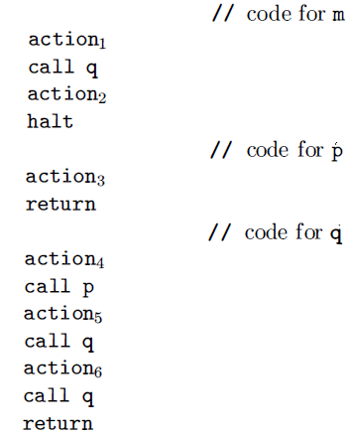
9.3 Addresses in the Target Code-Stack Allocation
An abstraction of the quicksort program in the previous chapter. Procedure q is recursive, so more than one activation of q can be alive at the same time.
Suppose that the sizes of the activation records for procedures m, p, and q have been determined to be msize, psize, and qsize, respectively. The first word in each activation record will hold a return address. We arbitrarily assume that the code for these procedures starts at addresses 100, 200 , and 300, respectively, and that the stack starts at address 600.

Slide 20
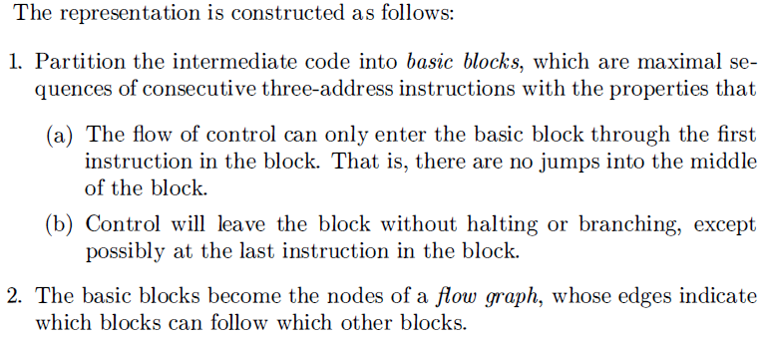
9.4 Basic Blocks and Flow Graphs
This section introduces a graph representation of intermediate code that is helpful for discussing code generation even if the graph is not constructed explicitly by a code-generation algorithm. Code generation benefits from context. We can do a better job of register allocation if we know how values are defined and used.

Slide 21
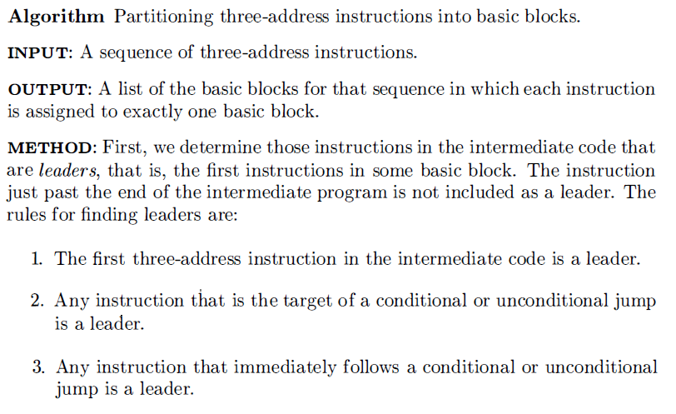
9.4 Basic Blocks and Flow Graphs-Basic Blocks
Our first job is to partition a sequence of three-address instructions into basic blocks. We begin a new basic block with the first instruction and keep adding instructions until we meet either a jump, a conditional jump, or a label on the following instruction.

Slide 22
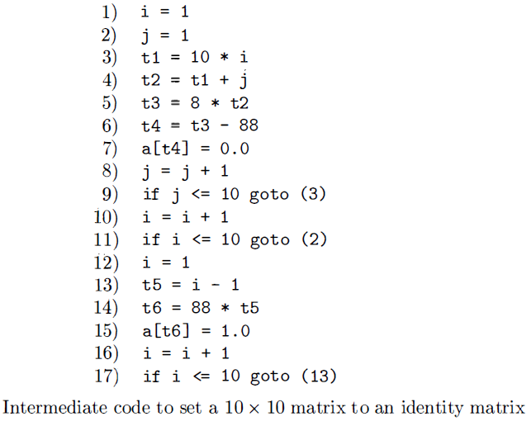
9.4 Basic Blocks and Flow Graphs-Basic Blocks
First, instruction 1 is a leader by rule (1). To find the
other leaders, we first need to find the jumps. In this example, there are three jumps, all conditional, at instructions 9, 11, and 17. By rule (2), the targets of these jumps are leaders; they are instructions 3, 2, and 13, respectively. Then, by rule (3), each instruction following a jump is a leader; those are instructions
10 and 12. Note that no instruction follows 17 in this code, but if there were code following, the 18th instruction would also be a leader.

Slide 23
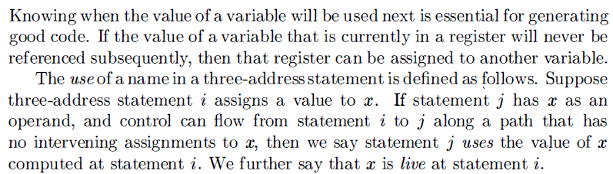

9.4 Basic Blocks and Flow Graphs-Next-Use Information

Slide 24
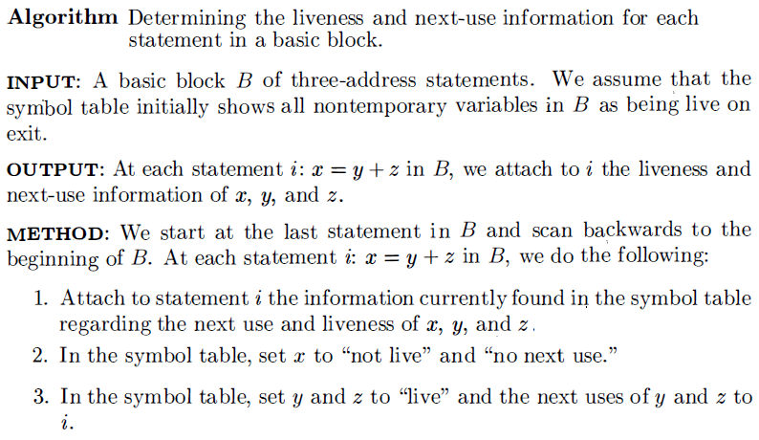
9.4 Basic Blocks and Flow Graphs-Next-Use Information

Slide 25
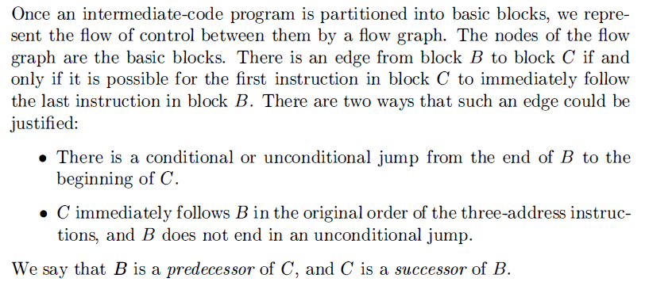
9.4 Basic Blocks and Flow Graphs-Flow Graphs

Slide 26
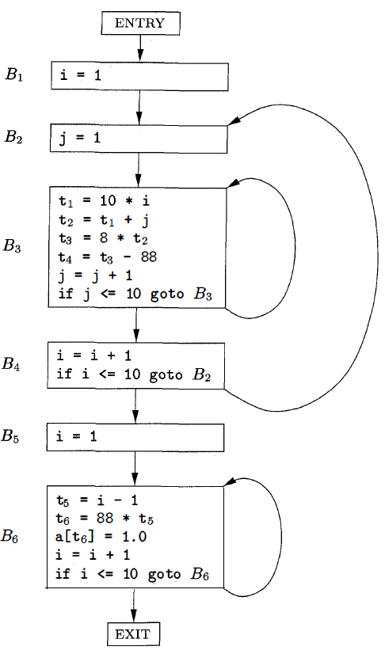
9.4 Basic Blocks and Flow Graphs-Flow Graphs

Slide 27
The rest content in this chapter is related to Code Optimization, which is out of the scope in this 48-instruction-hour course. If you interested in that content, please read it by yourselves.
END

