Slide 1

Compilers
Principles, Techniques, & Tools
Taught by Jing Zhang
(jzhang@njust.edu.cn)

Slide 2
Intermediate- Code
Generation

Slide 3
Outlines
Introduction
Variants of Syntax Trees
Three-Address Code
Types and Declarations
Translation of Expressions
Type Checking
Control Flow
Switch- Statements
Intermediate Code for Procedures

Slide 4
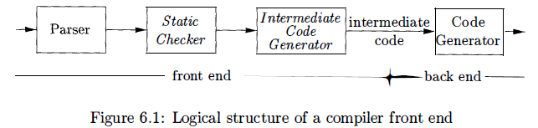

Introduction
we assume that a compiler front end is organized as follows, where parsing, static checking, and intermediate-code generation are done sequentially; sometimes they can be combined and folded into parsing.
In the process of translating a program in a given source language into code for a given target machine, a compiler may construct a sequence of intermediate representations. High-level representations are close to the source language and low-level representations are close to the target machine.

Slide 5
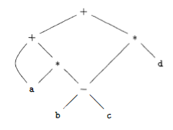
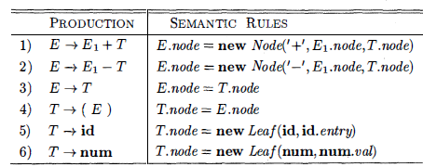
7.1 Variants of Syntax Trees
Directed Acyclic Graphs (DAG)
A node N in a DAG has more than one parent if N represents a common subexpression; in a syntax tree, the tree for the common sub expression would be replicated as many times as the sub expression appears in the original expression. Thus, a DAG not only represents expressions more succinctly, it gives the compiler important clues regarding the generation of efficient code to evaluate the expressions.
E.g. a + a * (b - c) + (b - c) * d

Slide 6
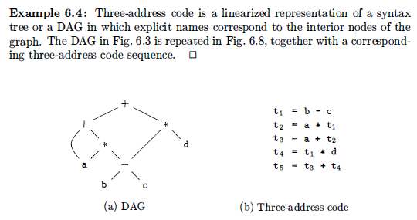
7.2 Three-Address Code
In three-address code, there is at most one operator on the right side of an instruction; that is, no built-up arithmetic expressions are permitted.
E.g. x+y*z
Three-Address Code:

Slide 7

7.2 Three-Address Code – Addresses and Instructions
Addresses
  A name.
  A constant.
  A compiler-generated temporary.
common three-address instruction forms
  assignment instructions of the form x = y op z.
  assignments of the form x = op y, where op is a unary operation.
  copy instructions of the form x = y.
  an unconditional jump goto L.
  conditional jumps of the form if x goto L and if False x goto L.
  conditional jumps such as if x relop y goto L,
  procedure calls and returns are implemented using the following instructions:
  param x for parameters; call p , n and y = call p , n for procedure and function calls,
  respectively; and return y, where y, representing a returned value, is optional.
  indexed copy instructions of the form x = y [i] and x [i] = y .
  address and pointer assignments of the form x = & y , x = * y , and * x = y.

Slide 8
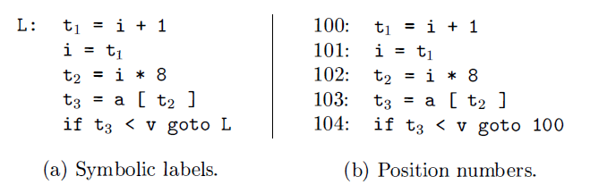
7.2 Three-Address Code – Addresses and Instructions
E.g.
do i = i+ l ; while ( a [i] < v) ;

Slide 9
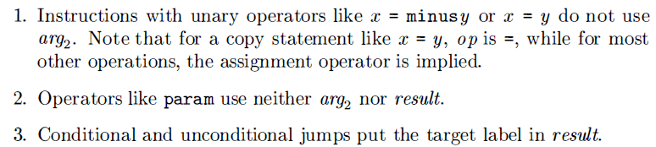
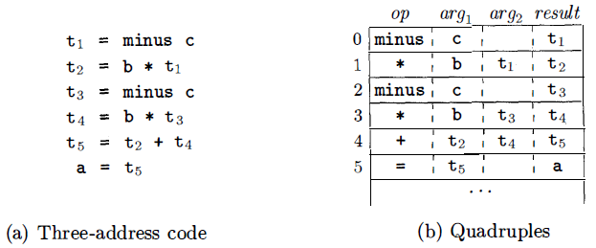
7.2 Three-Address Code – Quadruples
The description of three-address instructions specifies the components of each type of instruction, but it does not specify the representation of these instructions in a data structure. Three such representations are called "quadruples," "triples," and "indirect triples.“
Quadruples
A quadruple (or quad ) has four fields, which we call op, argl arg2 , and result.

Slide 10
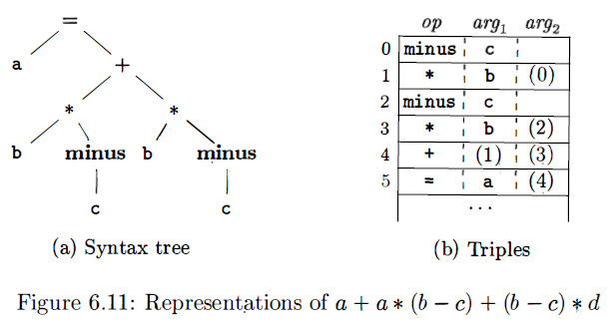
7.2 Three-Address Code – Triples
A triple has only three fields, which we call op, arg1 , and arg2. Using triples, we refer to the result of an operation x op y by its position, rather than by an explicit temporary name.
A ternary operation like x [i]= y requires two entries in the triple structure; for example, we can put x and i in one triple and y in the next. Similarly, x = y [i] can implemented by treating it as if it were the two instructions.

Slide 11
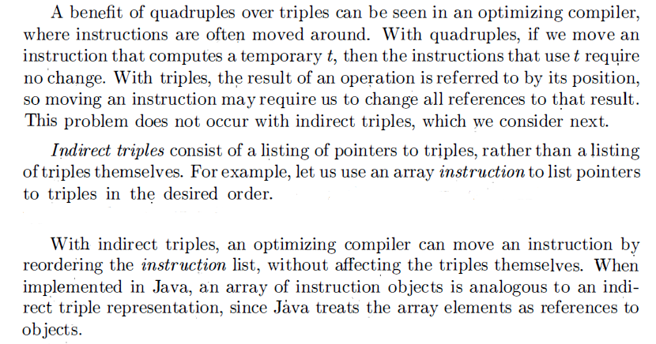
7.2 Three-Address Code – Indirect Triples

Slide 12
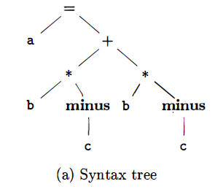
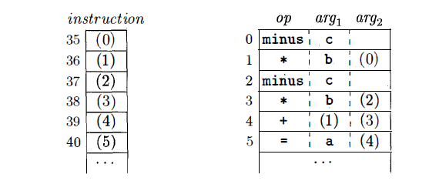
7.2 Three-Address Code – Triples

Slide 13
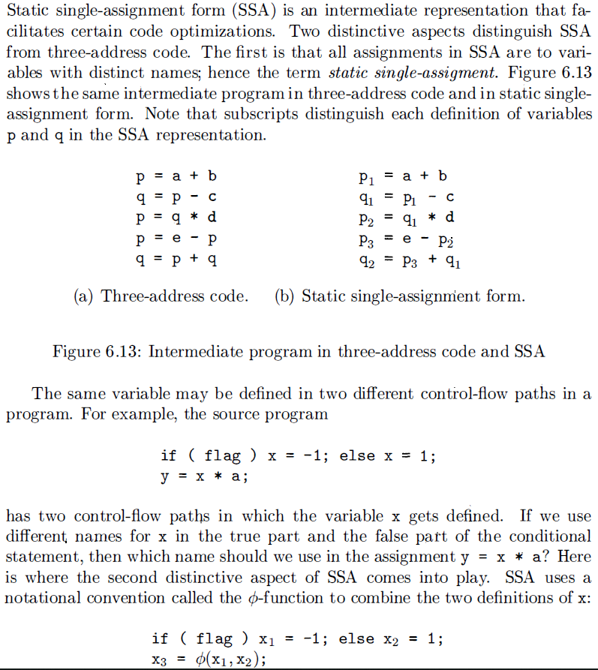
Three-Address Code – SSA

Slide 14
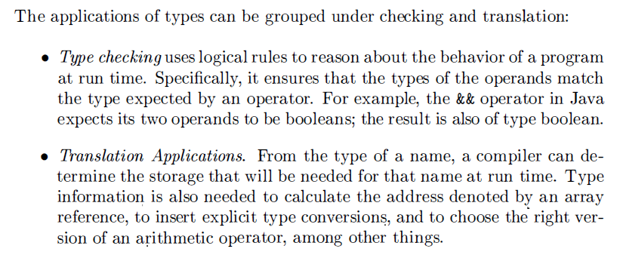
7.3 Types and Declarations

Slide 15
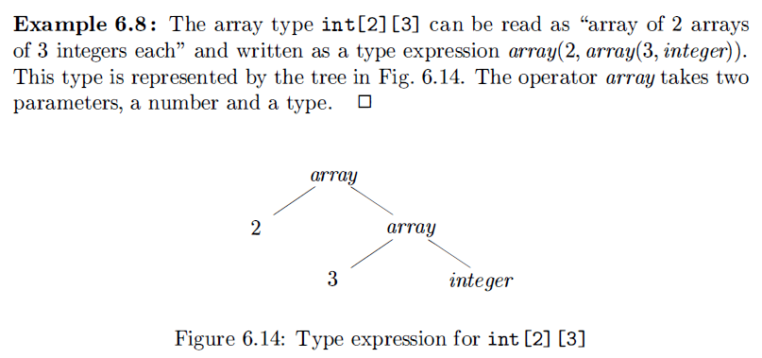
7.3 Types and Declarations-Type Expressions
type expressions: a type expression is either a basic type or is formed by applying an operator called a type constructor to a type expression.

Slide 16
7.3 Types and Declarations-Type Expressions
A basic type is a type expression. Typical basic types for a language include boolean, char, integer, float, and void;
A type name is a type expression;
A type expression can be formed by applying the array type constructor to a number and a type expression;
A type expression can be formed by applying the record type constructor to the field names and their types;
A type expression can be formed by using the type constructor “->”for function types. We write s ->t for "function from type s to type t.“
If s and t are type expressions, then their Cartesian product s x t is a type expression. Products are introduced for completeness; they can be used to represent a list or tuple of types (e.g. , for function parameters ) .
Type expressions may contain variables whose values are type expressions.

Slide 17
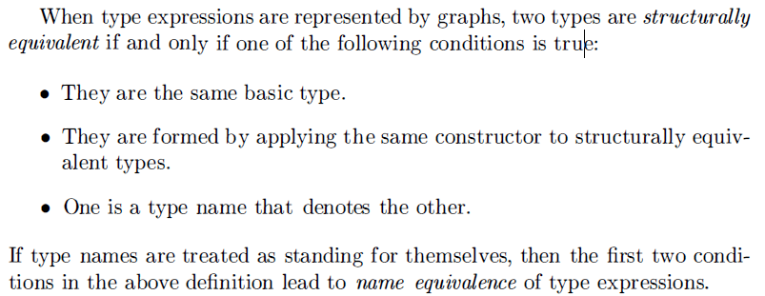
7.3 Types and Declarations-Type Equivalence
Many type-checking rules have the form, "if two type expressions are equal then return a certain type else error.“
The key issue is whether a name in a type expression stands for itself or whether it is an abbreviation for another type expression.

Slide 18
7.3 Types and Declarations-Examples
Type row = record
address: integer;
lexeme: array [1..15] of char
end
Int * func (char a, char b, char c)
High-order functions

Slide 19
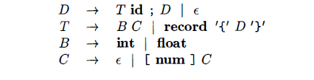
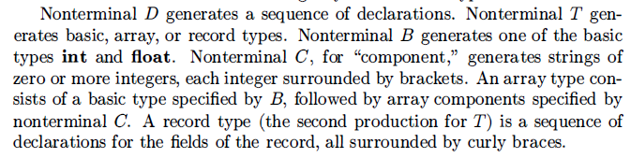
7.3 Types and Declarations-Declaration

Slide 20

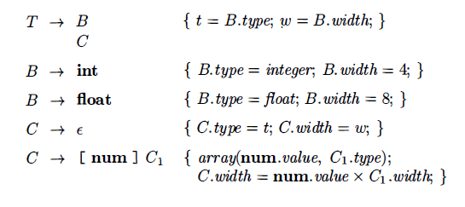
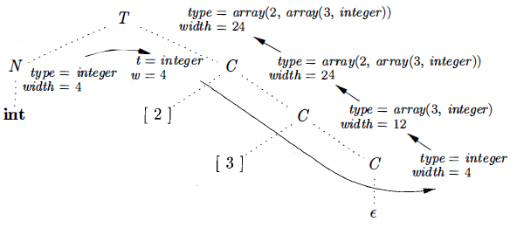
7.3 Types and Declarations-Storage Layout for Local Names
From the type of a name, we can determine the amount of storage that will be needed for the name at run time.

Slide 21
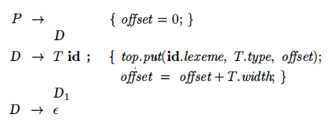
7.3 Types and Declarations-Sequences of Declarations
Languages such as C and Java allow all the declarations in a single procedure to be processed as a group. The declarations may be distributed within a Java procedure, but they can still be processed when the procedure is analyzed. Therefore , we can use a variable, say offset, to keep track of the next available relative address.
creates a symbol table
entry by executing top.put(id. lexeme, T. type, offset) . Here top denotes
the current symbol table.

Slide 22
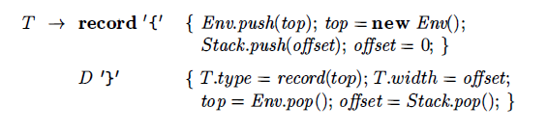
7.3 Types and Declarations-Fields in Records and Classes
This production has two semantic actions. The embedded action before D saves the existing symbol table, denoted by top and sets top to a fresh symbol table. It also saves the current offset, and sets offset to 0. The declarations generated by D will result in types and relative addresses being put in the fresh symbol table. The action after D creates a record type using top, before restoring the saved symbol table and offset.
Let class Env implement symbol tables. The call Env.push( top) pushes the current symbol table denoted by top onto a stack. Variable top is then set to a new symbol table. Similarly, offset is pushed onto a stack called Stack. Variable offset is then set to 0.

Slide 23
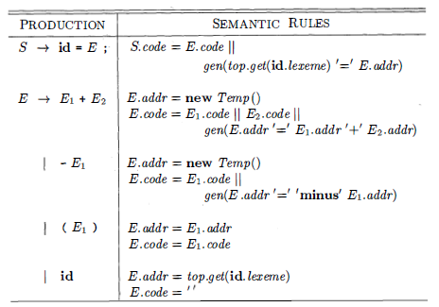
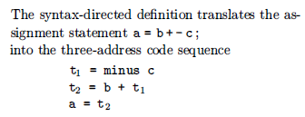
7.4 Translation of Expressions-Operations Within Expressions
The syntax-directed definition in the following table builds up the three-address code for an assignment statement S using attribute code for S and attributes addr and code for an expression E. Attributes S. code and E. code denote the three-address code for S and E, respectively. Attribute E.addr denotes the address that will hold the value of E.

Slide 24
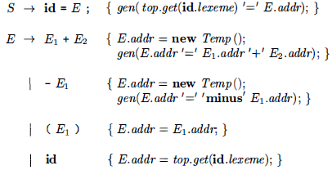
7.4 Translation of Expressions-Incremental Translation
Code attributes can be long strings, so they are usually generated incrementally. Thus , instead of building up E. code, we can arrange to generate only the new three-address instructions, as in the following translation scheme. In the incremental approach, gen not only constructs a three-address instruction, it appends the instruction to the sequence of instructions generated so far. The sequence may either be retained in memory for further processing, or it may be output incrementally.

Slide 25
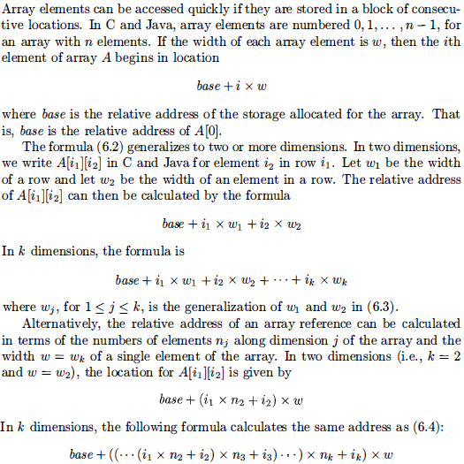
7.4 Translation of Expressions-Addressing Array Elements

Slide 26
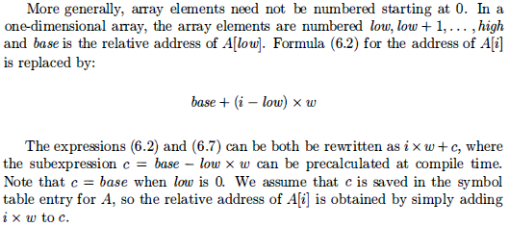
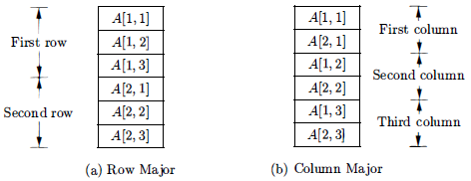
7.4 Translation of Expressions-Addressing Array Elements

Slide 27
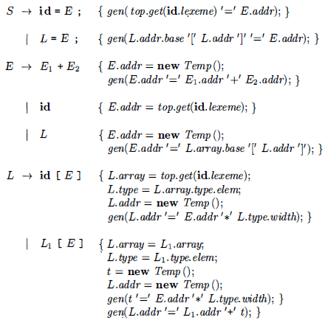
7.4 Translation of Expressions-Addressing Array Elements
Let nonterminal L generate an array name followed by a sequence of indexed expressions
As in C and Java, assume that the lowest-numbered array element is O. The translation scheme of the expression with arrays:
L.addr denotes a temporary that is used while computing the offset for the array reference
L.array is a pointer to the symbol-table entry for the array name. The base address of the array, say, L.array.base is used to determine the actual l-value of an array reference after all the index expressions are analyzed.
L.type is the type of the sub array generated by L.

Slide 28
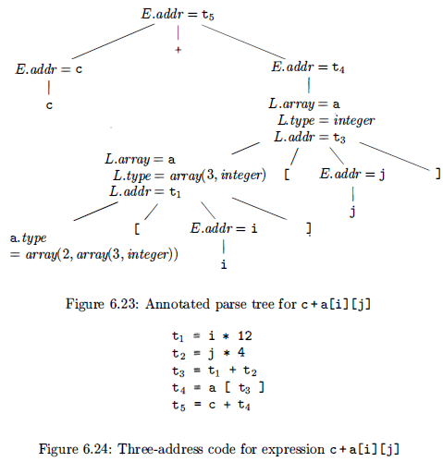
7.4 Translation of Expressions-Addressing Array Elements

Slide 29


7.5 Type checking-Rules for Type Checking
Type checking can take on two forms: synthesis and inference.
Type synthesis builds up the type of an expression from the types of its subexpressions. It requires names to be declared before they are used.
Type inference determines the type of a language construct from the way it is used.

Slide 30

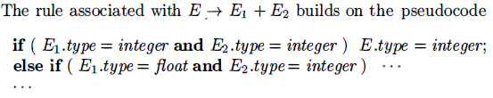
7.5 Type checking-Type Conversions
Consider expressions like x + i, where x is of type float and i is of type integer. Since the representation of integers and floating-point numbers is different within a computer and different machine instructions are used for operations on integers and floats, the compiler may need to convert one of the operands of + to ensure that both operands are of the same type when the addition occurs.

Slide 31
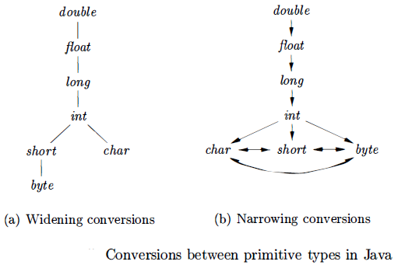
7.5 Type checking-Type Conversions
Type conversion rules vary from language to language. The rules for Java in the following figure distinguish between widening conversions, which are intended to preserve information, and narrowing conversions, which can lose information.

Slide 32
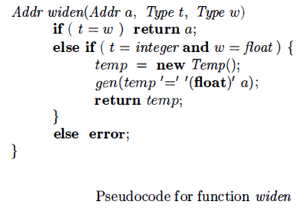
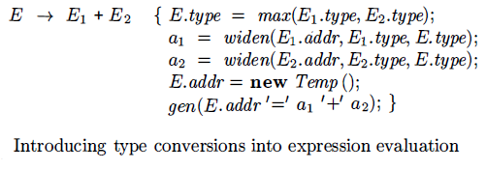
7.5 Type checking-Type Conversions

Slide 33
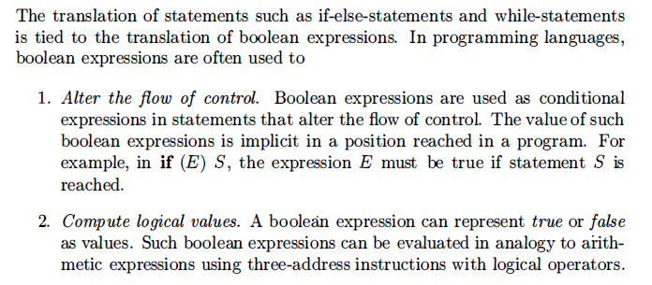
7.6 Control Flow – Introduction

Slide 34
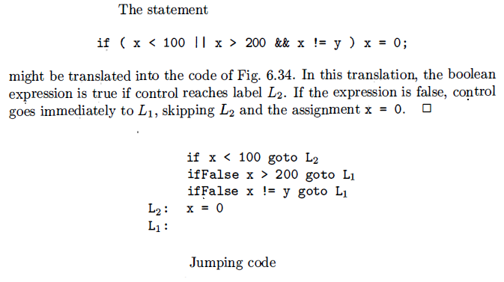
7.6 Control Flow – Boolean Expressions
In short-circuit (or jumping) code, the Boolean operators &&, ||, and ! translate into jumps. The operators themselves do not appear in the code; Instead,the value of a Boolean expression is represented by a position in the code sequence.

Slide 35
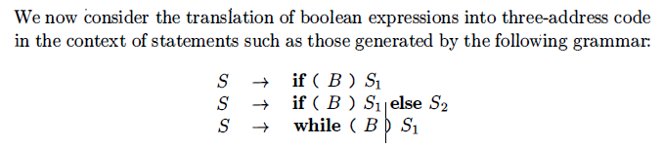
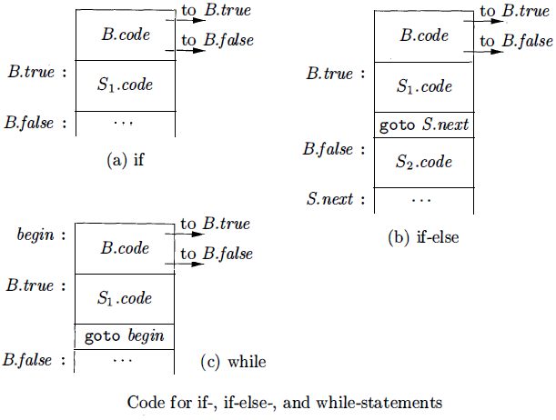
7.5 Control Flow – Flow-of-Control Statements

Slide 36
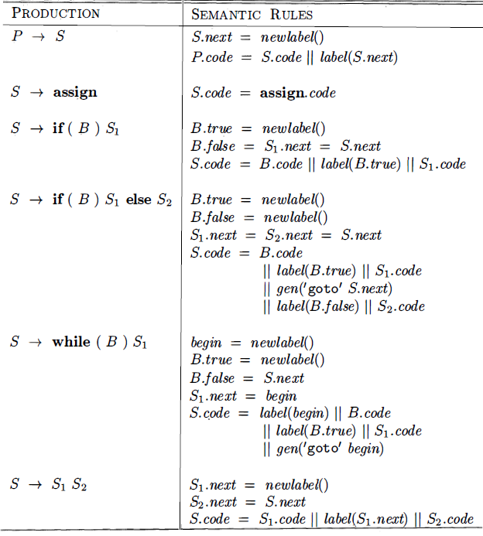
7.6 Control Flow – Flow-of-Control Statements

Slide 37
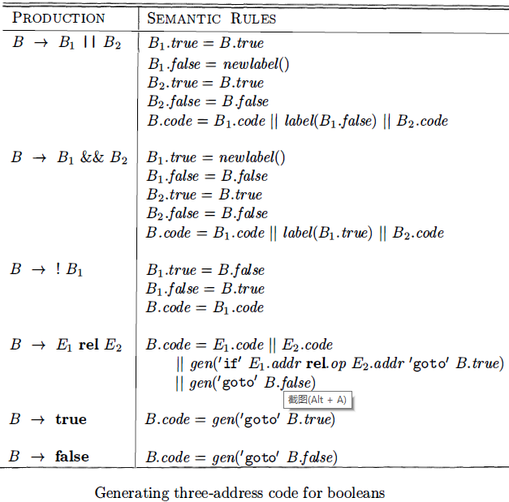
7.6 Control Flow – Translation of Boolean Expressions

Slide 38
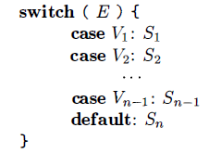
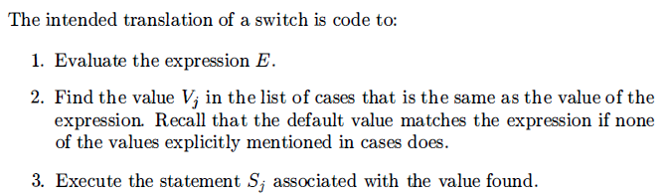
7.7 Switch- Statements
The "switch" or "case" statement is available in a variety of languages

Slide 39
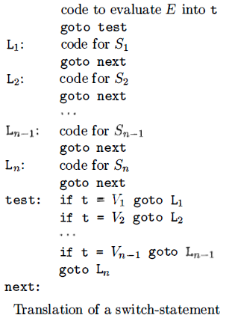
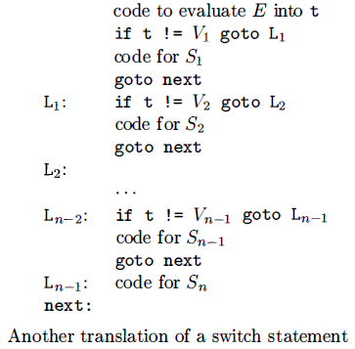
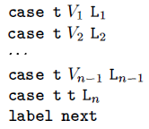
7.7 Switch- Statements

Slide 40
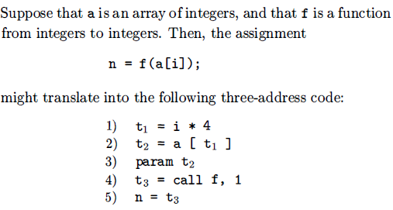
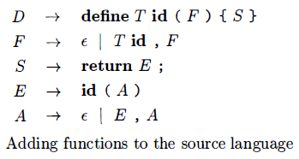
7.8 Intermediate Code for Procedures

Slide 41
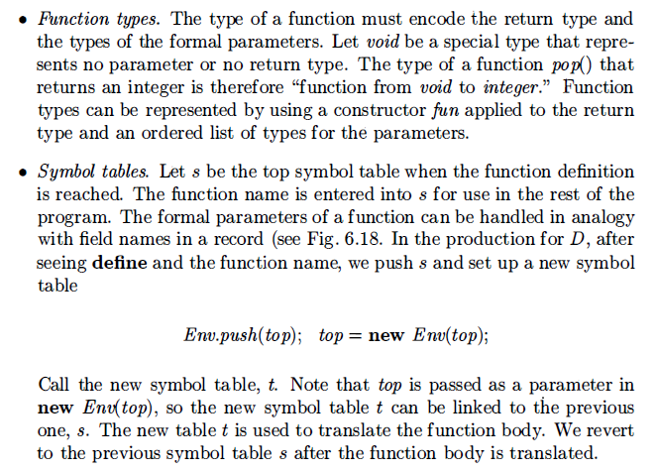
7.8 Intermediate Code for Procedures

Slide 42
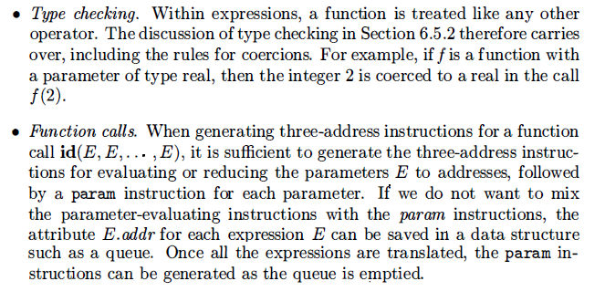
7.8 Intermediate Code for Procedures

