Slide 1

Compilers
Principles, Techniques, & Tools
Taught by Jing Zhang
(jzhang@njust.edu.cn)

Slide 2
Syntax-Directed Translation

Slide 3
Outlines
Introduction
Syntax-Directed Definitions
Evaluation Orders for SDD 's
Applications of Syntax-Directed Translation
Syntax-Directed Translation Schemes
Implementing L-Attributed SDD 's

Slide 4
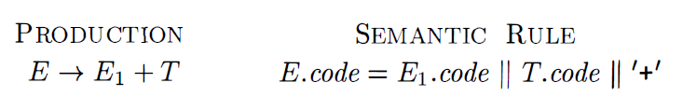
6.1 Introduction
We associate information with a language construct by attaching attributes to the grammar symbol(s) representing the construct.
A syntax-directed definition specifies the values of attributes by associating semantic rules with the grammar productions.
An infix-to-postfix translator
Subscript in E₁ distinguishes the occurrence of E in the production body from the occurrence of E as the head.

Slide 5
6.1 Introduction
A syntax-directed translation scheme embeds program fragments called semantic actions within production bodies.
The position of a semantic action in a production body determines the order in which the action is executed. In production (5. 2) , the action occurs at the end , after all the grammar symbols; in general, semantic actions may occur at any position in a production body.
Between the two notations, syntax-directed definitions can be more readable, and hence more useful for specifications. However, translation schemes can be more efficient , and hence more useful for implementations.

Slide 6
6.2 Syntax-Directed Definitions
A syntax-directed definition ( SDD) is a context-free grammar together with attributes and rules. Attributes are associated with grammar symbols and rules are associated with productions.
If X is a symbol and a is one of its attributes, then we write X.a to denote the value of a at a particular parse-tree node labeled X.
Attributes may be of any kind: numbers , types , table references , or strings, for instance. The strings may even be long sequences of code, say code in the intermediate language used by a compiler.

Slide 7
6.2 Syntax-Directed Definitions
- Inherited and Synthesized Attributes
A synthesized attribute for a nonterminal A at a parse-tree node N is defined by a semantic rule associated with the production at N. Note that the production must have A as its head. A synthesized attribute at node N is defined only in terms of attribute values at the children of N and at N itself.
An inherited attribute for a nonterminal B at a parse-tree node N is defined by a semantic rule associated with the production at the parent of N. Note that the production must have B as a symbol in its body. An inherited attribute at node N is defined only in terms of attribute values at N's parent , N itself, and N's siblings.

Slide 8
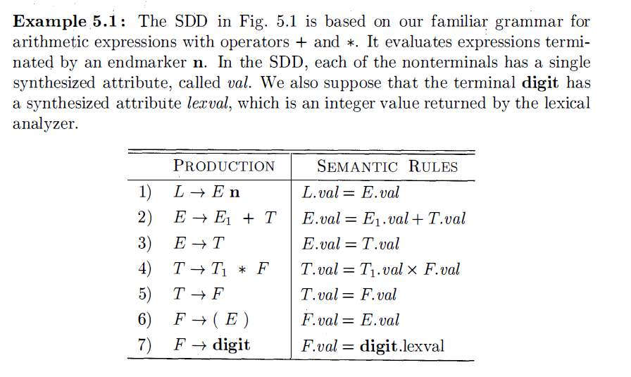
6.2 Syntax-Directed Definitions
- Inherited and Synthesized Attributes
Terminals can have synthesized attributes, but not inherited attributes. Attributes for terminals have lexical values that are supplied by the lexical analyzer; there are no semantic rules in the SDD itself for computing the value of an attribute for a terminal.
The rule for production 1 , sets L.val to E.val, which we shall see is the numerical value of the entire expression.
Production 2 also has one rule, which computes the val attribute for the head E as the sum of the values at E₁ and T.
At any parse tree node N labeled E, the value of val for E is the sum of the values of val at the children of node N labeled E and T.

Slide 9
6.2 Syntax-Directed Definitions
- Inherited and Synthesized Attributes
An SDD that involves only synthesized attributes is called S-attributed.
In an S-attributed SDD, each rule computes an attribute for the nonterminal at the head of a production from attributes taken from the body of the production.
An S-attributed SDD can be implemented naturally in conjunction with an LR parser.
An SDD without side effects is sometimes called an attribute grammar.
Side effects: printing the result or interacting with a symbol table

Slide 10
6.2 Syntax-Directed Definitions
- Inherited and Synthesized Attributes
Evaluating an SDD at the Nodes of a Parse Tree.
  To visualize the translation specified by an SDD, it helps to work with parse trees, even though a translator need not actually build a parse tree.
  A parse tree, showing the value(s) of its attribute(s) is called an annotated parse tree.
  For SDD's with both inherited and synthesized attributes, there is no guarantee that there is even one order in which to evaluate attributes at nodes.

Slide 11
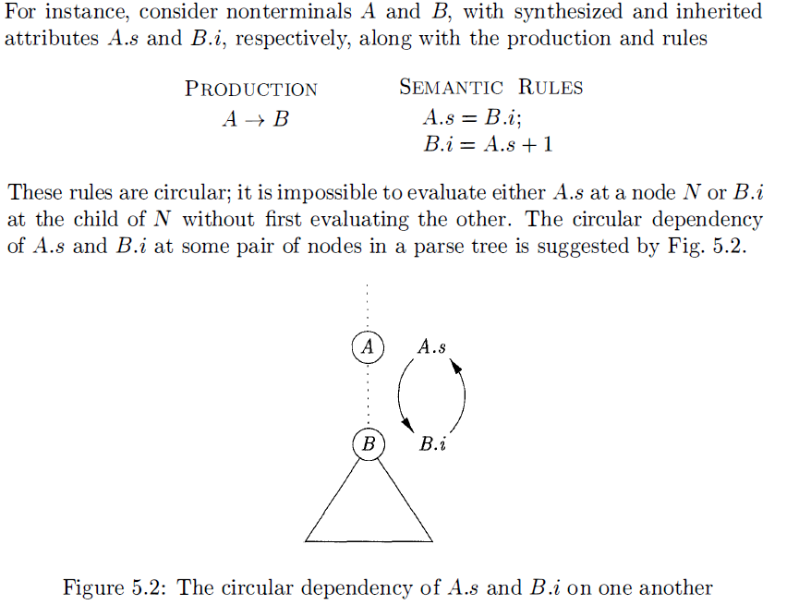
6.2 Syntax-Directed Definitions
- Inherited and Synthesized Attributes

Slide 12
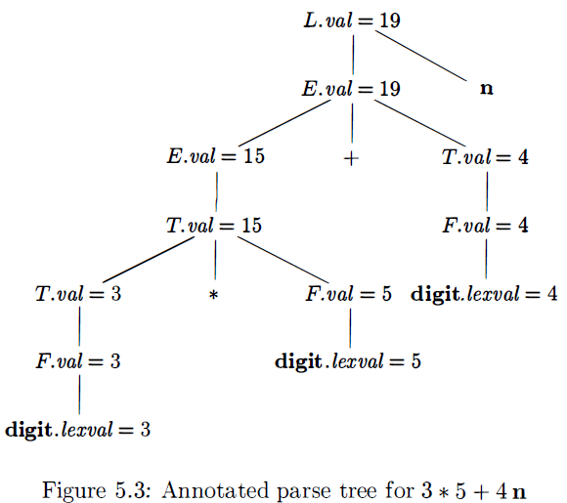
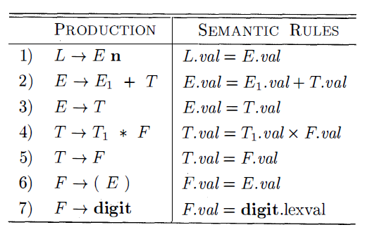
6.2 Syntax-Directed Definitions
- Inherited and Synthesized Attributes
The selection of the attributes is determined by parsing method.
Bottom-up

Slide 13
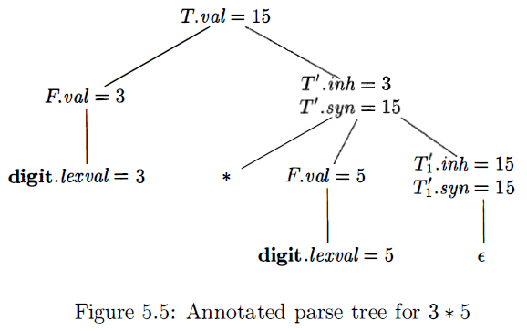
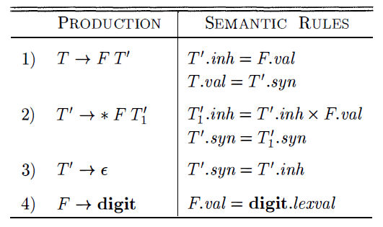

6.2 Syntax-Directed Definitions
- Inherited and Synthesized Attributes
The selection of the attributes is determined by parsing method.
Top-down (Inherited attributes are useful when the structure of a parse tree does not
“match” the abstract syntax of the source code.)
Given a term x*y*z, the root of the subtree for *y*z inherits x. Then, the root of the
Subtree for *z inherits the value of x*y, and so on.

Slide 14
6.3 Evaluation Orders for SDD 's - Dependency Graphs
Dependency graphs are a useful tool for determining an evaluation order for the attribute instances in a given parse tree. While an annotated parse tree shows the values of attributes, a dependency graph helps us determine how those values can be computed.
A dependency graph depicts the flow of information among the attribute instances in a particular parse tree; an edge from one attribute instance to another means that the value of the first is needed to compute the second. Edges express constraints implied by the semantic rules.

Slide 15
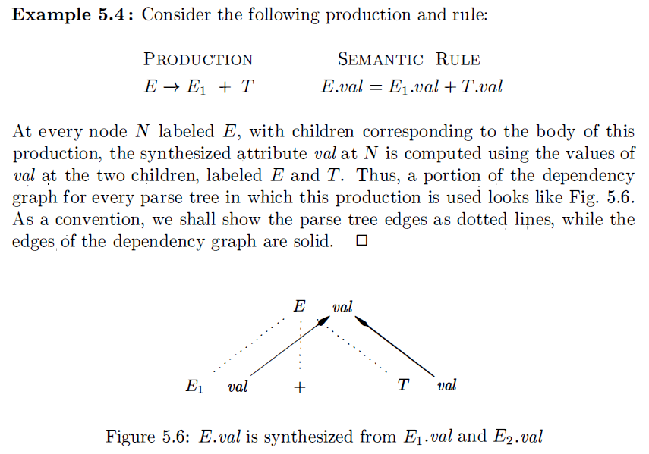
6.3 Evaluation Orders for SDD 's - Dependency Graphs

Slide 16
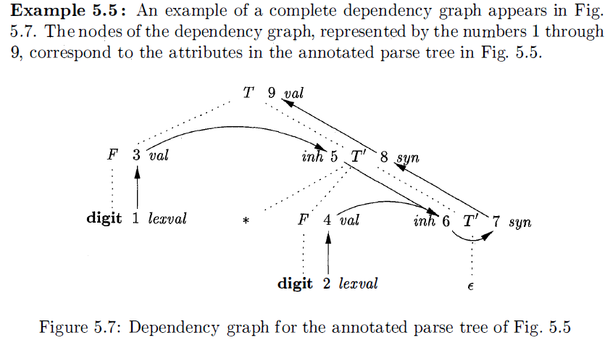
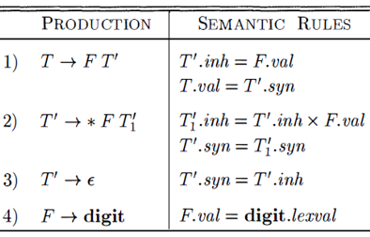
6.3 Evaluation Orders for SDD 's - Dependency Graphs

Slide 17
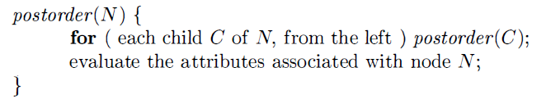
6.3 Evaluation Orders for SDD 's - S-Attributed Definitions
S-Attributed Definitions
  An SDD is S-attributed if every attribute is synthesized
When an SDD is S-attributed, we can evaluate its attributes in any bottom up order of the nodes of the parse tree. It is often especially simple to evaluate the attributes by performing a postorder traversal of the parse tree and evaluating the attributes at a node N when the traversal leaves N for the last time.
S-attributed definitions can be implemented during bottom-up parsing, since a bottom up parse corresponds to a postorder traversal.

Slide 18
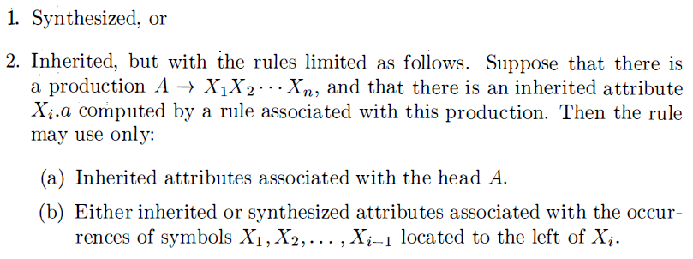
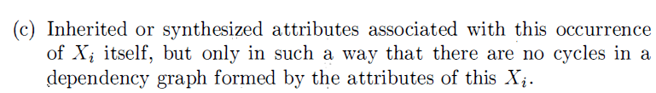
6.3 Evaluation Orders for SDD 's - L-Attributed Definitions
L-Attributed Definitions

Slide 19
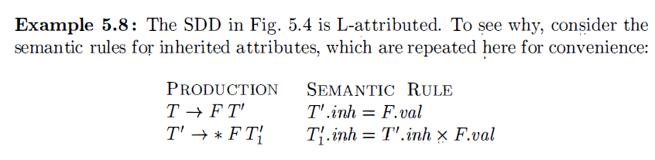
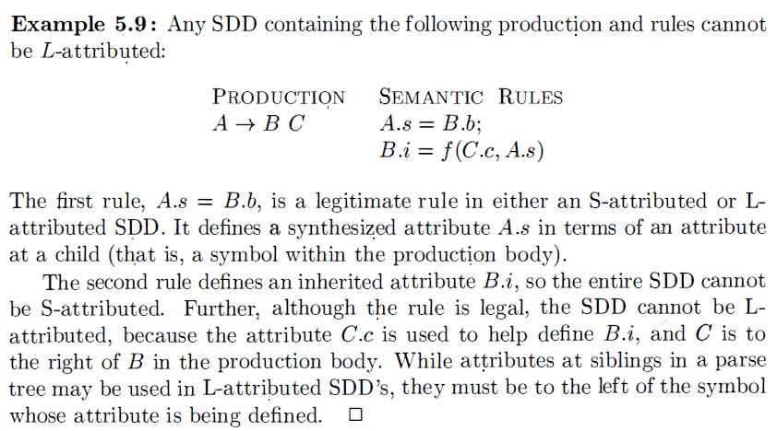
6.3 Evaluation Orders for SDD 's - L-Attributed Definitions

Slide 20
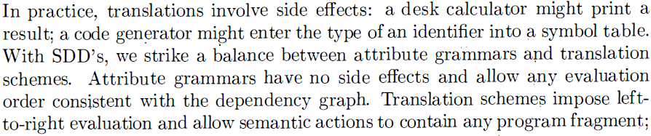
6.3 Evaluation Orders for SDD 's - Semantic Rules with Controlled Side Effects
We shall control side effects in SDD's in one of the following ways :
Permit incidental side effects that do not constrain attribute evaluation. In other words, permit side effects when attribute evaluation based on any topological sort of the dependency graph produces a "correct" translation, where "correct" depends on the application .
Constrain the allowable evaluation orders, so that the same translation is produced for any allowable order. The constraints can be thought of as implicit edges added to the dependency graph.

Slide 21
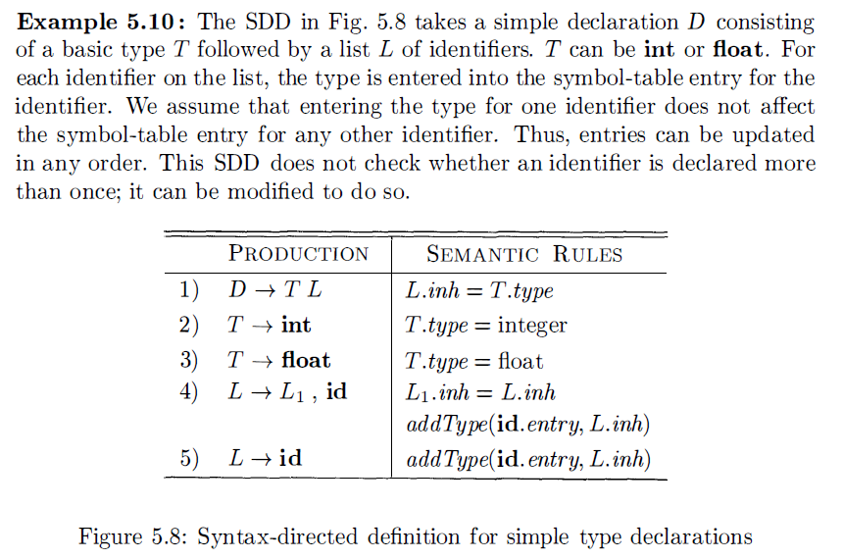
6.3 Evaluation Orders for SDD 's - Semantic Rules with Controlled Side Effects

Slide 22
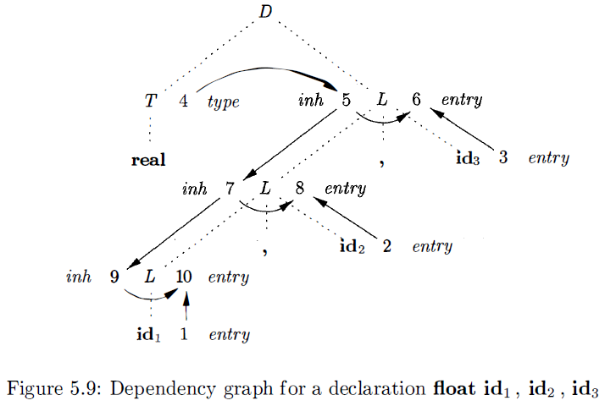
6.3 Evaluation Orders for SDD 's - Semantic Rules with Controlled Side Effects

Slide 23
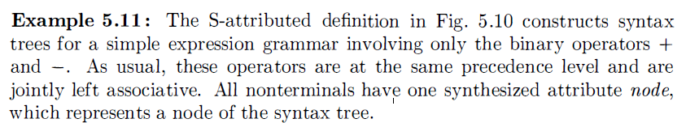
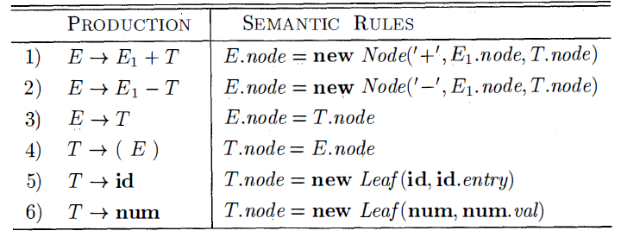
6.4 Applications of Syntax-Directed Translation
Construction of Syntax Trees

Slide 24
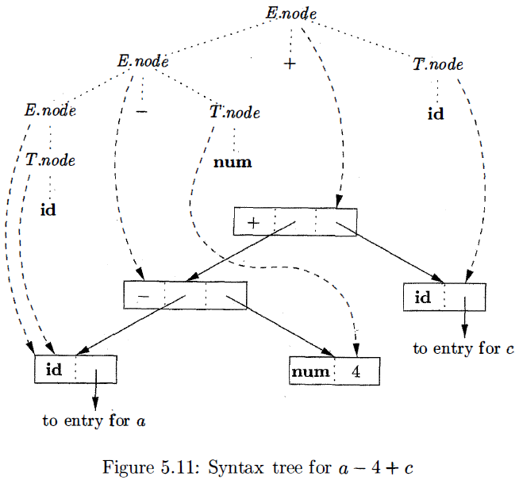
6.4 Applications of Syntax-Directed Translation

Slide 25
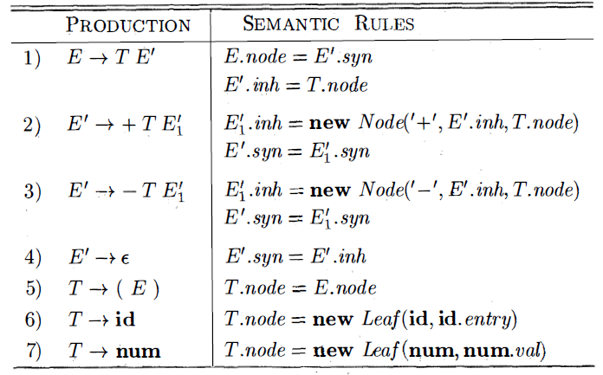
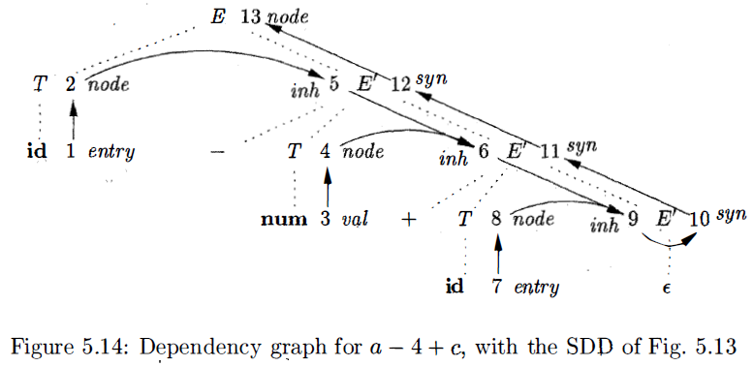

6.4 Applications of Syntax-Directed Translation

Slide 26
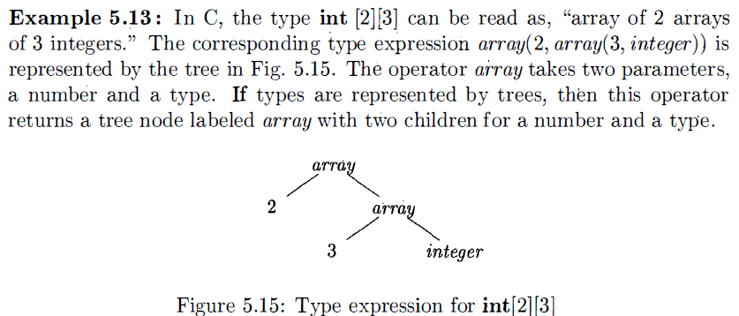
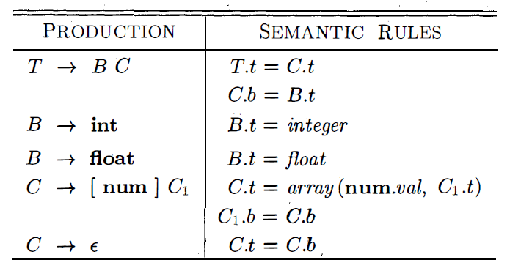
6.4 Applications of Syntax-Directed Translation
The Structure of a Type
The nonterminals B and T have a synthesized attribute t representing a type. The nonterminal C has two attributes: an inherited attribute b and a synthesized attribute t. The inherited b attributes pass a basic type down the tree, and the synthesized t attributes accumulate the result.

Slide 27
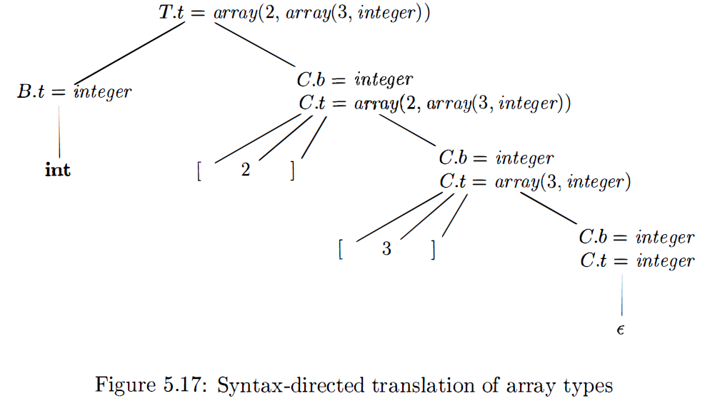
6.4 Applications of Syntax-Directed Translation

Slide 28
6.5 Syntax-Directed Translation Schemes
Syntax-directed translation schemes are a complementary notation to syntax directed definitions. All of the applications of syntax-directed definitions can be implemented using syntax-directed translation schemes.
A syntax- directed translation scheme (SDT) is a context free grammar with program fragments embedded within production bodies . The program fragments are called semantic actions and can appear at any position within a production body.

Slide 29
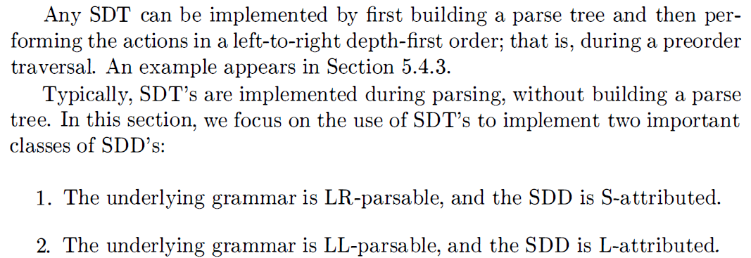
6.5 Syntax-Directed Translation Schemes

Slide 30
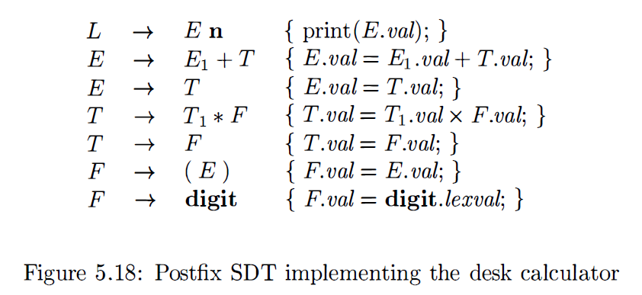
6.5 Syntax-Directed Translation Schemes
Postfix Translation Schemes
The simplest SDD implementation occurs when we can parse the grammar bottom-up and the SDD is S-attributed. In that case, we can construct an SDT in which each action is placed at the end of the production and is executed along with the reduction of the body to the head of that production.

Slide 31
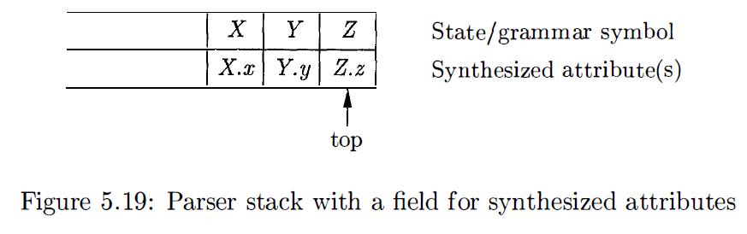
6.5 Syntax-Directed Translation Schemes
Parser-Stack Implementation of Postfix SDT’s
Postfix SDT's can be implemented during LR parsing by executing the actions when reductions occur. The attribute(s) of each grammar symbol can be put on the stack in a place where they can be found during the reduction. The best plan is to place the attributes along with the grammar symbols (or the LR states that represent these symbols) in records on the stack itself.

Slide 32
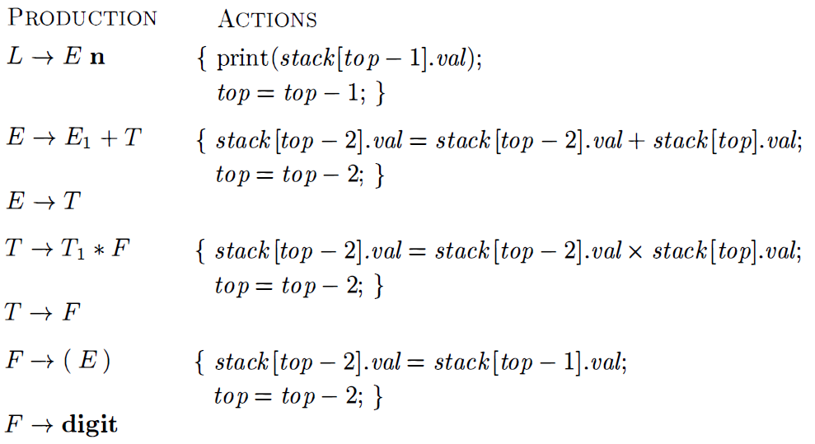
6.5 Syntax-Directed Translation Schemes

Slide 33
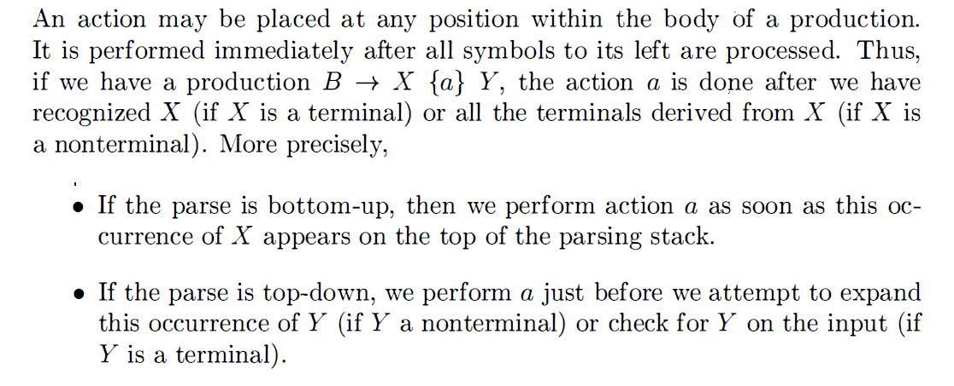
6.5 Syntax-Directed Translation Schemes
SDT's With Actions Inside Productions

Slide 34
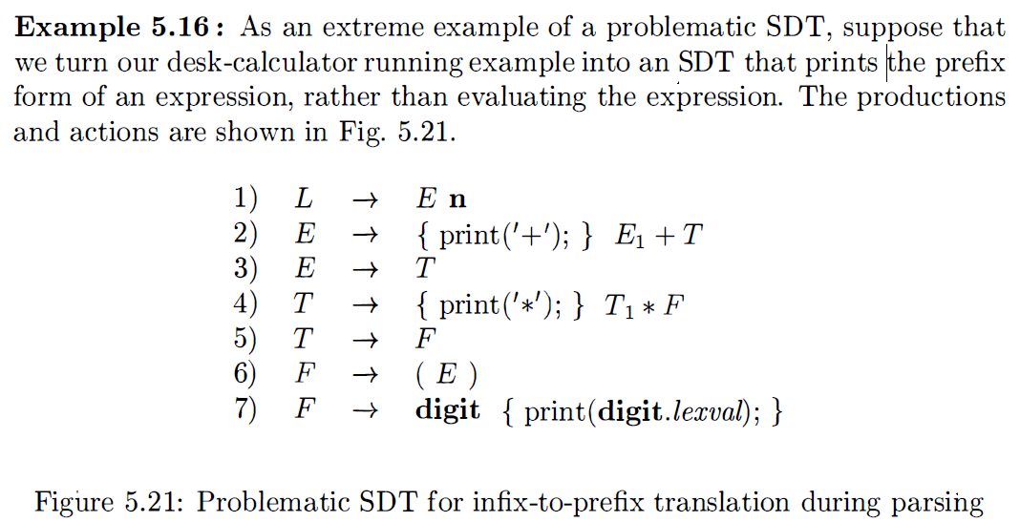
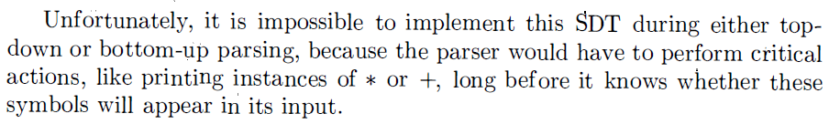
6.5 Syntax-Directed Translation Schemes

Slide 35
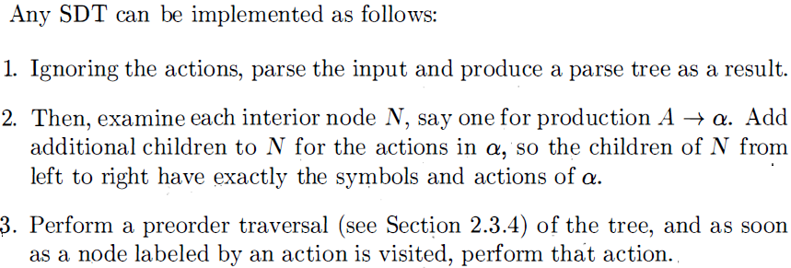
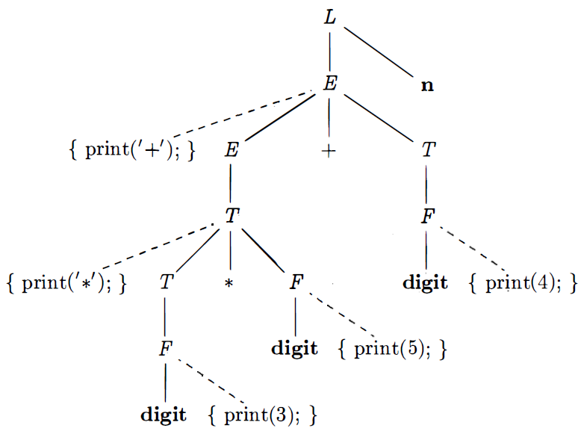
6.5 Syntax-Directed Translation Schemes

Slide 36


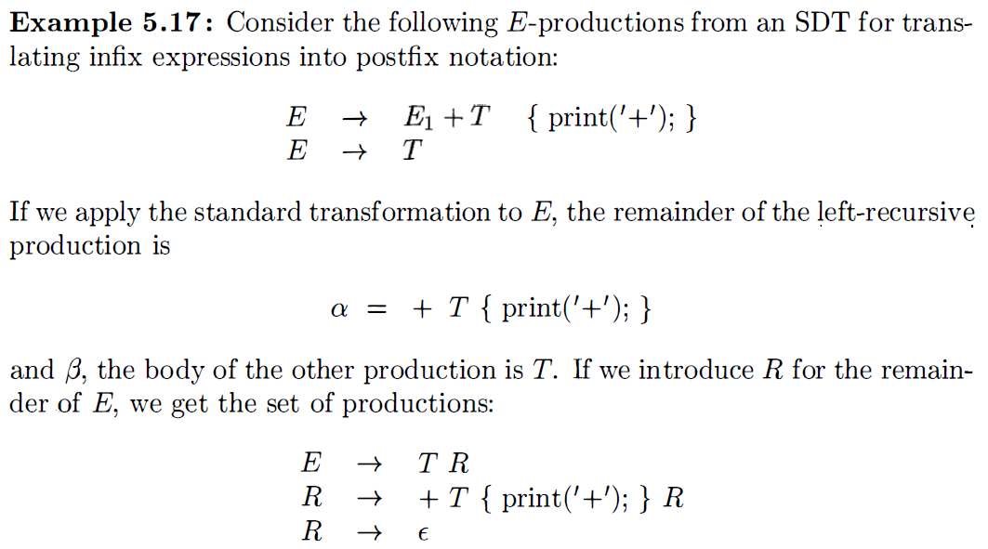
6.5 Syntax-Directed Translation Schemes-Left Recursion

Slide 37

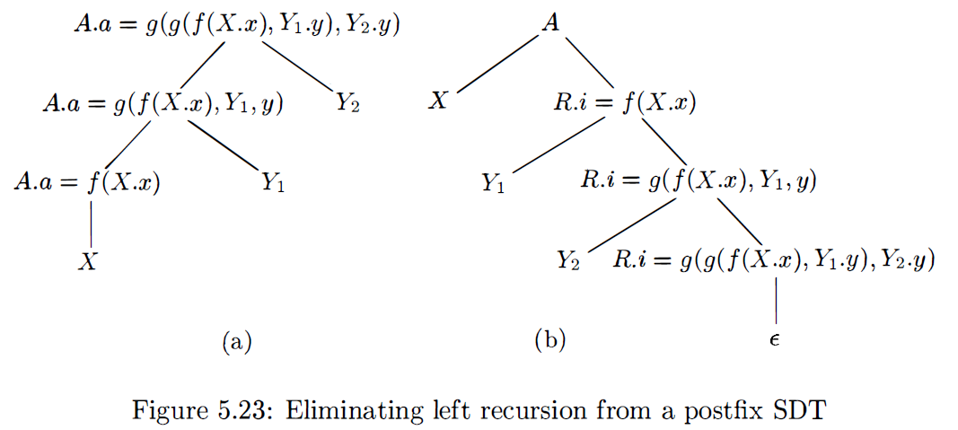
6.5 Syntax-Directed Translation Schemes
When the actions of an SDD compute attributes rather than merely printing output, we must be more careful about how we eliminate left recursion from a grammar. However , if the SDD is S-attributed, then we can always construct an SDT by placing attribute-computing actions at appropriate positions in the new productions.

Slide 38
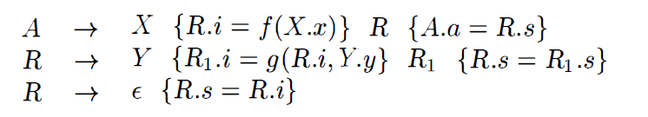
6.5 Syntax-Directed Translation Schemes

Slide 39
6.5 Syntax-Directed Translation Schemes
SDT's for L-Attributed Definitions
The rules for turning an L-attributed SDD into an SDT are as follows:
1. Embed the action that computes the inherited attributes for a nonterminal A immediately before that occurrence of A in the body of the production. If several inherited attributes for A depend on one another in an acyclic fashion, order the evaluation of attributes so that those needed first are computed first.
2. Place the actions that compute a synthesized attribute for the head of a production at the end of the body of that production.

Slide 40
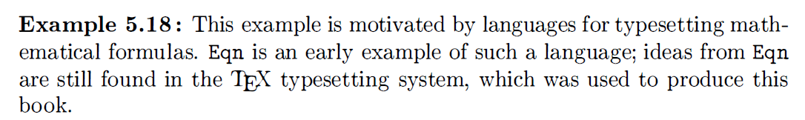
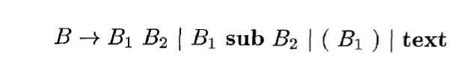
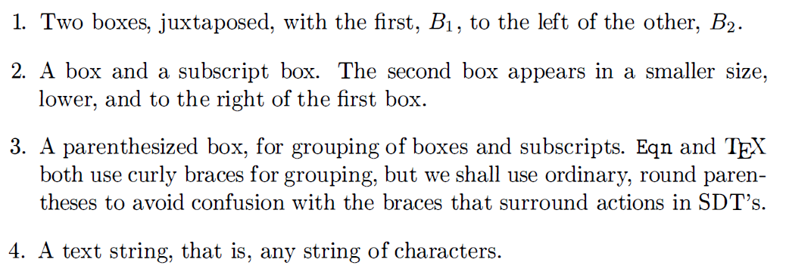
6.5 Syntax-Directed Translation Schemes

Slide 41
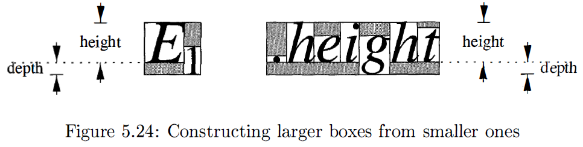
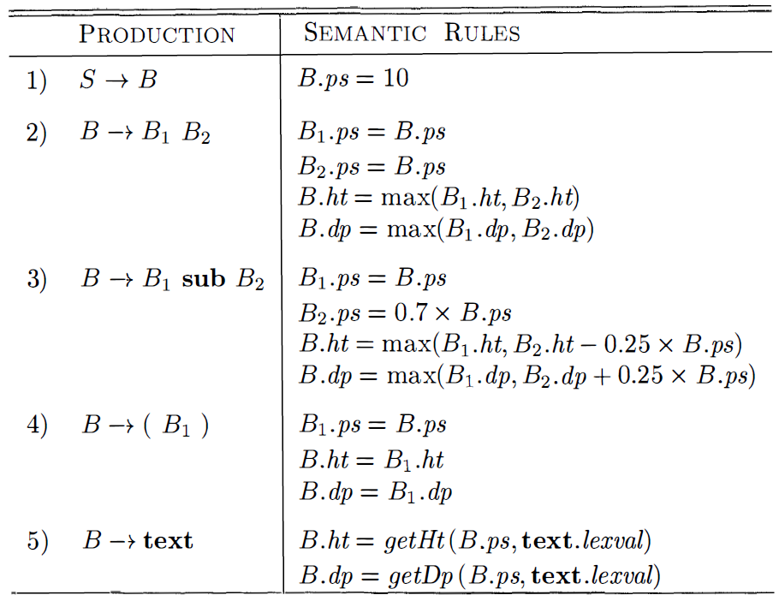
6.5 Syntax-Directed Translation Schemes

Slide 42
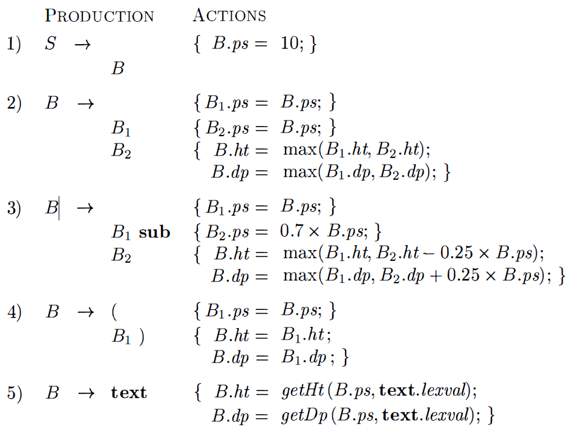
6.5 Syntax-Directed Translation Schemes

Slide 43
Homework 6
Consider the following grammar
(a) write a syntax-directed definition that prints out the number of parenthesis pairs.
(b) write a syntax-directed translation scheme that prints out the depth of each a.
(c) Write a syntax-directed translation scheme that prints out the order number of each a.

