Slide 1

Compiling METHOD
Taught by Jing Zhang
(jzhang@njust.edu.cn)
http:// jz81.github.io

Slide 2
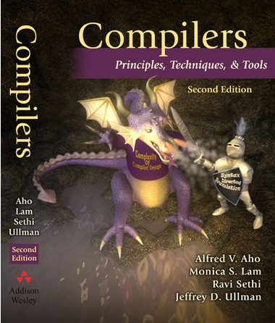
About the Course
Text book: Compilers – Principles, Techniques, & Tools
The 7th – 15th Week (9 weeks)
（April 6 – June 3）
(Twice / week, on Monday morning and Wednesday morning)
Final Examination: The last class in the 15th week （June 3）
Final Grade: 20% attendance + 20% homework + 60% final exam
Text book download:
  http://jz81.github.io/course/compiler/Compilers-Principes%20Techniques%20and%20Tools.pdf

Slide 3
Introduction

Slide 4
A Brief Overview of compiling

Slide 5
1.1 Language Processors-compiler
What is a compiler?
  All the software running on all the computers was written in some program language. Before a program can be run, it first must be translated into a form in which it can be executed by a computer.
  The software system that do this translation are called compiler.
  Simply stated, a compiler is a program that can read a program in one language – the source language – and translate it into an equivalent program in another language – the target language.
Source Program
Compiler
Target Program
input
Target Program
output

Slide 6
1.1 Language Processors-interpreter
An interpreter is another common kind of language processor. It directly execute the operations specified in the source program on inputs supplied by the user
A hybrid compiler
Source Program
Interpreter
output
input
Source Program
Translator
Intermediate program
Virtual Machine
output
input

Slide 7
1.1 Language Processors-system
Several other programs may be required to create an executable target program.
  Preprocessor
  Assembler
  Linker/Loader
Questions
  What is a linker?
  What is a Loader?

Slide 8
1.2 The Structure of a Compiler

Slide 9
1.2 The Structure of a Compiler-Lexical Analysis
Lexical Analysis (Scanning)
  Reads the stream of characters making up the source program and groups the characters into meaningful sequences called lexemes.
  For each lexeme, the lexical analyzer produces as output a token of the form
  E.g.
Position = initial + rate * 60
<id, 1> <=> <id, 2> <+> <id,3> <*> <60>
<number, 0xFFFF1230>

Slide 10
1.2 The Structure of a Compiler-Syntax Analysis
Syntax Analysis (parsing) uses the first components of the tokens produced by the lexical analyzer to create a tree-like intermediate representation that depicts the grammatical structure of the token stream.

Slide 11
1.2 The Structure of a Compiler-Semantic Analysis
The semantic analysis uses the syntax tree and the information in the symbol table to check the source program for semantic consistency with the language definition. It also gathers type information and saves it in either the syntax tree or the symbol table, for subsequent use during intermediate-code generation.
Type checking

Slide 12
1.2 The Structure of a Compiler-Intermediate Code Generation
After syntax and semantic analysis of the source program, many compilers generate an explicit low-level or machine-like intermediate representation, which we can think of as a program for an abstract machine. Two important properties:
  it should be easy to produce
  it should be easy to translate into the target machine
Three-address code
t1 = inttofloat(60)
t2 = id3 * t1
t3 = id2 + t2
id1 = t3

Slide 13
1.2 The Structure of a Compiler-Code Optimization
The machine-independent code-optimization phase attempts to improve the intermediate code so that better target code will result.
t1 = inttofloat(60)
t2 = id3 * t1
t3 = id2 + t2
id1 = t3
t1 = id3 * 60.0
id1 = id2 + t1

Slide 14
1.2 The Structure of a Compiler- Code Generation
The code generator takes as input an intermediate representation of the source program and maps it into the target language. If the target language is machine code, registers or memory locations are selected for each of the variables used by the program. Then, the intermediate instructions are translated into sequences of machine instructions that perform the same task.
judicious assignment of registers to hold variables
LDF R2, id3
MULF R2, R2, #60.0
LDF R1, id2
ADDF R1, R1, R2
STF id1, R1
t1 = id3 * 60.0
id1 = id2 + t1

Slide 15
1.2 The Structure of a Compiler
Symbol-Table Management
Compiler-Construction Tools
  Lex
  Yacc
  …..

