Slide 1

Compiling METHOD
Taught by Jing Zhang
(jzhang@njust.edu.cn)
http:// jz81.github.io

Slide 2
Generation of Compiliers

Slide 3
1.7 Generation of a compiler
The generation of a compiler
  Directly implementation
  Write a compiler for L2 language running on Machine A using L1 language and its compiler running on Machine A
  Transplant of a compiler
    Machine A -> Machine B

Slide 4
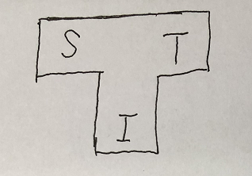
1.7 Generation of a compiler
Directly implementation
  Using machine code to implement a compiler is unrealistic
  We must resort to another existing programing language
T sharp diagram to represent the relationship among the source language (S), the target language (T), and the implementation language of the compiler (I)

Slide 5
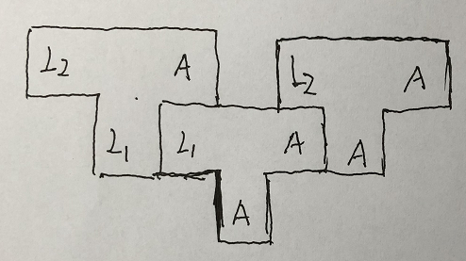
1.7 Generation of a compiler
We have a complier for L1 that can run on machine A (the compiler itself is implemented in machine code A). We want to create a complier for L2 that can run on machine A
  Write a compiler for L2 language running on Machine A using L1 language and its compiler running on Machine A

Slide 6
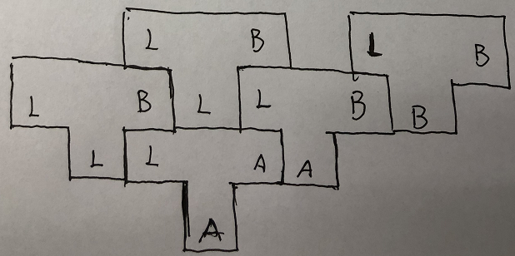
1.7 Generation of a compiler
We have a complier for L that can run on machine A. We want to create a complier for L that can run on machine B.

Slide 7
Homework
(1) Illustrate the phases of a compile. What is the main function for each phase?
(2) What are the differences among name, identifier and variable? What are the differences between declaration and definition？
(3) Briefly explain the parameter passing mechanisms “call-by-value” and “call-by-reference”.
(4) What are the advantages of (a) a compiler over interpreter (b) an interpreter over a compiler?
(5) A compiler that translates a high-level language into another high-level language is called a source-to-source translator. What advantages are there to using C as a target language for a compiler?

