Slide 1

Compilers
Principles, Techniques, & Tools
Taught by Jing Zhang
(jzhang@njust.edu.cn)
http:// jz81.github.io

Slide 2
Course Review

Slide 3
Definition of Compiler
What is a compiler?
  All the software running on all the computers was written in some program language. Before a program can be run, it first must be translated into a form in which it can be executed by a computer.
  The software system that do this translation are called compiler.
  Simply stated, a compiler is a program that can read a program in one language – the source language – and translate it into an equivalent program in another language – the target language.
Source Program
Compiler
Target Program
input
Target Program
output

Slide 4
Interpreter
An interpreter is another common kind of language processor. It directly execute the operations specified in the source program on inputs supplied by the user
A hybrid compiler
Source Program
Compiler
output
input
Source Program
Translator
Intermediate program
Target Program
output
input

Slide 5
Structure of a Compiler

Slide 6
The Running of a Program
Not all programming languages need compilers to run on a machine. There are different kinds of executions of programming languages, such as
(1) Compiling execution
C
C++
PASCAL
(2) Interpretive execution
BASIC
Java
Python

Slide 7
Parameter Passing Mechanisms
How the actual parameters (the parameters used in the call of a procedure) are associated with the formal parameters (those used in the procedure definition).
Call by Value:
  In call-by-value, the actual parameter is evaluated (if it is an expression) or copied (if it is a variable) .
Call by Reference:
  In call-by-reference, the address of the actual parameter is passed to the callee as the value of the corresponding formal parameter.
Call by Name
  the actual parameter were substituted literally for the formal parameter in the code of the callee, as if the formal parameter were a macro standing for the actual parameter
int function (int a, int b) {
return b = a+b*2;
}

Slide 8
The Construction of a Lexical Analyzer
Lexical Analyzer reads input stream and then generate the sequence of tokens that are required by a parser.
token
Lexical Analyzer
Parser
getNextToken
Symbol Table
Sometimes, lexical analyzers are divided into a cascade of two processes:
a) Scanning consists of the simple processes that do not require tokenization of the input, such as deletion of comments and compaction of consecutive whitespace characters into one.
b) Lexical analysis proper is the more complex portion, where the scanner produces the sequence of tokens as output.

Slide 9
3.1 The Construction of a Lexical Analyzer-token
Output of a lexical analyzer：token
  Token is a 2-tuple
  <name，attribute>
  attribute：a point to an entry in Symbol Table
Token name
Keyword：if, while, switch, … (any keyword as a token name)
Identifier：variables, functions, classes… defined by users … (all identifiers have one token name id)
Constant：integer，float, Boolean，literature （Each type has a token name）
Operator：+, -, *, /, %, … （each operator has a token name or each type has a token）
Delimiter：;, {, /**/, … (each delimiter has as token name)

Slide 10
Token-Example
int function (int a, int b) {
return b = a+b*2;
}

Slide 11
DFA and NFA – definition
DFA
M={S, ∑, δ, s₀, F}
S: a set of finite state
∑ is finite alphabet, where each element is a input symbol.
δ is a mapping from S ×∑ to one state in S. δ(s, a)=s’ ：when current state is s，if the input symbol is a , then the transition of the next state is s’
s₀∊S is a unique start state
F⊆S is a set of final states（can be empty ）
NFA
M={S, ∑, δ, S₀, F}
S: a set of finite state
∑ is finite alphabet, where each element is a input letter.
δ is a mapping from S ×∑* to a subset of S，i.e., δ: S ×∑* →2^{S}
S₀ ⊆ S is a non-empty set of start states
F⊆S is a set of final states (can be empty).

Slide 12
3.5 DFA and NFA – Example
Recognize strings on ∑={a, b} that include two consecutive a or two consecutive b
1
DFA
a
a
start
a
0
b
a
3
b
b
2
b
NFA
a
3
a
a
a
start
5
ε
1
2
ε
6
b
b
4
b
b
Notes:
这里给出一个例子。图中的DFA和NFA都是识别字符集∑={a, b}上含有相继两个a或者相继两个b的串。可以看到，DFA中每个状态都对应两条弧，这两条弧上的标签分别是a和b，而NFA不受此限制。弧上的标记可以是a，也可以是b，或者是ab的串，甚至是空字ε，每个状态的出弧也不要求必须和字母表中的字母数一样。另外，从这个例子，我们可以直观的看到，首先DFA和NFA两者的描述能力是等价的，其次，NFA具备比DFA更好的可读性。这也就是为什么使用NFA来构造识别器比较方便的原因。比如这里，只要将相继的两个a和相继的两个b作为整个NFA中的两个成分，在加上收尾的开始和结束状态，就很容易构造出NFA，但是如果想凭空构造出DFA就比较困难了。但是，DFA的好处就是，它的状态转换是确定的，便于程序处理。

Slide 13
3.6 Convert NFA to DFA（subset construction）
Auxiliary Functions
For a state set I, ε_CLOSURE(I) is defined as：
  （1）a state q∊ ε_CLOSURE(I), if q∊I
  （2） a state r∊ ε_CLOSURE(I), if r is a state reachable from some state q in I on ε-transition alone. (i.e., one or more ε-edge)
a-transition set of the state set I, notated as move(I, a), is defined as:
  For any state q∊I，r∊ move(I, a), if r is a state to which there is a transition on input symbol a from q.
Denote I_{a}=ε_CLOSURE(move(I, a))
Notes:
做完上面两个简单处理后我们就可以正式进入“子集法”转换算法了。在描述算法之前，我们先定义一些帮助标记的辅助函数。第一个称为状态集I的ε闭包。它是这样定义的，首先状态集I中的所有状态本身肯定在这个闭包中。其次从I中的状态出发，经过任意多的ε弧能够到达的状态r也在这个闭包中。
第二个辅助函数，称为状态集I的a转移集，定义为move（I，a）。这个集合定义了那些从I中的状态出发经过一条a弧能够到达的状态集。其中a是字母表中的一个字母。
有了这两个辅助函数，我们将状态集I的a转移集的ε闭包简单记为Ia。可见，Ia也是一个集合。

Slide 14
3.6 Convert NFA to DFA（subset construction）
Alphabet ∑={a₁, a₂, ..., a_{k}}；Input：NFA；Output：DFA
Algo: (1) construct a table with k+1 columns，where states in the zero-th column compose the states of the output DFA. Sets I_{a1}…I_{ak} are in the columns 1…k:
0
1
k
0
I | I_{a1} | ... | I_{ak}
ε_CLOSURE(X) | ε_CLOSURE(move(I, a₁))
1
2
  (2) ε_CLOSURE(X) is in row 1 column 0，From this set , we construct sets I_{a1}, ..., I_{ak} for row 1，and fill them in the corresponding positions . Once we fill a set, we exam all sets in column 0. If we cannot find the same set in column 0, we fill this set in the last empty position in column 0.
  (3) step (2) is continued until the sets in column 0 do not increase any more and the entire table is completed.
  (4) For all sets in column 0, we re-assign sequential numbers (start from 0) on them. For all sets in other columns, they are then substituted with their sequential numbers . The numbers stand for the names of the states in DFA. The state that includes X is the unique initial state and those states that include Y are final states.
  The final table are transition table for DFS. Algorithm done.
Notes:
这里就是算法的描述。假设字母表∑中有k个字母，算法的输入时NFA，输出是和这个NFA等价的DFA。
第一步，构造一个k+1列的表格，其中第0列为最终的DFA状态集合，第1到k列为集合Ia1到Iak。其中Ia1的定义就是a1转移集的ε闭包。表的第0行是表头，从第1行第0列开始。
第二步，第1行第0列是初始状态X的ε闭包，然后从这个集合开始，分别构造该集合的Ia1到Iak集合，并将其依次填到相应的位置上，每填写一个集合，就检查所有第0列的表格元素，如果没有发现相同的集合，则将这个集合顺次填在第0列的后续行中。
第三部，将第2步一直进行下去，直到第0列中的集合不在增加，整个表格构建完成为止。
第四步，对于第0列中的所有元素（状态集合）进行重新编号，编号从0开始，并将表中其它列中的元素（状态集合）替换为相应的编号。其中，包含X的状态集合为初态s0(唯一)，包含Y的状态集合为终态（可能有多个）
经过上述步骤，整个表格就变成了一张对应于DFA的状态转换表，算法完成。

Slide 15
Example
I | I₀=ε_closure(move(I, 0)) | I₁=ε_closure(move(I, 1))
{X} |  | {1, 2}
{1, 2} | {1, 2} | {1, 2, 3}
{1, 2, 3} | {1, 2, Y} | {1, 2}
{1, 2, Y} | {1, 2} | {1, 2}

Slide 16
2.2 Context-free Grammar – Derivations
A grammar derives strings by beginning with the start symbol and repeatedly replacing a nonterminal by the body of a production for that nonterminal.
Strictly, we call that derives in one step, i.e.,
if and only if is a production, and .
means “derives in one step”. When a sequence of derivation steps rewrites , we say
. We use symbol” and symbol to represent “derives in zero or more steps” and symbol to represent “derives in one or more steps”.
If , where S is the start symbol of a grammar G, we say that is a sentential form of G.

Slide 17
2.2 Context-free Grammar – Derivations
Note that a sentential form may contain both terminals and nonterminals, and may be empty. A sentence of G is a sentential form with no nonterminals. The language generated by a grammar G is its set of sentences, denoted by L(G) .
Thus, a string of terminals w is in L(G) , if and only if w is a sentence of G (or ). If two grammars generate the same language, the grammars are said to be equivalent.

Slide 18
2.2 Context-free Grammar – Derivations
We consider derivations in which the nonterminal to be replaced at each step is chosen as follows:
1. In leftmost derivations, the leftmost nonterminal in each sentential is always chosen. If is a step in which the leftmost nonterminal in is replaced, we write
2. In rightmost derivations, the rightmost nonterminal is always chosen; we write in this case.
Rightmost derivations are sometimes called canonical derivations.

Slide 19
Example
Consider grammar G1:
(a) Write the leftmost derivation for sentence (a,^)
(b) Write the right derivation for sentence (a,^)
(c) Write the rightmost derivation for sentence (a, (^, a)
(b) Write the handles of the of each step in the normal reduction of sentence (a, (^, a)

Slide 20
Parse Tree
A parse tree pictorially shows how the start symbol of a grammar derives a string in the language. If nonterminal A has a production , then a parse tree may have an interior node labeled A with three children labeled X, Y, and Z, from left to right:
A
X
Y
Z
The root is labeled by the start symbol
Each leaf is labeled by a terminal or by .
Each interior node is labeled by a nonterminal
If A is the nonterminal labeling some interior node and X_{l} , X₂, • • • , X_{n} are the labels of the children of that node from left to right, then there must be a production . Here, X_{I} , X₂ , . . . , X_{n} each stand for for a symbol that is either a terminal or a nonterminal . As a special case, if is a production, then a node labeled A may have a single child labeled .
From left to right , the leaves of a parse tree form the yield of the tree , which is the string generated or derived from the nonterminal at the root of the parse tree. The process of finding a parse tree for a given string of terminals is called parsing that string.

Slide 21
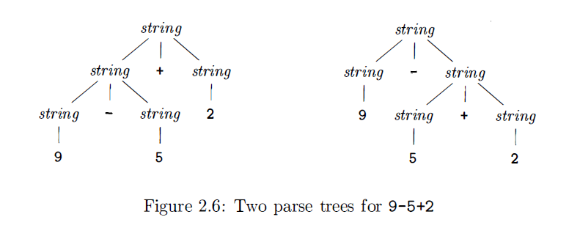
Ambiguity
A grammar can have more than one parse tree generating a given string of terminals. Such a grammar is said to be ambiguous.
Since a string with more than one parse tree usually has more than one meaning, we need to design unambiguous grammars for compiling applications, or to use ambiguous grammars with additional rules to resolve the ambiguities.

Slide 22
LL(1) Grammar
Predictive parsers, that is, recursive-descent parsers needing no backtracking, can be constructed for a class of grammars called LL(1) .The first "L" in LL(1) stands for scanning the input from left to right, the second "L" for producing a leftmost derivation, and the "I" for using one input symbol of lookahead at each step to make parsing action decisions.

Slide 23
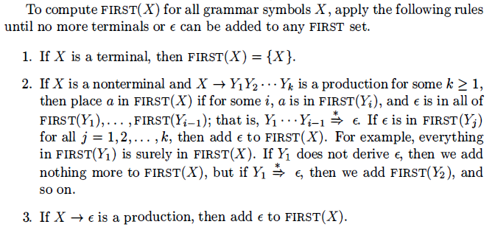
LL(1) Grammar - FIRST and FOLLOW
Suppose , when facing an input symbol a, if we know exactly which production of A should be designated to match a, we do not need backtracking. That is, the first terminals of should be different.
Formally,
Specially, if , we have
sometimes, start with a nonterminal X, how to compute FIRST(X)?

Slide 24
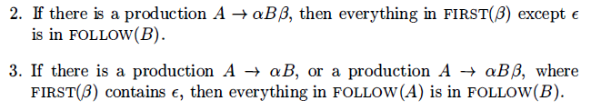
LL(1) Grammar - FIRST and FOLLOW
Define FOLLOW(A), for nonterminal A, to be the set of terminals a that can appear immediately to the right of A in some sentential form.
Specially, if we have , where is the right endmarker.
To compute FOLLOW(A) for all nonterminals A, apply the following rules
until nothing can be added to any FOLLOW set.

Slide 25
LL(1) Grammar - definition
A grammar G is LL(1) if the follow conditions are satisfied:
(1) no left recursive production
(2) For each nonterminal A in the grammar, if A has the form
then
(3) For each nonterminal A in the grammar, if
then

Slide 26
LL(1) Top-Down Parsing (Framework)
Suppose that we use a nonterminal A to match input symbol a , if the production of A is
(1) if then we use to match input a
(2) if
    if and then let A match
    otherwise, the occurrence of a is an error.
    According to LL(1) Grammar, each step is deterministic. It will result in a Recursive-Descent Parsing without Backtracking.

Slide 27
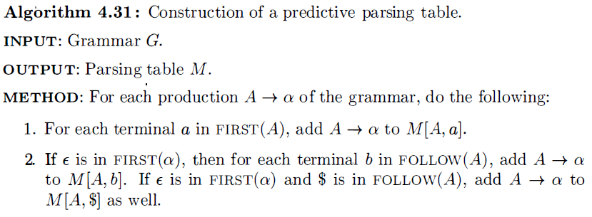
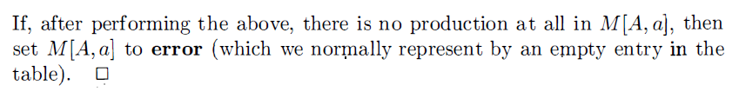
4.6 Predictive Parsing for LL(1) Grammar
Construction of a predictive parsing table M.

Slide 28
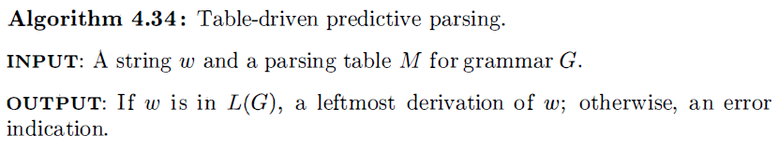
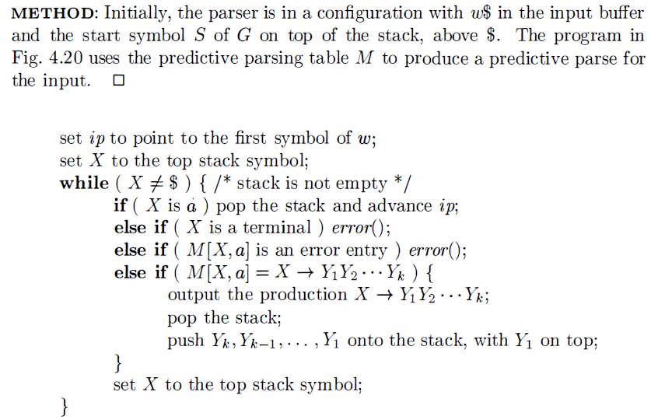
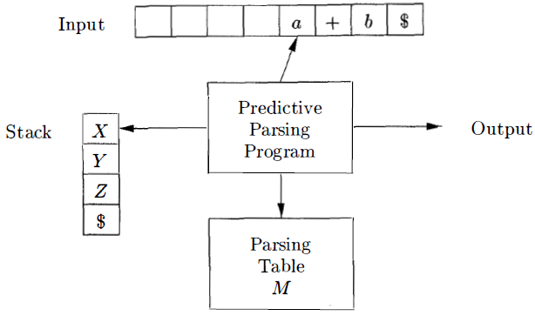
4.6 Predictive Parsing for LL(1) Grammar

Slide 29
Example
Consider Grammar G3:
(1) FIRST(S) = {a, b, c} FIRST (A) ={a, ε} FIRST(B)={b, ε}
FOLLOW(S) = {$} FOLLOW(A) = {b, c} FOLLOW(B) = {c}
(2) The grammar has no left-recursion
For A, FIRST(A) ∩ FOLLOW(A) =Φ
For B, FIRST(B) ∩ FOLLOW(B) =Φ The grammar is LL(1).
 | a | b | c | $
S | S->ABc | S->ABc | S->ABc
A | A->a | A->ε | A->ε
B |  | B->b | B->ε

Slide 30
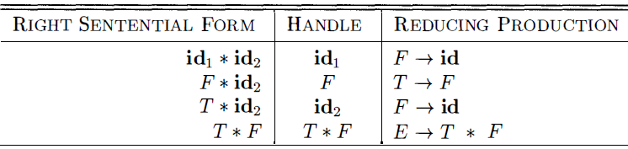
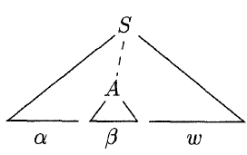
Bottom-Up Parsing – Handle Pruning
Bottom-up parsing during a left-to-right scan of the input constructs a rightmost derivation in reverse. Informally, a "handle" is a substring that matches the body of a production, and whose reduction represents one step along the reverse of a rightmost derivation.
rm
rm
rm
rm
rm
Formally, if then the production in the position following is a handle of . Notice that the string to the right of the handle must contain only terminal symbols. For convenience, we refer to the body rather than as a handle.
A rightmost derivation in reverse can be obtained by "handle pruning”.

Slide 31
Bottom-Up Parsing – More Explanations on “Handle”
Right-most derivation is also called “normal derivation”, which guarantees
  Proof. if has a handle , i.e, and , then under the rightmost derivation should not be derived out before .
  If has the form and , we do not call “handle”, because for right-sentential form then last rightmost derivation is , i.e., is previously derived out to . Thus, the reverse of the last rightmost derivation should take place on .
  Thus, a handle is at the leftmost position of a right-sentential form.
Note we say "a handle" rather than "the handle," because the grammar could be ambiguous, with more than one rightmost derivation of . If a grammar is unambiguous, then every right-sentential form of the grammar has exactly one handle.
No handle

Slide 32
Bottom-Up Parsing – More Explanations on “Handle”
Normal Reduction is a reverse of a Normal derivation (rightmost derivation).
Specifically, is a sentence of grammar G, we call the sequence of sentential forms is a Normal Reduction of , if the sequence satisfies:
(1)
(2) (start symbol of a grammar)
(3) For , can be obtained by replacing the handle of with the left part of its corresponding production.
Thus, Normal Reduction is also called leftmost reduction !

Slide 33
Simple LR
Items and the LR(0) Automaton
  An LR parser makes shift-reduce decisions by maintaining states to keep track of where we are in a parse. States represent sets of "items." An LR(0) item (item for short) of a grammar G is a production of G with a dot at some position of the body. Thus, production yields the four items
  For , we only have .
  The item indicates that we hope to see a string derivable from XYZ next on the input. Item indicates that we have just seen on the input a string derivable from X and that we hope next to see a string derivable from YZ. Item indicates that we have seen the body XYZ and that it may be time to reduce XYZ to A.
  One collection of sets of LR(0) items, called the canonical LR(0) collection,
  provides the basis for constructing a deterministic finite automaton that is used
  to make parsing decisions.

Slide 34
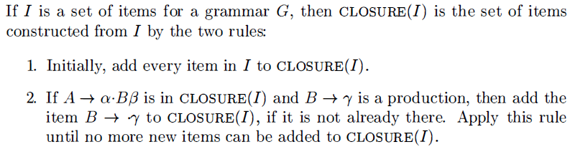
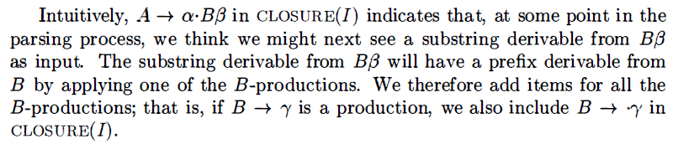
Simple LR
To construct the canonical LR(0) collection for a grammar, we define an augmented grammar and two functions, CLOSURE and GOTO . If G is a grammar with start symbol S, then G' , the augmented grammar for G, is G with a new start symbol S' and production . The purpose of this new starting production is to indicate to the parser when it should stop parsing and announce acceptance of the input. That is, acceptance occurs when and only when the parser is about to reduce by .
Closure of Item Sets

Slide 35
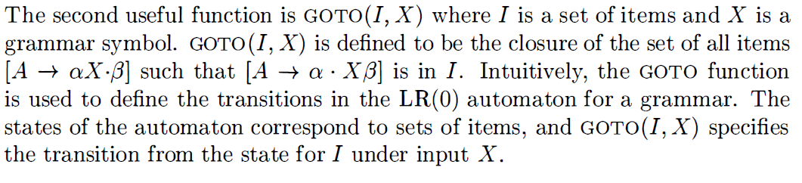
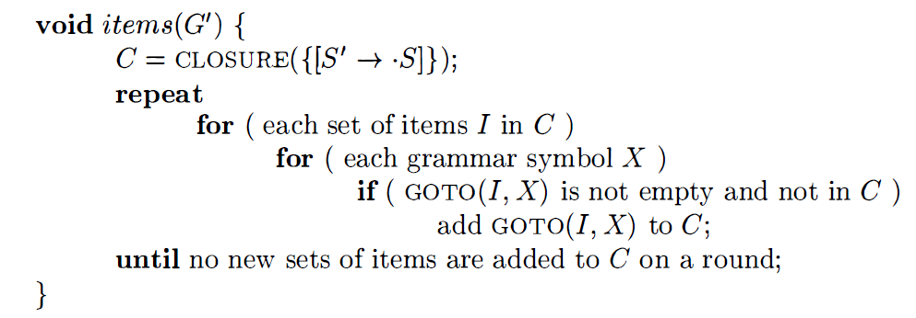
Simple LR
The Function GOTO

Slide 36
Simple LR
Use of the LR(0) Automaton
  The central idea behind "Simple LR," or SLR, parsing is the construction from the grammar of the LR(0) automaton. The states of this automaton are the sets of items from the canonical LR(0) collection, and the transitions are given by the GOTO function.
  Shift-reduce decisions can be made as follows. Suppose that the string “γ” of grammar symbols takes the LR(0) automaton from the start state 0 to some state j . Then, shift on next input symbol a if state j has a transition on a. Otherwise, we choose to reduce; the items in state j will tell us which production to use.

Slide 37
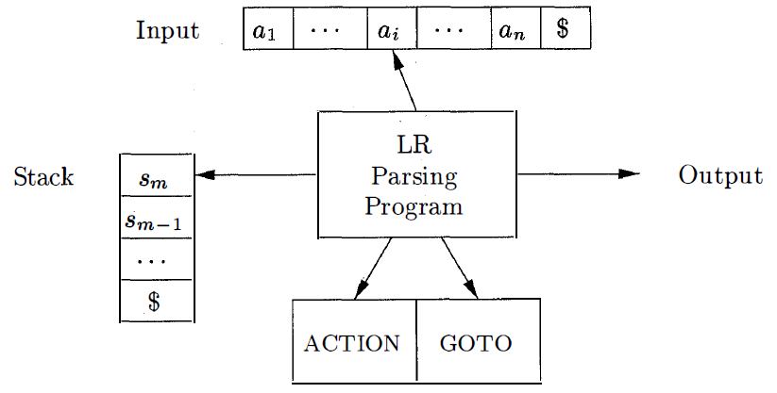
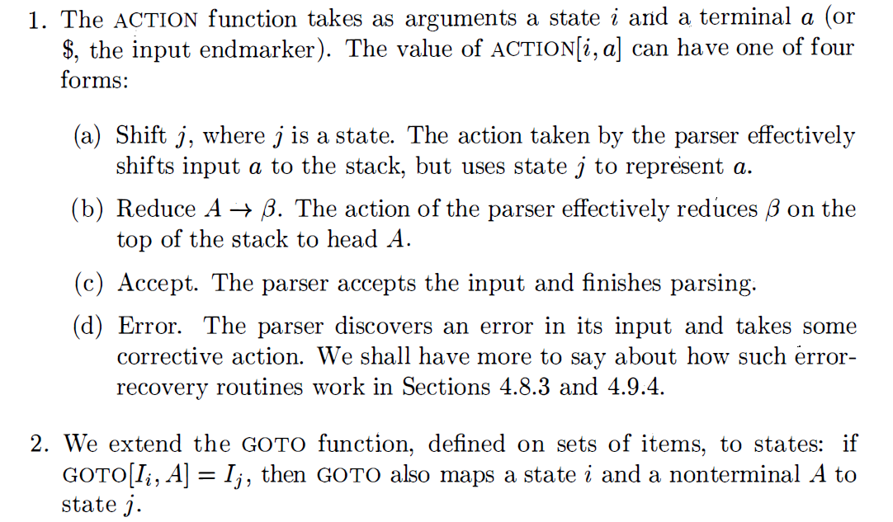
The LR-Parsing Algorithm
The model of LR Parser

Slide 38
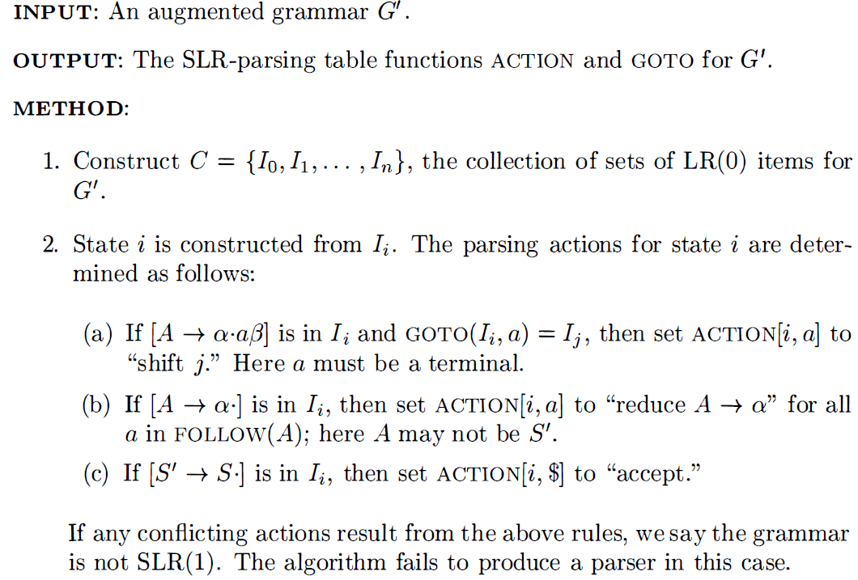
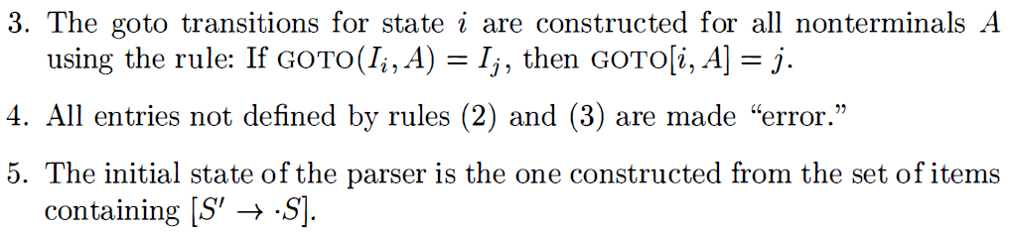
5.3 The LR-Parsing Algorithm
Constructing an SLR-parsing table
  The SLR method begins with LR(0) items and LR(0) automata

Slide 39
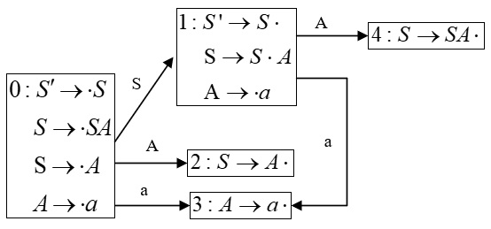
Example
Consider grammar G4:

Slide 40
6.2 Syntax-Directed Definitions
A syntax-directed definition ( SDD) is a context-free grammar together with attributes and rules. Attributes are associated with grammar symbols and rules are associated with productions.
If X is a symbol and a is one of its attributes, then we write X.a to denote the value of a at a particular parse-tree node labeled X.
Attributes may be of any kind: numbers , types , table references , or strings, for instance. The strings may even be long sequences of code, say code in the intermediate language used by a compiler.

Slide 41
6.2 Syntax-Directed Definitions
- Inherited and Synthesized Attributes
A synthesized attribute for a nonterminal A at a parse-tree node N is defined by a semantic rule associated with the production at N. Note that the production must have A as its head. A synthesized attribute at node N is defined only in terms of attribute values at the children of N and at N itself.
An inherited attribute for a nonterminal B at a parse-tree node N is defined by a semantic rule associated with the production at the parent of N. Note that the production must have B as a symbol in its body. An inherited attribute at node N is defined only in terms of attribute values at N's parent , N itself, and N's siblings.

Slide 42
Example
Consider the following grammar
(a) Write a syntax-directed definition that prints out the number of parenthesis pairs.
(b) Write a syntax-directed translation scheme that prints out the depth of each a.
(c) Write a syntax-directed translation scheme that prints out the order number of each a.
(a)
(b)

Slide 43
Example
(c) We use an inherited attribute in to represent the order number of the character left to a symbol.
We use a synthesized attribute out to represent the order number of the last character derived by a symbol.

