Slide 1
COMPILERS
Principles and Practice
Jing Zhang

Slide 2
8. Runtime Environments

Slide 3
Contents
8.1 Memory Organization During Program Execution
8.2 Fully Static Runtime Environments
8.3 Stack-Based Runtime Environments
8.4 Dynamic Memory

Slide 4
The precious chapters studied the phases of a compiler that perform static analysis of the source language
  Scanning, parsing, and static semantic analysis
  Depends only on the properties of the source language
This chapter and the next turn to the task of studying how a compiler generates executable code
  Additional analysis, such as that performed by an optimizer
  Some of this can be machine independent, but much of the task of code generation is dependent on the details of the target machine

Slide 5
Runtime Environment
  The structure of the target computer’s registers and memory that serves to manage memory and maintain the information needed to guide the execution process
Three kinds of runtime environments
  (1) Fully static environment; FORTRAN77
  (2) Stack-Based environment; C C++
  (3) Fully dynamic environment; LISP

Slide 6
Main issues will be discussed in more detail in the chapter:
  For each environment, the language features and their properties
  (1) Scoping and allocation issues;
  (2) Nature of procedure calls;
  (3) Parameter passing mechanisms
Focus on the general structure of the environment
Note:
  The compiler can only maintain an environment only indirectly
  It must generate code to perform the necessary maintenance operations during program execution.

Slide 7
8.1 Memory Organization During Program Execution

Slide 8
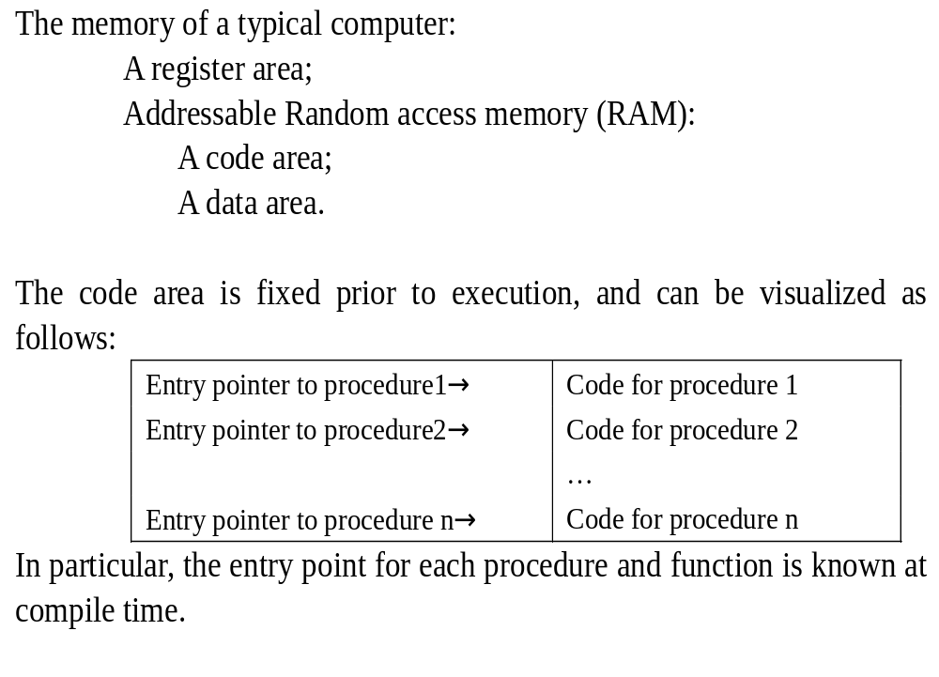

Slide 9
The global and/or static data of a program can be fixed in memory prior to execution
  Data are allocated separately in a fixed area in a similar fashion to the code
    In Fortran77, all data are in this class;
    In Pascal, global variables are in this class;
    In C, the external and static variables are in this class
The constants are usually allocated memory in the global/static area
  Const declarations of C and Pascal;
  Literal values used in the code,
    such as “Hello%D\n” and Integer value 12345:
    Printf(“Hello %d\n”,12345);

Slide 10
The memory area used for dynamic data can be organized in many different ways
  Typically, this memory can be divided into a stack area and a heap area;
    A stack area used for data whose allocation occurs in FIFO fashion;
    A heap area used for dynamic allocation occurs not in FIFO fashion.
Generally, the architecture of the target machine includes a processor stack for procedure calls and returns.
  Sometimes, a compiler will have to arrange for the explicit allocation of the processor stack in an appropriate place in memory.

Slide 11
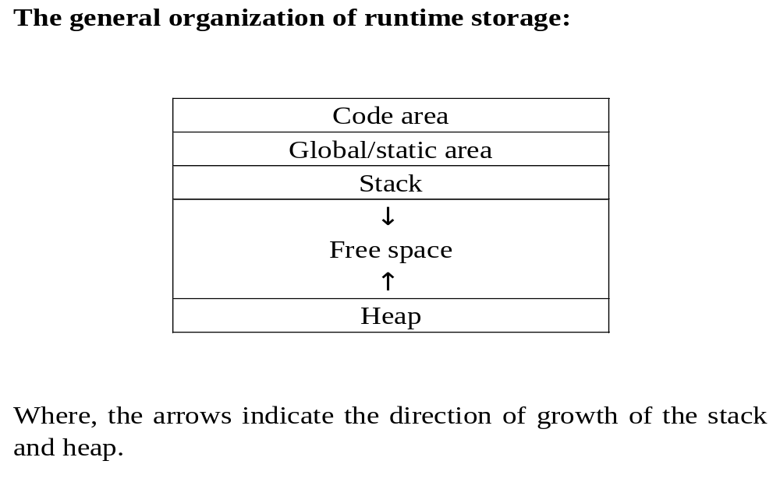

Slide 12
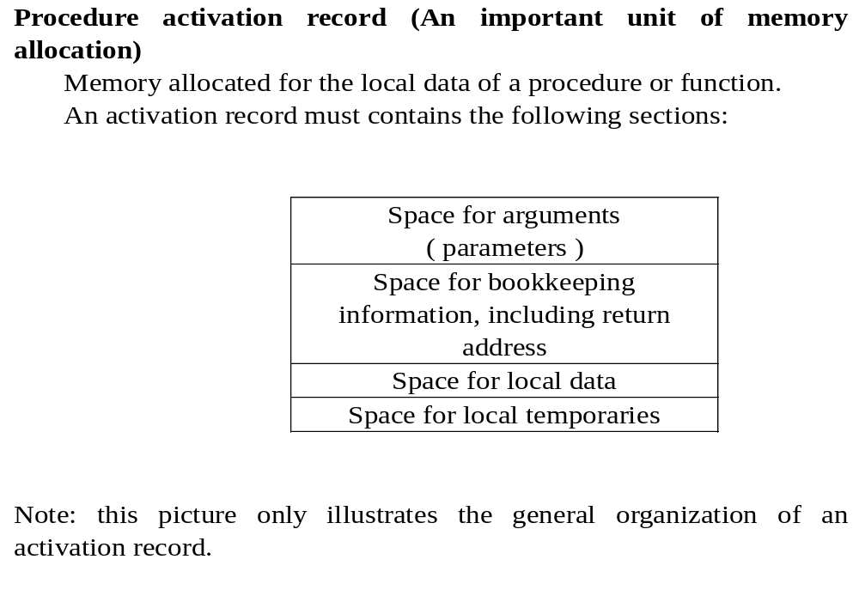

Slide 13
Some parts of an activation record have the same size for all procedures
  Space for bookkeeping information
Other parts of an activation record may remain fixed for each individual procedure
  Space for arguments and local data
Some parts of activation record may be allocated automatically on procedure calls:
  Storing the return address
Other parts of activation record may need to be allocated explicitly by instructions generated by the compiler:
  Local temporary space
Depending on the language, activation records may be allocated in different areas:
  Fortran77 in the static area;
  C and Pascal in the stack area; referred to as stack frames
  LISP in the heap area.

Slide 14
Processor registers are also part of the structure of the runtime environment
  Registers may be used to store temporaries, local variables, or even global variables;
  In newer RISC processor, keep entire static area and whole activation records;
  Special-purpose registers to keep track of execution
    PC program counter;
    SP stack pointer;
    FP frame pointer;
    AP argument pointer

Slide 15
The sequence of operations when calling the functions: calling sequence
  The allocation of memory for the activation record;
  The computation and storing of the arguments;
  The storing and setting of necessary registers to affect the call
The additional operations when a procedure or function returns: return sequence (VS call)
  The placing of the return value where the caller can access it;
  The readjustment of registers;
  The possible releasing for activation record memory

Slide 16
The important aspects of the design of the calling sequence:
  (1) How to divide the calling sequence operations between the caller and callee
    At a minimum, the caller is responsible for computing the arguments and placing them in locations where they may be found by the callee
  (2) To what extent to rely on processor support for calls rather that generating explicit code for each step of the calling sequence

Slide 17
8.2 Fully Static Runtime Environments

Slide 18
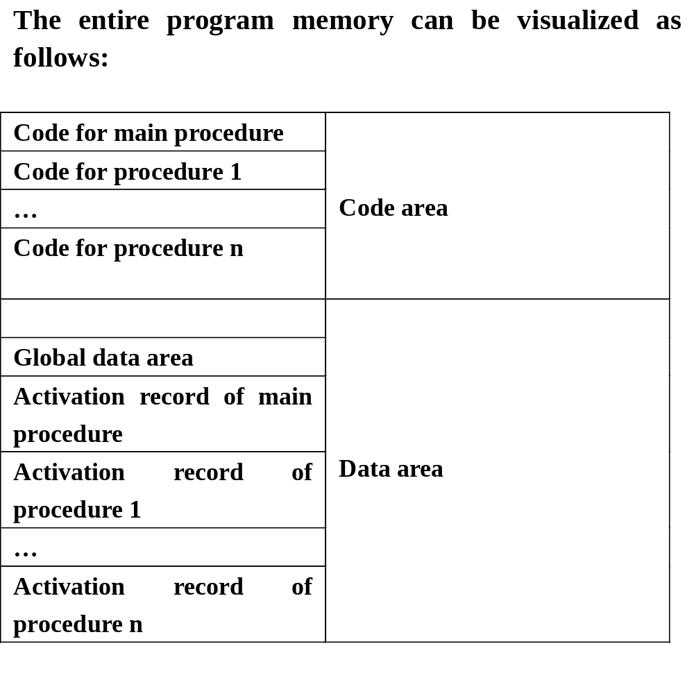

Slide 19
All data are static, remaining fixed in memory for the duration of program execution
For a language, such as FORTRAN77, no pointer or dynamic allocation, no recursive procedure calling
  The global variables and all variables are allocated statically.
  Each procedure has only a single activation record.
  All variable, whether local or global, can be accessed directly via fixed address.

Slide 20
Relative little overhead in terms of bookkeeping information to retain in each activation record;
And no extra information about the environment needs to be kept in an activation record;
The calling sequence is simple.
  Each argument is computed and stored into its appropriate parameter location;
  The return address is saved, and jump to the beginning of the code of the callee;
  On return, a simple jump is made to the return address.

Slide 21
Example: A FORTRAN77 sample program
PROGRAM TEST
COMMON MAXSIZE
INTEGER MAXSIZE
REAL TABLE(10),TEMP
MAXSIZE = 10
READ *, TABLE(1),TABLE(2),TABLE(3)
CALL QUADMEAN(TABLE,3,TEMP)
PRINT *, TEMP
END

Slide 22
  SUBROUTINE QUADMEAN(A, SIZE,QMEAN)
  COMMON MAXSIZE
  INTEGER MAXSIZE,SIZE
  REAL A(SIZE),QMEAN,TEMP
  INTEGER K
  TEMP=0.0
  IF ((SIZE .GT. MAXSIZE) .OR. (SIZE .LT. 1) GOTO 99
  DO 10 K=1,SIZE
  TEMP=TEMP+A(K)*A(K)
10 CONTINUE
99 QMEAN = SQRT(TEMP/SIZE)
  RETURN
  END

Slide 23
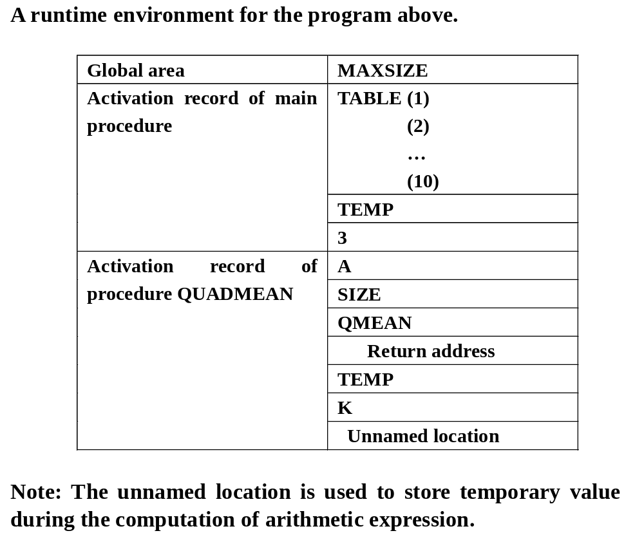

Slide 24
8.3 Stack-Based Runtime Environments

Slide 25
For a language, in which
  Recursive calls are allowed;
  Local variables are newly allocated at each call;
  Activation records cannot be allocated statically
Activation records must be allocated in a stack-based fashion
  The stack of activation records grows and shrinks with the chain of calls in the executing program.
  Each procedure may have several different activation records on the call stack at one time, each representing a distinct call.
  More complex strategy for bookkeeping and variable access, which depends heavily on the properties of the language being compiled.

Slide 26
7.3.1 Stack-Based Environments Without Local Procedures

Slide 27
In a language where all properties are global (such as C language), the stack-based environment requires two things:
  (1) Frame pointer or fp, a pointer to the current activation record to allow access to local variable; Control link or dynamic link, a point to a record of the immediately preceding activation
  (2) Stack pointer or sp, a point to the last location allocated on the call stack

Slide 28
Example: The simple recursive implementation of Euclid’s algorithm to compute the greatest common divisor of two non-negative integer
  # include <stdio.h>
  int x,y;
  int gcd(int u,int v)
  { if (v==0) return u;
  else return gcd(v,u%v);
  }
  main()
  {scanf(“%d%d”,&x,&y);
  printf(“%d\n”,gcd(x,y));
  return 0;
  }
Suppose the user inputs the values 15 and 10 to this program.

Slide 29
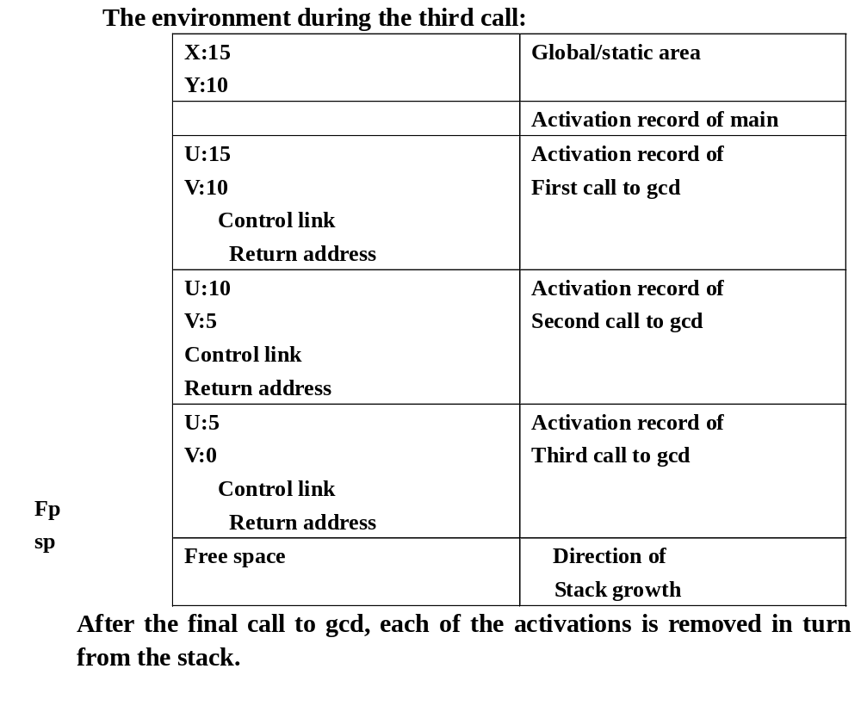

Slide 30
Example: Int x=2;
Void g(int);/*prototype*/
Void f(int n)
{static int x=1;
g(n);
x--;
}
void g(int m)
{int y=m-1;
if (y>0)
{ f(y);
x--;
g(y);
}
}
main( )
{g(x);
return 0;
}

Slide 31
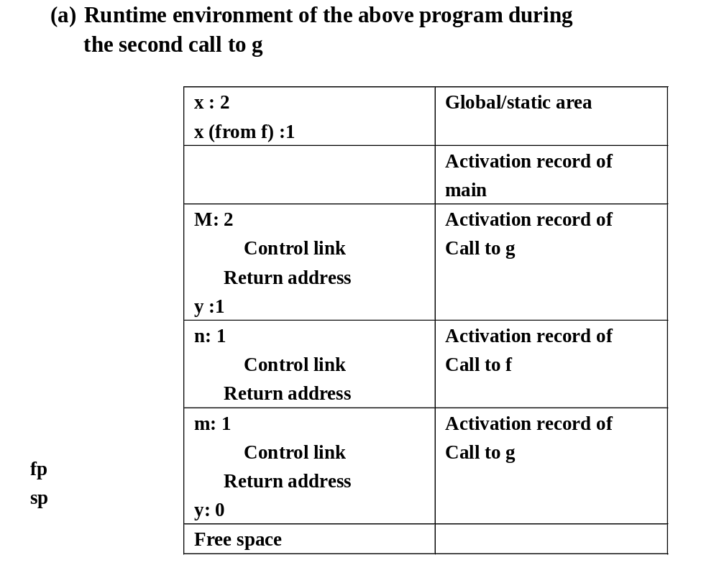

Slide 32
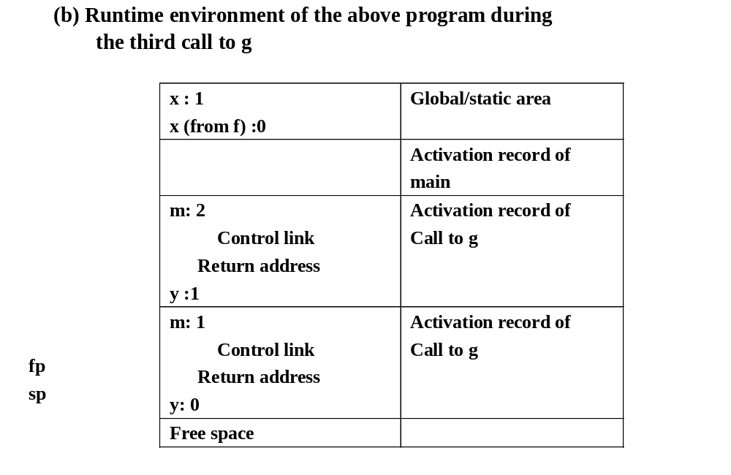

Slide 33
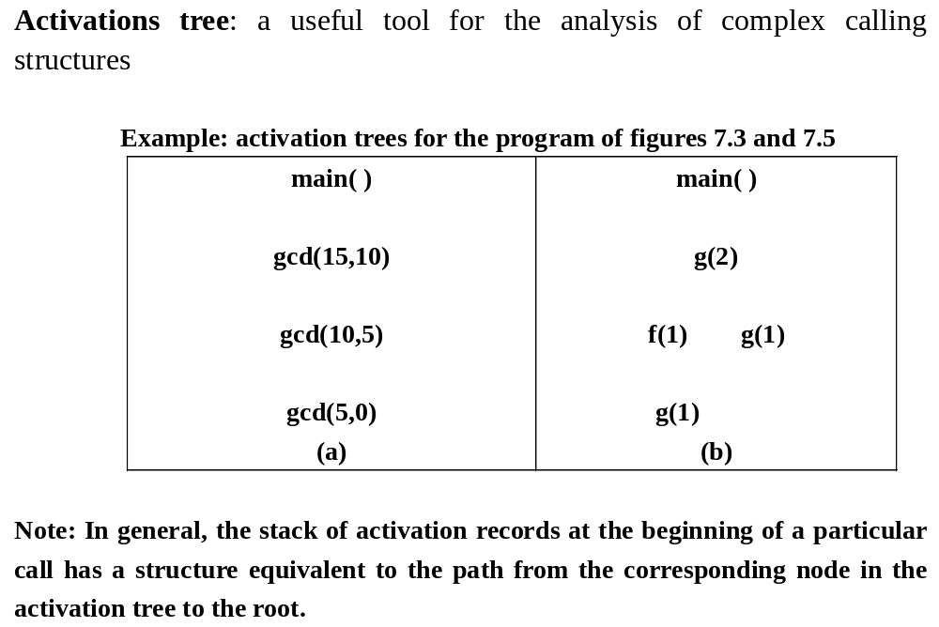

Slide 34
Access to Names:
  Parameters and local variable can no longer be accessed by fixed addresses, instead they must be found by offset from the current frame pointer.
  In most language, the offset can be statically computable by the compiler.

Slide 35
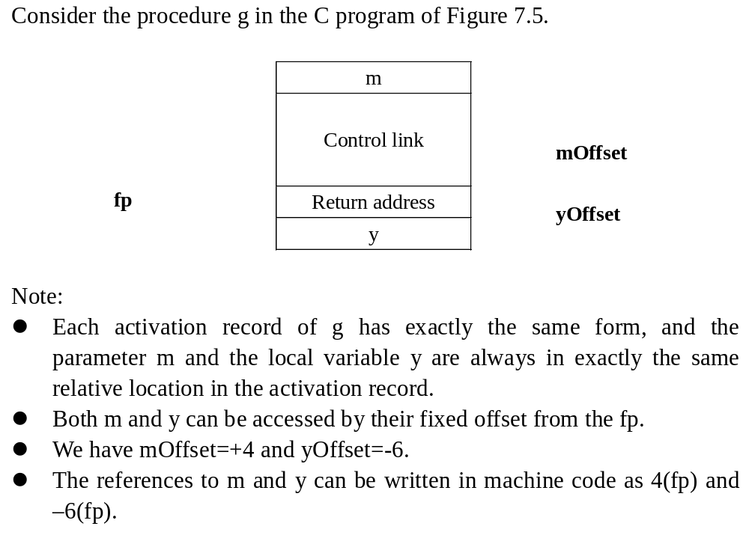

Slide 36
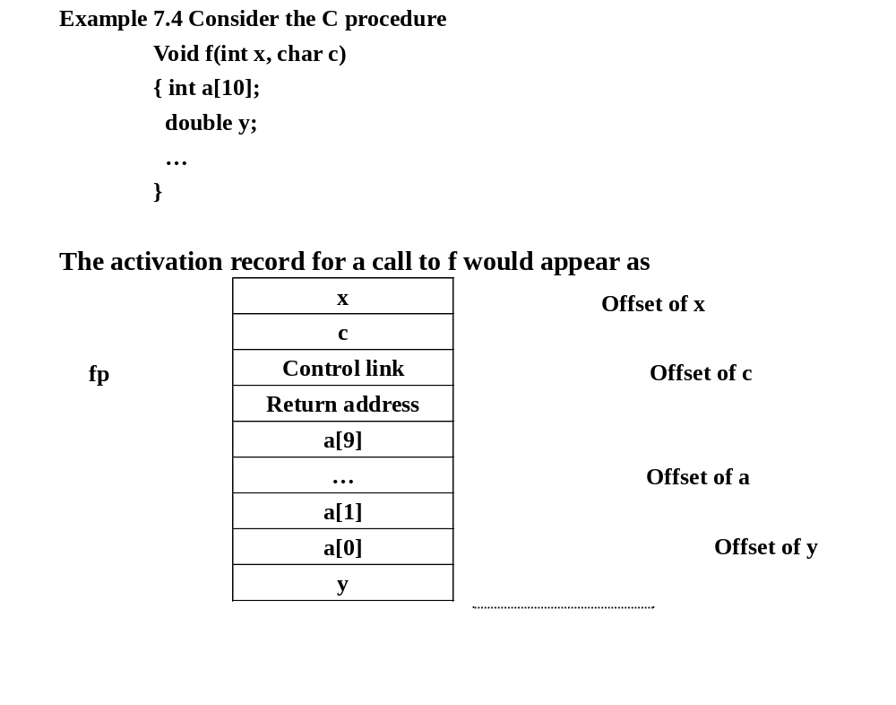

Slide 37
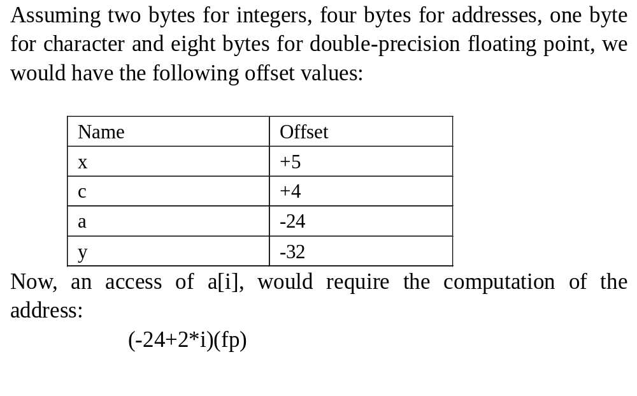

Slide 38
The calling sequence:
  When a procedure is called
    Compute the arguments and store them in their correct positions in the new activation record of the procedure;
    Store the fp as the control link in the new activation record;
    Change the fp so that it points to the beginning of the new activation record;
    Store the return address in the new activation record;
    Perform a jump to the code of the procedure to be called.
  When a procedure exits
    Copy the fp to the sp.
    Load the control link into the fp.
    Perform a jump to the return address;
    Change the sp to pop the arguments.

Slide 39
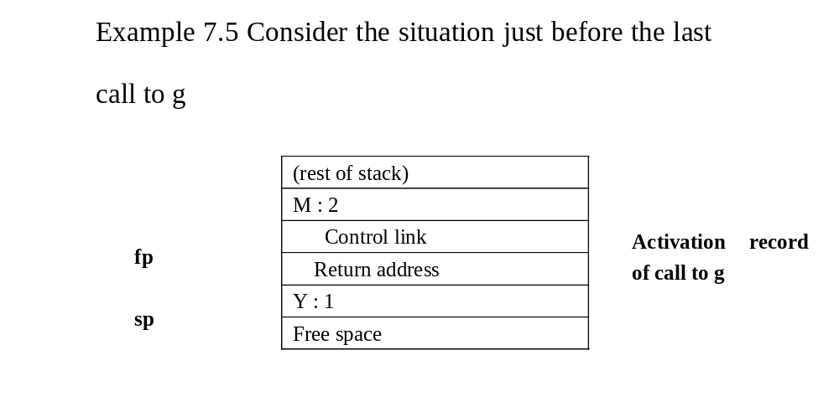

Slide 40
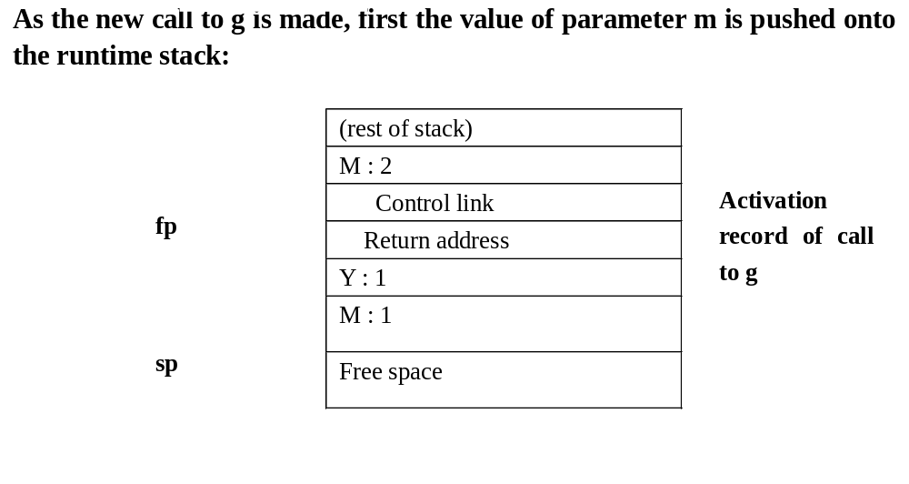

Slide 41
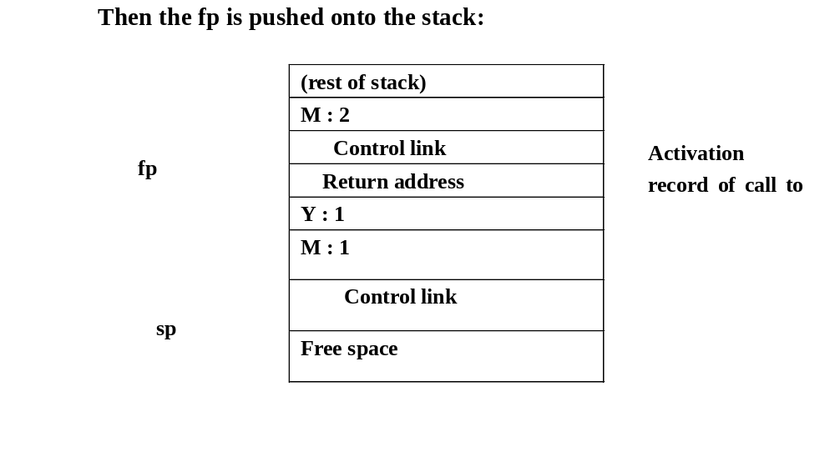

Slide 42
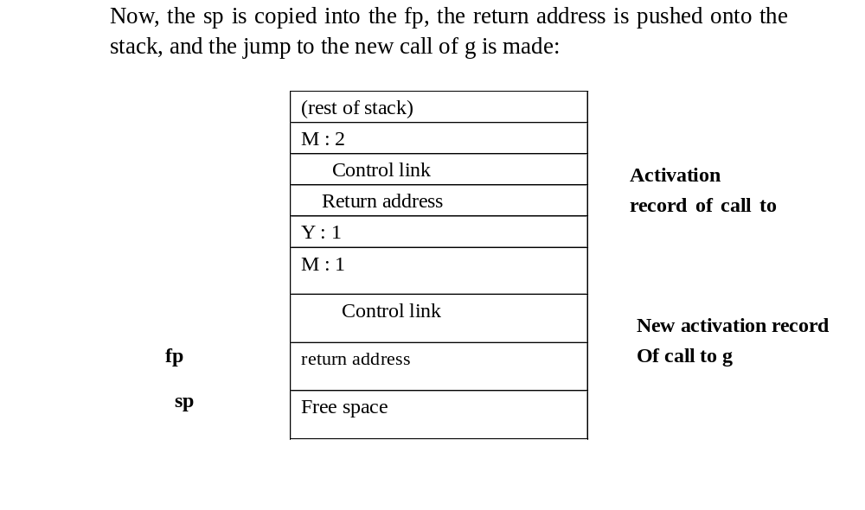

Slide 43
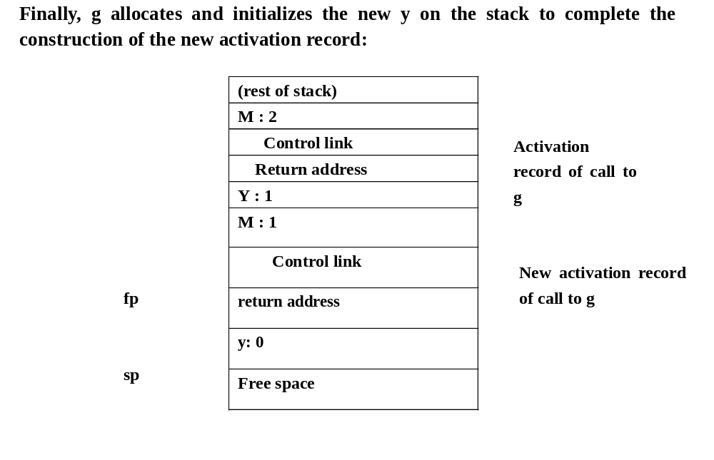

Slide 44
Dealing with variable-length data
  The number of arguments in a call may vary from call to call, and
  The size of an array parameter or a local array variable may vary from call to call
  An example of situation 1 is the printf function in C:
    Printf(“%d%s%c”,n,prompt,ch)
      Has four arguments, while
    Printf(“Hello, world\n”)
      Has only one argument

Slide 45
C compiler typically deal with this by pushing the arguments to a call in reverse order onto the runtime stack. The first parameter is always located at a fixed offset from the fp in the implementation described above
Another option is to use a processor mechanism such as ap (argument pointer) in VAX architecture.

Slide 46
An example of situation 2 is the unconstrained array of Ada:
  Type int_vector is
  Array(INTEGER range <>) of INTEGER;
  Procedure sum (low, high: INTEGER;
  A: Int_vector) return INTEGER
  Is
  Temp: Int_Array (low..high);
  Begin
  …
  end sum;
A typical method is to use an extra level of indirection for the variable-length data, storing a pointer to the actual data in a location that can be predicated at compile time.

Slide 47
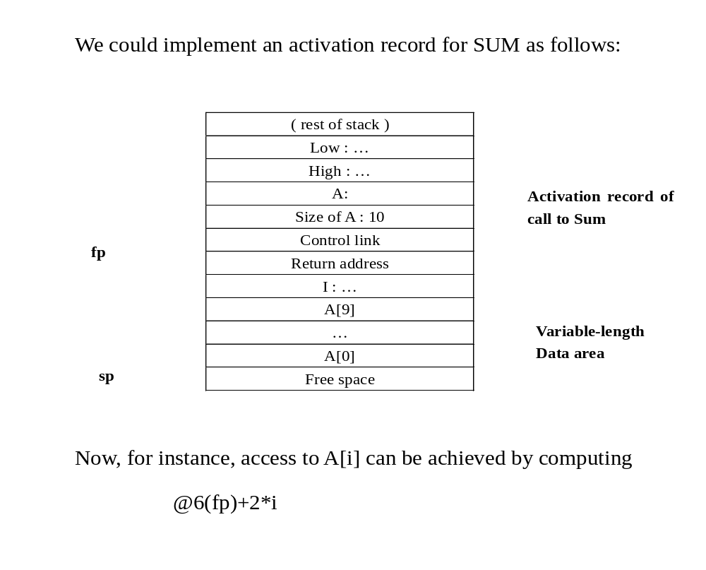

Slide 48
Note:
  In the implementation described in the previous example, the caller must know the size of any activation record of Sum
  The size of the parameter part and the bookkeeping part is known to the compiler at the point of call
  The size of the local variable part is not, in general, known at the point of call. Variable-length local variables can be dealt with in a similar way

Slide 49
Local Temporaries and Nested Declarations:
  Two more complications to the basic stack-based runtime environment
  (1) Local temporaries are partial results of computations that must be saved across procedure calls, for example:
  x[i] = (i + j) *(i/k + f(j))
The three partial results need to be saved across the call to f:
  The address x[i];
  The sum i+j;
  The quotient i/k;

Slide 50
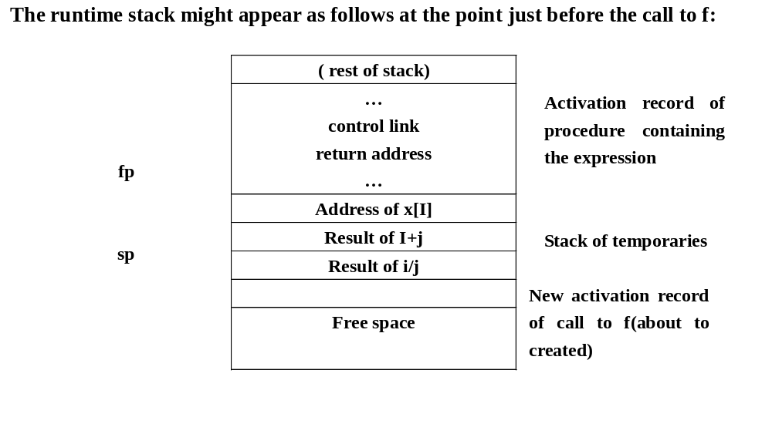

Slide 51
Nested declarations present a similar problem. Consider the C code
Void p( int x, double y)
{ char a;
int I;
…
A:{double x;
Int j;
…
}
…
B:{char *a;
Int k;
…
}
…
}
There are two block (also called compound statement), labeled A and B nested inside the body of procedure p.
The nested local declaration does not need to be allocated until entered;
Both A and B do not need to be allocated simultaneously.

Slide 52
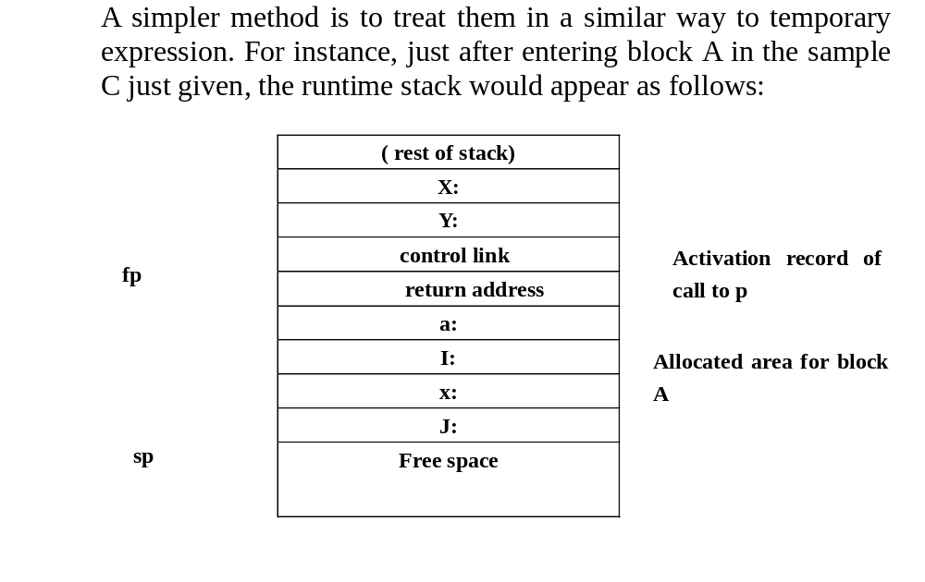

Slide 53
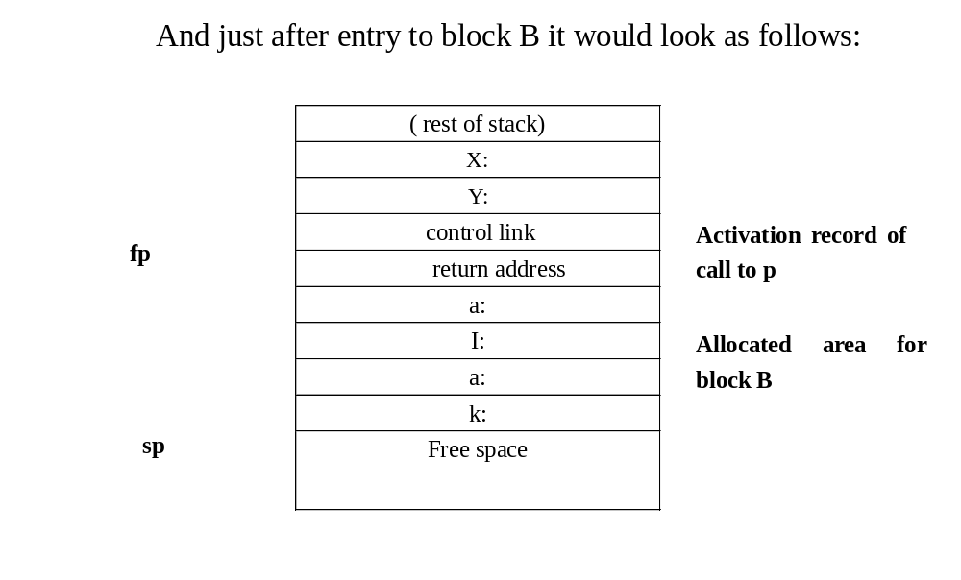

Slide 54
8.3.2 Stack-Based Environment with local Procedures

Slide 55
Consider the non-local and non-global references
Example: Pascal program showing nonlocal, nonglobal reference
Program nonlocalRef;
Procedure P;
Var N: integer;
Procedure Q;
Begin
(* a reference to N is now non-local andnon-global *)
end; (* q*)
Procedure R(N: integer);
Begin
Q;
End;(*r *)
Begin(*p*)
N:=1;
R(2);
End ;(*p*)
Begin (* main*)
P;
End.

Slide 56
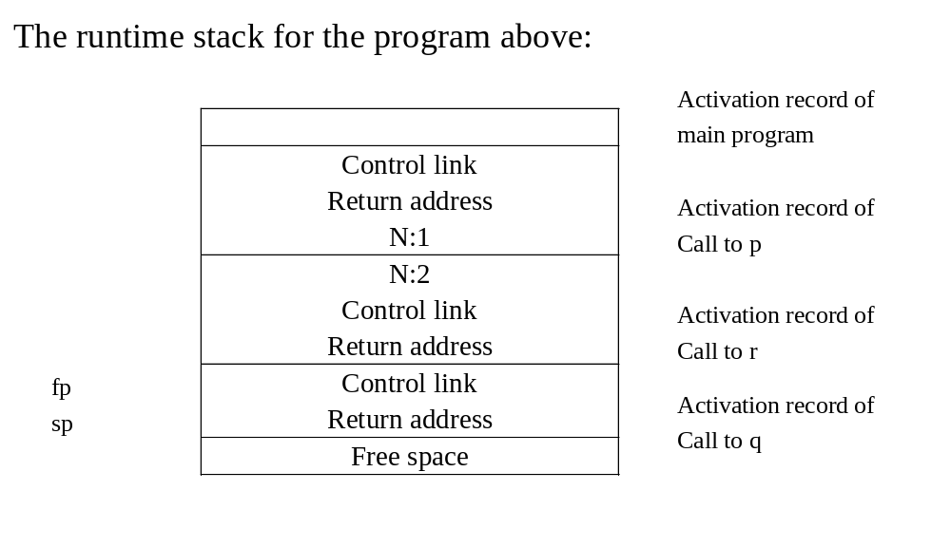

Slide 57
N cannot be found using any of the bookkeeping information that is kept in the runtime environment up to now
To solve the above problem about variable access, we add an extra piece of bookkeeping information called the access link to each activation record
Access link represents the defining environment of the procedure;
Control link represents the calling environment of the procedure.

Slide 58
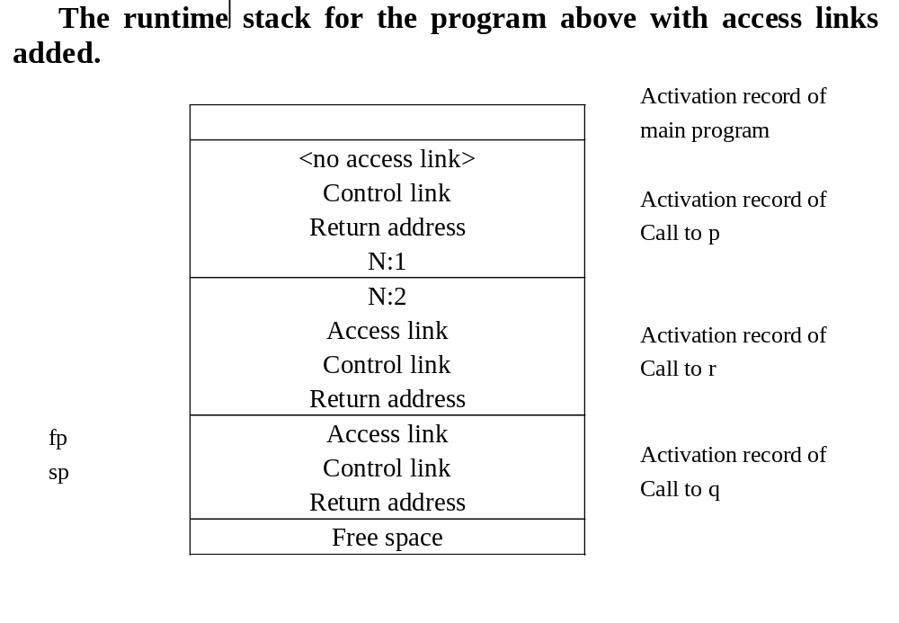

Slide 59
Note:
  The activation record of procedure p itself contains no access link, as any nonlocal reference with p must be a global reference and is accessed via the global reference mechanism
  This is the simplest situation, where the nonlocal reference is to a declaration in the next outermost scope.

Slide 60
Example: Pascal code demonstrating access chaining
Program chain
Procedure p;
Var x: integer;
Procedure q;
Procedure r;
Begin
X:=2;
…
if …then p;
end;(*r*)
begin
r;
end;(*q*)
begin
q;
end;(*p*)

Slide 61
begin(* main *)
p;
end.
In this code, the assignment to x inside r, which refers to the x of p, must traverse two scope levels to find x
In this environment, x must be reached by following tow access links, a process that is called access chaining

Slide 62
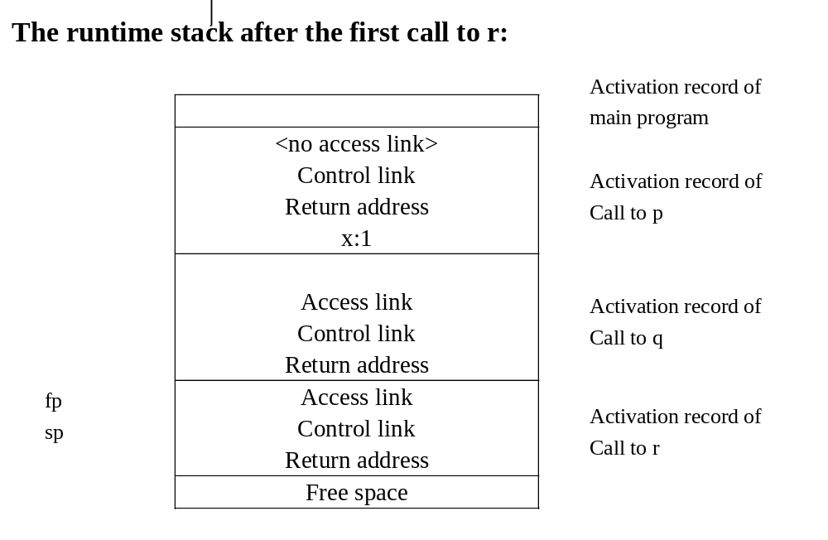

Slide 63
Note:
  The amount of chaining, determined by comparing the nesting level at the point of access with one of the declaration of the name
  In the above situation, the assignment to x is at nesting level 3, and x is declared at the nesting level 1, so two access links must be followed
  However, the access chaining is an inefficient method for variable access, for each nonlocal reference with a large nesting difference, a lengthy sequence of instruction must be executed.
  There is a method of implementing access links in a lookup table indexed by nesting level, called display, to avoid the execution overhead of chaining.

Slide 64
The calling sequence
The changes needed to implement access links:
  (1) The access link must be pushed onto the runtime stack just before the fp during a call
  (2) The sp must be adjusted by an extra amount to remove the access link after an exit
How to find the access link of a procedure during a call?
  Using the (compile-time) nesting level information attached to the declaration of the procedure
  Generate an access chain as if to access a variable at the same nesting level
  The access link and the control link are the same, if the procedure is local

Slide 65
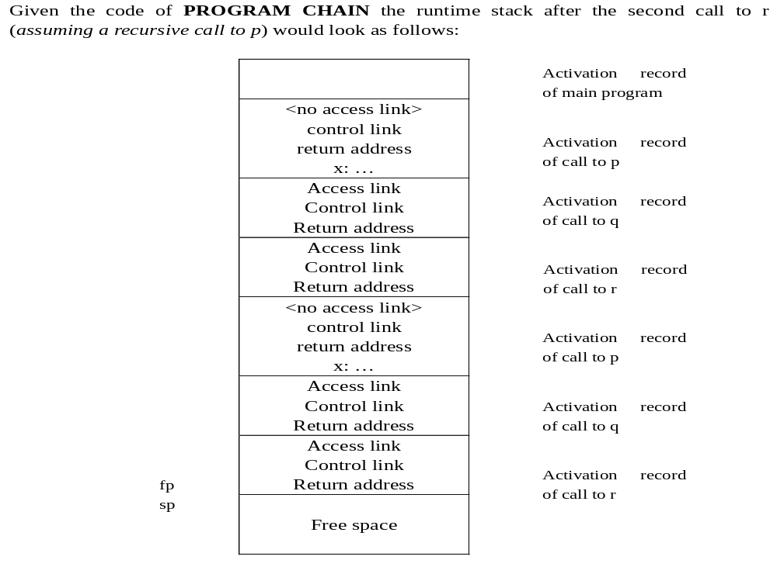

Slide 66
8.3.3 Stack-Based Environment with Procedure Parameters

Slide 67
Example 7.7 Consider the standard pascal program of Figure 7.14, which has a procedure p, with a parameter a that is also a procedure.
Program closureEx(output)
Procedure p (procedure a);
Begin
a;
end;
procedure q;
var x:integer;
procedure r;
begin
writeln(x);
end;
begin
x:=2;
p(r);
end; (* q*)
begin (* main *)
q;
end.

Slide 68
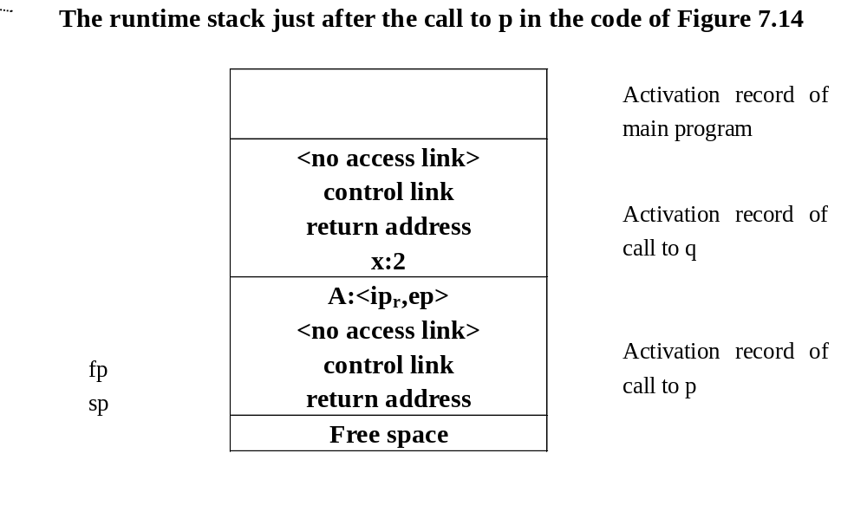

Slide 69
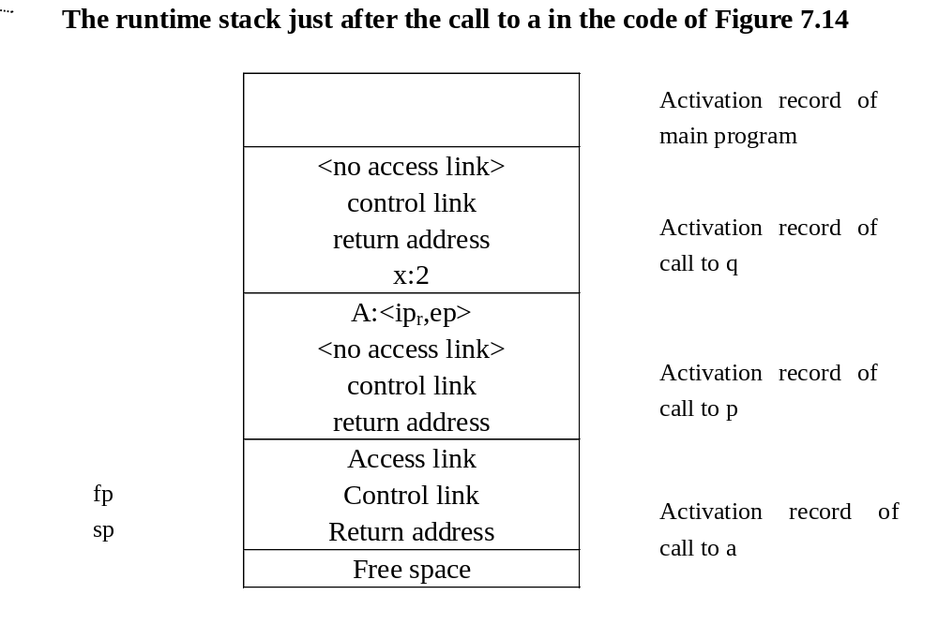

Slide 70
Note:
  The calling sequence must distinguish clearly between ordinary procedures and procedure parameters
  When calling ordinary procedure, fetch the access link using the nesting level and jump directly to the code of the procedure
  A procedure parameter has its access link stored in the local activation record, and an indirect call must be performed to the ip stored in the current activation record
  If all procedure values are stored in the environment as closures, the following page shows the environment

Slide 71
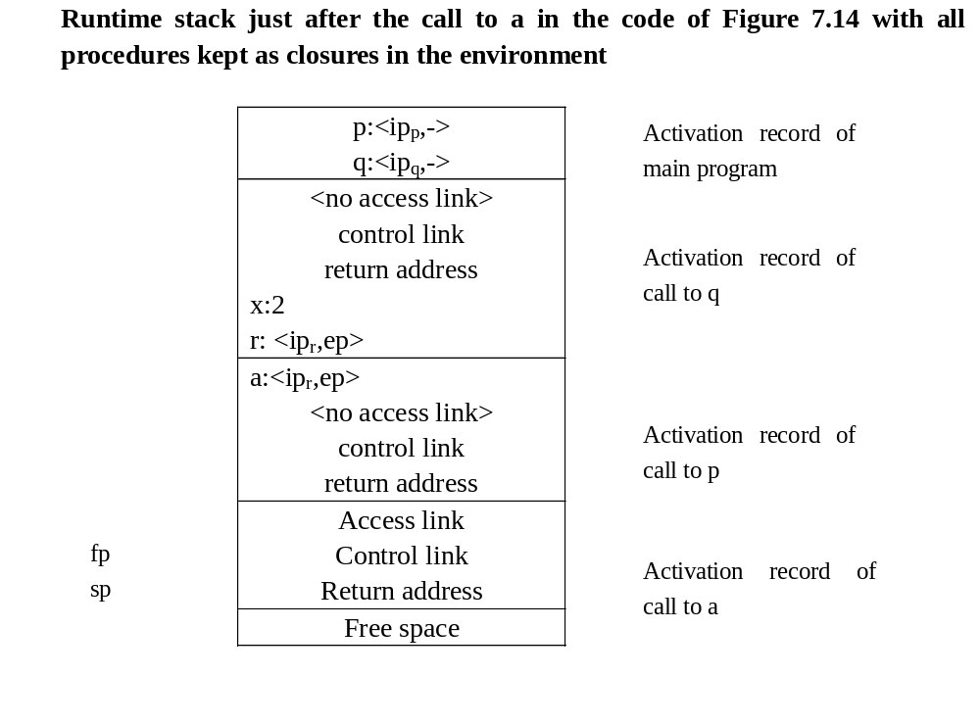

Slide 72
8.4 Dynamic Memory

Slide 73
8.4.1 Fully Dynamic Runtime Environments

Slide 74
A stack-based environment will result in a dangling reference when the procedure is exited if a local variable in a procedure can be returned to the caller
The simplest example:
Int * dangle(void)
{ int x;
return &x;}
Where, the address of a local variable is returned.
An assignment addr = dangle( ) now cause addr to point to an unsafe location in the activation stack

Slide 75
A somewhat more complex instance of a dangling reference occurs if a local function can be returned by a call
Typedef int(* proc)(void);
Proc g(int x)
{int f(void) /*illegal local function*/
{return x;}
return f;}
main()
{
proc c;
c= g(2);
printf(“%d\n”,c());/* should print 2*/
return 0;
}

Slide 76
Of course, C language avoids the above problem by prohibiting local procedure
Other languages, like Mudula-2, which have local procedures as well as procedure variables, parameters, and returned values, must state a special rule that makes such program erroneous
In the functional programming languages, such as LISP and ML, the functions must be able to be locally defined, passed as parameters, and returned as results.

Slide 77
Thus, a stack-based runtime environment is inadequate, and a more general form of environment is required, called Fully Dynamic Environment
In fully dynamic environment, the basic structure of activation record remains the same:
  The space must be allocated for parameters and local variables, and there is still a need for control and access links
When control is returned to the caller, the exited activation record remains in memory, to be de-allocated at some later time

Slide 78
8.4.2 Dynamic Memory in Object-Oriented Languages

Slide 79
OO language requires special mechanisms in the runtime environment to implement their added features:
  Objects, methods, inheritance, and dynamic binding
OO languages vary greatly in their requirements for the runtime environment.
Two good representatives of the extreme:
  Smalltake requires fully dynamic environment;
  C++ retains the stack-based environment of C in much of its design efforts.

Slide 80
Object in memory can be viewed as a cross between a traditional record structure and an activation record
One mechanism would be for initialization code to copy all the currently inherited features (and methods) directly into the record structure (with methods as code pointer);
An alternative is to keep a complete description of the class structure in memory at each point during execution, with inheritance maintained by superclass pointers, and all method pointers kept as field in the class structure (Inheritance graph).
Another alternative is to compute the list of code pointers for available methods of each class, and store this in (static) memory as a virtual function table. It is the method of choice in C++.

Slide 81
Example: Consider the following C++ class declarations:
    Class A
    {public:
    double x, y;
    void f();
    virtual void g();
    }
    class B : public A
    {public:
    double z;
    void f();
    virtual void h();
    }

Slide 82
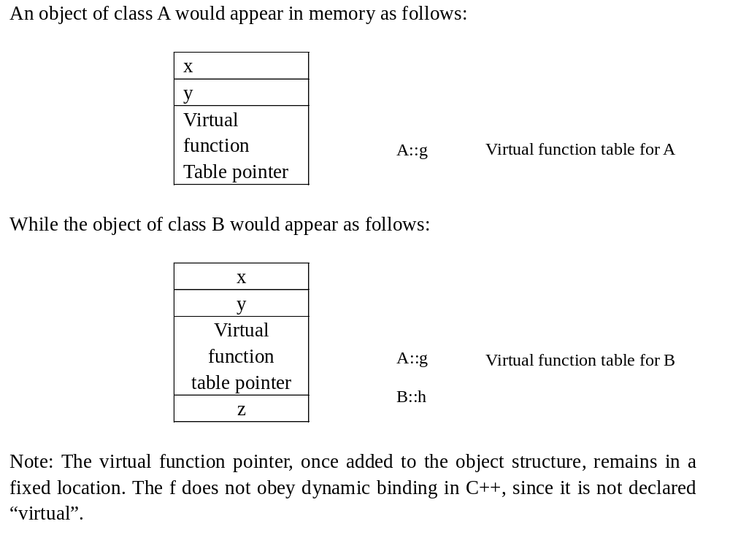

Slide 83
8.4.3 Heap Management

Slide 84
In most language, even a stack-based environment needs some dynamic capabilities in order to handle pointer allocation and de-allocation
HEAP, the data structure to handle such allocation.
Allocated as a linear block of memory, which provides two operations:
  (1) Allocate, which takes a size parameter and returns a pointer to a block of memory of the correct size, or a null pointer if none exists.
  (2) Free, which takes a pointer to an allocated block of memory and marks it as being free again

Slide 85
These two operations exist under different names in many languages:
  New and dispose in Pascal;
  New and delete in C++;
  Malloc and free in the C language.
A standard method for maintaining the heap and implementing these functions:
  (1) A circular linked list of free blocks;
  (2) Memory is taken by malloc;
  (3) Memory is return by free.
The drawbacks:
  (1) The free operation can not tell if the pointer is legal or not;
  (2) Care must be taken to coalesce blocks; otherwise, the heap can quickly become fragmented.

Slide 86
A different implementation of malloc and free, using a circular linked list data structure that keep track of both allocated and free block.
The code is given in the following figures:
#define NULL 0
#define MEMSIZE 8096 /* change for different sizes */
typedef double align;
typedef union header
{struct { union header *next;
unsigned usedsize;
unsigned freesize;
} s;
align a;
} header;
static header men[MEMSIZE];
static header *memptr=NULL;

Slide 87
void *malloc(unsigned nbytes)
{header *p, *newp;
unsigned nunits;
nunits = (nbytes+sizeof(header)-1)/sizeof(header)+1;
if (memptr == NULL)
{ memptr->s.next = memptr = mem;
memptr->s.usedsize = 1;
memptr->s.freesize = MEMSIZE-1;
}
for(p=memptr;
(p->s.next!=memptr) && (p->s.freesize <nunits);
p=p->s.next);

Slide 88
if (p->s.freesize < nunits) return NULL;
/* no block big enough */
newp =p +p->s.usedsize;
newp->s.usedsize = nunits;
newp->s.freesize =p->s.freesize –nunits;
newp->s.next = p->s.next;
p->s.freesize=0;
p->s.next = newp;
memptr = newp;
return (void *) (newp+1);
}

Slide 89
void free(void *ap)
{ header *bp, *p, *prev;
bp = (header *)ap –1;
for (prev=memptr, p=memptr->s.next;
(p!=bp) && (p!=memptr); prev=p, p=p->s.next);
if (p!=bp) return;
/* corrupted list, do nothing */
prev->s.freesize +=p->s.usedsize + p->s.freesize;
prev->s.next = p->s.next;
memptr = prev;
}

Slide 90
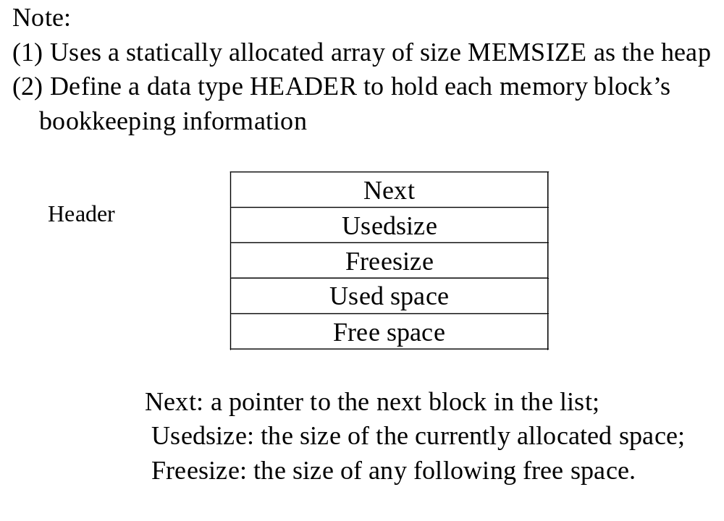

Slide 91
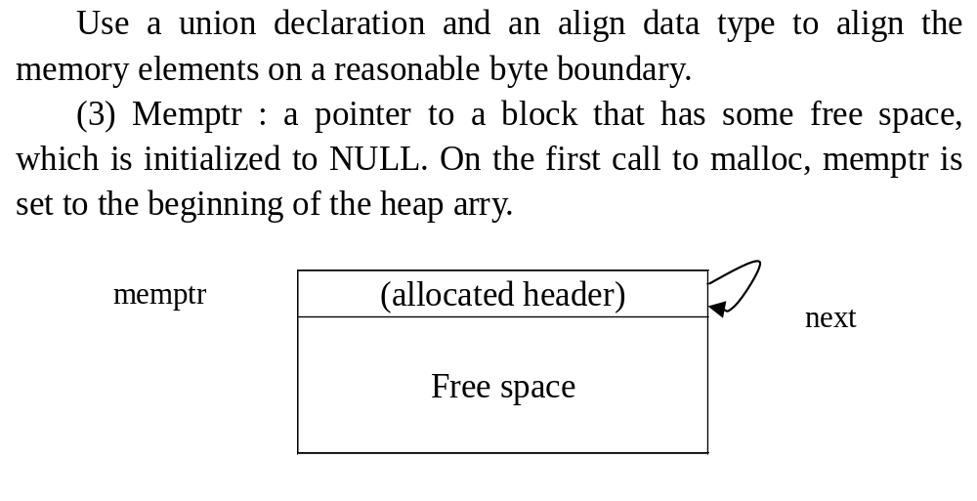

Slide 92
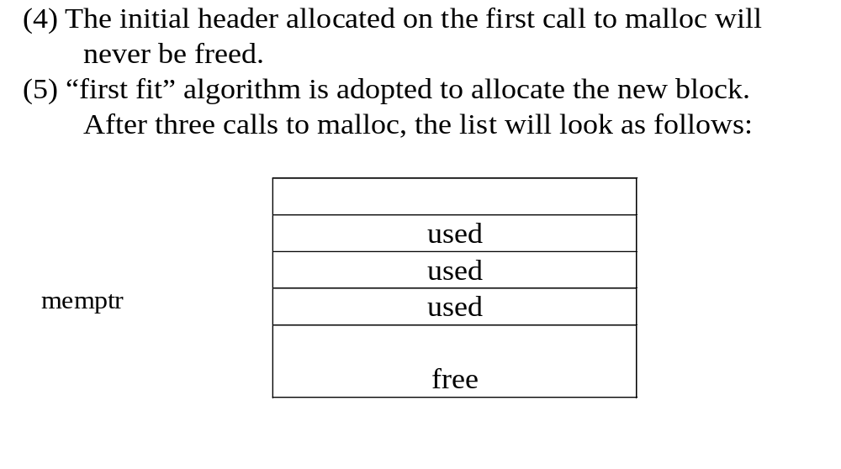

Slide 93
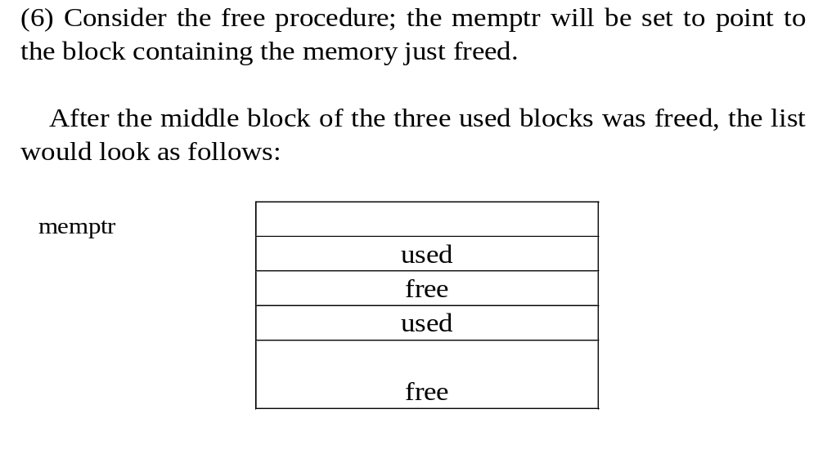

Slide 94
8.4.4 Automatic Management of the heap

Slide 95
The use of malloc and free to perform dynamic allocation and de-allocation of pointer is called manual method.
By contrast, the runtime stack is managed automatically by the calling sequence.
Garbarge collection: the process of reclamation of allocated but no longer used storage without an explicit call to free.
The standard technique is to perform mark and sweep garbage collection.
In this method no memory is freed until a call to malloc fails, which does this in two passes.
  Follows all pointers recursively, starting with all currently accessible pointer values and marks each block of storage reached; an extra bit for the marking.
  Sweeps linearly through memory, returning unmarked blocks to free memory.
  Also perform memory compaction to leave only one large block of contiguous free space at the other end.

Slide 96
The Mark and Sweep garbage collection has several drawbacks:
  Requires extra storage;
  The double pass through memory cause a significant delay in processing
A bookkeeping improvement can be made to this process by splitting available memory into two halves and allocating storage only from one half at a time.
Called stop-and-copy or two-space garbage collection.
  All reached blocks are immediately copied to the second half of storage not in use;
  No extra mark bit is required and only one pass is required;
  It also performs compaction automatically;
  It does little to improve processing delays during storage reclamation.

Slide 97
Generational garbage collection, which adds a permanent storage area to the reclamation scheme of the previous paragraph
Allocated objects that survive long enough are simply copied into permanent space and are never deallocated during subsequent storage reclamations.
Search only a very small section of memory for newer storage allocations, and the time for such a search is reduced to a fraction of a second.

