Slide 1
Milestone 1 Proposal
Group Name:
Data Minerz
Participants:
Muhammad Khan(mkhan408)
Omais Ahmed(oahme4),
Joshua Zacharia(jzach)
Pawan Kumar(pkuma45)

Slide 2
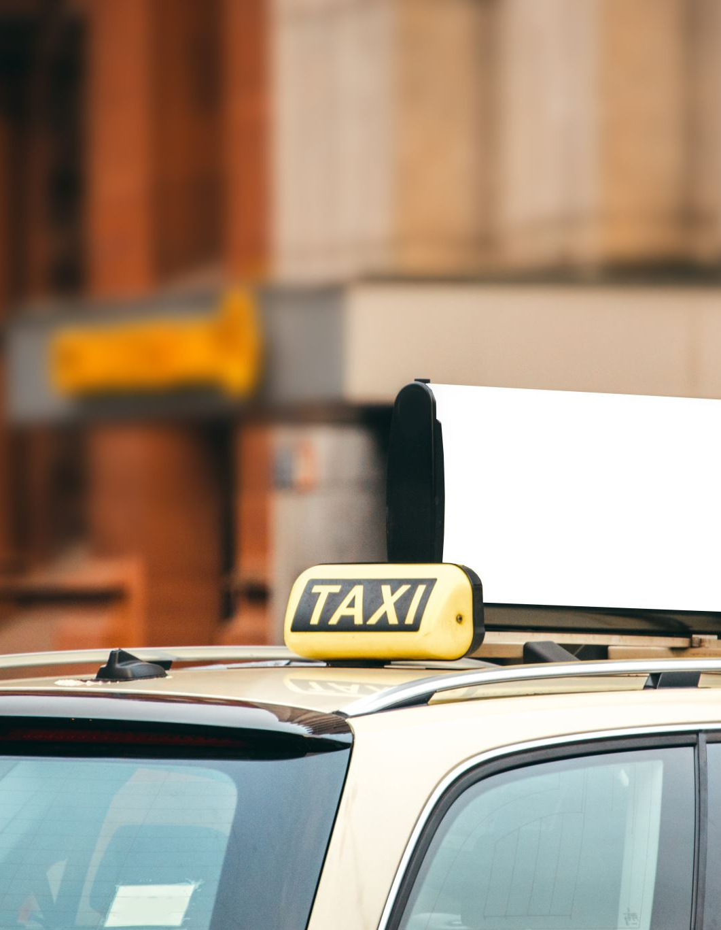
Problem and Goal
Research Question:
What role does the distance of the trip, the time at which the trip was picked up and the number of passengers in the taxi play in determining the fare in New York city? What is the degree of accuracy of such prediction using machine learning?
Why is it important?
The cost of the taxi service depends on different parameters and varies greatly. Through the analysis of numerous taxi trips in NYC we will be able to determine the factors affecting taxi fares and create a model of fare prediction.
Reference: Rashida048 (2020). Learn to Formulate Good Research Question For Efficient Statistical Analysis. https://regenerativetoday.com/learn-to-formulate-good-research-question-for-efficient-statistical-analysis/

Slide 3
Formalization into data mining task
Approach & Methods:
Employ PySpark to clean data, partition it, and perform feature engineering.
Regression: linear regression, Lasso regression, and decision tree regression to predict fares.
Classification: Decision Tree and Logistic Regression classify taxi fares as expensive (above $20) or affordable ($20 or less).
Perform model evaluation using RMSE, MAE, accuracy, and F1-score.
Expected Results:
Determine the factors affecting taxi fares.
Compare the performances of regression and classification models.
Develop a Streamlit dashboard for predicting taxi fares, analyzing historical fare patterns, and comparing ML model performance.

Slide 4
Data Plan
Dataset: NYC Taxi Fare Prediction (~55 million records, 5.7 GB).
Attributes: Pickup/drop-off locations, date/time, passenger count, and fare amount.
Source: Kaggle – NYC Taxi Fare Prediction, https://www.kaggle.com/competitions/new-york-city-taxi-fare-prediction/data
Collection: Download the CSV files and process them using PySpark.
Estimated Time: 5–20 minutes to download and a few hours for initial cleaning and preparation.

Slide 5
Teamwork agreement
We will use a hybrid of agile and waterfall methods, so we do have a plan with deadlines to follow, but we’re also not restricted from going off the plan.
Link to Team Agreement: CS483-project/teamAgreement.pdf at main · jzach-rgb/CS483-project
GitHub Repo link: https://github.com/jzach-rgb/CS483-project.git
For this project, the project management too that we will be using is Jira.

Slide 6
Schedule
Date | Milestone | Deliverables
Oct 13 | Project Proposal | Finalize research questions, dataset, and project plan.
Oct 27 | Data Preparation | Clean data, calculate trip distances, and partition data using PySpark.
Nov 8 | Intermediate Report | Submit progress report, initial analysis, and preliminary ML results.
Nov 24 | Model Development | Complete regression and classification models, compare performance, and build dashboard.
Dec 1 | Final Presentation | Present results and demonstrate the fare prediction dashboard.
Dec 6 | Final Report | Submit final report, code, dataset, and evaluation results.

