Slide 1
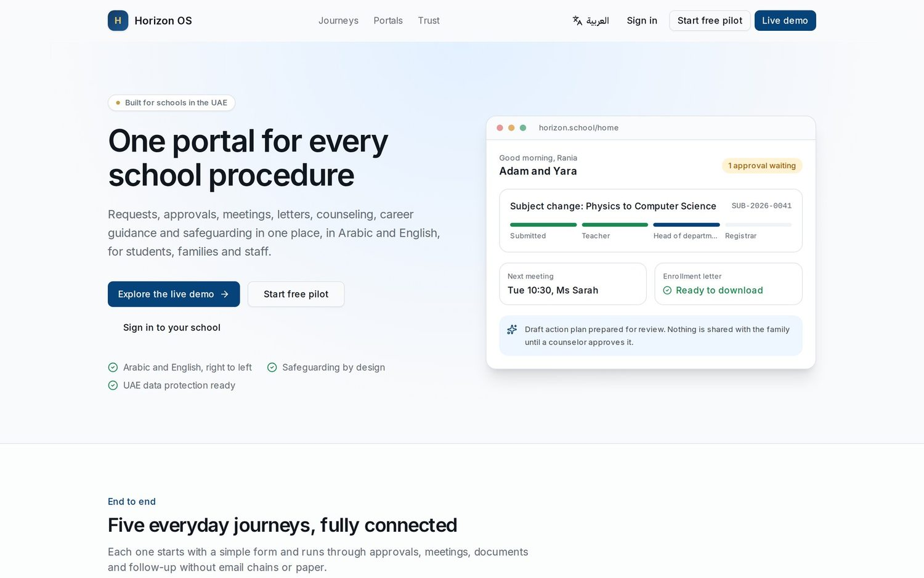
H
Horizon
SCHOOL OPERATIONS AND STUDENT SERVICES
One portal for every school procedure
Requests, approvals, meetings, letters, counseling, university guidance and safeguarding in one place, in Arabic and English, for students, families and staff.
Built for schools in the UAE
Notes:
Welcome and thank you for your time. Horizon is one portal for every school procedure: the requests, approvals, meetings, letters, counseling, university guidance and safeguarding that today live in many different places. It works fully in Arabic and English and it was built for schools in the UAE, with UAE data protection and child protection in mind. Over the next twenty minutes I will show you the problem we solve, walk through Horizon through the eyes of eight people in a school, explain how we protect children and data, and finish with a simple pilot proposal. Everything you will see is the real product, running on a fictional demo school called Horizon International School Dubai.

Slide 2




THE PROBLEM
Student services today run on scattered tools
Scattered tools
Paper requests
Safeguarding risk
University guidance in spreadsheets
Email threads, WhatsApp groups, shared drives and separate portals. Nobody sees the whole picture of a student.
Letters, absence notes and subject changes travel on paper and signatures. Families chase the office for updates.
Concerns are shared by email or in the staff room. Access is not controlled, decisions are not recorded, views are not audited.
Entry requirements live in counselors' spreadsheets and go out of date the day an admissions page changes.
The result: slow service for families, bottlenecks leaders cannot see, and real risk for children when a concern goes to the wrong inbox.
Horizon | 2
Notes:
Let us start with what most schools tell us. First, tools are scattered: email, WhatsApp, shared drives and several portals, so nobody sees the whole picture of a student. Second, many procedures are still on paper: a parent who needs an enrollment letter for an embassy, a subject change, an absence note. Families have to chase the office. Third, and most serious, safeguarding. When a teacher is worried about a child, that concern often goes by email or a conversation in the staff room. Access is not controlled, decisions about telling the family are not recorded, and nobody can show an inspector who read what. Fourth, university guidance. Counselors maintain entry requirements in spreadsheets, and those go stale as soon as a university changes its admissions page. The result is slow service, invisible bottlenecks and real risk. Ask the room: which of these feels most familiar here?

Slide 3
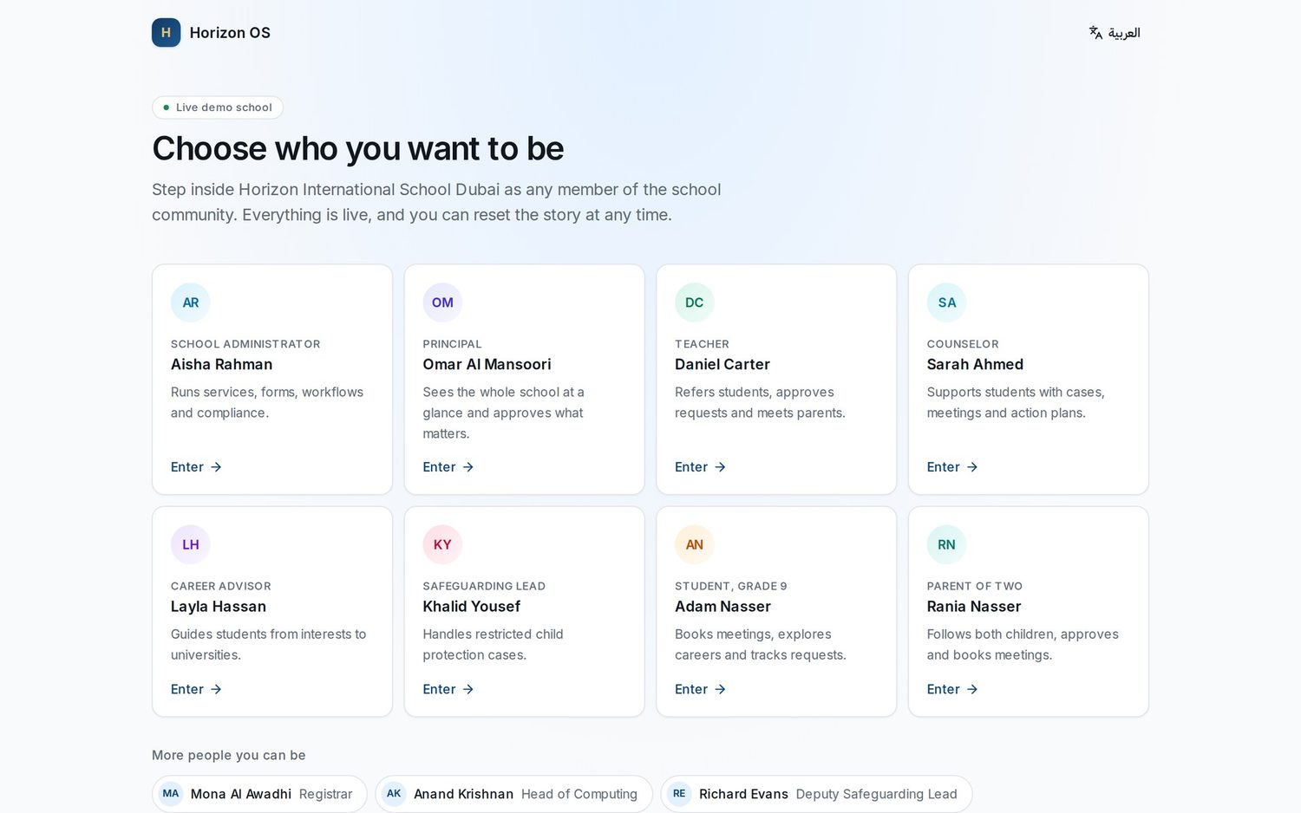






WHAT HORIZON IS
One calm place for every request, case and conversation
A multi-tenant platform where each role has its own portal and sees only what it is allowed to see. Schools configure their own services, forms, approval routes and letters.
Services and approvals
Cases and safeguarding
Meetings and calendar
Letters and documents
Career and university pathways
Subjects, timetable and grades
The demo entry: every card is a real account with its own permissions.
Horizon | 3
Notes:
Horizon brings all of this into one place. Think of it as six connected modules: services and approvals, cases and safeguarding, meetings and calendar, letters and documents, career and university pathways, and academics such as subject registration, timetable and grades. The important idea is that each person gets their own portal. A parent sees their children. A teacher sees their classes and referrals. A safeguarding lead sees the restricted queue. And the school, not a vendor, configures the services, forms, approval routes and letters. On the right is the demo entry page: each card is a real account with real permissions, and that is how I will walk you through the product.

Slide 4





END TO END
Five everyday journeys, fully connected
Career guidance
Teacher referral
Official letters
Subject change
Parent meetings
1
Student takes the aptitude assessment
1
Teacher refers in two minutes
1
Parent requests a letter
1
Parent asks to switch subjects
1
Parent picks a child and teacher
2
Chooses a matched career
2
Counselor opens a case
2
Registrar approves with a signature
2
Subject teacher gives a view
2
Chooses an open slot
3
Books the career advisor
3
Parent meeting booked
3
Arabic and English PDF generated
3
Head of department approves
3
Calendar invite and reminders
4
Advisor approves a plan the family sees
4
Action plan and follow-up on the calendar
4
Family notified and downloads it
4
Registrar updates the timetable
4
Notes and next steps recorded
Horizon | 4
Notes:
Here are five journeys that happen every week in every school, and each one runs end to end in Horizon. Career guidance: the student takes an aptitude assessment, picks a career, books the advisor, and the advisor approves a plan the family can see. Teacher referral: a teacher raises an academic concern in two minutes, the counselor opens a case and books a meeting with the parent. Official letters: a parent requests an enrollment letter, the registrar approves with a signature, and a bilingual PDF is generated. Subject change: three approval steps, teacher, head of department and registrar, with a clear trail. And parent meetings with real availability, invites and reminders. No email chains, no paper. Now let us meet the people who use it.

Slide 5
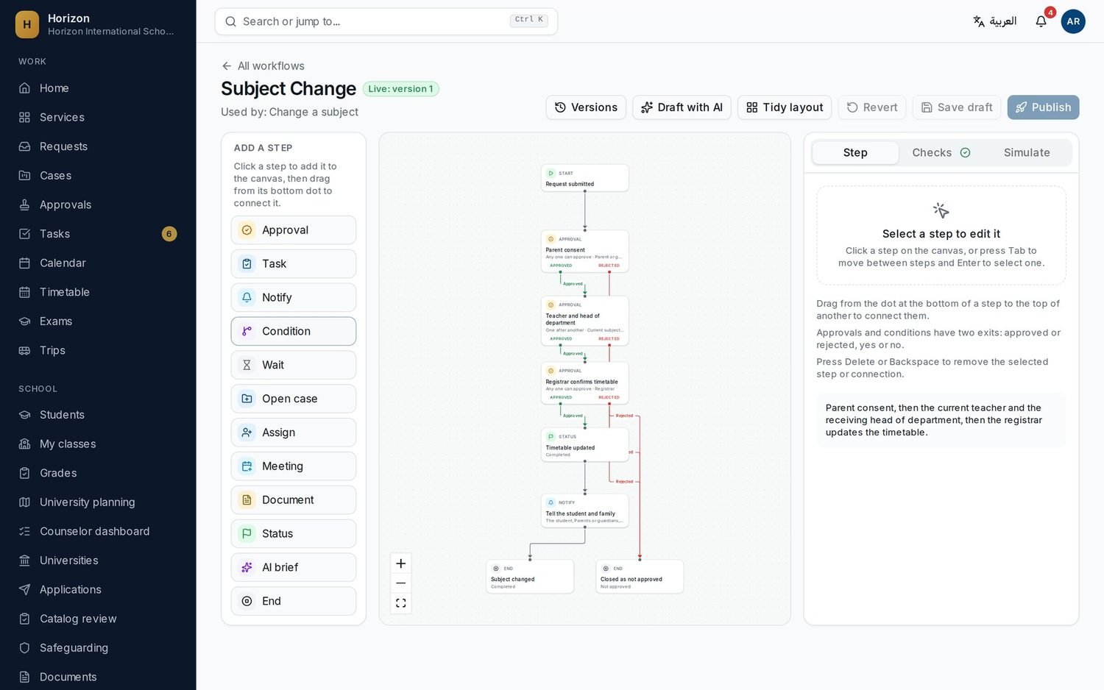


SCHOOL ADMINISTRATOR
The school configures it. No vendor coding.
AR
Aisha Rahman
School Administrator
Visual workflow builder
Approvals, tasks, waits and notifications. Validate and simulate before you publish.
Drag-and-drop forms
21 field types, conditional logic, Arabic and English labels, versioned publishing.
Letter templates
Bilingual letters with a live PDF preview and correct Arabic shaping.
Roles, access and audit
Plain-language permissions, an access check per person and a full audit log.
Horizon | 5
Notes:
Meet Aisha, the school administrator. Her job in Horizon is to shape how the school works, without calling a developer. On screen is the visual workflow builder for a subject change: approval steps, conditions, notifications and waits. Before publishing she can validate it and simulate a run, and every publish creates a new version, so running requests are never broken. She also has a drag-and-drop form builder with 21 field types and conditional logic, bilingual letter templates with a live PDF preview, and roles and access described in plain language, with an Access check that shows exactly what any person can see. Everything sensitive she does is recorded in the audit log.

Slide 6
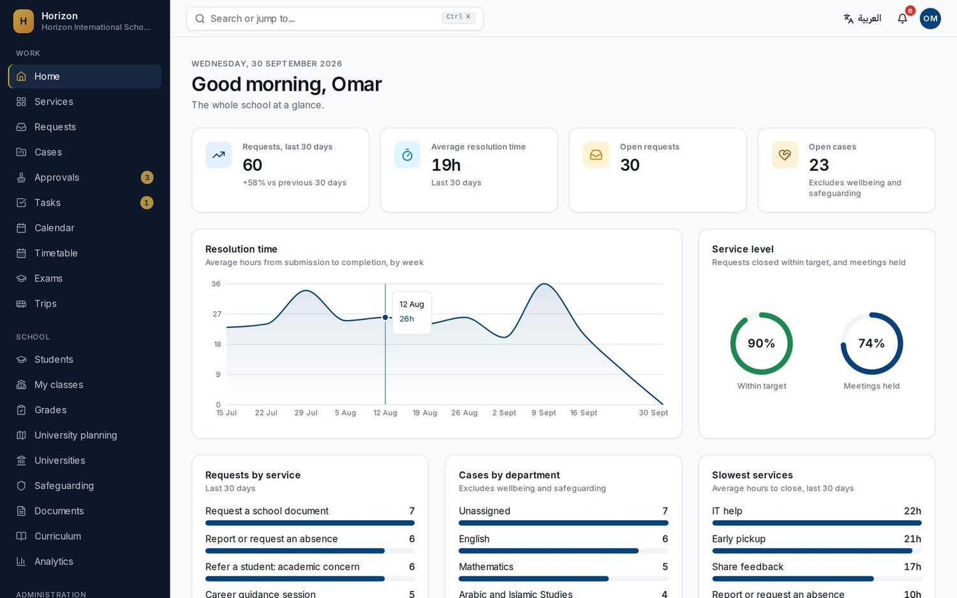




PRINCIPAL
The whole school at a glance
OM
Omar Al Mansoori
Principal
Live KPIs
Requests, average resolution time, open requests and open cases, compared with the previous period.
Service levels
Share of requests closed within target, meetings held and the slowest services.
Ask in plain language
Questions such as "Which service is slowest?" answered over aggregates.
Sensitive data excluded
Wellbeing and safeguarding cases never appear in dashboards or analytics.
Horizon | 6
Notes:
Omar is the principal. When he logs in he sees the school at a glance: requests in the last 30 days, average resolution time, open requests and open cases, and how that compares with the previous period. Service levels show how many requests closed within target and which services are slowest, so bottlenecks become visible. In Analytics he can ask questions in plain language, such as which service is slowest, and the answer is computed over aggregate figures. Importantly, wellbeing and safeguarding cases are excluded from every one of these figures. Leadership gets oversight without exposing sensitive records.

Slide 7
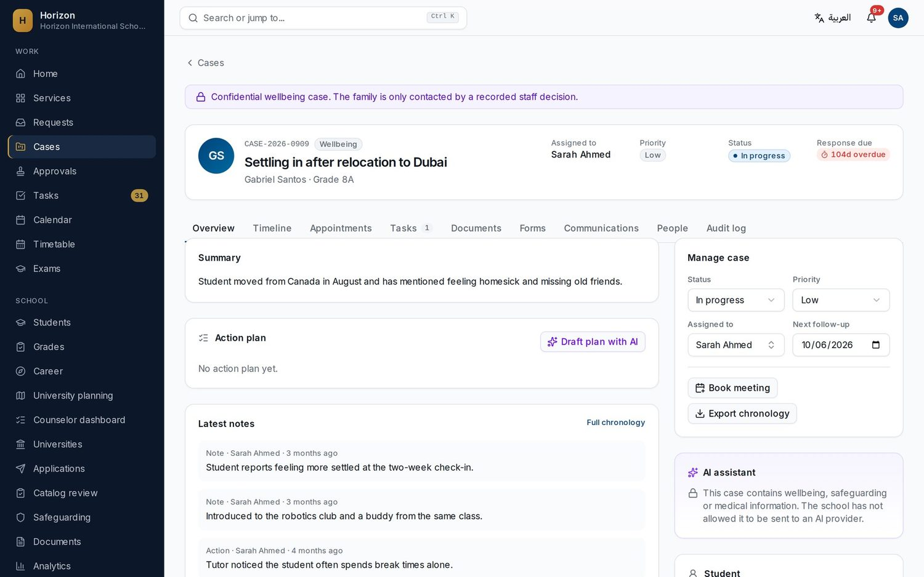

COUNSELOR
A caseload, not an inbox
SA
Sarah Ahmed
Counselor
Referrals become cases
Teacher referrals arrive in her caseload with response timers and priorities.
Versioned notes
Notes can be amended with a reason, never silently edited or deleted.
Meetings and follow-ups
Book meetings with the family invited; follow-ups land on her calendar.
AI with guardrails
Draft briefs and action plans. Blocked for wellbeing data unless the school allows it.
Horizon | 7
Notes:
Sarah is a counselor. Referrals from teachers arrive as cases in her caseload, each with a priority and a response timer, so nothing sits in an inbox. Case notes are versioned: they can be amended with a reason, but never silently edited or deleted. She books meetings with the parent invited, and follow-up dates appear on her calendar. Notice the AI assistant panel on the right of this wellbeing case: it says the case contains wellbeing information and the school has not allowed it to be sent to an AI provider. On ordinary cases, AI can draft a brief or an action plan, but it is always a draft that Sarah reviews and approves before anything is shared. Also notice the purple banner: the family is only contacted by a recorded staff decision.

Slide 8
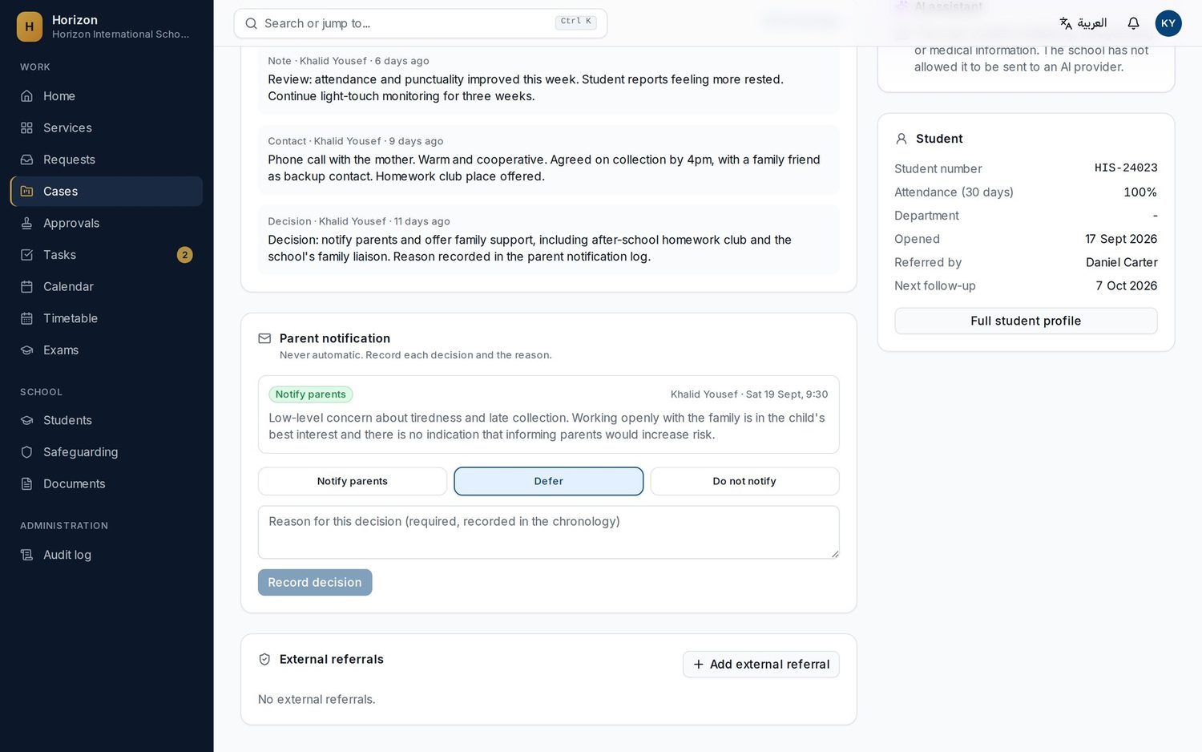




DESIGNATED SAFEGUARDING LEAD
A restricted queue with a full chronology
KY
Khalid Yousef
Designated Safeguarding Lead
One click to raise a concern
Any staff member can report. Referrers only see "Received" and "Being handled".
Restricted by design
Only the DSL, the deputy and explicitly granted staff. Every view is audited.
Family decisions recorded
Notify, defer or do not notify, always with a written reason.
Chronology and referrals
Timestamped record, external agency referrals, export by the DSL only.
Break-glass access
Emergency access needs a written reason and alerts the DSL.
Horizon | 8
Notes:
Khalid is the Designated Safeguarding Lead. Any member of staff can raise a safeguarding concern in one click from their home page. After they submit, the teacher only sees Received and Being handled: they cannot read the case. The case goes to a restricted queue visible only to the DSL, the deputy, and staff the DSL explicitly grants. It never appears in search, dashboards or analytics, and every view writes an audit event. On screen is the parent notification panel. Telling the family is never automatic: Khalid records a decision, notify, defer or do not notify, with a reason, and it goes into the chronology. The chronology is timestamped, notes can be amended but never deleted, external referrals to agencies are logged, and only the DSL can export it. Break-glass emergency access requires a written reason and alerts the DSL. The demo case is fictional and deliberately low level.

Slide 9
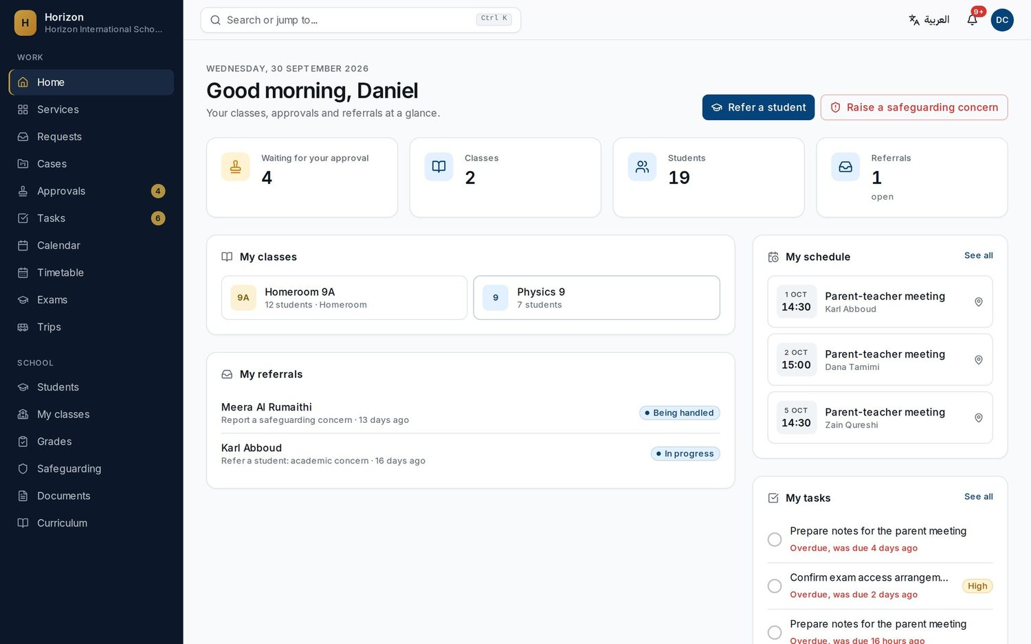

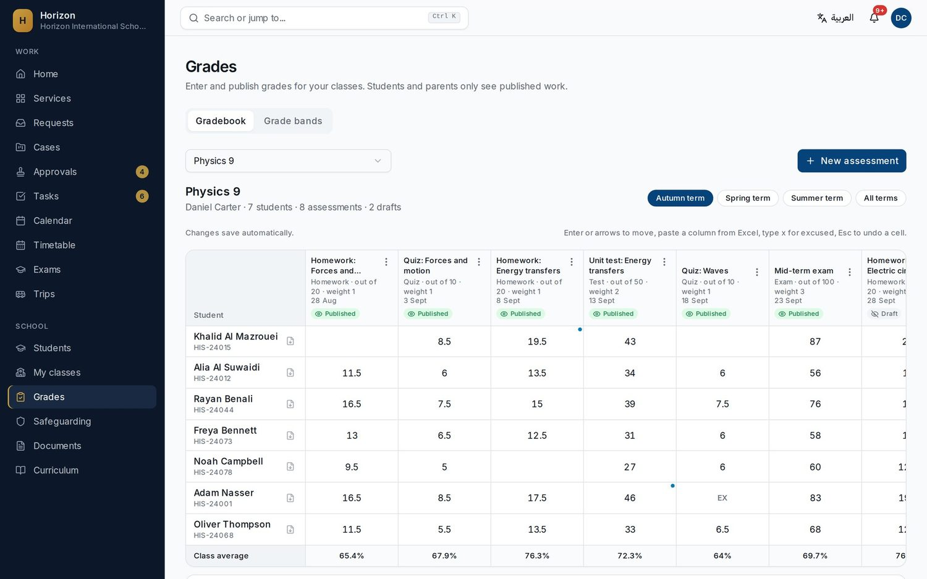
TEACHER
Refer, approve and grade in a few taps
DC
Daniel Carter
Teacher
Refer a student
Academic, behaviour, wellbeing or learning support, straight from Home.
Raise a safeguarding concern
Always one click away. The DSL is alerted; details stay restricted.
Approvals in context
Subject changes and requests arrive as steps in the workflow.
Spreadsheet-style gradebook
Autosave, Excel paste, weighted averages and publishing to families.
Horizon | 9
Notes:
Daniel is a teacher, and teachers are busy, so everything is a few taps. From Home he can refer a student, for an academic concern, behaviour, wellbeing or learning support, and the Raise a safeguarding concern button is always visible. Requests that need his view, such as a subject change for a student in his class, arrive as approval steps. His schedule shows parent meetings booked by families against his real availability. The inset shows the gradebook: it works like a spreadsheet, with autosave, keyboard navigation and paste from Excel, and students and parents only see grades once he publishes them.

Slide 10
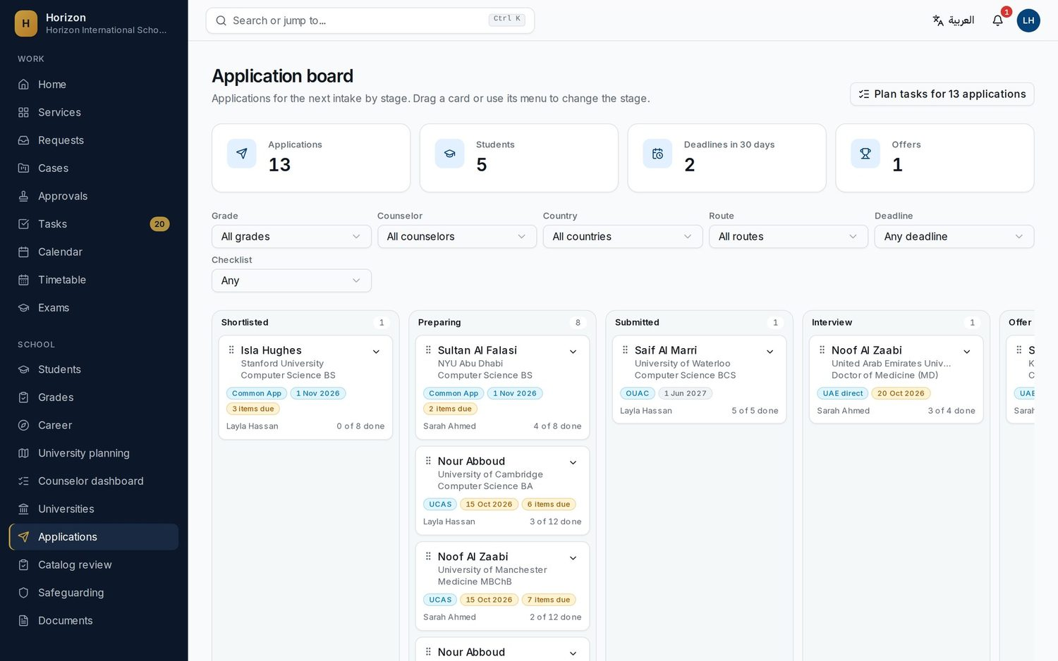



CAREER ADVISOR
Every application and deadline on one board
LH
Layla Hassan
Career Advisor
Assessment and matches
Students take an aptitude assessment and explore careers matched to their strengths.
Application board
Applications by stage, with the next deadline and checklist progress on each card.
Letters and tasks
Teacher recommendation letter requests and deadline-aware task plans.
Requirement changes
When a university changes its entry rules, she sees the before, the after and who is affected.
Horizon | 10
Notes:
Layla is the career advisor. Students start with an aptitude assessment and explore careers matched to their strengths, then book time with her. For older students she runs this application board: every Grade 12 application by stage, shortlisted, preparing, submitted, interview, offer, with the next deadline and checklist progress on each card. She can plan tasks for all applications at once, and teachers receive recommendation letter requests in their own queue. When a university changes its entry requirements, the change arrives in her catalog review with the before and after and the list of affected students. I will come back to that on the university pathways slide.

Slide 11
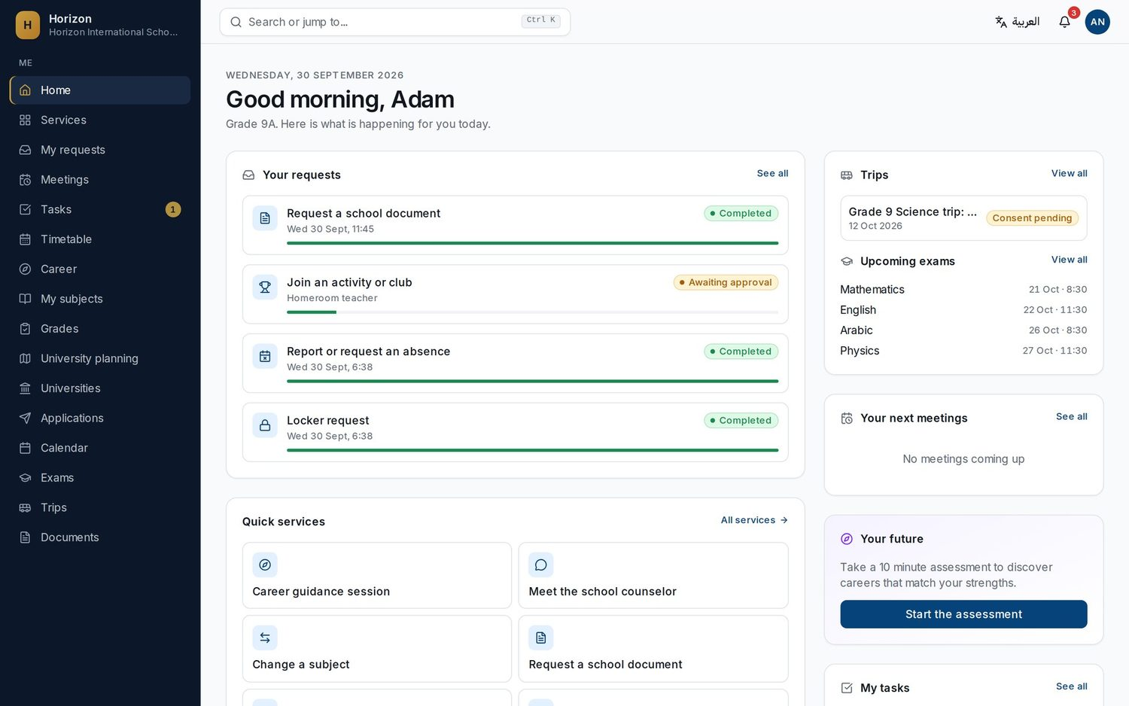
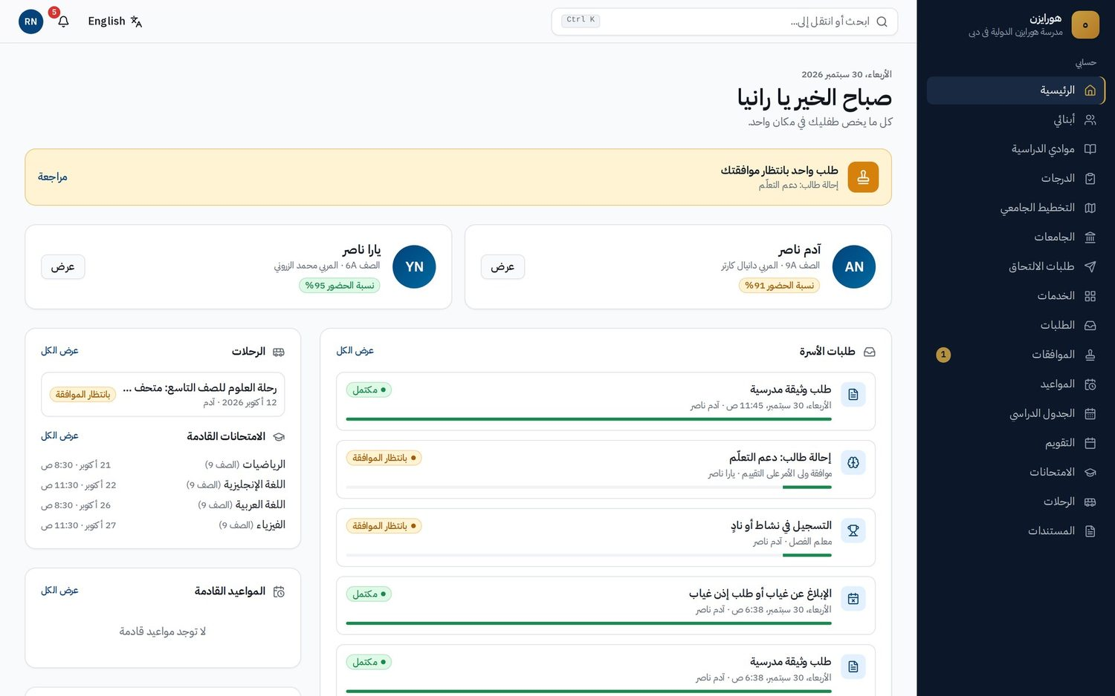
STUDENT AND PARENT
Students and families, served in their own language
AN
Adam Nasser
Student, Grade 9
RN
Rania Nasser
Parent of Adam and Yara, in Arabic
Requests, meetings, tasks, the career assessment and his university plan. Always sees the status of each request, step by step.
Both children in one account: approvals, letters, meetings, trips and exams. Joins with the school's family code.
Horizon | 11
Notes:
Now the people the school serves. Adam is a Grade 9 student. His home page shows his requests with a progress bar for each one, upcoming exams, trips, meetings and tasks, and a prompt to take the career assessment. Rania is Adam's mother, and she also has a younger daughter, Yara, at the school. She sees both children in one account: an approval waiting for her, family requests and their status, trips needing consent, and upcoming exams. Rania uses Horizon in Arabic, and you can see the whole interface mirrors correctly from right to left. She joined using the school's family code, which I will show in onboarding. Parents never see wellbeing or safeguarding case content through their portal.

Slide 12






TRUST BY DESIGN
Safeguarding and privacy are enforced by the system
One access module
Every view audited
Families never told automatically
A single module decides who may see wellbeing and safeguarding cases. They never appear in search, dashboards, analytics or portals unless it allows it.
Opening a sensitive record writes an audit event. Audit entries cannot be edited or deleted from the app.
On wellbeing and safeguarding cases, notifying parents is a staff decision with a recorded reason.
AI drafts, people decide
Tenant isolation
UAE PDPL controls
Sensitive data is never sent to AI unless the school enables it. AI output on sensitive matters is always a draft for human approval.
Each school's data is isolated by row-level security in the database. The app connects as a restricted, non-owner role.
Purposes and consent, data subject requests, retention, incident log, and encrypted Emirates ID and passport numbers with audited reveal.
Horizon | 12
Notes:
This is the slide I would like the leadership team to remember. In Horizon, the rules that matter are enforced by the system, not left to good intentions. First, one access module decides who can see wellbeing and safeguarding cases, and those cases never appear in search, dashboards, analytics or the parent and student portals unless that module allows it. Second, every view of a sensitive record writes an audit event, and audit entries cannot be edited or deleted. Third, parents are never notified automatically on wellbeing or safeguarding cases: it is always a staff decision with a recorded reason. Fourth, AI: counseling, wellbeing, safeguarding and medical data are never sent to an AI provider unless the school turns that on, and AI output on sensitive matters is always a draft that a person approves. Fifth, each school's data is isolated in the database with row-level security, and the application itself runs as a restricted database role. And sixth, the compliance page covers UAE PDPL controls: purposes and consent records, data subject requests, retention periods, an incident log, and encrypted identity numbers that are masked by default.

Slide 13
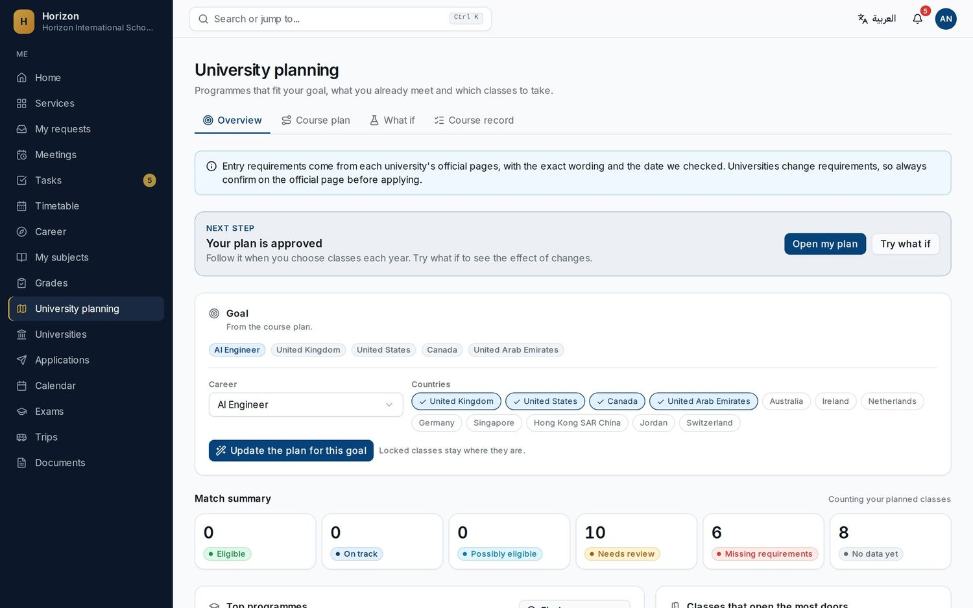
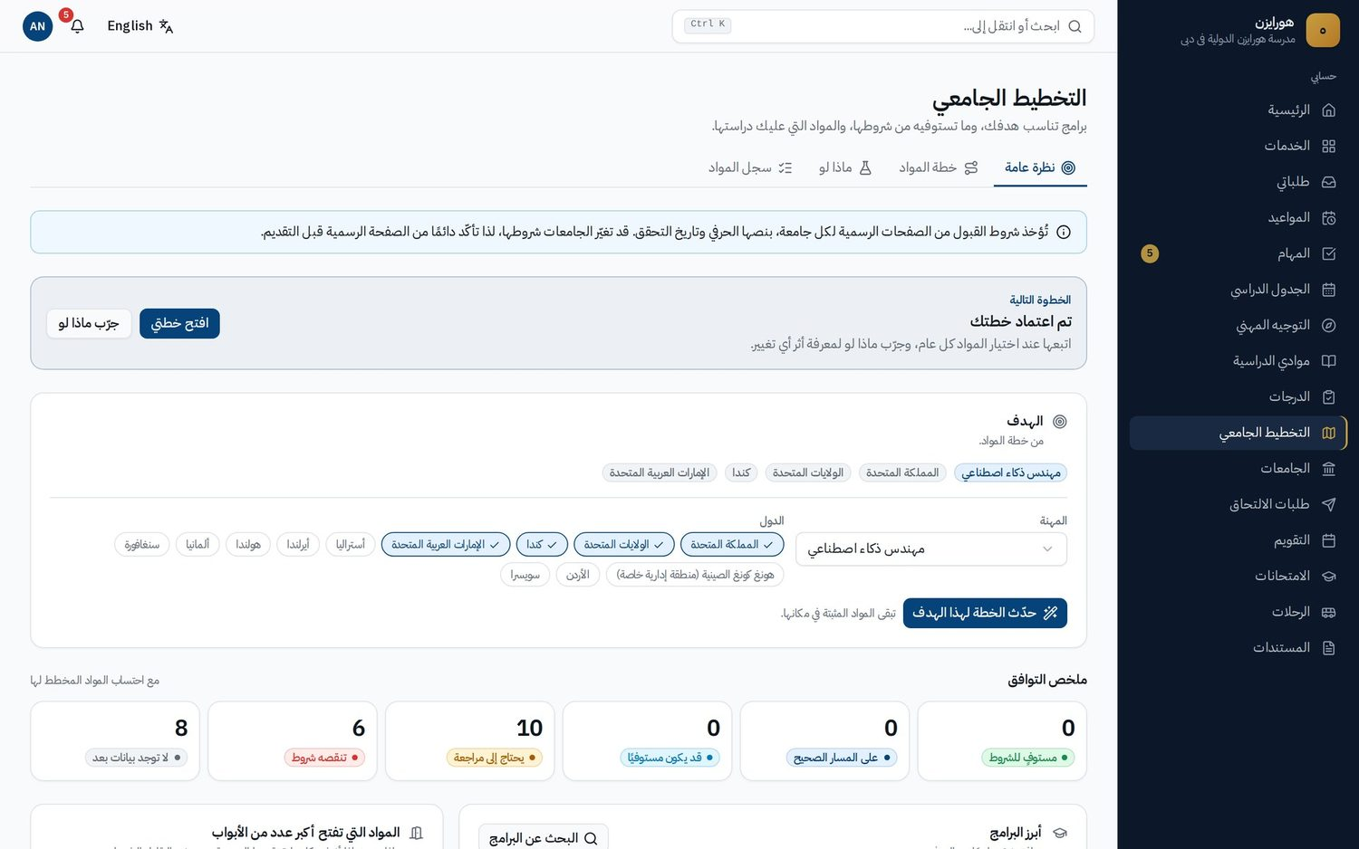

ARABIC AND ENGLISH
Fully bilingual, fully right to left
Per-user language
Each person picks Arabic or English; the school sets the default.
Bilingual letters
Arabic, English or side-by-side PDFs with correct Arabic shaping.
Local formats
Optional Hijri dates and Arabic-Indic numerals, Dubai time zone.
Bilingual records
Names in both languages; search matches either.
Horizon | 13
Notes:
Horizon is not an English product with a translation layer. Every screen, email, notification and letter works in Arabic and English, and the Arabic interface is fully mirrored from right to left: navigation, tables, calendars and charts. Here is the same university planning page for Adam in English and in Arabic. Each person chooses their language and the school sets the default. Letters can be generated in Arabic, English or side by side, with correct Arabic shaping. Hijri dates and Arabic-Indic numerals are options, and people's names are stored in both languages so search finds either. If the room is comfortable, this is a good moment to switch the live demo to Arabic.

Slide 14
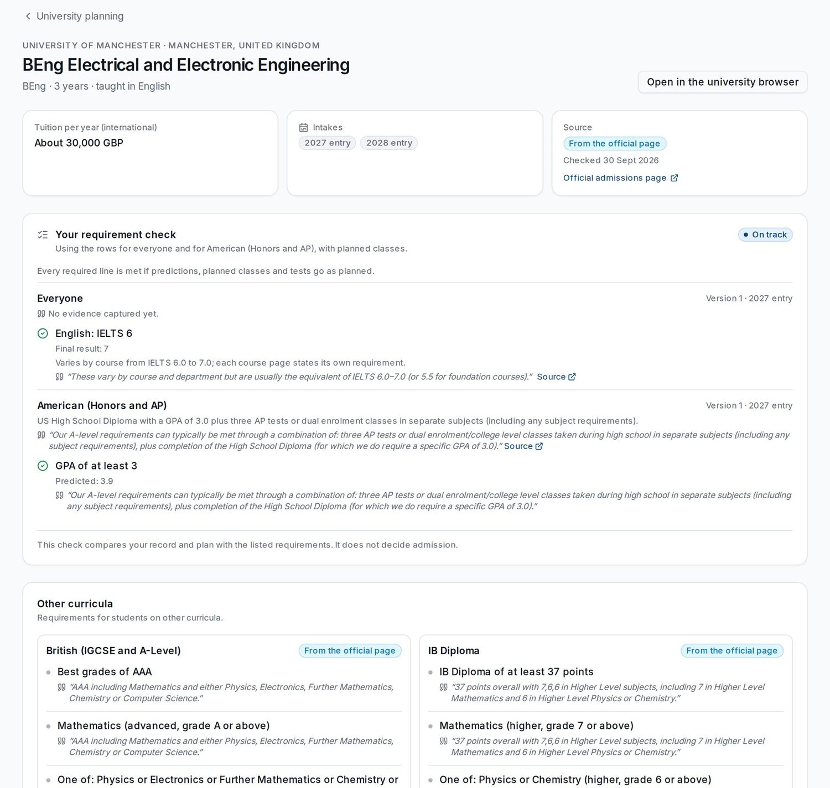



UNIVERSITY PATHWAYS ENGINE
University guidance grounded in official pages
Word for word from official pages
Every requirement is taken from the university's official page, quoted exactly, with the source link and the date it was checked.
Rules decide, not AI
Each line is met, not met or unknown for the student's curriculum: British, IB, American, UAE MoE, Indian or Tawjihi.
Plans and what-if
A Grade 9 to 12 course plan approved by the counselor, and what-if to see which programmes move when a class or grade changes.
Year-on-year changes flagged for review
University of Birmingham Medicine MBChB
A*AA to AAA
Durham University Law LLB (Hons)
IB 38 to 37
Australian National University BComp
IB 30 to 31
Each university's current page is compared with last year's archived copy. Staff review each change; families are never notified automatically.
Horizon | 14
Notes:
This is where Horizon goes beyond a request system. The university pathways engine checks a student's courses and grades against each programme's entry requirements, line by line, for the British, IB, American, UAE Ministry, Indian and Jordanian Tawjihi curricula. Every requirement is taken from the university's official page, word for word, with the source link and the date it was checked. Eligibility is decided by rules, never by AI. On screen is the University of Manchester's Electrical and Electronic Engineering programme for Adam: he is on track, each line shows which of his courses meets it, and in italics you see the exact wording from Manchester's own page with a link to the source. Below, the same programme's requirements for British, IB and other curricula, each marked From the official page. Universities change their rules from year to year, so Horizon compares each university's current page with its archived copy from last year and flags the differences for staff review. Real examples: Birmingham Medicine moved from A*AA to AAA, Durham Law from IB 38 to 37, and ANU Computing from IB 30 to 31. Advisors see the before, the after and the affected students; families are never notified automatically. Students also get a Grade 9 to 12 course plan that the counselor approves, and a what-if tool. We still advise students to confirm on the official page before applying, and every page links to it.

Slide 15




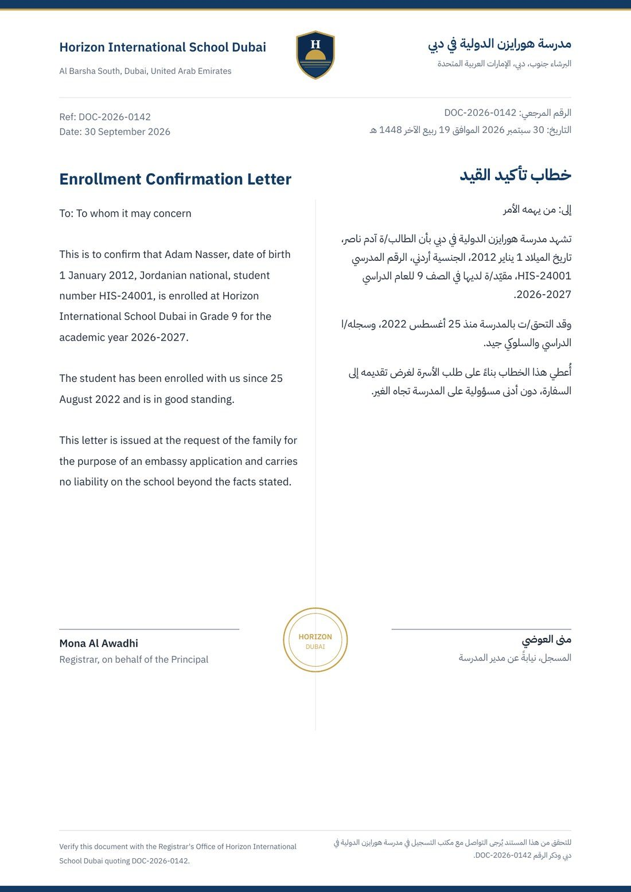
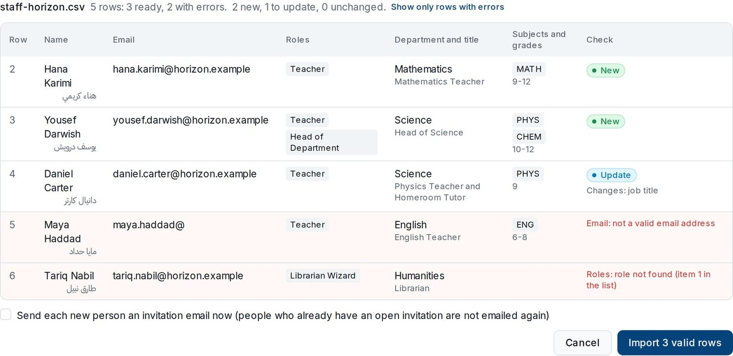
ONBOARDING
Live in a day, set up by the school itself
Self-serve sign-up
Names in English and Arabic, emirate and curricula. A complete working school is created instantly.
Setup wizard and brand
Seven short steps, skip and resume any time. Logo and colors change the whole app live.
Import center
Staff, students and guardians, classes, enrollments and subject choices from CSV or Excel, with bilingual templates.
Checked before saving
Every row is previewed with its errors first. Re-imports update and never duplicate, and never remove staff roles.
Sign-in your way
Email and password, plus Google or Microsoft 365 when the school turns them on.
Family join code
A printable poster with a QR code. Parents verify each child with student number and date of birth.
Your school's identity on every document
The school's logo, name, address and seal on letters, report cards, exam timetables and the family join poster, in Arabic and English.
Import preview: new, updated and invalid rows before anything is saved.
Horizon | 15
Notes:
How hard is it to start? A school can be live in a day. The administrator signs up with the school name in English and Arabic, the emirate and the curricula taught, and Horizon immediately creates a complete working school: roles, the service catalog with forms and approval routes, bilingual letters, message templates, the current academic year with UAE holidays, a bell schedule and the course catalog. Nothing starts empty. A seven-step setup wizard covers profile and brand, year and holidays, curricula, modules, people and invitations; the logo and colors change the whole app live. People come in through the Import center, in order: staff, then students and guardians, then classes and enrollments, then subject choices, from CSV or Excel files exported from the school's current system. Templates have English and Arabic headers. Every file is previewed row by row before anything is saved: here you see two new teachers, one existing teacher whose job title will be updated, and two rows with clear errors, an invalid email and a role that does not exist. Re-importing a file updates records rather than duplicating them, and a staff re-import never removes anyone's roles. Every import is kept in the import history. On the right is an enrollment letter: generated documents such as letters, report cards, exam timetables and the join poster carry the school's own logo, name, address and seal. Sign-in can be email and password, Google or Microsoft 365, and families join with a school code on a printed poster with a QR code. For a pilot school we also offer a 90-minute guided setup call.

Slide 16



LIGHT TO RUN
Little for your IT team to maintain
0
Weekly
Daily
custom builds per school
official page checks
live site check
Every school starts from a complete, working configuration.
The shared university catalog refreshes itself; changes wait for review.
Every page, for every role, in both languages, on desktop and phone.
Your administrators change everything
Names, logo, colors, services, forms, approval routes, letters, notification texts, subjects, roles, modules and calendar.
Safe to re-run
Imports and background jobs are idempotent, so a repeated file or a retried job never creates duplicates.
Modules you can switch off
Turn modules on or off per school; core modules such as requests, safeguarding and documents stay on.
Horizon | 16
Notes:
Schools often worry about the effort to keep a system running. Horizon is designed to be light. There are no custom builds per school: every school starts from a complete configuration and the school's own administrators change names, logo, colors, services, forms, approval routes, letters, notification texts, subjects, roles and the calendar themselves. The university requirements catalog is shared and refreshes itself weekly from official pages, with changes waiting for human review. Every morning an automated check opens every page for every role, in Arabic and English, on desktop and phone, against the live site. Imports and background jobs are idempotent, so repeating an import never creates duplicates. And modules can be switched on or off per school.

Slide 17


PILOT PROPOSAL
A one-term pilot with five launch services
WEEK 1
WEEKS 2 TO 3
WEEKS 4 TO 12
END OF TERM
Setup day
Staff go live
Families join
Review together
90-minute guided call: profile, calendar, imports, roles, DSL and deputy assigned.
Five launch services: documents, absences, parent meetings, teacher referrals, safeguarding concerns.
Family join code poster and letter. Counselors start university plans for one grade.
Measure against the agreed goals and decide on a whole-school rollout.
Success measures we agree up front
Days to issue an official letter
Share of requests closed on time
Time for a concern to reach the DSL
Share of families signed in
Horizon | 17
Notes:
Here is what we propose. A one-term pilot with five launch services. In week one we run a 90-minute guided setup call with your administrator: profile and branding, calendar, importing students, guardians and staff, assigning roles, and naming the DSL and deputy. In weeks two and three staff go live with five services: school documents, absence requests, parent meetings, teacher referrals and safeguarding concerns. From week four families join using the family code, and counselors start university plans with one grade. At the end of term we review together against measures we agree today, for example days to issue a letter, the share of requests closed on time, how quickly a concern reaches the DSL, and how many families are signed in, and then you decide on a whole-school rollout. Discuss commercial terms for the pilot here.

Slide 18
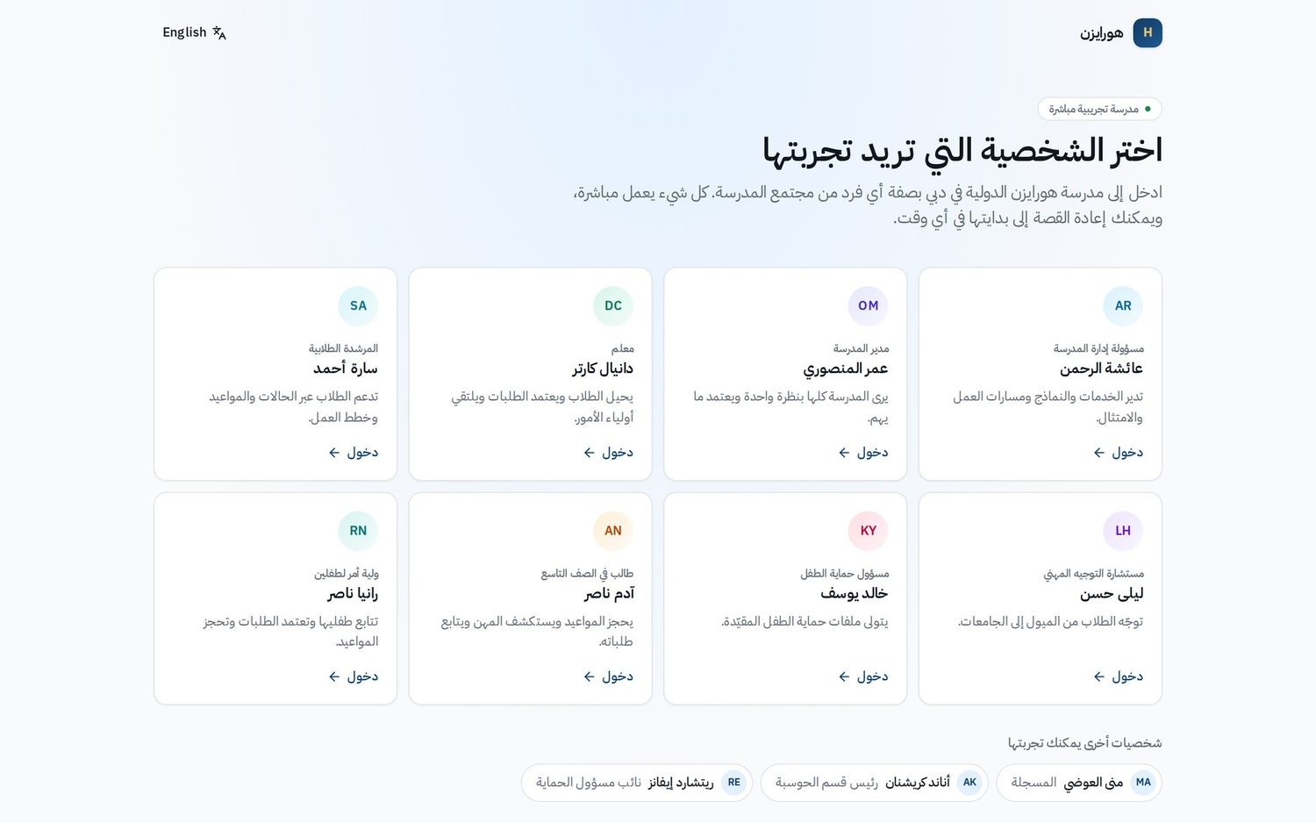
NEXT STEPS
Let us start with your pilot
1
Today
Choose a pilot lead and confirm your DSL and deputy.
2
This week
Send the data request: school details, logo and colors, staff list, students and guardians, term dates.
3
Next week
90-minute setup call, then go live with the five launch services.
Explore the live demo school as any persona, in English or Arabic.
Your contact details
Horizon | 18
Notes:
To close, three simple next steps. Today: choose a pilot lead, usually the school administrator or a deputy head, and confirm who your Designated Safeguarding Lead and deputy are. This week: send us the data request list, which covers school details, logo and colors, the staff list, students and guardians, and term dates; every template is available in English and Arabic. Next week: a 90-minute setup call, and then staff go live with the five launch services. In the meantime you are welcome to explore the live demo school yourselves, as any persona, in English or Arabic, and I will leave you a brochure with everything we covered. Thank you. Questions?

