Slide 1
Dollars for Disks
Thoughts on Running Postgresql in the Cloud Computing Era
Jeffrey Zampieron – Postgres Conf NY 2019

Slide 2
About Me
Technical Lead/Architect @ MedAcuity Software
MedTech Consulting
Specializing in software compliant w/ ISO13485:2016 and ISO/IEC62304
https://www.medacuitysoftware.com/
Previous
CTO/Director of Cloud @ Beco/Convene Technology
IoT/Mobile/Cloud system for Experiential User Engagement
Big-Data for the CRE Stakeholder
Sr. Tech Staff @ Systems & Technology Research LLC
DoD/IC Research into UxV navigation, Vision, ML, Cyber
Hyper-scale data processing via private cloud systems

Slide 3
Motivation
Where did this talk come from?
Lessons learned running PG in the cloud
A startup needing to be efficient to survive
Goals
System engineering approach to PG solutions
Provoke thoughts: Data and Example to guide evaluating your own situation
Non-goals
Exhaustive PG performance or cost studies
Tuning and tweaking every last ounce of $/TPS out of PG
Notes:
PG Pain points
What does it mean to be efficient
Trade Studies based on what you think you know about what you need

Slide 4
Background
Problem Statement
High volume/High concurrency data ingest (OLTP)
Real Time and Historical Analytics (OLAP)
Management/Provisioning and Production Fulfillment (ERP)
Assets & Constraints
Limited budget (cloud credits)
Small Dev/Ops team
No legacy concerns
Time to market is critical
The first big customer just landed
Notes:
This is the problem we were trying to solve.
Crowd-Sourced IoT data from Mobile (Android/iOS)

Slide 5
Landing Pad – System Overview
Cloud Native Architecture
Azure
DC/OS – Mesos
Stateful
Postgres 9/10
Kafka
Stateful on dedicated VMs
I/O contention on shared VMs was problematic
Initial PG design focused only on required application performance
Expected PG load + headroom

Slide 6
Landing Pad - PG
PG was running on a Standard D32s v3 - $2885.15 / month
32 vCPU, 128G RAM w/ 128G AMD SSD - $1330.88/month (PAYG)
Data (4xP40 – 2TB – RAID0), Log (2xP40 – 2TB – RAID0)
6xP40 @ $259.05/month = $1554.27/month
Prices as of 17-March-2019
Also had a read-replica – Duplicate Machine
Spending ~$5500/month just on Postgres
Performance was ~6000TPS
Observation: Disks and I/O in the cloud is expensive!
First thought is usually… what did I do wrong?
Notes:
P40 is 7500 IOPS, 250MB/s, optimal block size: 32kB

Slide 7
Dollars for Disks – The Wrong Way
Scenario
At the time, we were on Azure and not moving.
Spending lots of $/month on disks
Are we getting what we are paying for?
What other options exist?
What do we really need?
How we landed in the above scenario is an interesting story itself…
Focus in on “what do we need”
With some measure of “Are we getting what we are paying for?”
Plus reasonable room to grow

Slide 8
What do you need – System Eng.
Looking at cost reducing the PG server (largest spend)
The rough approach – Trying “the right way”
Start with top-level customer visible requirements
Define some PG KPIs (derived requirements)
Survey the landscape
Identify limitations
Prototype and Test
Implement
Profit!?!?
Foreshadowing: AWS tests results and thoughts

Slide 9
Top-Level Requirements
Can be loosely defined as long as they are bounded
Scenario below is what we used to inform the tests
SLAs
Uptime (planned/unplanned) – 99%, ~3 days per year
RTO – 8 hours
RPO – 1 day
Response Time – Human perceptible (less than 250ms – 99%)
Context dependent
Concurrent Users/Application TPS Load
~500k concurrent handsets – application specific
Notes:
- PG as a SPOF
- Unbounded systems are a recipe for disaster. Don’t boil the ocean.
The uptime doesn’t separate planned vs unplanned. However you chose to do it is on you. The reality is that most systems will need some kind of downtime for major upgrades
Response time is our system, not accounting for network latency
Scenario is derived from the real system at the time based on input from the sales and business adoption predictions + slop

Slide 10
PG KPIs
Based on the previous slide we derive the following PG goals:
Replica is a nice-to-have. Manual fail-over is tolerable in minutes
5000TPS min
Daily backups
What’s the lowest TCO way to achieve the above?
TCO considerations
NRE
PG Deployment setup
Backup/Restore/Failover tooling
Ops
Recurring IaaS/DBaaS depending on solution

Slide 11
Survey the Landscape
We selected the following landscape to limit test scope and cost
DBaaS
AWS RDS
Self-Hosted
AWS EC2
Metal
Private “Datacenter”
Notes:
Other providers and metal are future work
Co-Lo Rent-A-Box (shared datacenter) – future work

Slide 12
Bounds – Identified Limitations
RDS
RAM, CPU, IOPS, I/O Throughput, Network Throughput
EC2
RAM, CPU, IOPS, I/O Throughput, Disks per VM, Network Throughput
EBS
IOPS per Vol, Capacity per Vol
Metal
RAM, CPU, IOPS, I/O Throughput, Disks per Box, Network Throughput

Slide 13
Bounds - Caveats
When is persistent storage not actually persistent?
When its an AWS Instance Store.
When its an Azure “Temporary” Disk/Cache
Thought exercise: How are these super-fast, low-latency disk usable for a database? Is this a problem on metal?
FMEA
What does AWS/Azure/etc talk about as far as failure modes?
What are the effects and recovery scenarios?
How much redundancy do I need in my system for an application SLA?
Notes:
These are just some food for though points on dealing with cloud.
A restart vs redeploy with or without loss of the ephemeral disk.
In Jan 2018 after Spectre and Meltdown hit, I was losing 1 – 2 VMs a week on Azure as they patched the hypervisors. The reason was always a “hardware failure”.

Slide 14
Prototype and Test
All tests are run on AWS or Metal
Using the same tooling
IaaC, Tooling and Raw/Collected Results all provided
https://github.com/jzampieron/pgconf2019
Master branch is the “release” branch
Develop branch is my work in progress

Slide 15
Results
$/month/TPS are used to normalize cost
Recurring costs are included in the $/month/TPS
Power, Cooling, Network, etc
Assumptions about costs are listed and are rough estimates
Use your own numbers if repeating this exercise
Non-recurring costs
Amortized over 36 months for cap-ex into $/month
36 months is a typical depreciation schedule for cap-ex assets.
Amortized over 18 months for NRE into $/month
18 months is the expected design life for a cloud implementation
Your design lifespan may be different. Adjust accordingly.

Slide 16
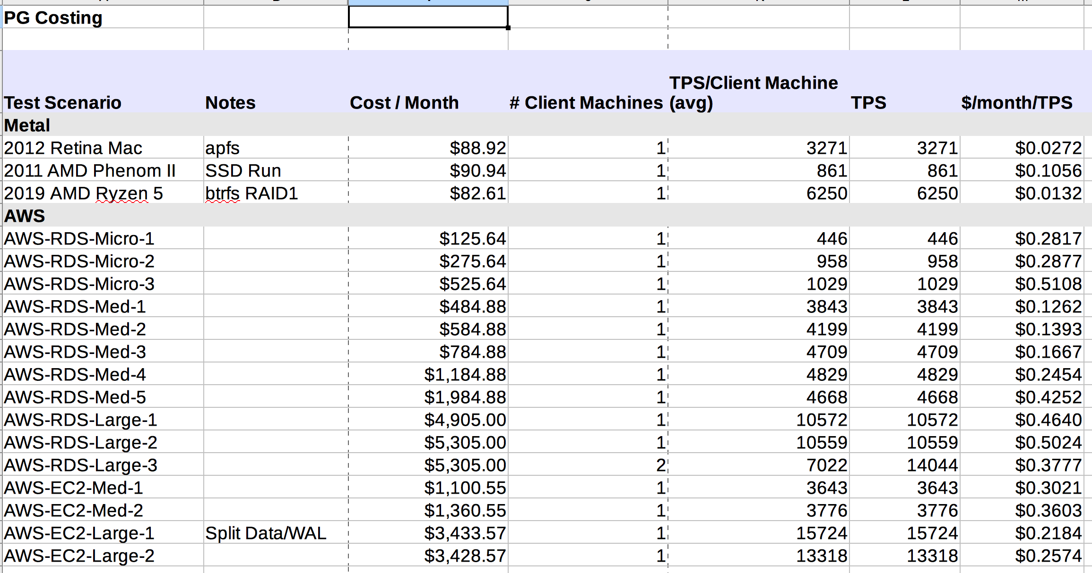
Results Matrix

Slide 17
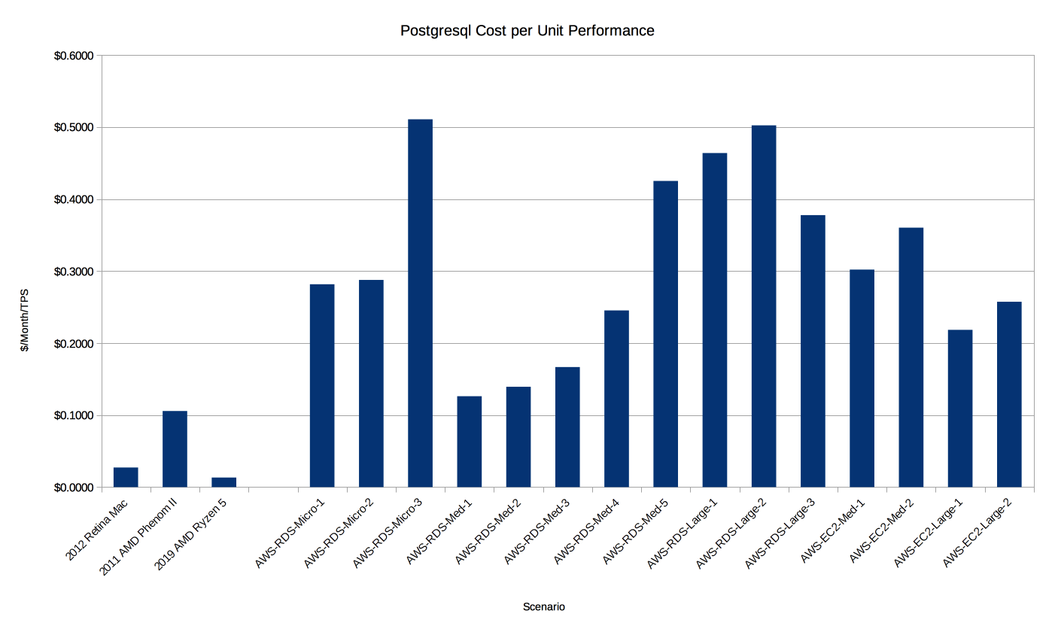
Results Chart
Smaller Values are Better
Metal
AWS

Slide 18
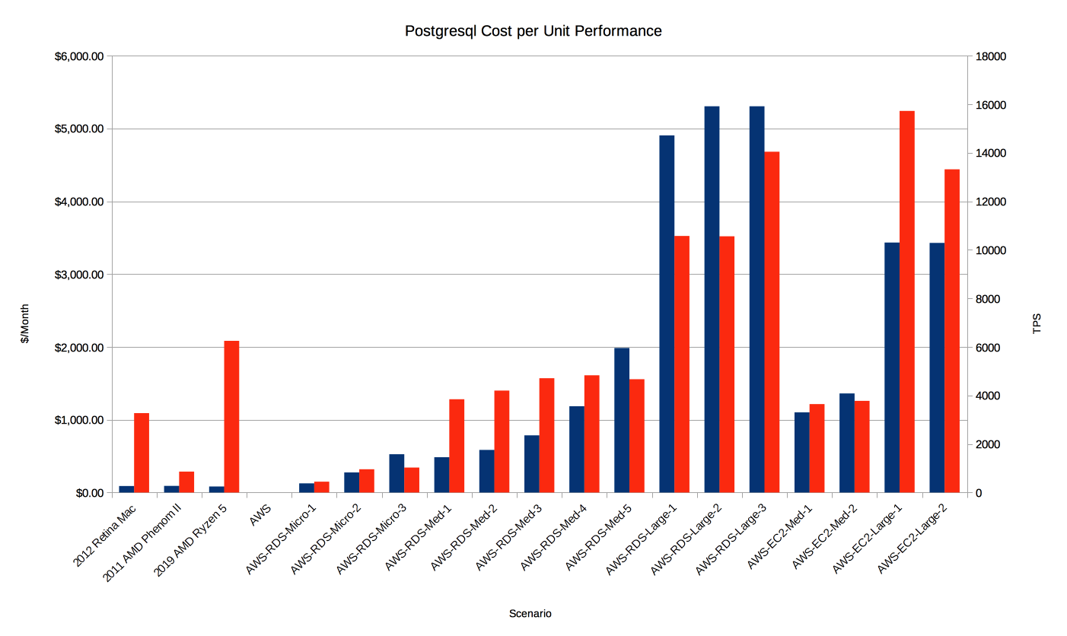
Results Chart w/ TPS
Notes:
Want the red bars to be larger than blue -> Highly cost efficient.
When the bars start to pass each other, that’s the inflection point. You are throwing money away.

Slide 19
Results Analysis
RDS
There is a plateau point for a given instance size
Increasing the disk IOPS evaporates money for no performance benefit
Unable identify an obvious cause for larger instances: CPU isn’t pegged
Would be nice if AWS RDS was smart enough to set limits here for you
Small and medium instances better value
EC2
For larger instances (r5.12xlarge) it appears to be trivially easy to beat RDS

Slide 20
Analysis
For the simple, non-redundant case
Metal is king. Bar none. This laptop matches a m5.xlarge at ~1/5th the cost ratio
DBaaS has certain price/performance points where its maybe worthwhile
DevOps for this case is easy
Do some analysis
If run-your-own is cheaper (EC2) then do it!
Future Work: Complex Cases: Multi-master, Replicas
The story is much less clear
How much is DevOps time worth?
Know of companies spending substantial engineering $ to avoid DBaaS
Understand and test the failure cases. Try that with DBaaS.
Notes:
What would a Raspberry PI do? Tegra? Marvel ARMADA?

Slide 21
Summary
It is OK to solve problems by throwing $ at them
Should at least understand what you are paying for.
Are you getting what you need
The obvious solution may not be the right solution
EC2 may be better than RDS for large sizes
Don’t boil the ocean
Understand your redundancy and DR requirements
Build to fit with a little room to grow

Slide 22
Future Work
Expand the Trade Study
Metal Configurations / Co-Lo (rent-a-box)
Private Clouds
Nutanix, DC/OS on Metal, Tectonic/OpenShift on Metal
Various SDS solutions (OpenEBS, Portworx, Rook, ScaleIO, etc.)
Public Clouds
Azure, Rackspace, Digital Ocean, Google Cloud
Refine the approach
Optimization
Anyone want to help tune PG in docker for each AWS EC2 instance type/disk setup?
Additional considerations
Technical
Cost
Focus is still on TCO for a given set of requirements ($/month/TPS)

Slide 23
Enhancement Opportunities
These are some ideas to make PG even better
DevOps Enhancements
Quiesce for filesystems with Atomic CoW snapshots
Matters more for split Data / WAL
Some SDS vendors support this (Portworx)
Something like a CHECKPOINT_AND_PAUSE
Consistent Backup to Blob Storage
Maybe a pg_cloud_dump
Loadable module
Data FEC instead of data checksums
Are data checksums really useful if you can’t recover

Slide 24
Questions and Discussion
Thanks for your attention.
Questions?
Presentation, Code and Raw Test Data at:
https://github.com/jzampieron/pgconf2019/tree/master

Slide 25
Extra Material

Slide 26
Motivation
Where did this talk come from?
Lessons learned running PG in the Cloud
Balancing DevOps, Data Science and R&D
Trying to understand Total Cost of Ownership
NRE
Recurring OpEx vs CapEx
DX
How does produce lifecycle fit into these considerations?
Learning to ask the correct questions

