Slide 1
CNN

Slide 2
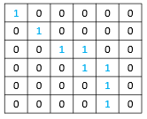
Step 1: Assuming we are having a 6x6 data:
1: wet
2: dry

Slide 3
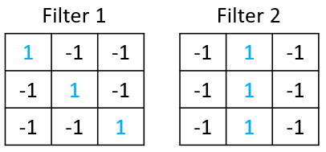
Step 2: the neuron (or filter) in CNN includes some basic information of the data ~ a filter is a matrix, e.g., the following example gives two 3x3 filters
Step 1: Assuming we are having a 6x6 data:
The elements in each filter is the parameters to be determined through the training process (like the weights in ANN).
in this example, if we have a 3x3 filter, then CNN only look at the area of 3x3 in the image at once instead of every grid point.
1: wet
2: dry

Slide 4
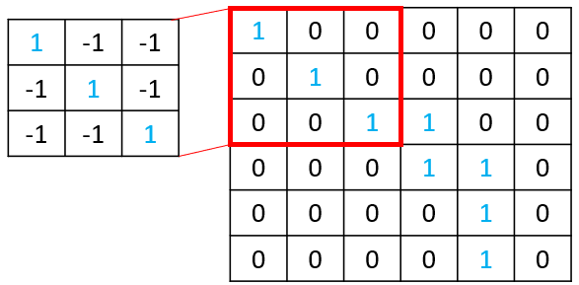
Step 2: the neuron (or filter) in CNN includes some basic information of the data ~ a filter is a matrix, e.g., the following example gives two 3x3 filters
Step 3: Applying the Filter onto the image from the top-left corner:
Step 1: Assuming we are having a 6x6 data:
The elements in each filter is the parameters to be determined through the training process (like the weights in ANN).
in this example, if we have a 3x3 filter, then CNN only look at the area of 3x3 in the image at once instead of every grid point.
1: wet
2: dry

Slide 5
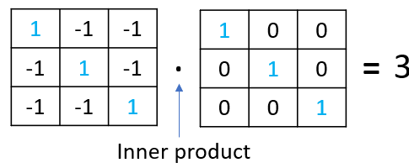
Step 3: Applying the Filter onto the image from the top-left corner:
Step 4: Generating the inner product between the filter the corresponding area of the image

Slide 6
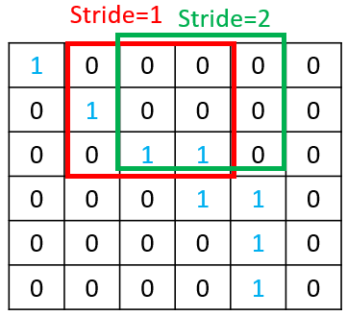
Step 4: moving the filter the entire dataset based on a predefined “stride”, and get the inner product for each movement
Step 3: Applying the Filter onto the image from the top-left corner:
Step 4: Generating the inner product between the filter the corresponding area of the image

Slide 7
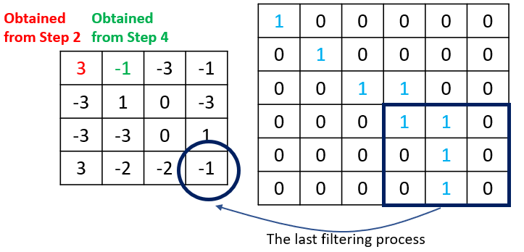
Step 4: moving the filter the entire dataset based on a predefined “stride”, and get the inner product for each movement
Step 3: Applying the Filter onto the image from the top-left corner:
Step 3.1: Generating the inner product between the filter the corresponding area of the image
the purpose of this filter is to detect if there is similar pattern of the filter in the image. The higher number in the inner product matrix usually means the higher similarity between the filter and the corresponding area of image
Note that in a CNN there are usually a dozen of filters.

Slide 8
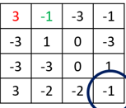
4x4 data
6x6 data
The inner product matrix from a filter
Input data matrix

Slide 9
4x4 data
pooling
6x6 data
The inner product matrix from a filter
Using ”pooling” to reduce the size of the inner product
Input data matrix

Slide 10
Taking the maximum value from this subdomain
3 | 0
3 | 0
3 | 0
3 | 0
We can have many of these small matrices (depth = the number of filters)
3 | 0
3 | 0
2x2 data
4x4 data
pooling
6x6 data
The inner product matrix from a filter
Using ”pooling” to reduce the size of the inner product
Input data matrix

Slide 11
6x6 data

Slide 12
1
1
0
0
0
0
2
3
4
5
7
0
1
0
0
0
8
9
6x6 data
13
0
0
1
0
14
15

Slide 13
1
1
0
0
0
0
2
3
4
5
7
0
1
0
0
0
8
9
6x6 data
13
0
0
1
0
14
15

Slide 14
1
1
0
0
0
0
2
3
location of the item
4
1
2
3
5
7
8
9
13
14
15
7
0
1
0
0
0
8
9
6x6 data
13
0
0
1
0
14
15

Slide 15
1
1
0
0
0
0
2
3
3
4
1
2
3
5
7
8
9
13
14
15
7
0
1
0
0
0
8
9
6x6 data
13
0
0
1
0
14
15

Slide 16
So for this neuron (“3”) it only needs to have the weights for some of the elements
1
1
0
0
0
0
2
3
3
4
1
2
3
5
7
8
9
13
14
15
7
0
1
0
0
0
8
9
6x6 data
13
0
0
1
0
14
15

Slide 17
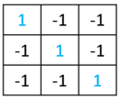
So for this neuron (“3”) it only needs to have the weights for some of the elements
1
1
0
0
0
0
2
3
3
And the weight for these 9 synapses is “defined” by the filter itself
4
1
2
3
5
7
8
9
13
14
15
7
0
1
0
0
0
8
9
6x6 data
13
0
0
1
0
14
15

Slide 18
1
1
0
0
0
0
2
3
3
4
2
3
4
5
-1
8
9
10
Therefore, the solution of CNN turns to something like ANN, all we need to do is just to solve the weights (which included in the filter) through the training (e.g., the cost function in ANN).
14
15
16
7
0
1
0
0
0
8
……
9
6x6 data
13
0
0
1
0
14
15

Slide 19
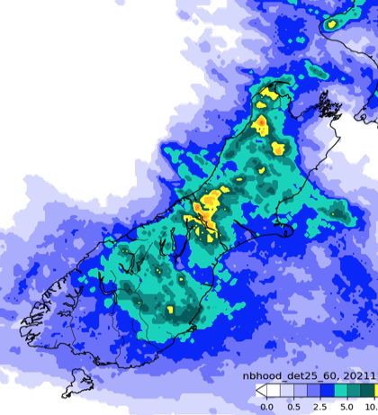
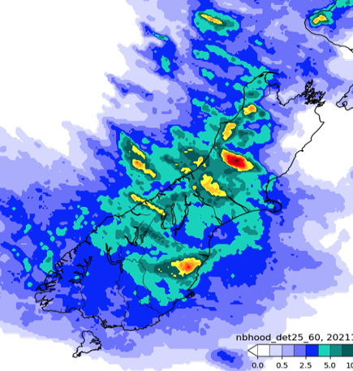
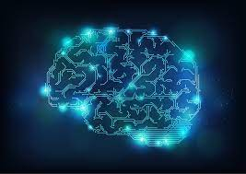
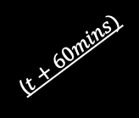
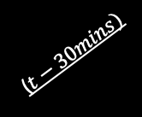
Best practice for CNN
https://towardsdatascience.com/a-guide-to-an-efficient-way-to-build-neural-network-architectures-part-ii-hyper-parameter-42efca01e5d7
https://www.pyimagesearch.com/2018/12/31/keras-conv2d-and-convolutional-layers/
300
300
A Deep Learning model
5
8
300
300
time steps
time steps
($t+60mins)$
($t−30mins)$
Input data (x) size:
(N, 300, 300, 5)
Input data (y) size:
(N, 300, 300, 8)
number of cases
number of cases

Slide 20

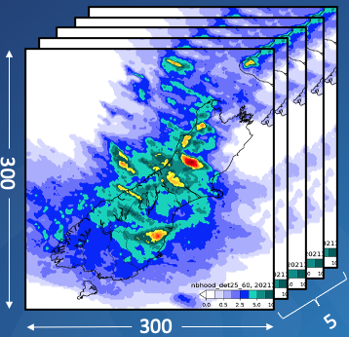
Best practice for CNN: How filter works?
https://www.pyimagesearch.com/2018/12/31/keras-conv2d-and-convolutional-layers/
https://stackoverflow.com/questions/43306323/keras-conv2d-and-input-channels
number of filters/kernels to be applied to the training data
Kernel size

Slide 21
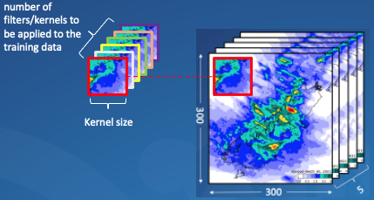
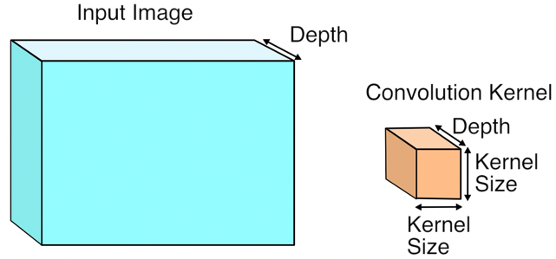
Best practice for CNN: How filter works?
https://www.pyimagesearch.com/2018/12/31/keras-conv2d-and-convolutional-layers/
https://stackoverflow.com/questions/43306323/keras-conv2d-and-input-channels
=
in Conv2D, a filter actually is 3D which contains the depth of the image (in this case the depth is 5)

Slide 22
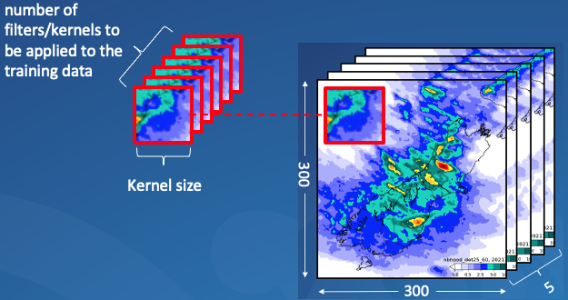












Best practice for CNN: How filter works?
https://www.pyimagesearch.com/2018/12/31/keras-conv2d-and-convolutional-layers/
https://stackoverflow.com/questions/43306323/keras-conv2d-and-input-channels
How the filter works ?
Depth:1
Depth:2
Depth:3
Depth:4
Depth:5
=
=
=
Kernel depth (=5)
Kernel size
Inner product
$$X_{1}$$
$$X_{2}$$
$$X_{3}$$
$$X_{4}$$
$$X_{5}$$
in Conv2D, a filter actually is 3D which contains the depth of the image (in this case the depth is 5)
Inner product
combination
=
+
+
+
+
$$X$$
$$X_{1}$$
$$X_{2}$$
$$X_{3}$$
$$X_{4}$$
$$X_{5}$$
$$X$$
Put the combined inner product into the “inner product matrix”
A good example from https://stackoverflow.com/questions/43306323/keras-conv2d-and-input-channels

Slide 23
Best practice for CNN: How filter works?
https://www.pyimagesearch.com/2018/12/31/keras-conv2d-and-convolutional-layers/
https://stackoverflow.com/questions/43306323/keras-conv2d-and-input-channels
Thumb of rules: How to set the number of filters
In most cases, over layers the number of filters is generally ascending. The reason is that:
The higher the number of filters, the higher the number of abstractions that your Network can extract from image data.
The reason why the number of filters is generally ascending is that at the input layer the Network receives raw pixel data. Raw data are always noisy, and this is especially true for image data.
Because of this, we let CNNs extract first some relevant information from noisy, "dirty" raw pixel data. Once the useful features have been extracted, then we make the CNN elaborate more complex abstractions on it.
That is why the number of filters usually increases as the Network gets deeper, even though it doesn't necessarily have to be like that.

Slide 24
Best practice for CNN: Why max pooling
Reducing Computational Load
Since max pooling is reducing the resolution of the given output of a convolutional layer, the network will be looking at larger areas of the image at a time going forward, which reduces the amount of parameters in the network and consequently reduces computational load.
Reducing Overfitting
Additionally, max pooling may also help to reduce overfitting.
For example, from a radar image, a filter looks for the pattern which is closest to itself. From the output of the convolutional layer, we can think of the higher valued pixels as being the ones that are the most similar to the filter.
With max pooling, as we're going over each region from the convolutional output, we're able to pick out the most activated pixels and therefore “only” preserve the features match the filter the most while discarding those features which are not very close to the filter
Drop out
We randomly remove neurons in the neural network during the training to reduce the chances of overfitting
https://www.quora.com/How-does-pooling-control-overfitting-in-CNN

Slide 25
Best practice for CNN: up-sampling & conv transpose
https://towardsdatascience.com/understand-transposed-convolutions-and-build-your-own-transposed-convolution-layer-from-scratch-4f5d97b2967
First Stride
input_shape = (6, 6, 1)
inputs = Input(input_shape)
conv1 = Conv2D(1, (3, 3), padding='valid', name="conv1")(inputs)
conv2 = MaxPooling2D(pool_size=(2, 2), name="conv2")(conv1)
model = Model(inputs=inputs, outputs=conv2)
2nd Stride
max pooling
Without any padding, this operation transforms a “6x6” matrix into a “4x4” matrix, after max-pooling the matrix becomes “2x2”
Now, our question is: what if we want to go backward from a 2x2 matrix to a 6x6 matrix?
Filter
Inner
product
max
pooling
……
convolutional layer
Inner product
(convolutional layer)
“conv2”
“conv1”
(Note that an additional “padding” can be used to address the shape issue for “conv1”, but not for “conv2”)
Last Stride

Slide 26
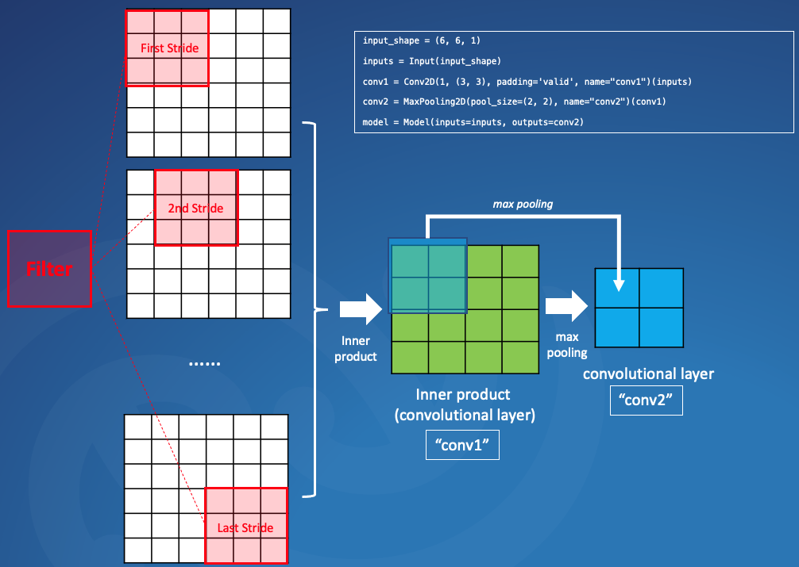
Best practice for CNN: up-sampling & conv transpose
https://towardsdatascience.com/understand-transposed-convolutions-and-build-your-own-transposed-convolution-layer-from-scratch-4f5d97b2967
In order to restore the shape from “2x2” to “6x6”, first we need to understand that two activities made the shape changes:
convolution
max-pooling
In order to resume the shape from
convolution: we can use padding or conv-tranposed
max-pooling: we can use up-sampling
convolution
max-pooling

Slide 27
Best practice for CNN: up-sampling & conv transpose
https://towardsdatascience.com/understand-transposed-convolutions-and-build-your-own-transposed-convolution-layer-from-scratch-4f5d97b2967
In order to resume the shape from
convolution: we can use padding, or conv-tranposed
max-pooling: we can use up-sampling or conv-transpose
What is padding
As we just discussed, the convolutional layers reduce the size of the output.
Padding basically extends the area of an image. The kernel/filter which moves across the image scans each pixel and converts the image into a smaller image. In order to work the kernel with processing in the image, padding is added to the outer frame of the image to allow for more space for the filter to cover in the image. Adding padding to an image processed by a CNN allows for a more accurate analysis of images.
Filter
Original
0 | 0 | 0 | 0 | 0 | 0 | 0
0 |  |  |  |  |  | 0
0 |  |  |  |  |  | 0
0 |  |  |  |  |  | 0
0 |  |  |  |  |  | 0
0 |  |  |  |  |  | 0
0 | 0 | 0 | 0 | 0 | 0 | 0
with padding
Filter
0 | 0 | 0 | 0 | 0 | 0 | 0
0 |  |  |  |  |  | 0
0 |  |  |  |  |  | 0
0 |  |  |  |  |  | 0
0 |  |  |  |  |  | 0
0 |  |  |  |  |  | 0
0 | 0 | 0 | 0 | 0 | 0 | 0
……
conv layer
……
0 | 0 | 0 | 0 | 0 | 0 | 0
0 |  |  |  |  |  | 0
0 |  |  |  |  |  | 0
0 |  |  |  |  |  | 0
0 |  |  |  |  |  | 0
0 |  |  |  |  |  | 0
0 | 0 | 0 | 0 | 0 | 0 | 0
Filter
6 x 6
4 x 4
6 x 6
6 x 6

Slide 28
Best practice for CNN: up-sampling & conv transpose
https://towardsdatascience.com/understand-transposed-convolutions-and-build-your-own-transposed-convolution-layer-from-scratch-4f5d97b2967
In order to resume the shape from
convolution: we can use padding, or conv-tranposed
max-pooling: we can use up-sampling or conv-transpose
What is conv-transposed
x
=
Filter
Original
filter
=
Filter
x
……
filter
conv layer
……
Filter
6 x 6
4 x 4
conv-transposed
https://towardsdatascience.com/understand-transposed-convolutions-and-build-your-own-transposed-convolution-layer-from-scratch-4f5d97b2967

Slide 29
Best practice for CNN: up-sampling & conv transpose
https://towardsdatascience.com/understand-transposed-convolutions-and-build-your-own-transposed-convolution-layer-from-scratch-4f5d97b2967
In order to resume the shape from
convolution: we can use padding, or conv-tranposed
max-pooling: we can use up-sampling
What is up-sampling
https://www.machinecurve.com/index.php/2019/12/11/upsampling2d-how-to-use-upsampling-with-keras/#what-is-upsampling
23 | 21.5 | 18.5 | 17
23.25 | 22.44 | 20.81 | 20
23.75 | 24.31 | 25.43 | 26
24 | 25.25 | 27.75 | 29
23 | 23 | 17 | 17
23 | 23 | 17 | 17
24 | 24 | 29 | 29
24 | 24 | 29 | 29
23 | 17
24 | 29
output after max-pooling
up-sampling
up-sampling
interpolation='bilinear'
interpolation=nearest'

Slide 30
Best practice for CNN: Why Dropout
https://stackoverflow.com/questions/59717290/does-maxpooling-reduce-overfitting

