Slide 1
RNN: LSTM (Long short-term memory)

Slide 2


The difference between Simple RNN and LSTM
For simple RNN, all the updated neuron values are written into the memory and can be used by subsequent time step
Updated neuron values
$$f$$
$$f$$
?
?

Slide 3

The difference between Simple RNN and LSTM
For LSTM, First there is an “input gate” to control whether we write the updated neuron value into memory
For simple RNN, all the updated neuron values are written into the memory and can be used by subsequent time step
Updated neuron values
$$f$$
$$f$$
?
?
input gate
input gate
$$f$$
$$f$$
?
?
whether the status of “input gate” is “open” or “close” is learnt by the model during training

Slide 4
The difference between Simple RNN and LSTM
For LSTM, First there is an “input gate” to control whether we write the updated neuron value into memory
Second there is an “output gate” to control whether the next timestep can use these updated neuron values
For simple RNN, all the updated neuron values are written into the memory and can be used by subsequent time step
Updated neuron values
$$f$$
$$f$$
?
?
input gate
input gate
$$f$$
$$f$$
?
?
output gate
……
output gate
whether the status of “input gate” is “open” or “close” is learnt by the model during training

Slide 5
The difference between Simple RNN and LSTM
For LSTM, First there is an “input gate” to control whether we write the updated neuron value into memory
Second there is an “output gate” to control whether the next timestep can use these updated neuron values
For simple RNN, all the updated neuron values are written into the memory and can be used by subsequent time step
Third there is an “forget gate” to decide whether to forget ”all” the memorized neuron values
Note that for the input or output gates, we only controls whether the updated neurons for this timestep will be remembered (or used), however, for the forget gate, if it is “on”, then any previous learnt memory will be erased
Updated neuron values
$$f$$
$$f$$
?
?
input gate
input gate
$$f$$
$$f$$
?
?
forget gate
forget gate
output gate
……
output gate
Note the status of the gates are learnt by the model during training

Slide 6



The difference between Simple RNN and LSTM
Input: Updated values from neurons/hidden layers
Input: Signal control input gate
Memory
Memory
input gate
input gate
Output: used by next time step
$$f$$
$$f$$
?
?
$$f$$
?
?
$$f$$
forget gate
forget gate
output gate
……
Input: Updated values from neurons/hidden layers
Output: used by next time step
output gate
Input: Signal control output gate
Input: Signal control forget gate
Simple RNN has:
“1” input to be stored in the memory
“1” output to be used by next time step of RNN (or other parts of network)
LSTM has:
“4” input to be stored in the memory
“1” output to be used by next time step of LSTM (or other parts of network)

Slide 7










How LSTM works
Step 1
Assuming that
the input from external of this cell is called $Z$
the signal controls input gate is called $Z_{i}$
the signal controls forget gate is called $Z_{f}$
the signal controls output gate is called $Z_{o}$
the output is $a$
$f$ represents the activation function for gates
$f_{a}$ or $f_{m}$ represent the activation functions used for non-gate related activities
Also, before this cell, the memory already has a value $c$
used by next time step
$$a$$
Signal control output gate
$$f$$
$$Z_{o}$$
output gate
$$f_{m}$$
Memory
$$f$$
Signal control forget gate
$$c$$
$$Z_{f}$$
forget gate
Signal control input gate
$$f$$
$$Z_{i}$$
Input gate
$$f_{a}$$
Updated values from neurons/hidden layers
$$Z$$

Slide 8
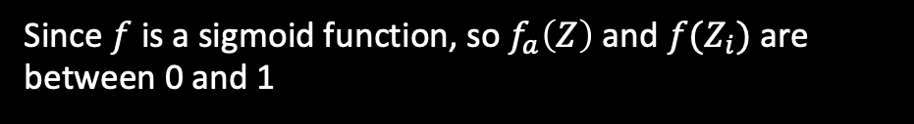




How LSTM works
Step 1
Assuming that
the input from external of this cell is called $Z$
the signal controls input gate is called $Z_{i}$
the signal controls forget gate is called $Z_{f}$
the signal controls output gate is called $Z_{o}$
the output is $a$
$f$ represents the activation function for gates
$f_{a}$ or $f_{m}$ represent the activation functions used for non-gate related activities
Also, before this cell, the memory already has a value $c$
used by next time step
$$a$$
Signal control output gate
$$f$$
$$Z_{o}$$
output gate
$$f_{m}$$
Memory
$$f$$
Signal control forget gate
$$c$$
$$Z_{f}$$
forget gate
Step 2
Apply the $f$ to $Z$ and $Z_{i}$
Signal control input gate
$f(Z_{i})$
Since $f$ is a sigmoid function, so $f_{a}\left(Z\right)$ and $f(Z_{i})$ are between 0 and 1
$$f$$
$X_{1}=f\left(Z\right)$ $f(Z_{i})$
$$Z_{i}$$
Input gate
$$f_{a}\left(Z\right)$$
Creating a multiplication product: $X_{1}=f_{a}\left(Z\right)f(Z_{i})$
$$f_{a}$$
Updated values from neurons/hidden layers
$$Z$$

Slide 9




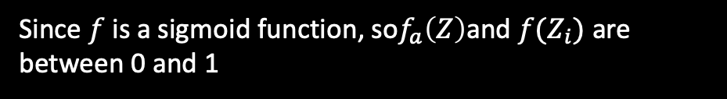
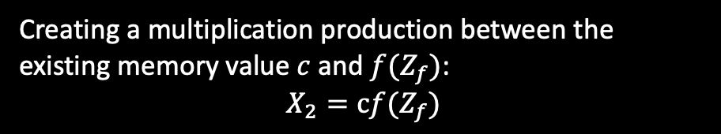
How LSTM works
Step 2
Apply the $f$ to $Z$ and $Z_{i}$
used by next time step
Since $f$ is a sigmoid function, so$f_{a}\left(Z\right)$and $f(Z_{i})$ are between 0 and 1
$$a$$
Signal control output gate
$$f$$
Creating a multiplication product: $X_{1}=f_{a}\left(Z\right)f(Z_{i})$
$$Z_{o}$$
output gate
Step 3
$$f_{m}$$
Apply the $f$ to $Z_{f}$: $f(Z_{f})$
$X_{2}=cf(Z_{f})$
Creating a multiplication production between the existing memory value $c$ and $f(Z_{f})$:
$$X_{2}=cf(Z_{f})$$
Memory
$$f$$
Signal control forget gate
$$c$$
$f(Z_{f})$
$$Z_{f}$$
forget gate
Signal control input gate
$f(Z_{i})$
$$f$$
$X_{1}=f\left(Z\right)$ $f(Z_{i})$
$$Z_{i}$$
Input gate
$$f_{a}\left(Z\right)$$
$$f_{a}$$
Updated values from neurons/hidden layers
$$Z$$

Slide 10

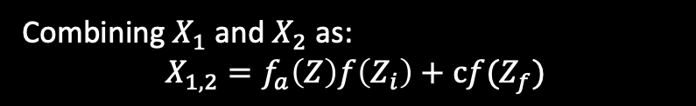
How LSTM works
Step 2
Apply the $f$ to $Z$ and $Z_{i}$
used by next time step
Since $f$ is a sigmoid function, so$f_{a}\left(Z\right)$and $f(Z_{i})$ are between 0 and 1
$$a$$
Signal control output gate
$$f$$
Creating a multiplication product: $X_{1}=f_{a}\left(Z\right)f(Z_{i})$
$$Z_{o}$$
output gate
Step 3
$$f_{m}$$
Apply the $f$ to $Z_{f}$: $f(Z_{f})$
$X_{2}=cf(Z_{f})$
Creating a multiplication production between the existing memory value $c$ and $f(Z_{f})$:
$$X_{2}=cf(Z_{f})$$
Memory
$$f$$
Signal control forget gate
$$c$$
$f(Z_{f})$
$$Z_{f}$$
forget gate
Step 4
$f(Z_{i})$
Combining $X_{1}$ and $X_{2}$ as:
$X_{1,2}=f_{a}\left(Z\right)f\left(Z_{i}\right)+cf(Z_{f})$
Signal control input gate
$$f$$
$X_{1}=f\left(Z\right)$ $f(Z_{i})$
$$Z_{i}$$
Input gate
$$f_{a}\left(Z\right)$$
So $X_{1,2}$ is the new value to be saved in the memory
$$f_{a}$$
Updated values from neurons/hidden layers
$$Z$$

Slide 11



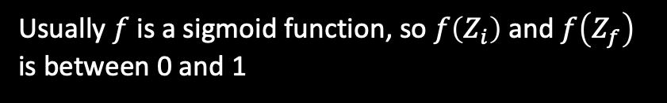

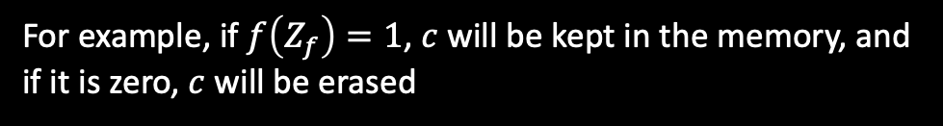
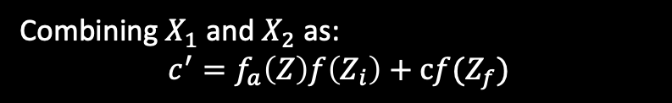
How LSTM works
Step 3
Apply the $f$ to $Z_{f}$: $f(Z_{f})$
used by next time step
$$a$$
Creating a multiplication production between the existing memory value $c$ and $f(Z_{f})$:
$$X_{2}=cf(Z_{f})$$
Signal control output gate
$$f$$
$$Z_{o}$$
output gate
Step 4
$$f_{m}$$
Combining $X_{1}$ and $X_{2}$ as:
$$c^{′}=f_{a}\left(Z\right)f\left(Z_{i}\right)+cf(Z_{f})$$
$$c^{′}=f_{a}\left(Z\right)f\left(Z_{i}\right)+cf(Z_{f})$$
$X_{2}=cf(Z_{f})$
Memory
$$f$$
Signal control forget gate
So $c^{′}$is the new value to be saved in the memory
$$c$$
$f(Z_{f})$
$$Z_{f}$$
forget gate
Usually $f$ is a sigmoid function, so $f\left(Z_{i}\right)$ and $f\left(Z_{f}\right)$ is between 0 and 1
Signal control input gate
$f(Z_{i})$
$f\left(x\right)=0$: this means that the gate is closed (no data pass)
$$f$$
$X_{1}=f\left(Z\right)$ $f(Z_{i})$
$$Z_{i}$$
$$f_{a}\left(Z\right)$$
$f\left(x\right)=1$: this means that the gate is open (no data pass)
Input gate
$$f_{a}$$
For example, if $f\left(Z_{f}\right)=1$, $c$ will be kept in the memory, and if it is zero, $c$ will be erased
Updated values from neurons/hidden layers
$$Z$$

Slide 12




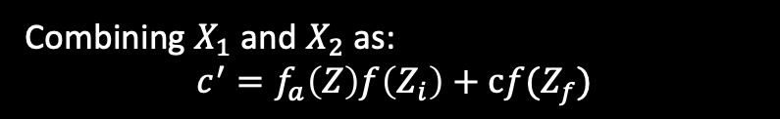
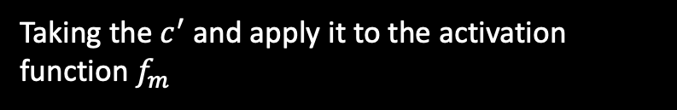
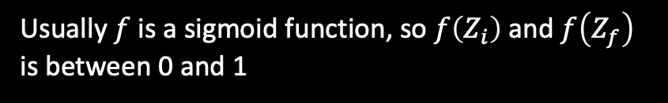
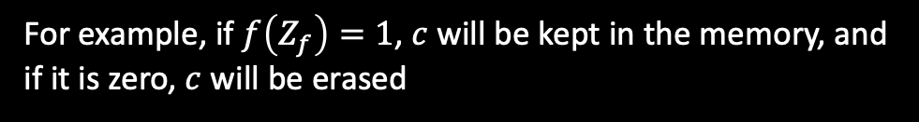
How LSTM works
Step 4
Combining $X_{1}$ and $X_{2}$ as:
$$c^{′}=f_{a}\left(Z\right)f\left(Z_{i}\right)+cf(Z_{f})$$
used by next time step
$$a$$
So $c^{′}$is the new value to be saved in the memory
Signal control output gate
$$f$$
Usually $f$ is a sigmoid function, so $f\left(Z_{i}\right)$ and $f\left(Z_{f}\right)$ is between 0 and 1
$$Z_{o}$$
output gate
$X_{3}=f_{m}\left(c^{′}\right)$
$$f_{m}$$
$f\left(x\right)=0$: this means that the gate is closed (no data pass)
$$c^{′}=f_{a}\left(Z\right)f\left(Z_{i}\right)+cf(Z_{f})$$
$X_{2}=cf(Z_{f})$
$f\left(x\right)=1$: this means that the gate is open (no data pass)
Memory
$$f$$
Signal control forget gate
$$c$$
$f(Z_{f})$
For example, if $f\left(Z_{f}\right)=1$, $c$ will be kept in the memory, and if it is zero, $c$ will be erased
$$Z_{f}$$
forget gate
$f(Z_{i})$
Step 5
Signal control input gate
$$f$$
$X_{1}=f\left(Z\right)$ $f(Z_{i})$
Taking the $c^{′}$ and apply it to the activation function $f_{m}$
$$Z_{i}$$
Input gate
$$f\left(Z\right)$$
$X_{3}=f_{m}\left(c^{′}\right)$
$$f_{a}$$
Updated values from neurons/hidden layers
$$Z$$

Slide 13


How LSTM works
Step 4
Combining $X_{1}$ and $X_{2}$ as:
$$c^{′}=f_{a}\left(Z\right)f\left(Z_{i}\right)+cf(Z_{f})$$
used by next time step
$$a$$
So $c^{′}$is the new value to be saved in the memory
Signal control output gate
$$f$$
$X_{4}=f\left(Z_{o}\right)$
Usually $f$ is a sigmoid function, so $f\left(Z_{i}\right)$ and $f\left(Z_{f}\right)$ is between 0 and 1
$$Z_{o}$$
output gate
$X_{3}=f_{m}\left(c^{′}\right)$
$$f_{m}$$
$f\left(x\right)=0$: this means that the gate is closed (no data pass)
$$c^{′}=f_{a}\left(Z\right)f\left(Z_{i}\right)+cf(Z_{f})$$
$X_{2}=cf(Z_{f})$
$f\left(x\right)=1$: this means that the gate is open (no data pass)
Memory
$$f$$
Signal control forget gate
$$c$$
$f(Z_{f})$
For example, if $f\left(Z_{f}\right)=1$, $c$ will be kept in the memory, and if it is zero, $c$ will be erased
$$Z_{f}$$
forget gate
$f(Z_{i})$
Step 5
Signal control input gate
$$f$$
$X_{1}=f\left(Z\right)$ $f(Z_{i})$
Taking the $c^{′}$ and apply it to the activation function $f_{m}$
$$Z_{i}$$
Input gate
$$f\left(Z\right)$$
$X_{3}=f_{m}\left(c^{′}\right)$
$$f_{a}$$
Step 6
The output gate can be represented as:
Updated values from neurons/hidden layers
$$Z$$
$X_{4}=f\left(Z_{o}\right)$

Slide 14




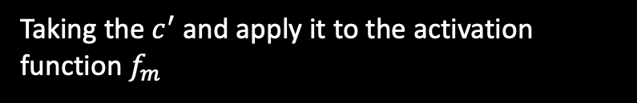
How LSTM works
used by next time step
$$a=f_{m}\left(c^{′}\right)f\left(Z_{o}\right)$$
Signal control output gate
$$f$$
Step 5
$X_{4}=f\left(Z_{o}\right)$
$$Z_{o}$$
output gate
$X_{3}=f_{m}\left(c^{′}\right)$
Taking the $c^{′}$ and apply it to the activation function $f_{m}$
$$f_{m}$$
$$c^{′}=f_{a}\left(Z\right)f\left(Z_{i}\right)+cf(Z_{f})$$
$X_{3}=f_{m}\left(c^{′}\right)$
$X_{2}=cf(Z_{f})$
Memory
$$f$$
Signal control forget gate
Step 6
$$c$$
$f(Z_{f})$
$$Z_{f}$$
The output gate can be represented as:
forget gate
$X_{4}=f\left(Z_{o}\right)$
Signal control input gate
$f(Z_{i})$
Step 7
$$f$$
$X_{1}=f\left(Z\right)$ $f(Z_{i})$
$$Z_{i}$$
$$f\left(Z\right)$$
Finally we can get the output as
Input gate
$a=f_{m}\left(c^{′}\right)f\left(Z_{o}\right)$
$$f_{a}$$
Updated values from neurons/hidden layers
$$Z$$

Slide 15

How LSTM works
used by next time step
$$a=f_{m}\left(c^{′}\right)f\left(Z_{o}\right)$$
Signal control output gate
$$f$$
In a summary, the output from a LSTM is produced by
$X_{4}=f\left(Z_{o}\right)$
$$Z_{o}$$
output gate
$X_{3}=f_{m}\left(c^{′}\right)$
$$f_{m}$$
output gate
input gate
forget gate
$$c^{′}=f_{a}\left(Z\right)f\left(Z_{i}\right)+cf(Z_{f})$$
$X_{2}=cf(Z_{f})$
$a=f_{m}\left(f_{a}\left(Z\right)f\left(Z_{i}\right)+cf(Z_{f})\right)f\left(Z_{o}\right)$
Memory
$$f$$
Signal control forget gate
$$c$$
$f(Z_{f})$
Decide whether：
erase the old neuron value in the memory
using “input” to update (or initialize) the neuron value in the memory
contribution from input
$$Z_{f}$$
forget gate
contribution from previous stored value in memory
Signal control input gate
$f(Z_{i})$
$$f$$
$X_{1}=f\left(Z\right)$ $f(Z_{i})$
$$Z_{i}$$
Input gate
$$f\left(Z\right)$$
Contribution from the current input + memory
$$f_{a}$$
output
Updated values from neurons/hidden layers
$$Z$$

Slide 16
How LSTM works
The next question is that where $Z$, $Z_{i}$, $Z_{f}$ and $Z_{o}$ comes from ?
used by next time step
$$a=f_{m}\left(c^{′}\right)f\left(Z_{o}\right)$$
Signal control output gate
$$f$$
$X_{4}=f\left(Z_{o}\right)$
$$Z_{o}$$
output gate
$X_{3}=f_{m}\left(c^{′}\right)$
$$f_{m}$$
$$c^{′}=f_{a}\left(Z\right)f\left(Z_{i}\right)+cf(Z_{f})$$
They are actually all determined by the input data
$X_{2}=cf(Z_{f})$
Memory
$$f$$
Signal control forget gate
$$c$$
$f(Z_{f})$
$$Z_{f}$$
forget gate
Signal control input gate
$f(Z_{i})$
$$f$$
$X_{1}=f\left(Z\right)$ $f(Z_{i})$
$$Z_{i}$$
Input gate
$$f\left(Z\right)$$
$$f_{a}$$
Updated values from neurons/hidden layers
$$Z$$

Slide 17
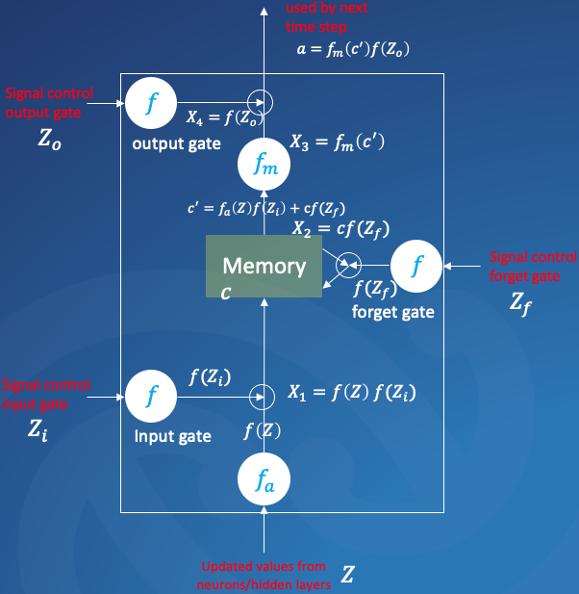

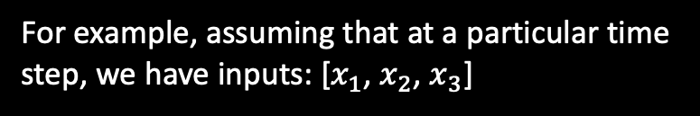



How LSTM works
The next question is that where $Z$, $Z_{i}$, $Z_{f}$ and $Z_{o}$ comes from ?
[$x_{1}$, $x_{2}$, $x_{3}$]
For example, assuming that at a particular time step, we have inputs: [$x_{1}$, $x_{2}$, $x_{3}$]
So apparently, the signals control all the gates are the input
[$x_{1}$, $x_{2}$, $x_{3}$]
[$x_{1}$, $x_{2}$, $x_{3}$]
[$x_{1}$, $x_{2}$, $x_{3}$]

Slide 18





How LSTM works
The next question is that where $Z$, $Z_{i}$, $Z_{f}$ and $Z_{o}$ comes from ?
[$x_{1}$, $x_{2}$, $x_{3}$]
For example, assuming that at a particular time step, we have inputs: [$x_{1}$, $x_{2}$, $x_{3}$]
So apparently, the signals control all the gates are the input
[$x_{1}$, $x_{2}$, $x_{3}$]
$f\left(Z_{i}\right)=f\left(0+0−10\right)=0$
e.g., for the input gate, given that we have the input [3,5,10], the weights are [0, 0, -1], then the input gate is ”-10” (via the sigmoid function, it is “0”) so the gate will be closed
$$w=0$$
[$3$, $5$, $10$]
$$w=0$$
$$w=−1$$
Note that those weights are obtained via the backpropagation training
[$x_{1}$, $x_{2}$, $x_{3}$]

Slide 19
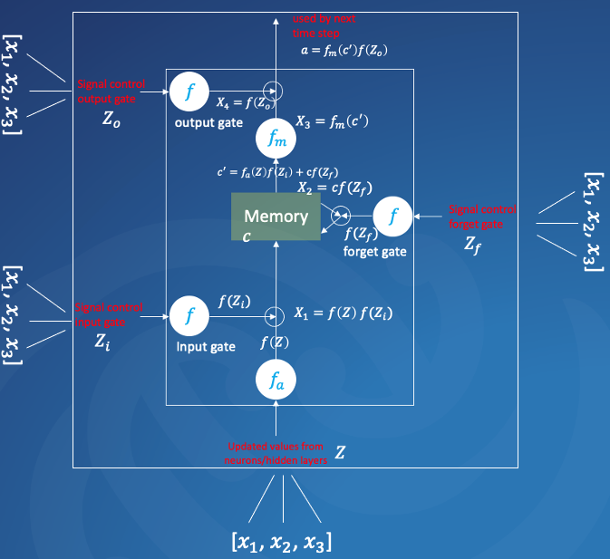





How LSTM works
So for one cell of LSTM, the workflow can be represented as
(1) the input is multiplied by weights to form the inputs for different gates and the input itself
$$Z$$
$$Z_{i}$$
$$Z_{f}$$
$$Z_{o}$$
$$x_{t}$$

Slide 20


How LSTM works
So for one cell of LSTM, the workflow can be represented as
(1) the input is multiplied by weights to form the inputs for different gates and the input itself
(2) the input multiplied by a activation function $f_{a}$
$$f_{a}$$
$$Z$$
$$Z_{i}$$
$$Z_{f}$$
$$Z_{o}$$
$$x_{t}$$

Slide 21


How LSTM works
So for one cell of LSTM, the workflow can be represented as
(1) the input is multiplied by weights to form the inputs for different gates and the input itself
(2) the input multiplied by a activation function $f_{a}$
(3) the input gate is multiplied by a activation function $f$
$$f_{a}$$
$$f$$
$$Z$$
$$Z_{i}$$
$$Z_{f}$$
$$Z_{o}$$
$$x_{t}$$

Slide 22
How LSTM works
So for one cell of LSTM, the workflow can be represented as
(1) the input is multiplied by weights to form the inputs for different gates and the input itself
(2) the input multiplied by a activation function $f_{a}$
(3) the input gate is multiplied by a activation function $f$
(4) the output from (2) and (3) are multiplied together
$$f_{a}$$
$$f$$
$$Z$$
$$Z_{i}$$
$$Z_{f}$$
$$Z_{o}$$
$$x_{t}$$

Slide 23


How LSTM works
So for one cell of LSTM, the workflow can be represented as
(1) the input is multiplied by weights to form the inputs for different gates and the input itself
(2) the input multiplied by a activation function $f_{a}$
(3) the input gate is multiplied by a activation function $f$
(4) the output from (2) and (3) are multiplied together
(5) the forget gate is multiplied by a activation function $f$
$$f_{a}$$
$$f$$
$$f$$
$$Z$$
$$Z_{i}$$
$$Z_{f}$$
$$Z_{o}$$
$$x_{t}$$

Slide 24


How LSTM works
So for one cell of LSTM, the workflow can be represented as
(1) the input is multiplied by weights to form the inputs for different gates and the input itself
(2) the input multiplied by a activation function $f_{a}$
(3) the input gate is multiplied by a activation function $f$
(4) the output from (2) and (3) are multiplied together
$$c_{t−1}$$
(5) the forget gate is multiplied by a activation function $f$
(6) Take the memory value from last time step $c_{t−1}$
$$f$$
$$f$$
(7) the output from (5) and (6) are multiplied together
$$f_{a}$$
$$Z$$
$$Z_{i}$$
$$Z_{f}$$
$$Z_{o}$$
$$x_{t}$$

Slide 25
How LSTM works
So for one cell of LSTM, the workflow can be represented as
(1) the input is multiplied by weights to form the inputs for different gates and the input itself
(2) the input multiplied by a activation function $f_{a}$
(3) the input gate is multiplied by a activation function $f$
(4) the output from (2) and (3) are multiplied together
$$c_{t−1}$$
(5) the forget gate is multiplied by a activation function $f$
(6) Take the memory value from last time step $c_{t−1}$
$$f$$
$$f$$
(7) the output from (5) and (6) are multiplied together
$$f_{a}$$
(8) the output from (4) and (7) are added together
$$Z$$
$$Z_{i}$$
$$Z_{f}$$
$$Z_{o}$$
$$x_{t}$$

Slide 26


How LSTM works
So for one cell of LSTM, the workflow can be represented as
(1) the input is multiplied by weights to form the inputs for different gates and the input itself
(2) the input multiplied by a activation function $f_{a}$
(3) the input gate is multiplied by a activation function $f$
(4) the output from (2) and (3) are multiplied together
$$c_{t−1}$$
$$f_{m}$$
(5) the forget gate is multiplied by a activation function $f$
(6) Take the memory value from last time step $c_{t−1}$
$$f$$
$$f$$
(7) the output from (5) and (6) are multiplied together
$$f_{a}$$
(8) the output from (4) and (7) are added together
$$Z$$
$$Z_{i}$$
$$Z_{f}$$
$$Z_{o}$$
(9) Apply the activation function $f_{m}$ to the output of (8)
$$x_{t}$$

Slide 27

How LSTM works
So for one cell of LSTM, the workflow can be represented as
(1) the input is multiplied by weights to form the inputs for different gates and the input itself
(2) the input multiplied by a activation function $f_{a}$
(3) the input gate is multiplied by a activation function $f$
(4) the output from (2) and (3) are multiplied together
$$c_{t−1}$$
$$f_{m}$$
(5) the forget gate is multiplied by a activation function $f$
(6) Take the memory value from last time step $c_{t−1}$
$$f$$
$$f$$
$$f$$
(7) the output from (5) and (6) are multiplied together
$$f_{a}$$
(8) the output from (4) and (7) are added together
$$Z$$
$$Z_{i}$$
$$Z_{f}$$
$$Z_{o}$$
(9) Apply the activation function $f_{m}$ to the output of (8)
(10) Apply the activation function $f$to the output gate
$$x_{t}$$

Slide 28

How LSTM works
So for one cell of LSTM, the workflow can be represented as
(1) the input is multiplied by weights to form the inputs for different gates and the input itself
(2) the input multiplied by a activation function $f_{a}$
(3) the input gate is multiplied by a activation function $f$
(4) the output from (2) and (3) are multiplied together
$$c_{t−1}$$
$$f_{m}$$
(5) the forget gate is multiplied by a activation function $f$
$$y_{t}$$
(6) Take the memory value from last time step $c_{t−1}$
$$f$$
$$f$$
$$f$$
(7) the output from (5) and (6) are multiplied together
$$f_{a}$$
(8) the output from (4) and (7) are added together
$$Z$$
$$Z_{i}$$
$$Z_{f}$$
$$Z_{o}$$
(9) Apply the activation function $f_{m}$ to the output of (8)
(10) Apply the activation function $f$to the output gate
$$x_{t}$$
(11) the output from (9) and (10) are multiplied together as the “output”

Slide 29

How LSTM works
So for one cell of LSTM, the workflow can be represented as
(1) the input is multiplied by weights to form the inputs for different gates and the input itself
(2) the input multiplied by a activation function $f_{a}$
(3) the input gate is multiplied by a activation function $f$
(4) the output from (2) and (3) are multiplied together
$$c_{t−1}$$
$$f_{m}$$
$$c_{t}$$
(5) the forget gate is multiplied by a activation function $f$
$$y_{t}$$
(6) Take the memory value from last time step $c_{t−1}$
$$f$$
$$f$$
$$f$$
(7) the output from (5) and (6) are multiplied together
$$f_{a}$$
(8) the output from (4) and (7) are added together
$$Z$$
$$Z_{i}$$
$$Z_{f}$$
$$Z_{o}$$
(9) Apply the activation function $f_{m}$ to the output of (8)
(10) Apply the activation function $f$to the output gate
$$x_{t}$$
(11) the output from (9) and (10) are multiplied together as the “output”
(12) store the updated memory value
for next step

Slide 30




















How LSTM works
So for the subsequent time step, we have
$$c_{t−1}$$
$$f_{m}$$
$$c_{t}$$
$$f_{m}$$
$$c_{t+1}$$
$$y_{t}$$
$$y_{t+1}$$
$$f_{a}$$
$$f$$
$$f$$
$$f$$
$$f_{a}$$
$$f$$
$$f$$
$$f$$
……
$$Z$$
$$Z_{i}$$
$$Z_{f}$$
$$Z_{o}$$
$$Z$$
$$Z_{i}$$
$$Z_{f}$$
$$Z_{o}$$
$$x_{t}$$
$$x_{t+1}$$

Slide 31
How LSTM works
And for a LSTM with multiple neurons
$$c_{t−1}$$
$$f_{m}$$
$$c_{t}$$
$$f_{m}$$
$$c_{t+1}$$
$$y_{t}$$
$$y_{t+1}$$
$$f_{a}$$
$$f$$
$$f$$
$$f$$
$$f_{a}$$
$$f$$
$$f$$
$$f$$
……
$$Z$$
$$Z_{i}$$
$$Z_{f}$$
$$Z_{o}$$
$$Z$$
$$Z_{i}$$
$$Z_{f}$$
$$Z_{o}$$
$$x_{t}$$
$$x_{t+1}$$

Slide 32
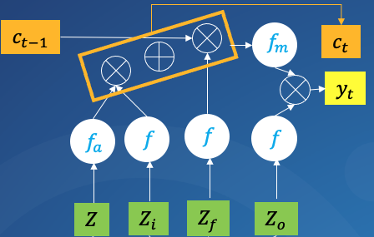



How LSTM works
And for a LSTM with multiple neurons
$$y_{t+1}$$
……
……
……
$$x_{t}$$
$$x_{t+1}$$

