Slide 1
RNN: simple RNN

Slide 2

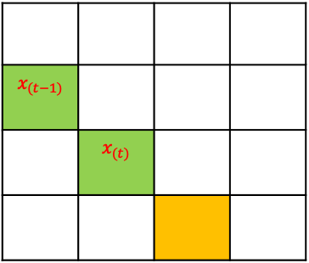



RNN is usually used to do the prediction for sequential data
Why RNN ?
There are two radar points obtained at $(t−1)$ and $(t)$, and we want to predict the radar point at $(t+1)$
$$x_{(t−1)}$$
 | $$x_{(t)}$$
Training
$$y$$
Therefore, in order to make the train the model, we have two points in the training dataset:
$x_{(t−1)}$: the radar point obtained at $(t−1)$
$x_{(t)}$: the radar point obtained at $(t)$
$y$: the truth in the training data

Slide 3
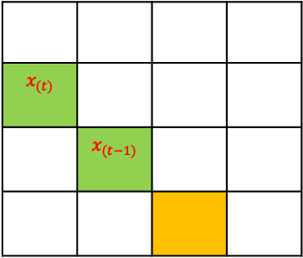



RNN is usually used to do the prediction for sequential data
Why RNN ?
There are two radar points obtained at $(t−1)$ and $(t)$, and we want to predict the radar point at $(t+1)$
Expected right prediction
$$x_{(t−1)}$$
 | $$x_{(t)}$$
$$y$$
$$x_{(t)}$$
 | $$x_{(t−1)}$$
Training
Predicting
Wrong prediction
$$y$$
$$y$$
Therefore, in order to make the train the model, we have two points in the training dataset:
In the dataset used for predicting, $x_{(t−1)}$ and $x_{(t)}$ located in opposite locations, however from the ANN training process, we are not able to recognize this sequential difference here, therefore the prediction will be in a wrong place (followed the training dataset)
$x_{(t−1)}$: the radar point obtained at $(t−1)$
$x_{(t)}$: the radar point obtained at $(t)$
$y$: the truth in the training data

Slide 4

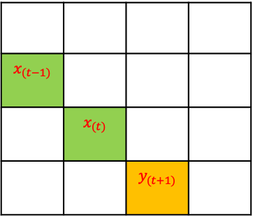

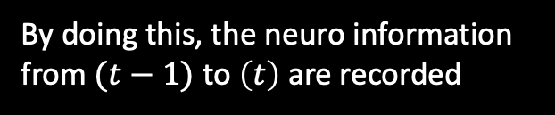






RNN is usually used to do the prediction for sequential data
Why RNN ?
There are two radar points obtained at $(t−1)$ and $(t)$, and we want to predict the radar point at $(t+1)$
In order to make such a prediction right, we need a sequential of training dataset, e.g.,
$$x_{(t−1)}$$
 | $$x_{(t)}$$
 |  | $$y_{(t+1)}$$
Training
And during the training, the model needs to be able to ”connect” these two training datasets, e.g.,
The information (t-1) will be used by the next time step (t)
$$y_{(t−1)}$$
$$y_{(t+1)}$$
By doing this, the neuro information from $(t−1)$ to $\left(t\right)$ are recorded
Neuron
Neuron
$$w_{t−1}$$
$$a_{t−1}=f(w_{t−1}×x_{t−1})$$
$$a_{t}=a_{t−1}+f(w_{t}×x_{t})$$
Activation function, e.g., sigmoid
$$w_{t}$$
$$x_{(t−1)}$$
$$x_{(t)}$$

Slide 5





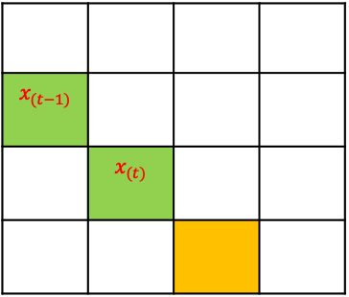






RNN is usually used to do the prediction for sequential data
Why RNN ?
There are two radar points obtained at $(t−1)$ and $(t)$, and we want to predict the radar point at $(t+1)$
$$x_{(t−1)}$$
If it is an ANN, there are 6 weights to be estimated
$$w_{1}$$
$$w_{2}$$
$$w_{6}$$
$$y$$
$$w_{1}$$
->
$w_{6}$
$$x_{(t)}$$
$$w_{4}$$
$$w_{5}$$
$$w_{3}$$
From the back propagation method
$$x_{(t−1)}$$
 | $$x_{(t)}$$
ANN
Training
$$y$$

Slide 6


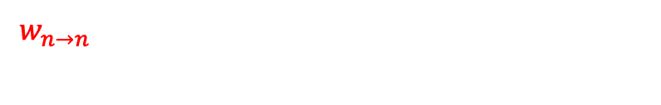


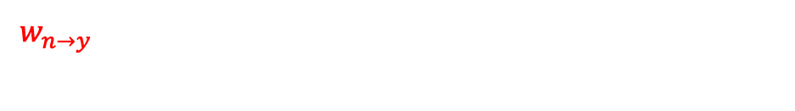






RNN is usually used to do the prediction for sequential data
Why RNN ?
There are two radar points obtained at $(t−1)$ and $(t)$, and we want to predict the radar point at $(t+1)$
$$x_{(t−1)}$$
If it is an ANN, there are 3 weights to be estimated
$$w_{1}$$
$$y$$
$$w_{3}$$
$$w_{1}$$
->
$w_{3}$
$$x_{(t)}$$
$$w_{2}$$
From the back propagation method
$$x_{(t−1)}$$
 | $$x_{(t)}$$
ANN
Pseudo output, usually not used in training
Training
If it is an CNN, there are also 3 weights to be estimated, but one more neuro to be added
$$y_{(t−1)}$$
$$y$$
$$y$$
$$w_{n→y}$$
$w_{n→y}$: the weights for connecting neuro (activation function) to output
$$w_{n→n}$$
$$w_{x→n}$$
$$w_{x→n}$$
$$x_{(t−1)}$$
$$x_{(t)}$$
$w_{x→n}$: the weights for connecting input and neuro
$w_{n→n}$: the weights for connecting neuro from previous timestep to the next
CNN

Slide 7





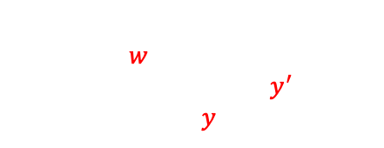

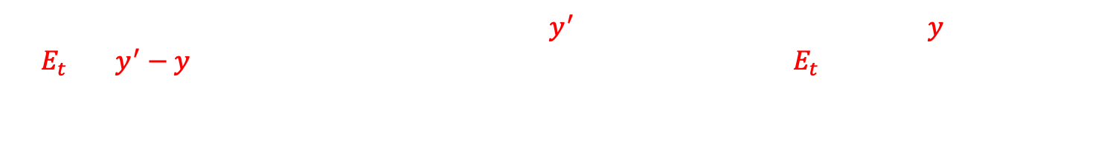
RNN is usually used to do the prediction for sequential data
How RNN can be trained ?
Purpose of training: finding a set of weights $w$ to minimize the error between the truth $y^{′}$ and the trained result $y$
$$y_{(t−1)}$$
$$y$$
$$w_{n→y}$$
$$w_{n→n}$$
During the training, we know the ground truth $y^{′}$, assuming the trained result is $y$, so the error is $E_{t}={\left(y^{′}−y\right)}^{2}$. The purpose of training is to obtain the minimum $E_{t}$, so by setting up the cost function as $\frac{{∂E}_{t}}{∂w }$, using a backpropagation method we are able to obtain all the weights.
$$w_{x→n}$$
$$w_{x→n}$$
$$x_{(t−1)}$$
$$x_{(t)}$$

Slide 8









RNN is usually used to do the prediction for sequential data
How RNN can be trained ? (how about we have more than one unfolded layers)
$$y_{(t−1)}$$
$$y$$
$$w_{n→y}$$
Note that in RNN, the weights are the same from different time steps (as the left figure shown)
$$w_{n→n}$$
$$w_{n→n}$$
* The left figure just shows an extremely simplified situation, in reality, we will have multiple neuros in multiple hidden layers
$$w_{x→n}$$
$$w_{x→n}$$
$$w_{x→n}$$
$$x_{(t−2)}$$
$$x_{(t−1)}$$
$$x_{(t)}$$

Slide 9







RNN is usually used to do the prediction for sequential data
How RNN do the prediction ?
$$(t−1)$$
The neuron value in a RNN is updated based on
The initial values for the neurons are [0, 0]
$${x_{t}}^{′}=c+f(w_{t}∙x_{t})$$
Updated neuron values
Therefore, for the neuro “A” the updated value of neuron is
(A)
(B)
?
?
0 + 0 + $f\left[{{(w}^{x→n})}^{1}∙1\right]+f\left[{{(w}^{x→n})}^{2}∙3\right]$
$$f$$
$$f$$
Contribution from 1st initial neuro
Contribution from 2nd initial neuro
Contribution from 1st input with the activation function
Contribution from the 2nd input with the activation function
$${{(w}^{x→n})}^{1}$$
$${{(w}^{x→n})}^{2}$$
1
3
We can update the neuro “B” the same way
inputs [1, 3]
If it is not the last time step, we don’t need to produce the output

Slide 10






RNN is usually used to do the prediction for sequential data
How RNN do the prediction ?
The neuron value in a RNN is updated based on
$$(t)$$
$${x_{t}}^{′}=c+f(w_{t}∙x_{t})$$
The updated neurons values are [?, ?]
?
Therefore, for the neuro “A” the updated value of neuron is
$${{(w}^{n→o})}^{1}$$
$${{(w}^{n→o})}^{2}$$
$X_{1}$= ? + ? + $f\left[{{(w}^{x→n})}^{1}∙2\right]+f\left[{{(w}^{x→n})}^{2}∙4\right]$
(A)
(B)
Contribution from the previous 1st neuro
Contribution from the previous 2nd initial neuro
Contribution from 1st input with the activation function
Contribution from the 2nd input with the activation function
$$f$$
$$f$$
$${{(w}^{x→n})}^{1}$$
$${{(w}^{x→n})}^{2}$$
2
4
We can update the neuro “B” the same way as $X_{2}$
inputs [2, 4]
So the final prediction would be
$$Y={{(w}^{n→o})}^{1}X_{1}+{{(w}^{n→o})}^{2}X_{2}$$
For the last timestep, we don’t need to update the neurons anymore

Slide 11




RNN is usually used to do the prediction for sequential data
How RNN do the prediction ?
In summary, after we obtained all the weights from the training, the prediction can be done as below:
$$(t−1)$$
$$(t)$$
Y
Updated neuron values
[0, 0]
(A)
(B)
?
?
(A)
(B)
$$f$$
$$f$$
$$f$$
$$f$$
1
3
2
4
inputs [1, 3]
inputs [2, 4]

Slide 12



RNN is usually used to do the prediction for sequential data
Of course, RNN can become deep, and can use many timesteps, e.g.,
$$(t−n)$$
$$(t−n+1)$$
$$(t)$$
Y
…
…
…
…
…
…
…
…
…
…
…
…
…
…
…
…

Slide 13
RNN is usually used to do the prediction for sequential data
Of course, RNN can be bidirectional, e.g.,
$$(t−n)$$
$$(t−n+1)$$
$$(t)$$
Y
…
…
…
…
…
…
…
…
…
…
…
…
…
…
…
…

