Slide 1
Gradient boost (classification)

Slide 2
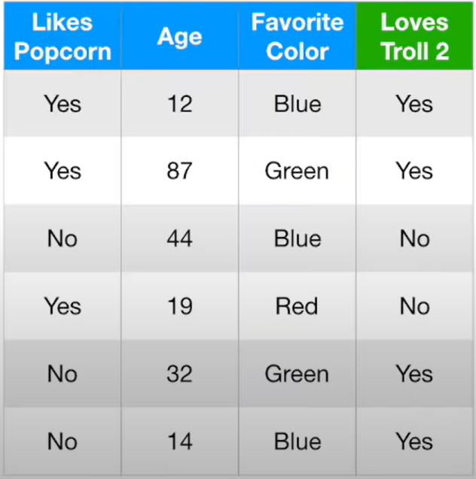
How gradient booting works
If we have the above dataset, and we want to predict if a person love to watch “Troll2” or not

Slide 3
How gradient booting works
Step 1: we start from a leaf (the “initial prediction” for all samples)

Slide 4
How gradient booting works
Step 1: we start from a leaf (the “initial prediction” for all samples)
In gradient boosting for classification, the original leaf is the “log(odds)” of “Yes”

Slide 5
How gradient booting works
Step 1: we start from a leaf (the “initial prediction” for all samples)
In gradient boosting for classification, the original leaf is the “log(odds)” of “Yes”
- 4 people in the dataset “Loves Trolls == True”

Slide 6
How gradient booting works
Step 1: we start from a leaf (the “initial prediction” for all samples)
In gradient boosting for classification, the original leaf is the “log(odds)” of “Yes”
- 4 people in the dataset “Loves Trolls == True”
- 2 people in the dataset “Loves Trolls == False”

Slide 7
How gradient booting works
Step 1: we start from a leaf (the “initial prediction” for all samples)
In gradient boosting for classification, the original leaf is the “log(odds)” of “Yes”
- 4 people in the dataset “Loves Trolls == True”
- 2 people in the dataset “Loves Trolls == False”
Then “log(odds)” is log(4/2) = 0.69

Slide 8
How gradient booting works
Step 1: we start from a leaf (the “initial prediction” for all samples)
In gradient boosting for classification, the original leaf is the “log(odds)”
- 4 people in the dataset “Loves Trolls == True”
- 2 people in the dataset “Loves Trolls == False”
Then “log(odds)” is log(4/2) = 0.69
So the first/original leaf is
Log(odds) = 0.69

Slide 9
How gradient booting works
Step 1: we start from a leaf (the “initial prediction” for all samples)
The first/original leaf is
Log(odds) = 0.69
Step 2: Create “probability” and use it to do the classification

Slide 10

How gradient booting works
Step 1: we start from a leaf (the “initial prediction” for all samples)
The first/original leaf is
Log(odds) = 0.69
Step 2: Create “probability” and use it to do the classification
The probability is estimated by the “Logistic Function”, which is
$${Probability}_{Yes}=\frac{e^{log⁡(odds)}}{1+e^{log⁡(odds)}}$$

Slide 11

How gradient booting works
Step 1: we start from a leaf (the “initial prediction” for all samples)
The first/original leaf is
Log(odds) = 0.69
Step 2: Create “probability” and use it to do the classification
The probability is estimated by the “Logistic Function”, which is
$${Probability}_{Yes}=\frac{e^{log⁡(odds)}}{1+e^{log⁡(odds)}}=\frac{e^{0.69}}{1+e^{0.69}}=0.67$$
So we got 0.67 as the probability of “loving Troll2” (or “Yes”)

Slide 12
How gradient booting works
Step 1: we start from a leaf (the “initial prediction” for all samples)
The first/original leaf is
Log(odds) = 0.69
Step 2: Create “probability” and use it to do the classification
The probability is estimated by the “Logistic Function”, which is
$${Probability}_{Yes}=\frac{e^{log⁡(odds)}}{1+e^{log⁡(odds)}}=\frac{e^{0.69}}{1+e^{0.69}}=0.67$$
So we got 0.67 as the probability of “loving Troll2” (or “Yes”)
Normally, the probability of “Yes” can be calculated as 4/6 = 0.67

Slide 13
How gradient booting works
The probability of “Yes” (initial guess)
Step 1: we start from a leaf (the “initial prediction” for all samples)
The first/original leaf is
Log(odds) = 0.69
Prob (Yes)
Step 2: Create “probability” and use it to do the classification
The probability is estimated by the “Logistic Function”, which is
$${Probability}_{Yes}=\frac{e^{log⁡(odds)}}{1+e^{log⁡(odds)}}=\frac{e^{0.69}}{1+e^{0.69}}=0.67$$
0.67
So we got 0.67 as the probability of “loving Troll2” (or “Yes”)

Slide 14
How gradient booting works
Step 1: we start from a leaf (the “initial prediction” for all samples)
The first/original leaf is
Log(odds) = 0.69
Step 2: Create “probability” and use it to do the classification
We got 0.67 as the predicted probability of “loving Troll2”
Step 3: calculate Residual

Slide 15
How gradient booting works
Step 1: we start from a leaf (the “initial prediction” for all samples)
The first/original leaf is
Log(odds) = 0.69
Step 2: Create “probability” and use it to do the classification
We got 0.67 as the predicted probability of “loving Troll2”
100%
Step 3: calculate Residual
For example for the first sample
People loves Troll2 from the observation, so the observation is 100%
And the predicted probability is 0.67 Therefore the residual is:
100% - 67% = 33%

Slide 16
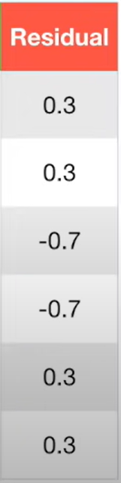
How gradient booting works
Step 1: we start from a leaf (the “initial prediction” for all samples)
The first/original leaf is
Log(odds) = 0.69
Step 2: Create “probability” and use it to do the classification
100% - 67% = 33%
We got 0.67 as the predicted probability of “loving Troll2”
Step 3: calculate Residual
For example for the first sample
People loves Troll2 from the observation, so the observation is 100%
And the predicted probability is 0.67 Therefore the residual is:
100% - 67% = 33%
By doing this over all samples, we can have the Residuals column as the left

Slide 17
How gradient booting works
Step 1: we start from a leaf (the “initial prediction” for all samples)
The first/original leaf is
Log(odds) = 0.69
Step 2: Create “probability” and use it to do the classification
100% - 67% = 33%
We got 0.67 as the predicted probability of “loving Troll2”
Step 3: calculate Residual
For example for the first sample
People loves Troll2 from the observation, so the observation is 100%
And the predicted probability is 0.67 Therefore the residual is:
100% - 67% = 33%
By doing this over all samples, we can have the Residuals column as the left
The purpose of gradient boosting is to grow trees that gives the smallest “Residuals”

Slide 18
How gradient booting works
Step 1: we start from a leaf (the “initial prediction” for all samples)
The first/original leaf is
Log(odds) = 0.69
Step 2: Create “probability” and use it to do the classification
We got 0.67 as the predicted probability of “loving Troll2”
Step 3: calculate Residual
Step 4: Build the first tree and predict the Residual

Slide 19
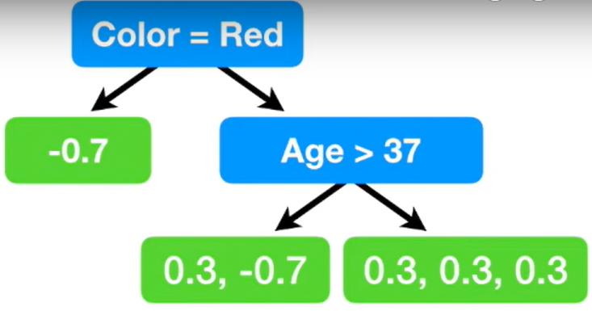
How gradient booting works
Step 1: we start from a leaf (the “initial prediction” for all samples)
The first/original leaf is
Log(odds) = 0.69
Step 2: Create “probability” and use it to do the classification
We got 0.67 as the predicted probability of “loving Troll2”
Step 3: calculate Residual
Step 4: Build the first tree and predict the Residual
Following the regular tree building process, we can have the tree as left

Slide 20
How gradient booting works
Step 1: we start from a leaf (the “initial prediction” for all samples)
The first/original leaf is
Log(odds) = 0.69
Step 2: Create “probability” and use it to do the classification
We got 0.67 as the predicted probability of “loving Troll2”
Step 3: calculate Residual
Step 4: Build the first tree and predict the Residual
Following the regular tree building process, we can have the tree as left
Step 5: Combine the tree and the first/original leaf to predict “log(odds)”

Slide 21
How gradient booting works
Step 1: we start from a leaf (the “initial prediction” for all samples)
The first/original leaf is
Log(odds) = 0.69
Step 2: Create “probability” and use it to do the classification
We got 0.67 as the predicted probability of “loving Troll2”
Step 3: calculate Residual
Step 4: Build the first tree and predict the Residual
Following the regular tree building process, we can have the tree as left
Step 5: Combine the tree and the first/original leaf to predict “log(odds)”
Let’s look at the example for the 2nd and 3rd sample, which go through the three like above

Slide 22

How gradient booting works
Step 1: we start from a leaf (the “initial prediction” for all samples)
The first/original leaf is
Log(odds) = 0.69
Step 2: Create “probability” and use it to do the classification
We got 0.67 as the predicted probability of “loving Troll2”
Step 3: calculate Residual
Step 4: Build the first tree and predict the Residual
Following the regular tree building process, we can have the tree as left
Step 5: Combine the tree and the first/original leaf to predict “log(odds)”
Let’s look at the example for the 2nd and 3rd sample, which go through the three like above
However, here the output for the tree is “Residual”, we need to convert it to “log(odds)”
The “log(odds)” is calculated based on:

Slide 23
How gradient booting works
Step 1: we start from a leaf (the “initial prediction” for all samples)
The first/original leaf is
Log(odds) = 0.69
Step 2: Create “probability” and use it to do the classification
We got 0.67 as the predicted probability of “loving Troll2”
Step 3: calculate Residual
Step 4: Build the first tree and predict the Residual
Following the regular tree building process, we can have the tree as left
Step 5: Combine the tree and the first/original leaf to predict “log(odds)”
Let’s look at the example for the 2nd and 3rd sample, which go through the three like above
0.3 + (-0.7)
The prediction is calculated based on:
0.67
1- 0.67

Slide 24
How gradient booting works
Step 1: we start from a leaf (the “initial prediction” for all samples)
The first/original leaf is
Log(odds) = 0.69
Step 2: Create “probability” and use it to do the classification
We got 0.67 as the predicted probability of “loving Troll2”
Step 3: calculate Residual
Step 4: Build the first tree and predict the Residual
Following the regular tree building process, we can have the tree as left
Step 5: Combine the tree and the first/original leaf to predict “log(odds)”
-1.0
Let’s look at the example for the 2nd and 3rd sample, which go through the three like above

Slide 25
How gradient booting works
Step 1: we start from a leaf (the “initial prediction” for all samples)
The first/original leaf is
Log(odds) = 0.69
Step 2: Create “probability” and use it to do the classification
We got 0.67 as the predicted probability of “loving Troll2”
Step 3: calculate Residual
Step 4: Build the first tree and predict the Residual
Step 5: Combine the tree and the first/original leaf to predict “log(odds)”
Similarly, we can postprocess the tree and get the log(odds) prediction as below
-3.3
-1.0
1.4

Slide 26
How gradient booting works
Step 1: we start from a leaf (the “initial prediction” for all samples)
The first/original leaf is
Log(odds) = 0.69
Step 2: Create “probability” and use it to do the classification
We got 0.67 as the predicted probability of “loving Troll2”
Step 3: calculate Residual
Step 4: Build the first tree and predict the Residual
Step 5: Combine the tree and the first/original leaf to predict “log(odds)”
+
Log(odds) = 0.69
0.8
Original leaf
Learning rate
-3.3
-1.0
1.4

Slide 27
How gradient booting works
Step 1: we start from a leaf (the “initial prediction” for all samples)
The first/original leaf is
Log(odds) = 0.69
Step 2: Create “probability” and use it to do the classification
We got 0.67 as the predicted probability of “loving Troll2”
Step 3: calculate Residual
Step 4: Build the first tree and predict the Residual
Step 5: Combine the tree and the first/original leaf to predict “log(odds)”
+
Log(odds) = 0.69
0.8
Original leaf
Learning rate
-3.3
-1.0
1.4
So for the first sample, we can have the predicted Log(odds) as 0.69 + 0.8 x 1.4 = 1.8

Slide 28
How gradient booting works
Step 1: we start from a leaf (the “initial prediction” for all samples)
The first/original leaf is
Log(odds) = 0.69
Step 2: Create “probability” and use it to do the classification
Log(odds) = 1.8
We got 0.67 as the predicted probability of “loving Troll2”
Step 3: calculate Residual
Step 4: Build the first tree and predict the Residuals
Step 5: Combine the tree and the first/original leaf to predict “log(odds)”
So for the first sample, we can have the predicted Log(odds) as 0.69 + 0.8 x 1.4 = 1.8

Slide 29
How gradient booting works
Step 1: we start from a leaf (the “initial prediction” for all samples)
The first/original leaf is
Log(odds) = 0.69
Step 2: Create “probability” and use it to do the classification
Log(odds) = 1.8
We got 0.67 as the predicted probability of “loving Troll2”
Step 3: calculate Residual
Step 4: Build the first tree and predict the Residuals
……
Step 5: Combine the tree and the first/original leaf to predict “log(odds)”
So for the first sample, we can have the predicted Log(odds) as 0.69 + 0.8 x 1.4 = 1.8
Following this, we can predict “log(odds)” for all other samples

Slide 30
How gradient booting works
Step 1: we start from a leaf (the “initial prediction” for all samples)
The first/original leaf is
Log(odds) = 0.69
Step 2: Create “probability” and use it to do the classification
Log(odds) = 1.8
We got 0.67 as the predicted probability of “loving Troll2”
Step 3: calculate Residual
Step 4: Build the first tree and predict the Residuals
……
Step 5: Combine the tree and the first/original leaf to predict “log(odds)”
So for the first sample, we can have the predicted Log(odds) as 0.69 + 0.8 x 1.4 = 1.8
Following this, we can predict “log(odds)” for all other samples
Step 6: Convert the predicted “log(odds)” to probability

Slide 31
How gradient booting works
Step 1: we start from a leaf (the “initial prediction” for all samples)
The first/original leaf is
Log(odds) = 0.69
Step 2: Create “probability” and use it to do the classification
Log(odds) = 1.8
P=0.9
We got 0.67 as the predicted probability of “loving Troll2”
Step 3: calculate Residual
Step 4: Build the first tree and predict the Residuals
……
Step 5: Combine the tree and the first/original leaf to predict “log(odds)”
So for the first sample, we can have the predicted Log(odds) as 0.69 + 0.8 x 1.4 = 1.8
Following this, we can predict “log(odds)” for all other samples
Step 6: Convert the predicted “log(odds)” to probability
For example, for the first sample,
We can convert log(odds) to probability as $\frac{e^{1.8}}{1+e^{1.8}}=0.9$

Slide 32
How gradient booting works
Step 1: we start from a leaf (the “initial prediction” for all samples)
First prediction
0.67
Update prediction 1
0.9
The first/original leaf is
Log(odds) = 0.69
Step 2: Create “probability” and use it to do the classification
We got 0.67 as the predicted probability of “loving Troll2”
Step 3: calculate Residual
Step 4: Build the first tree and predict the Residuals
Step 5: Combine the tree and the first/original leaf to predict “log(odds)”
Step 6: Convert the predicted “log(odds)” to probability
For example, for the first sample,
We can convert log(odds) to probability as $\frac{e^{1.8}}{1+e^{1.8}}=0.9$

Slide 33
How gradient booting works
Step 1: we start from a leaf (the “initial prediction” for all samples)
First prediction
0.67
Update prediction 1
0.9
The first/original leaf is
Log(odds) = 0.69
Step 2: Create “probability” and use it to do the classification
The updated prediction (0.9) is clearly better than the original one (0.67)
We got 0.67 as the predicted probability of “loving Troll2”
Step 3: calculate Residual
Step 4: Build the first tree and predict the Residuals
Step 5: Combine the tree and the first/original leaf to predict “log(odds)”
Step 6: Convert the predicted “log(odds)” to probability
For example, for the first sample,
We can convert log(odds) to probability as $\frac{e^{1.8}}{1+e^{1.8}}=0.9$

Slide 34
How gradient booting works
Step 1: we start from a leaf (the “initial prediction” for all samples)
First prediction
0.67
Update prediction 1
0.9
0.5
0.5
0.1
0.9
0.9
The first/original leaf is
Log(odds) = 0.69
Step 2: Create “probability” and use it to do the classification
We got 0.67 as the predicted probability of “loving Troll2”
Step 3: calculate Residual
Step 4: Build the first tree and predict the Residuals
Step 5: Combine the tree and the first/original leaf to predict “log(odds)”
Step 6: Convert the predicted “log(odds)” to probability
For example, for the first sample,
We can convert log(odds) to probability as $\frac{e^{1.8}}{1+e^{1.8}}=0.9$
We do these for all the samples, and can get the updated predictions for all of them

Slide 35
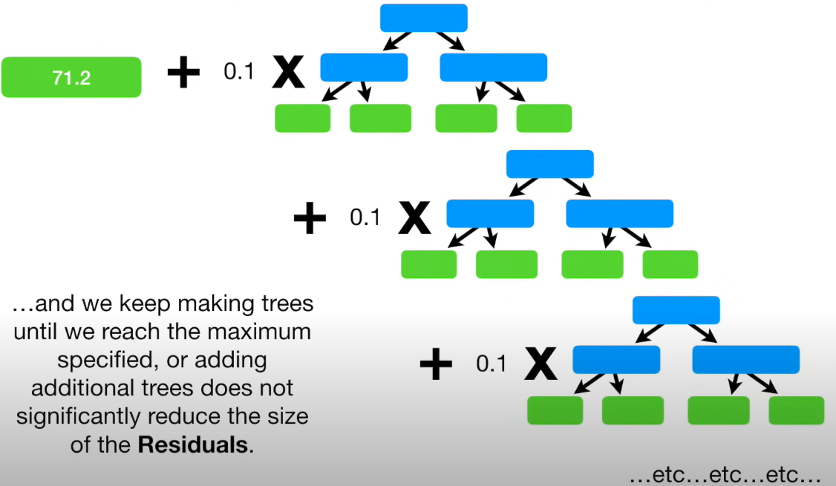
How gradient booting works
Step 1: we start from a leaf (the “initial prediction” for all samples)
First prediction
0.67
Update prediction 1
0.9
0.5
0.5
0.1
0.9
0.9
The first/original leaf is
Log(odds) = 0.69
Step 2: Create “probability” and use it to do the classification
We got 0.67 as the predicted probability of “loving Troll2”
Step 3: calculate Residual
Step 4: Build the first tree and predict the Residuals
Step 5: Combine the tree and the first/original leaf to predict “log(odds)”
Step 6: Convert the predicted “log(odds)” to probability
Step 7: We then repeat Step 3-6 with the updated predictions, until the calculated residuals do not change much
Log(odds) = 0.69

Slide 36
How gradient booting works
Step 1: we start from a leaf (the “initial prediction” for all samples)
First prediction
0.67
Update prediction 1
0.9
0.5
0.5
0.1
0.9
0.9
The first/original leaf is
Log(odds) = 0.69
Step 2: Create “probability” and use it to do the classification
We got 0.67 as the predicted probability of “loving Troll2”
Step 3: calculate Residual
Step 4: Build the first tree and predict the Residuals
Step 5: Combine the tree and the first/original leaf to predict “log(odds)”
Step 6: Convert the predicted “log(odds)” to probability
Step 7: We then repeat Step 3-6 with the updated predictions, until the calculated residuals do not change much
In prediction, we just need to use the test data to go through all the trees and add them up, the results are predicted Log(odds), which can be converted to probability and indicate the classified category
Log(odds) = 0.69

Slide 37
Create the original “log(odds)”
Summary
Obtain “log(odds)”
“log(odds)” => probability
Calculate Residuals
For example
Build a tree:
Input: Dependants
Output: “Residuals”
Covert Residuals in the tree to “log(odds)”. So for the tree:
Input: dependants
Output: “log(odds)”
Apply “learning rate” to the tree, and therefore update the tree output “log(odds)”
Calculate the “updated log(odds)” for all samples using the above tree
Covert “updated log(odds)” to “updated probability” for all samples

