Slide 1
Gradient boost (regression)

Slide 2
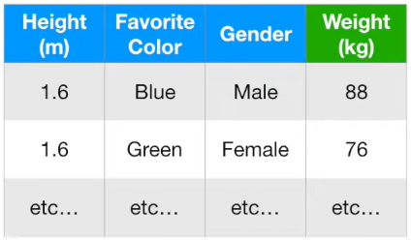
Difference between Adaboost and Gradient boost
Adaboost starts by building “stump” from the training data, and assign an initial weight
Calculate the error and the amount of say for the stump
Based on the error, update the weight and grow the next stump
If we want to use this data to predict weight
Each tree/stump will do a better job than the previous stump and we do this continuously until we get a satisfied result
Gradient starts by making a single “leaf” ~ which represents the initial guess for the weights for all the samples
Then gradient boost start growing tree (larger than the a stump but not a full tree, e.g., maximum leaf less than 4)
Calculate the error and the for this fixed size tree
Based on the error, update the next tree

Slide 3
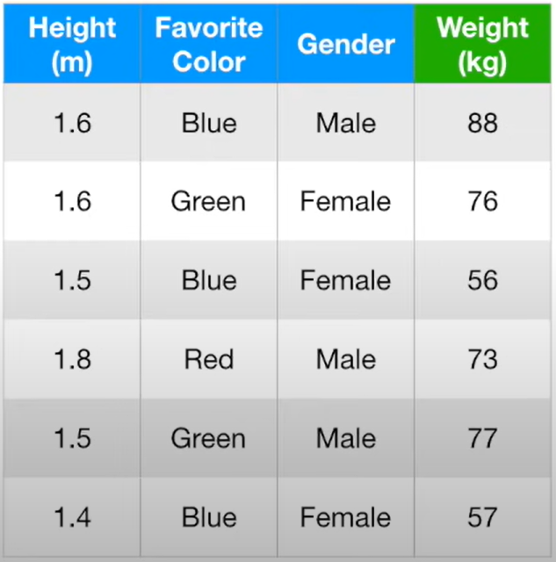
How gradient boost works
Assuming that if we have the above dataset

Slide 4
How gradient boost works
Step 1: calculate the original leaf
Assuming that if we have the above dataset

Slide 5
How gradient boost works
Step 1: calculate the original leaf
The first leave usually has the value of average of target variable (e.g., “weight” in this example), which is 71.2 in this example
71.2
Assuming that if we have the above dataset

Slide 6
How gradient boost works
Step 1: calculate the original leaf
First leaf
71.2
In other words, if we stop now, all the predictions (does not matter the input) will have the prediction of 71.2
Assuming that if we have the above dataset

Slide 7
How gradient boost works
Step 1: calculate the original leaf
First leaf
71.2
Step 2: Create error of original leaf or “pseudo residual”
Assuming that if we have the above dataset

Slide 8
How gradient boost works
Step 1: calculate the original leaf
First leaf
71.2
Step 2: Create error of original leaf or “pseudo residual”
The error is the of ”prediction - observation”:
The prediction is always 71.2
The observation from the training data is 88, 76, …, 57
Assuming that if we have the above dataset

Slide 9
How gradient boost works
Step 1: calculate the original leaf
First leaf
71.2
Step 2: Create error of original leaf or “pseudo residual”
The error is the of ”prediction - observation”:
The prediction is always 71.2
The observation from the training data is 88, 76, …, 57
Err = 88 - 71.2
Assuming that if we have the above dataset

Slide 10
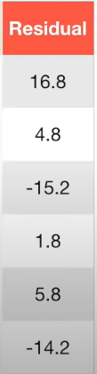
How gradient boost works
Step 1: calculate the original leaf
First leaf
71.2
88 - 71.2
Step 2: Create error of original leaf or “pseudo residual”
The error is the of ”prediction - observation”:
The prediction is always 71.2
The observation from the training data is 88, 76, …, 57
Each of the error can form a new column called “pseudo residual” or “residual”
Assuming that if we have the above dataset

Slide 11
How gradient boost works
Step 1: calculate the original leaf
First leaf
71.2
Step 2: Create error of original leaf or “pseudo residual”
The error is the of ”prediction - observation”:
The prediction is always 71.2
The observation from the training data is 88, 76, …, 57
Each of the error can form a new column called “pseudo residual” or “residual”
The purpose of Gradient boost is to produce a tree predicting the smallest “Residual”
Assuming that if we have the above dataset

Slide 12
How gradient boost works
Step 1: calculate the original leaf
First leaf
71.2
Step 2: Create error of original leaf or “pseudo residual”
The error is the of ”prediction - observation”:
The prediction is always 71.2
The observation from the training data is 88, 76, …, 57
Each of the error can form a new column called “pseudo residual” or “residual”
The purpose of Gradient boost is to produce a tree predicting the smallest “Residual”
Assuming that if we have the above dataset
Now we will create a tree using “Height”, “Color”, “Gender” to predict “Residual”

Slide 13
How gradient boost works
Step 1: calculate the original leaf
First leaf
71.2
Step 2: Create error of original leaf or “pseudo residual”
Step 3: Create a tree using “Height”, “Color”, “Gender” to predict “Residual”
Assuming that if we have the above dataset

Slide 14
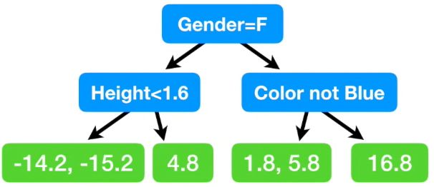
How gradient boost works
Step 1: calculate the original leaf
First leaf
71.2
Step 2: Create error of original leaf or “pseudo residual”
Step 3: Create a tree using “Height”, “Color”, “Gender” to predict “Residual”
Following the regular process of creating a decision tree (we only allow 4 leaves in this example), we can have the tree like:
Assuming that if we have the above dataset

Slide 15
How gradient boost works
Step 1: calculate the original leaf
First leaf
71.2
Step 2: Create error of original leaf or “pseudo residual”
Step 3: Create a tree using “Height”, “Color”, “Gender” to predict “Residual”
Following the regular process of creating a decision tree (we only allow 4 leaves in this example), we can have the tree like:
Assuming that if we have the above dataset
As a result, we get less leaves (4) than residuals (6)

Slide 16
How gradient boost works
Step 1: calculate the original leaf
First leaf
71.2
Step 2: Create error of original leaf or “pseudo residual”
Step 3: Create a tree using “Height”, “Color”, “Gender” to predict “Residual”
Following the regular process of creating a decision tree (we only allow 4 leaves in this example), we can have the tree like:
Assuming that if we have the above dataset
As a result, we get less leaves (4) than residuals (6)
For example, we have two samples end up at the same leaf

Slide 17
How gradient boost works
Step 1: calculate the original leaf
First leaf
71.2
Step 2: Create error of original leaf or “pseudo residual”
Step 3: Create a tree using “Height”, “Color”, “Gender” to predict “Residual”
Following the regular process of creating a decision tree (we only allow 4 leaves in this example), we can have the tree like:
Assuming that if we have the above dataset
As a result, we get less leaves (4) than residuals (6)
All we need to do is just to replace these residuals with the “mean”

Slide 18
How gradient boost works
Step 1: calculate the original leaf
First leaf
71.2
Step 2: Create error of original leaf or “pseudo residual”
Step 3: Create a tree using “Height”, “Color”, “Gender” to predict “Residual”
Following the regular process of creating a decision tree (we only allow 4 leaves in this example), we can have the tree like:
Assuming that if we have the above dataset
As a result, we get less leaves (4) than residuals (6)
All we need to do is just to replace these residuals with the mean
-14.7
3.8

Slide 19
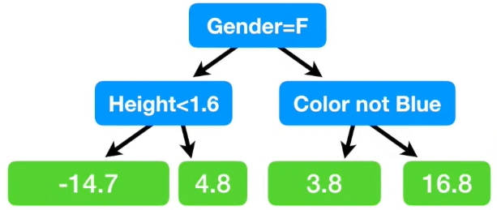
How gradient boost works
Step 1: calculate the original leaf
First leaf
71.2
Step 2: Create error of original leaf or “pseudo residual”
Step 3: Create a tree using “Height”, “Color”, “Gender” to predict “Residual”
Assuming that if we have the above dataset

Slide 20
How gradient boost works
Step 1: calculate the original leaf
First leaf
71.2
Step 2: Create error of original leaf or “pseudo residual”
Step 3: Create a tree using “Height”, “Color”, “Gender” to predict “Residual”
Assuming that if we have the above dataset
Step 4: combine the original leaf with the 1st tree
71.2
+

Slide 21
How gradient boost works
Step 1: calculate the original leaf
First leaf
71.2
Step 2: Create error of original leaf or “pseudo residual”
Step 3: Create a tree using “Height”, “Color”, “Gender” to predict “Residual”
Assuming that if we have the above dataset
Step 4: combine the original leaf with the 1st tree
+
= 71.2 + 16.8 = 88
71.2
Taking the first sample as an example, we can have the above prediction

Slide 22
How gradient boost works
Step 1: calculate the original leaf
First leaf
71.2
Step 2: Create error of original leaf or “pseudo residual”
Step 3: Create a tree using “Height”, “Color”, “Gender” to predict “Residual”
Assuming that if we have the above dataset
Step 4: combine the original leaf with the 1st tree
+
= 71.2 + 16.8 = 88
71.2
Taking the first sample as an example, we can have the above prediction
So the prediction is exactly the same to the actual value

Slide 23
How gradient boost works
Step 1: calculate the original leaf
First leaf
71.2
Step 2: Create error of original leaf or “pseudo residual”
Step 3: Create a tree using “Height”, “Color”, “Gender” to predict “Residual”
Assuming that if we have the above dataset
Step 4: combine the original leaf with the 1st tree
+
= 71.2 + 16.8 = 88
71.2
Taking the first sample as an example, we can have the above prediction
So the prediction is exactly the same to the actual value
This is not too good ~ the model fits too well usually means overfitting
(low bias but large variance)

Slide 24
How gradient boost works
Step 1: calculate the original leaf
First leaf
71.2
Step 2: Create error of original leaf or “pseudo residual”
Step 3: Create a tree using “Height”, “Color”, “Gender” to predict “Residual”
Assuming that if we have the above dataset
Step 4: combine the original leaf with the 1st tree
+
= 71.2 + 16.8 = 88
71.2
Taking the first sample as an example, we can have the above prediction
So the prediction is exactly the same to the actual value
Gradient Boost deals with this issue by introducing the concept of “learning rate”
This is not too good ~ the model fits too well usually means overfitting
(low bias but large variance)

Slide 25
How gradient boost works
Step 1: calculate the original leaf
First leaf
71.2
Step 2: Create error of original leaf or “pseudo residual”
Step 3: Create a tree using “Height”, “Color”, “Gender” to predict “Residual”
Assuming that if we have the above dataset
Step 4: combine the original leaf with the 1st tree
+
Learning rate
x
71.2
To scale the contribution from the tree (the rate is between 0 and 1)

Slide 26
How gradient boost works
Step 1: calculate the original leaf
First leaf
71.2
Step 2: Create error of original leaf or “pseudo residual”
Step 3: Create a tree using “Height”, “Color”, “Gender” to predict “Residual”
Assuming that if we have the above dataset
Step 4: combine the original leaf with the 1st tree
+
x
71.2
0.1
In this case, we assume the rate = 0.1

Slide 27
How gradient boost works
Step 1: calculate the original leaf
First leaf
71.2
Step 2: Create error of original leaf or “pseudo residual”
Step 3: Create a tree using “Height”, “Color”, “Gender” to predict “Residual”
Assuming that if we have the above dataset
Step 4: combine the original leaf with the 1st tree
+
x
= 71.2 + 0.1*16.8 = 72.9
71.2
0.1
In this case, we assume the rate = 0.1

Slide 28
How gradient boost works
Step 1: calculate the original leaf
First leaf
71.2
Step 2: Create error of original leaf or “pseudo residual”
Step 3: Create a tree using “Height”, “Color”, “Gender” to predict “Residual”
Assuming that if we have the above dataset
Step 4: combine the original leaf with the 1st tree
+
x
= 71.2 + 0.1*16.8 = 72.9
71.2
0.1
Compared to the actual data for the first sample, the prediction (72.9) is better than the original leaf (71.2)
In this case, we assume the rate = 0.1

Slide 29
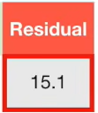
How gradient boost works
Step 1: calculate the original leaf
First leaf
71.2
Step 2: Create error of original leaf or “pseudo residual”
Step 3: Create a tree using “Height”, “Color”, “Gender” to predict “Residual”
Assuming that if we have the above dataset
Step 4: combine the original leaf with the 1st tree
+
x
= 72.9
71.2
0.1
The new residual will be:
88 – 72.9 = 15.1
In this case, we assume the rate = 0.1

Slide 30
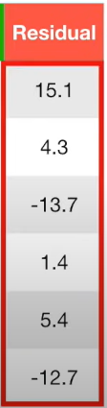
How gradient boost works
Step 1: calculate the original leaf
First leaf
71.2
Step 2: Create error of original leaf or “pseudo residual”
Step 3: Create a tree using “Height”, “Color”, “Gender” to predict “Residual”
Assuming that if we have the above dataset
Step 4: combine the original leaf with the 1st tree
We go through all the samples then we can get a new set of residuals

Slide 31
How gradient boost works
Step 1: calculate the original leaf
First leaf
71.2
Step 2: Create error of original leaf or “pseudo residual”
Step 3: Create a tree using “Height”, “Color”, “Gender” to predict “Residual”
Assuming that if we have the above dataset
Step 4: combine the original leaf with the 1st tree
We go through all the samples then we can get a new set of residuals
Apparently after the first tree, the residual/error is getting smaller ~ so we are making a small step towards the right direction

Slide 32
How gradient boost works
Step 1: calculate the original leaf
First leaf
71.2
Step 2: Create error of original leaf or “pseudo residual”
Step 3: Create a tree using “Height”, “Color”, “Gender” to predict “Residual”
Assuming that if we have the above dataset
Step 4: combine the original leaf with the 1st tree
Step 5: create a new tree with the new “Residual”

Slide 33
How gradient boost works
Step 1: calculate the original leaf
First leaf
71.2
Step 2: Create error of original leaf or “pseudo residual”
Step 3: Create a tree using “Height”, “Color”, “Gender” to predict “Residual”
Assuming that if we have the above dataset
Step 4: combine the original leaf with the 1st tree
Step 5: create a new tree with the new “Residual”
……

Slide 34
How gradient boost works
Step 1: calculate the original leaf
First leaf
71.2
Step 2: Create error of original leaf or “pseudo residual”
Step 3: Create a tree using “Height”, “Color”, “Gender” to predict “Residual”
Assuming that if we have the above dataset
Step 4: combine the original leaf with the 1st tree
Step 5: create a new tree with the new “Residual”
……
We do these again and again until the residual does not change much ….

Slide 35
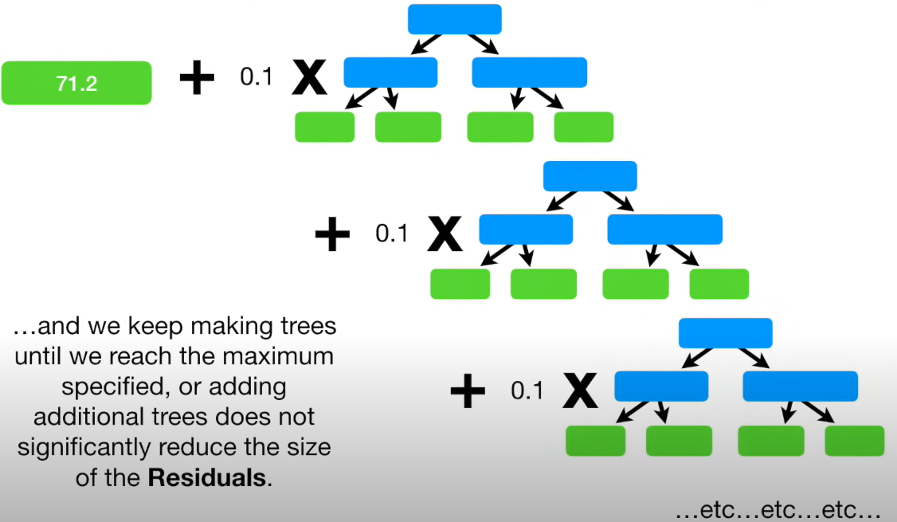
How gradient boost works
Step 1: calculate the original leaf
First leaf
71.2
Step 2: Create error of original leaf or “pseudo residual”
Step 3: Create a tree using “Height”, “Color”, “Gender” to predict “Residual”
Assuming that if we have the above dataset
Step 4: combine the original leaf with the 1st tree
Step 5: create a new tree with the new “Residual”
……
We do these again and again until the residual does not change much ….

Slide 36
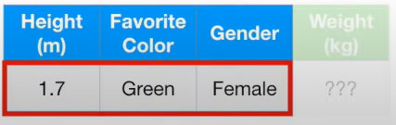
How gradient boost works
After we get the test dataset, we can just walk through the original leaf + trained scaled trees, and get the prediction, e.g.,
71.2 + 0.1xTree1 + 0.1xTree2 + …

