Slide 1
Regularization

Slide 2
Let’s use Linear regression as an example
Let’s start by collecting Weight and Size measurements from a bunch of mice …
Size
Weight

Slide 3
Let’s use Linear regression as an example
Let’s start by collecting Weight and Size measurements from a bunch of mice …
Size
Weight
We can use Linear regression to model the relationship between weight and size

Slide 4
Let’s use Linear regression as an example
Let’s start by collecting Weight and Size measurements from a bunch of mice …
In other words, we find the line that results in the minimum sum of squared residuals
Size
Weight
We can use Linear regression to model the relationship between weight and size

Slide 5
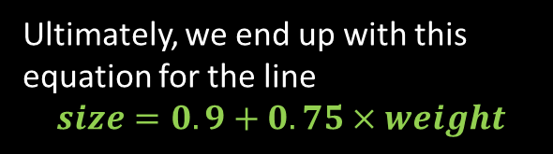
Let’s use Linear regression as an example
Let’s start by collecting Weight and Size measurements from a bunch of mice …
In other words, we find the line that results in the minimum sum of squared residuals
Size
Ultimately, we end up with this equation for the line
$$size=0.9+0.75×weight$$
Weight
We can use Linear regression to model the relationship between weight and size

Slide 6
Let’s use Linear regression as an example
Let’s start by collecting Weight and Size measurements from a bunch of mice …
In other words, we find the line that results in the minimum sum of squared residuals
Size
Ultimately, we end up with this equation for the line
$$size=0.9+0.75×weight$$
Weight
Y-axis intercept
slop
We can use Linear regression to model the relationship between weight and size
The equation has two parameters

Slide 7
Let’s use Linear regression as an example
Let’s start by collecting Weight and Size measurements from a bunch of mice …
In other words, we find the line that results in the minimum sum of squared residuals
When we have many measurements, we can be fairly confident that the linear regression line accurately reflects the relationship between size and weight
Size
Ultimately, we end up with this equation for the line
$$size=0.9+0.75×weight$$
Weight
Y-axis intercept
slop
We can use Linear regression to model the relationship between weight and size
The equation has two parameters

Slide 8
Let’s use Linear regression as an example
However, what if we have very limited measurements, for example, if only two measurements (selected from the original dataset)
Size
Weight

Slide 9
Let’s use Linear regression as an example
However, what if we have very limited measurements, for example, if only two measurements (selected from the original dataset)
Size
Weight
We fit a new line with linear regression
This line overlaps the two data points, the minimum sum of squared residuals = 0

Slide 10
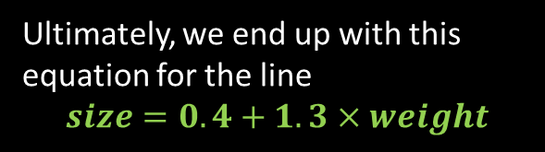
Let’s use Linear regression as an example
However, what if we have very limited measurements, for example, if only two measurements (selected from the original dataset)
Ultimately, we end up with this equation for the line
$$size=0.4+1.3×weight$$
Size
Weight
We fit a new line with linear regression
This line overlaps the two data points, the minimum sum of squared residuals = 0

Slide 11
Let’s use Linear regression as an example
However, what if we have very limited measurements, for example, if only two measurements (selected from the original dataset)
training data
Ultimately, we end up with this equation for the line
$$size=0.4+1.3×weight$$
Size
testing data
Weight
We fit a new line with linear regression
This line overlaps the two data points, the minimum sum of squared residuals = 0

Slide 12
Let’s use Linear regression as an example
However, what if we have very limited measurements, for example, if only two measurements (selected from the original dataset)
training data
Ultimately, we end up with this equation for the line
$$size=0.4+1.3×weight$$
Size
testing data
The residuals for the training data site is prefect (in this case it’s 0)
However the residuals for the testing data is huge
Weight
We fit a new line with linear regression
This line overlaps the two data points, the minimum sum of squared residuals = 0
This means that the results have (1) low bias, but (2) high variance

Slide 13
Let’s use Linear regression as an example
However, what if we have very limited measurements, for example, if only two measurements (selected from the original dataset)
training data
Ultimately, we end up with this equation for the line
$$size=0.4+1.3×weight$$
Size
testing data
The residuals for the training data site is prefect (in this case it’s 0)
However the residuals for the testing data is huge
Weight
We fit a new line with linear regression
This line overlaps the two data points, the minimum sum of squared residuals = 0
This means that the results have (1) low bias, but (2) high variance
The regression is over fit the training data

Slide 14
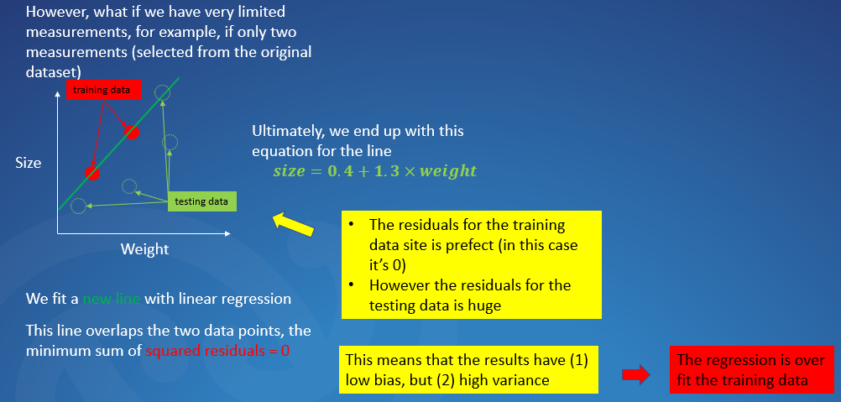
Let’s use Linear regression as an example
The main idea behind Ridge regularization is to find a new line that does not fit the training data so we

Slide 15
Let’s use Linear regression as an example
The main idea behind Ridge regularization is to find a new line that does not fit the training data so we
Regression without regularization
For example:
Regression with regularization
Size
Weight
In other words, we introduce a bit “bias” to the fitted line, but in return we get a significant drop in “variance”

Slide 16
Let’s use Linear regression as an example
Ridge regularization step-by-step
Let’s go back to just the training data (two red dots)
When linear regression applied, we need to determine values for the following two parameters in this equation (intercept and slop)
Size
$$size=intercept+slop×weight$$
Weight

Slide 17
Let’s use Linear regression as an example
Ridge regularization step-by-step
Let’s go back to just the training data (two red dots)
When linear regression applied, we need to determine values for the following two parameters in this equation (intercept and slop)
Size
$$size=intercept+slop×weight$$
Without regularization, the cost function minimizes “the sum of the squared residuals”
Weight

Slide 18
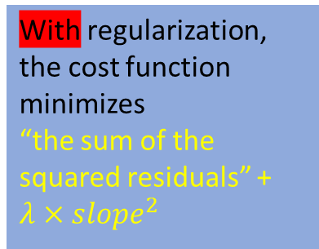
Let’s use Linear regression as an example
Ridge regularization step-by-step
Let’s go back to just the training data (two red dots)
When linear regression applied, we need to determine values for the following two parameters in this equation (intercept and slop)
Size
$$size=intercept+slop×weight$$
Without regularization, the cost function minimizes “the sum of the squared residuals”
With regularization, the cost function minimizes
“the sum of the squared residuals” + $λ×{slope}^{2}$
Weight

Slide 19
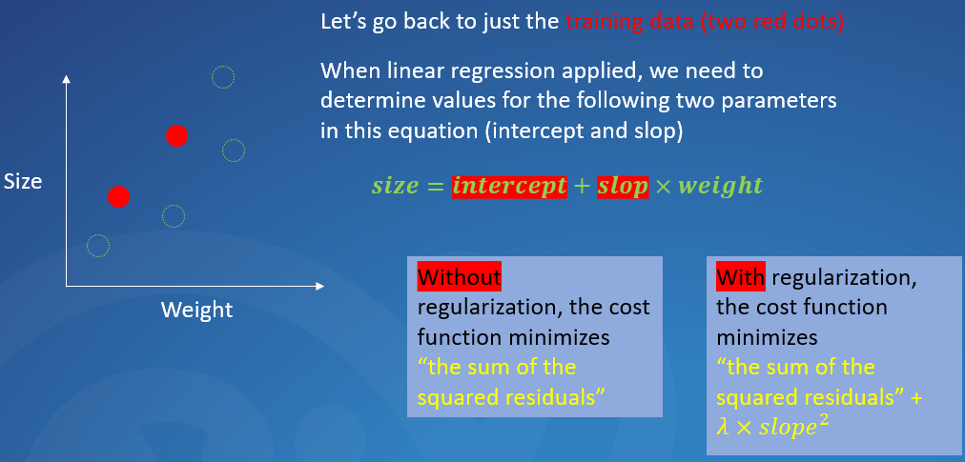

Let’s use Linear regression as an example
Ridge regularization step-by-step
Assuming that the regression equation to calculate the size is
$$size=0.4+1.3×weight$$

Slide 20
Let’s use Linear regression as an example
Ridge regularization step-by-step
The line overlap the data points
Assuming that the regression equation to calculate the size is
The sum of the squared residuals=0
$$size=0.4+1.3×weight$$

Slide 21

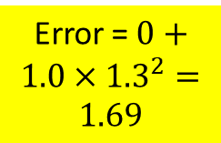
Let’s use Linear regression as an example
Ridge regularization step-by-step
The line overlap the data points
Assuming that the regression equation to calculate the size is
Error = The sum of the squared residuals=0
Error = $0+1.0×{1.3}^{2}=1.69$
$$size=0.4+1.3×weight$$
Assuming $λ=1.0$

Slide 22

Let’s use Linear regression as an example
Ridge regularization step-by-step
In the left example, we use $λ=1.0$. But how $λ$ would affect the results ?
The line overlap the data points
Assuming that the regression equation to calculate the size is
Error = The sum of the squared residuals=0
Error = $0+1.0×{1.3}^{2}=1.69$
$$size=0.4+1.3×weight$$
Assuming $λ=1.0$

Slide 23

Let’s use Linear regression as an example
Ridge regularization step-by-step
In the left example, we use $λ=1.0$. But how $λ$ would affect the results ?
Size
Weight
The line overlap the data points
When $λ=0.0$, the error is the same to the one without any regularization
Assuming that the regression equation to calculate the size is
Error = The sum of the squared residuals=0
Error = $0+1.0×{1.3}^{2}=1.69$
$$size=0.4+1.3×weight$$
Assuming $λ=1.0$

Slide 24

Let’s use Linear regression as an example
Ridge regularization step-by-step
In the left example, we use $λ=1.0$. But how $λ$ would affect the results ?
Size
Size
Weight
Weight
The line overlap the data points
When $λ=0.0$, the error is the same to the one without any regularization
When $λ=1.0$, the fitted line will be less steep
Assuming that the regression equation to calculate the size is
Error = The sum of the squared residuals=0
Error = $0+1.0×{1.3}^{2}=1.69$
$$size=0.4+1.3×weight$$
Assuming $λ=1.0$

Slide 25

Let’s use Linear regression as an example
Ridge regularization step-by-step
In the left example, we use $λ=1.0$. But how $λ$ would affect the results ?
Size
Size
……
Size
Weight
Weight
Weight
The line overlap the data points
When $λ=0.0$, the error is the same to the one without any regularization
When $λ=1.0$, the fitted line will be less steep
When we keep increasing $λ=10000+$, the fitted line will be less and less steep …
Assuming that the regression equation to calculate the size is
Error = The sum of the squared residuals=0
Error = $0+1.0×{1.3}^{2}=1.69$
$$size=0.4+1.3×weight$$
Assuming $λ=1.0$

Slide 26
Let’s use Linear regression as an example
Ridge regularization step-by-step
In the left example, we use $λ=1.0$. But how $λ$ would affect the results ?
Size
Size
……
Size
Weight
Weight
Weight
The line overlap the data points
When $λ=0.0$, the error is the same to the one without any regularization
When $λ=1.0$, the fitted line will be less steep
When we keep increasing $λ=10000+$, the fitted line will be less and less steep …
Assuming that the regression equation to calculate the size is
Error = The sum of the squared residuals=0
Error = $0+1.0×{1.3}^{2}=1.69$
This means that the prediction (“size”) is getting less dependant on the dependencies (e.g., “weight”)
$$size=0.4+1.3×weight$$
For example:
Assuming $λ=1.0$
For a less steep line: 1 unit of “weight” change will lead to less than 1 unit of “size” change
Size
1 unit of “weight” change will lead to 1 unit of “size” change
Size
Weight
Weight

Slide 27

Let’s use Linear regression as an example
Ridge regularization step-by-step
So what we do in practical is that
We try a bunch of $λ$ value, and
then create corresponding fitted lines (regression equations)
then compare them (through cross validation) and
get the best one
The line overlap the data points
Assuming that the regression equation to calculate the size is
Error = The sum of the squared residuals=0
Error = $0+1.0×{1.3}^{2}=1.69$
$$size=0.4+1.3×weight$$
Assuming $λ=1.0$

Slide 28
Let’s use Linear regression as an example
Ridge regularization step-by-step
So what we do in practical is that
We try a bunch of $λ$ value, and
then create corresponding fitted lines (regression equations)
then compare them (through cross validation) and
get the best one
The line overlap the data points
Regularization uses a new error to make the prediction being less dependant on the dependants (“shrinking dependants”), and therefore reducing the impact of “overfitting”
Assuming that the regression equation to calculate the size is
Error = The sum of the squared residuals=0
Error = $0+1.0×{1.3}^{2}=1.69$
$$size=0.4+1.3×weight$$
Assuming $λ=1.0$

Slide 29
Let’s use Linear regression as an example
There are other regularization approach, e.g., Lasso regularization

Slide 30
Let’s use Linear regression as an example
There are other regularization approach, e.g., Lasso regularization
For Ridge regularization, the error is
“the sum of the squared residuals” + $λ×{slope}^{2}$

Slide 31
Let’s use Linear regression as an example
There are other regularization approach, e.g., Lasso regularization
For Ridge regularization, the error is
“the sum of the squared residuals” + $λ×{slope}^{2}$
For Lasso regularization, the error is
“the sum of the squared residuals” + $λ×|slope|$

Slide 32
Let’s use Linear regression as an example
There are other regularization approach, e.g., Lasso regularization
For Ridge regularization, the error is
“the sum of the squared residuals” + $λ×{slope}^{2}$
For Lasso regularization, the error is
“the sum of the squared residuals” + $λ×|slope|$
The big difference here is that
For Ridge regularization
Size
If weight is totally irrelevant to size, then the fitted line is very close to flat (but not completely flat)
Weight

Slide 33
Let’s use Linear regression as an example
There are other regularization approach, e.g., Lasso regularization
For Ridge regularization, the error is
“the sum of the squared residuals” + $λ×{slope}^{2}$
For Lasso regularization, the error is
“the sum of the squared residuals” + $λ×|slope|$
The big difference here is that
For Ridge regularization
For Lasso regularization
Size
Size
If weight is totally irrelevant to size, then the fitted line is very close to flat (but not completely flat)
If weight is totally irrelevant to size, then the fitted line is completely flat
Weight
Weight

Slide 34
Let’s use Linear regression as an example
There are other regularization approach, e.g., Lasso regularization
For Ridge regularization, the error is
“the sum of the squared residuals” + $λ×{slope}^{2}$
For Lasso regularization, the error is
“the sum of the squared residuals” + $λ×|slope|$
The big difference here is that
For Ridge regularization
For Lasso regularization
This means that Lasso regularization is better at removing irrelevant dependants than Ridge regularization
Size
Size
If weight is totally irrelevant to size, then the fitted line is very close to flat (but not completely flat)
If weight is totally irrelevant to size, then the fitted line is completely flat
Weight
Weight

