Slide 1
Random Forest
how to evaluate RF

Slide 2
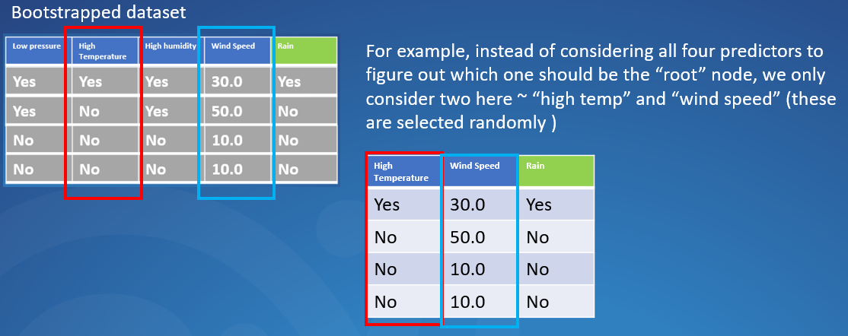
So how can we know if RF is good
When we create the bootstrapped dataset, some original data are not included in the bootstrapped dataset
For example, if this sample is not included in the bootstrapped dataset

Slide 3
So how can we know if RF is good
When we create the bootstrapped dataset, some original data are not included in the bootstrapped dataset
For example, if this sample is not included in the bootstrapped dataset
Those “missed” dataset is called “out-of-bag” dataset
When the sample size is big, there might be many “out-of-bag” dataset

Slide 4
So how can we know if RF is good
When we create the bootstrapped dataset, some original data are not included in the bootstrapped dataset
For example, if this sample is not included in the bootstrapped dataset
Those “missed” dataset is called “out-of-bag” dataset
When the sample size is big, there might be many “out-of-bag” dataset
Since the “out-of-bag” dataset is not used to create the tree, we can use it to test the tree and see if the tree gets the right prediction

Slide 5
So how can we know if RF is good
When we create the bootstrapped dataset, some original data are not included in the bootstrapped dataset
For example, if this sample is not included in the bootstrapped dataset
Those “missed” dataset is called “out-of-bag” dataset
When the sample size is big, there might be many “out-of-bag” dataset
Since the “out-of-bag” dataset is not used to create the tree, we can use it to test the tree and see if the tree gets the right prediction
We can search all the trees without this dataset, and get all the predictions

Slide 6
So how can we know if RF is good
When we create the bootstrapped dataset, some original data are not included in the bootstrapped dataset
For example, if this sample is not included in the bootstrapped dataset
Those “missed” dataset is called “out-of-bag” dataset
The out-of-bag dataset will give us the prediction “YES”, which does not match the dataset observation “NO”
When the sample size is big, there might be many “out-of-bag” dataset
Since the “out-of-bag” dataset is not used to create the tree, we can use it to test the tree and see if the tree gets the right prediction
We can search all the trees without this dataset, and get all the predictions
Rain: YES | Rain: NO
11 | 7

Slide 7
So how can we know if RF is good
When we create the bootstrapped dataset, some original data are not included in the bootstrapped dataset
For example, if this sample is not included in the bootstrapped dataset
We repeat this process for all “out-of-bag” samples for all the trees
Those “missed” dataset is called “out-of-bag” dataset
The out-of-bag dataset will give us the prediction “YES”, which does not match the dataset observation “NO”
When the sample size is big, there might be many “out-of-bag” dataset
Since the “out-of-bag” dataset is not used to create the tree, we can use it to test the tree and see if the tree gets the right prediction
We can search all the trees without this dataset, and get all the predictions
Rain: YES | Rain: NO
11 | 7

Slide 8
So how can we know if RF is good
When we create the bootstrapped dataset, some original data are not included in the bootstrapped dataset
Ultimately, we can measure how accurate the RF is based on the proportion of how many “out-of-bag” dataset gets the correct prediction
For example, if this sample is not included in the bootstrapped dataset
We repeat this process for all “out-of-bag” samples for all the trees
Those “missed” dataset is called “out-of-bag” dataset
The out-of-bag dataset will give us the prediction “YES”, which does not match the dataset observation “NO”
When the sample size is big, there might be many “out-of-bag” dataset
Since the “out-of-bag” dataset is not used to create the tree, we can use it to test the tree and see if the tree gets the right prediction
We can search all the trees without this dataset, and get all the predictions
Rain: YES | Rain: NO
11 | 7

