Slide 1
Decision Tree
Random forest: how to optimize RF

Slide 2
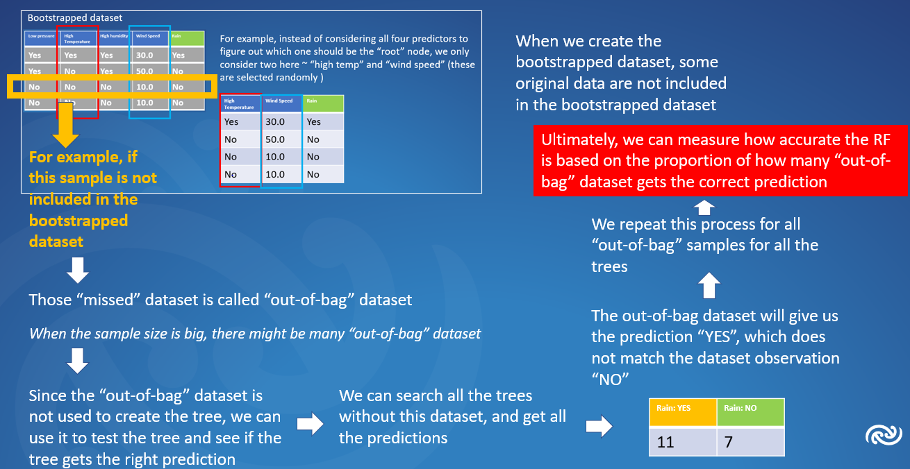
So how can we optimize RF
Now we know how measure the accuracy of RF

Slide 3
So how can we optimize RF
Now we know how measure the accuracy of RF
So we can change how to create the bootstrapped data every time, and create many different types of trees

Slide 4
So how can we optimize RF
Now we know how measure the accuracy of RF
So we can change how to create the bootstrapped data every time, and create many different types of trees
By comparing all those different types of trees, we can come up the best random forest model

