Slide 1
Feature importance – Gini based method
Sijin Zhang

Slide 2
Impurity based feature importance
Future 1
Future 2
Future 3
Target
……
Assuming that we have a bunch of samples, and through Bagging we created many decision trees

Slide 3
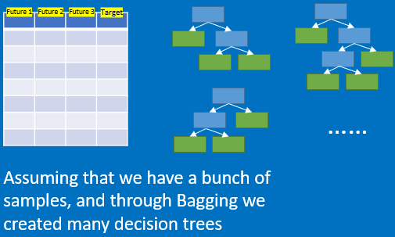
Impurity based feature importance
Usually the importance is estimated as below:
For each feature
For each tree
Compute impurity decrease
Weighted by number of samples at node
Averaged over all trees
Normalize the results if needed

Slide 4
Impurity based feature importance
For example, we have 3 features in this example, let’s look at feature 1, “F1”
Usually the importance is estimated as below:
For each feature
For each tree
Compute impurity decrease
Weighted by number of samples at node
Averaged over all trees
Normalize the results if needed

Slide 5
Impurity based feature importance
Usually the importance is estimated as below:
For each feature
F1
Let’s look at the first tree
For each tree
Compute impurity decrease
Weighted by number of samples at node
Averaged over all trees
Normalize the results if needed

Slide 6

Impurity based feature importance
Usually the importance is estimated as below:
For each feature
F1
For each tree
Compute impurity decrease
Weighted by number of samples at node
Averaged over all trees
Normalize the results if needed

Slide 7
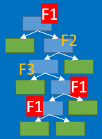
Impurity based feature importance
Usually the importance is estimated as below:
For each feature
F1
Assuming we have 5 levels of tree, and 3 “F1” features are included.
For each tree
Compute impurity decrease
Weighted by number of samples at node
Averaged over all trees
Normalize the results if needed

Slide 8
Impurity based feature importance
Usually the importance is estimated as below:
For each feature
F1
0.75
Assuming we have the “Gini” values as left …
For each tree
Compute impurity decrease
0.45
0.10
Weighted by number of samples at node
Averaged over all trees
Normalize the results if needed

Slide 9
Impurity based feature importance
Usually the importance is estimated as below:
F1
0.75
20
Assuming that in total we have 20 samples, and the samples that each node has is shown left
For each feature
3
17
For each tree
16
1
Compute impurity decrease
4
0.45
12
10
0.10
2
7
3
Weighted by number of samples at node
Averaged over all trees
Normalize the results if needed

Slide 10

Impurity based feature importance
Usually the importance is estimated as below:
F1
0.75
20
The impotence for F1 can be calculated as
For each feature
3
17
For each tree
16
1
$$I=\sum{P△Gini}$$
Compute impurity decrease
4
0.45
12
10
0.10
2
weight
Gini decrease
7
3
Weighted by number of samples at node
Averaged over all trees
Normalize the results if needed

Slide 11
Impurity based feature importance
Usually the importance is estimated as below:
F1
0.75
20
The impotence for F1 can be calculated as
For each feature
3
17
For each tree
16
1
$$I=\sum{P△Gini}$$
Compute impurity decrease
4
0.45
12
10
0.10
2
weight
Gini decrease
7
3
Weighted by number of samples at node
Step 1: calculate the percentage of samples for each level
Averaged over all trees
Normalize the results if needed

Slide 12
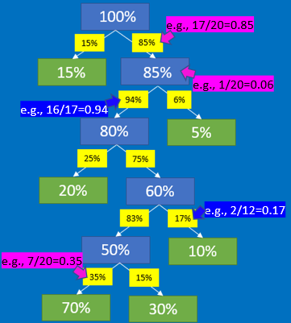
Impurity based feature importance
Usually the importance is estimated as below:
F1
0.75
20
The impotence for F1 can be calculated as
For each feature
3
17
For each tree
16
1
$$I=\sum{P△Gini}$$
Compute impurity decrease
4
0.45
12
10
0.10
2
weight
Gini decrease
7
3
Weighted by number of samples at node
Step 1: calculate the
level dependant percentage of samples, and
total percentage of samples
Averaged over all trees
Normalize the results if needed
We have 3 “F1” feature appear in the tree

Slide 13

Impurity based feature importance
Usually the importance is estimated as below:
F1
0.75
20
The impotence for F1 can be calculated as
For each feature
0.1
17
For each tree
3
0.5
16
1
$$I=\sum{P△Gini}$$
Compute impurity decrease
4
0.45
12
10
0.10
2
weight
Gini decrease
7
3
Weighted by number of samples at node
Step 1: calculate the
level dependant percentage of samples, and
total percentage of samples
We can calculate $△Gini$ as
Averaged over all trees
$${△Gini}_{1}=0.75−\left(0.85×0.5+0.15×0.1\right)=0.31$$
Normalize the results if needed
We have 3 “F1” feature appear in the tree
Node Gini
Next node Gini
Next leaf Gini
Total percentage of samples
Total percentage of samples

Slide 14


Impurity based feature importance
Usually the importance is estimated as below:
F1
0.75
20
The impotence for F1 can be calculated as
For each feature
0.1
17
For each tree
3
0.5
16
1
$$I=\sum{P△Gini}$$
Compute impurity decrease
4
0.45
12
10
0.10
2
weight
Gini decrease
7
3
Weighted by number of samples at node
Step 1: calculate the
level dependant percentage of samples, and
total percentage of samples
We can calculate $△Gini$ as
Averaged over all trees
$${△Gini}_{1}=0.75−\left(0.85×0.5+0.15×0.1\right)=0.31$$
The more impurity decrease, the more important the feature is
We have 3 “F1” feature appear in the tree
Node Gini
Next node Gini
Next leaf Gini
Total percentage of samples
Total percentage of samples
$${△Gini}_{2}=0.25$$
$${△Gini}_{3}=0.1$$

Slide 15
Impurity based feature importance
Usually the importance is estimated as below:
F1
0.75
20
The impotence for F1 can be calculated as
For each feature
0.1
17
For each tree
3
0.5
16
1
$$I=\sum{P△Gini}$$
Compute impurity decrease
4
0.45
12
10
0.10
2
weight
Gini decrease
7
3
Weighted by number of samples at node
Step 1: calculate the
level dependant percentage of samples, and
total percentage of samples
Level dependant percentage of samples
We can calculate $△Gini$ as
Averaged over all trees
100%
$${△Gini}_{1}=0.75−\left(0.85×0.5+0.15×0.1\right)=0.31$$
Normalize the results if needed
We have 3 “F1” feature appear in the tree
Node Gini
Next node Gini
Next leaf Gini
Total percentage of samples
Total percentage of samples
60%
$${△Gini}_{2}=0.25$$
50%
$${△Gini}_{3}=0.1$$

Slide 16
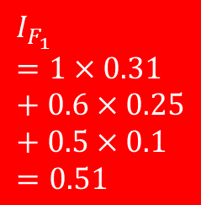
Impurity based feature importance
Usually the importance is estimated as below:
F1
0.75
20
The impotence for F1 can be calculated as
For each feature
0.1
17
For each tree
3
0.5
16
1
$$I=\sum{P△Gini}$$
Compute impurity decrease
4
0.45
12
10
0.10
2
weight
Gini decrease
7
3
Weighted by number of samples at node
Step 1: calculate the
level dependant percentage of samples, and
total percentage of samples
We can calculate $△Gini$ as
Averaged over all trees
100%
$${△Gini}_{1}=0.75−\left(0.85×0.5+0.15×0.1\right)=0.31$$
Normalize the results if needed
We have 3 “F1” feature appear in the tree
Node Gini
Next node Gini
Next leaf Gini
Total percentage of samples
Total percentage of samples
$$I_{F_{1}}=1×0.31+0.6×0.25+0.5×0.1=0.51$$
60%
$${△Gini}_{2}=0.25$$
50%
$${△Gini}_{3}=0.1$$
The importance for F1

Slide 17
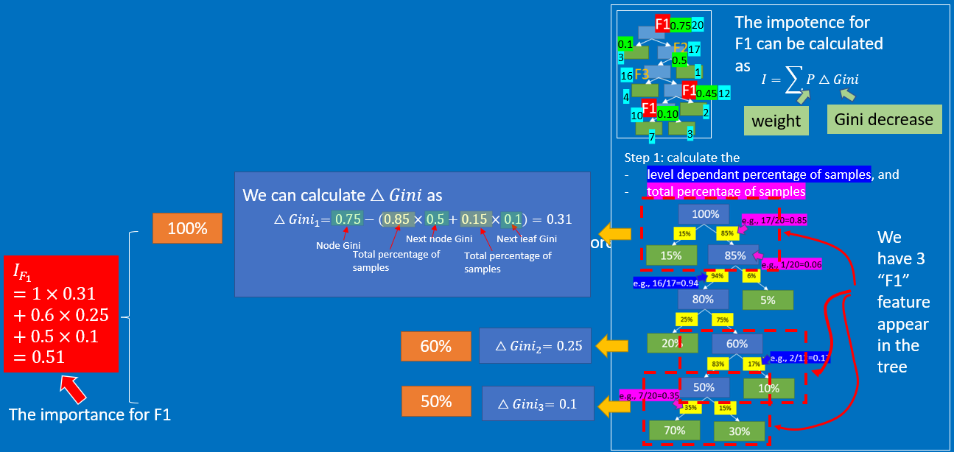
Impurity based feature importance
Usually the importance is estimated as below:
For each feature
F1
For each tree
Compute impurity decrease
Weighted by number of samples at node
Averaged over all trees
We go through all the trees with the last step, and average the results
Normalize the results if needed
We through all the features for the above process, and normalize the results.
For example, we can divide the averaged results by the number of trees being used …
The high the value, the more important that the feature is

Slide 18
Impurity based feature importance
Usually the importance is estimated as below:
For each feature
F1
For each tree
Compute impurity decrease
Weighted by number of samples at node
Averaged over all trees
We go through all the trees with the last step, and average the results
Normalize the results if needed
We through all the features for the above process, and normalize the results.
For example, we can divide the averaged results by the number of trees being used …
Eventually, the higher the value, the more important the feature is

