Slide 1
Permutation importance
Sijin Zhang

Slide 2
Assuming that we have the above dataset, with 3 features and 1 target

Slide 3
Step 1: use the training dataset to fit a model
Assuming that we have the above dataset, with 3 features and 1 target

Slide 4
Step 1: use the training dataset to fit a model
Step 2: use test data to evaluate the trained model’s performance (e.g., we can use ACC or something else)
0.9
accuracy = 0.9
Assuming that we have the above dataset, with 3 features and 1 target

Slide 5
Step 1: use the training dataset to fit a model
Step 2: use test data to evaluate the trained model’s performance (e.g., we can use ACC or something else)
0.9
This is used as the baseline performance
Assuming that we have the above dataset, with 3 features and 1 target

Slide 6
Step 1: use the training dataset to fit a model
Step 2: use test data to evaluate the trained model’s performance (e.g., we can use ACC or something else)
0.9
Step 3: data permutation
Assuming that we have the above dataset, with 3 features and 1 target

Slide 7
Step 1: use the training dataset to fit a model
Step 2: use test data to evaluate the trained model’s performance (e.g., we can use ACC or something else)
0.9
Step 3: test data permutation
For 1st feature, we randomly permute the column
Assuming that we have the above dataset, with 3 features and 1 target

Slide 8
Step 1: use the training dataset to fit a model
Step 2: use test data to evaluate the trained model’s performance (e.g., we can use ACC or something else)
0.9
Step 3: test data permutation
For 1st feature, we randomly permute the column
1.4
1.1
-0.1
2.2
1.1
-0.1
2.2
1.4
Assuming that we have the above dataset, with 3 features and 1 target
For example, we randomly “shuffle” the 1st feature (the order for sample is changed)

Slide 9
Step 1: use the training dataset to fit a model
Step 2: use test data to evaluate the trained model’s performance (e.g., we can use ACC or something else)
0.9
Step 3: test data permutation
For 1st feature, we randomly permute the column
1.4
1.1
-0.1
2.2
1.1
-0.1
2.2
1.4
Note that we are not touching any other features and the target
Assuming that we have the above dataset, with 3 features and 1 target
For example, we randomly “shuffle” the 1st feature (the order for sample is changed)

Slide 10
Step 1: use the training dataset to fit a model
Step 2: use test data to evaluate the trained model’s performance (e.g., we can use ACC or something else)
0.9
Step 3: test data permutation
For 1st feature, we randomly permute the column
1.4
1.1
-0.1
2.2
1.1
-0.1
2.2
1.4
Note that we are not touching any other features and the target
Assuming that we have the above dataset, with 3 features and 1 target
For example, we randomly “shuffle” the 1st feature (the order for sample is changed)
Then we use the permuted data to evaluate the trained model’s performance

Slide 11
Step 1: use the training dataset to fit a model
Step 2: use test data to evaluate the trained model’s performance (e.g., we can use ACC or something else)
0.9
Step 3: test data permutation
For 1st feature, we randomly permute the column
1.4
1.1
-0.1
2.2
1.1
-0.1
2.2
1.4
Note that we are not touching any other features and the target
Assuming that we have the above dataset, with 3 features and 1 target
For example, we randomly “shuffle” the 1st feature (the order for sample is changed)
accuracy = 0.7
Then we use the permuted data to evaluate the trained model’s performance
0.7

Slide 12
Step 1: use the training dataset to fit a model
Step 2: use test data to evaluate the trained model’s performance (e.g., we can use ACC or something else)
0.9
Step 3: test data permutation
For 1st feature, we randomly permute the column
1.4
1.1
-0.1
2.2
1.1
-0.1
2.2
1.4
Note that we are not touching any other features and the target
Assuming that we have the above dataset, with 3 features and 1 target
For example, we randomly “shuffle” the 1st feature (the order for sample is changed)
accuracy = 0.7
Then we use the permuted data to evaluate the trained model’s performance
0.7
(usually we shuffle the dataset many times and get the average performance …)

Slide 13
Step 1: use the training dataset to fit a model
Step 2: use test data to evaluate the trained model’s performance (e.g., we can use ACC or something else)
0.9
Step 3: test data permutation
For 1st feature, we randomly permute the column
1.4
1.1
-0.1
2.2
1.1
-0.1
2.2
1.4
Note that we are not touching any other features and the target
Assuming that we have the above dataset, with 3 features and 1 target
For example, we randomly “shuffle” the 1st feature (the order for sample is changed)
accuracy = 0.7
Then we use the permuted data to evaluate the trained model’s performance
0.7
(usually we shuffle the dataset many times and get the average performance …)
We would repeat the above process for all the features (in this case there are three features)

Slide 14
Step 1: use the training dataset to fit a model
Step 2: use test data to evaluate the trained model’s performance (e.g., we can use ACC or something else)
0.9
Step 3: test data permutation
For 1st feature
0.7
Model accuracies for shuffled/permuted test data
For 2nd feature
0.4
Assuming that we have the above dataset, with 3 features and 1 target
For 3rd feature
0.6

Slide 15
Step 1: use the training dataset to fit a model
Step 2: use test data to evaluate the trained model’s performance (e.g., we can use ACC or something else)
0.9
e.g., 0.9 – 0.7 = 0.2
Step 3: test data permutation
Difference between the base model performance (0.9) and the one with permuted dataset
0.2
For 1st feature
0.7
0.5
For 2nd feature
0.4
Assuming that we have the above dataset, with 3 features and 1 target
For 3rd feature
0.6
0.3

Slide 16
Step 1: use the training dataset to fit a model
Step 2: use test data to evaluate the trained model’s performance (e.g., we can use ACC or something else)
0.9
Step 3: test data permutation
Difference between the base model performance (0.9) and the one with permuted dataset
0.2
For 1st feature
0.7
0.5
For 2nd feature
0.4
Assuming that we have the above dataset, with 3 features and 1 target
For 3rd feature
0.6
0.3
We can think about the value as how much the model relies on this feature

Slide 17
Step 1: use the training dataset to fit a model
Step 2: use test data to evaluate the trained model’s performance (e.g., we can use ACC or something else)
0.9
Step 3: test data permutation
Difference between the base model performance (0.9) and the one with permuted dataset
0.2
For 1st feature
0.7
0.5
For 2nd feature
0.4
Assuming that we have the above dataset, with 3 features and 1 target
For 3rd feature
0.6
0.3
We can think about the value as how much the model relies on this feature
The larger the skill drops, the more the model relies on that particular feature

Slide 18
Step 1: use the training dataset to fit a model
Step 2: use test data to evaluate the trained model’s performance (e.g., we can use ACC or something else)
0.9
Step 3: test data permutation
Difference between the base model performance (0.9) and the one with permuted dataset
0.2
For 1st feature
0.7
0.5
For 2nd feature
0.4
Assuming that we have the above dataset, with 3 features and 1 target
For 3rd feature
0.6
0.3
We can think about the value as how much the model relies on this feature
Therefore, in this example, feature2 is the most important feature, and feature 1 is the least important feature
The larger the skill drops, the more the model relies on that particular feature

Slide 19
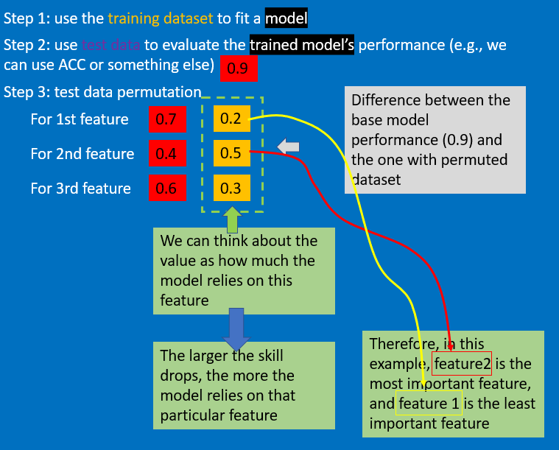
Note that there is a similar method called “column-drop” method
The difference is that:
Instead of shuffle the feature, we remove the entire feature, and “refit” a model
We compare the base model performance (the one with entire dataset) and the “refitted” model performance (the one with one less feature)
The feature corresponds to the most dropped skill is usually considered the most important feature

Slide 20
Note that there is a similar method called “column-drop” method
The difference is that:
Instead of shuffle the feature, we remove the entire feature, and “refit” a model
We compare the base model performance (the one with entire dataset) and the “refitted” model performance (the one with one less feature)
The feature corresponds to the most dropped skill is usually considered the most important feature
Compared to the permutation method, “column-drop” method is usually more accurate, but more expensive (we need to refit the model)

